Slide 1
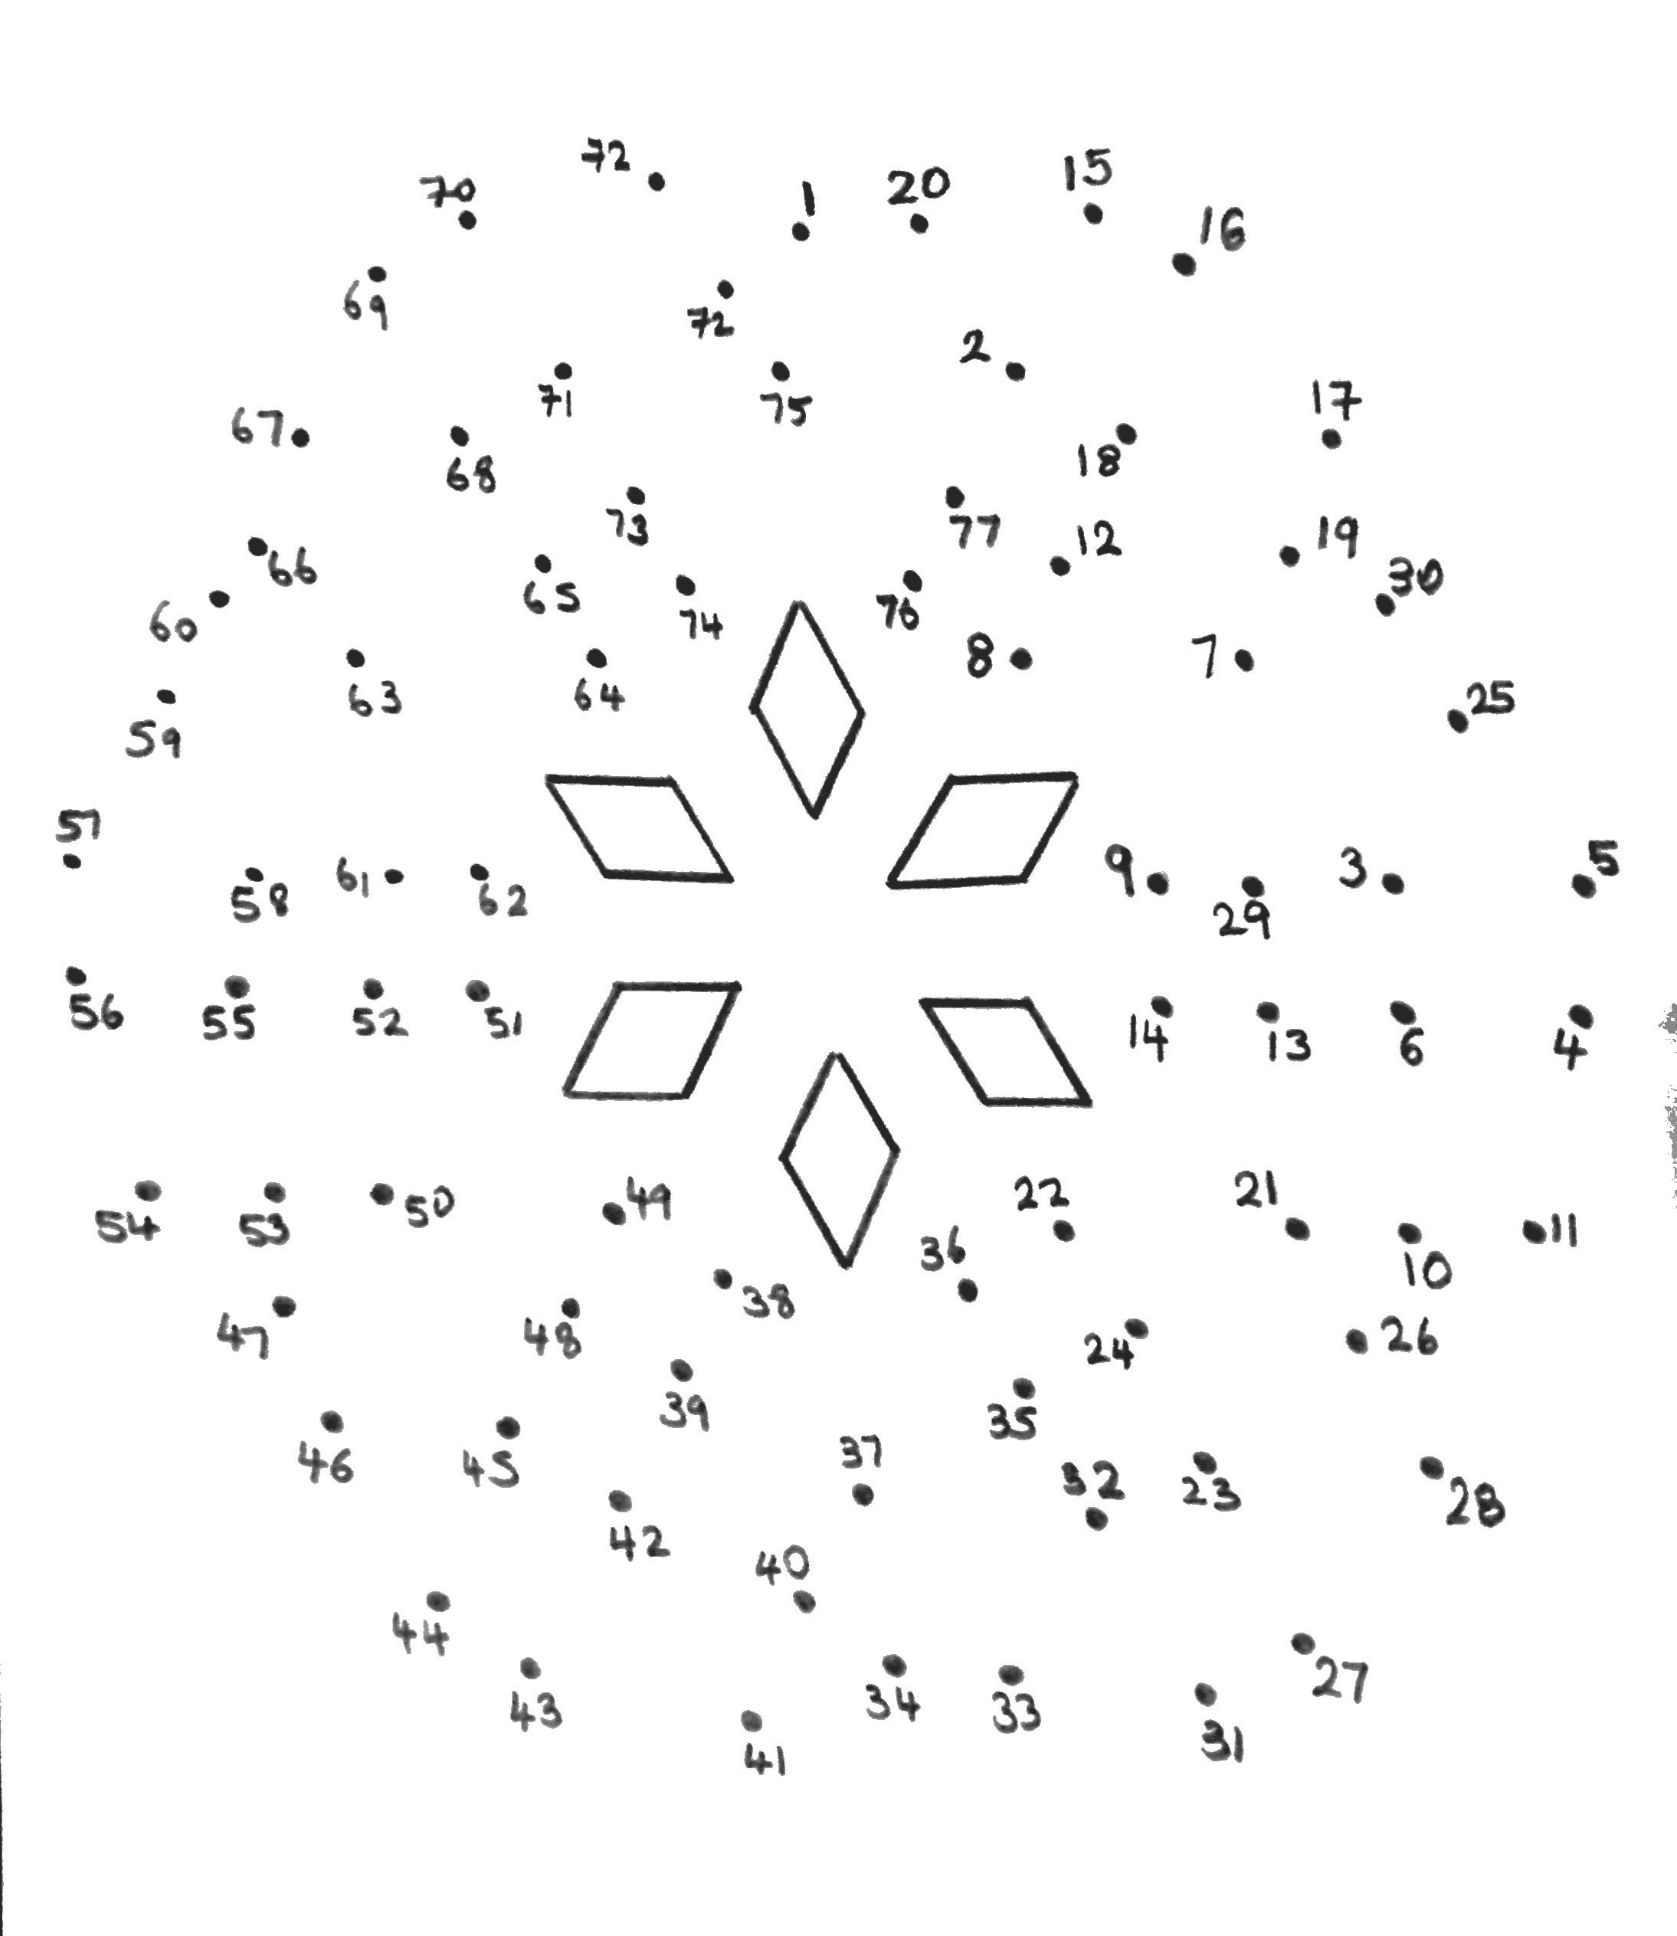
Dot to Dot Types of Number
Join 1 to the next term in the sequence:5, 8, 11, 14, 17…
Join that to the only even prime number
Join that to the missing factor of 15; 1, 3, 5 …
Join that to 4 squared
Join that to the 3rd multiple of 6
Join that to the 7th Prime number
Join that to the largest prime factor of 57
Join that to the LCM of 3 and 4
Join that to 2 cubed
Join that to the 4th Prime Number
Join that to 3 squared
Join that to the next number in the sequence:5, 11, 17, 23, …
Join that to the LCM of 5 and 6
Join that to 5 squared
Join that to the next 2 odd numbers after 1
Join that to the next 2 even numbers after 2
Join that to the 5th prime number
Join that to the missing factor of 20; 1,2,4,5,20
Join that to the 6th prime number
Join that to 1² + 2² + 3²
Join that to the 7th multiple of 3
Join that to the first 4 terms in the sequence; 2n + 20
Join that to the 9th prime number
Join that to missing factor of 27; 1,3,9 …
To finish the pattern join the last point to 31 and continue to join the dots in order until you reach 77
Then join that to 1

Slide 3
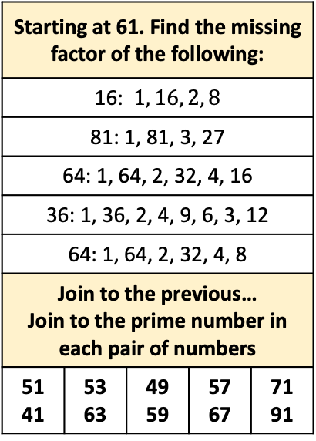
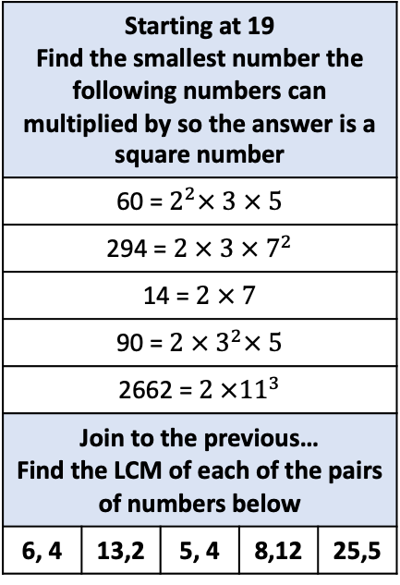
Starting at 2 Find the smallest Prime factor of the following numbers
35 | 143 | 77 | 47 | 39
Join the previous answer Find the largest Prime Factor of the following numbers
51 | 46 | 290 | 91 | 93
Starting at 61. Find the missing factor of the following:
16: $1, 16, 2, 8$ | 143 | 77 | 47 | 39
81: 1, 81, 3, 27
64: 1, 64, 2, 32, 4, 16
36: 1, 36, 2, 4, 9, 6, 3, 12
64: 1, 64, 2, 32, 4, 8
Join to the previous… Join to the prime number in each pair of numbers
51 41 | 53 63 | 49 59 | 57 67 | 71 91
30
21
32
2
4
5
17
61
34
33
92
8
3
29
9
28
11
23
18
13
Starting at 19 Find the smallest number the following numbers can multiplied by so the answer is a square number
60 = $2^{2}× 3 × 5$ | 143 | 77 | 47 | 39
294 = $2 × 3 × 7^{2}$
14 = $2 × 7$
90 = ${2 × 3}^{2}× 5$
2662 = $2 ×{11}^{3}$
Join to the previous… Find the LCM of each of the pairs of numbers below
6, 4 | 13,2 | 5, 4 | 8,12 | 25,5
16
35
47
7
31
41
59
27
39
53
45
67
42
48
73
54
71
36
19
51
57
Start at 92. Choose the correct numbers from the list: 21, 27, 28, 30, 32, 33, 34, 35
Multiple of 7 and 3
Multiple of 6
Multiple of 11
Multiple of 8
Multiple of 17
Multiple of 14
Multiple of 9
Multiple of 7 and 5
79
60
83
49
78
89
100
25
15
69
63
97
66
64
24
26
10
6
75
81
72
20
14
Starting at 25 Find the next 5 SQUARE numbers
12
22
Starting at 71 Find the next 5 PRIMES and join them
Starting at 39 Find the next 13 multiples of 3

Slide 4

Starting at 2 Find the smallest Prime factor of the following numbers
35 | 143 | 77 | 47 | 39
Join the previous answer Find the largest Prime Factor of the following numbers
51 | 46 | 290 | 91 | 93
Starting at 61. Find the missing factor of the following:
16: $1, 16, 2, 8$ | 143 | 77 | 47 | 39
81: 1, 81, 3, 27
64: 1, 64, 2, 32, 4, 16
36: 1, 36, 2, 4, 9, 6, 3, 12
64: 1, 64, 2, 32, 4, 8
Join to the previous… Join to the prime number in each pair of numbers
51 41 | 53 63 | 49 59 | 57 67 | 71 91
30
21
32
2
4
5
17
61
34
33
92
8
3
29
9
28
11
23
18
13
Starting at 19 Find the smallest number the following numbers can multiplied by so the answer is a square number
60 = $2^{2}× 3 × 5$ | 143 | 77 | 47 | 39
294 = $2 × 3 × 7^{2}$
14 = $2 × 7$
90 = ${2 × 3}^{2}× 5$
2662 = $2 ×{11}^{3}$
Join to the previous… Find the LCM of each of the pairs of numbers below
6, 4 | 13,2 | 5, 4 | 8,12 | 25,5
16
35
47
7
31
41
59
27
39
53
45
67
42
48
73
54
71
36
19
51
57
Start at 92. Choose the correct numbers from the list: 21, 27, 28, 30, 32, 33, 34, 35
Multiple of 7 and 3
Multiple of 6
Multiple of 11
Multiple of 8
Multiple of 17
Multiple of 14
Multiple of 9
Multiple of 7 and 5
79
60
83
49
78
89
100
25
15
69
63
97
66
64
24
26
10
6
75
81
72
20
14
Starting at 25 Find the next 5 SQUARE numbers
12
22
Starting at 71 Find the next 5 PRIMES and join them
Starting at 39 Find the next 13 multiples of 3

