Slide 1
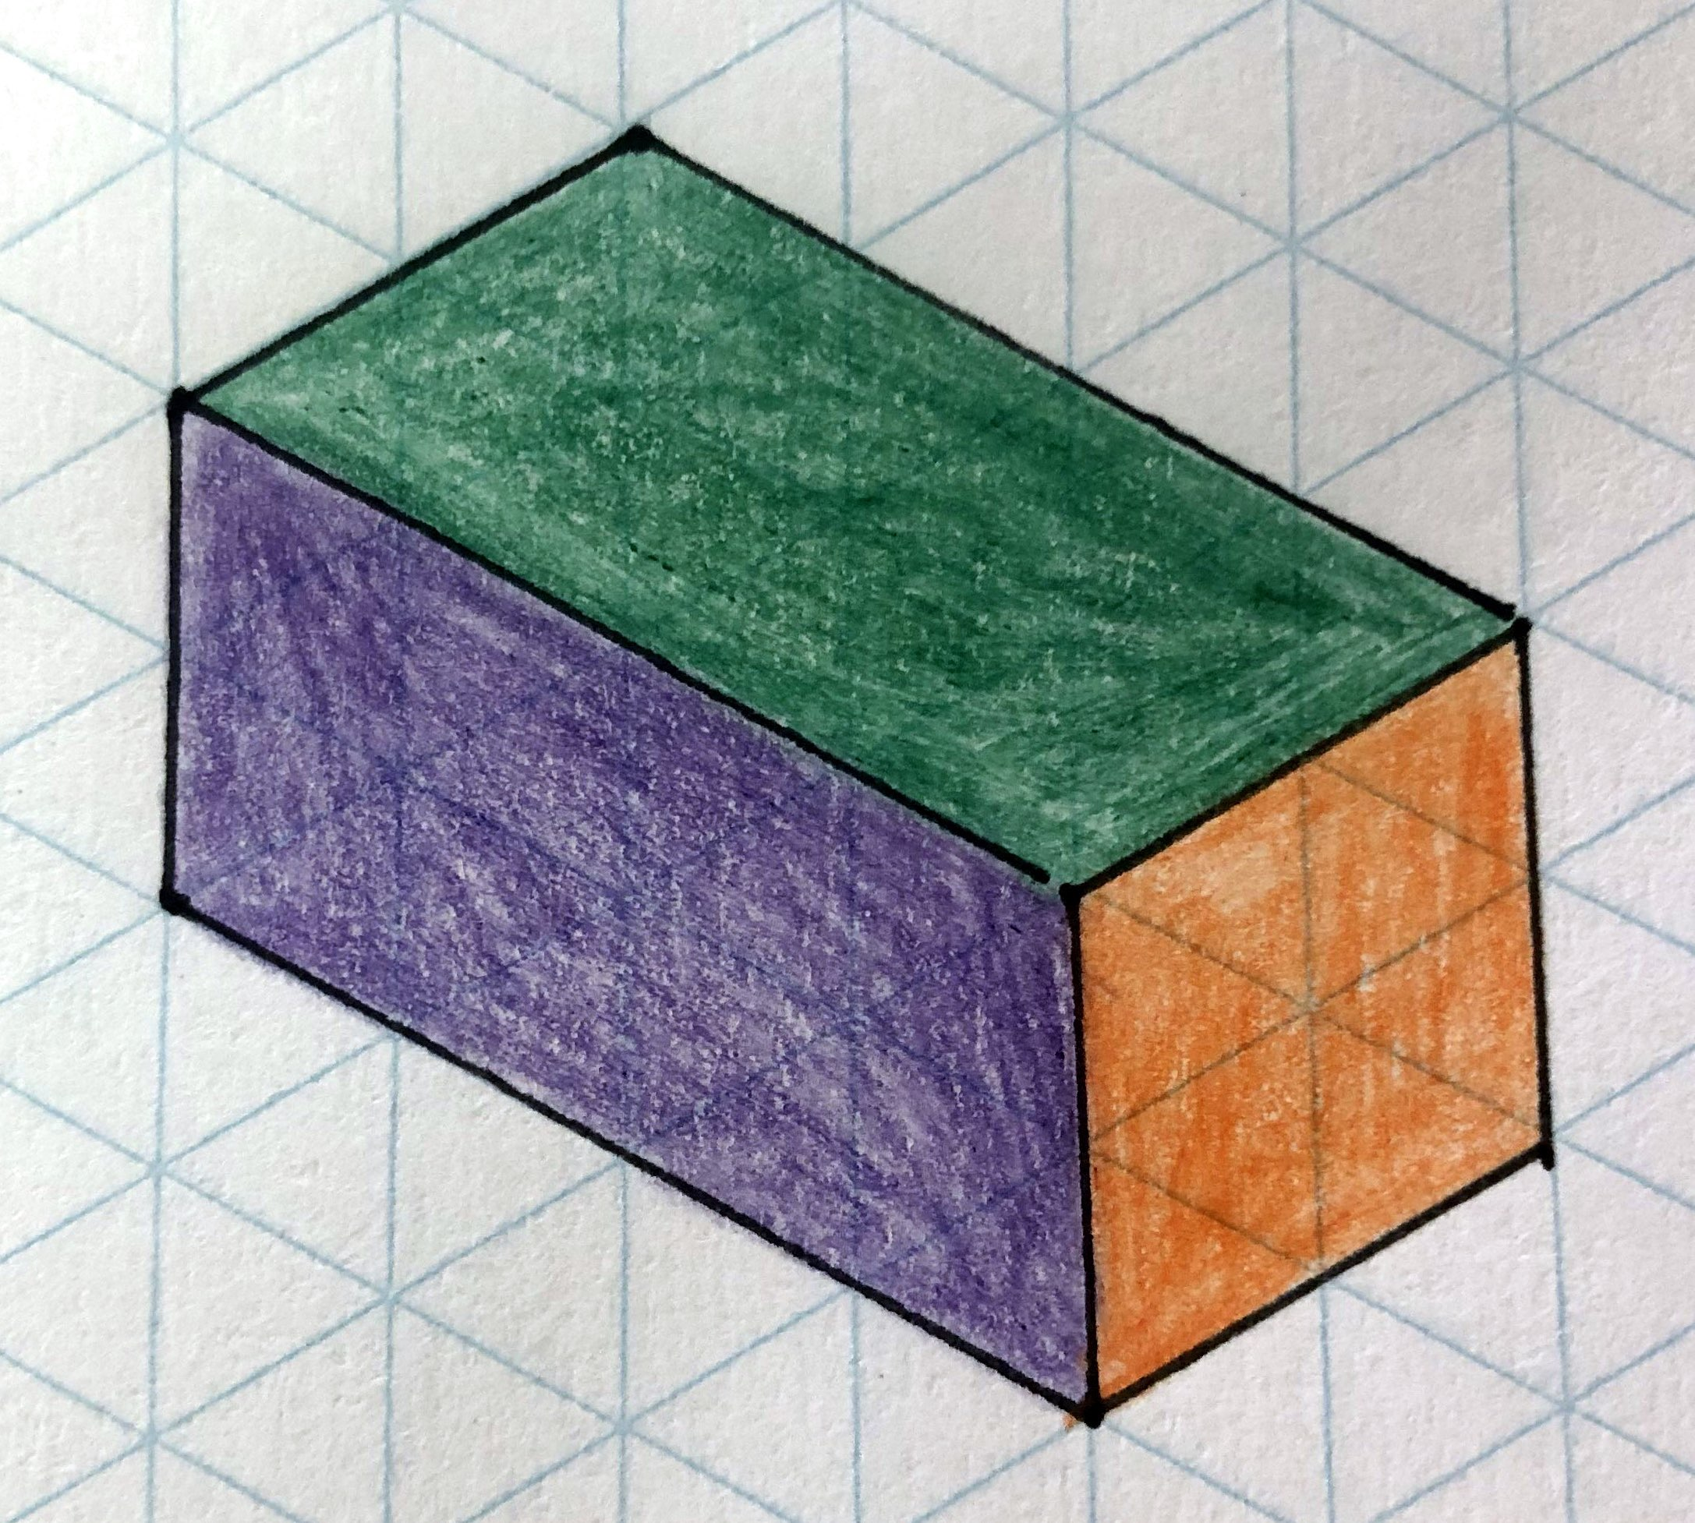
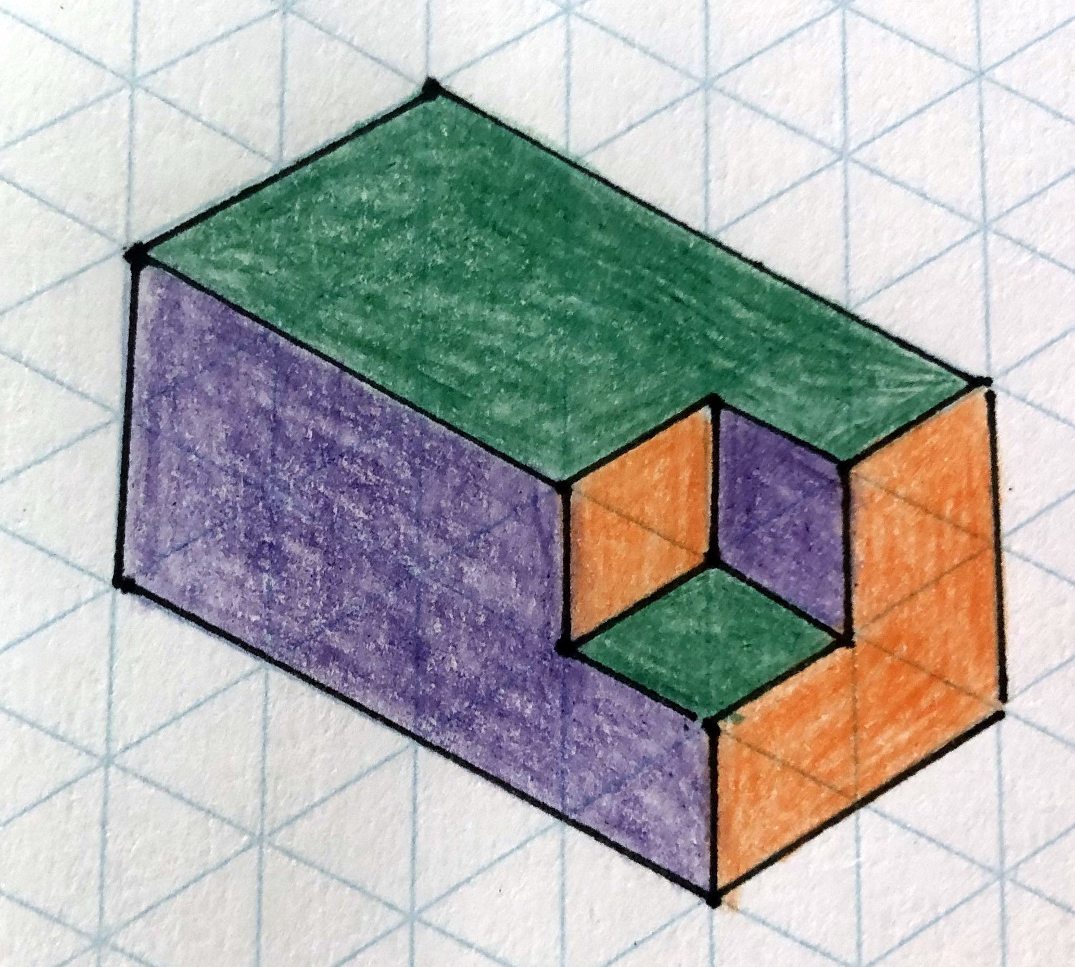
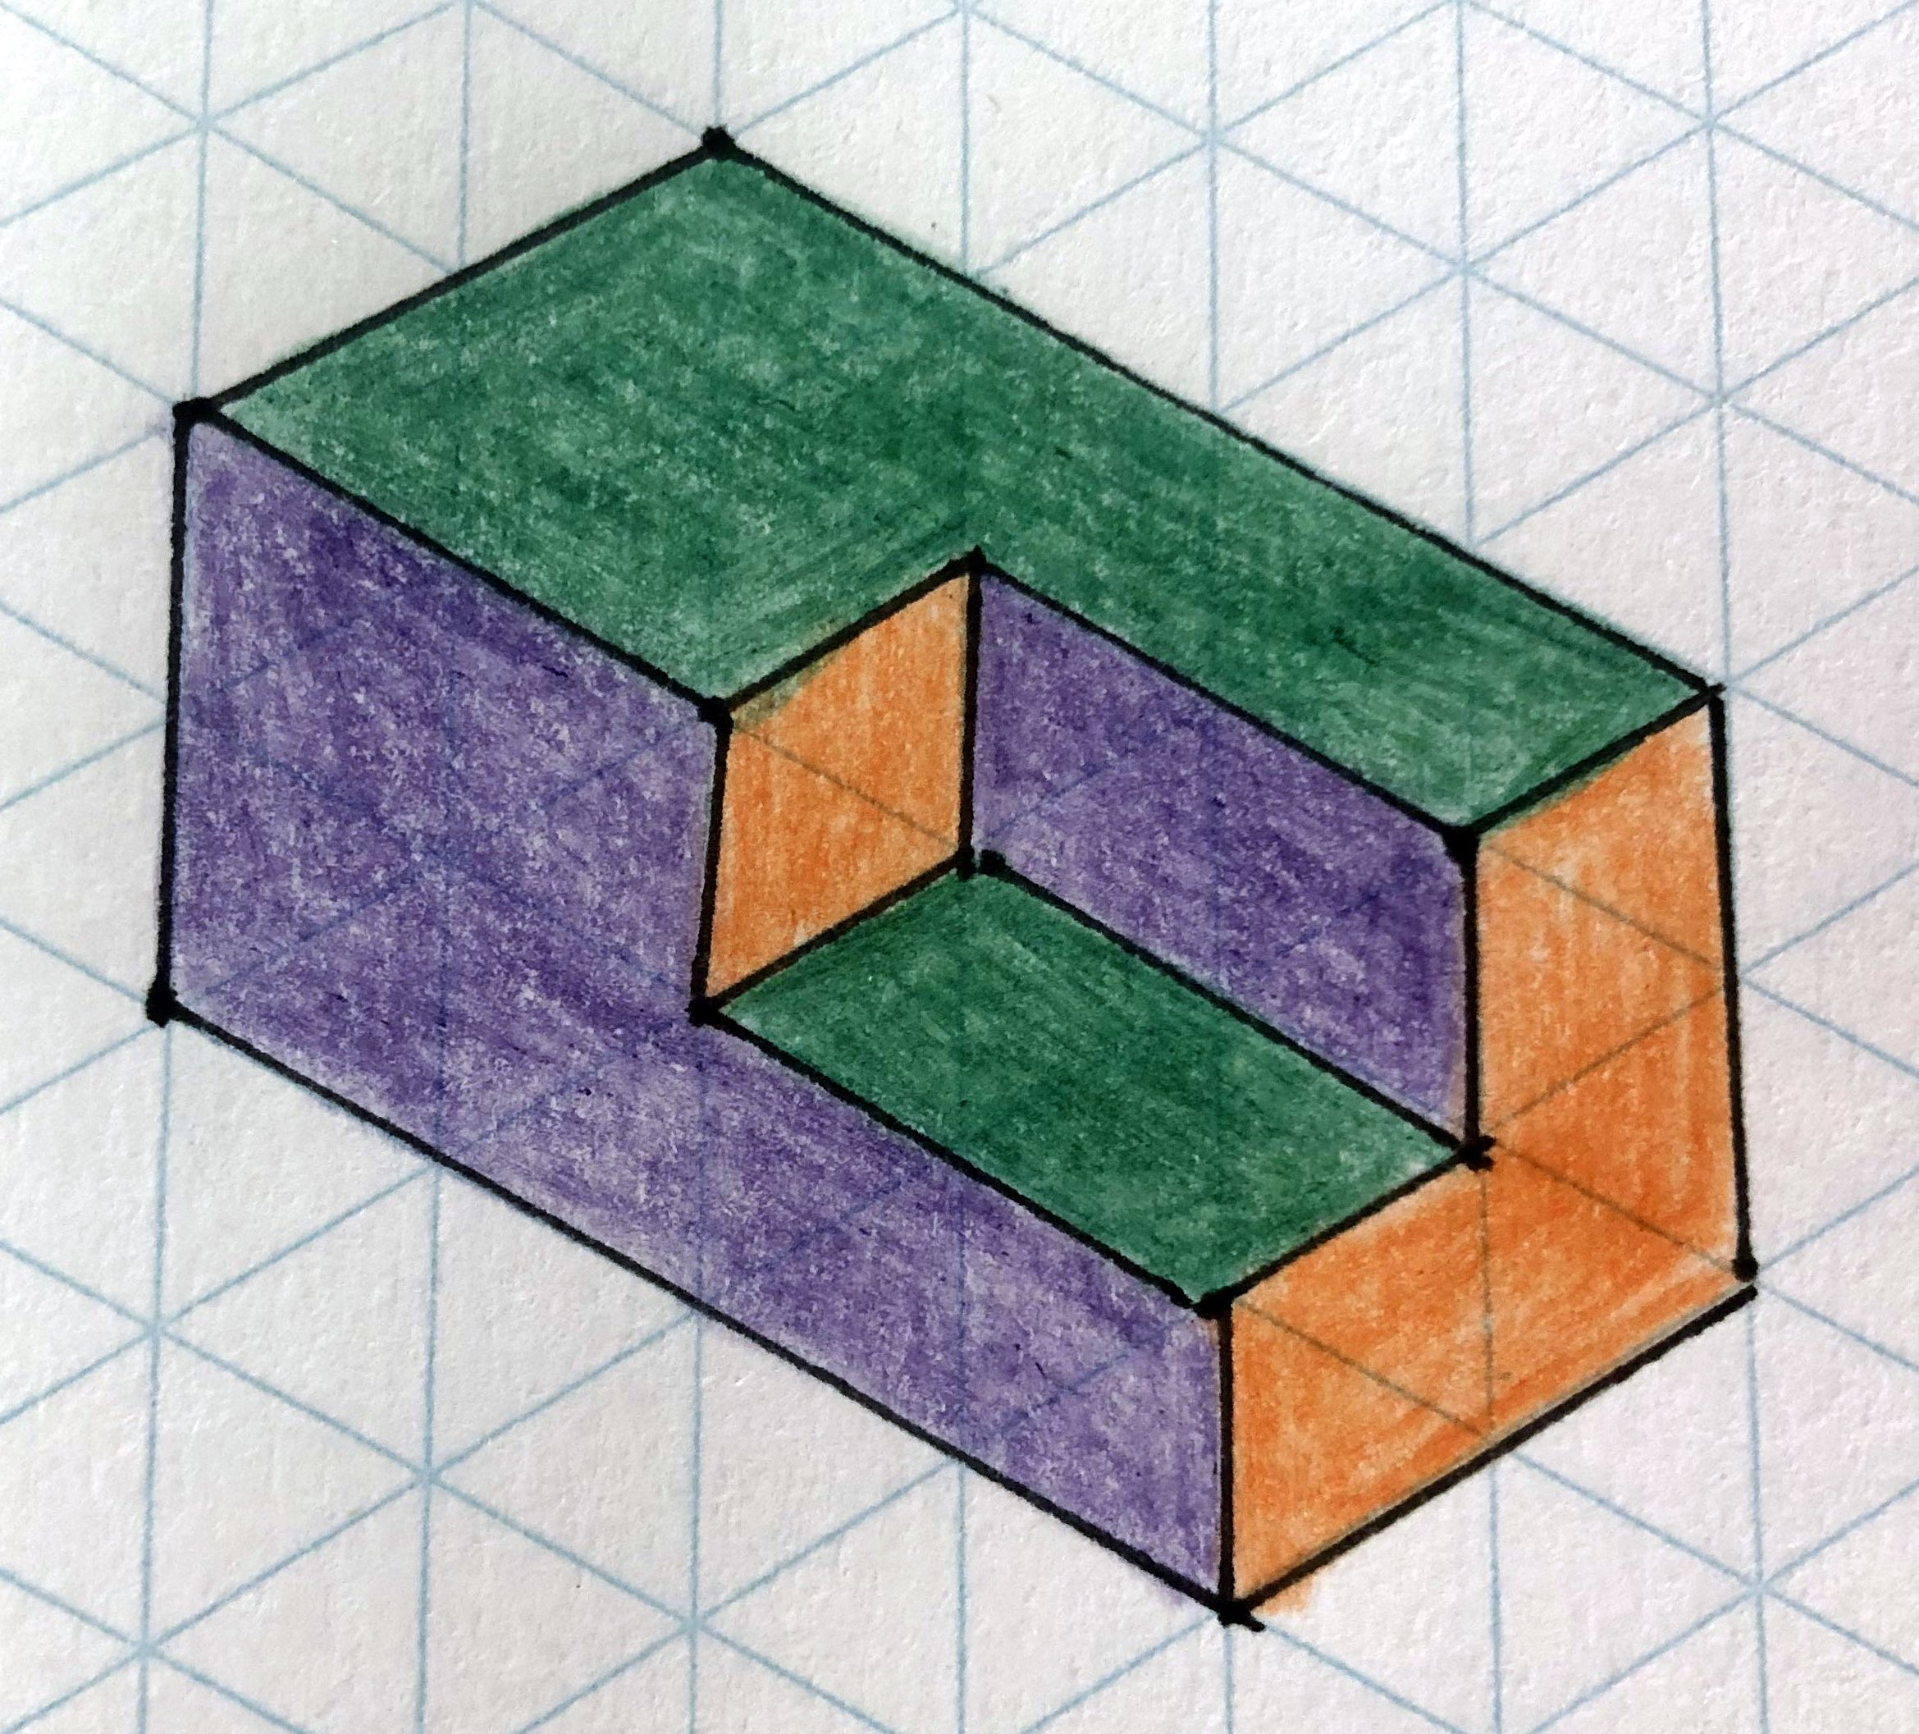
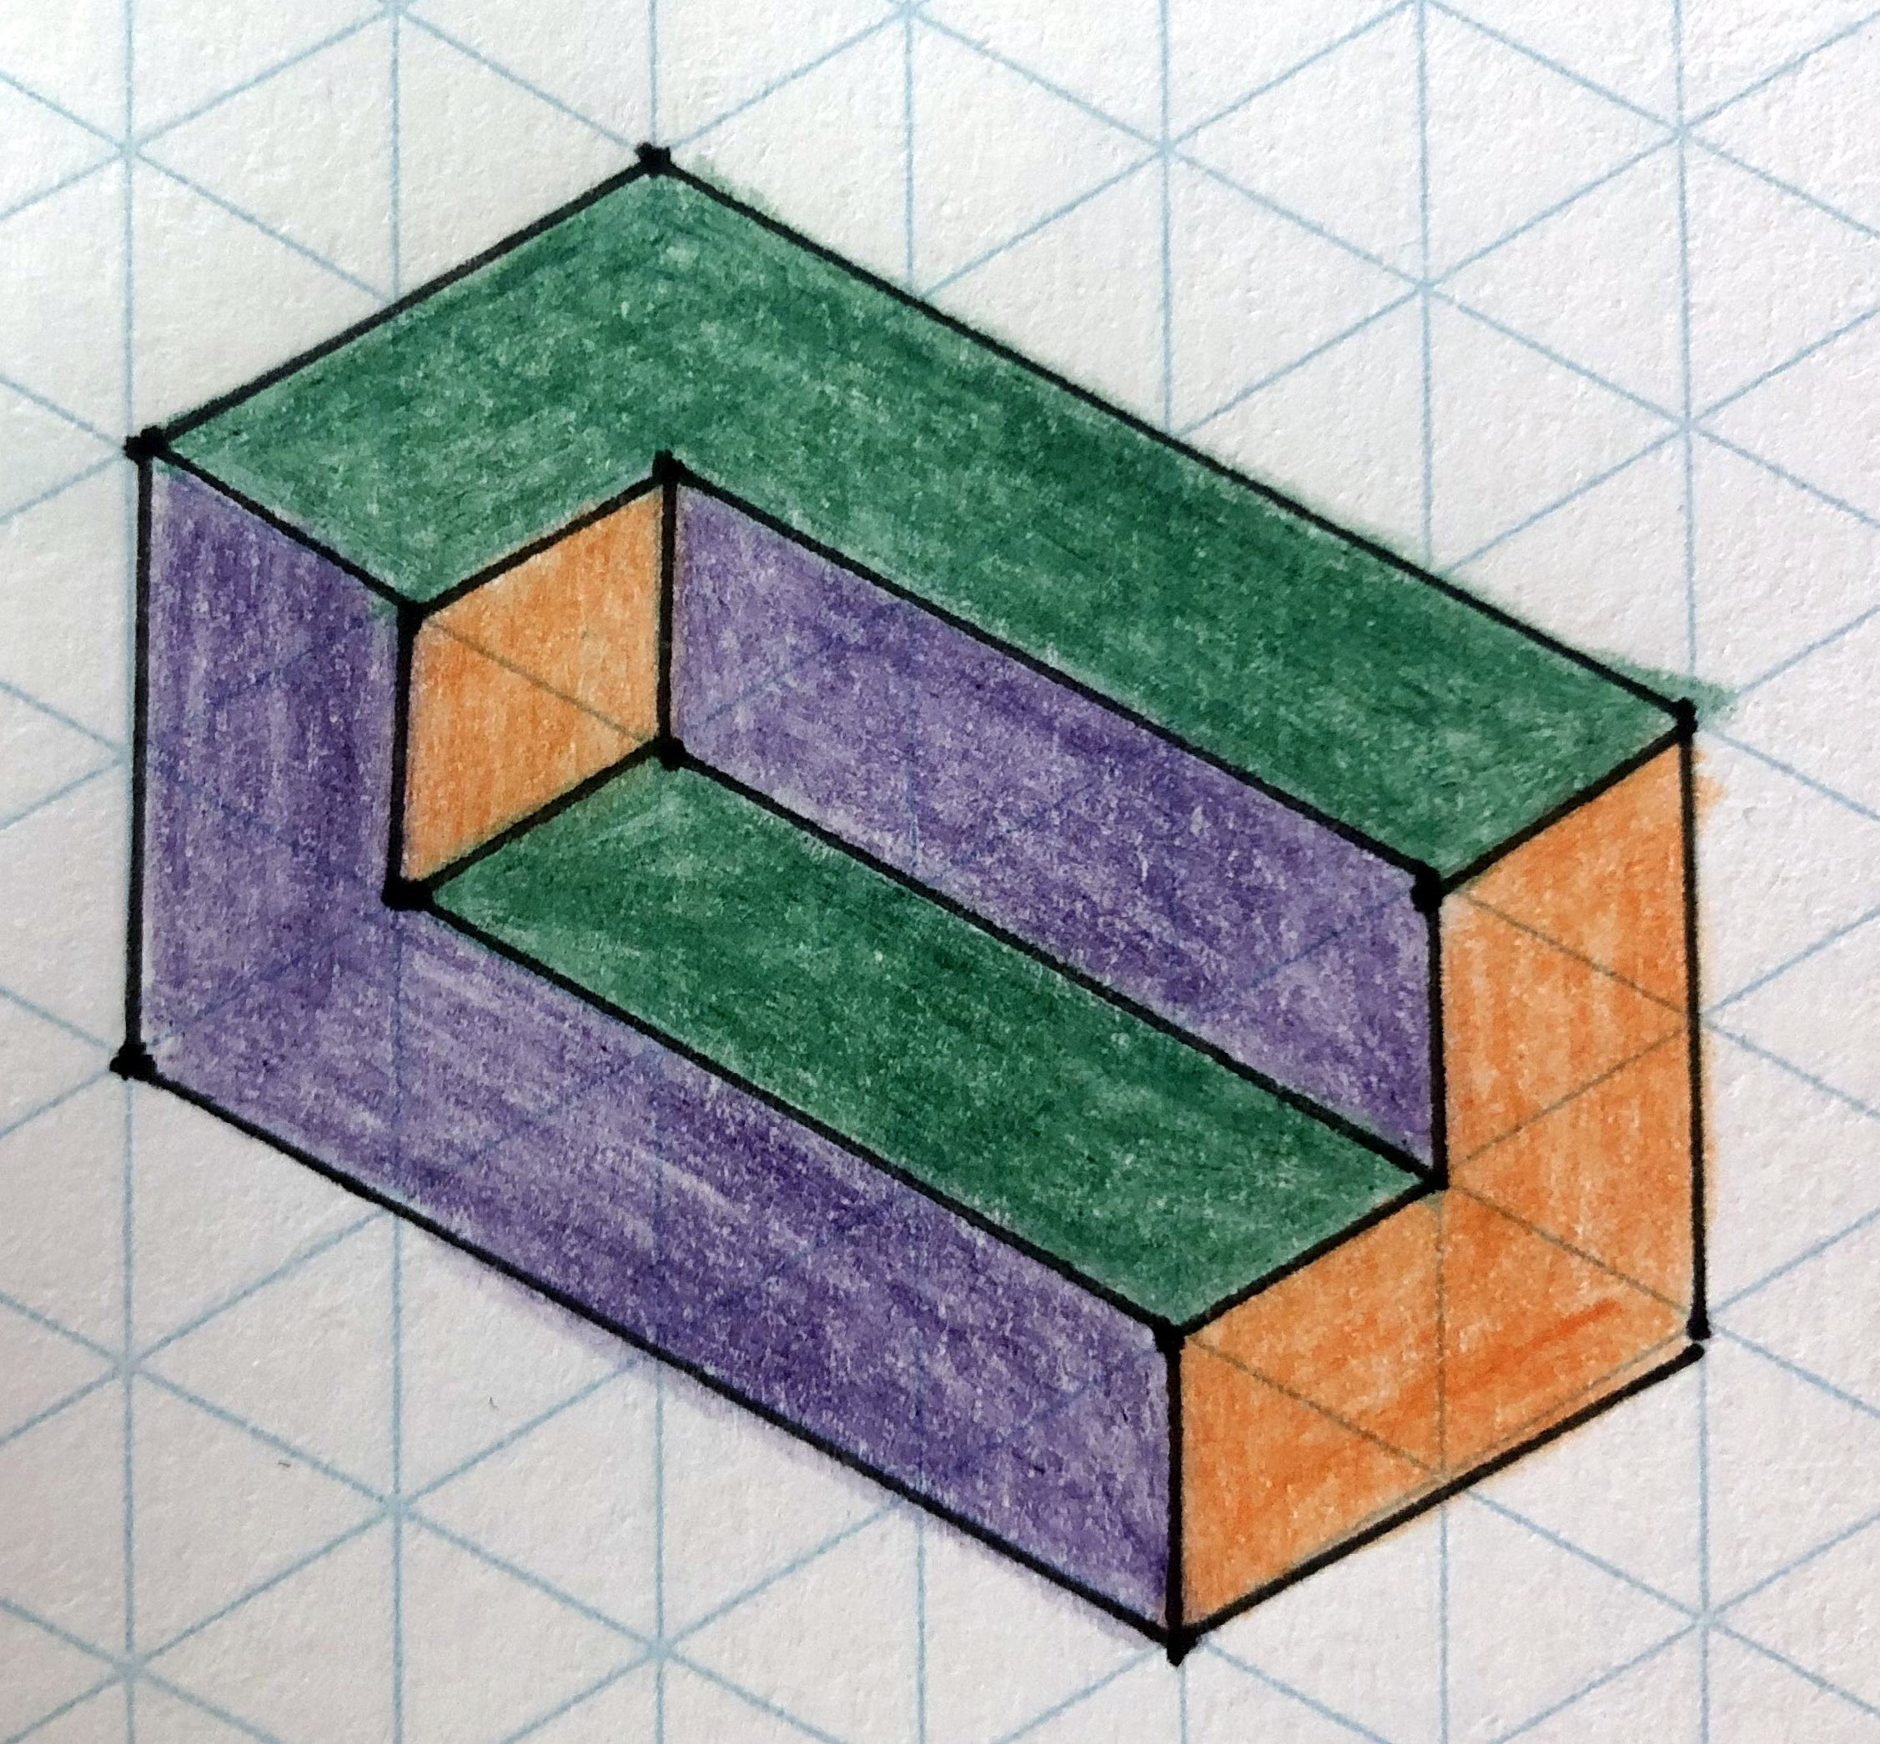
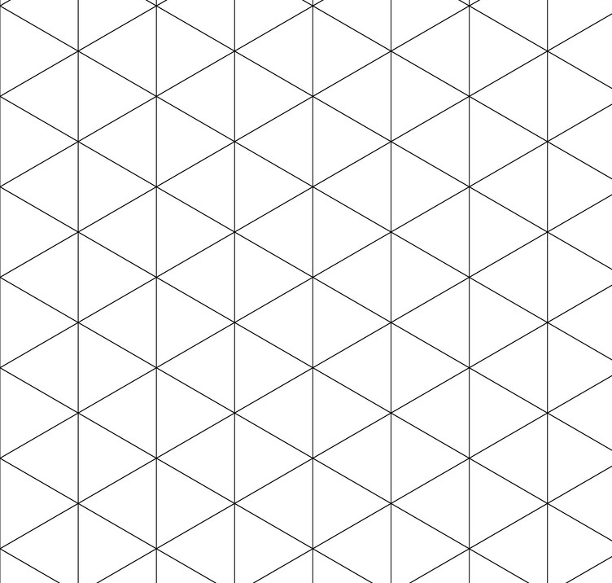
3D shape | Side Elevation | Front Elevation | Plan | Surface Area
 |  |  |  | 40cm²
F
F
F
F

Slide 2
3D shape | Side Elevation | Front Elevation | Plan | Surface Area
 |  |  |  | 40cm²
F
F
F
F

