Slide 1
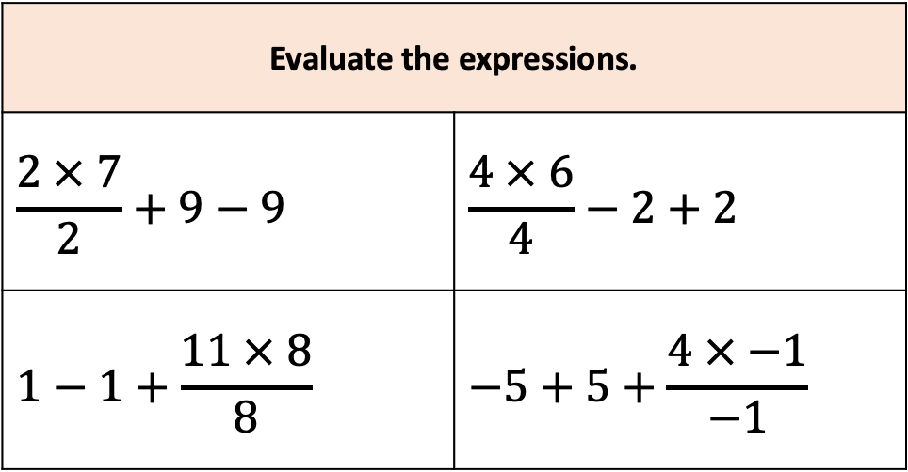
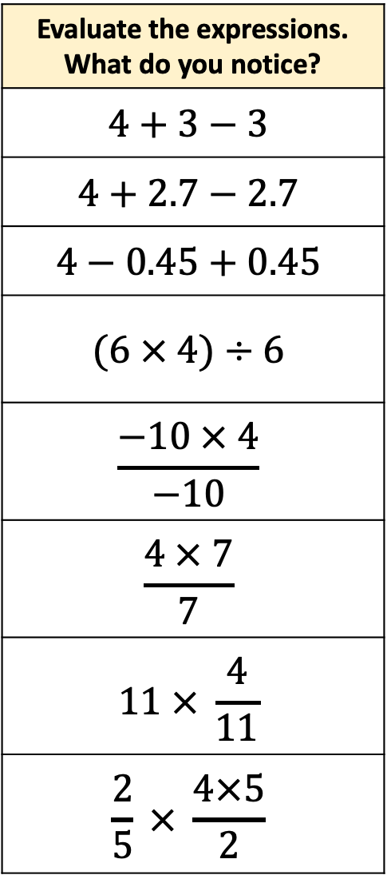
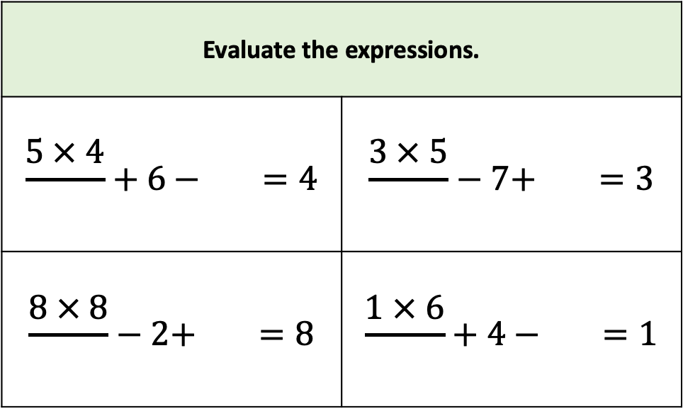
Evaluate the expressions. What do you notice?
$$4+3−3$$
$$4+2.7−2.7$$
$$4−0.45+0.45$$
$$(6 × 4)÷6$$
$$\frac{−10 × 4}{−10}$$
$$\frac{4 × 7}{7}$$
$$11 × \frac{4}{11}$$
$$\frac{2}{5} × \frac{4×5}{2}$$
Evaluate the expressions.
$$\frac{2 × 7}{2}+9−9$$ | $$\frac{4 × 6}{4}−2+2$$
$$1−1+\frac{11 × 8}{8}$$ | $$−5+5+\frac{4 × −1}{−1}$$
Evaluate the expressions.
$$\frac{5 × 4}{}+6 − =4$$ | $$\frac{3 × 5}{}−7+ =3$$
$$\frac{8 × 8}{}−2+ =8$$ | $$\frac{1 × 6}{}+4 − =1$$

