Slide 1
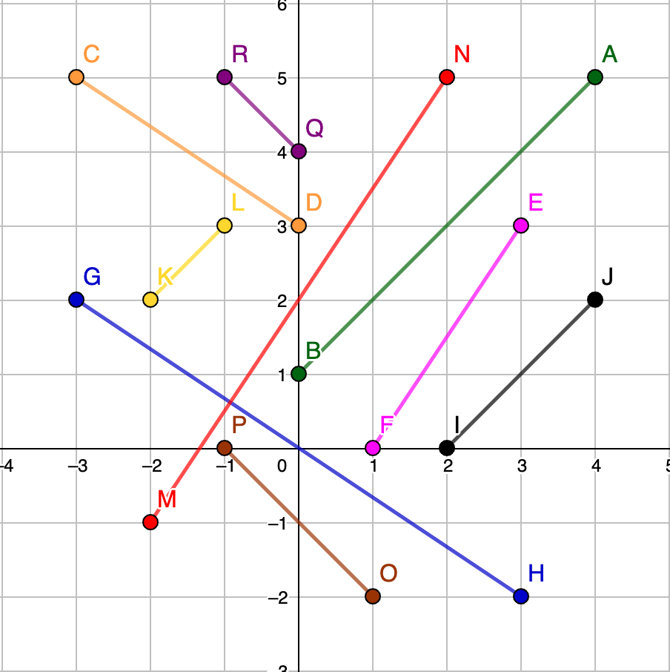
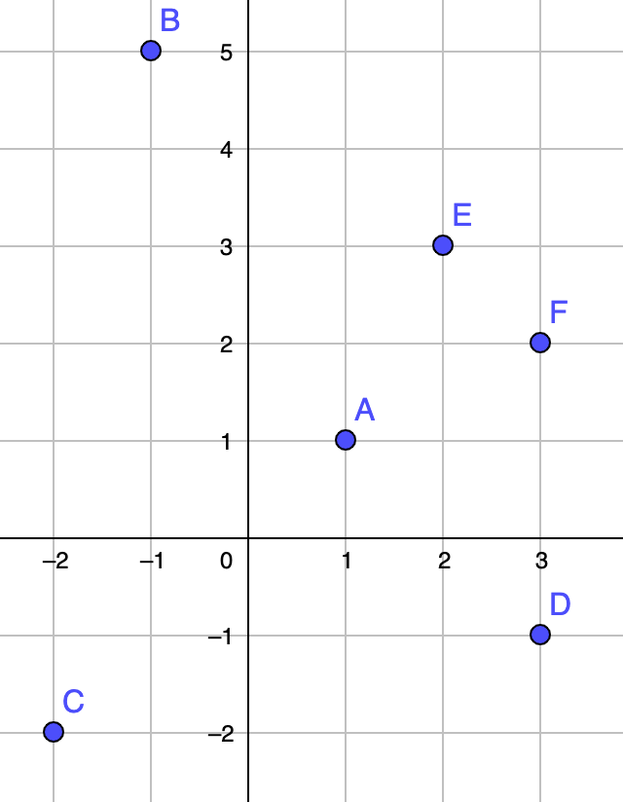
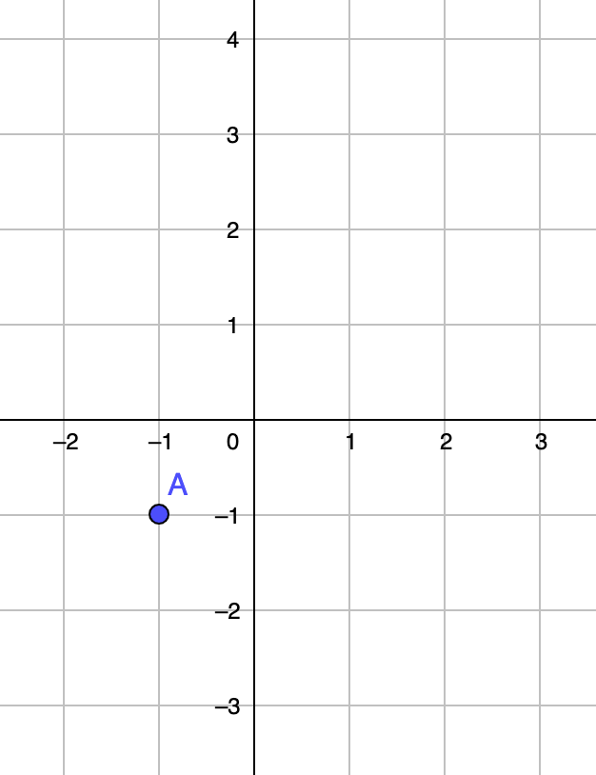
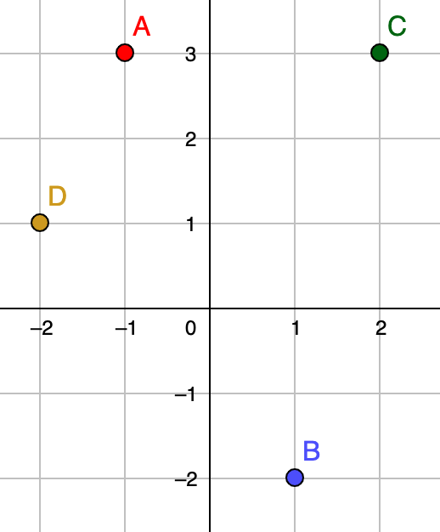
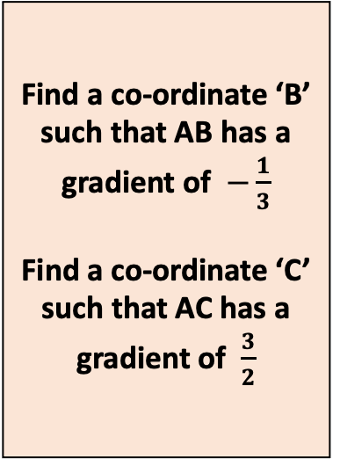
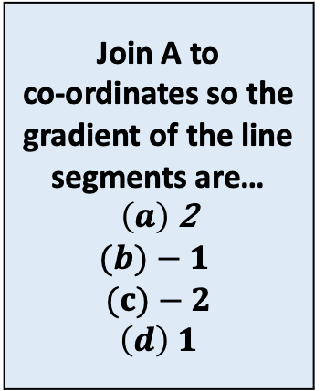

Which line segments are parallel?
How do you know?
The line segment AF has a gradient of$\frac{1}{2}$
Join A to
co-ordinates so the gradient of the line segments are…
$\left(a\right)$ 2
$$(b)−1$$
$(c)−2$
$$\left(d\right) 1$$
By joining any 2 of the labelled co-ordinates
Find a co-ordinate ‘B’ such that AB has a gradient of $−\frac{1}{3}$
Find a co-ordinate ‘C’ such that AC has a gradient of $\frac{3}{2}$
Can you find the line segment with the largest gradient?

Slide 2
Which line segments are parallel?
How do you know?

Slide 3

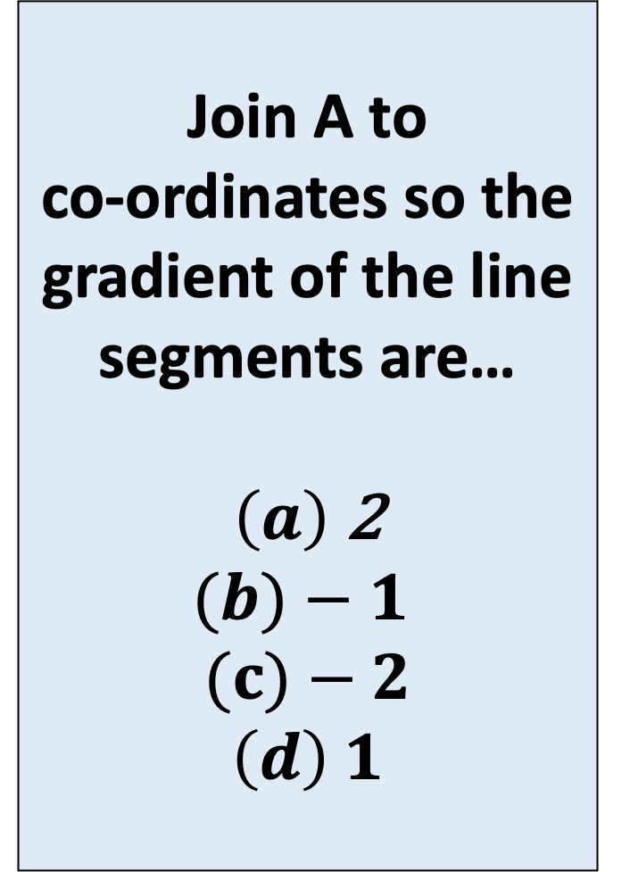
The line segment AF has a gradient of$\frac{1}{2}$
Join A to
co-ordinates so the gradient of the line segments are…
$\left(a\right)$ 2
$$(b)−1$$
$(c)−2$
$$\left(d\right) 1$$

Slide 4
By joining any 2 of the labelled co-ordinates
Can you find the line segment with the largest gradient?
Can you find the smallest gradient?

Slide 5
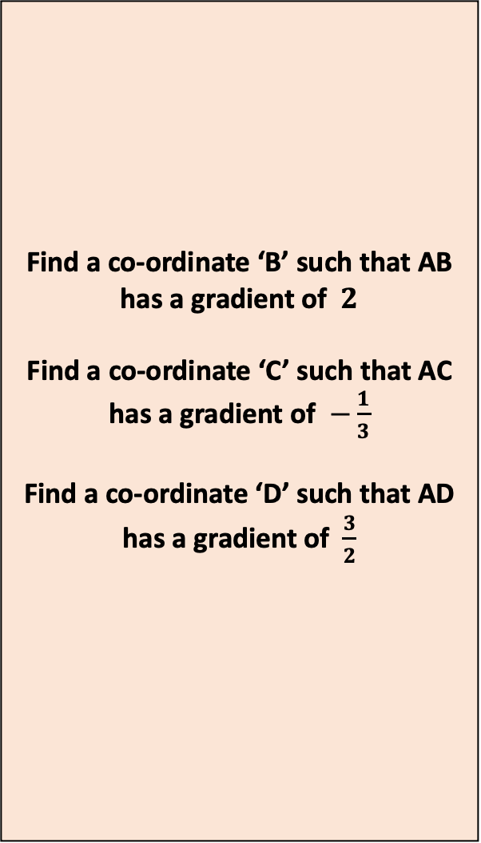
Find a co-ordinate ‘B’ such that AB has a gradient of $2$
Find a co-ordinate ‘C’ such that AC has a gradient of $−\frac{1}{3}$
Find a co-ordinate ‘D’ such that AD has a gradient of $\frac{3}{2}$

