Slide 1
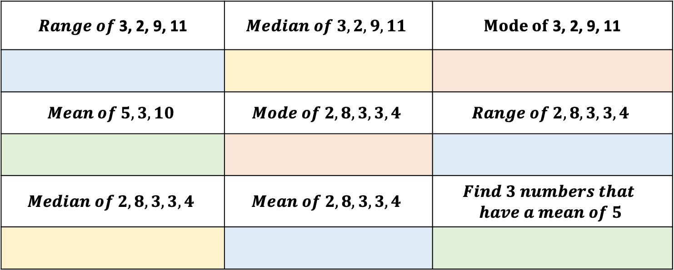
Fractions: Comparing Fractions
Please use the chat for Math’s related conversations
Draw the grid to the right on your paper and answer the questions below. Then fill your grid with the correct answer
$Range of$3, 2, 9, 11 | $$Median of 3, 2, 9, 11$$ | $Mode of$3, 2, 9, 11
$$Mean of 5, 3, 10$$ | $$Mode of 2, 8, 3, 3, 4$$ | $$Range of 2, 8, 3, 3, 4$$
$$Median of 2, 8, 3, 3, 4$$ | $$Mean of 2, 8, 3, 3, 4$$ | $$Find 3 numbers that$$ $$have a mean of 5$$

Slide 2
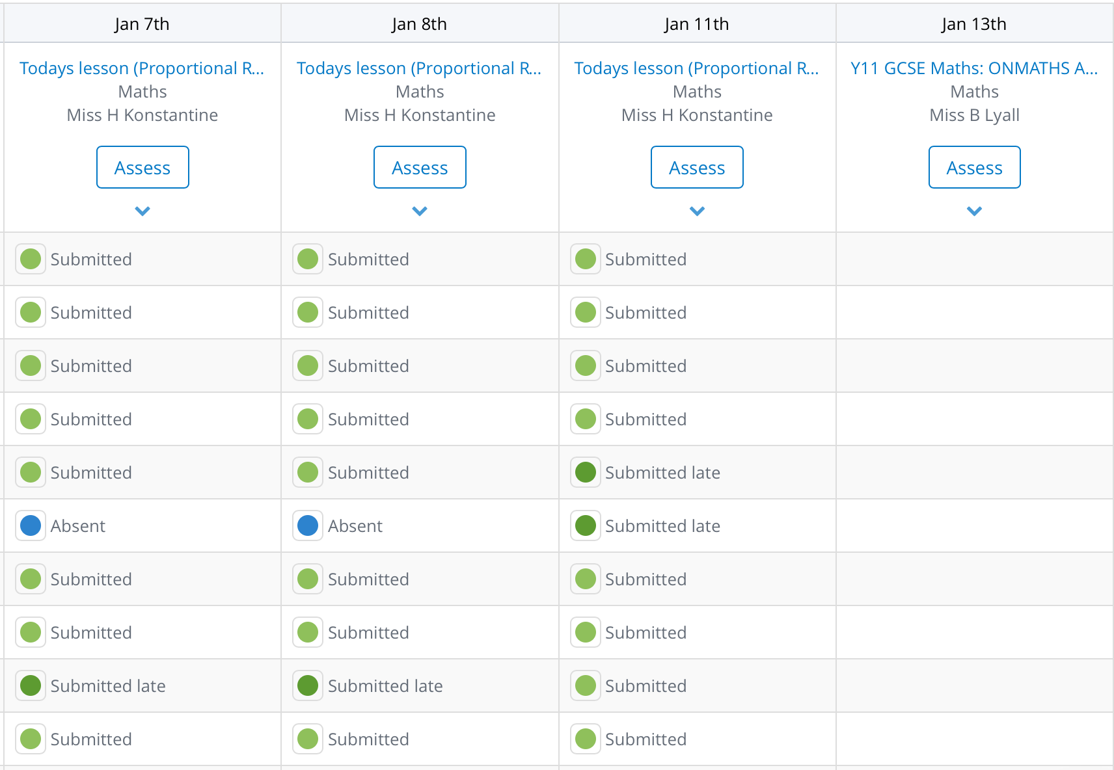
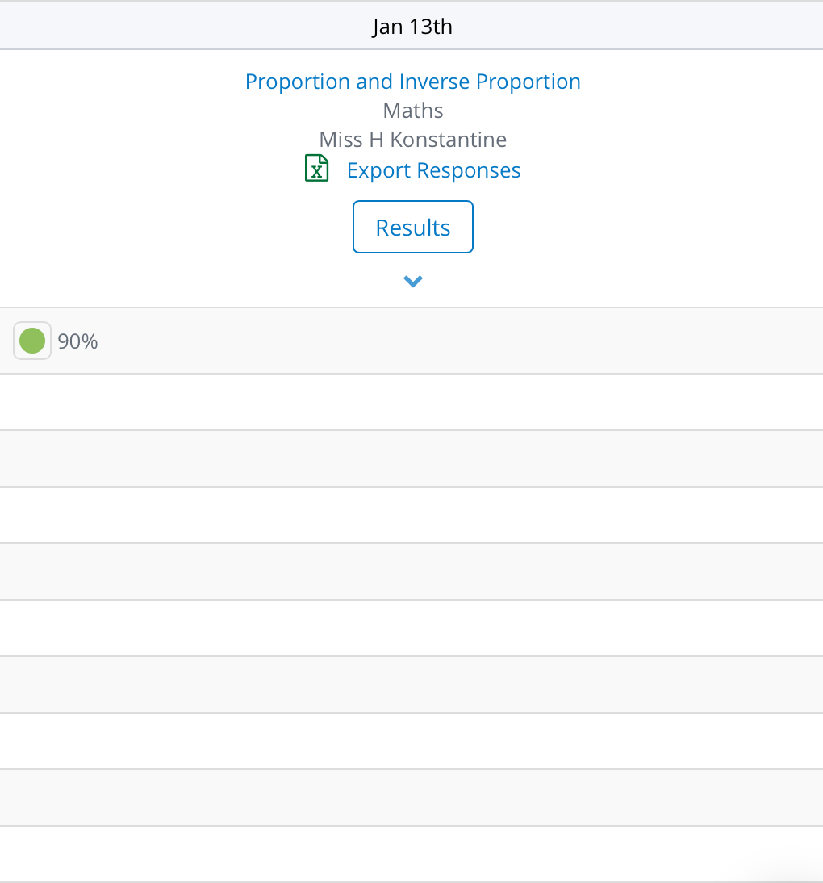
SMHW

Slide 3
Whiteboard activity
Wait for the link in the chat or use room code: g42mt
Make sure you write your name so I can see who’s writing
You can only see my board or your own. I can see everyone's you can type rather than write if you prefer

Slide 4
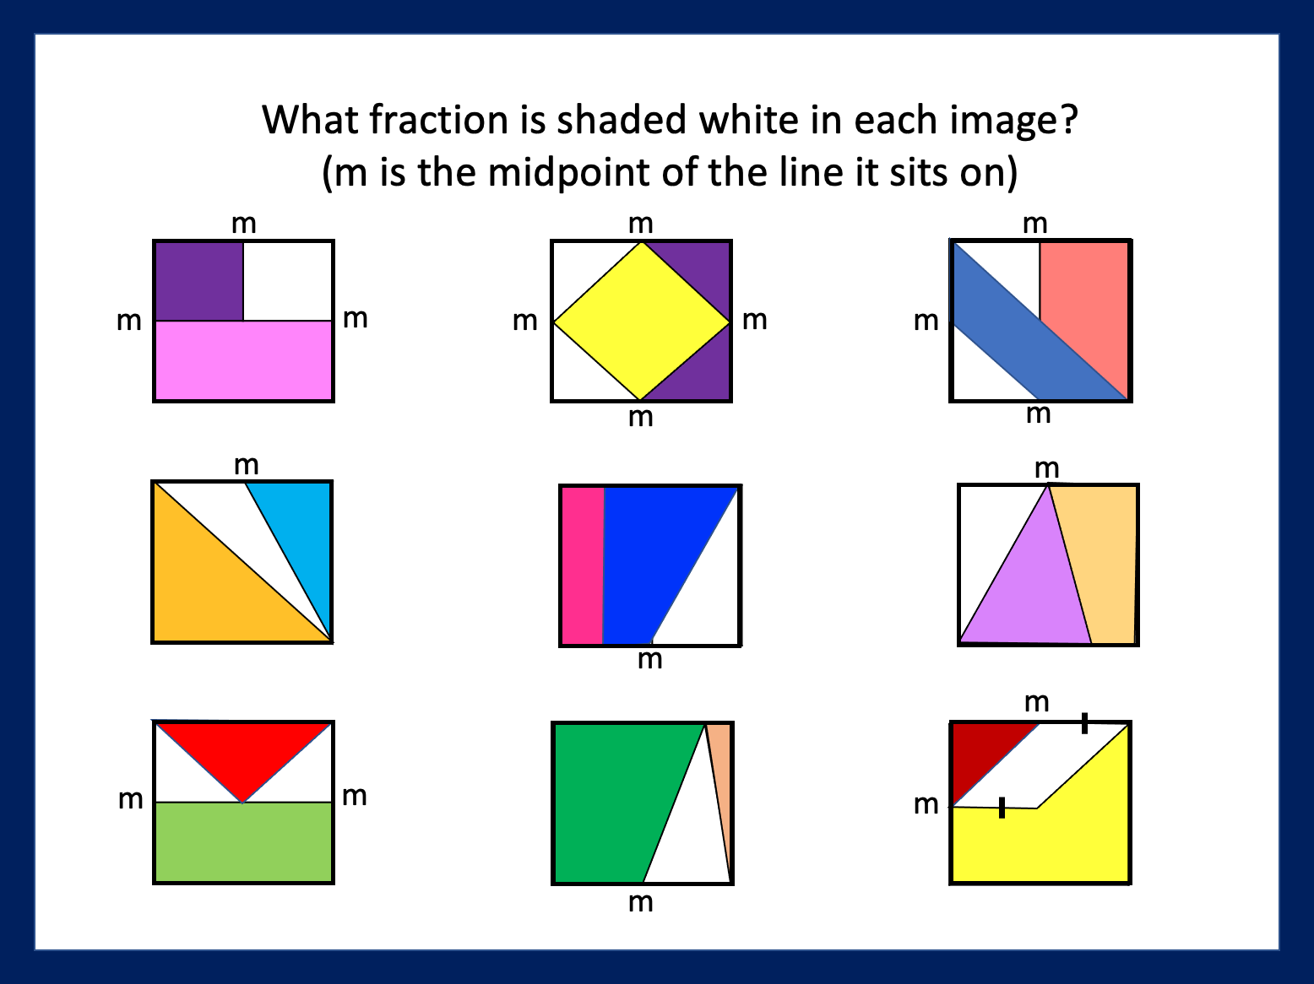
FDP: Fraction shaded
Please don’t write your answers in the chat box yet.
A B C
D E F
G H I

Slide 5



Find fractions that are equivalent to…
$$\frac{4}{9}$$
Draw an image to show $\frac{4}{9}$
Can you find a fractions equivalent to $\frac{4}{9}$ that has a denominator bigger than 1000
Can you find a smaller fraction than $\frac{4}{9}$ that’s as close to $\frac{4}{9}$ as possible
Can you find a larger fraction than $\frac{4}{9}$ that’s as close to $\frac{4}{9}$ as possible
I$s \frac{5}{11}$ b$igger or smaller than \frac{4}{9}$ ? How do you know?

Slide 6
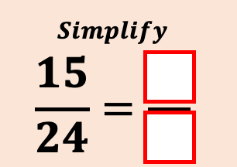
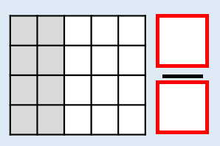
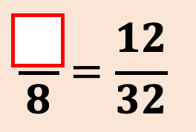
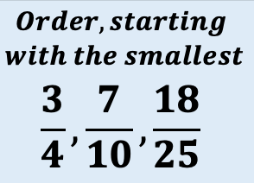
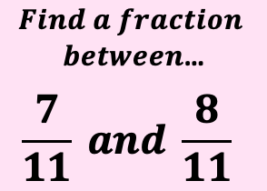
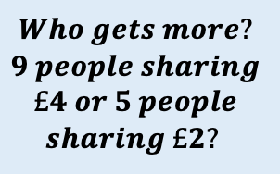

Slide 7
Taran gained 7 marks from 25 in a Maths test. Shayan achieved 27/100 on his Maths test and Abdullah got just 3 marks from 10 on his Maths test. Who do you think has done better? Explain your answer
Maria, Jeena and Tasniya were each given an identical cake. Maria cut her cake into 8 pieces and ate 3 of them, Jeena cut hers into 3 pieces and ate 1 of them, Tasniya cut hers into 24 pieces and ate 7 of them. Who ate more?

Slide 8
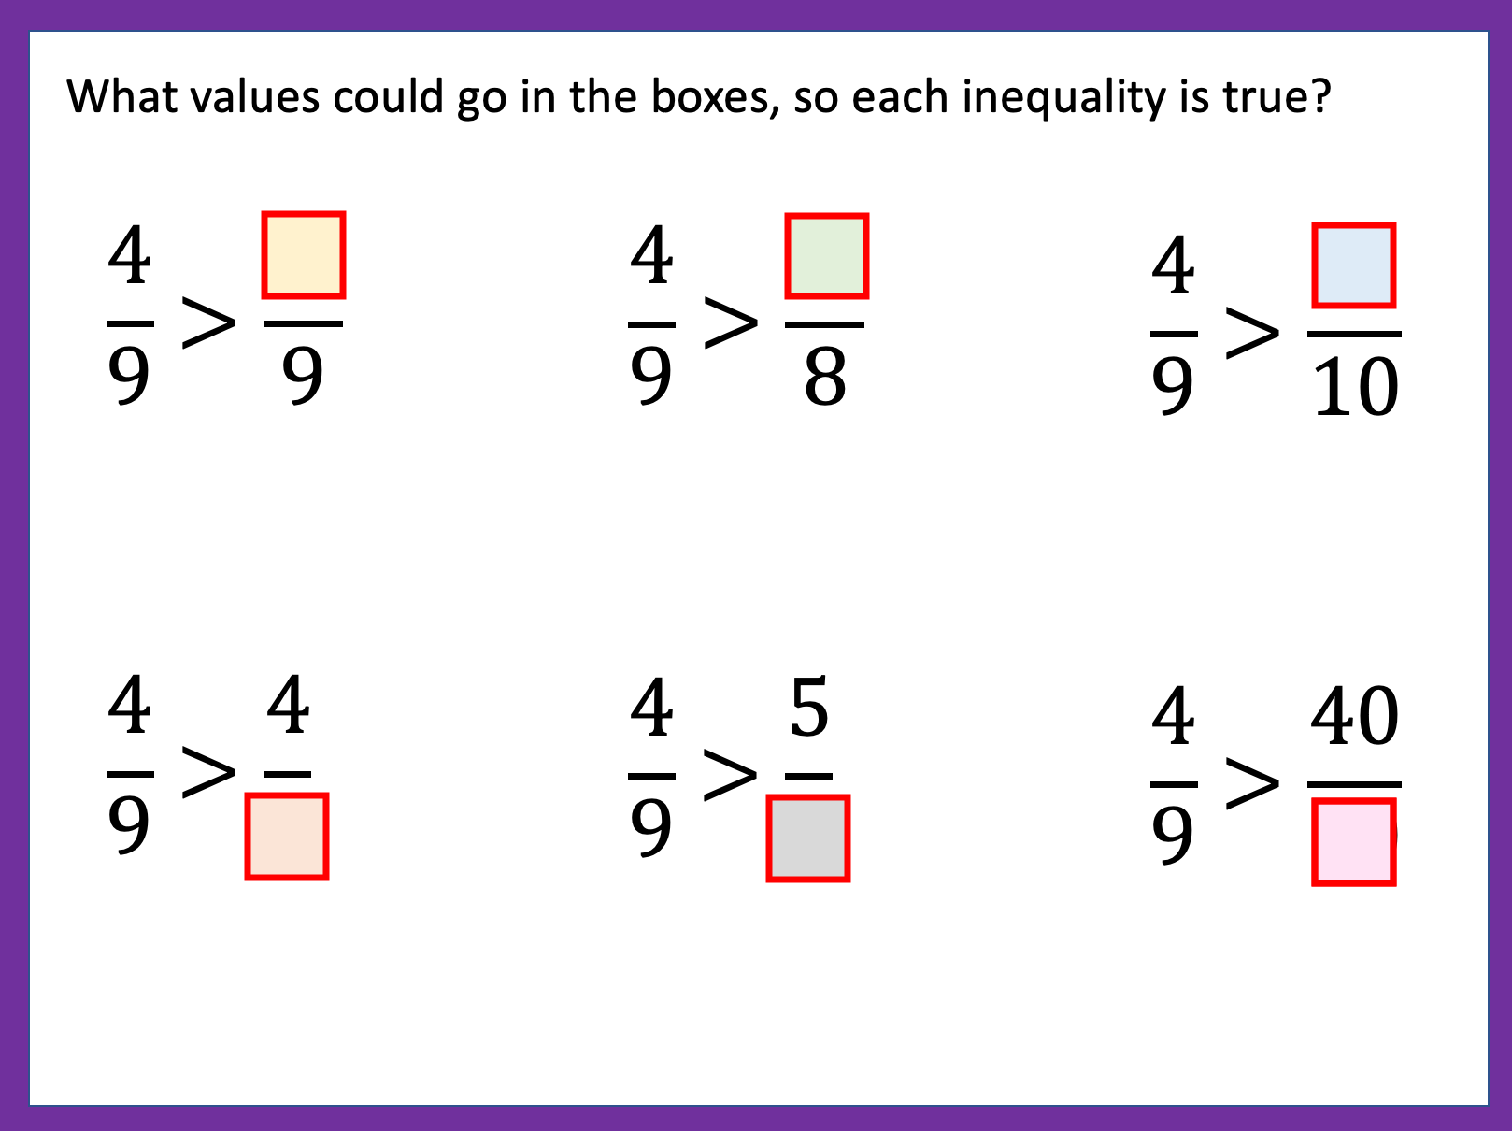
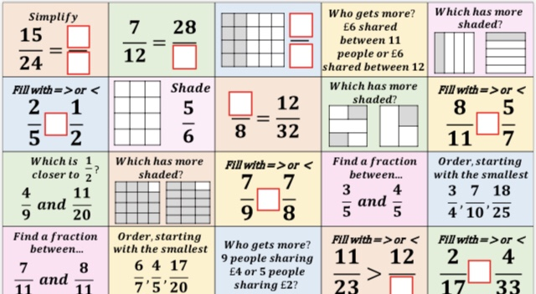

Slide 9
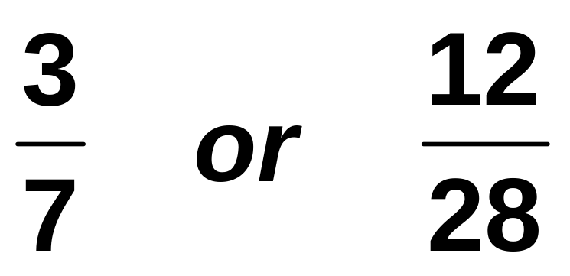

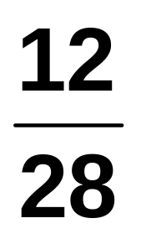
1.) For each of the following select the correct answer:
Which is bigger?
A
B
C
They are Equal
Notes:
9

Slide 10
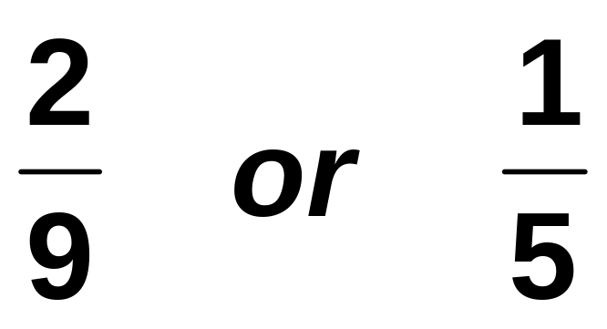


2.) For each of the following select the correct answer:
Which is bigger?
A
B
C
They are Equal
Notes:
10

Slide 11
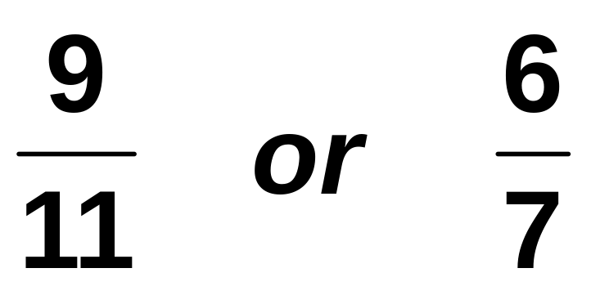
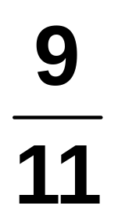
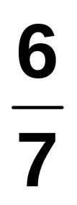
3.) For each of the following select the correct answer:
Which is bigger?
A
B
C
They are Equal
Notes:
11

Slide 12
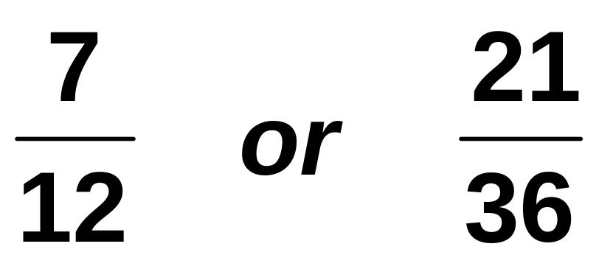
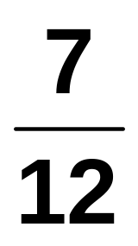
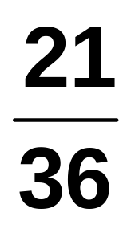
4.) For each of the following select the correct answer:
Which is bigger?
A
B
C
They are Equal
Notes:
12

Slide 13

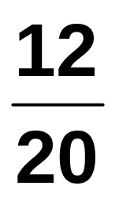
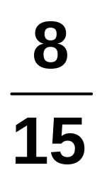
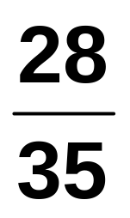
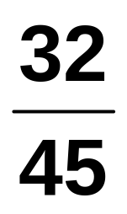
5.) For each of the following select the correct answer:
Which fraction is equivalent to…
A
B
C
D
Notes:
13

Slide 14
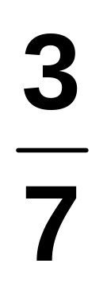
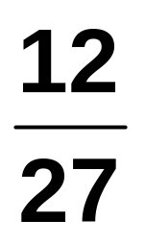
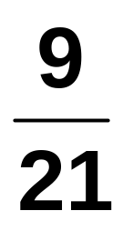
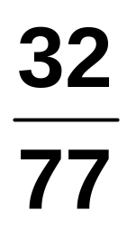
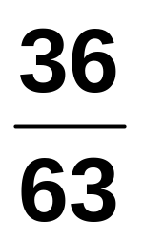
6.) For each of the following select the correct answer:
Which fraction is equivalent to…
A
B
C
D
Notes:
14

Slide 15
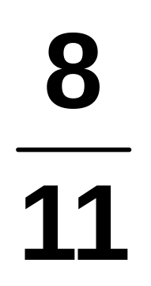
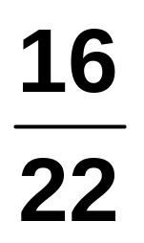
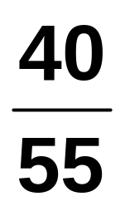
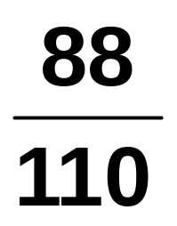
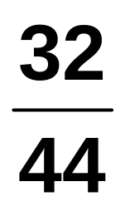
7.) For each of the following select the correct answer:
Which fraction isn’t equivalent to…
A
B
C
D
Notes:
15

Slide 16

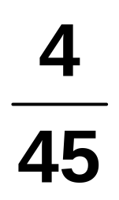
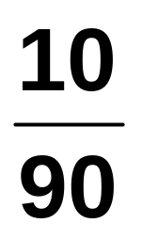

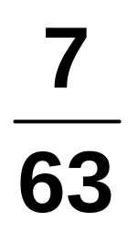
8.) For each of the following select the correct answer:
Which fraction isn’t equivalent to…
A
B
C
D
Notes:
16

Slide 17
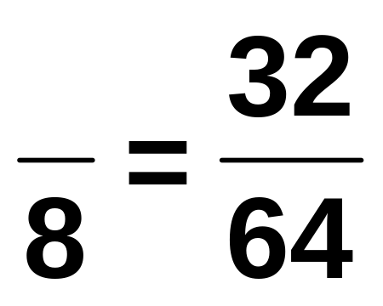




9.) For each of the following select the correct answer:
What number is missing?
A
B
C
D
Notes:
17

Slide 18
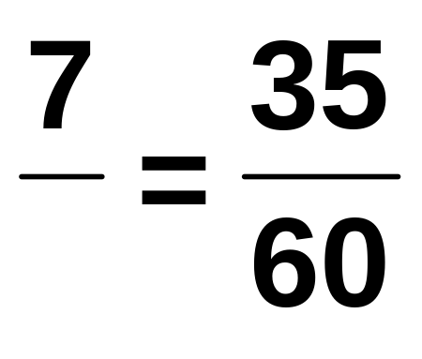
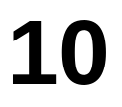
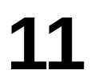
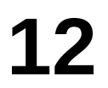
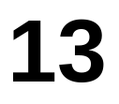
10.) For each of the following select the correct answer:
What number is missing?
A
B
C
D
Notes:
18

