Slide 1
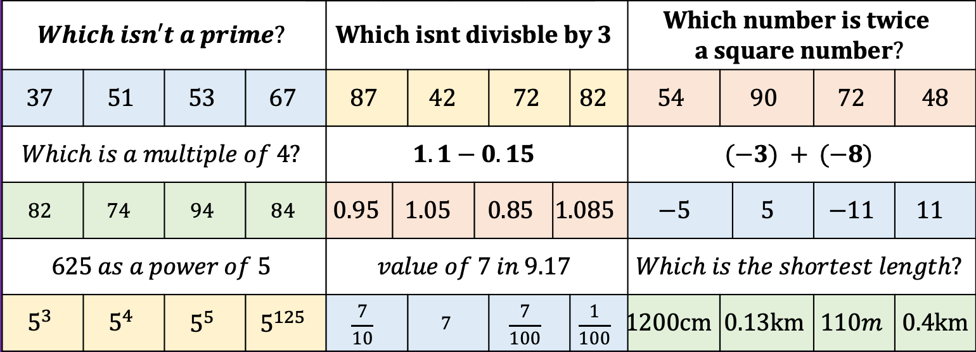
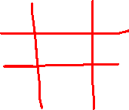

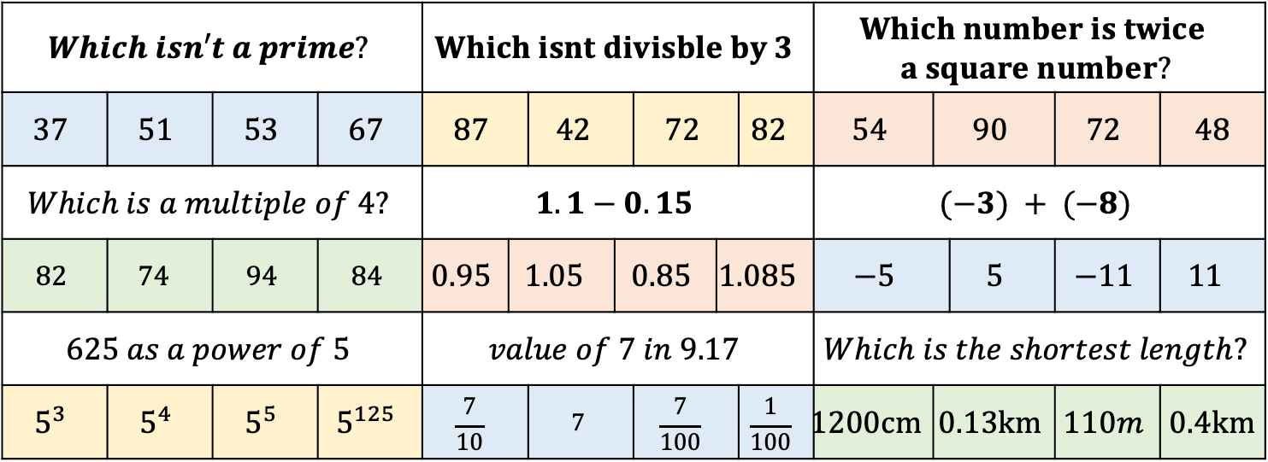
Linear Graphs: Co-ordinates
Please use the chat for Math’s related conversations
Draw the grid to the right on your paper and answer the questions below. Then fill your grid with the correct letter.
PLEASE WRITE A,B,C,D so its easier for me to check
$$A$$ | $$B$$ | $$C$$ | $$D$$
$$Which isn′t a prime?$$ |  |  |  | $$Which isnt divisble by 3$$ |  |  |  |  |  |  | $$Which number is twice$$ $$a square number?$$
$$37$$ | $$51$$ | $$53$$ | $$67$$ | $$87$$ |  | $$42$$ |  | $$72$$ |  | $$82$$ | $$54$$ | $$90$$ | $$0.13km$$ | $$72$$ | $$48$$
$$Which is a multiple of 4?$$ |  |  |  | $$1.1−0.15$$ |  |  |  |  |  |  | $$(−3) + (−8)$$
$$82$$ | $$74$$ | $$94$$ | $$84$$ | $$0.95$$ | $$1.05$$ | $$1.05$$ | $$0.85$$ | $$0.85$$ | $$1.085$$ | $$1.085$$ | $$−5$$ |  | $$5$$ | $$−11$$ | $$11$$
$$625 as a power of 5$$ |  |  |  | $$value of 7 in 9.17$$ |  |  |  |  |  |  | $$Which is the shortest length?$$
$$5^{3}$$ | $$5^{4}$$ | $$5^{5}$$ | $$5^{125}$$ | $$\frac{7}{10}$$ |  | $$7$$ |  | $$\frac{7}{100}$$ |  | $$\frac{1}{100}$$ | $$1200cm$$ | $$0.13km$$ | $$0.13km$$ | $$110m$$ | $$0.4km$$

Slide 2
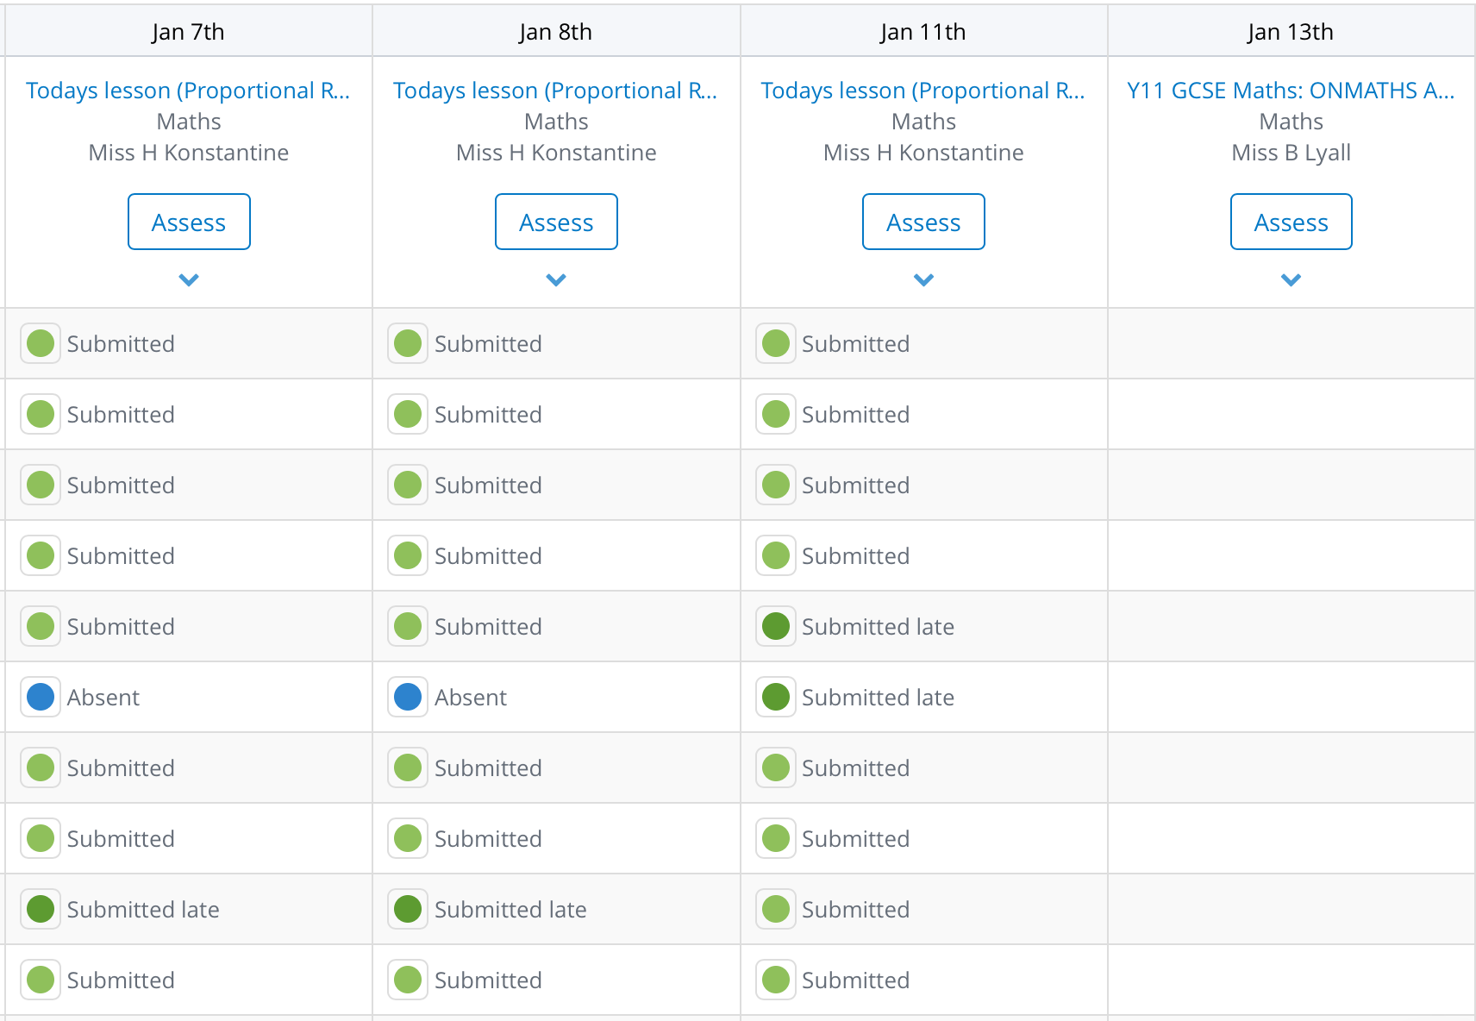
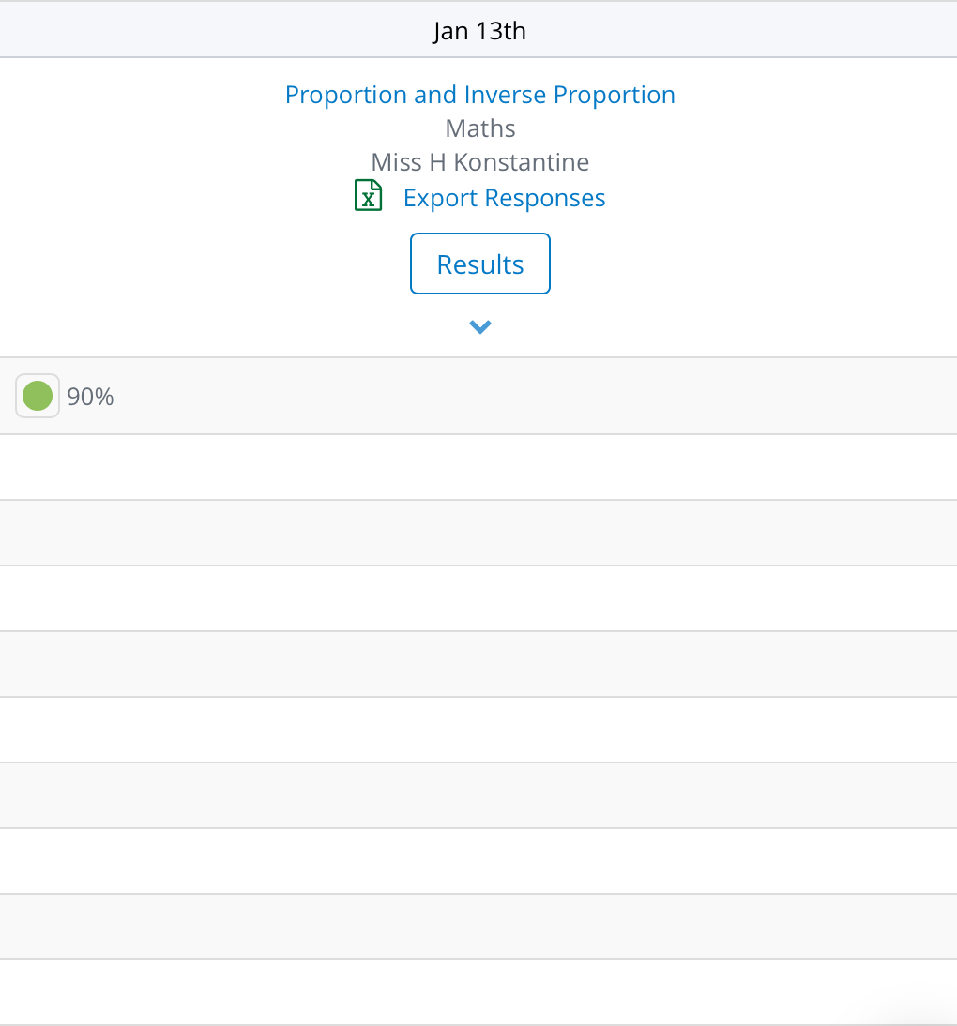
SMHW

Slide 3
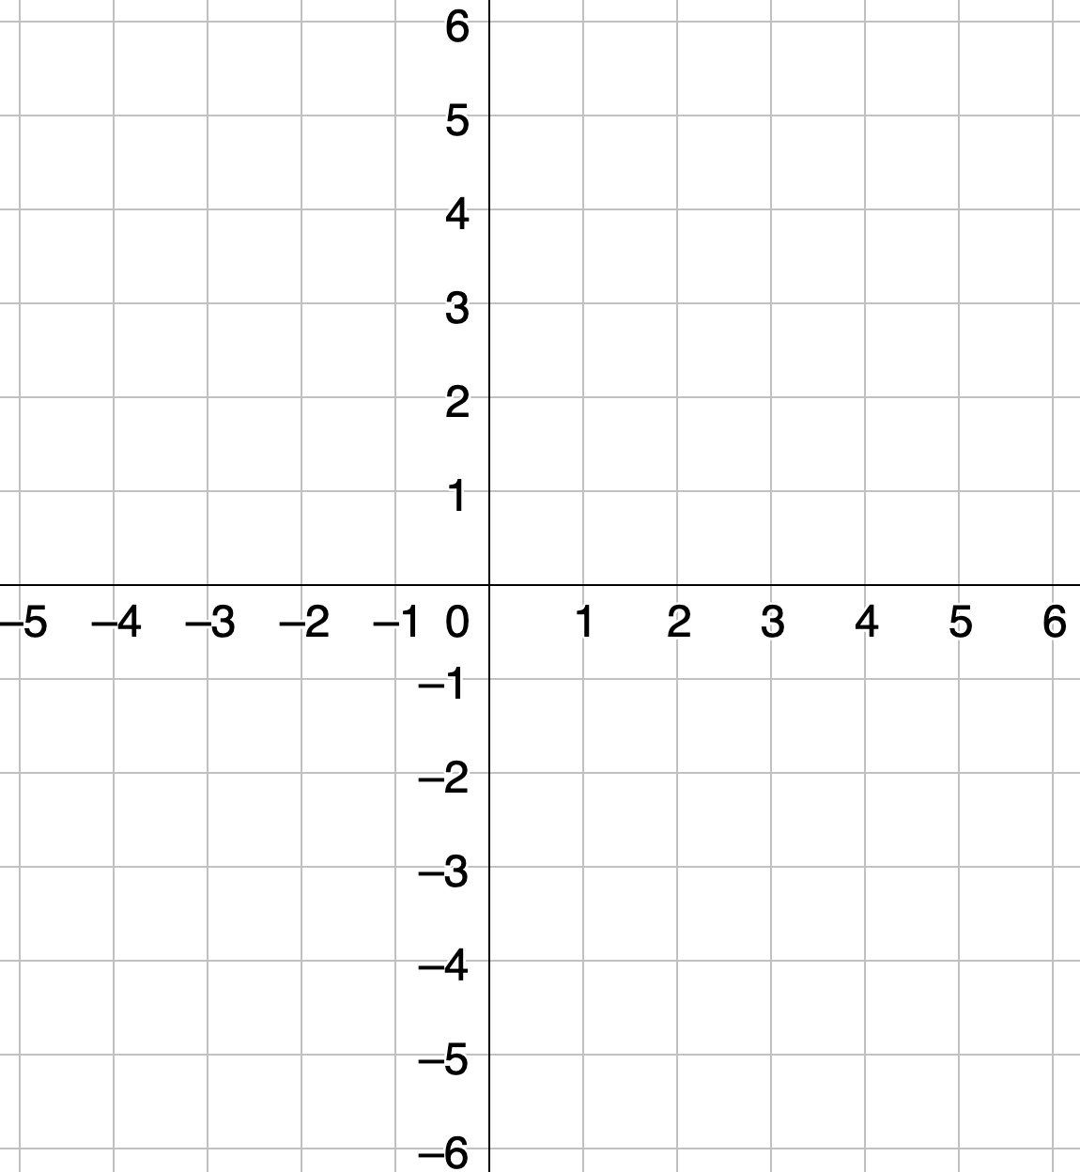
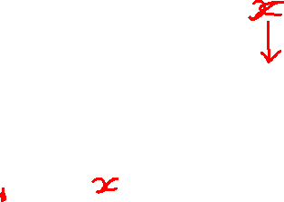







A (3, 3)
$$D$$
$$A$$
B (3, -3)
C (-3, -3)
$$C$$
$$B$$
D (-3, 3)

Slide 4














Which lines are equal in length? How do you know?
$$H$$
$$B$$
$$L$$
$$P$$
$$G$$
$$A$$
$$F$$
$$K$$
$$O$$
$$E$$
$$M$$
$$N$$
$$I$$
$$D$$
$$C$$
$$J$$

Slide 5





Which co-ordinate E, makes ACED a rectangle? | Which co-ordinate E, makes ACED a rectangle?
A | (-3, -1)
B | (-3, -2)
C | (-2, -3)
D | (-3, -3)
$$C$$
$$A$$
$$B$$
$$D$$

Slide 6
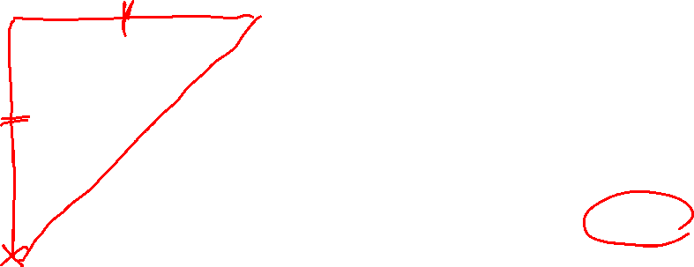
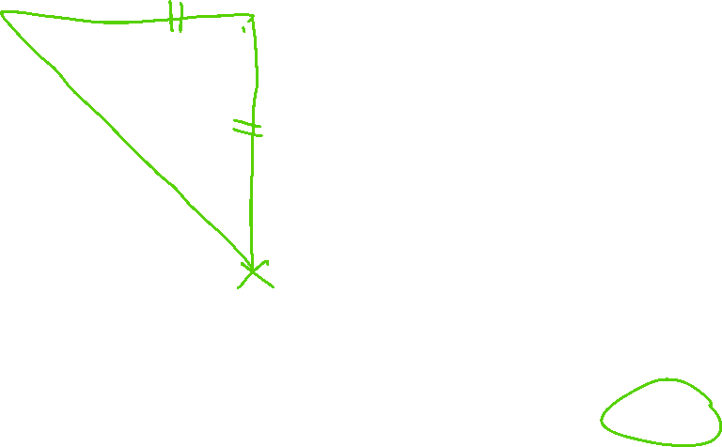
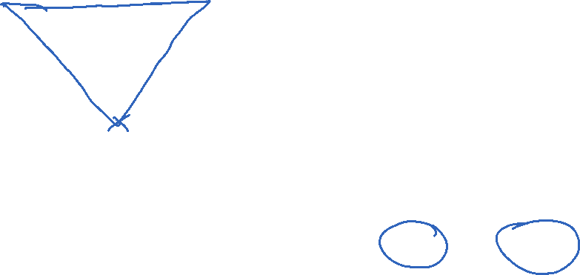
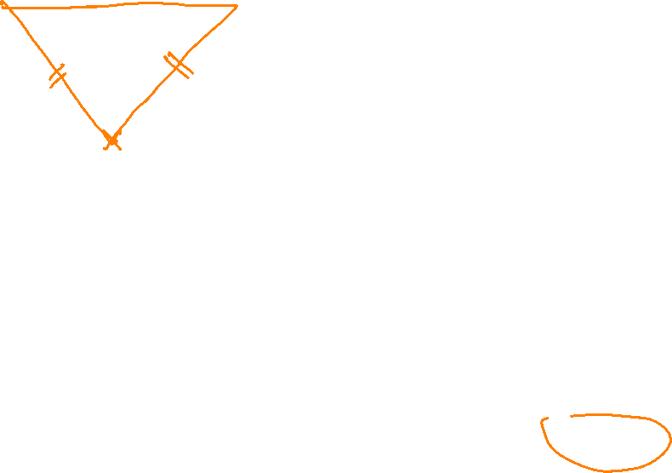
Which co-ordinate E, doesn’t make ACE an Isosceles Triangle?
A | (-3, -1)
B | (0, 1)
C | (2, -1)
D | (-0.5, 1)
$$C$$
$$A$$
$$B$$
$$D$$

Slide 7
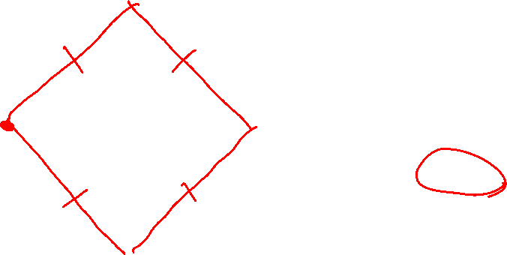



Which co-ordinate E, makes ABDE a square? | Which co-ordinate E, makes ABDE a square?
A | (-1, 1)
B | (-1, 0)
C | (0, -1)
D | (0, 1)
$$C$$
$$A$$
$$B$$
$$D$$

Slide 8



Which co-ordinate E, doesn’t make ABDE a kite? | Which co-ordinate E, doesn’t make ABDE a kite?
A | (-4, 1)
B | (-5, 1)
C | (1, -4)
D | (-1, 1)
$$C$$
$$A$$
$$B$$
$$D$$

Slide 9


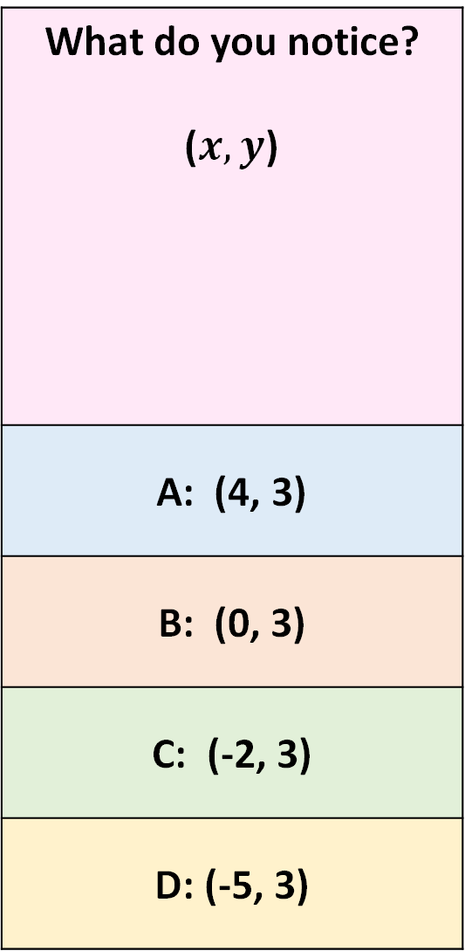




What do you notice? ($x, y$)
A: (4, 3)
B: (0, 3)
C: (-2, 3)
D: (-5, 3)
$$D$$
$$C$$
$$B$$
$$A$$
$$y=3$$

Slide 10

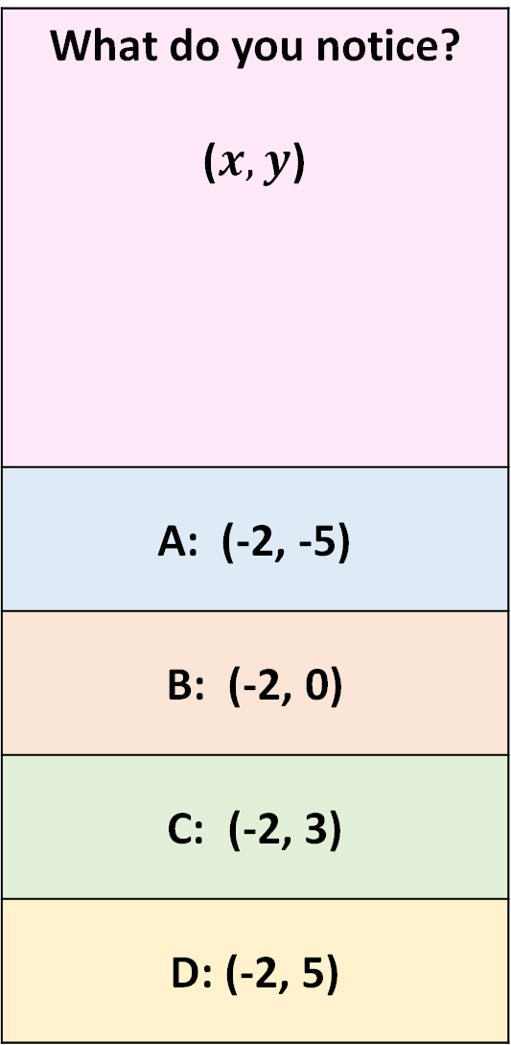

What do you notice? ($x, y$)
A: (-2, -5)
B: (-2, 0)
C: (-2, 3)
D: (-2, 5)
$$D$$
$$C$$
$$x=−2$$
$$B$$
$$A$$

Slide 11

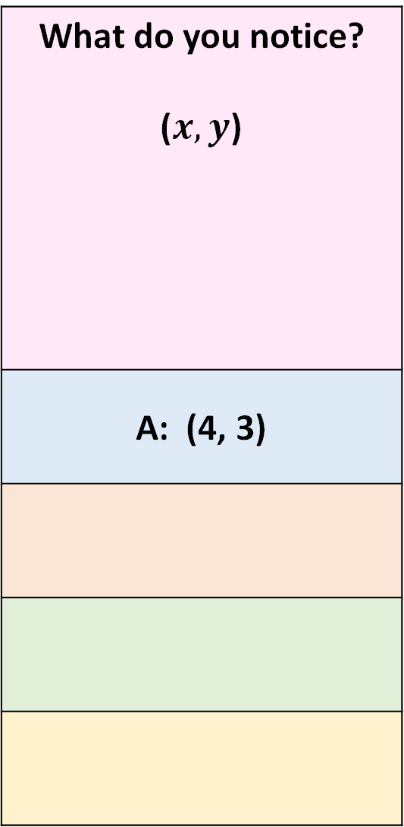
What do you notice? ($x, y$)
A: (4, 3)
$$A$$
$$B$$
$$x→y$$

Slide 12
What do you notice? ($x, y$)
A: (4, 3)
$$B$$
$$A$$
$$x→y$$

Slide 13

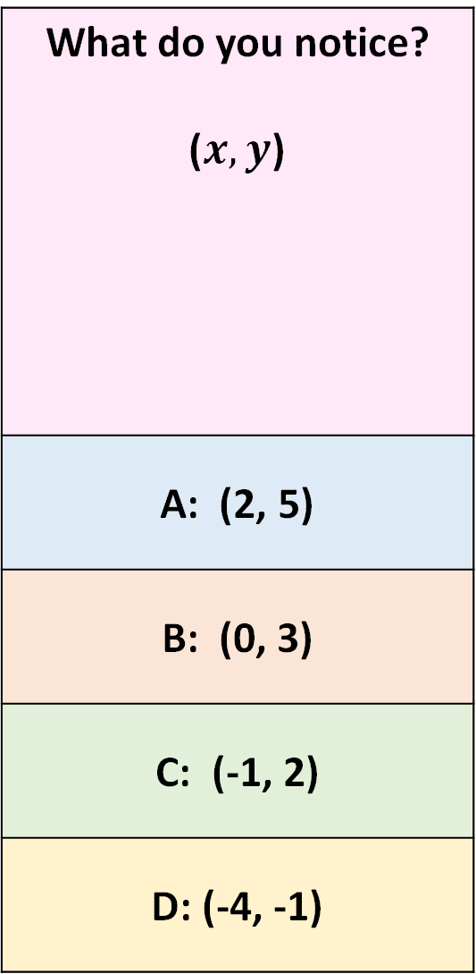
What do you notice? ($x, y$)
A: (2, 5)
B: (0, 3)
C: (-1, 2)
D: (-4, -1)
$$A$$
$$B$$
$$x+3=y$$

Slide 14

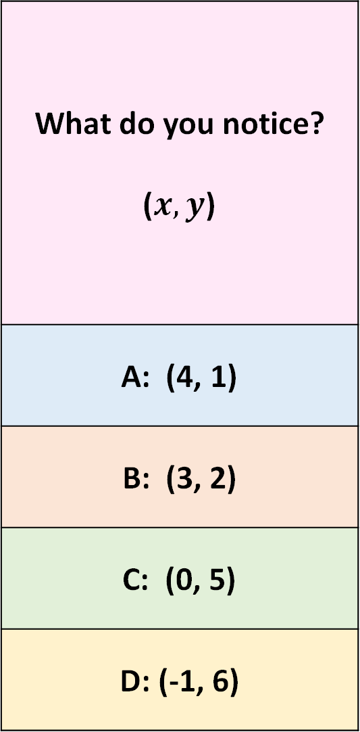
What do you notice? ($x, y$)
A: (4, 1)
B: (3, 2)
C: (0, 5)
D: (-1, 6)
$$B$$
$$x+ y=5$$
$$A$$

Slide 15
Whiteboard activity
Wait for the link in the chat or use room code:
Make sure you write your name so I can see who’s writing
You can only see my board or your own. I can see everyone's you can type rather than write if you prefer

Slide 16




Notes:
X6+5
X12+10

Slide 17
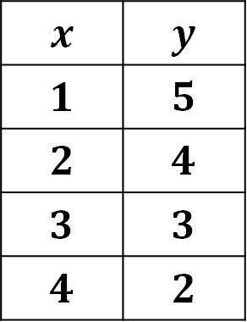
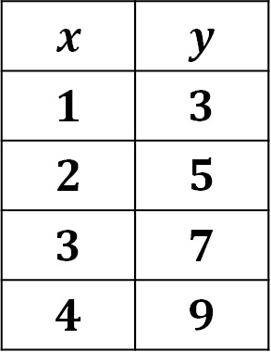
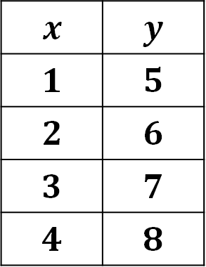
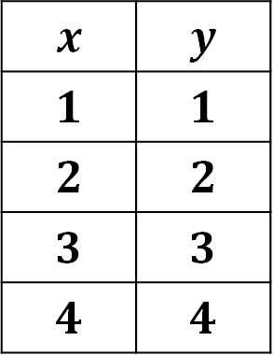
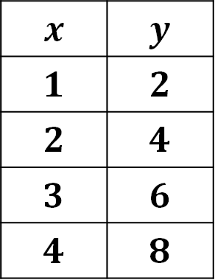
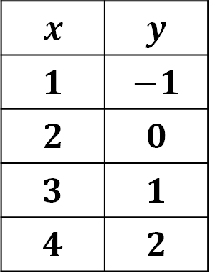
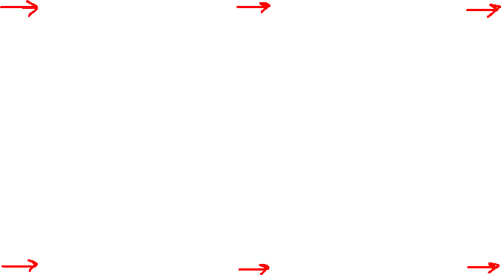
Table A | Table B | Table C
Table D | Table E | Table F
$$x$$ | $$y$$
$$1$$ | $$5$$
$$2$$ | $$6$$
$$3$$ | $$7$$
$$4$$ | $$8$$
$$x$$ | $$y$$
$$1$$ | $$5$$
$$2$$ | $$4$$
$$3$$ | $$3$$
$$4$$ | $$2$$
$$x$$ | $$y$$
$$1$$ | $$1$$
$$2$$ | $$2$$
$$3$$ | $$3$$
$$4$$ | $$4$$
$$x$$ | $$y$$
$$1$$ | $$−1$$
$$2$$ | $$0$$
$$3$$ | $$1$$
$$4$$ | $$2$$
$$x$$ | $$y$$
$$1$$ | $$2$$
$$2$$ | $$4$$
$$3$$ | $$6$$
$$4$$ | $$8$$
$$x$$ | $$y$$
$$1$$ | $$3$$
$$2$$ | $$5$$
$$3$$ | $$7$$
$$4$$ | $$9$$

Slide 18
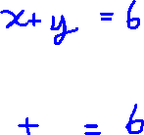
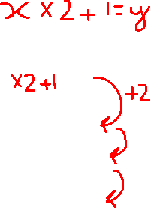


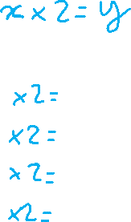
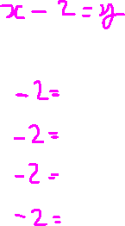
Table A | Table B | Table C
Table D | Table E | Table F
$$x$$ | $$y$$
$$1$$ | $$5$$
$$2$$ | $$6$$
$$3$$ | $$7$$
$$4$$ | $$8$$
$$x$$ | $$y$$
$$1$$ | $$5$$
$$2$$ | $$4$$
$$3$$ | $$3$$
$$4$$ | $$2$$
$$x$$ | $$y$$
$$1$$ | $$1$$
$$2$$ | $$2$$
$$3$$ | $$3$$
$$4$$ | $$4$$
$$x$$ | $$y$$
$$1$$ | $$−1$$
$$2$$ | $$0$$
$$3$$ | $$1$$
$$4$$ | $$2$$
$$x$$ | $$y$$
$$1$$ | $$2$$
$$2$$ | $$4$$
$$3$$ | $$6$$
$$4$$ | $$8$$
$$x$$ | $$y$$
$$1$$ | $$3$$
$$2$$ | $$5$$
$$3$$ | $$7$$
$$4$$ | $$9$$

