Slide 1
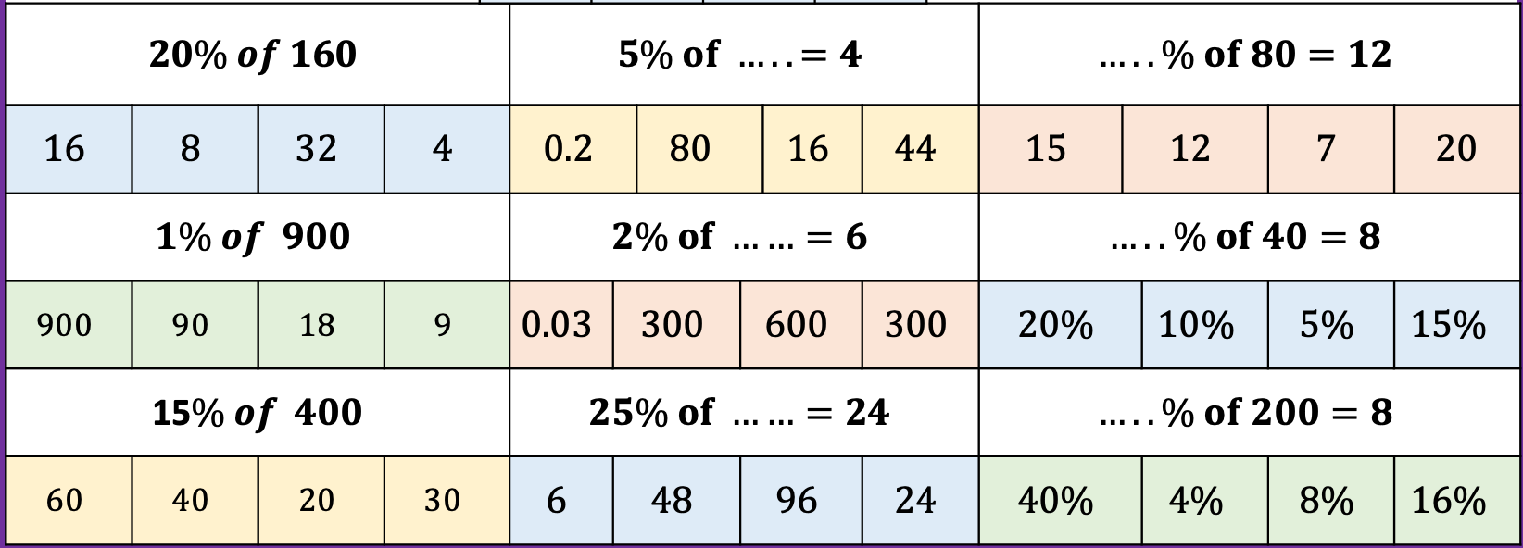
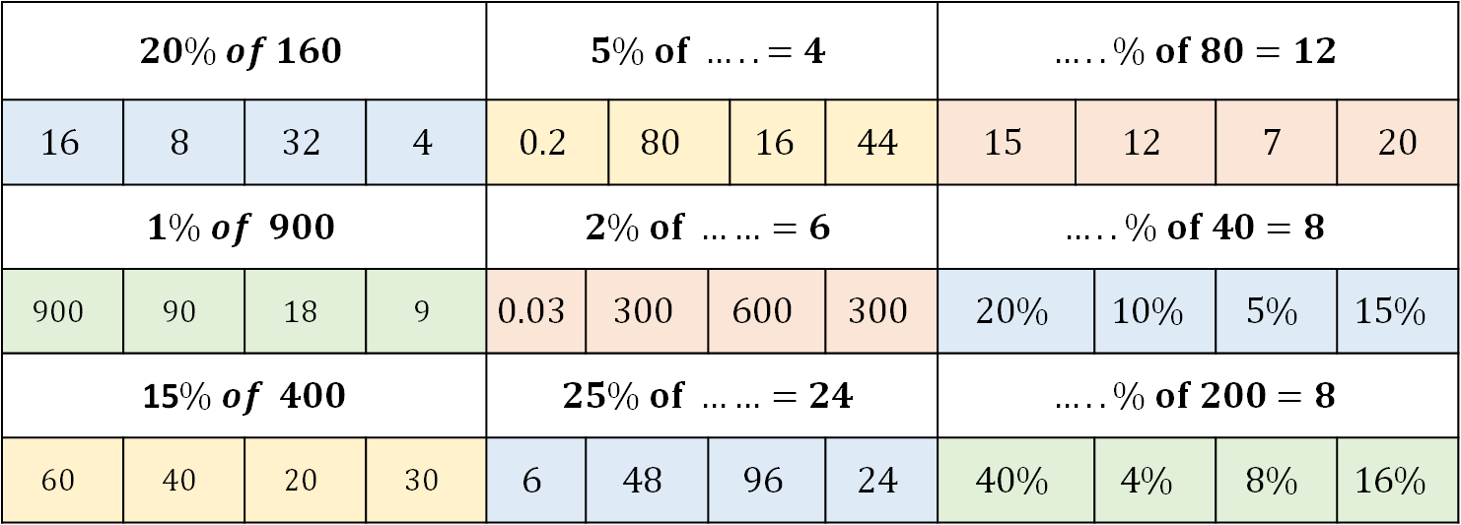
Linear Graphs: Plotting
Work the following out on paper/in your books
DO NOT WRITE ANYTHING IN THE CHAT BOX YET
$$20\% of 160$$ |  |  |  | $$5\% of ….. =4$$ |  |  |  |  |  | $$…..\% of 80=12$$
$$16$$ | $$8$$ | $$32$$ | $$4$$ | $$0.2$$ |  | $$80$$ |  | $$16$$ | $$44$$ | $$15$$ | $$12$$ | $$0.13km$$ | $$7$$ | $$20$$
$$1\% of 900$$ |  |  |  | $$2\% of ……=6$$ |  |  |  |  |  | $$…..\% of 40=8$$
$$900$$ | $$90$$ | $$18$$ | $$9$$ | $$0.03$$ | $$300$$ | $$1.05$$ | $$600$$ | $$0.85$$ | $$300$$ | $$20\%$$ |  | $$10\%$$ | $$5\%$$ | $$15\%$$
15$\% of 400$ |  |  |  | $$25\% of ……=24$$ |  |  |  |  |  | $$…..\% of 200=8$$
$$60$$ | $$40$$ | $$20$$ | $$30$$ | $$6$$ | $$48$$ | $$1.05$$ | $$96$$ | $$0.85$$ | $$24$$ | $$40\%$$ |  | $$4\%$$ | $$8\%$$ | $$16\%$$
1 2 3
4 5 6
7 8 9

Slide 2


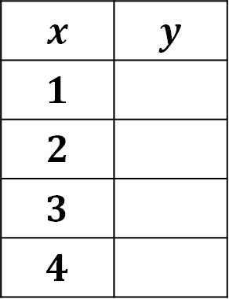


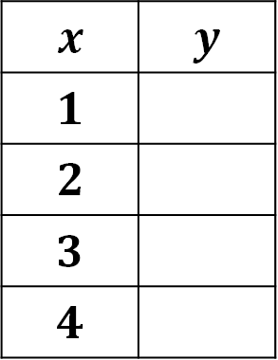

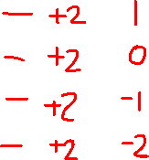






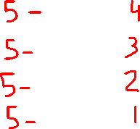
Table A | Table B | Table C
Table D | Table E | Table F
$$y=3x$$
$$y=2x−1$$
$$y=4x+3$$
$$x$$ | $$y$$
$$1$$
$$2$$
$$3$$
$$4$$
$$x$$ | $$y$$
$$1$$
$$2$$
$$3$$
$$4$$
$$x$$ | $$y$$
$$1$$
$$2$$
$$3$$
$$4$$
$$y=−4x$$
$$y=−x+2$$
$$y=5−x$$
$$x$$ | $$y$$
$$1$$
$$2$$
$$3$$
$$4$$
$$x$$ | $$y$$
$$1$$
$$2$$
$$3$$
$$4$$
$$x$$ | $$y$$
$$1$$
$$2$$
$$3$$
$$4$$

Slide 3
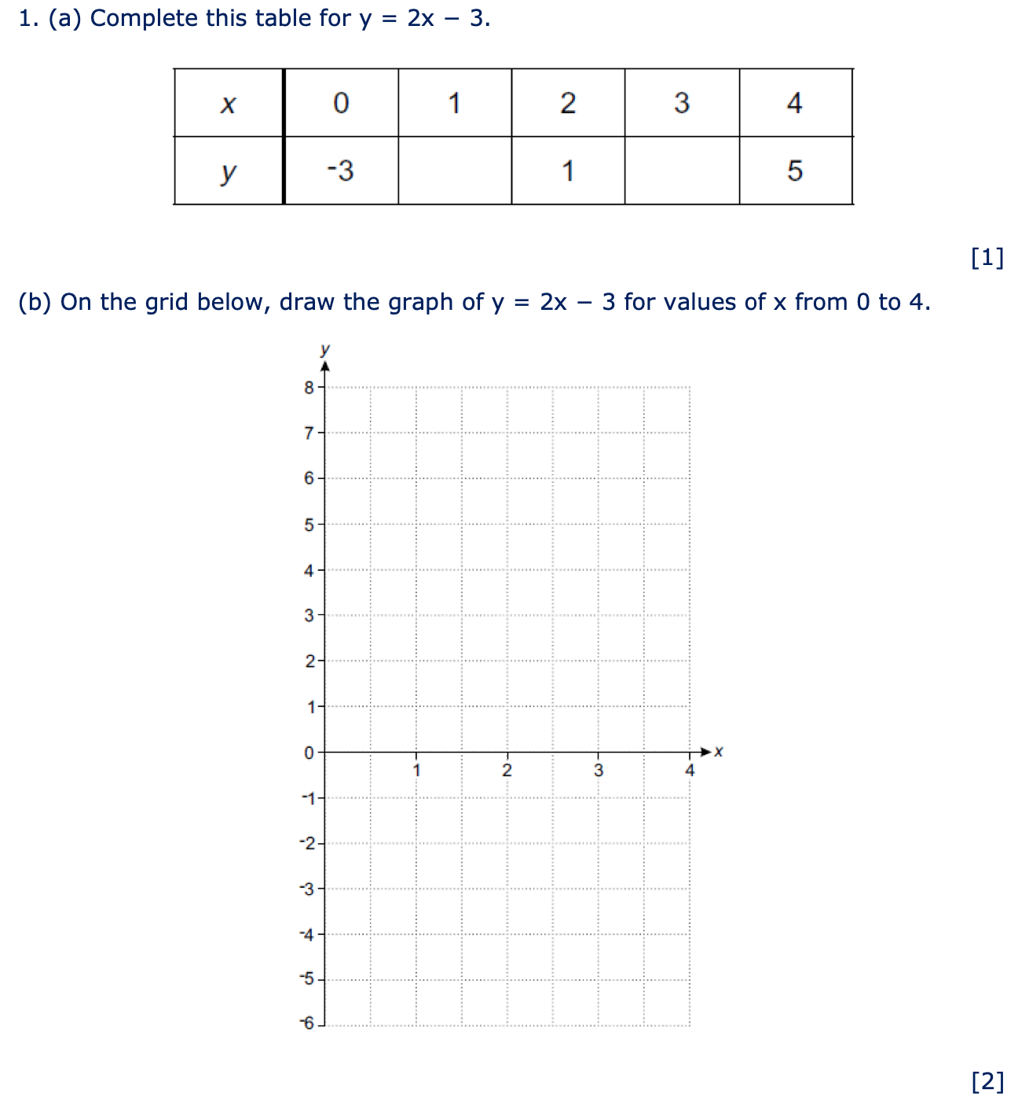
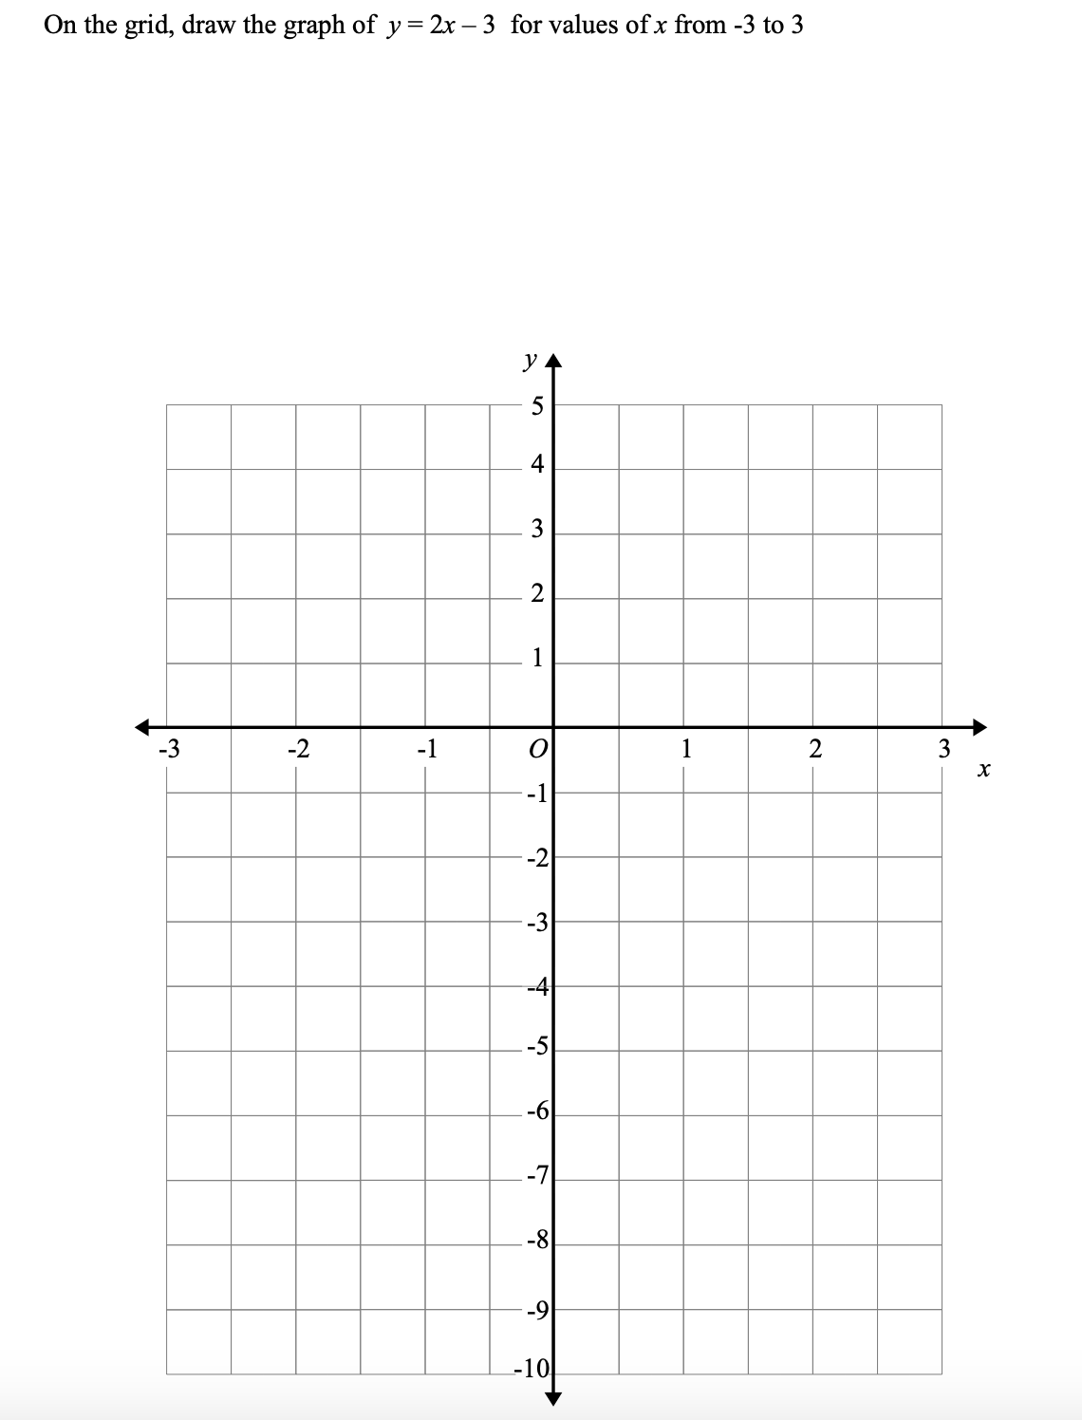

Slide 4
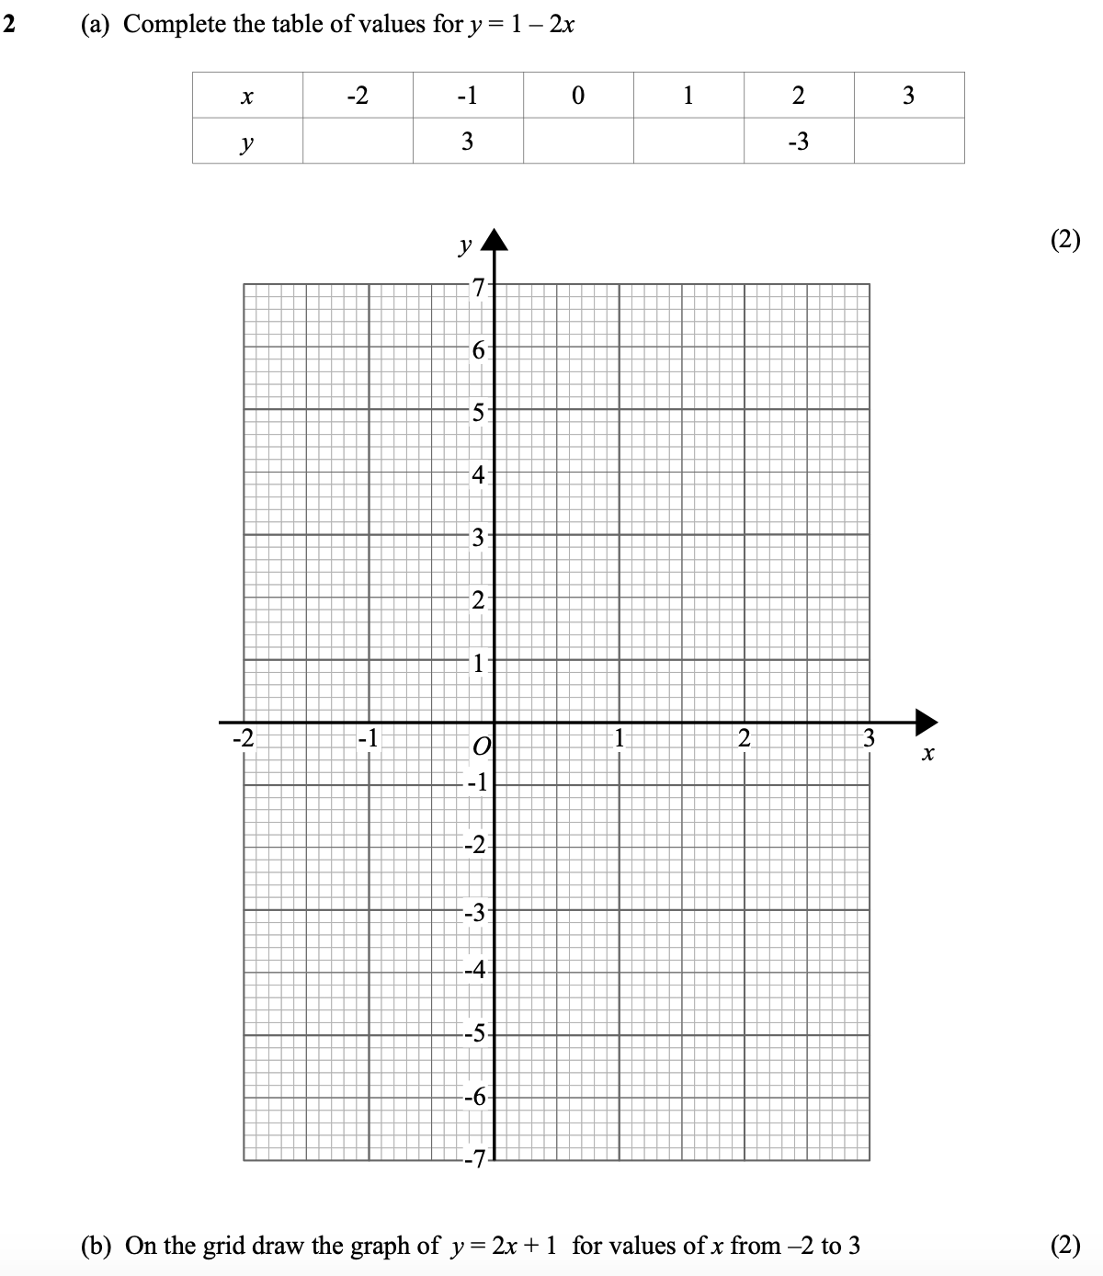

Slide 6
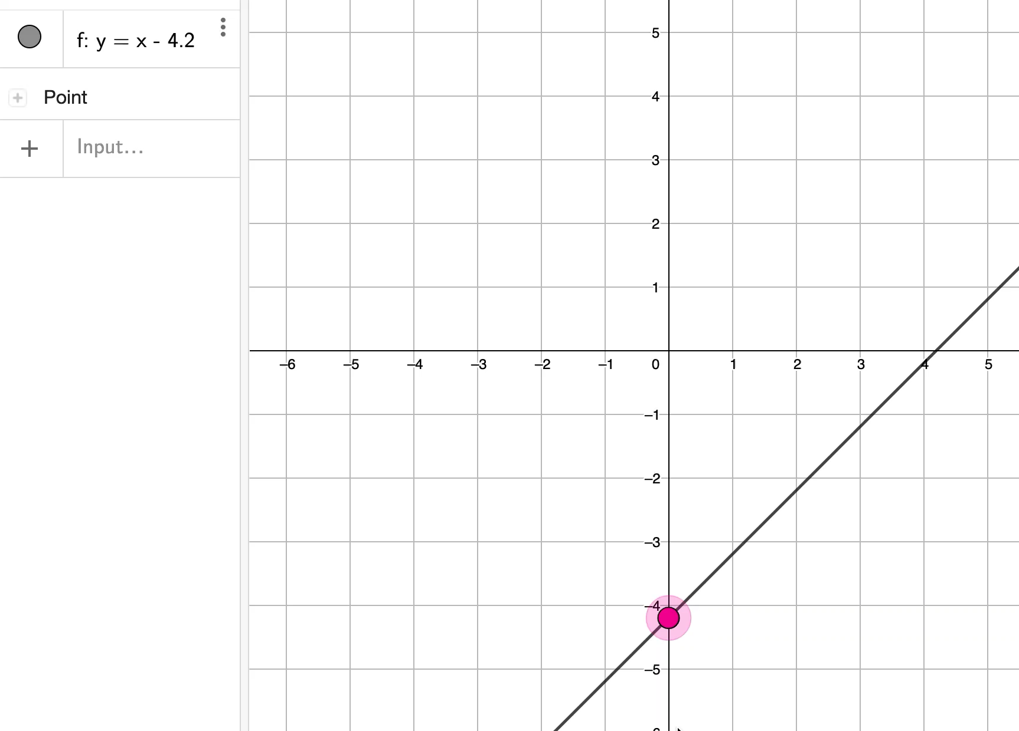

Slide 7
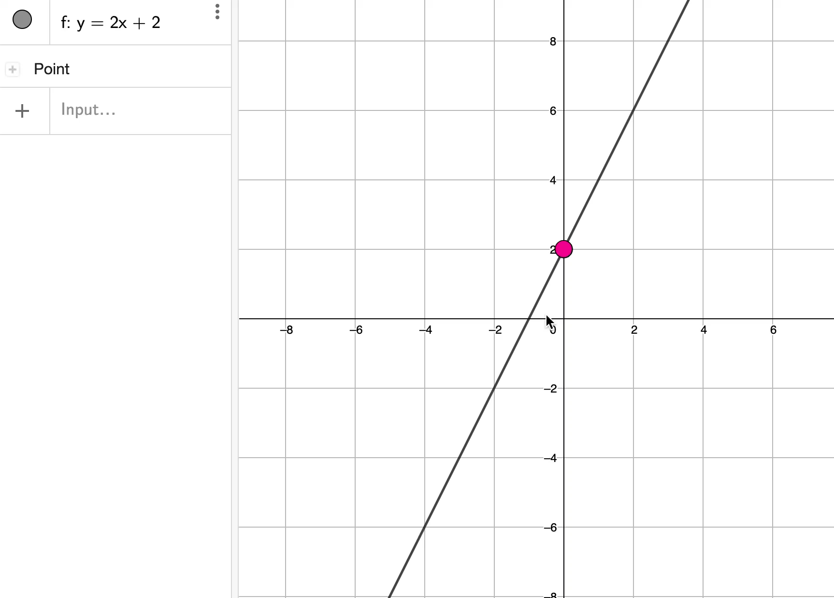

Slide 8
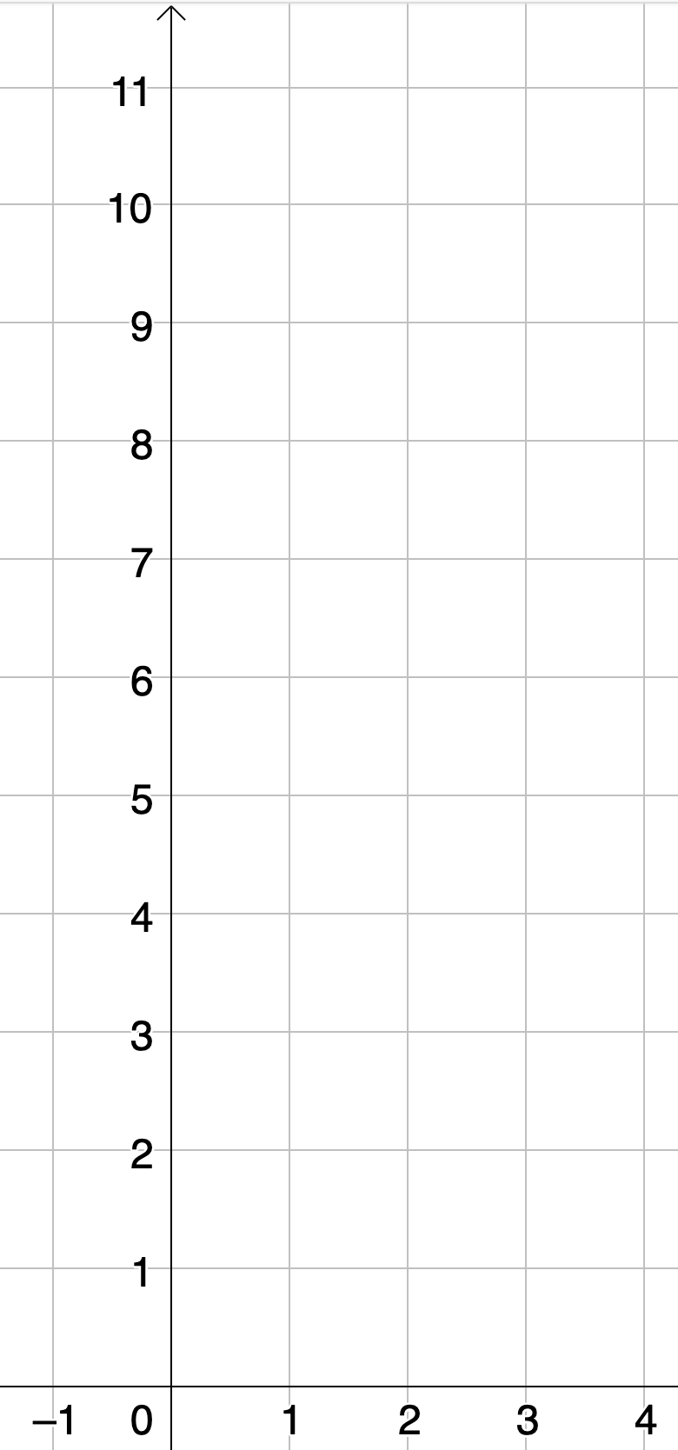

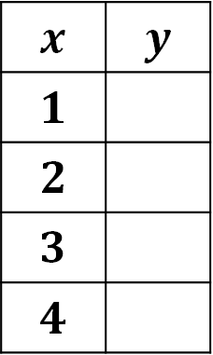



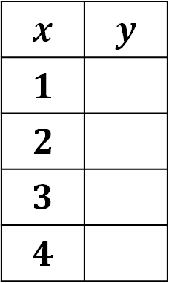
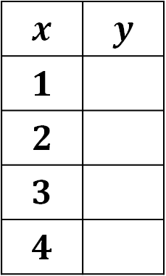

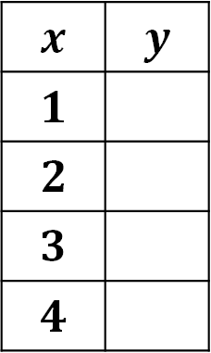


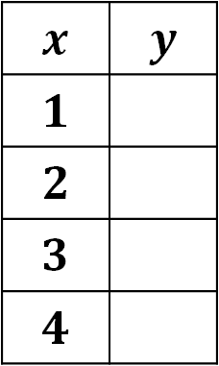
Table A | Table B | Table C
Table D | Table E | Table F
$$y=2x$$
$$y=2x+1$$
$$y=−2+2x$$
$$x$$ | $$y$$
$$1$$
$$2$$
$$3$$
$$4$$
$$x$$ | $$y$$
$$1$$
$$2$$
$$3$$
$$4$$
$$x$$ | $$y$$
$$1$$
$$2$$
$$3$$
$$4$$
$$y=2x−1$$
$$y=2x+3$$
$$y=2+2x$$
$$x$$ | $$y$$
$$1$$
$$2$$
$$3$$
$$4$$
$$x$$ | $$y$$
$$1$$
$$2$$
$$3$$
$$4$$
$$x$$ | $$y$$
$$1$$
$$2$$
$$3$$
$$4$$

Slide 9

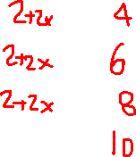








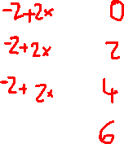
Table A | Table B | Table C
Table D | Table E | Table F
$$y=2x$$
$$y=2x+1$$
$$y=−2+2x$$
Parallel lines have Equal GRADIENT
$$x$$ | $$y$$
$$1$$
$$2$$
$$3$$
$$4$$
$$x$$ | $$y$$
$$1$$
$$2$$
$$3$$
$$4$$
$$x$$ | $$y$$
$$1$$
$$2$$
$$3$$
$$4$$
$$y=2x−1$$
$$y=2x+3$$
$$y=2+2x$$
$$x$$ | $$y$$
$$1$$
$$2$$
$$3$$
$$4$$
$$x$$ | $$y$$
$$1$$
$$2$$
$$3$$
$$4$$
$$x$$ | $$y$$
$$1$$
$$2$$
$$3$$
$$4$$

Slide 10
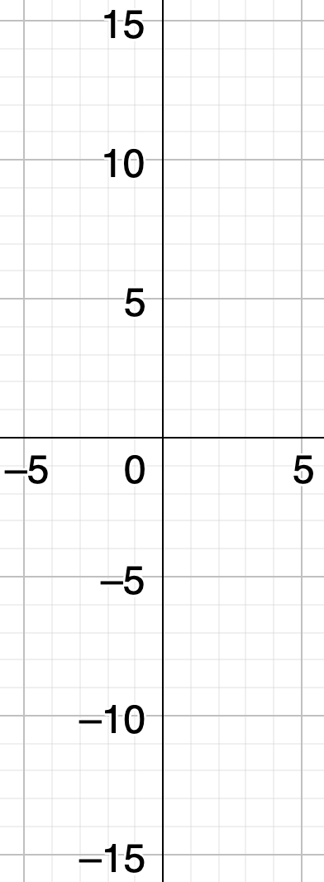

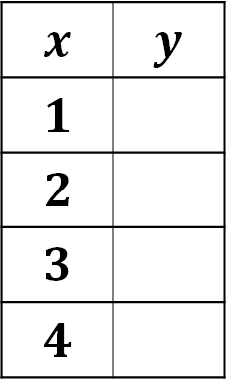


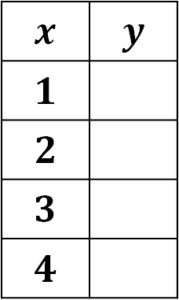


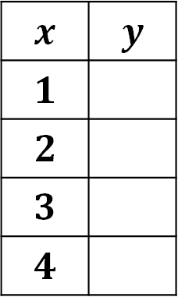


Table A | Table B | Table C
Table D | Table E | Table F
$$y=x+1$$
$$y=2x+1$$
$$y=3x+1$$
$$x$$ | $$y$$
$$1$$
$$2$$
$$3$$
$$4$$
$$x$$ | $$y$$
$$1$$
$$2$$
$$3$$
$$4$$
$$x$$ | $$y$$
$$1$$
$$2$$
$$3$$
$$4$$
$$y=1−x$$
$$y=1−2x$$
$$y=1−3x$$
$$x$$ | $$y$$
$$1$$
$$2$$
$$3$$
$$4$$
$$x$$ | $$y$$
$$1$$
$$2$$
$$3$$
$$4$$
$$x$$ | $$y$$
$$1$$
$$2$$
$$3$$
$$4$$

Slide 11






Table A | Table B | Table C
Table D | Table E | Table F
$$y=x+1$$
$$y=2x+1$$
$$y=3x+1$$
The y-intercept is where the line crosses the y-axis
$$x$$ | $$y$$
$$1$$
$$2$$
$$3$$
$$4$$
$$x$$ | $$y$$
$$1$$
$$2$$
$$3$$
$$4$$
$$x$$ | $$y$$
$$1$$
$$2$$
$$3$$
$$4$$
$$y=1−x$$
$$y=1−2x$$
$$y=1−3x$$
$$x$$ | $$y$$
$$1$$
$$2$$
$$3$$
$$4$$
$$x$$ | $$y$$
$$1$$
$$2$$
$$3$$
$$4$$
$$x$$ | $$y$$
$$1$$
$$2$$
$$3$$
$$4$$

Slide 12

https://student.desmos.com/
Code: UNNDHZ

