Slide 1
Proportion
Compound Measures &
Ratio table
Remember that the chat box is purely for Math's related chat

Slide 2
Whiteboard activity
Wait for the link in the chat
Make sure you write your name so I can see who’s writing
You can only see my board or your own. I can see everyone's you can type rather than write if you prefer

Slide 3





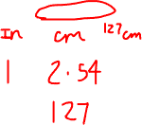

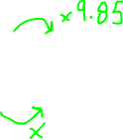

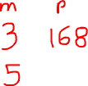
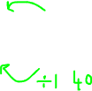



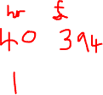

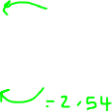
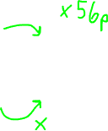
Ratio tables
If 3 metres of ribbon cost £1.68, how much does 5 metres cost?
Jay works 40 hours a week. What is her hourly rate if she’s paid £394?
The exchange rate is
£1 to $1.40
How many pounds equals 84 dollars?
Find the rate of flow litres/s for a pipe that produces 20 litres in 8 seconds
I use 18 units of electricity over 7.5 hours. What is the hourly rate of consumption?
If 1 inch is approximately 2.54cm. How many inches in 1.27m?

Slide 4
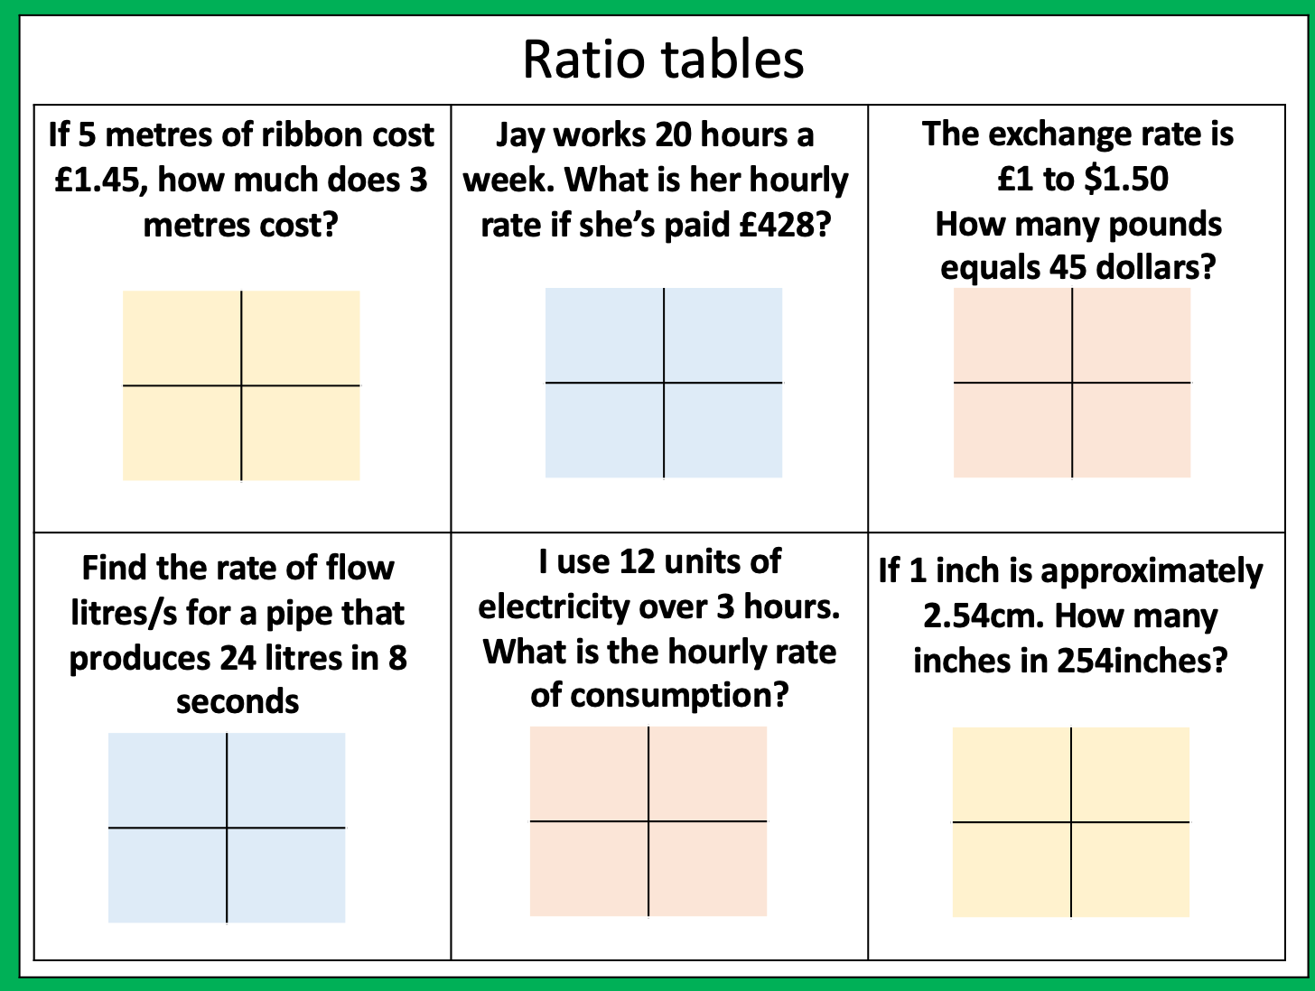
Ratio tables
If 5 metres of ribbon cost £1.45, how much does 3 metres cost?
Jay works 20 hours a week. What is her hourly rate if she’s paid £428?
The exchange rate is
£1 to $1.50
How many pounds equals 45 dollars?
Find the rate of flow litres/s for a pipe that produces 24 litres in 8 seconds
I use 12 units of electricity over 3 hours. What is the hourly rate of consumption?
If 1 inch is approximately 2.54cm. How many inches in 254inches?

Slide 5

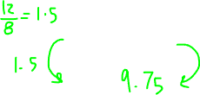
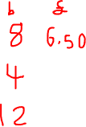
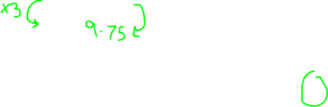
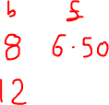
A pack of 8 batteries cost £6.50.
How much do 12 batteries cost?
A: 9.50
B: 9.75
C: 10.50
D: 3.25

Slide 6
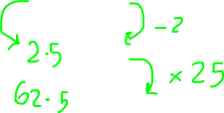
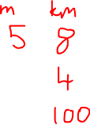
If 5 miles is approximately 8 kilometres
How many miles is 100 kilometres?
A: 62.5
B: 97
C: 12.5
D: 125

Slide 7
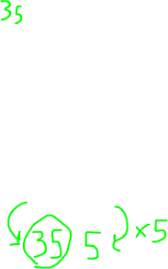
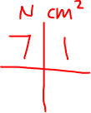
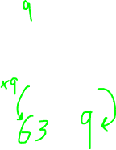
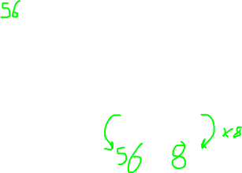
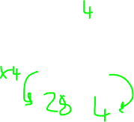
The pressure of a sheet of metal is 7N/cm²
7N
Force of 28N on an area of ….cm²
1cm
1cm
….. N exerted on an area of 5cm²
….N exerted on an area of 8cm²
Force of 63N on an area of ….cm²

Slide 8
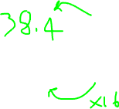
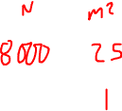
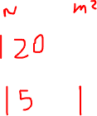
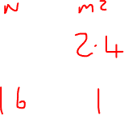


Find the pressure exerted by a force of 8000 Newtons on an area of 25m². Give your answer in N/m²
A crate exerts a force of 120 newtons on a table. The pressure on the table is 15 N/m². Calculate the area of the crate that is in contact with the table.
A box is placed on the floor. The area of the box in contact with the floor is 2.4m² Pressure exerted on the floor 16 N/m². Work out the force exerted by the box on the floor.

Slide 12
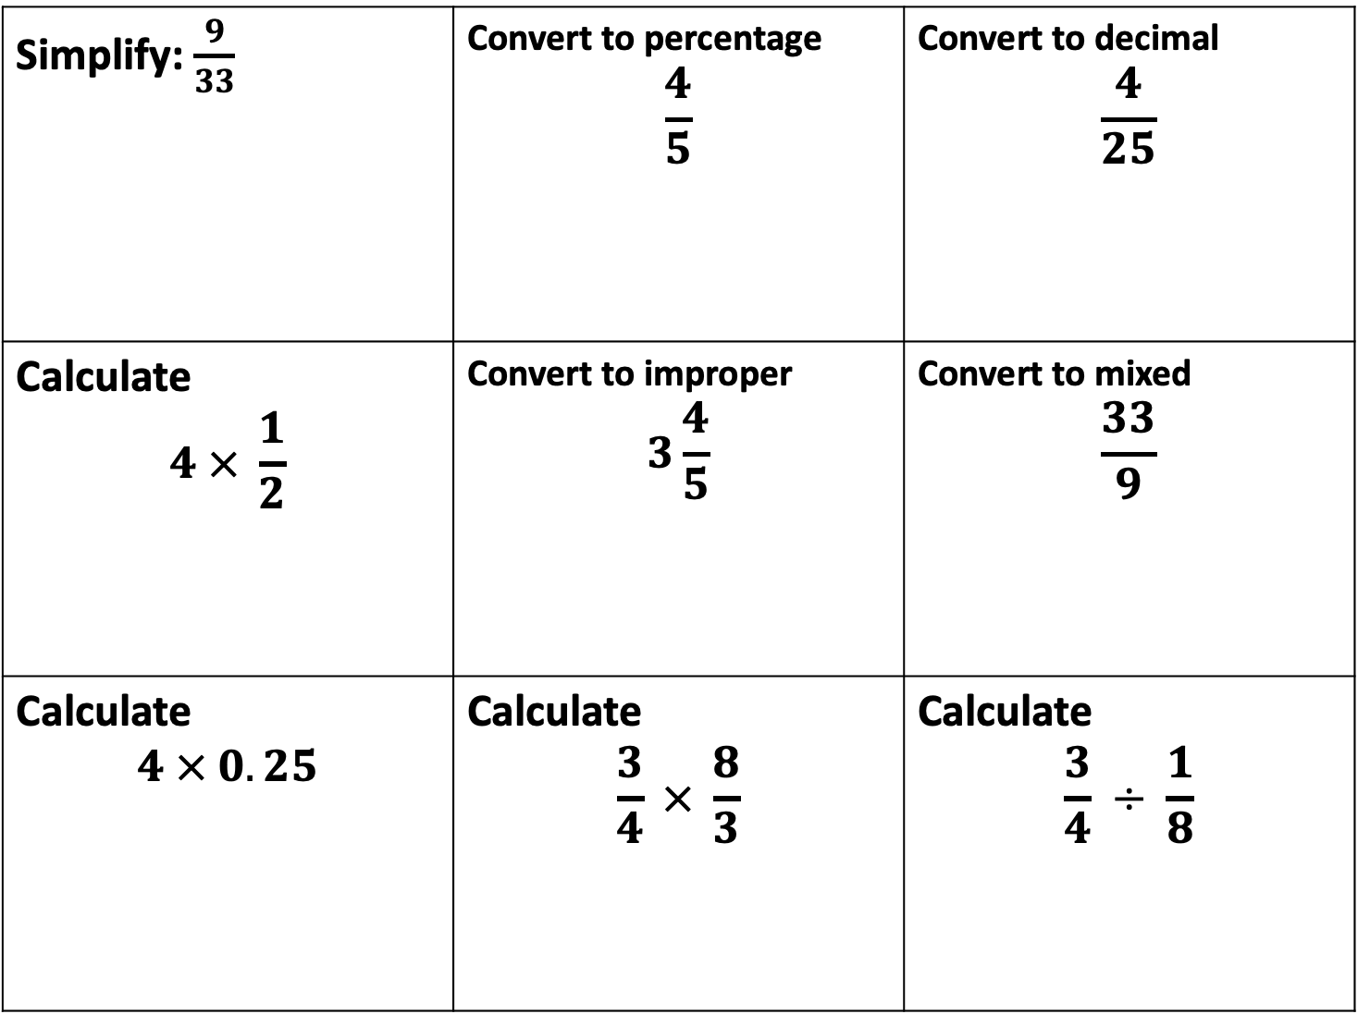
Simplify: $\frac{9}{33}$ | Convert to percentage $$\frac{4}{5}$$ | Convert to decimal $$\frac{4}{25}$$
Calculate $$4 × \frac{1}{2}$$ | Convert to improper $$3\frac{4}{5}$$ | Convert to mixed $$\frac{33}{9}$$
Calculate $$4 × 0.25$$ | Calculate $$\frac{3}{4} × \frac{8}{3}$$ | Calculate $$\frac{3}{4} ÷ \frac{1}{8}$$

