Slide 1
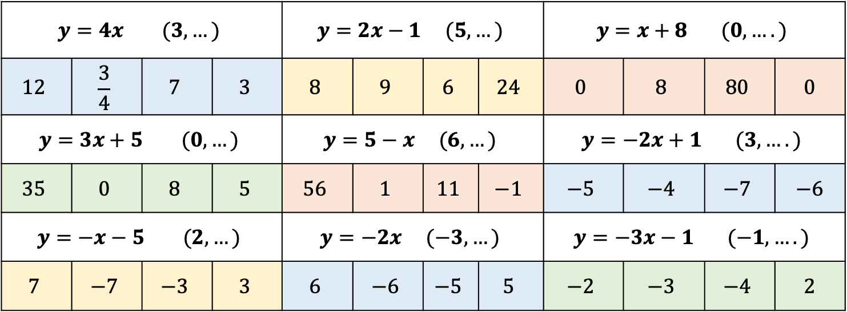
Linear Graphs: Gradient
Work the following out on paper/in your books
DO NOT WRITE ANYTHING IN THE CHAT BOX YET
1 2 3
$$y=4x (3, …)$$ |  |  |  | $$y=2x−1 (5, …)$$ |  |  |  | $$y=x+8 (0, ….)$$
$$12$$ | $$\frac{3}{4}$$ | $$7$$ | $$3$$ | $$8$$ | $$9$$ | $$6$$ | $$24$$ | $$0$$ | $$8$$ | $$80$$ | $$0$$
$$y=3x+5 (0, …)$$ |  |  |  | $$y=5−x (6, …)$$ |  |  |  | $$y=−2x+1 (3, ….)$$
$$35$$ | $$0$$ | $$8$$ | $$5$$ | $$56$$ | $$1$$ | $$11$$ | $$−1$$ | $$−5$$ | $$−4$$ | $$−7$$ | $$−6$$
$$y=−x−5 (2, …)$$ |  |  |  | $$y=−2x (−3, …)$$ |  |  |  | $$y=−3x−1 (−1, ….)$$
$$7$$ | $$−7$$ | $$−3$$ | $$3$$ | $$6$$ | $$−6$$ | $$−5$$ | $$5$$ | $$−2$$ | $$−3$$ | $$−4$$ | $$2$$
4 5 6
7 8 9

Slide 2
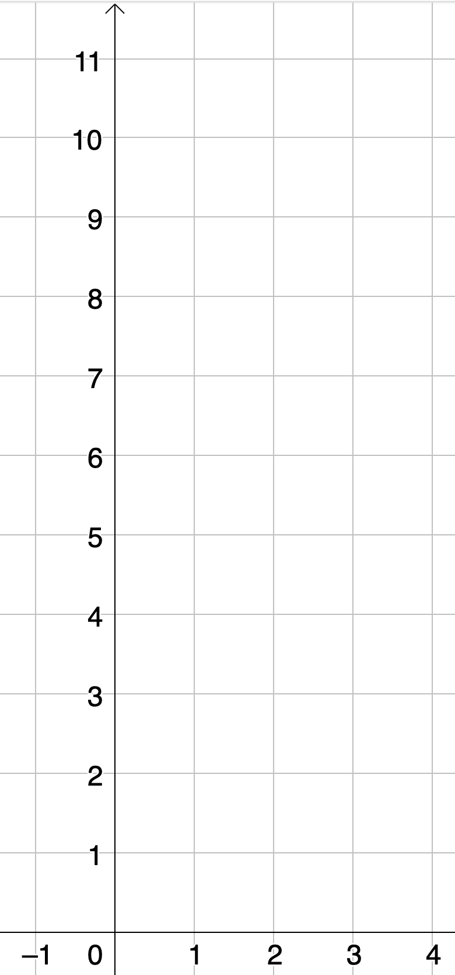

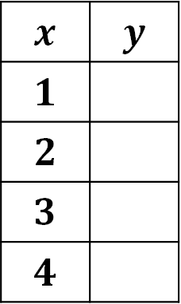



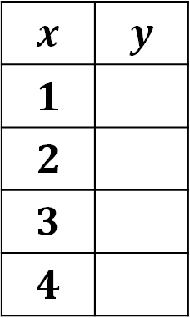
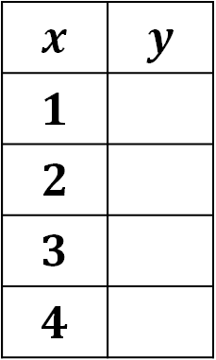

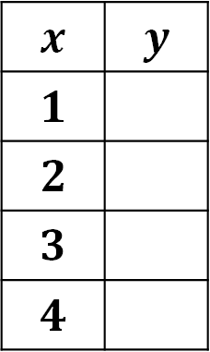


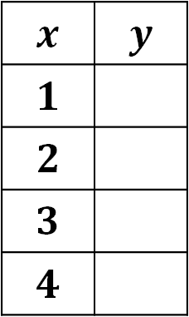
Table A | Table B | Table C
Table D | Table E | Table F
$$y=2x$$
$$y=2x+1$$
$$y=−2+2x$$
$$x$$ | $$y$$
$$1$$
$$2$$
$$3$$
$$4$$
$$x$$ | $$y$$
$$1$$
$$2$$
$$3$$
$$4$$
$$x$$ | $$y$$
$$1$$
$$2$$
$$3$$
$$4$$
$$y=2x−1$$
$$y=2x+3$$
$$y=2+2x$$
$$x$$ | $$y$$
$$1$$
$$2$$
$$3$$
$$4$$
$$x$$ | $$y$$
$$1$$
$$2$$
$$3$$
$$4$$
$$x$$ | $$y$$
$$1$$
$$2$$
$$3$$
$$4$$

Slide 3

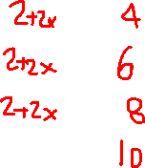








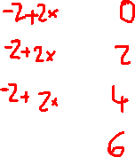
Table A | Table B | Table C
Table D | Table E | Table F
$$y=2x$$
$$y=2x+1$$
$$y=−2+2x$$
Parallel lines have Equal GRADIENT
$$x$$ | $$y$$
$$1$$
$$2$$
$$3$$
$$4$$
$$x$$ | $$y$$
$$1$$
$$2$$
$$3$$
$$4$$
$$x$$ | $$y$$
$$1$$
$$2$$
$$3$$
$$4$$
$$y=2x−1$$
$$y=2x+3$$
$$y=2+2x$$
$$x$$ | $$y$$
$$1$$
$$2$$
$$3$$
$$4$$
$$x$$ | $$y$$
$$1$$
$$2$$
$$3$$
$$4$$
$$x$$ | $$y$$
$$1$$
$$2$$
$$3$$
$$4$$

Slide 4
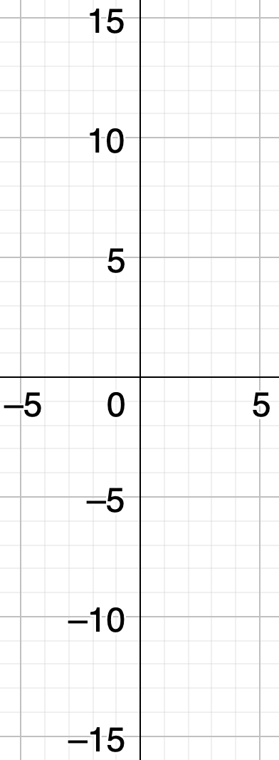



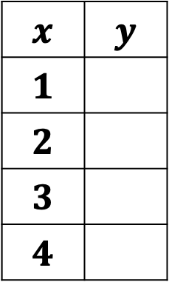
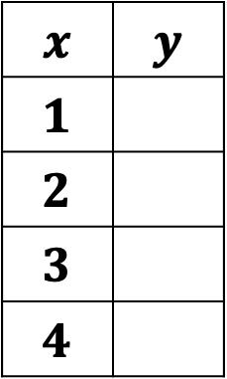




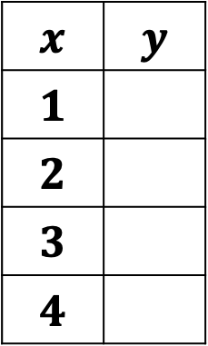
Table A | Table B | Table C
Table D | Table E | Table F
$$y=x+1$$
$$y=2x+1$$
$$y=3x+1$$
$$x$$ | $$y$$
$$1$$
$$2$$
$$3$$
$$4$$
$$x$$ | $$y$$
$$1$$
$$2$$
$$3$$
$$4$$
$$x$$ | $$y$$
$$1$$
$$2$$
$$3$$
$$4$$
$$y=1−x$$
$$y=1−2x$$
$$y=1−3x$$
$$x$$ | $$y$$
$$1$$
$$2$$
$$3$$
$$4$$
$$x$$ | $$y$$
$$1$$
$$2$$
$$3$$
$$4$$
$$x$$ | $$y$$
$$1$$
$$2$$
$$3$$
$$4$$

Slide 5


Table A | Table B | Table C
Table D | Table E | Table F
$$y=x+1$$
$$y=2x+1$$
$$y=3x+1$$
The y-intercept is where the line crosses the y-axis
$$x$$ | $$y$$
$$1$$
$$2$$
$$3$$
$$4$$
$$x$$ | $$y$$
$$1$$
$$2$$
$$3$$
$$4$$
$$x$$ | $$y$$
$$1$$
$$2$$
$$3$$
$$4$$
$$y=1−x$$
$$y=1−2x$$
$$y=1−3x$$
$$x$$ | $$y$$
$$1$$
$$2$$
$$3$$
$$4$$
$$x$$ | $$y$$
$$1$$
$$2$$
$$3$$
$$4$$
$$x$$ | $$y$$
$$1$$
$$2$$
$$3$$
$$4$$

Slide 6

What is the gradient?
$$y=5x+1$$

Slide 7
y
y
y
x
x
x
y
y
y
x
x
x
y
y
y
x
x
x

Slide 8
1.)
y
5
4
3
2
1
x
-5
-4
-3
-2
1
2
3
4
5
-1
0
-1
-2
-3
-4
-5

Slide 9
y
2.)
5
4
3
2
1
x
-5
-4
-3
-2
1
2
3
4
5
-1
0
-1
-2
-3
-4
-5

Slide 10
y
3.)
5
4
3
2
1
x
-5
-4
-3
-2
1
2
3
4
5
-1
0
-1
-2
-3
-4
-5

Slide 11
y
4.)
5
4
3
2
1
x
-5
-4
-3
-2
1
2
3
4
5
-1
0
-1
-2
-3
-4
-5

Slide 12
y
5.)
Which points are on the line y = -4
5
4
B
3
D
2
1
x
-5
-4
-3
-2
1
2
3
4
5
-1
0
-1
-2
-3
A
-4
C
-5

Slide 13
y
6.)
5
4
3
2
1
x
-5
-4
-3
-2
1
2
3
4
5
-1
0
-1
-2
-3
-4
-5

Slide 14
y
7.)
Which points are on the line x = 2
5
4
3
2
A
D
1
x
-5
-4
-3
-2
1
2
3
4
5
-1
0
-1
C
E
-2
B
-3
-4
-5

Slide 15
y
8.)
5
4
3
2
1
x
-5
-4
-3
-2
1
2
3
4
5
-1
0
-1
-2
-3
-4
-5

Slide 16
y
9.)
Which line is x = 1
5
4
3
2
1
B
x
-5
-4
-3
-2
1
2
3
4
5
-1
0
-1
-2
-3
-4
A
-5
D
C

Slide 17
y
10.)
5
4
3
2
1
x
-5
-4
-3
-2
1
2
3
4
5
-1
0
-1
-2
-3
-4
-5

Slide 18
JQ3TKT

