Slide 1
Inverse Proportion
Solving using a ratio tables
Homework Reminder
Proportion Quiz
ONMATHS Exam reminder

Slide 2
Whiteboard activity
Wait for the link in the chat or use room code: e4753
Make sure you write your name so I can see who’s writing
You can only see my board or your own. I can see everyone's you can type rather than write if you prefer

Slide 3
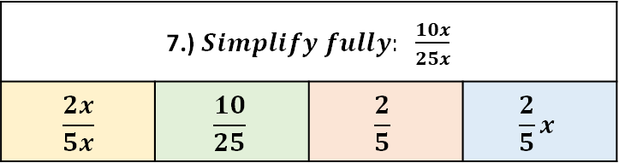
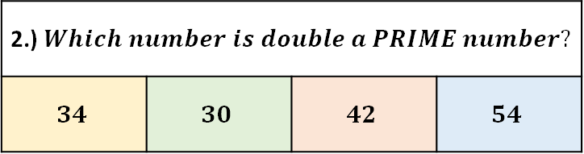
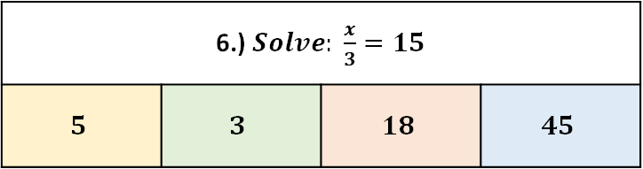
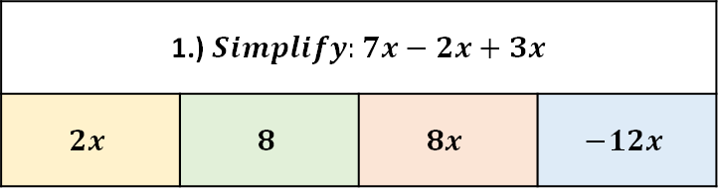
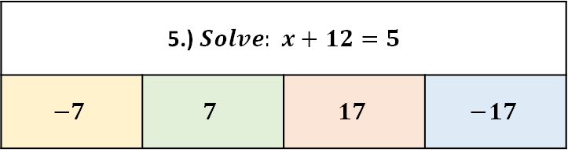
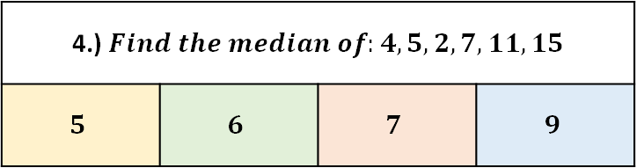
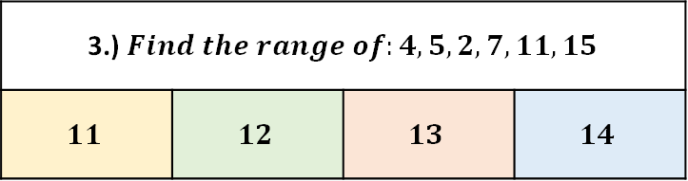
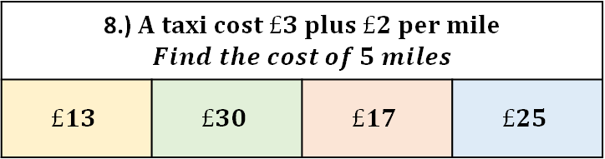
Try the following…
1.) $Simplify:7x−2x+3x$
$$2x$$ | $$8$$ | $$8x$$ | $$−12x$$
2.) $Which number is double a PRIME number?$
$$34$$ | $$30$$ | $$42$$ | $$54$$
3.) $Find the range of:4, 5, 2, 7, 11, 15$
$$11$$ | $$12$$ | $$13$$ | $$14$$
4.)$Find the median of:4, 5, 2, 7, 11, 15$
$$5$$ | $$6$$ | $$7$$ | $$9$$
5.) $Solve: x+12=5$
$$−7$$ | $$7$$ | $$17$$ | $$−17$$
6.)$Solve: \frac{x}{3}=15$
$$5$$ | $$3$$ | $$18$$ | $$45$$
7.) $Simplify fully: \frac{10x}{25x}$
$$\frac{2x}{5x}$$ | $$\frac{10}{25}$$ | $$\frac{2}{5}$$ | $$\frac{2}{5}x$$
8.) $A taxi cost £3 plus £2 per mile$ $$Find the cost of 5 miles$$
$$£13$$ | $$£30$$ | $$£17$$ | $$£25$$

Slide 4
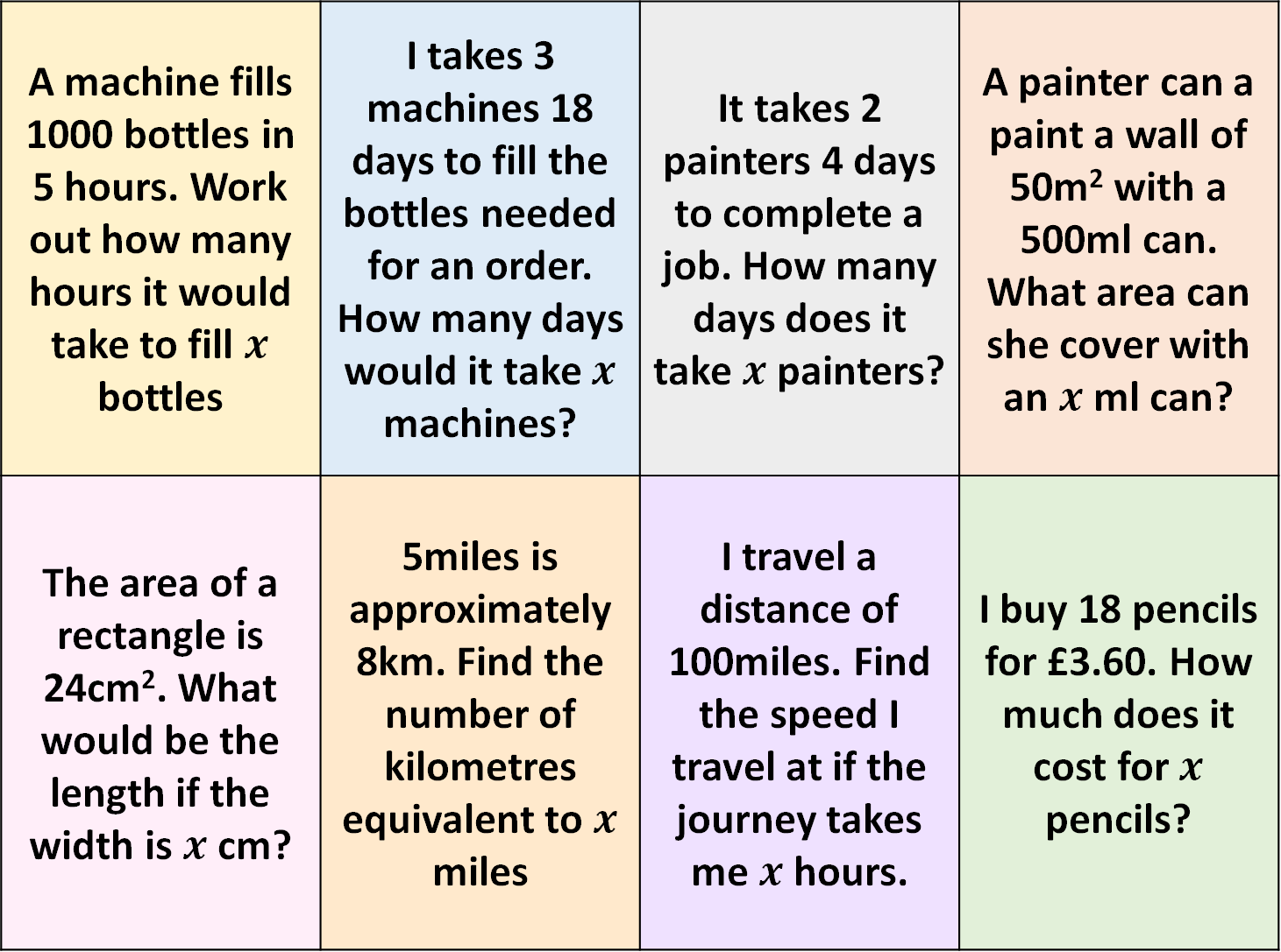
A machine fills 1000 bottles in 5 hours. Work out how many hours it would take to fill $x$ bottles | I takes 3 machines 18 days to fill the bottles needed for an order. How many days would it take $x$ machines? | It takes 2 painters 4 days to complete a job. How many days does it take $x$ painters? | A painter can a paint a wall of 50m² with a 500ml can. What area can she cover with an $x$ ml can?
The area of a rectangle is 24cm². What would be the length if the width is $x$ cm? | 5miles is approximately 8km. Find the number of kilometres equivalent to $x$ miles | I travel a distance of 100miles. Find the speed I travel at if the journey takes me$x$ hours. | I buy 18 pencils for £3.60. How much does it cost for $x$ pencils?
A B C D
E F G H

Slide 5
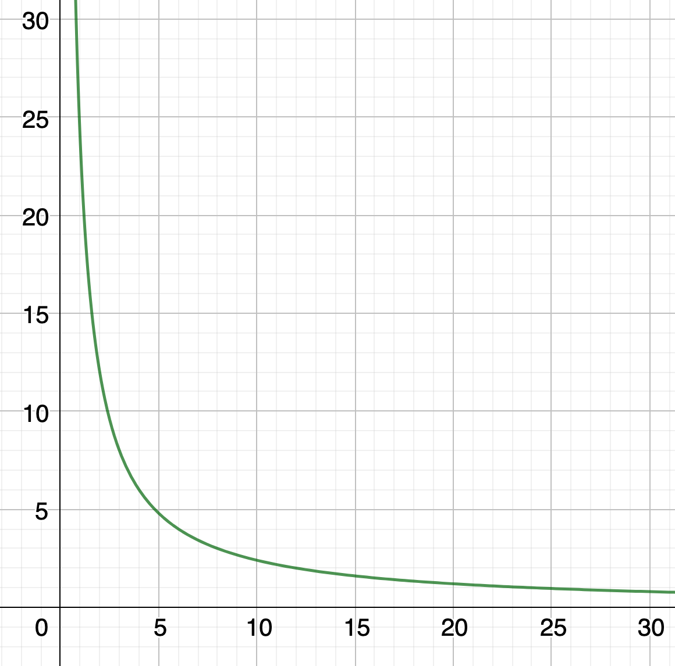
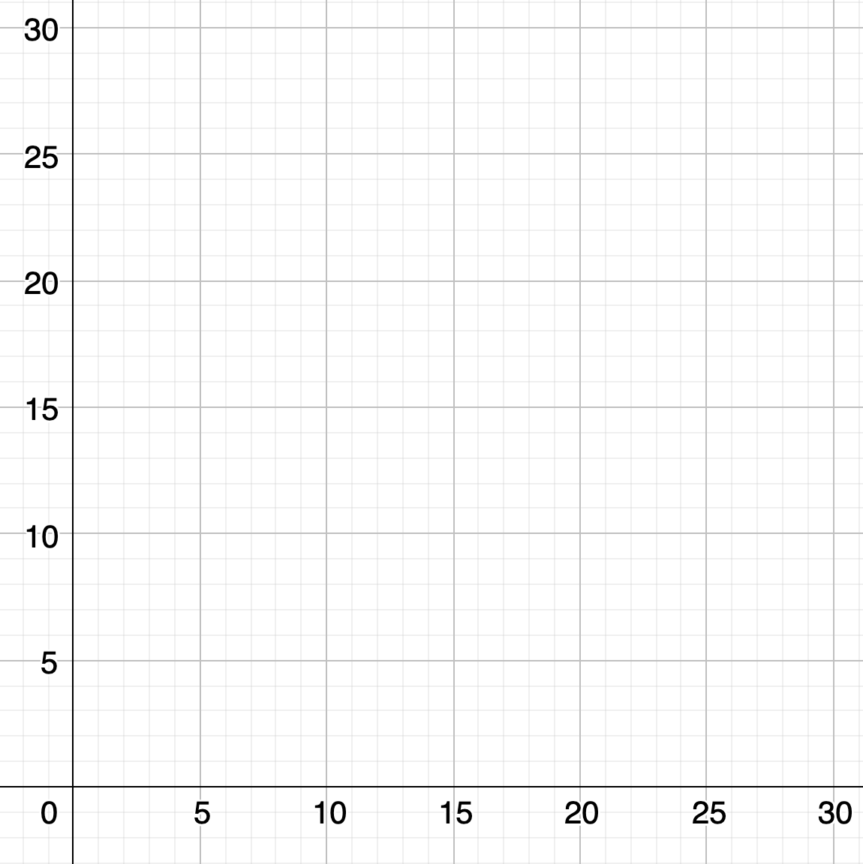







The area of the rectangle is 24cm²
Find the lengths of the rectangle
$$1×24$$
$$2×12$$
$$3×8$$
$$4×6$$
$$0.5 × 48$$
$$0.1 × 240$$
$$0.02 × 1200$$

Slide 6
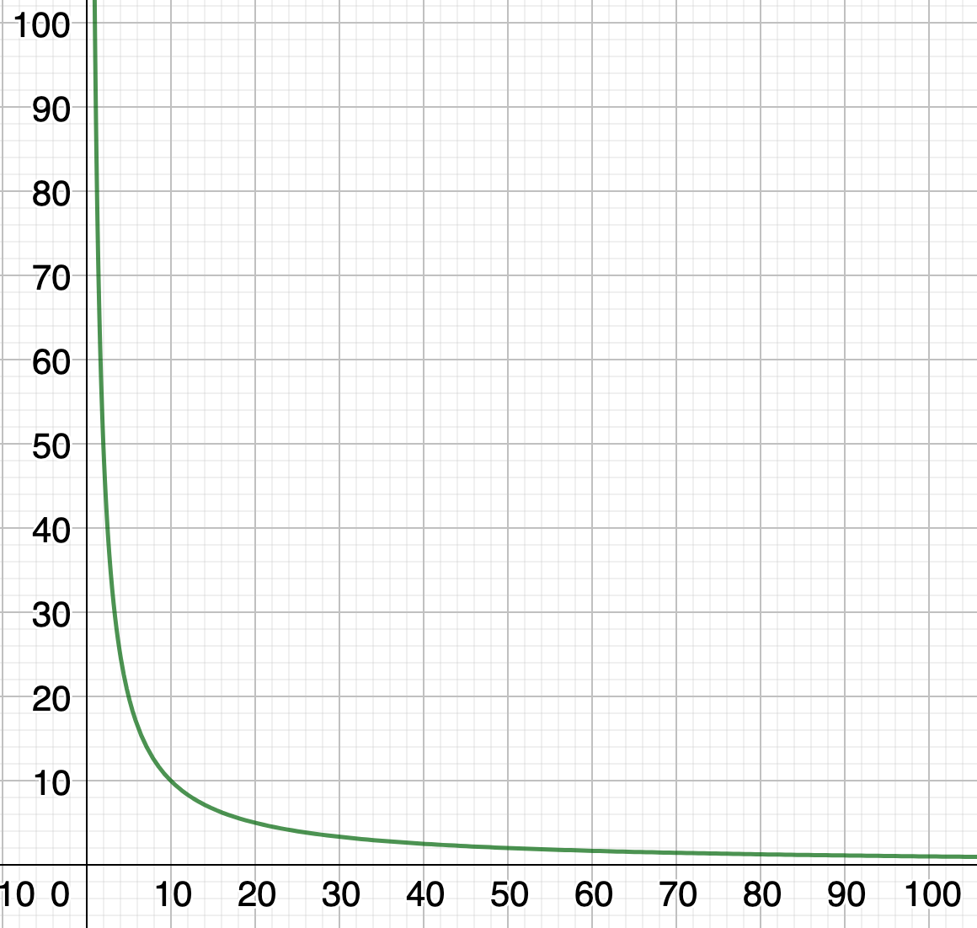
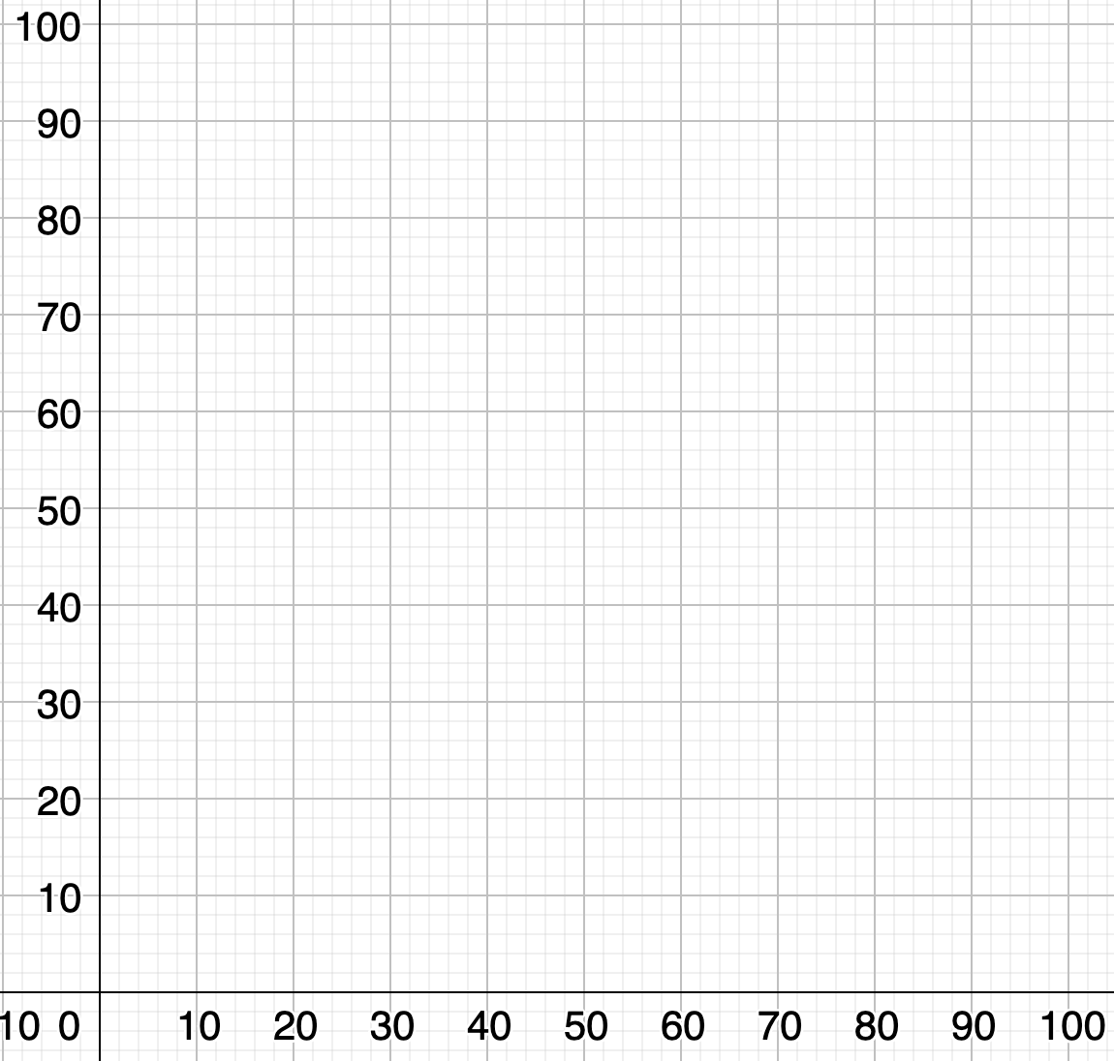
100 miles
100miles in 1 hour
50miles in 2 hour
25miles in 4 hour
20miles in 5 hour
10miles in 10 hour
1mile in 100 hour

Slide 7
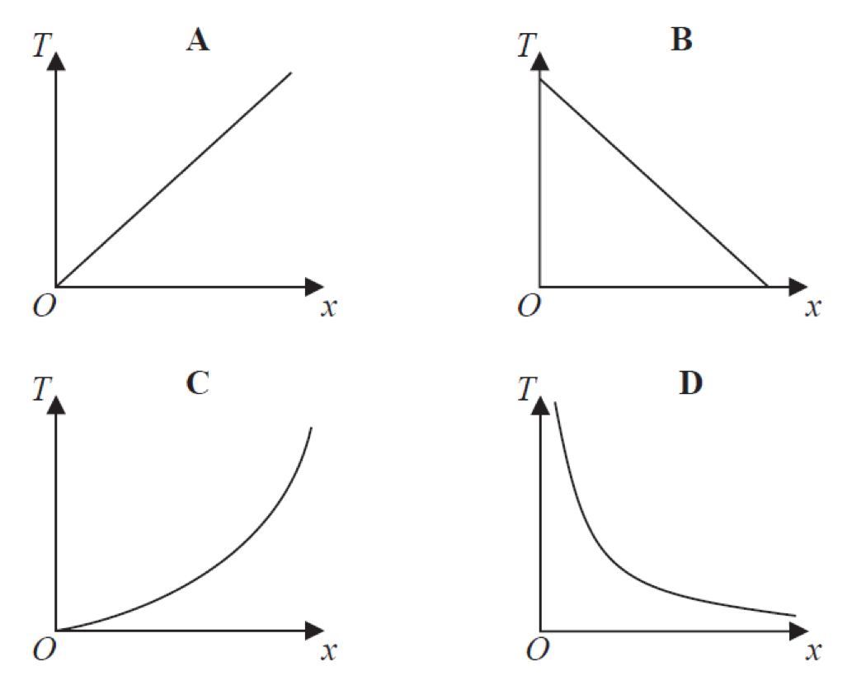
Which Type of Graphs is….

Slide 8
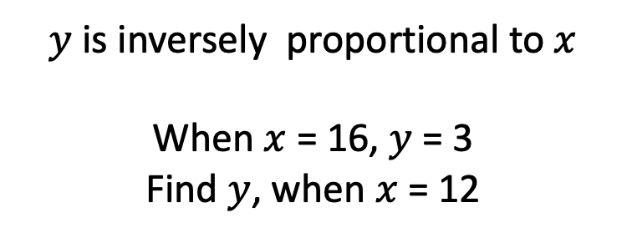
$y$ is inversely proportional to $x$
When $x$ = 16, $y$ = 3
Find $y$, when $x$ = 12

Slide 9
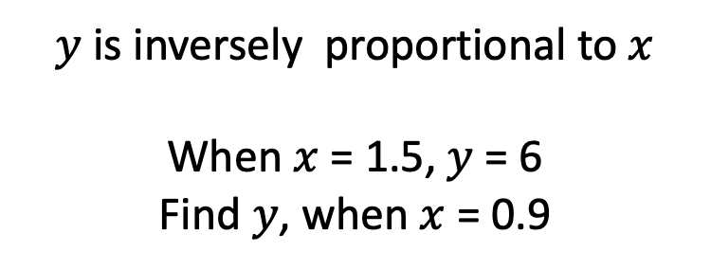
$y$ is inversely proportional to $x$
When $x$ = 1.5, $y$ = 6
Find $y$, when $x$ = 0.9

Slide 10
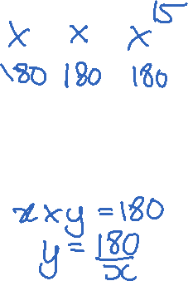
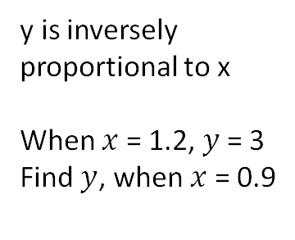
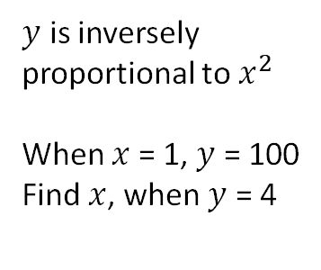
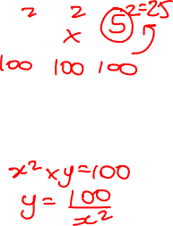
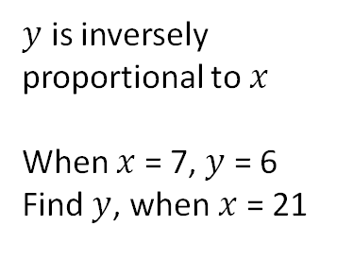
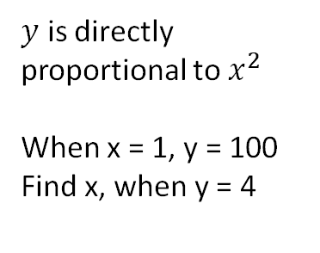
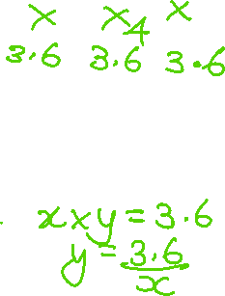
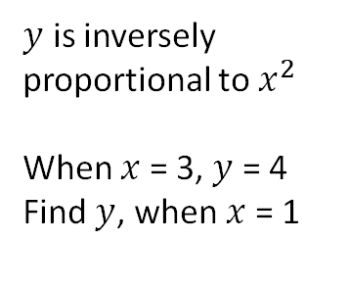
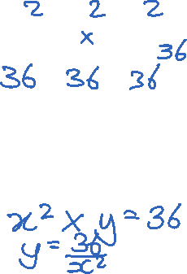
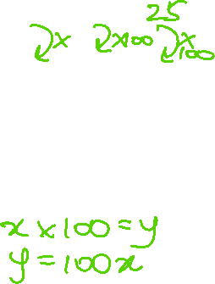
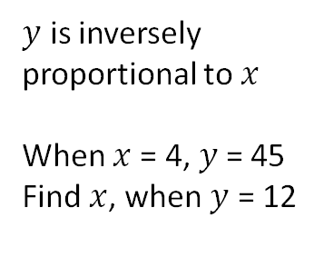
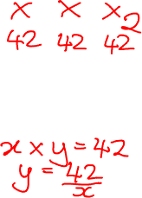
x | 7 | 21
y | 6 | ?
x | 0.9 | 1.2
y | ? | 3
x | 4 | ?
y | 45 | 12
$y$ is inversely proportional to $x$
When $x$ = 7, $y$ = 6
Find $y$, when $x$ = 21
y is inversely proportional to x
When $x$ = 1.2, $y$ = 3
Find $y$, when $x$ = 0.9
$y$ is inversely proportional to $x$
When $x$= 4, $y$= 45
Find $x$, when $y$ = 12
A: 18 | B: 42
C: 2 | D: 20
A: 3.6 | B: 4
C: 2.25 | D: 2.7
A: 3.6 | B: 4
C: 2.25 | D: 2.7
x | 3 | 1
y | 4 | ?
x | 1 | ?
y | 100 | 4
x | 1 | ?
y | 100 | 4
$y$ is inversely proportional to $x^{2}$
When $x$ = 3, $y$ = 4
Find $y$, when $x$ = 1
$y$ is inversely proportional to $x^{2}$
When $x$ = 1, $y$ = 100
Find $x$, when $y$ = 4
$y$ is directly proportional to $x^{2}$
When x = 1, y = 100
Find x, when y = 4
A: 36 | B: 12
C: 18 | D: 1.3 (1dp)
A: 100 | B: 25
C: 5 | D: 0.04
A: 100 | B: 25
C: 5 | D: 0.04

