Slide 1
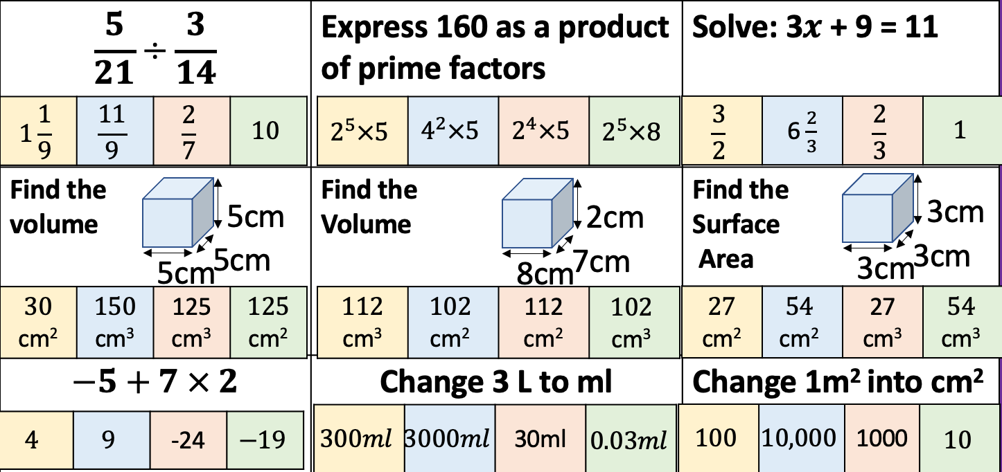
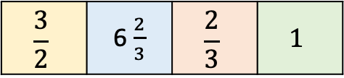
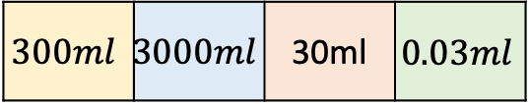
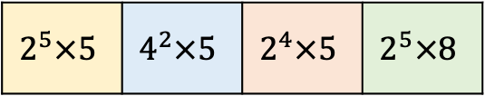


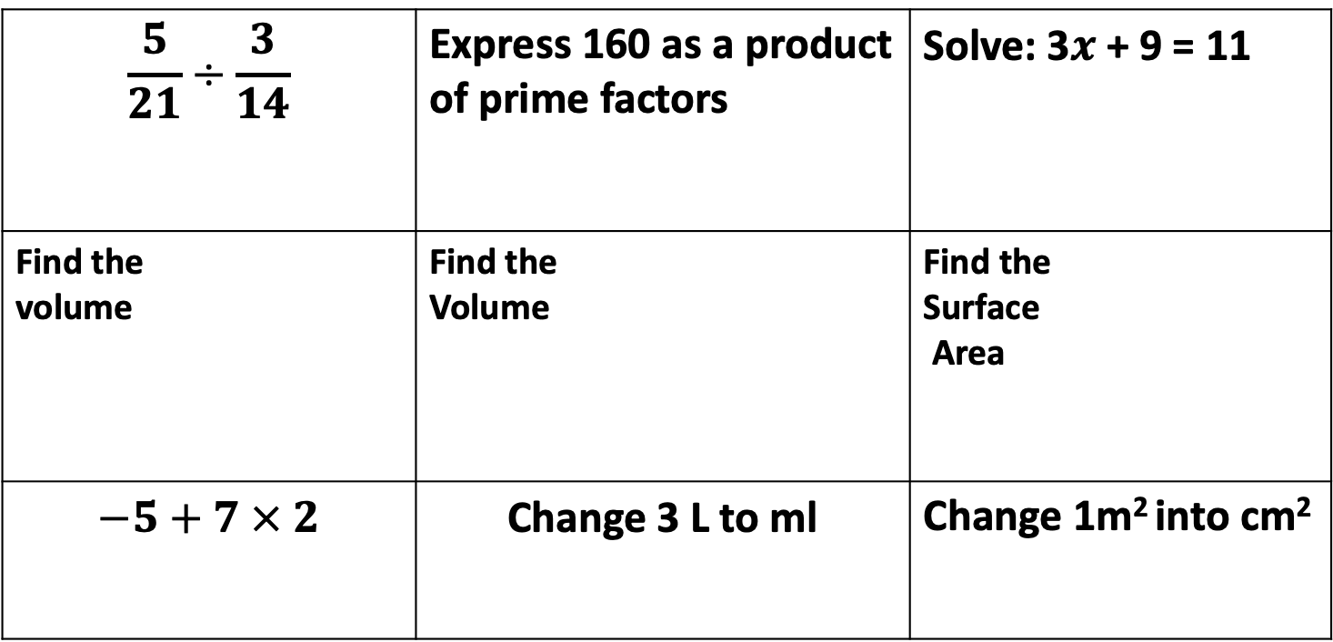
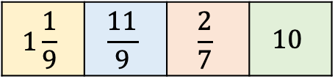
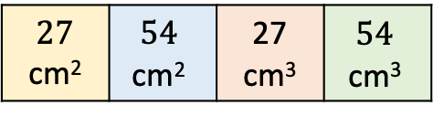

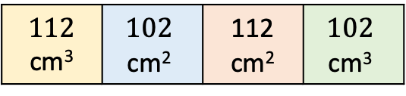
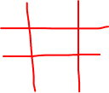
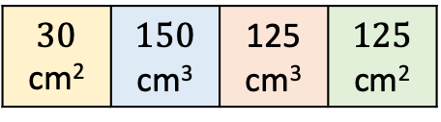
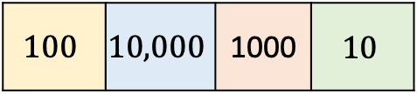
Density Mass Volume
Please join the link in the chat box for todays whiteboards. ROOM CODE:
Draw the grid to the right on your whiteboard and answer the questions below. Then fill your grid with the correct letter.
PLEASE WRITE A,B,C,D so its easier for me to check
$$A$$ | $$B$$ | $$C$$ | $$D$$
$$\frac{5}{21}÷\frac{3}{14}$$ | Express 160 as a product of prime factors | Solve: 3$x$ + 9 = 11
Find the volume | Find the Volume | Find the Surface Area
$$−5+7 × 2$$ | $$\text{Change}\text{ 3 }\text{L} \text{to} \text{ml}$$ | Change 1m² into cm²
$$1\frac{1}{9}$$ | $$\frac{11}{9}$$ | $$\frac{2}{7}$$ | $$10$$
$$2^{5}×5$$ | $$4^{2}×5$$ | $$2^{4}×5$$ | $$2^{5}×8$$
$$\frac{3}{2}$$ | 6 $\frac{2}{3}$ | $$\frac{2}{3}$$ | $$1$$
5cm
2cm
3cm
5cm
7cm
3cm
3cm
5cm
8cm
$$30$$ cm² | $$150$$ $$\text{cm}\text{3}$$ | 125 $$\text{cm}\text{3}$$ | $$125$$ $$\text{cm}\text{2}$$
$$112$$ cm³ | $$102$$ $$\text{cm}\text{2}$$ | 112 $$\text{cm}\text{2}$$ | $$102$$ $$\text{cm}\text{3}$$
$$27$$ cm² | $$54$$ $$\text{cm}\text{2}$$ | 27 $$\text{cm}\text{3}$$ | $$54$$ $$\text{cm}\text{3}$$
$$4$$ | $$9$$ | -24 | $$−19$$
$$300ml$$ | $$3000ml$$ | 30ml | $$0.03ml$$
$$100$$ | $$10,000$$ | 1000 | $$10$$

Slide 2
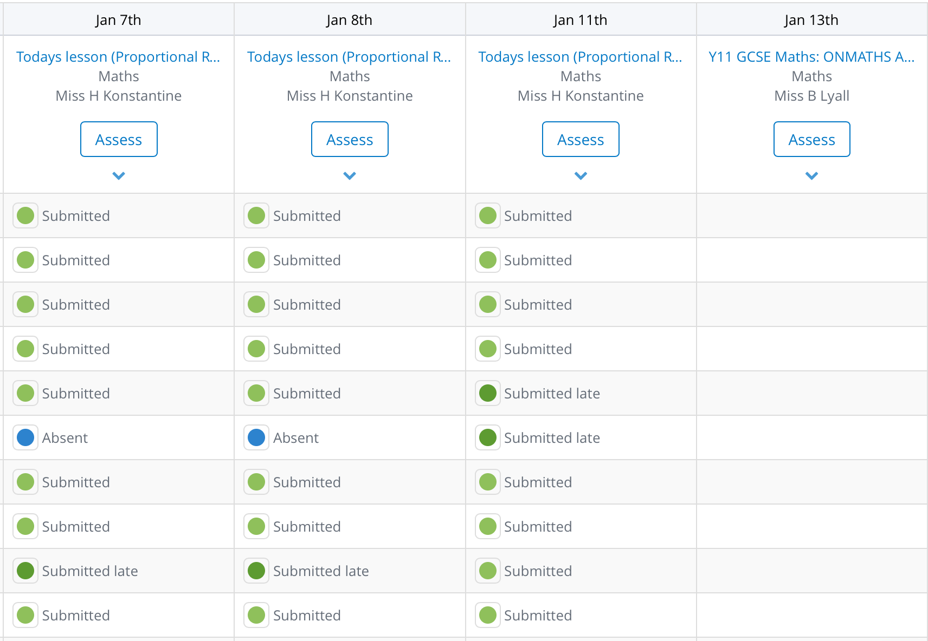
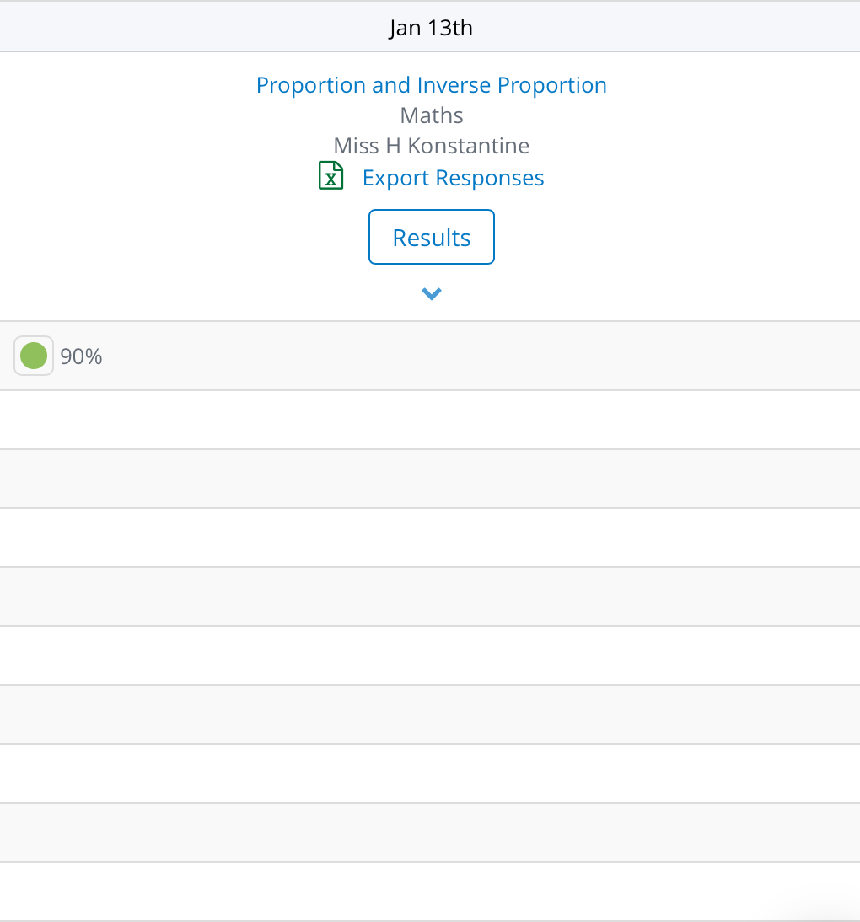

SMHW

Slide 3
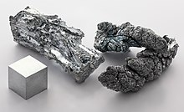

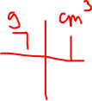

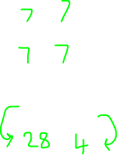
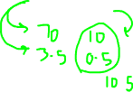
The density of Zinc is approximately 7g/cm³ 7/cm³
Weighs 7 gram
……. block
Weighs 73.5 grams
1cm
1cm
1cm
4cm³ block
Weighs …. grams
2.5cm³ block
Weighs …. grams
……. block
Weighs 63 grams

Slide 4
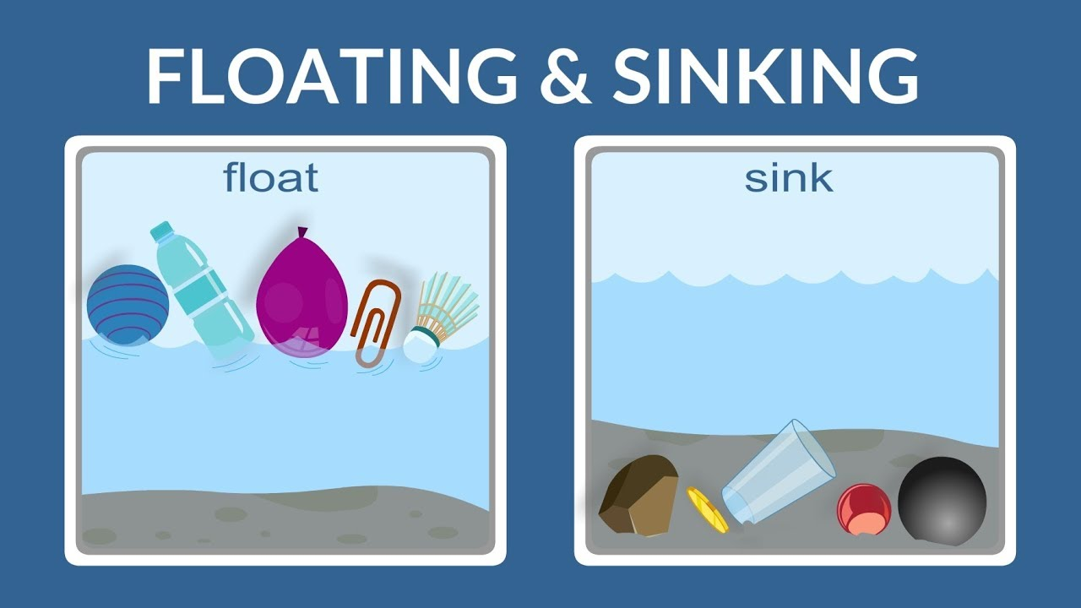
The density of water is approximately 1g/cm³ 1g/cm³ Objects that are denser than water will sink Objects that are less dense than water will float.
Weighs 1 gram
1cm
1cm
1cm

Slide 5
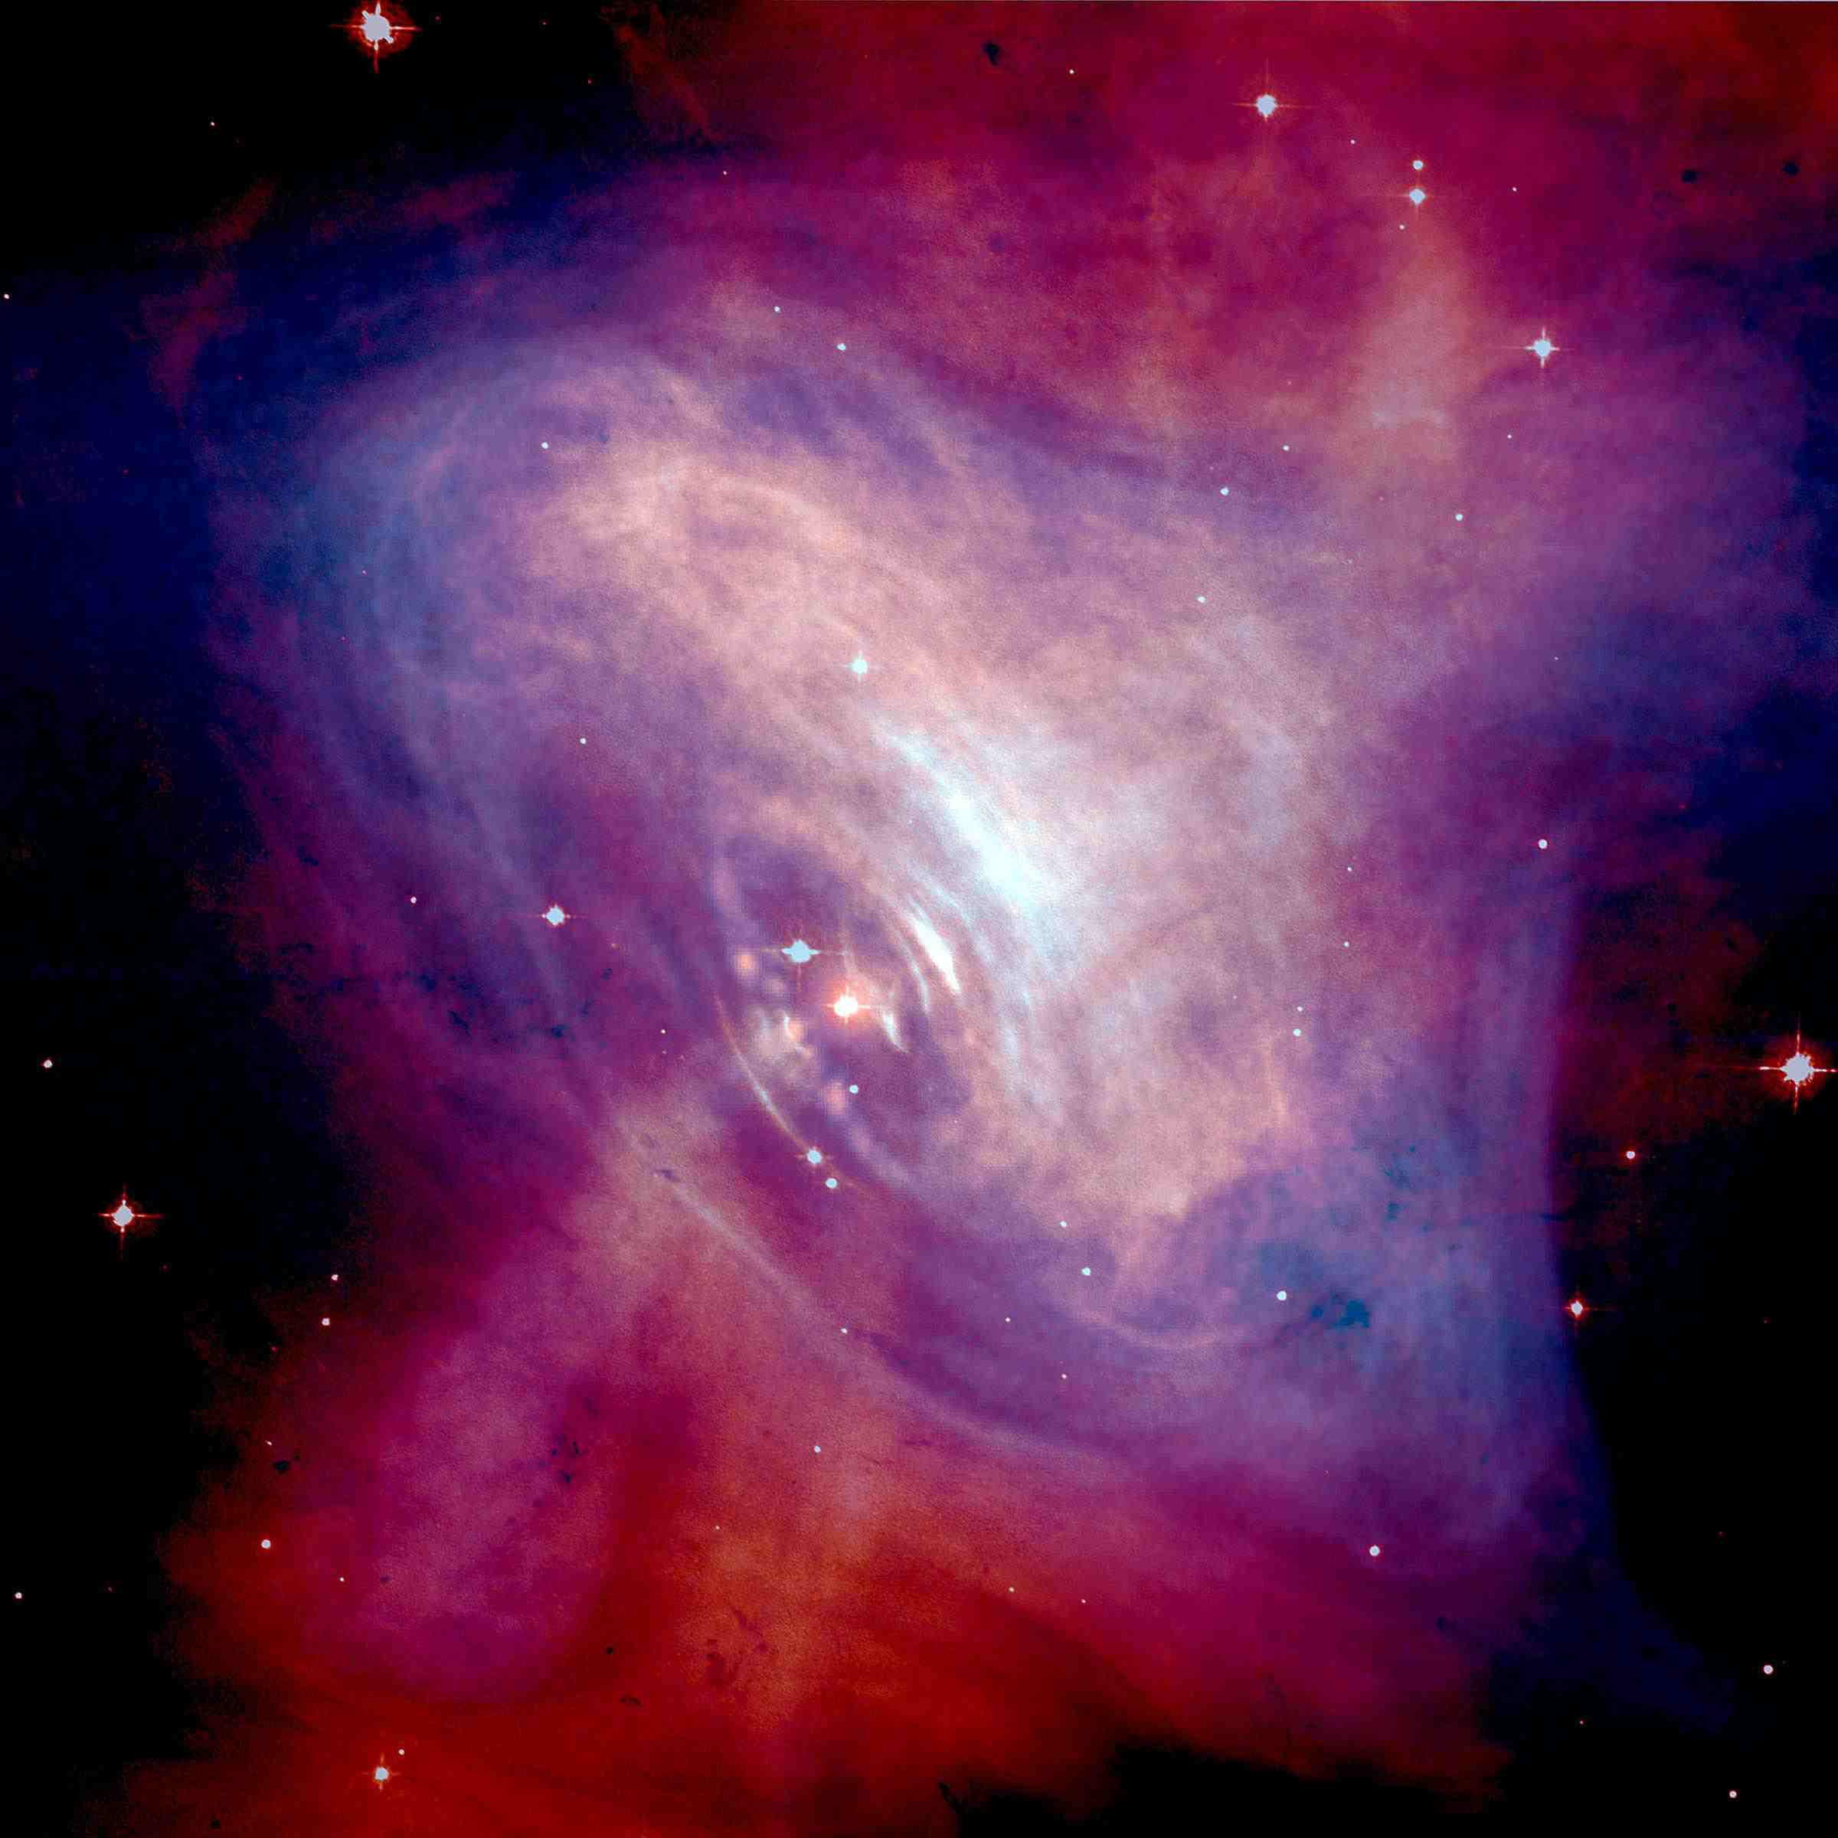

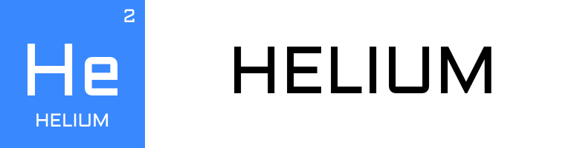
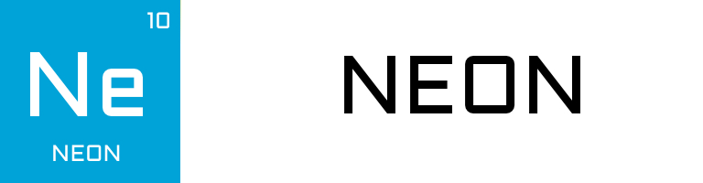
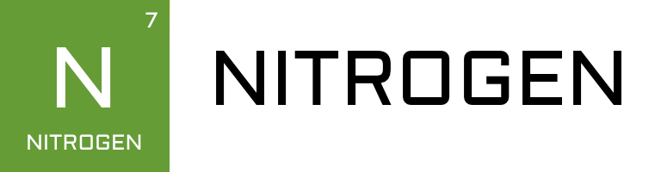
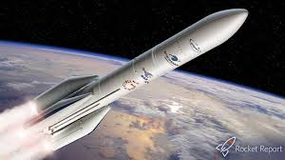
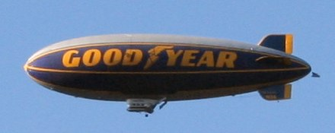

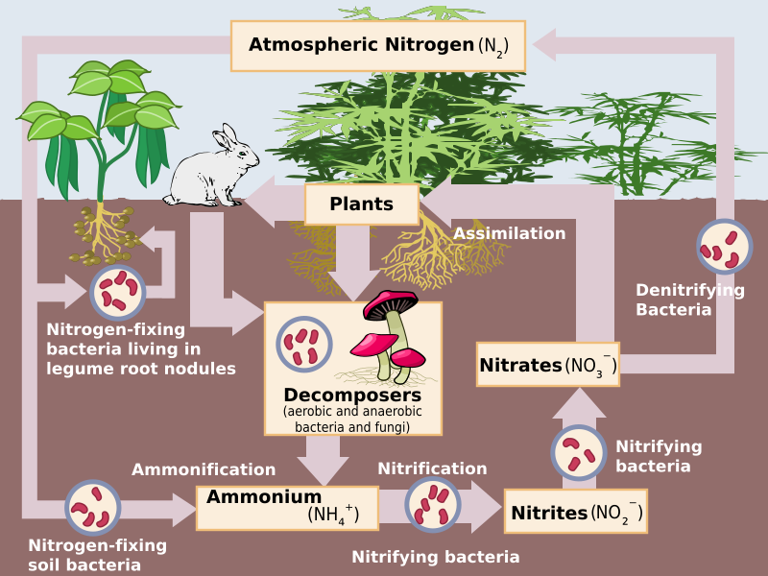
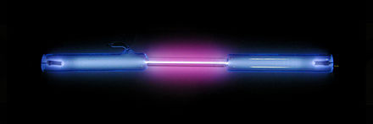
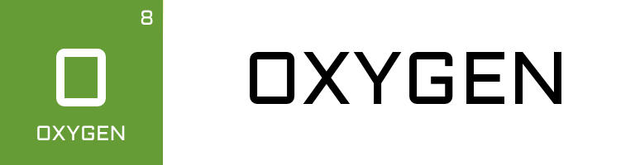
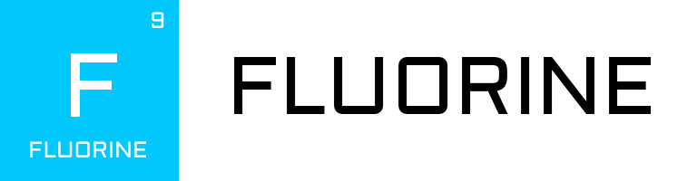
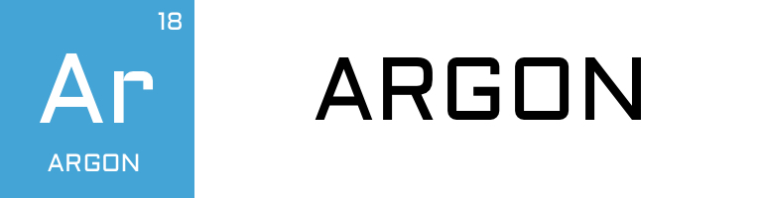
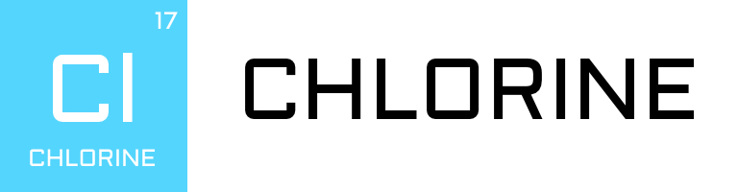

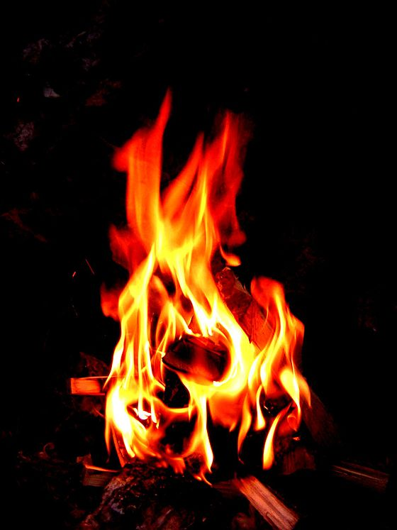
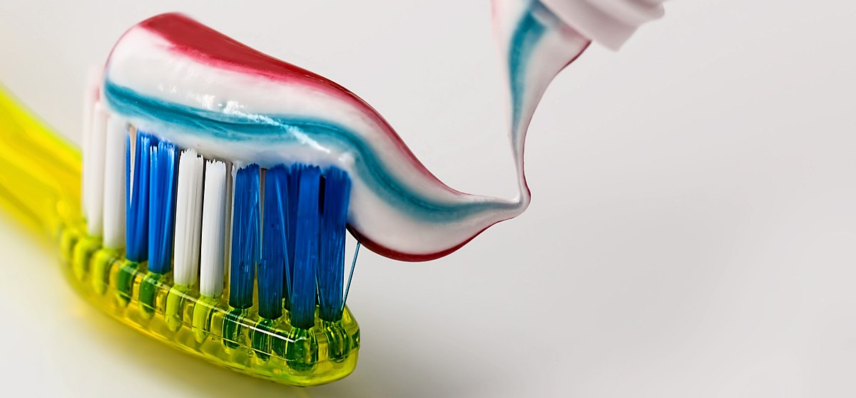
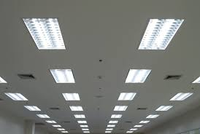
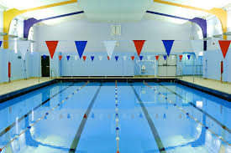








 | Helium |  | Nitrogen
Oxygen | Fluorine | Argon | Chlorine
$$0.00009g/cm3$$
$$0.00018g/cm3$$
$$0.0009g/cm3$$
$$0.0013g/cm3$$
$$0.0014g/cm3$$
$$0.0017g/cm3$$
$$0.0018g/cm3$$
$$0.0032g/cm3$$

Slide 6

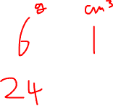
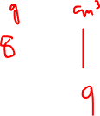
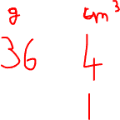

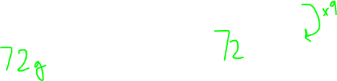
A substance has a density of 6g/cm³ and weights 24g. What is its volume?
If the density of a substance is 8g/cm³. What would a 9cm³ block weigh?
What is the density of a 4cm³ block weighing 36g?

Slide 7
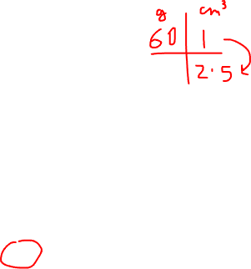
A substance has a density of 60g/cm³ How much does a 2.5cm³ block weigh?
A: 120g
B: 90g
C: 24g
D: 150g

Slide 8
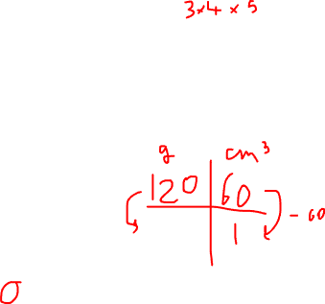
The block to the right weighs 120g What is the density?
A: 2g/cm³
B: 0.5g/cm³
C: 10g/cm³
D: 24g/cm³
4cm
5cm
3cm

Slide 9
A block has a density of 4.2g/cm³ What is the volume of a 21g block?
A: 0.5cm³
B: 2cm³
C: 5cm³
D: 5.5cm³

Slide 10
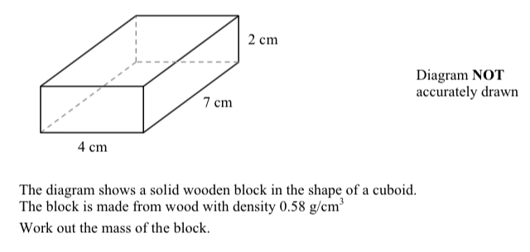

Slide 11
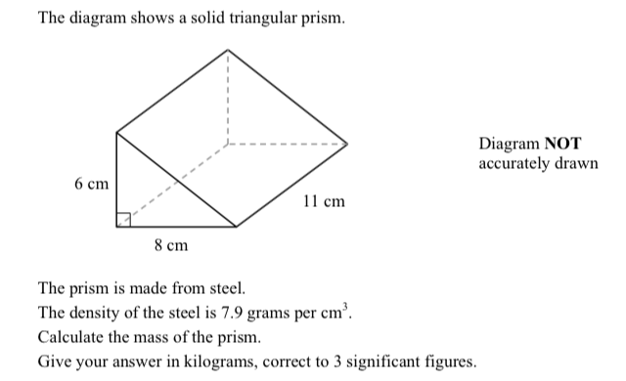

Slide 12
