Slide 1
Year 10: Revision
Rules for todays lesson
Chat is ONLY for Maths discussion
It is to be used for asking or answering questions only
Students incorrectly using the chat function will be removed from the lesson, reported and contact will be made with your parent/guardian

Slide 2
Chapter 2
Simplifying expressions
Expanding and factorising expressions

Slide 3
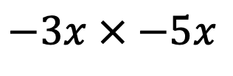
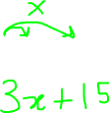

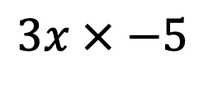

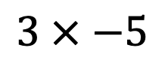
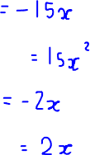

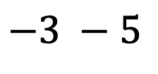


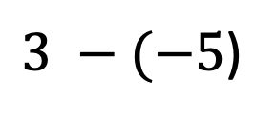

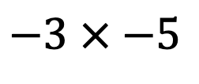

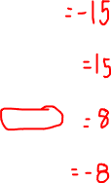
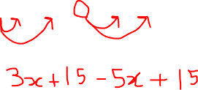
Work out the answer and then type your answer in the chat.
Evaluate
Simplify:
Expand :
$$3 × −5$$
$$3x × −5$$
$$3(x+5)$$
$$−3 × −5$$
$$−3x × −5x$$
$3 −(−5$)
$$−5(x−3)$$
$$3x−5x$$
$$−3 −5$$
$$−3x+5x$$
Expand and Simplify:
$$3\left(x+5\right)−5(x−3)$$

Slide 4


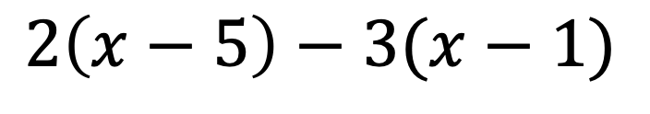
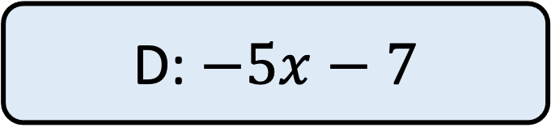
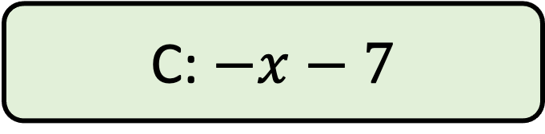
Work out the answer and then type your answer in the chat.
$$2\left(x−5\right)−3(x−1)$$
A: $5x−13$
B: $−x−13$
C: $−x−7$
D: $−5x−7$

Slide 5
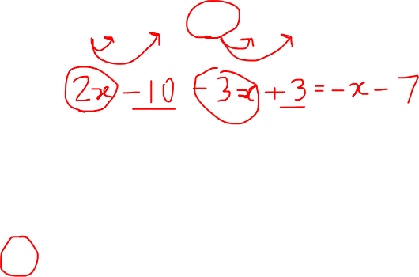
Work out the answer and then type your answer in the chat.
$$2\left(x−5\right)−3(x−1)$$
A: $5x−13$
B: $−x−13$
C: $−x−7$
D: $−5x−7$

Slide 6
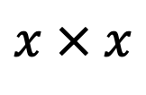



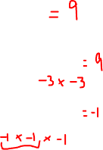


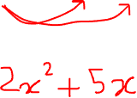



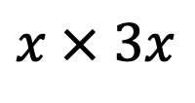

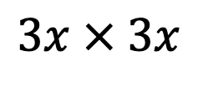

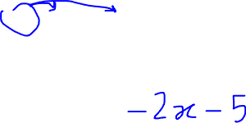
Work out the answer and then type your answer in the chat.
Evaluate
Simplify:
Expand :
$$32$$
$$x × x$$
$$x(x−1)$$
$$(−3)2$$
$$3x × 3x$$
$$x(2x+5)$$
$$\left(−1\right)3$$
$$x × 3x$$
Expand and Simplify:
$$(x−1)\left(2x+5\right)$$

Slide 7
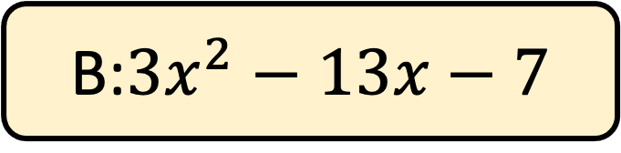
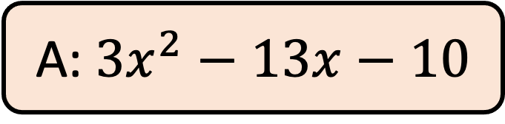
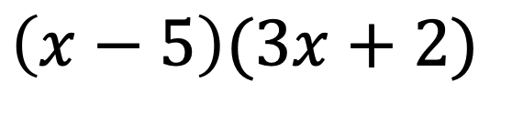
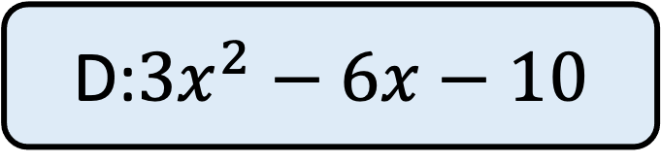
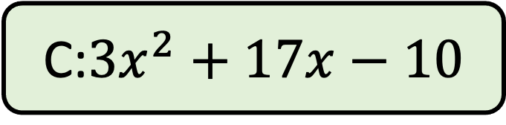
Work out the answer and then type your answer in the chat.
$$\left(x−5\right)(3x+2)$$
A: $3x^{2}−13x−10$
B:$3x^{2}−13x−7$
C:$3x^{2}+17x−10$
D:$3x^{2}−6x−10$

Slide 8
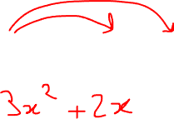
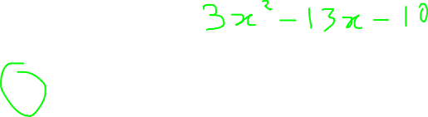

Work out the answer and then type your answer in the chat.
$$\left(x−5\right)(3x+2)$$
A: $3x^{2}−13x−10$
B:$3x^{2}−13x−7$
C:$3x^{2}+17x−10$
D:$3x^{2}−6x−10$

Slide 9
Chapter 7
Area of 2D shapes
Transformations
Bearings

Slide 10
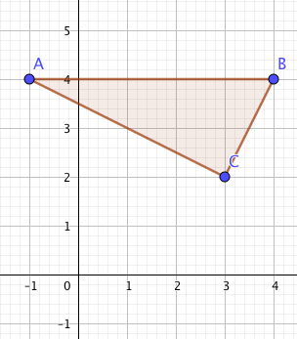
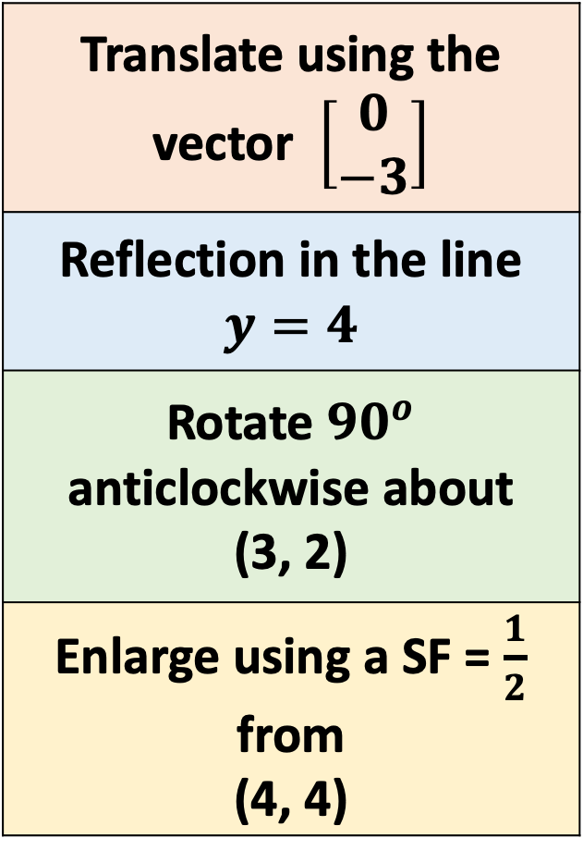
How many vertices are invariant when the transformations to the right are applied?
Translate using the vector $\left[\begin{aligned}0 \\ −3\end{aligned}\right]$
Reflection in the line $y=4$
Rotate ${90}^{o}$ anticlockwise about (3, 2)
Enlarge using a SF = $\frac{1}{2}$ from (4, 4)

Slide 11
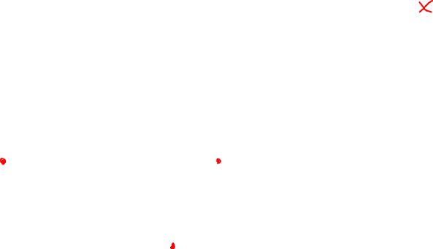
How many vertices are invariant when the transformations to the right are applied?
Translate using the vector $\left[\begin{aligned}0 \\ −3\end{aligned}\right]$
Reflection in the line $y=4$
Rotate ${90}^{o}$ anticlockwise about (3, 2)
Enlarge using a SF = $\frac{1}{2}$ from (4, 4)

Slide 12
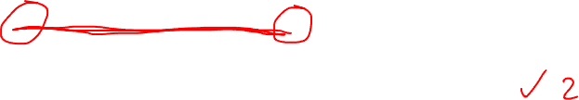
How many vertices are invariant when the transformations to the right are applied?
Translate using the vector $\left[\begin{aligned}0 \\ −3\end{aligned}\right]$
Reflection in the line $y=4$
Rotate ${90}^{o}$ anticlockwise about (3, 2)
Enlarge using a SF = $\frac{1}{2}$ from (4, 4)

Slide 13
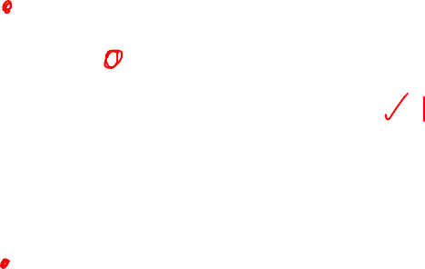
How many vertices are invariant when the transformations to the right are applied?
Translate using the vector $\left[\begin{aligned}0 \\ −3\end{aligned}\right]$
Reflection in the line $y=4$
Rotate ${90}^{o}$ anticlockwise about (3, 2)
Enlarge using a SF = $\frac{1}{2}$ from (4, 4)

Slide 14

How many vertices are invariant when the transformations to the right are applied?
Translate using the vector $\left[\begin{aligned}0 \\ −3\end{aligned}\right]$
Reflection in the line $y=4$
Rotate ${90}^{o}$ anticlockwise about (3, 2)
Enlarge using a SF = $\frac{1}{2}$ from (4, 4)

Slide 15
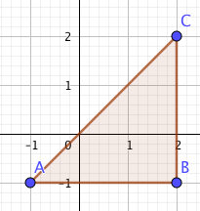
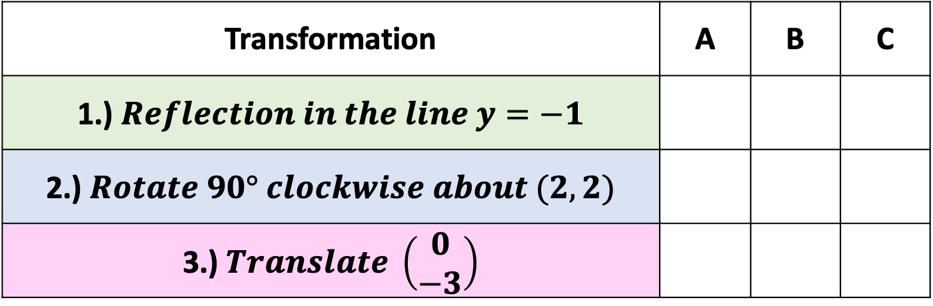
Tick the box for the vertices that are invariant when the transformations to the right are applied to the shape ABC?
Transformation | A | B | C
1.) $Reflection in the line y=−1$
2.) $Rotate 90° clockwise about (2, 2)$
3.) $Translate \left(\begin{aligned}0 \\ −3\end{aligned}\right)$

Slide 16

Tick the box for the vertices that are invariant when the transformations to the right are applied to the shape ABC?
Transformation | A | B | C
1.) $Reflection in the line y=−1$
2.) $Rotate 90° clockwise about (2, 2)$
3.) $Translate \left(\begin{aligned}0 \\ −3\end{aligned}\right)$

Slide 17

Tick the box for the vertices that are invariant when the transformations to the right are applied to the shape ABC?
Transformation | A | B | C
1.) $Reflection in the line y=−1$
2.) $Rotate 90° clockwise about (2, 2)$
3.) $Translate \left(\begin{aligned}0 \\ −3\end{aligned}\right)$

Slide 18
Tick the box for the vertices that are invariant when the transformations to the right are applied to the shape ABC?
Transformation | A | B | C
1.) $Reflection in the line y=−1$
2.) $Rotate 90° clockwise about (2, 2)$
3.) $Translate \left(\begin{aligned}0 \\ −3\end{aligned}\right)$

Slide 19

B
B
80º
80º
A
A
B
B
80º
80º
A
A

Slide 20
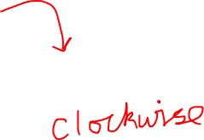
B
B
80º
80º
A
A
B
B
80º
80º
A
A

Slide 21

B
B
80º
80º
A
A
B
B
80º
80º
A
A

Slide 22
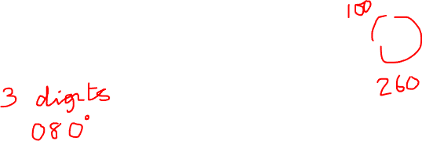
B
B
80º
80º
A
A
B
B
80º
80º
A
A

Slide 23
The bearing of B from A is 108º
Find the bearing of A from B
108º
A
B
A: 288º
B: 72º
C: 252º
D: 108º

Slide 24
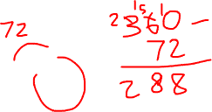
The bearing of B from A is 108º
Find the bearing of A from B
108º
A
B
A: 288º
B: 72º
C: 252º
D: 108º

Slide 25
Chapter 8
Probability events
Mutually Exclusive events
Theoretical Probability

Slide 26
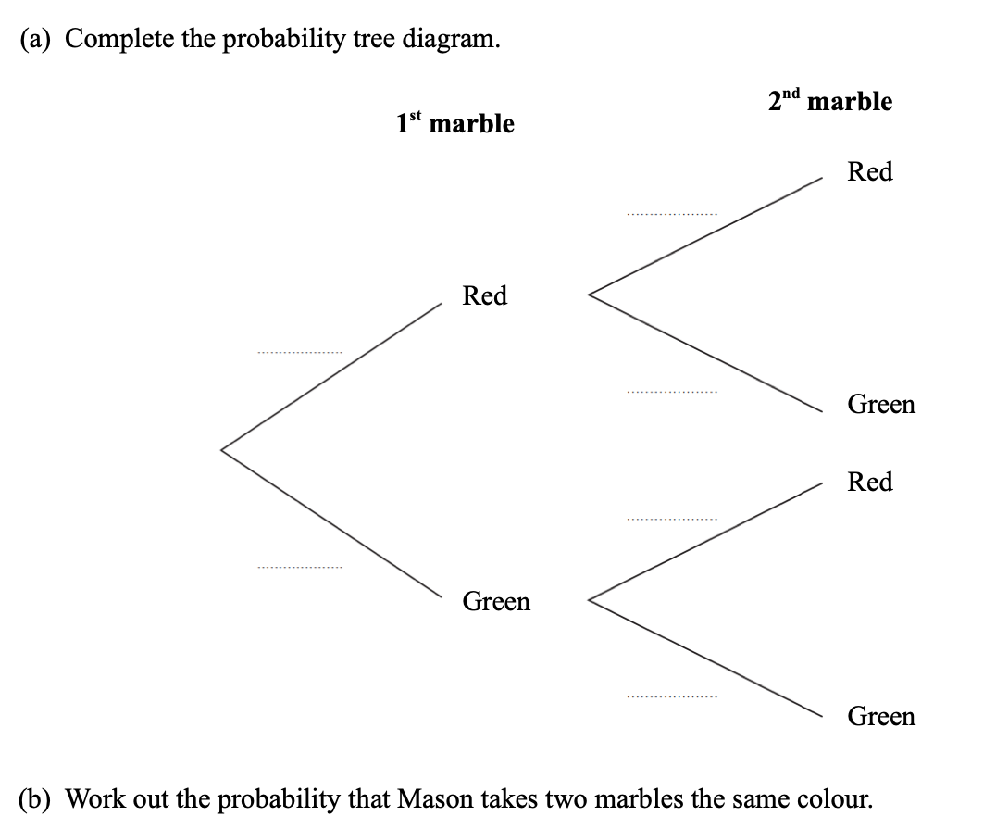
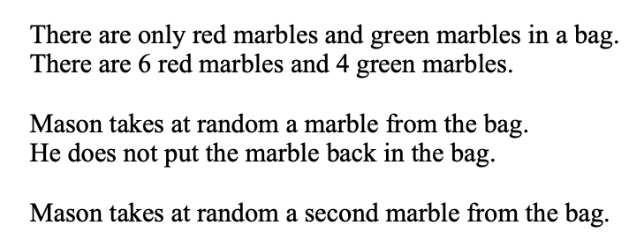

Slide 27


Slide 29




Slide 30
