Slide 1
Angles in parallel lines
Rules for todays lesson
Chat is ONLY for Maths discussion
It is to be used for asking or answering questions only
Students incorrectly using the chat function will be removed from the lesson, reported and contact will be made with your parent/guardian

Slide 2
 | Drawings are not to scale Decide if $θ$ is Always, Sometimes or Never equal to 70$°$
1.) 2.) 3.)
4.) 5.)
6.) 7.) 8.)
$$65°$$
$$70°$$
$$θ$$
$$40°$$
$$45°$$
$$θ$$
$$θ$$
$$θ$$
$$θ$$
$$θ$$
$$θ$$
$$40°$$
$$θ$$
$$40°$$
$$55°$$
Notes:
S A A
N N
A A S

Slide 3
We describe angles with 3 letters
EG: the marked angle is FGB or BGF
F
Parallel lines are marked with arrows
A
G
B
C
H
D
The traversal (meaning to travel) crosses the parallel lines
E
We describe lines with two letters EG: the green line is CD

Slide 4
 | Corresponding angles equal
 | Alternate angles equal
 | Co-interior angles add up to 180⁰
F
F
A
A
B
B
C
C
D
D
E
E
F
A
B
C
D
E

Slide 5
F
H
F
b
A
a
A
B
85º
B
C
82º
C
D
D
E
G
E
F
F
A
A
B
88º
B
89º
C
C
88º
89º
D
D
E
E

Slide 6


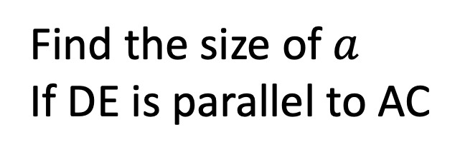

B
Find the size of $a$
If DE is parallel to AC
$$a$$
D
E
$$123o$$
$$82o$$
A
C

Slide 7






B
Find the size of $a$
If DE is parallel to AC
$$a$$
D
E
$$123o$$
$$82o$$
A
C
B
$$a$$
D
E
$$123o$$
$$82o$$
A
C

Slide 8





B
Find the size of $a$
If DE is parallel to AC
$$a$$
D
E
$$123o$$
$$82o$$
A
C
B
B
$$a$$
$$a$$
D
E
D
E
$$123o$$
$$123o$$
$$82o$$
$$82o$$
A
C
A
C

Slide 9










B
Find the size of $a$
If DE is parallel to AC
$$a$$
D
E
$$123o$$
$$82o$$
A
C
B
B
B
$$a$$
$$a$$
$$a$$
D
E
D
E
D
E
$$123o$$
$$123o$$
$$123o$$
$$82o$$
$$82o$$
$$82o$$
A
C
A
C
A
C

Slide 10




B
E
D
$$73o$$
D
C
$$71o$$
$$44o$$
$$48o$$
A
C
A
B
E
Find the missing angles in each of the shapes above
What can you say about triangles ABC and CDE in both questions?

Slide 11


B
E
D
$$73o$$
D
C
$$71o$$
$$44o$$
$$48o$$
A
C
A
B
E
Find the missing angles in each of the shapes above
What can you say about triangles ABC and CDE in both questions?

Slide 12

B
E
D
$$73o$$
D
C
$$71o$$
$$44o$$
$$48o$$
A
C
A
B
E
Find the missing angles in each of the shapes above
What can you say about triangles ABC and CDE in both questions?

Slide 13

B
E
D
$$73o$$
D
C
$$71o$$
$$44o$$
$$48o$$
A
C
A
B
E
Find the missing angles in each of the shapes above
What can you say about triangles ABC and CDE in both questions?

Slide 14
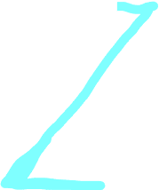
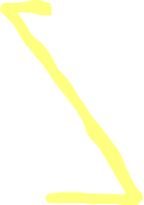
B
E
D
$$73o$$
D
C
$$71o$$
$$44o$$
$$48o$$
A
C
A
B
E
Find the missing angles in each of the shapes above
What can you say about triangles ABC and CDE in both questions?

Slide 15

B
E
D
$$73o$$
D
C
$$71o$$
$$44o$$
$$48o$$
A
C
A
B
E
Find the missing angles in each of the shapes above
What can you say about triangles ABC and CDE in both questions?

Slide 16
B
E
D
$$73o$$
D
C
$$71o$$
$$44o$$
$$48o$$
A
C
A
B
E
Find the missing angles in each of the shapes above
What can you say about triangles ABC and CDE in both questions?

Slide 17
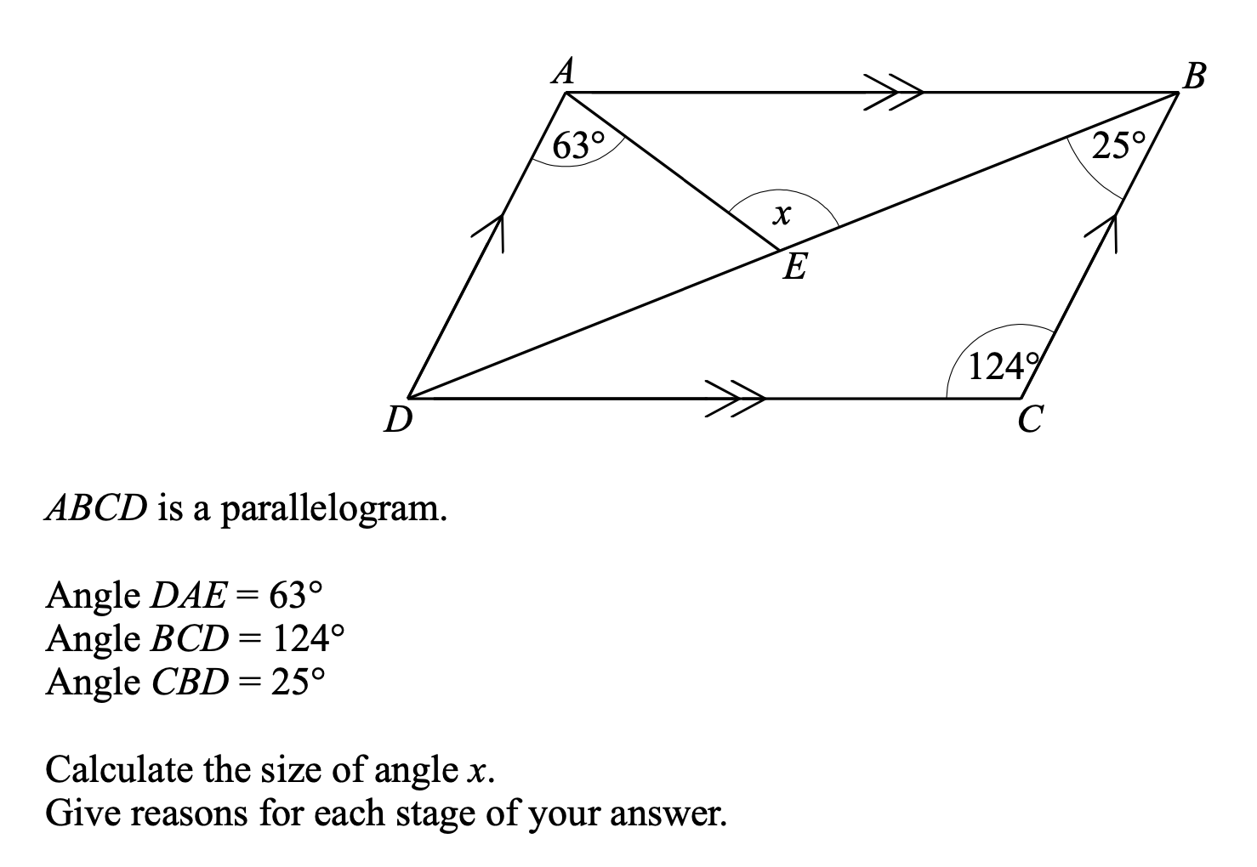

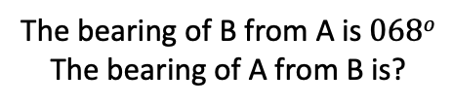




N
N
$$34o$$
$$x$$
B
$$068o$$
$$y$$
$$29o$$
A
The bearing of B from A is $068o$
The bearing of A from B is?
Find the size of the unknown angle

Slide 18
N
N
$$34o$$
$$x$$
B
$$068o$$
$$y$$
$$29o$$
A
The bearing of B from A is $068o$
The bearing of A from B is?
Find the size of the unknown angle

Slide 19
Type your answer in the chat or just work it out in your book.
Find the size of angle a?
a
74º
124º
A: 56º
B: 50º
C: 130º
D: 74º

Slide 20
Type your answer in the chat or just work it out in your book.
Find the size of angle a?
33º
108º
99º
A: 60º
B: 39º
C: 33º
D: 66º

Slide 21
Type your answer in the chat or just work it out in your book.
Find the size of angle a?
32º
a
107º
A: 73º
B: 107º
C: 32º
D: 105º

Slide 22
Type your answer in the chat or just work it out in your book.
How many of the angles; b, c, d, e are ALWAYS equal to angle a?
a
b
e
d
c
A: 1
B: 2
C: 3
D: 4

Slide 23


Challenge
$$34o$$
$$29o$$
Find the size of the unknown angle

