Slide 1

Revision
Rules for todays lesson
Chat is ONLY for Maths discussion
It is to be used for asking or answering questions only
Students incorrectly using the chat function will be removed from the lesson, reported and contact will be made with your parent/guardian

Slide 2
What is the MODE?
A: Largest value minus the smallest value
B: The most frequent/common value
C: The middle value of an order set
D: The sum of the values divided by the number of values

Slide 3
What is the RANGE?
A: Largest value minus the smallest value
B: The most frequent/common value
C: The middle value of an order set
D: The sum of the values divided by the number of values

Slide 4
What is the MEDIAN?
A: Largest value minus the smallest value
B: The most frequent/common value
C: The middle value of an order set
D: The sum of the values divided by the number of values

Slide 5
What is the MEAN?
A: Largest value minus the smallest value
B: The most frequent/common value
C: The middle value of an order set
D: The sum of the values divided by the number of values

Slide 6
1, 1, 1 2, 2 3, 3, 3, 3 4
10 students recorded how many pets they owned
Pets | Freq
1
2
3
4
10 students recorded how many pets they owned

Slide 7

1, 1, 1 2, 2 3, 3, 3, 3 4
10 students recorded how many pets they owned
Pets | Freq
1
2
3
4
10 students recorded how many pets they owned

Slide 8
1, 1, 1 2, 2 3, 3, 3, 3 4
10 students recorded how many pets they owned
Pets | Freq
1
2
3
4
10 students recorded how many pets they owned

Slide 9

1, 1, 1 2, 2 3, 3, 3, 3 4
10 students recorded how many pets they owned
Pets | Freq
1
2
3
4
10 students recorded how many pets they owned

Slide 10

1, 1, 1 2, 2 3, 3, 3, 3 4
10 students recorded how many pets they owned
Pets | Freq
1
2
3
4
10 students recorded how many pets they owned

Slide 11

1, 1, 1 2, 2 3, 3, 3, 3 4
10 students recorded how many pets they owned
Pets | Freq
1
2
3
4
10 students recorded how many pets they owned

Slide 12

1, 1, 1 2, 2 3, 3, 3, 3 4
10 students recorded how many pets they owned
Pets | Freq
1
2
3
4
10 students recorded how many pets they owned

Slide 13
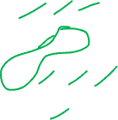
1, 1, 1 2, 2 3, 3, 3, 3 4
10 students recorded how many pets they owned
Pets | Freq
1
2
3
4
10 students recorded how many pets they owned

Slide 14
1, 1, 1 2, 2 3, 3, 3, 3 4
10 students recorded how many pets they owned
Pets | Freq
1
2
3
4
10 students recorded how many pets they owned

Slide 15

1, 1, 1 2, 2 3, 3, 3, 3 4
10 students recorded how many pets they owned
Pets | Freq
1
2
3
4
10 students recorded how many pets they owned

Slide 16
1, 1, 1 2, 2 3, 3, 3, 3 4
10 students recorded how many pets they owned
Pets | Freq
1
2
3
4
10 students recorded how many pets they owned

Slide 17

1, 1, 1 2, 2 3, 3, 3, 3 4
10 students recorded how many pets they owned
Pets | Freq
1
2
3
4
10 students recorded how many pets they owned

Slide 18


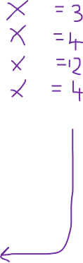
Pets | Freq
1
2
3
4
Find the
Mode
Range
Median
Mean
10 students recorded how many pets they owned

Slide 19
Cars | Freq
0 | 1
1 | 3
2 | 5
3 | 1
10 people recorded how many cars on their drive
 | A | B | C | D
Mode | 5 | 1 | 0 and 3 | 2
Median | 1.5 | 4 | 5.5 | 2
Range | 4 | 3 | 2 | 1
Mean | 1.7 | 1.6 | 16 | 2.5

Slide 20
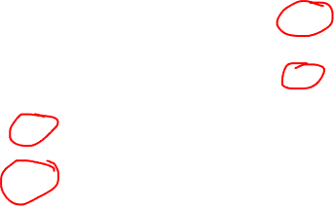
Cars | Freq
0 | 1
1 | 3
2 | 5
3 | 1
10 people recorded how many cars on their drive
 | A | B | C | D
Mode | 5 | 1 | 0 and 3 | 2
Median | 1.5 | 4 | 5.5 | 2
Range | 4 | 3 | 2 | 1
Mean | 1.7 | 1.6 | 16 | 2.5

Slide 21


$${45}^{o}$$
Yellow | 7
White
Blue
Total

Slide 22
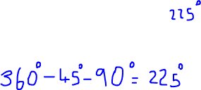
$${45}^{o}$$
Yellow | 7
White
Blue
Total

Slide 23

$${45}^{o}$$
Yellow | 7
White
Blue
Total

Slide 24
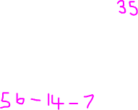
$${45}^{o}$$
Yellow | 7
White
Blue
Total

Slide 25
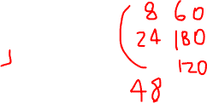

$${45}^{o}$$
Yellow | 7
White
Blue
Total
Green
White
Yellow | 16
Total
$${120}^{o}$$

Slide 26
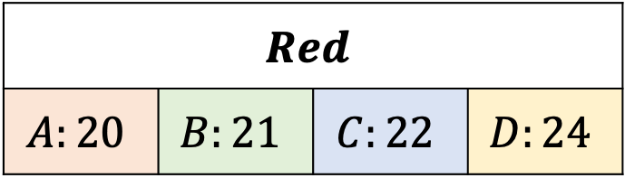
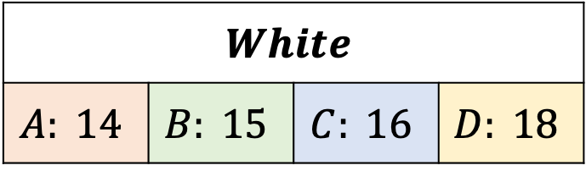

$${45}^{o}$$
Yellow | 7
White
Blue
Total
Green
White
Yellow | 16
Total
$${120}^{o}$$
$$White$$
$$A: 14$$ | $$B: 15$$ | $$C: 16$$ | $$D: 18$$
Yellow | 12
White
Red
Total
$${120}^{o}$$
$$Red$$
$$A:20$$ | $$B:21$$ | $$C:22$$ | $$D:24$$

Slide 27
Find the set of data that has a range of 7
A: 3, 1, 4, 8
B: 9, 3, 1, 2
C: 5, 11, 10, 6
D: 7, 1, 0, 8

Slide 28
Find the set of data that has a range of 7 and median of 3
A: 8, 1, 3, 7, 6
B: 3, 3, 9, 1, 5
C: 2, 1, 3, 8, 8
D: 0, 7, 1, 2, 6

Slide 29
Which of the following ISN’T an example of continuous data?
Height of trees
Weight of apples
Number of pets owned
Speed of cars

Slide 30
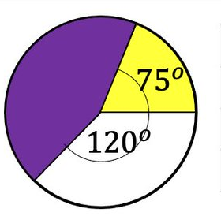

The white sector represents 30 people
How many people are represented by the yellow sector
$${80}^{o }$$
A: 24
B: 60
C: 20
D: 28

Slide 31
Number of cars people own
Cars | Freq
0 | 6
1 | 1
2 | 1
Find the mode
A: 6
B: 0
C: 1
D: 1 or 2

Slide 32
Angles

Slide 33









$${88}^{o}$$
$${131}^{o}$$
$$x$$
$$x$$
$${43}^{o}$$
A
B
C
D
$${31}^{o}$$
$$x$$
$${131}^{o}$$
$$x$$
$${100}^{o}$$

Slide 34









$$θ$$
$$70°$$
$$x$$
$$55°$$
A
B
C
D
$$65°$$
$$x$$
$$70°$$
$$45°$$
$$x$$

Slide 35
 | Corresponding angles equal
 | Alternate angles equal
 | Co-interior angles add up to 180⁰
F
F
A
A
B
B
C
C
D
D
E
E
F
A
B
C
D
E

Slide 36
H
F
F
b
A
a
A
B
82º
B
C
82º
C
D
D
A
B
G
E
E
C
D
F
F
A
A
82º
B
82º
B
C
82º
C
82º
D
D
E
E

Slide 37
a
105°
  A 105° … alternate angles
B 75° … corresponding angles
  C 105° … angles in a triangle = 180°
  D 105° … corresponding angles
  D a = 105° … corresponding angles
Notes:
37

Slide 38
e
98°
  A 82° … alternate angles
B 98° … corresponding angles
  C e = 98° … alternate angles
  C 98° … alternate angles
  D 82° … angles on a str. line = 180 °
Notes:
38

Slide 39
f
56°
54°
  A 56° … alternate angles
B f = 70° … angles in a triangle = 180°
  B 70° … angles in a triangle = 180°
  C 54° … corresponding angles
  D 124° … angles on a str. line = 180 °
Notes:
39

Slide 40
30°
g
100°
  A 30° … corresponding angles
B g = 70° … alternate angles
  B 70° … alternate angles
  C 100° … alternate angles
  D 99° … corresponding angles
Notes:
40

Slide 41
h
30°
70°
100°
  A h = 80° … angles on a str. line = 180 °
  A 80° … angles on a str. line = 180 °
B 70° … corresponding angles
  C 100° … alternate angles
  D 30° … angles in a triangle = 180°
Notes:
41

Slide 42
i
30°
70°
100°
  A 100° … alternate angles
B 30° … angles in a triangle = 180°
  C 70° … corresponding angles
  D i = 100° … corresponding angles
  D 100° … corresponding angles
Notes:
42

Slide 43
100°
j
30°
80°
70°
100°
  A 30° … angles in a triangle = 180°
B 70° … corresponding angles
  C j = 80° … angles round a point = 360°
  C 80° … angles round a point = 360°
  D 100° … alternate angles
Notes:
43

Slide 44
100°
30°
80°
70°
k
100°
  A k = 40° … angles in a triangle = 180°
  A 40° … angles in a triangle = 180°
B 30° … corresponding angles
  C 100° … alternate angles
  D 30° … alternate angles
Notes:
44

Slide 45
23°
47°
m
  A m = 110° … alternate + on a str line
  A 110° … alternate + on a str line
B 23° … corresponding + on a str line
  C 64° … angles in a triangle = 180°
  D 47° … alternate angles
Notes:
45

