Slide 1
Year 10: Revision
Rules for todays lesson
Chat is ONLY for Maths discussion
It is to be used for asking or answering questions only
Students incorrectly using the chat function will be removed from the lesson, reported and contact will be made with your parent/guardian

Slide 2
Chapter 1
Estimation
Dividing Decimals
Multiplying Decimals
Order of Operations
Negatives

Slide 3
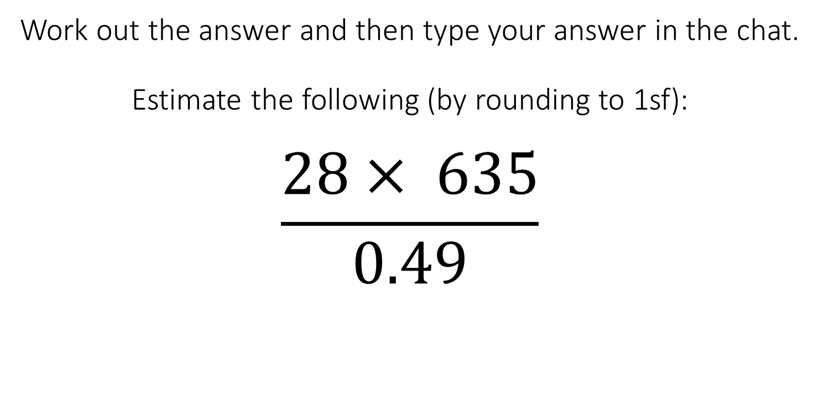
Work out the answer and then type your answer in the chat.
Estimate the following (by rounding to 1sf):
$$\frac{28× 635}{0.49}$$
A: 9000
B: 36,000
C: 35,840
D: 8960

Slide 4
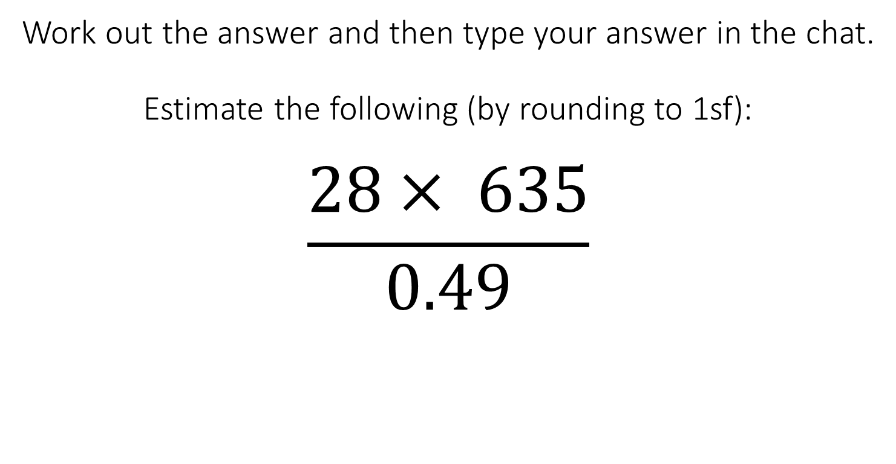
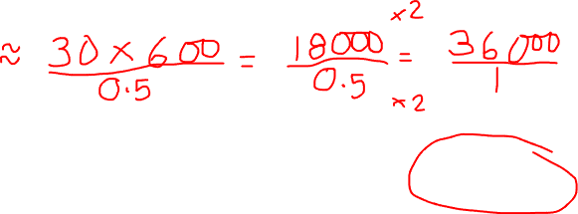
Work out the answer and then type your answer in the chat.
Estimate the following (by rounding to 1sf):
$$\frac{28× 635}{0.49}$$
A: 9000
B: 36,000
C: 35,840
D: 8960

Slide 5
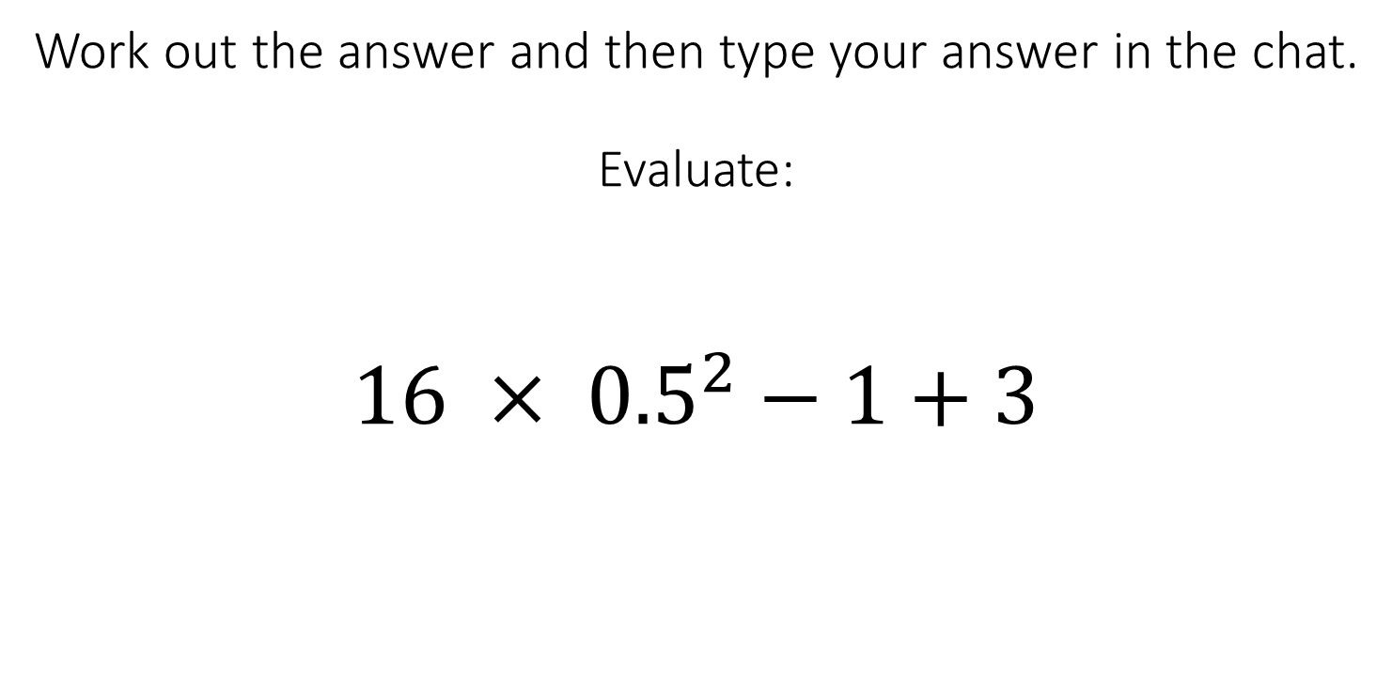
Work out the answer and then type your answer in the chat.
Evaluate:
$${16 × 0.5}^{2}−1+3$$
A: 66
B: 0
C: 60
D: 6

Slide 6
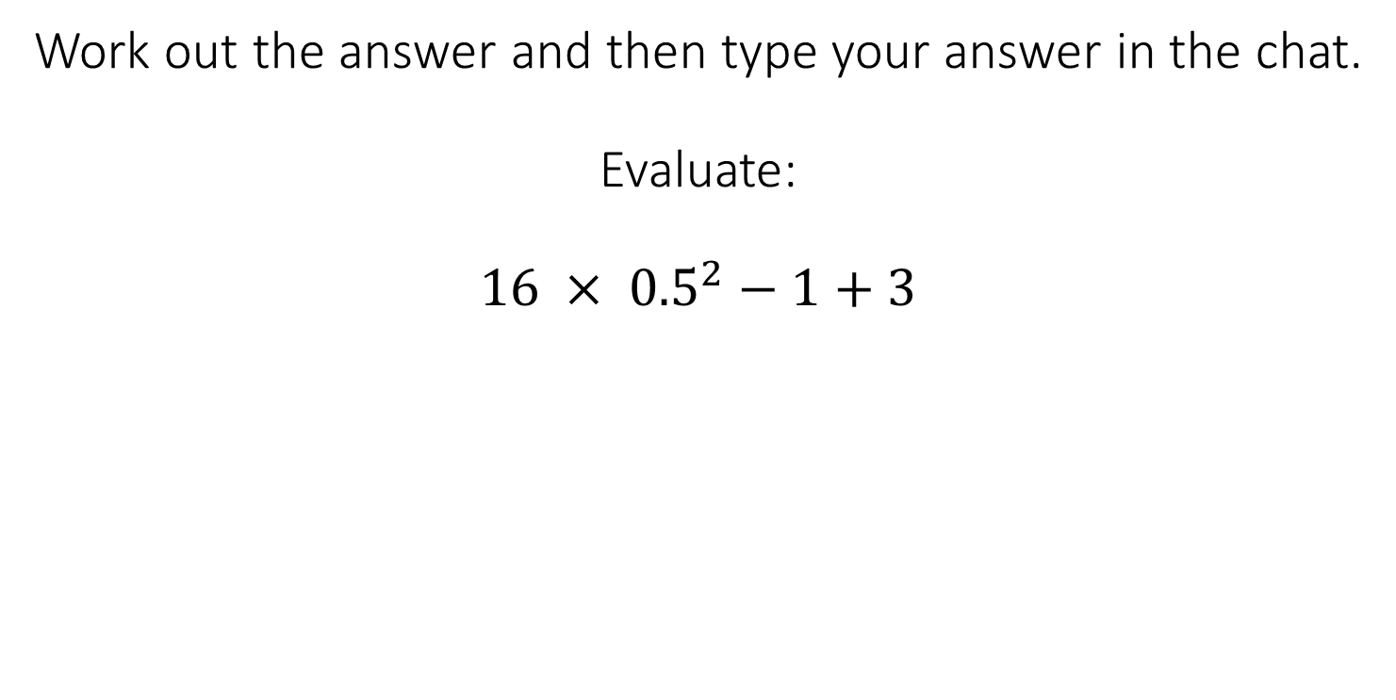
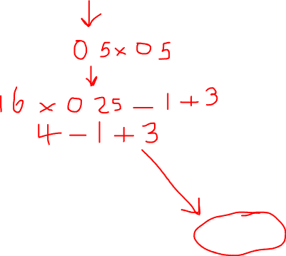
Work out the answer and then type your answer in the chat.
Evaluate:
$${16 × 0.5}^{2}−1+3$$
A: 66
B: 0
C: 60
D: 6

Slide 7
Chapter 2
Simplifying expressions
Expanding and factorising expressions
Simplifying algebraic fractions

Slide 8
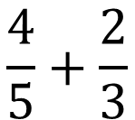
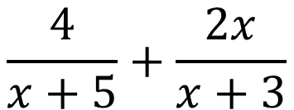


Work out the answer and then type your answer in the chat.
Expand and Simplify:
Expand and Simplify:
$$\frac{4}{5}+\frac{2}{3}$$
$$\left(x+5\right)(x+3)$$
$$4\left(x+3\right)+2x(x+5)$$
$$\frac{4}{x+5}+\frac{2x}{x+3}$$

Slide 9
Work out the answer and then type your answer in the chat.
Expand and Simplify:
Expand and Simplify:
$$\frac{4}{5}+\frac{2}{3}$$
$$\left(x+5\right)(x+3)$$
$$4\left(x+3\right)+2x(x+5)$$
$$\frac{4}{x+5}+\frac{2x}{x+3}$$

Slide 10
Work out the answer and then type your answer in the chat.
Expand and Simplify:
Expand and Simplify:
$$\frac{4}{5}+\frac{2}{3}$$
$$\left(x+5\right)(x+3)$$
$$4\left(x+3\right)+2x(x+5)$$
$$\frac{4}{x+5}+\frac{2x}{x+3}$$

Slide 11
Work out the answer and then type your answer in the chat.
Expand and Simplify:
Expand and Simplify:
$$\frac{4}{5}+\frac{2}{3}$$
$$\left(x+5\right)(x+3)$$
$$4\left(x+3\right)+2x(x+5)$$
$$\frac{4}{x+5}+\frac{2x}{x+3}$$

Slide 12
Work out the answer and then type your answer in the chat.
Expand and Simplify:
Expand and Simplify:
$$\frac{4}{5}+\frac{2}{3}$$
$$\left(x+5\right)(x+3)$$
$$4\left(x+3\right)+2x(x+5)$$
$$\frac{4}{x+5}+\frac{2x}{x+3}$$

Slide 13
Work out the answer and then type your answer in the chat.
Expand and Simplify:
Expand and Simplify:
$$\frac{4}{5}+\frac{2}{3}$$
$$\left(x+5\right)(x+3)$$
$$4\left(x+3\right)+2x(x+5)$$
$$\frac{4}{x+5}+\frac{2x}{x+3}$$

Slide 14
Work out the answer and then type your answer in the chat.
$$\frac{4}{5}+\frac{2}{3}$$
$$\left(x+5\right)(x+3)$$
$$4\left(x+3\right)+2x(x+5)$$
$$\frac{4}{x+5}+\frac{2x}{x+3}$$

Slide 15
Work out the answer and then type your answer in the chat.
Expand and Simplify:
Expand and Simplify:
$$\frac{4}{5}+\frac{2}{3}$$
$$\left(x+5\right)(x+3)$$
$$4\left(x+3\right)+2x(x+5)$$
$$\frac{4}{x+5}+\frac{2x}{x+3}$$

Slide 16

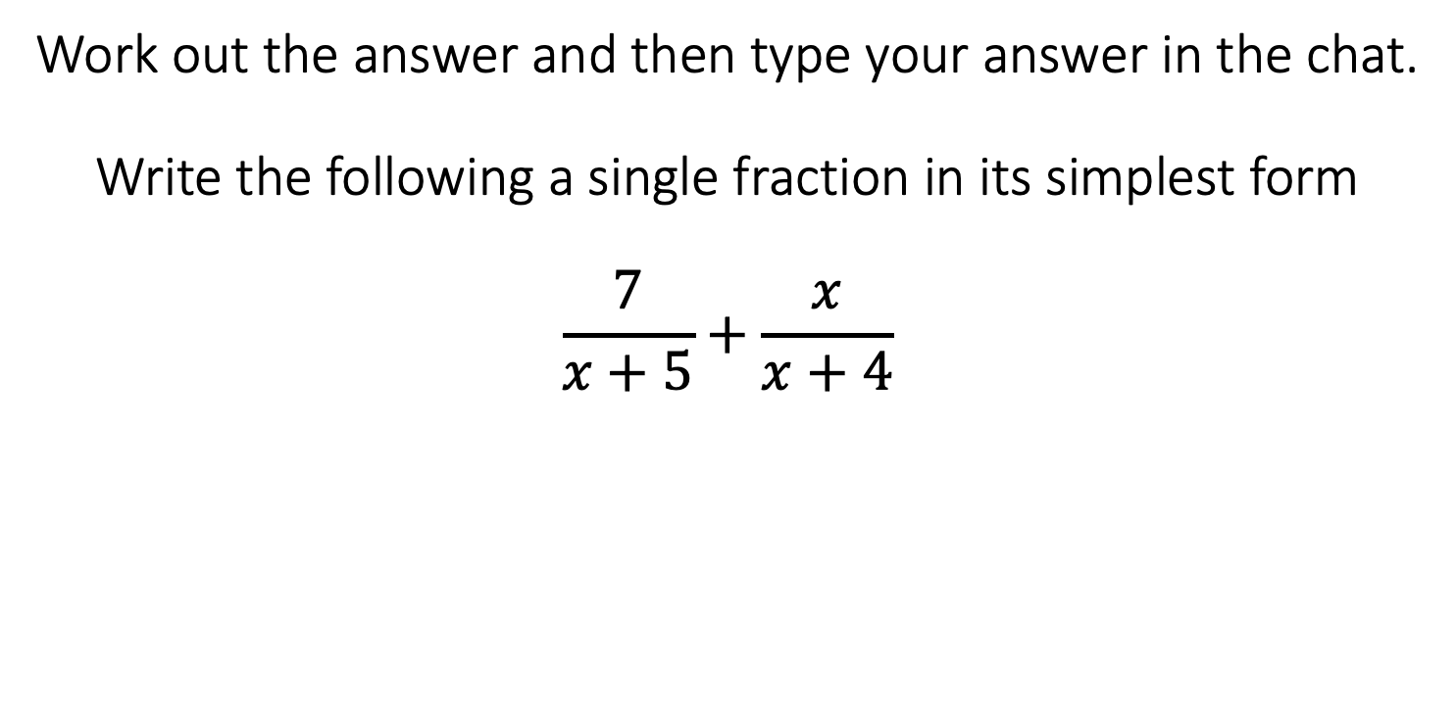
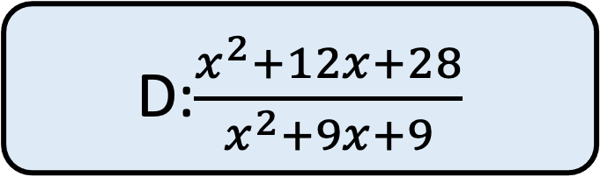
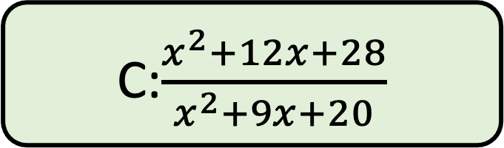
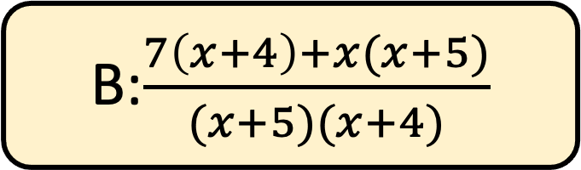
Work out the answer and then type your answer in the chat.
Write the following a single fraction in its simplest form
$$\frac{7}{x+5}+\frac{x}{x+4}$$
A:$\frac{12x+28}{9x+20}$
B:$\frac{7\left(x+4\right)+x(x+5)}{(x+5)(x+4)}$
C:$\frac{x^{2}+12x+28}{x^{2}+9x+20}$
D:$\frac{x^{2}+12x+28}{x^{2}+9x+9}$

Slide 17
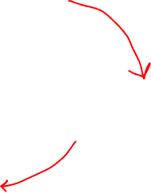

Work out the answer and then type your answer in the chat.
Write the following a single fraction in its simplest form
$$\frac{7}{x+5}+\frac{x}{x+4}$$
A:$\frac{12x+28}{9x+20}$
B:$\frac{7\left(x+4\right)+x(x+5)}{(x+5)(x+4)}$
C:$\frac{x^{2}+12x+28}{x^{2}+9x+20}$
D:$\frac{x^{2}+12x+28}{x^{2}+9x+9}$

Slide 18
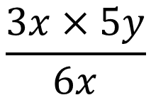
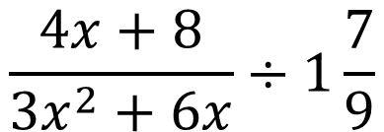
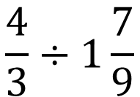

Work out the answer and then type your answer in the chat.
Factorise:
Simplify:
$$\frac{4}{3}÷1\frac{7}{9}$$
$$3x^{2}+6x$$
$$\frac{3x×5y}{6x}$$
Simplify:
$$\frac{4x+8}{{3x}^{2}+6x}÷1\frac{7}{9}$$

Slide 19
Work out the answer and then type your answer in the chat.
Factorise:
Simplify:
$$\frac{4}{3}÷1\frac{7}{9}$$
$$3x^{2}+6x$$
$$\frac{3x×5y}{6x}$$
Simplify:
$$\frac{4x+8}{{3x}^{2}+6x}÷1\frac{7}{9}$$

Slide 20
Work out the answer and then type your answer in the chat.
Factorise:
Simplify:
$$\frac{4}{3}÷1\frac{7}{9}$$
$$3x^{2}+6x$$
$$\frac{3x×5y}{6x}$$
Simplify:
$$\frac{4x+8}{{3x}^{2}+6x}÷1\frac{7}{9}$$

Slide 21
Work out the answer and then type your answer in the chat.
Factorise:
Simplify:
$$\frac{4}{3}÷1\frac{7}{9}$$
$$3x^{2}+6x$$
$$\frac{3x×5y}{6x}$$
Simplify:
$$\frac{4x+8}{{3x}^{2}+6x}÷1\frac{7}{9}$$

Slide 22
Work out the answer and then type your answer in the chat.
Factorise:
Simplify:
$$\frac{4}{3}÷1\frac{7}{9}$$
$$3x^{2}+6x$$
$$\frac{3x×5y}{6x}$$
Simplify:
$$\frac{4x+8}{{3x}^{2}+6x}÷1\frac{7}{9}$$

Slide 23
Work out the answer and then type your answer in the chat.
Factorise:
Simplify:
$$\frac{4}{3}÷1\frac{7}{9}$$
$$3x^{2}+6x$$
$$\frac{3x×5y}{6x}$$
Simplify:
$$\frac{4x+8}{{3x}^{2}+6x}÷1\frac{7}{9}$$

Slide 24
Work out the answer and then type your answer in the chat.
Factorise:
Simplify:
$$\frac{4}{3}÷1\frac{7}{9}$$
$$3x^{2}+6x$$
$$\frac{3x×5y}{6x}$$
Simplify:
$$\frac{4x+8}{{3x}^{2}+6x}÷1\frac{7}{9}$$

Slide 25

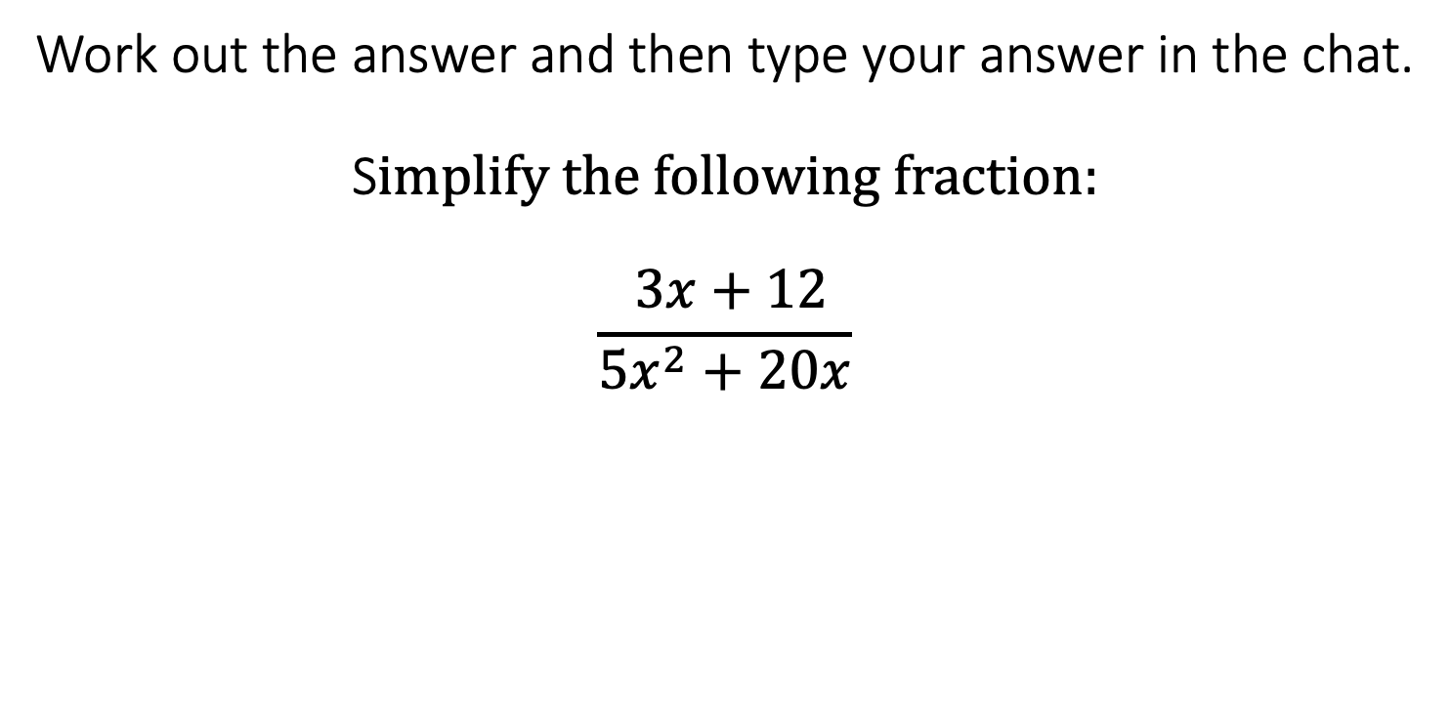
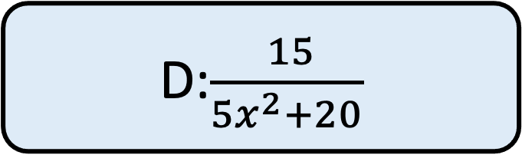
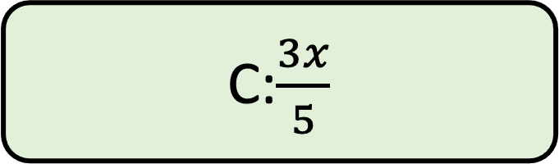

Work out the answer and then type your answer in the chat.
S$implify the following fraction:$
$$\frac{ 3x+12}{{5x}^{2}+20x}$$
A:$\frac{3}{5x}$
B:$\frac{ 3(x+4)}{ 5x(x+4)}$
C:$\frac{3x}{5}$
D:$\frac{ 15}{{5x}^{2}+20}$

Slide 26
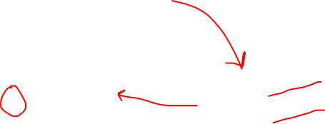
Work out the answer and then type your answer in the chat.
S$implify the following fraction:$
$$\frac{ 3x+12}{{5x}^{2}+20x}$$
A:$\frac{3}{5x}$
B:$\frac{ 3(x+4)}{ 5x(x+4)}$
C:$\frac{3x}{5}$
D:$\frac{ 15}{{5x}^{2}+20}$

Slide 27
Chapter 3
Angles in a triangle, quadrilateral polygons
Angles in parallel lines
Congruency and Similarity
Bearings

Slide 28
 | Corresponding angles equal
 | Alternate angles equal
 | Co-interior angles add up to 180⁰
F
F
A
A
B
B
C
C
D
D
E
E
F
A
B
C
D
E

Slide 29
F
H
F
b
A
a
A
B
85º
B
C
82º
C
D
D
E
G
E
F
F
A
A
B
88º
B
89º
C
C
88º
89º
D
D
E
E

Slide 30




Diagram not drawn to scale
B
E
D
$$73o$$
D
C
$$71o$$
$$44o$$
$$48o$$
A
C
A
B
E
Find the missing angles in each of the shapes above
What can you say about triangles ABC and CDE in both questions?

Slide 31


Diagram not drawn to scale
B
E
D
$$73o$$
D
C
$$71o$$
$$44o$$
$$48o$$
A
C
A
B
E
Find the missing angles in each of the shapes above
What can you say about triangles ABC and CDE in both questions?

Slide 32

Diagram not drawn to scale
B
E
D
$$73o$$
D
C
$$71o$$
$$44o$$
$$48o$$
A
C
A
B
E
Find the missing angles in each of the shapes above
What can you say about triangles ABC and CDE in both questions?

Slide 33

Diagram not drawn to scale
B
E
D
$$73o$$
D
C
$$71o$$
$$44o$$
$$48o$$
A
C
A
B
E
Find the missing angles in each of the shapes above
What can you say about triangles ABC and CDE in both questions?

Slide 34
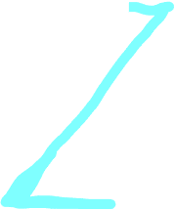
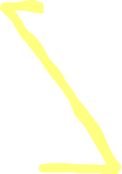
Diagram not drawn to scale
B
E
D
$$73o$$
D
C
$$71o$$
$$44o$$
$$48o$$
A
C
A
B
E
Find the missing angles in each of the shapes above
What can you say about triangles ABC and CDE in both questions?

Slide 35

Diagram not drawn to scale
B
E
D
$$73o$$
D
C
$$71o$$
$$44o$$
$$48o$$
A
C
A
B
E
Find the missing angles in each of the shapes above
What can you say about triangles ABC and CDE in both questions?

Slide 36
Diagram not drawn to scale
B
E
D
$$73o$$
D
C
$$71o$$
$$44o$$
$$48o$$
A
C
A
B
E
Find the missing angles in each of the shapes above
What can you say about triangles ABC and CDE in both questions?

Slide 37
Diagram not drawn to scale
B
$$73o$$
D
16cm
10cm
6cm
$$71o$$
A
C
E
9cm
Find the length of CD and AE

Slide 38
Diagram not drawn to scale
B
$$73o$$
D
16cm
10cm
6cm
$$71o$$
A
C
E
9cm
Find the length of CD and AE

Slide 39
Diagram not drawn to scale
B
$$73o$$
D
16cm
10cm
6cm
$$71o$$
A
C
E
9cm
Find the length of CD and AE

Slide 40
Diagram not drawn to scale
B
$$73o$$
D
16cm
10cm
6cm
$$71o$$
A
C
E
9cm
Find the length of CD and AE

Slide 41
Diagram not drawn to scale
B
$$73o$$
D
16cm
10cm
6cm
$$71o$$
A
C
E
9cm
Find the length of CD and AE

Slide 42
Diagram not drawn to scale
E
4cm
D
3cm
Find the length of AC
C
$$44o$$
$$48o$$
A
B
10cm
A: 2.5
B: 8
C: 9
D: 7.5

Slide 43
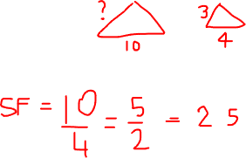
Diagram not drawn to scale
E
4cm
D
3cm
Find the length of AC
C
$$44o$$
$$48o$$
A
B
10cm
A: 2.5
B: 8
C: 9
D: 7.5

Slide 44
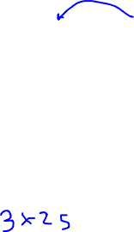
Diagram not drawn to scale
E
4cm
D
3cm
Find the length of AC
C
$$44o$$
$$48o$$
A
B
10cm
A: 2.5
B: 8
C: 9
D: 7.5

Slide 45
Chapter 4
Representing Data
Averages and Spread
Frequency diagrams

Slide 46
1, 1, 1 2, 2 3, 3, 3, 3, 3 4
10 students recorded how many pets they owned

Slide 47
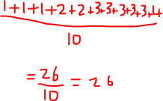
1, 1, 1 2, 2 3, 3, 3, 3, 3 4
10 students recorded how many pets they owned

Slide 48
10 students recorded how many pets they owned
1, 1, 1 2, 2 3, 3, 3, 3, 3 4
10 students recorded how many pets they owned
Pets | Freq
1
2
3
4

Slide 49
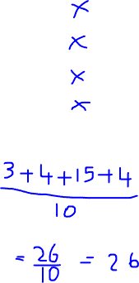
10 students recorded how many pets they owned
1, 1, 1 2, 2 3, 3, 3, 3, 3 4
10 students recorded how many pets they owned
Pets | Freq
1
2
3
4

Slide 50
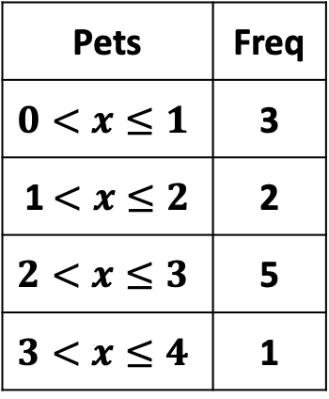
10 students recorded how many pets they owned
1, 1, 1 2, 2 3, 3, 3, 3, 3 4
10 students recorded how many pets they owned
Weight of 10 dogs
Pets | Freq
1
2
3
4
Pets | Freq
$$0<x≤1$$ | 3
1$<x≤2$ | 2
$$2<x≤3$$ | 5
$$3<x≤4$$ | 1

Slide 51
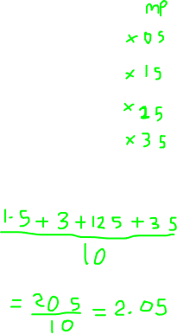
10 students recorded how many pets they owned
1, 1, 1 2, 2 3, 3, 3, 3, 3 4
10 students recorded how many pets they owned
Weight of 10 dogs
Pets | Freq
1
2
3
4
Pets | Freq
$$0<x≤1$$ | 3
1$<x≤2$ | 2
$$2<x≤3$$ | 5
$$3<x≤4$$ | 1

Slide 52
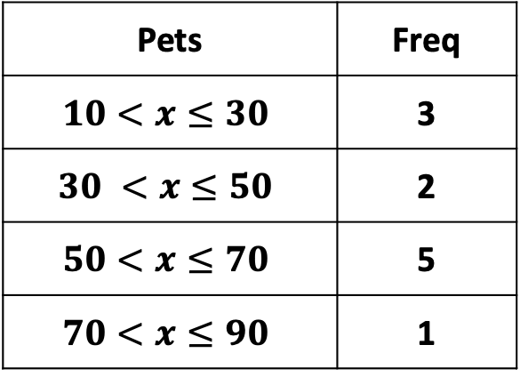
Height of 10 plants
Pets | Freq
$$10<x≤30$$ | 3
$$30 <x≤50$$ | 2
$$50<x≤70$$ | 5
$$70<x≤90$$ | 1
A: 60
B: 52
C: 50
D: 520

Slide 53
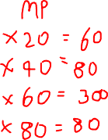
Height of 10 plants
Pets | Freq
$$10<x≤30$$ | 3
$$30 <x≤50$$ | 2
$$50<x≤70$$ | 5
$$70<x≤90$$ | 1
A: 60
B: 52
C: 50
D: 520

Slide 54

Height of 10 plants
Pets | Freq
$$10<x≤30$$ | 3
$$30 <x≤50$$ | 2
$$50<x≤70$$ | 5
$$70<x≤90$$ | 1
A: 60
B: 52
C: 50
D: 520

