Slide 1
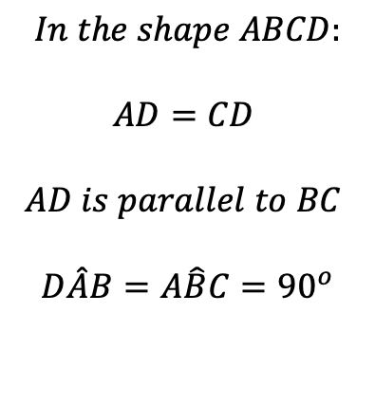
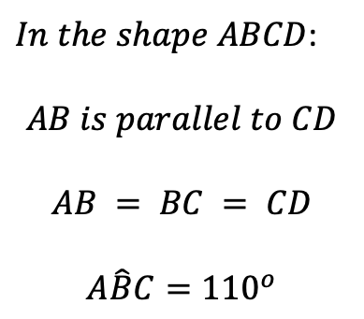
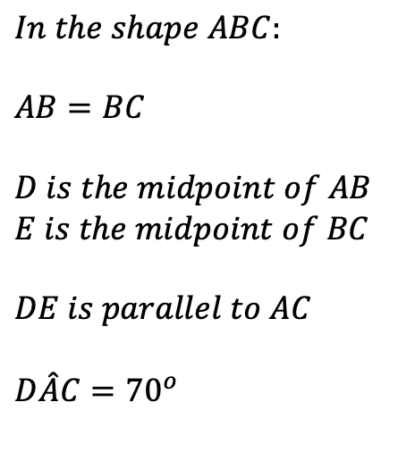
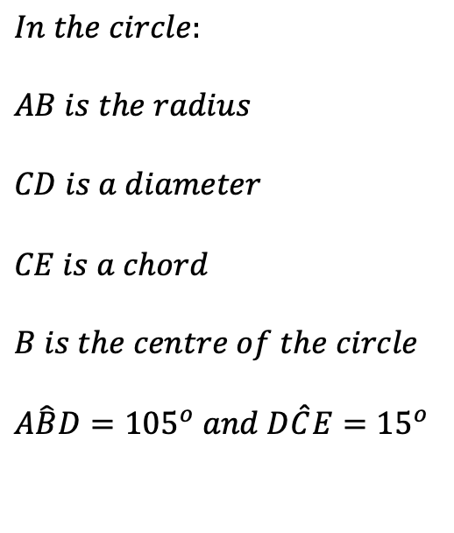
$In the shape ABCD$:
$$AB is parallel to CD$$
$$AB = BC = CD$$
$$A\hat{B}C={110}^{o}$$
$$In the shape ABCD:$$
$$AD=CD$$
$$AD is parallel to BC$$
$$D\hat{A}B=A\hat{B}C={90}^{o}$$
$$In the shape ABC:$$
$$AB=BC$$
$$D is the midpoint of AB$$
$$E is the midpoint of BC$$
$$DE is parallel to AC$$
$$D\hat{A}C={70}^{o}$$
$$In the circle:$$
$$AB is the radius$$
$$CD is a diameter$$
$$CE is a chord$$
$$B is the centre of the circle$$
$$A\hat{B}D={105}^{o} and D\hat{C}E={15}^{o}$$

Slide 2
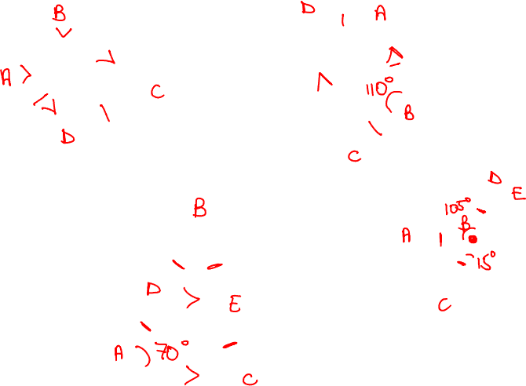
$In the shape ABCD$:
$$AB is parallel to CD$$
$$AB = BC = CD$$
$$A\hat{B}C={110}^{o}$$
$$In the shape ABCD:$$
$$AD=CD$$
$$AD is parallel to BC$$
$$D\hat{A}B=A\hat{B}C={90}^{o}$$
$$In the shape ABC:$$
$$AB=BC$$
$$D is the midpoint of AB$$
$$E is the midpoint of BC$$
$$DE is parallel to AC$$
$$D\hat{A}C={70}^{o}$$
$$In the circle:$$
$$AB is the radius$$
$$CD is a diameter$$
$$CE is a chord$$
$$B is the centre of the circle$$
$$A\hat{B}D={105}^{o} and D\hat{C}E={15}^{o}$$

