Slide 1
Graphs: Distance/Time Graphs
Work the following out on paper/in your books
DO NOT WRITE ANYTHING IN THE CHAT BOX YET
How long does it take to travel 96miles?
48mph
How far do I travel in an hour?
How long does it take to travel 480miles?
How far do I travel in half an hour?
How long does it take to travel 72miles?
How far do I travel in 20 minutes?
How long does it take to travel 60miles?
How far do I travel in 15 minutes?

Slide 2
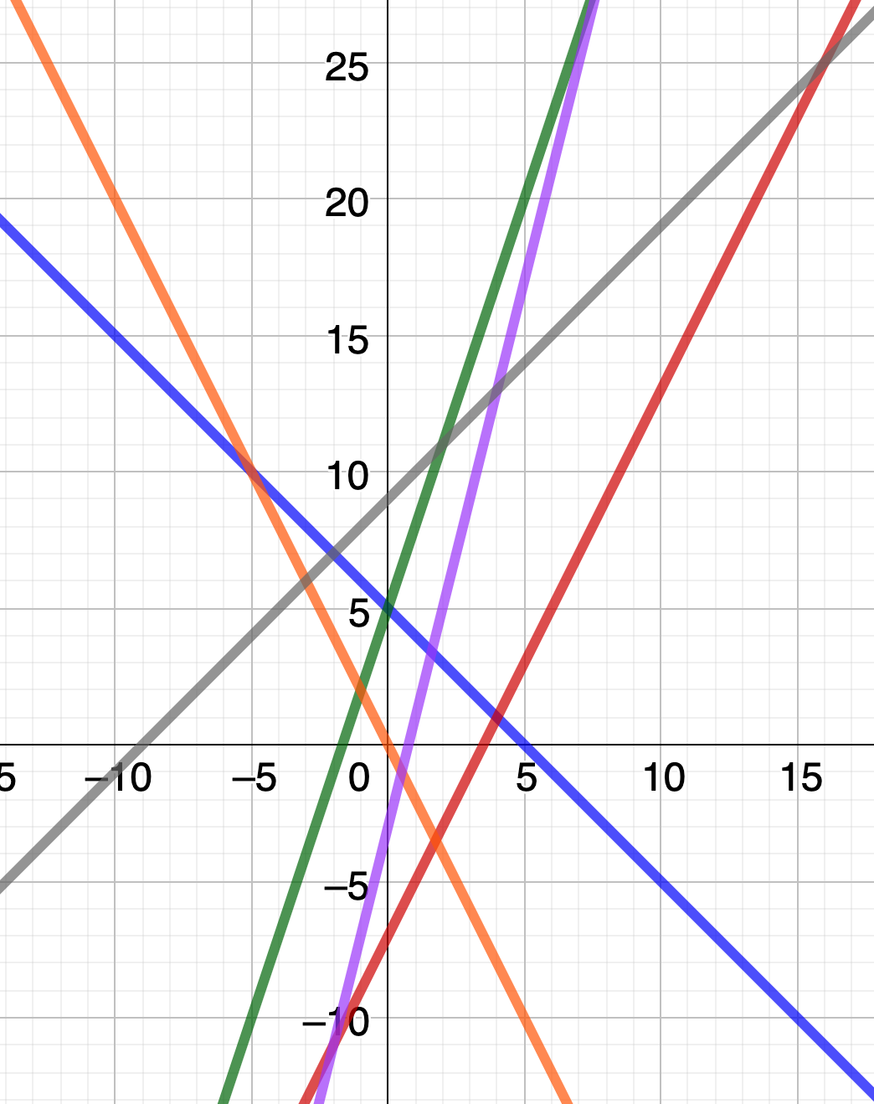
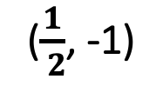
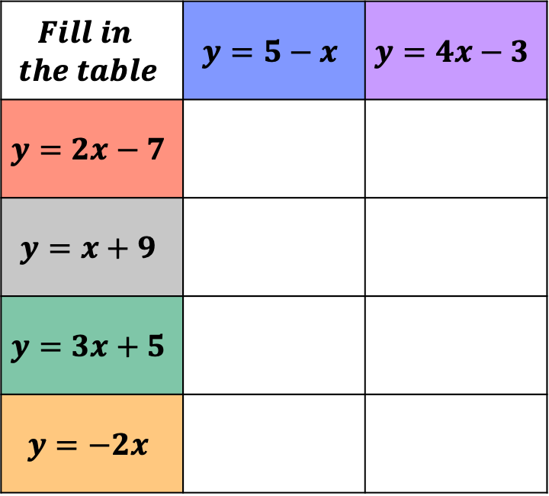
(4, 1)
Place the co-ordinates in the table
(4, 13)
(8, 29)
(-2, -11)
($\frac{1}{ 2}$, -1)
(-2, 7)
(-5, 10)
(0, 5)
$$Fill in$$ $$the table$$ | $$y=5−x$$ | $$y=4x−3$$
$$y=2x−7$$
$$y=x+9$$
$$y=3x+5$$
$$y=−2x$$

Slide 3



Which car is travelling at the fastest speed?
10
miles
20
miles

Slide 4
Which car is travelling at the fastest speed?
10
miles
20
miles

Slide 5
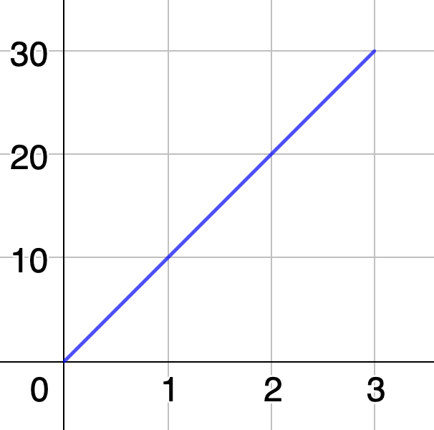
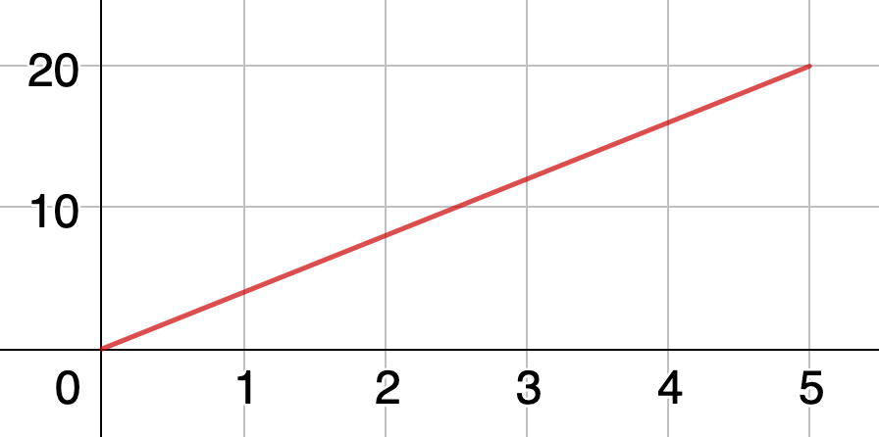
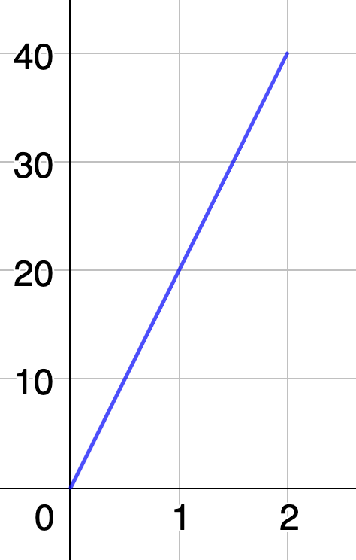
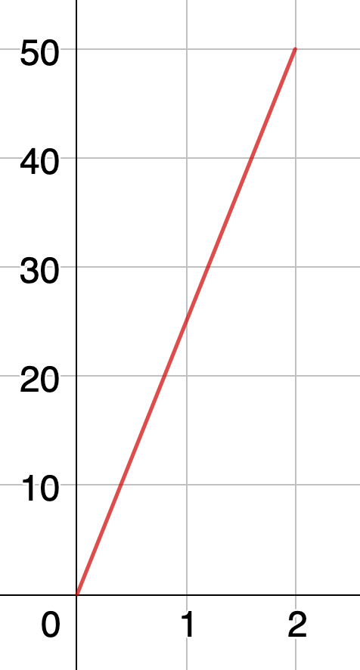
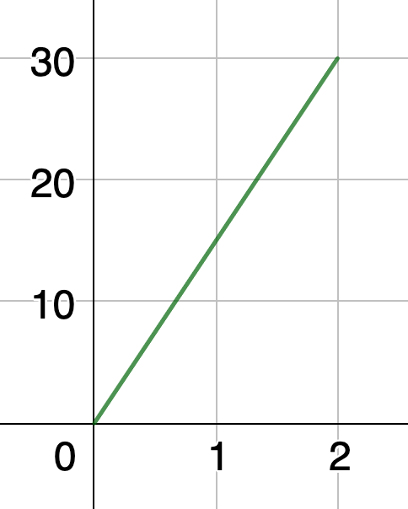
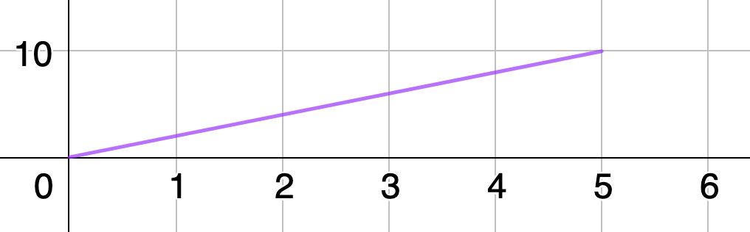
Bella’s Journey
Alf’s Journey
Dani’s Journey
km from home
km from home
km from home
Hours
Hours
Each graph represents a person's journey. What speed is each person traveling at?
Who is travelling at the fastest speed? How do you know?
Hours
Carla’s Journey
Farhan’s Journey
km from home
Emir’s Journey
km from home
km from home
Hours
Hours
Hours

Slide 6
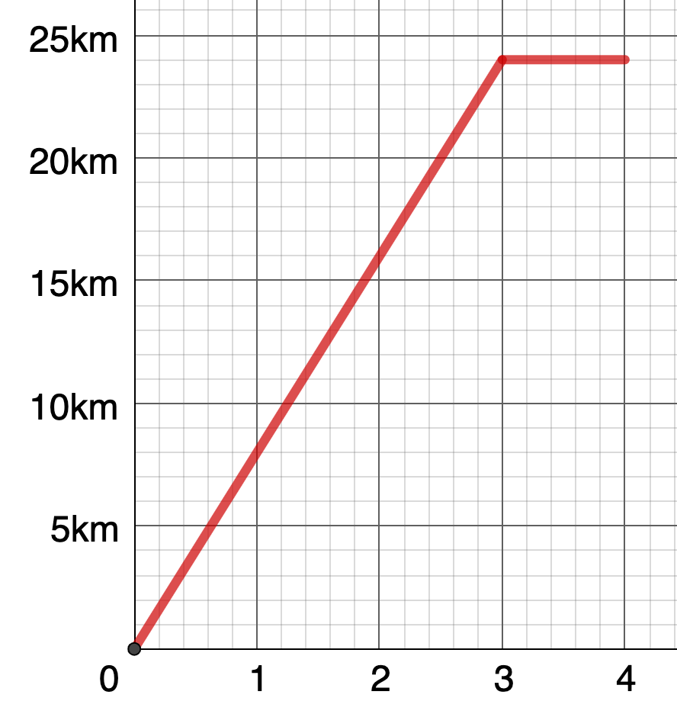
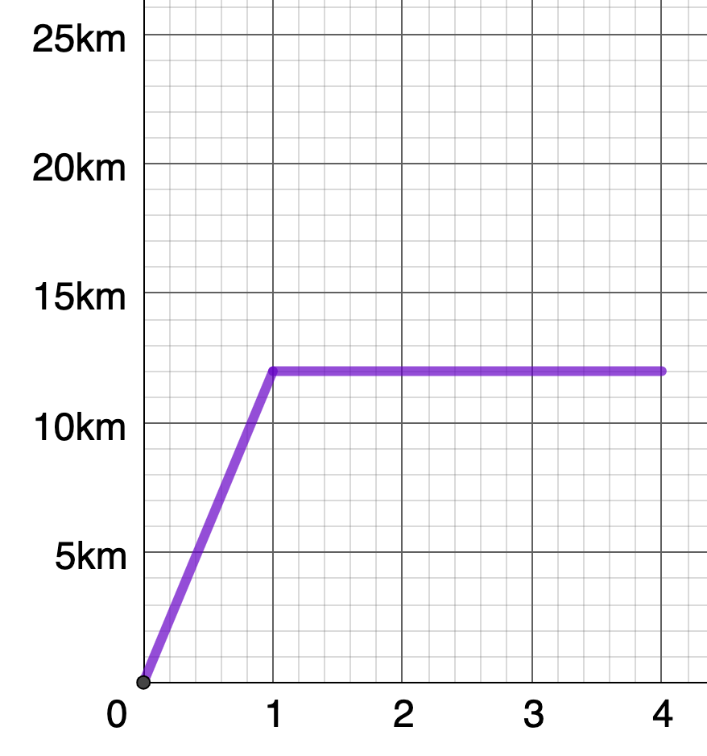
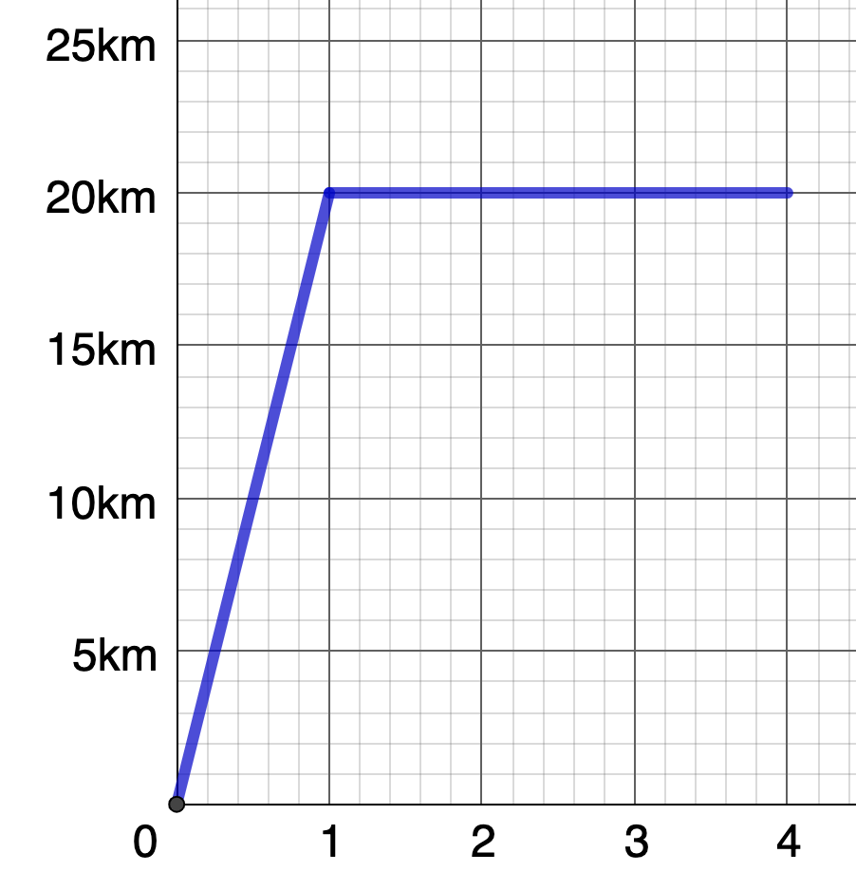
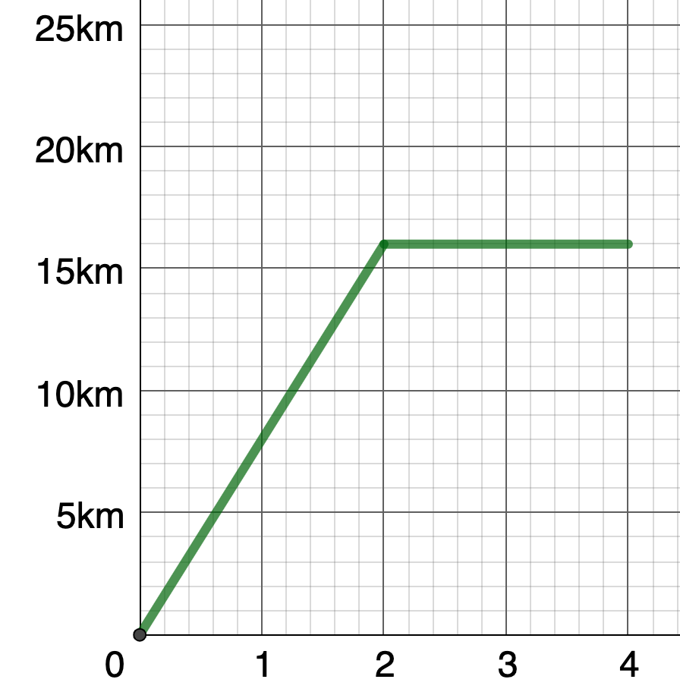
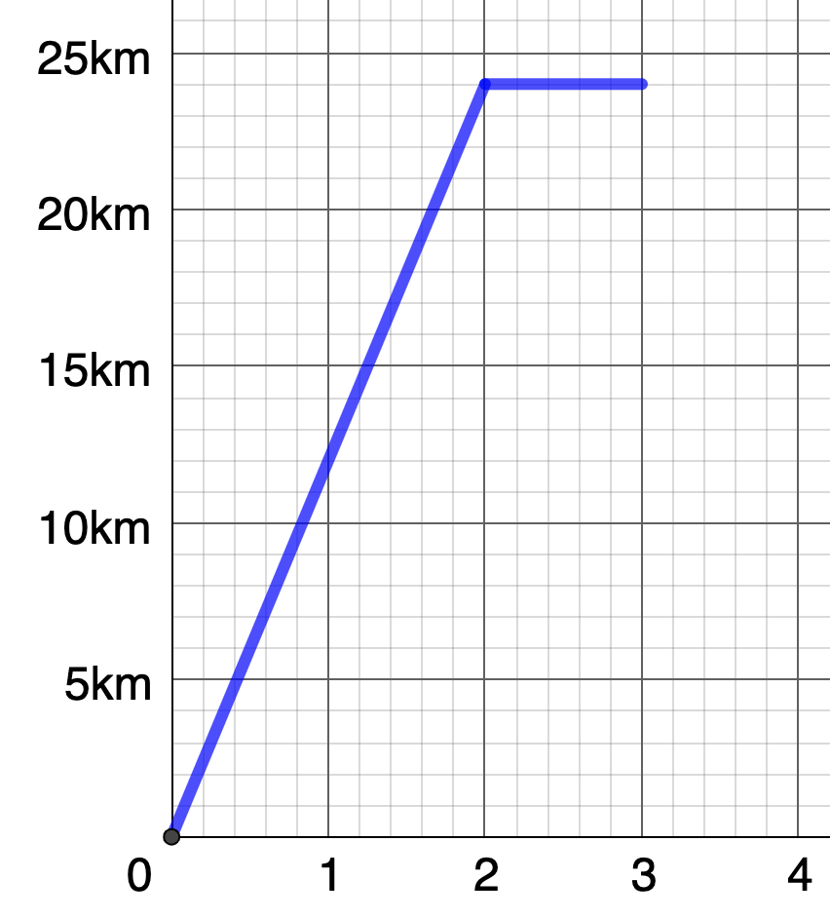
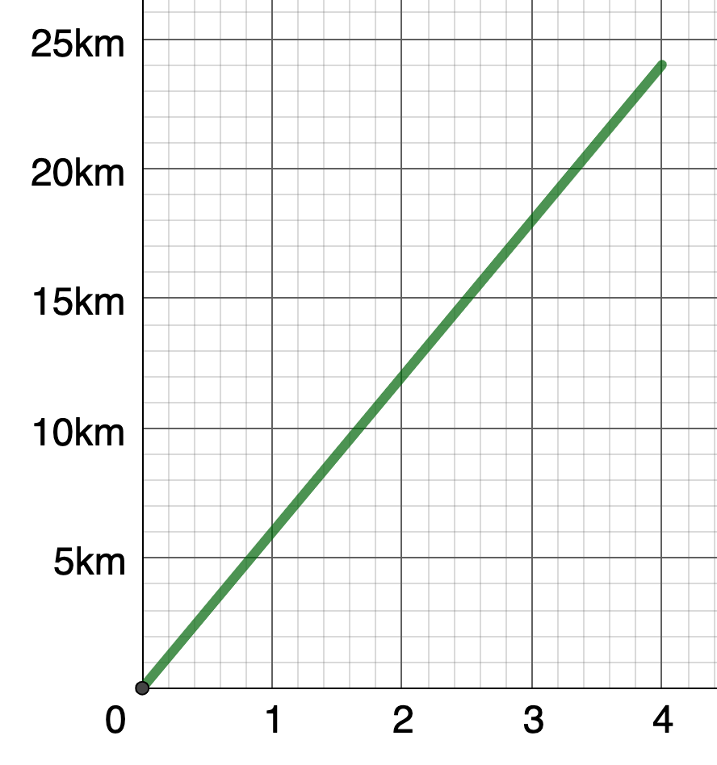
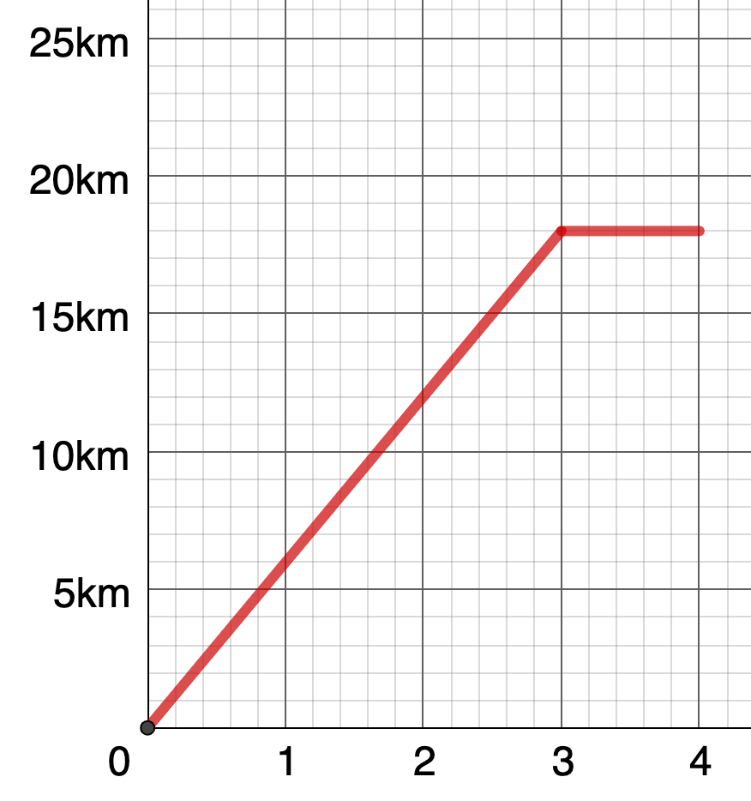
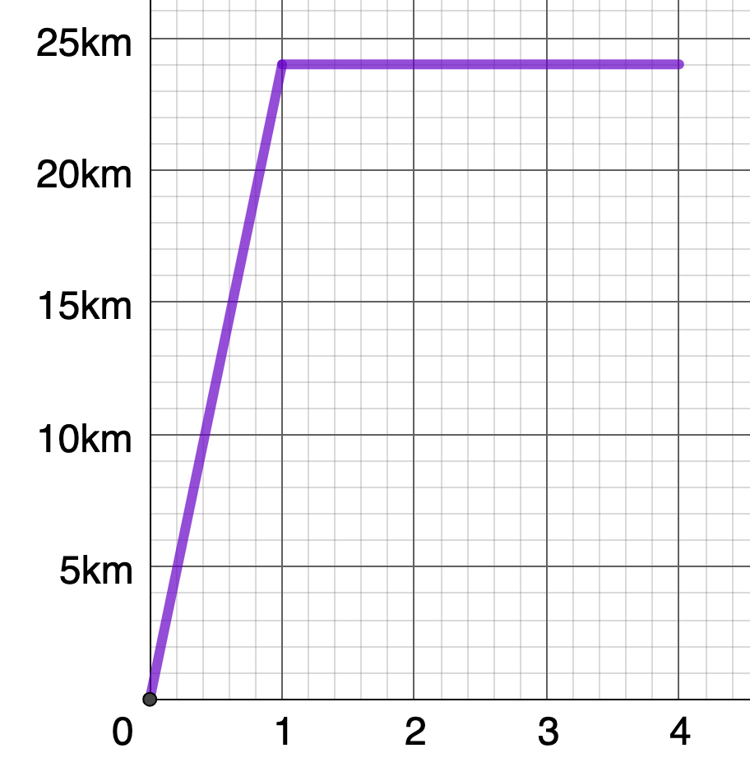
1.)
2.)
3.)
4.)
I travel a speed of 24km/h then I stop for 3 hours
I travel a speed of 20km/h then I stop for 3 hours
I travel a speed of 12km/h then I stop for 3 hours
I travel a speed of 12km/h then I stop for an hour
I travel a speed of 8km/h then I stop for 2 hours
I travel a speed of 6km/h without stopping
I travel a speed of 6km/h then I stop for 1 hour
I travel a speed of 8km/h then I stop for an hour
5.)
6.)
7.)
8.)

