Slide 1











Fill in the boxes below with values that match the comment in each box.
(The calculations vertically and horizontally must also be true)
prime
prime
prime
prime
$$×$$
$$=$$
Square
$$×$$
$$=$$
Even
$$×$$
$$×$$
$$×$$
$$×$$
prime
prime
prime
prime
$$×$$
$$=$$
Even
$$×$$
$$=$$
Factor of 154
$$=$$
$$=$$
$$=$$
$$=$$
10
multiple of 3
Factor of 99
square

Slide 2






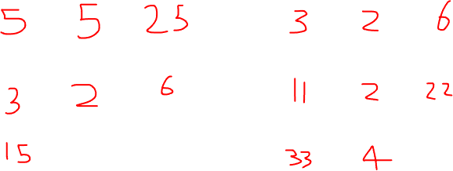
Fill in the boxes below with values that match the comment in each box.
(The calculations vertically and horizontally must also be true)
prime
prime
prime
prime
$$×$$
$$=$$
Square
$$×$$
$$=$$
Even
$$×$$
$$×$$
$$×$$
$$×$$
prime
prime
prime
prime
$$×$$
$$=$$
Even
$$×$$
$$=$$
Factor of 154
$$=$$
$$=$$
$$=$$
$$=$$
10
multiple of 3
Factor of 99
square

Slide 3






Fill in the boxes below with values that match the comment in each box.
(The calculations vertically and horizontally must also be true)
prime
prime
prime
$$×$$
$$×$$
$$=$$
Cube
$$×$$
$$×$$
$$×$$
prime
prime
prime
$$×$$
$$×$$
$$=$$
Even
$$×$$
$$×$$
$$×$$
prime
prime
prime
165
$$×$$
$$×$$
$$=$$
Even
$$=$$
$$=$$
$$=$$
70
multiple of 13
multiple of 51
Notes:
7x7x7
2x13x17
5x11x3

Slide 4
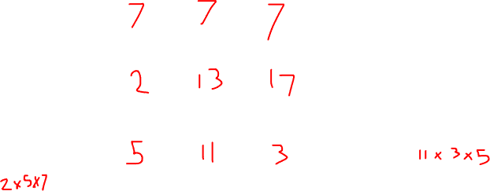
Fill in the boxes below with values that match the comment in each box.
(The calculations vertically and horizontally must also be true)
prime
prime
prime
$$×$$
$$×$$
$$=$$
Cube
$$×$$
$$×$$
$$×$$
prime
prime
prime
$$×$$
$$×$$
$$=$$
Even
$$×$$
$$×$$
$$×$$
prime
prime
prime
165
$$×$$
$$×$$
$$=$$
Even
$$=$$
$$=$$
$$=$$
70
multiple of 13
multiple of 51
Notes:
7x7x7
2x13x17
5x11x3

