Slide 1
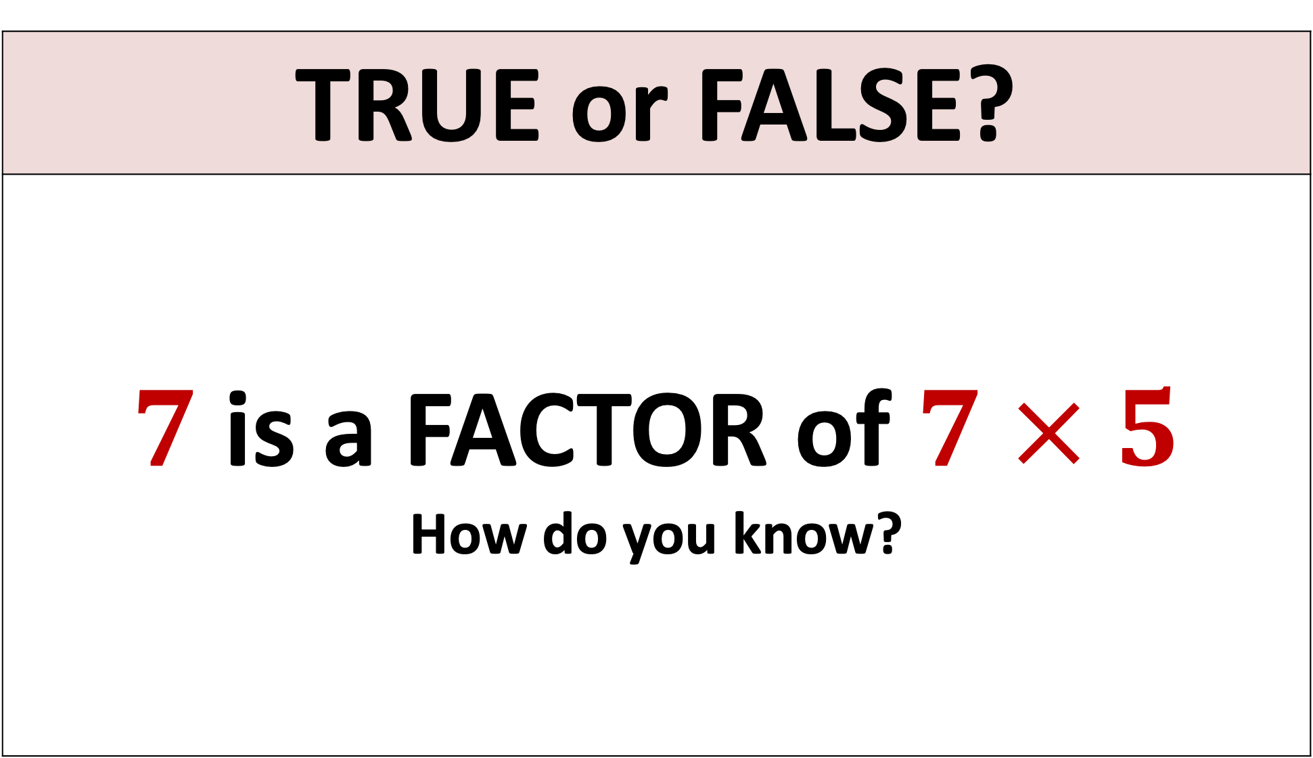
TRUE or FALSE?
$7$ is a FACTOR of $7 × 5$ How do you know?

Slide 2
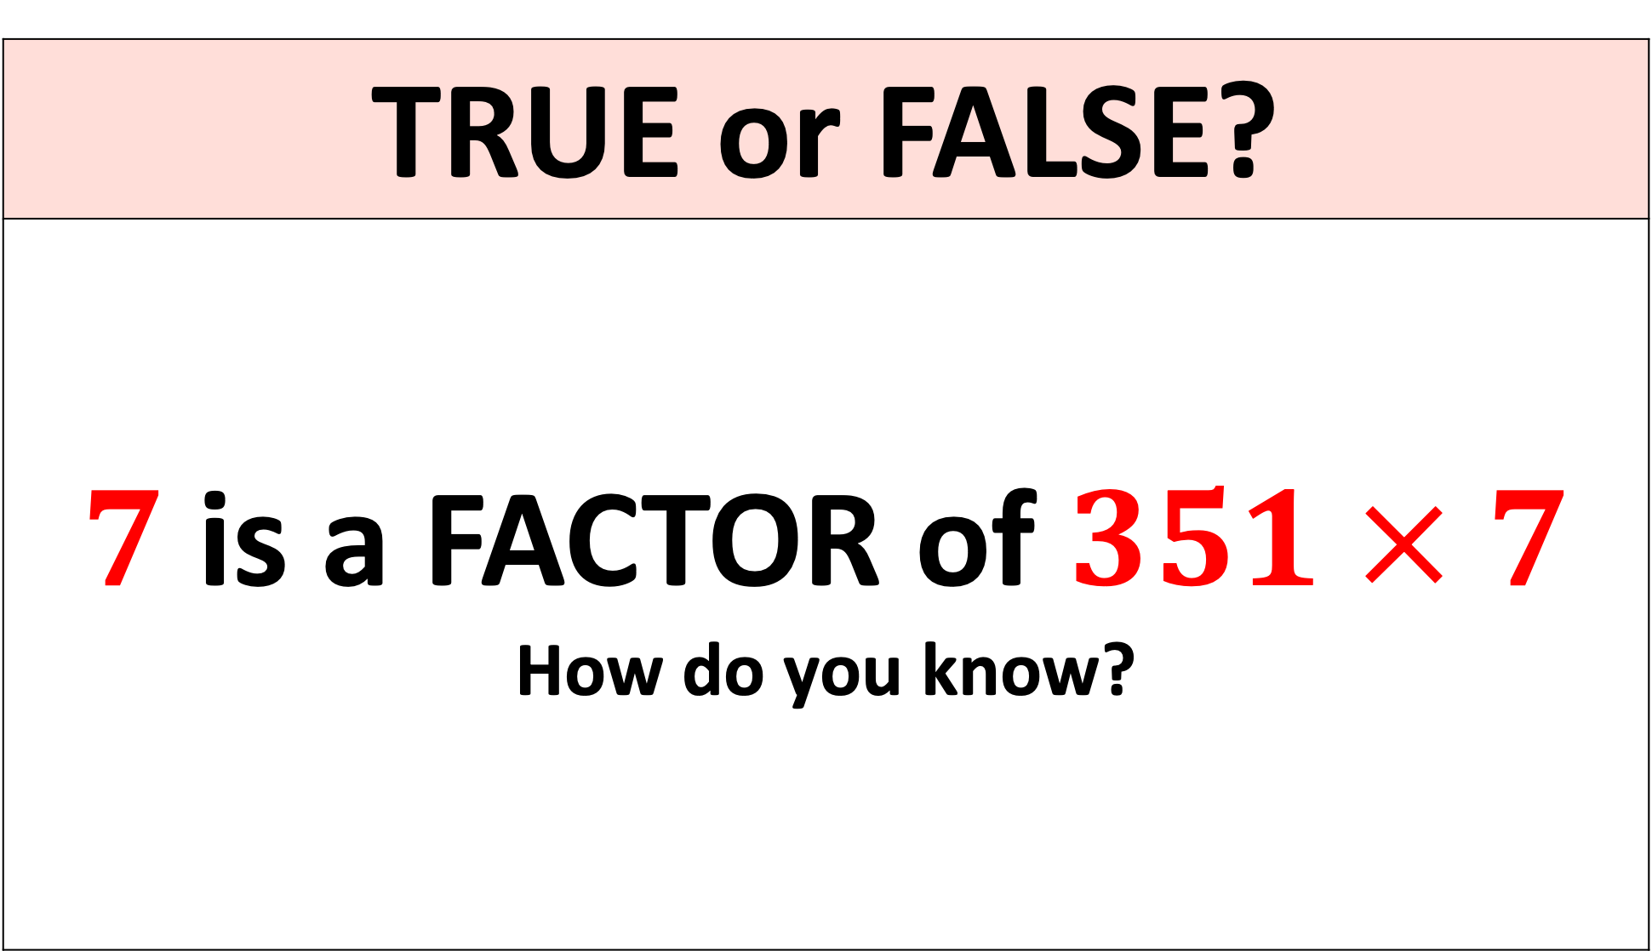
TRUE or FALSE?
$7$ is a FACTOR of$351 × 7$ How do you know?

Slide 3
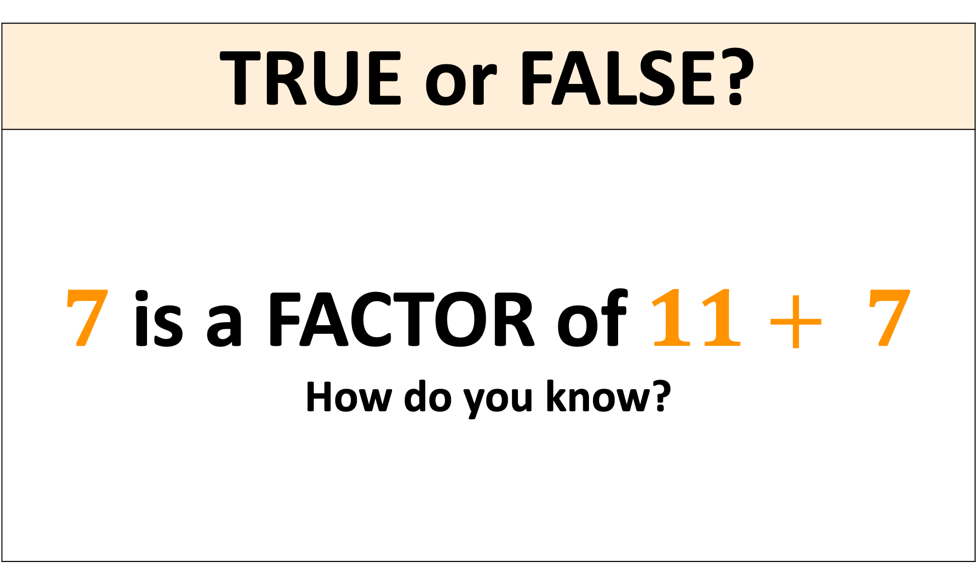
TRUE or FALSE?
$7$ is a FACTOR of$11+ 7$ How do you know?

Slide 4
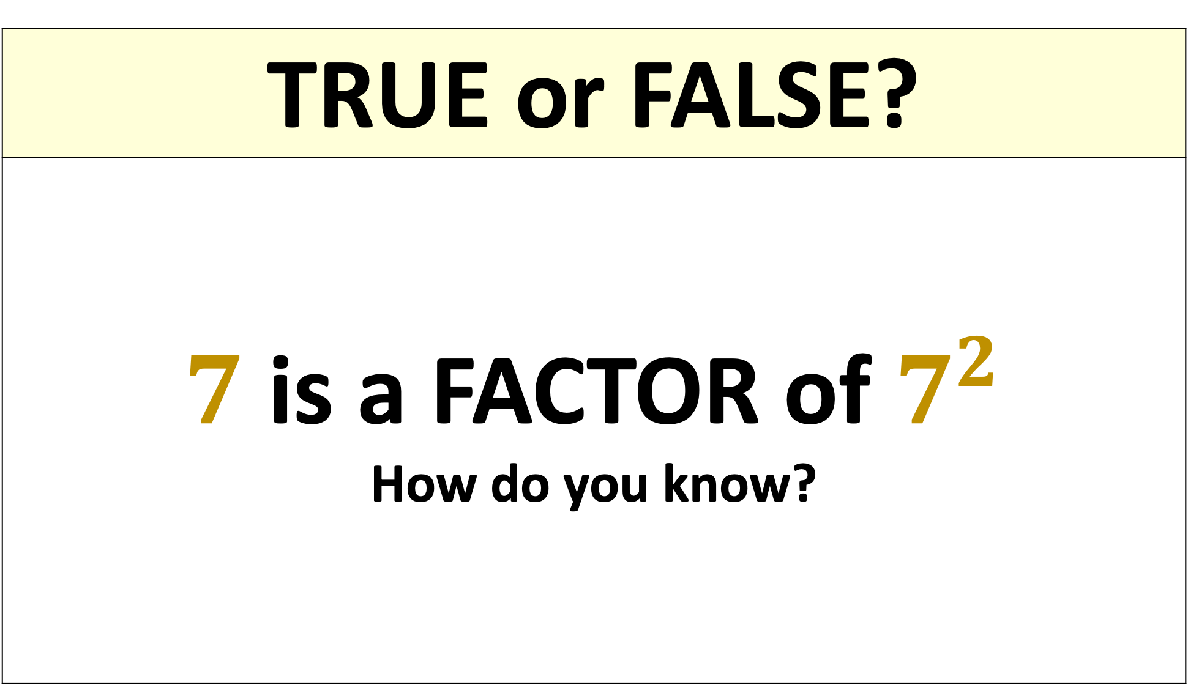
TRUE or FALSE?
$7$ is a FACTOR of $7^{2}$ How do you know?

Slide 5
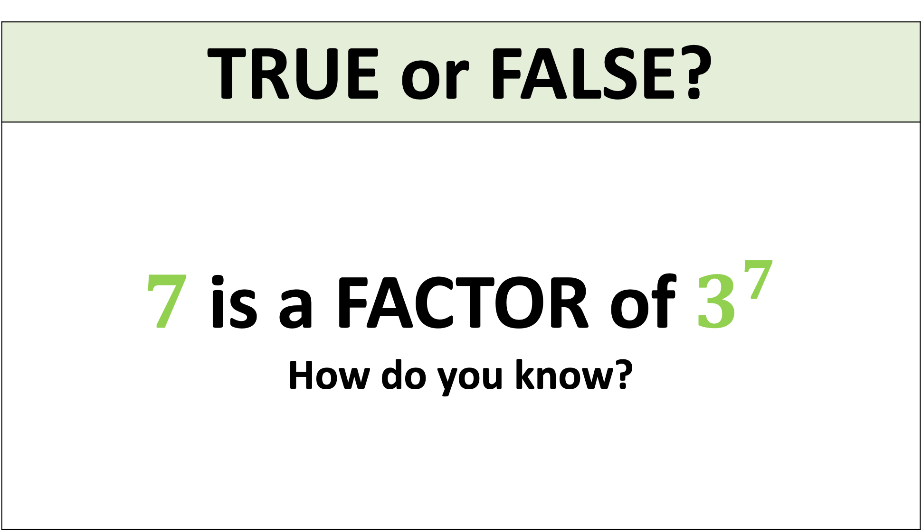
TRUE or FALSE?
$7$ is a FACTOR of$3^{7}$ How do you know?

Slide 6
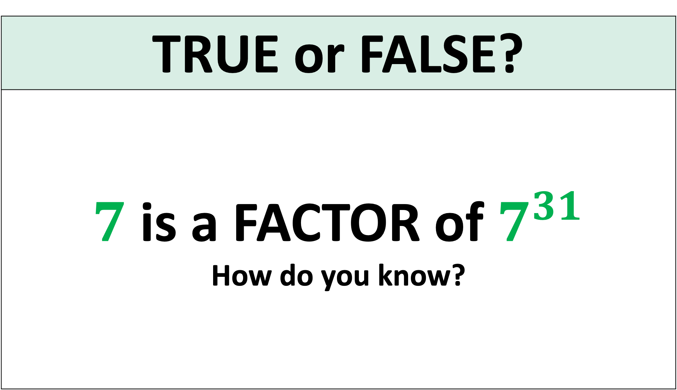
TRUE or FALSE?
$7$ is a FACTOR of $7^{31}$ How do you know?

Slide 7
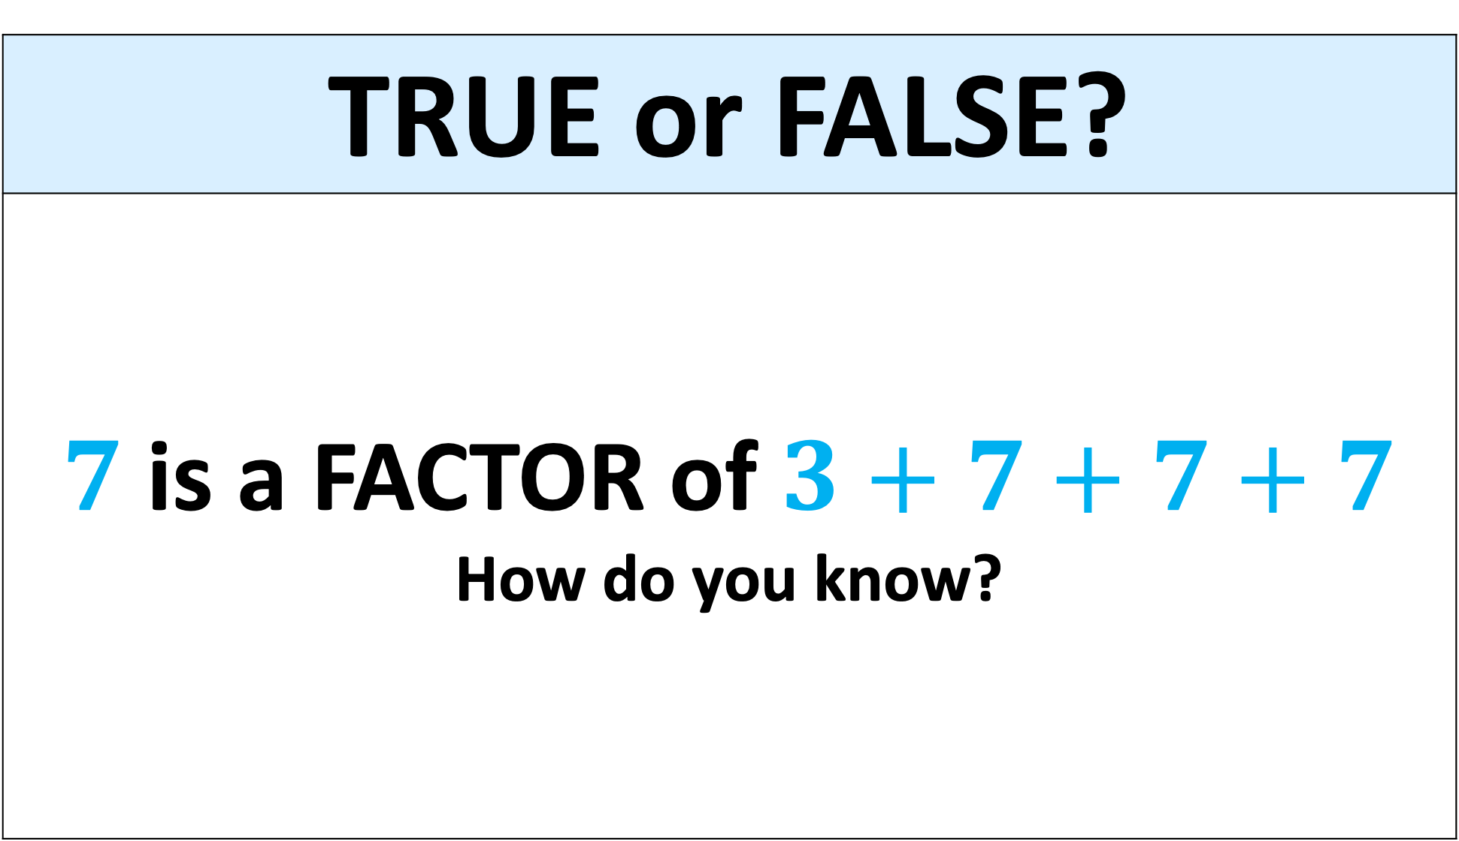
TRUE or FALSE?
$7$ is a FACTOR of$3+7+7+7$ How do you know?

Slide 8
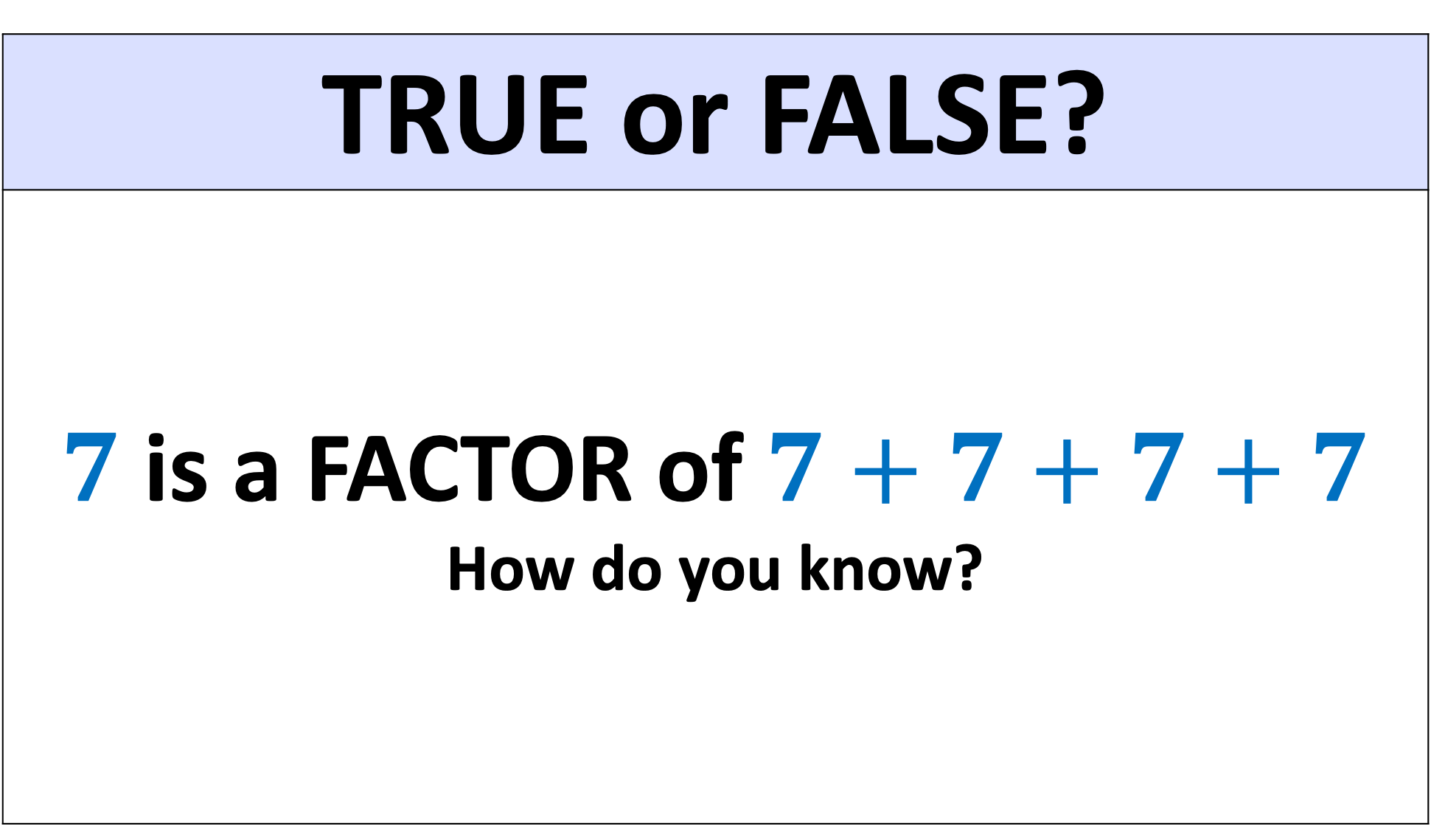
TRUE or FALSE?
$7$ is a FACTOR of$7+7+7+7$ How do you know?

Slide 9
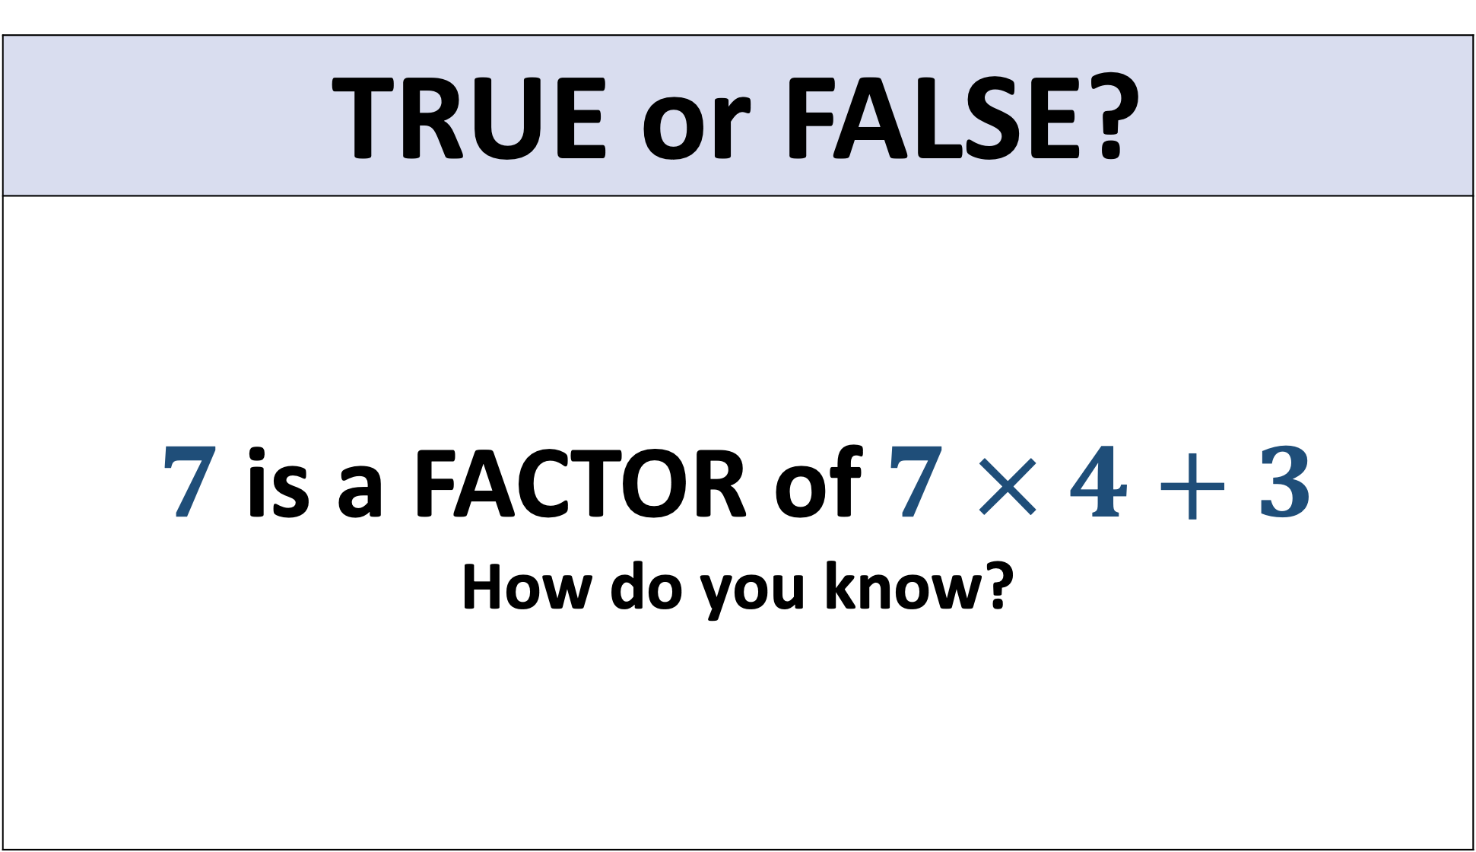
TRUE or FALSE?
$7$ is a FACTOR of$7 × 4+3$ How do you know?

Slide 10
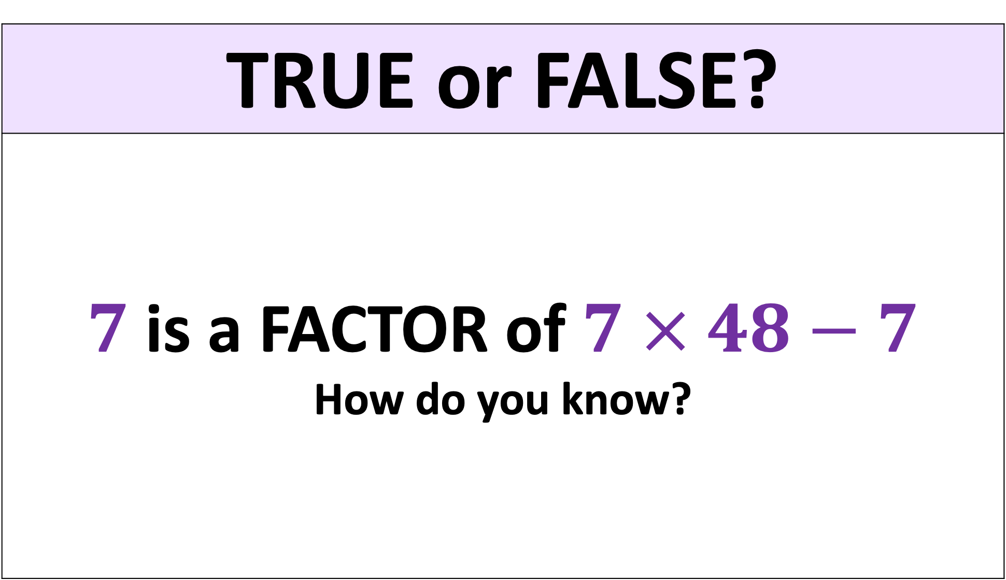
TRUE or FALSE?
$7$ is a FACTOR of$7 × 48−7$ How do you know?

Slide 11
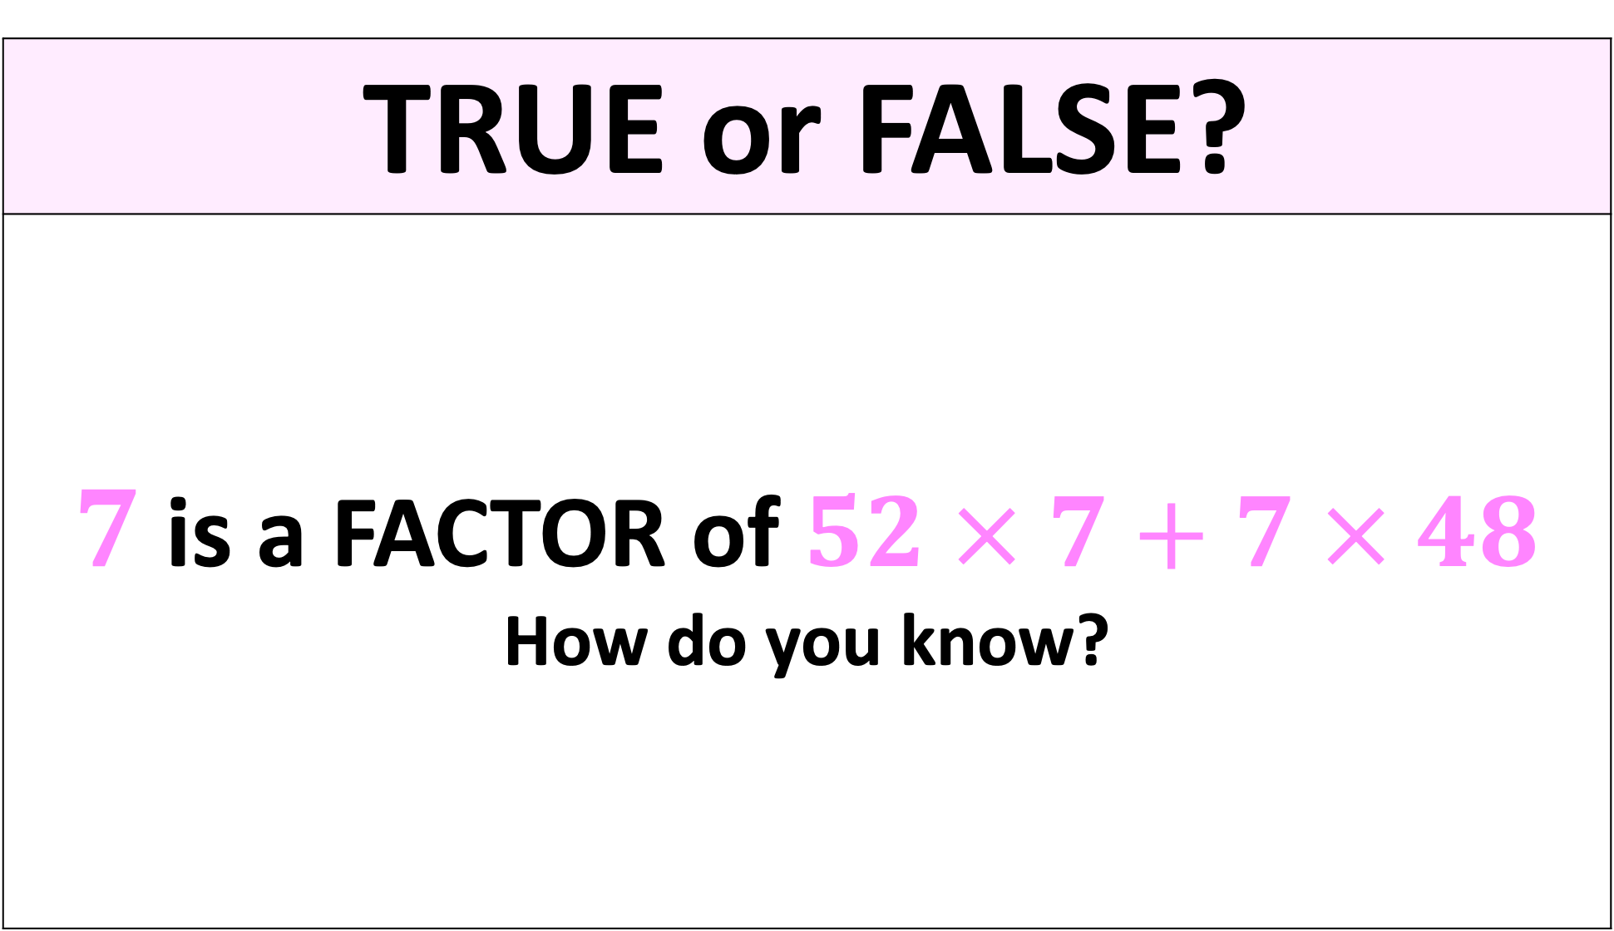
TRUE or FALSE?
$7$ is a FACTOR of$52 × 7+7 × 48$ How do you know?

Slide 12
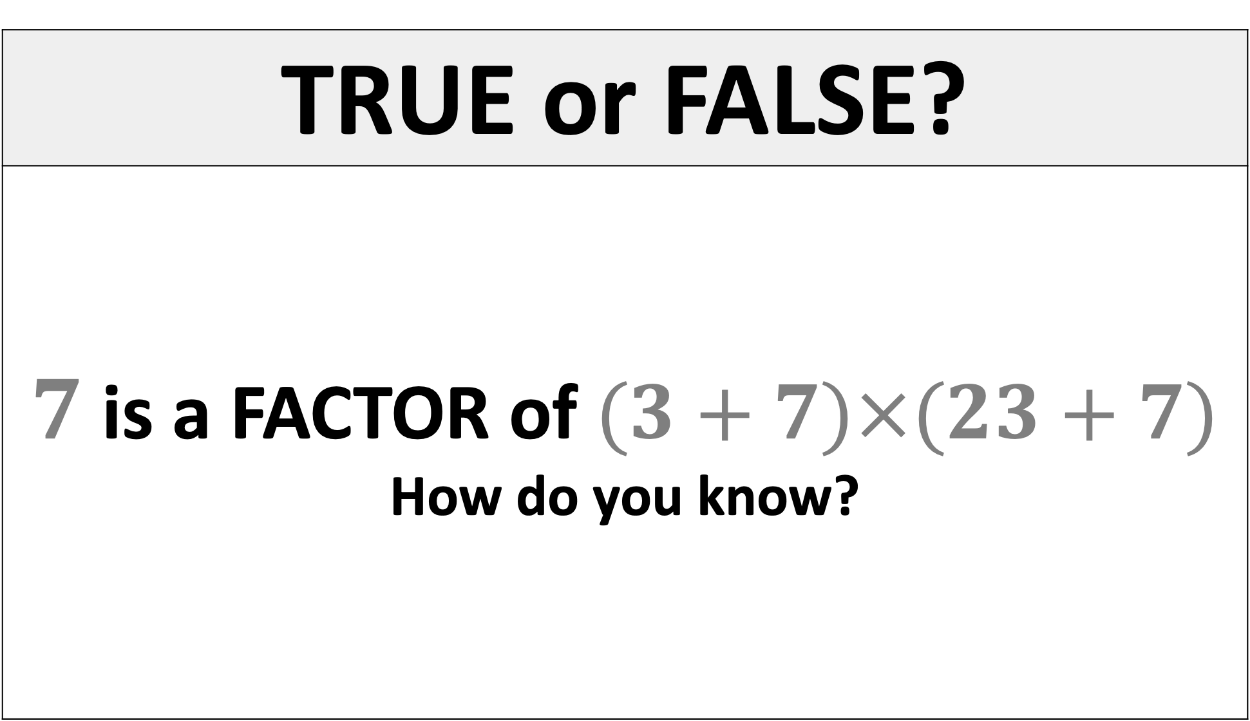
TRUE or FALSE?
$7$ is a FACTOR of$(3+7)×(23+7)$ How do you know?

Slide 13
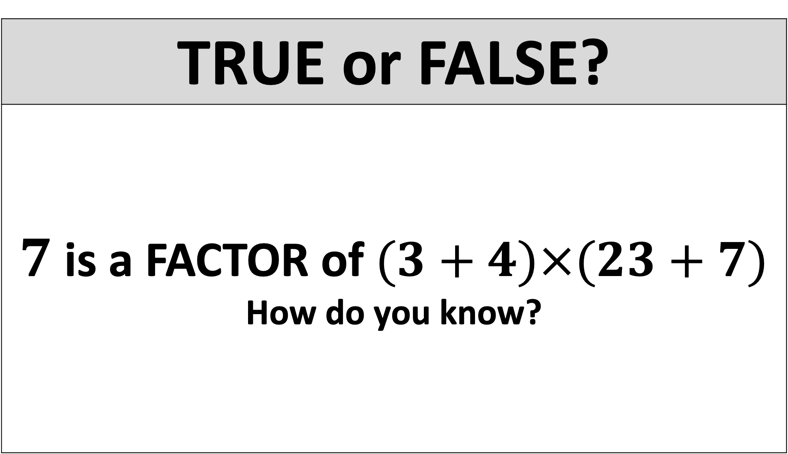
TRUE or FALSE?
$7$ is a FACTOR of$(3+4)×(23+7)$ How do you know?

Slide 14
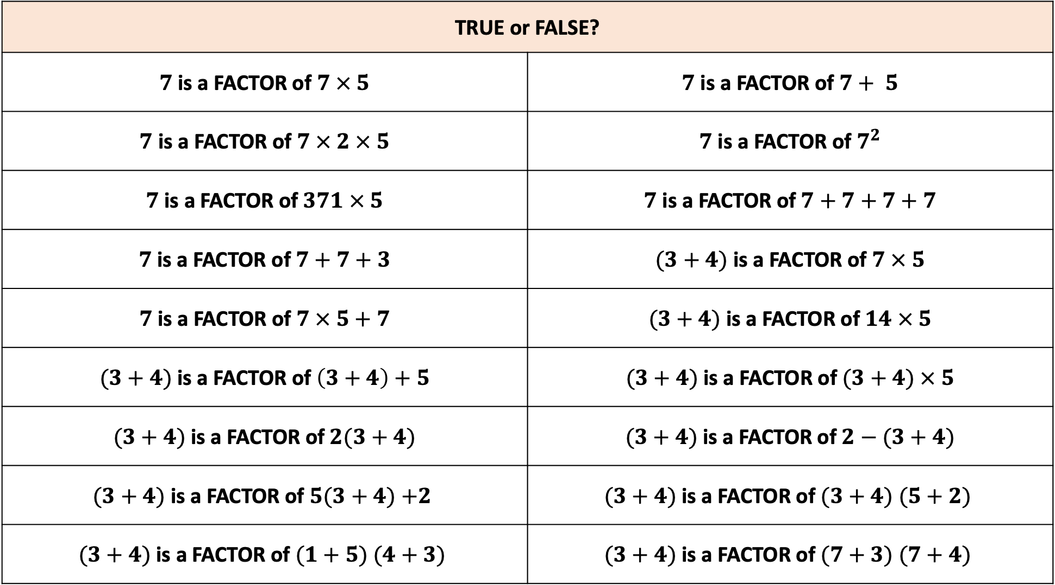
TRUE or FALSE?
$7$ is a FACTOR of $7 × 5$ | $7$ is a FACTOR of $7+ 5$
$7$ is a FACTOR of $7 × 2 × 5$ | $7$ is a FACTOR of $7^{2}$
$7$ is a FACTOR of$371 × 5$ | $7$ is a FACTOR of$7+7+7+7$
$7$is a FACTOR of$7+7+3$ | $(3+4)$ is a FACTOR of$7 × 5$
$7$is a FACTOR of $7 × 5+7$ | $(3+4)$ is a FACTOR of $14 × 5$
$(3+4)$ is a FACTOR of$\left(3+4\right)+5$ | $(3+4)$ is a FACTOR of$(3+4) × 5$
$(3+4)$ is a FACTOR of$2(3+4)$ | $(3+4)$ is a FACTOR of$2−(3+4)$
$(3+4)$ is a FACTOR of $5(3+4)$ $+2$ | $(3+4)$ is a FACTOR of $(3+4)$ $(5+2)$
$(3+4)$ is a FACTOR of $(1+5)$ $(4+3)$ | $(3+4)$ is a FACTOR of $(7+3)$ $(7+4)$

Slide 15
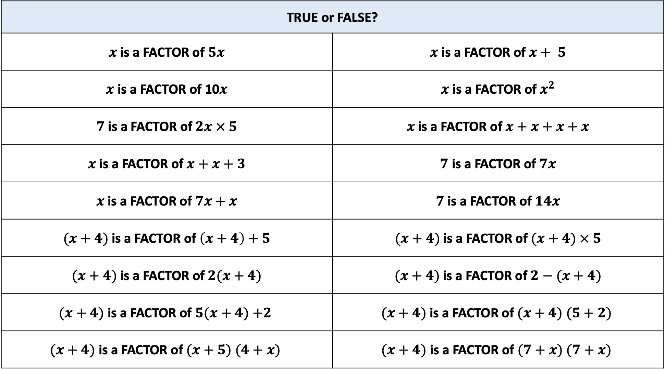
TRUE or FALSE?
$x$ is a FACTOR of $5x$ | $x$ is a FACTOR of $x+ 5$
$x$ is a FACTOR of 10$x$ | $x$ is a FACTOR of $x^{2}$
$7$ is a FACTOR of$2x × 5$ | $x$ is a FACTOR of$x+x+x+x$
$x$is a FACTOR of$x+x+3$ | $7$ is a FACTOR of$7x$
$x$is a FACTOR of $7x+x$ | $7$is a FACTOR of $14x$
$(x+4)$ is a FACTOR of$\left(x+4\right)+5$ | $(x+4)$ is a FACTOR of$(x+4) × 5$
$(x+4)$ is a FACTOR of$2(x+4)$ | $(x+4)$ is a FACTOR of$2−(x+4)$
$(x+4)$ is a FACTOR of $5(x+4)$ $+2$ | $(x+4)$ is a FACTOR of $(x+4)$ $(5+2)$
$(x+4)$ is a FACTOR of $(x+5)$ $(4+x)$ | $(x+4)$ is a FACTOR of $(7+x)$ $(7+x)$

