Slide 1


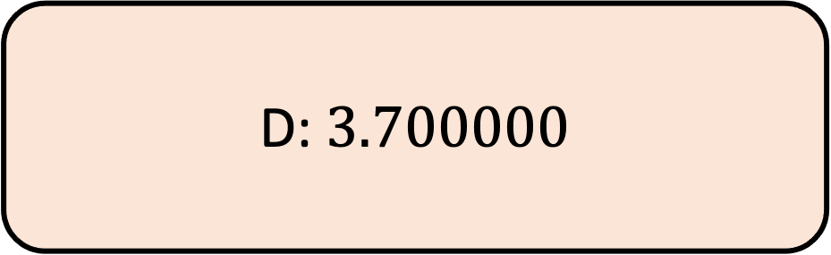
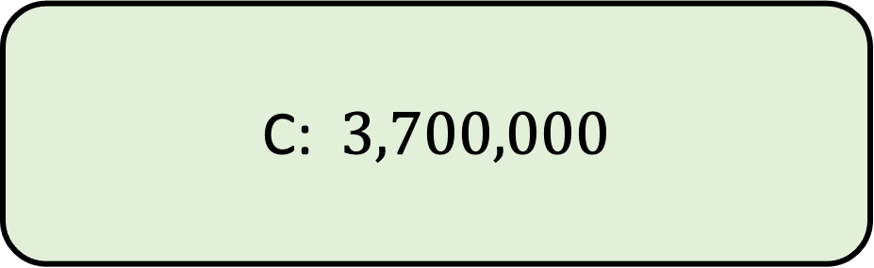

1.) Write$3.7 × {10}^{5}$ as an ordinary number
A:$37,000$
B: $370,000$
C:$3,700,000$
D: $3.700000$

Slide 2


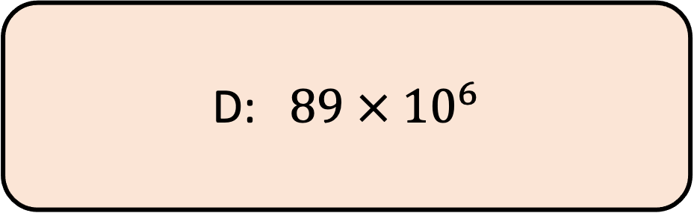
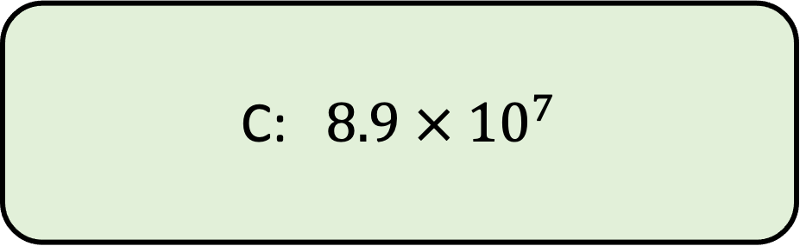
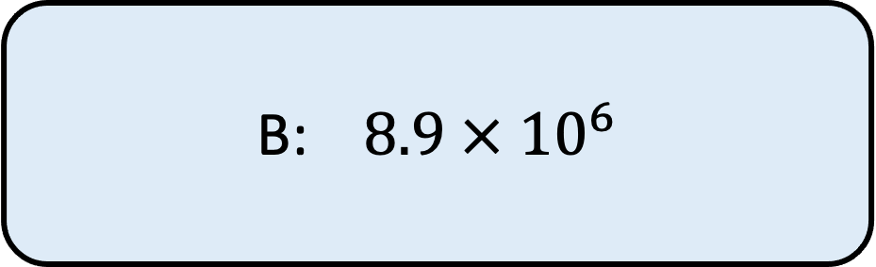
2.) Write $89,000,000$ in standard form
A:$8.9 × {10}^{5}$
B:$8.9 × {10}^{6}$
C:$8.9 × {10}^{7}$
D: $89 × {10}^{6}$

Slide 3


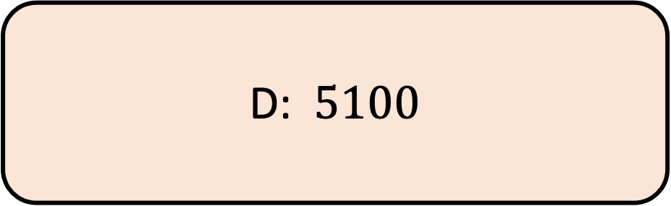
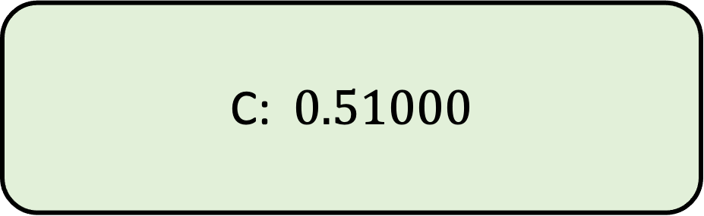

3.) Write$5.1 × {10}^{−3}$ as an ordinary number
A:$0.0051$
B:$0.00051$
C:$0.51000$
D: $5100$

Slide 4

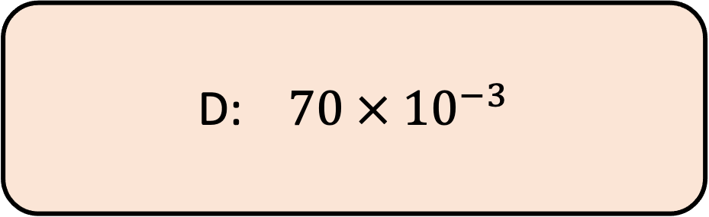
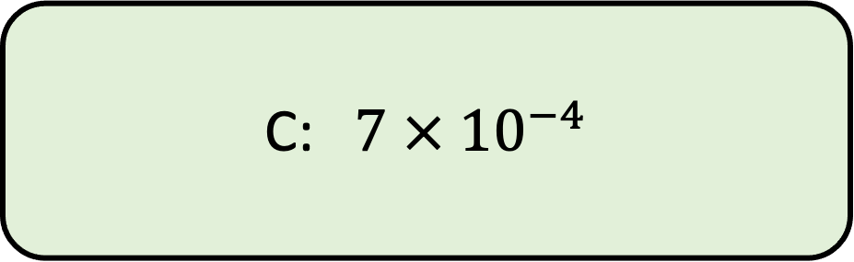
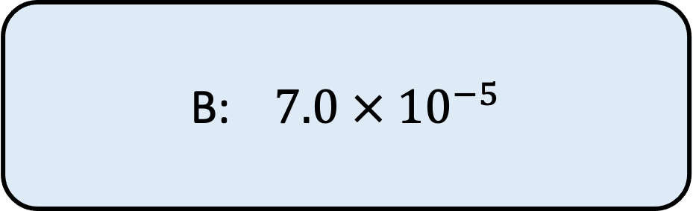

4.) Write $0.0007$ in standard form
A:$7 × {10}^{−3}$
B:$7.0 × {10}^{−5}$
C:$7 × {10}^{−4}$
D:$70 × {10}^{−3}$
Notes:
7/5 x 11/4 = 77/20

Slide 5

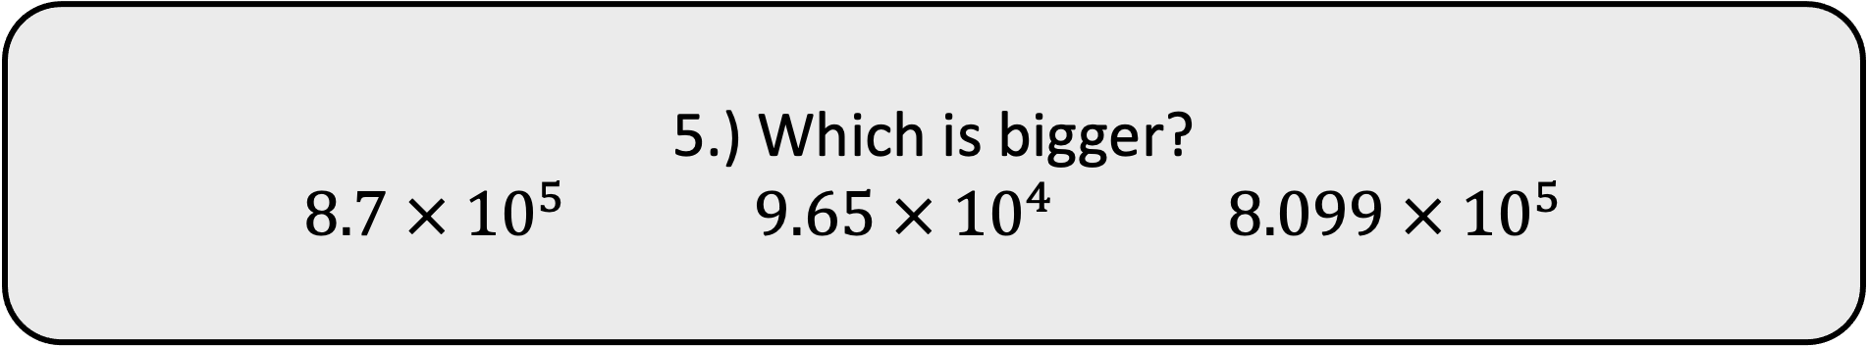
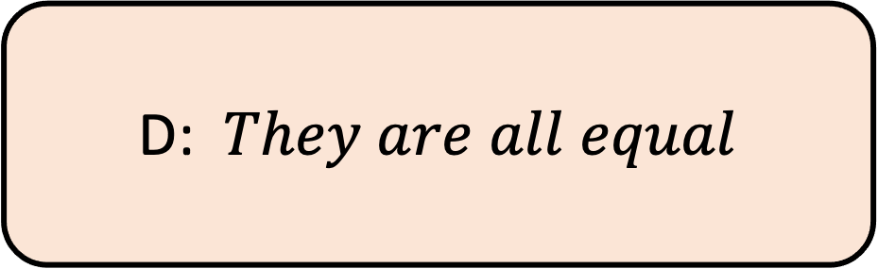
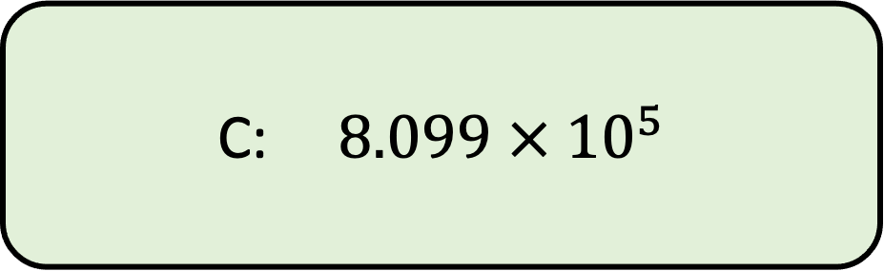
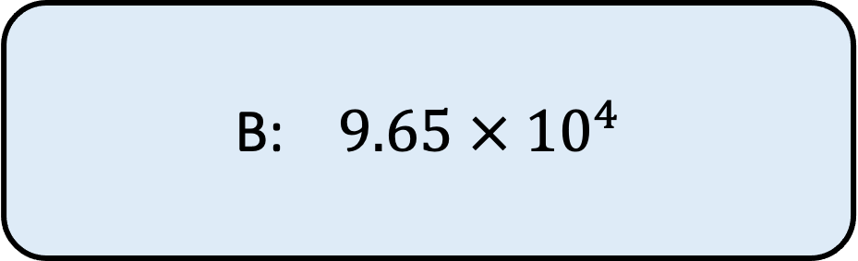
5.) Which is bigger?
$8.7 × {10}^{5}$ $9.65 × {10}^{4} 8.099 × {10}^{5}$
A:$8.7 × {10}^{5}$
B:$9.65 × {10}^{4}$
C:$8.099 × {10}^{5}$
D: $They are all equal$

Slide 6
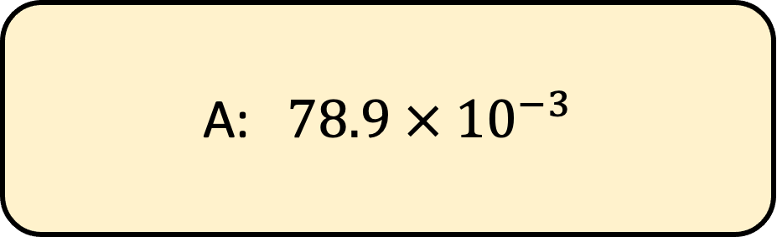

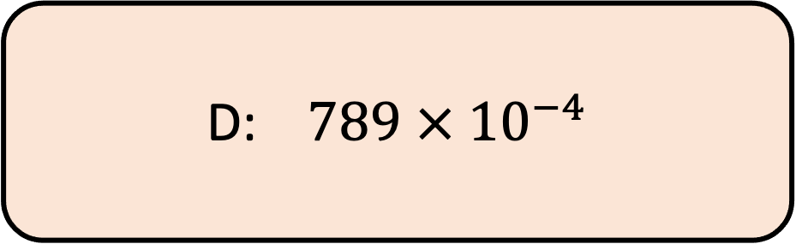
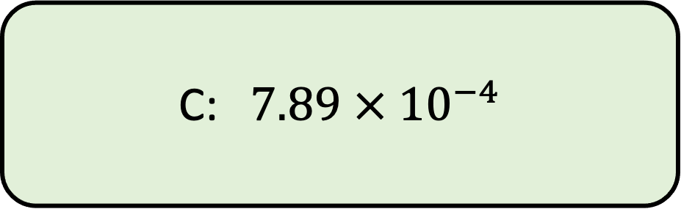
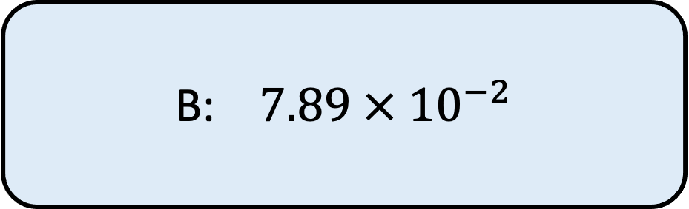
6.) Write$78.9 × {10}^{−3}$ in standard form
A:$78.9 × {10}^{−3}$
B:$7.89 × {10}^{−2}$
C:$7.89 × {10}^{−4}$
D:$789 × {10}^{−4}$

Slide 7


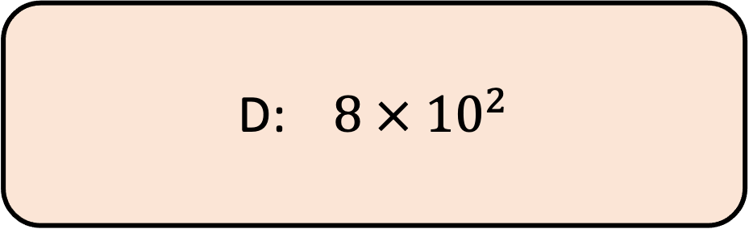
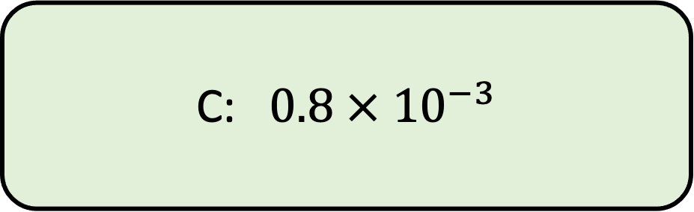
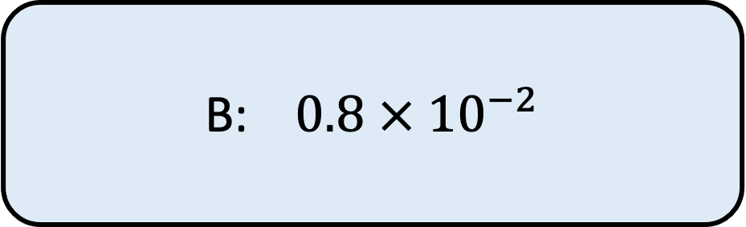
7.) Write$0.008 × {10}^{−1}$ in standard form
A:$8 × {10}^{−4}$
B:$0.8 × {10}^{−2}$
C:$0.8 × {10}^{−3}$
D:$8 × {10}^{2}$

Slide 8

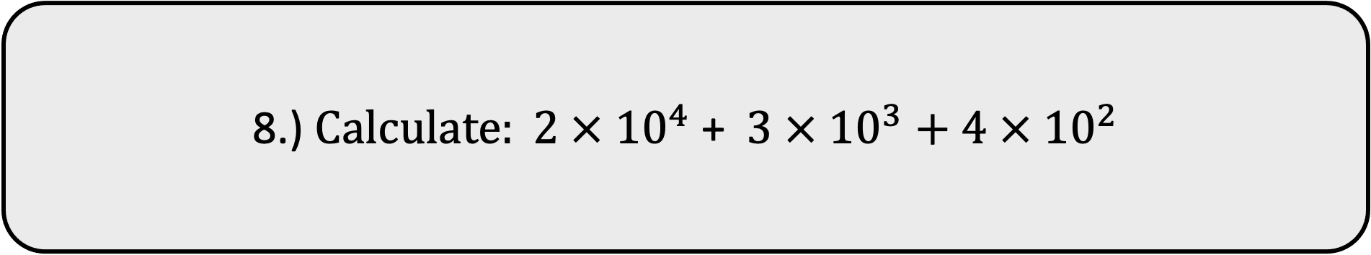
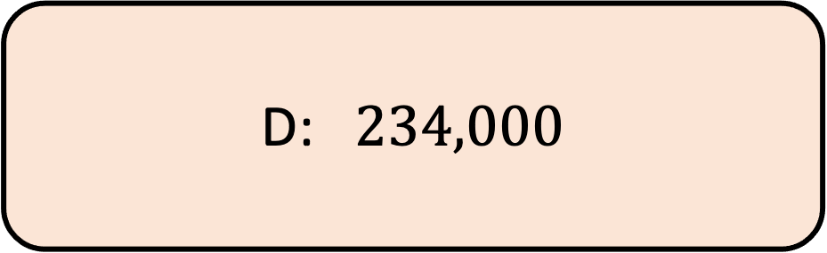
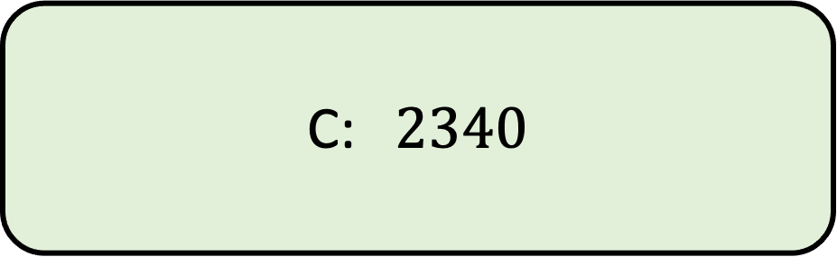

8.) $Calculate: 2 × {10}^{4}$ +$3 × {10}^{3}+4 × {10}^{2}$
A:$23,400$
B:$234$
C:$2340$
D: $234,000$

Slide 9

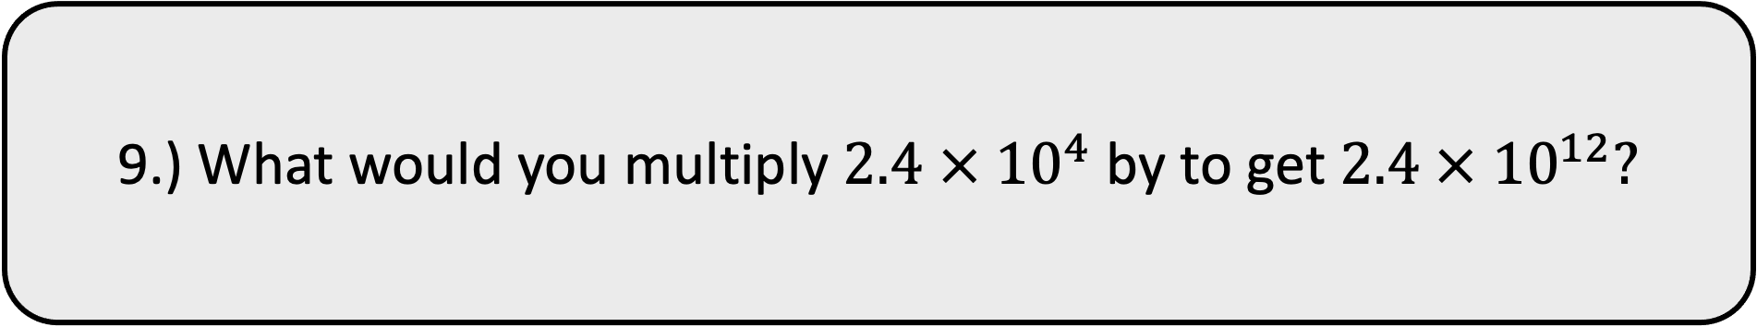
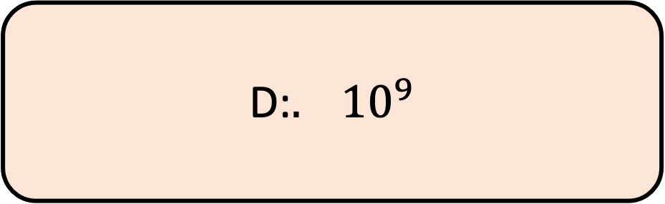
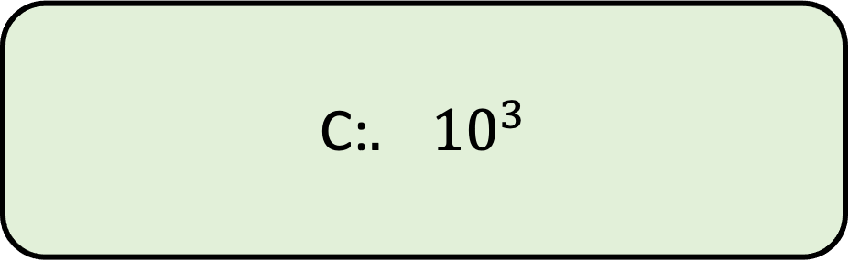

9.) What would you multiply $2.4 × {10}^{4}$ by to get $2.4 × {10}^{12}?$
A:${. 10}^{4}$
B:${. 10}^{5}$
C:${. 10}^{3}$
D:${. 10}^{9}$

Slide 10

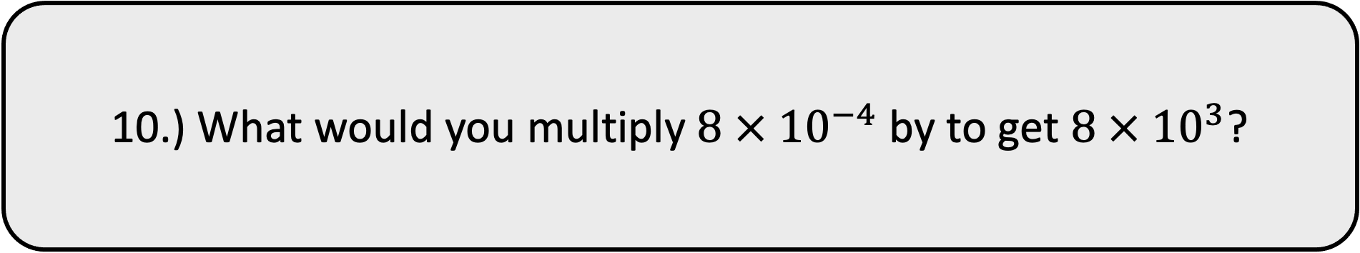
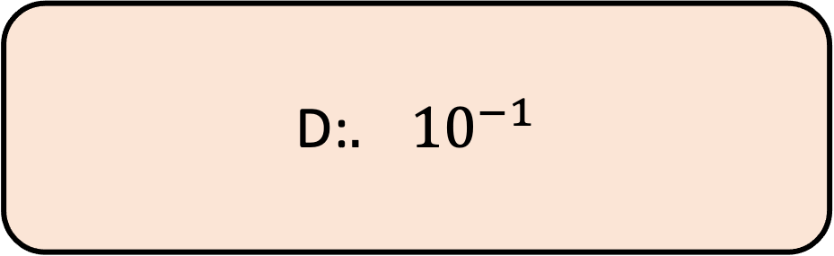
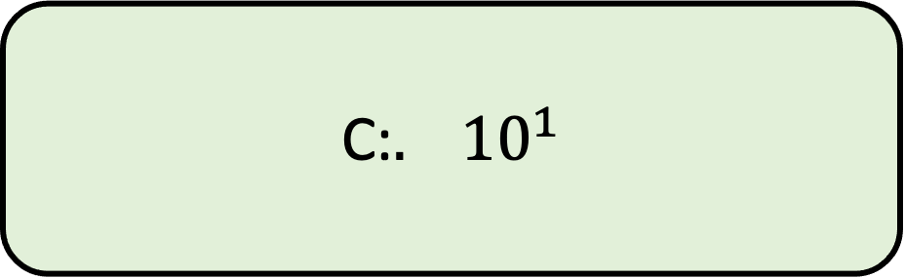

10.) What would you multiply $8 × {10}^{−4}$ by to get $8 × {10}^{3}$?
A:${. 10}^{−7}$
B:${. 10}^{7}$
C:${. 10}^{1}$
D:${. 10}^{−1}$

