Slide 1




















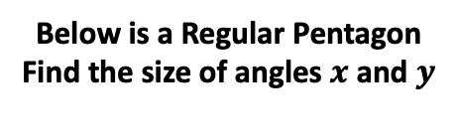


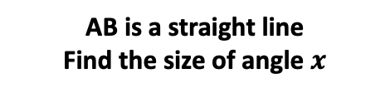















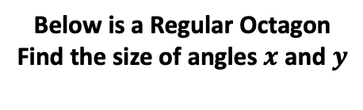


Find the size of angles $x$ and $y$
Find the size of angles $x$ and $y$
The 2 triangles below are Isosceles. If each triangle has an 80º angle. Label the triangles so each triangle is unique
AB is a straight line
Find the size of angle $x$
$$y$$
$$x$$
$$A$$
$$B$$
$$x$$
134º
78º
$$y$$
78º
$$x$$
Shape ABCD is a square
Shape ABCD is a rhombus
Below is a Regular Pentagon
Find the size of angles $x$ and $y$
Below is a Regular Octagon
Find the size of angles $x$ and $y$
$$D$$
$$C$$
$$D$$
$$C$$
$$x$$
$$y$$
$$x$$
$$x$$
41º
$$x$$
$$y$$
$$A$$
$$B$$
$$A$$
$$B$$
O is the centre and OA, OB, OC and and OD are radii in the circle below
$$A$$
$$B$$
$$A$$
$$B$$
36º
$$A$$
$$B$$
36º
41º
$$x$$
107º
88º
$$O$$
$$B$$
$$O$$
$$O$$
$x$
$$O$$
$$C$$
$x$
102º
152º
$$C$$
$$C$$
$$A$$
$$D$$
BC is the diameter

