Slide 1
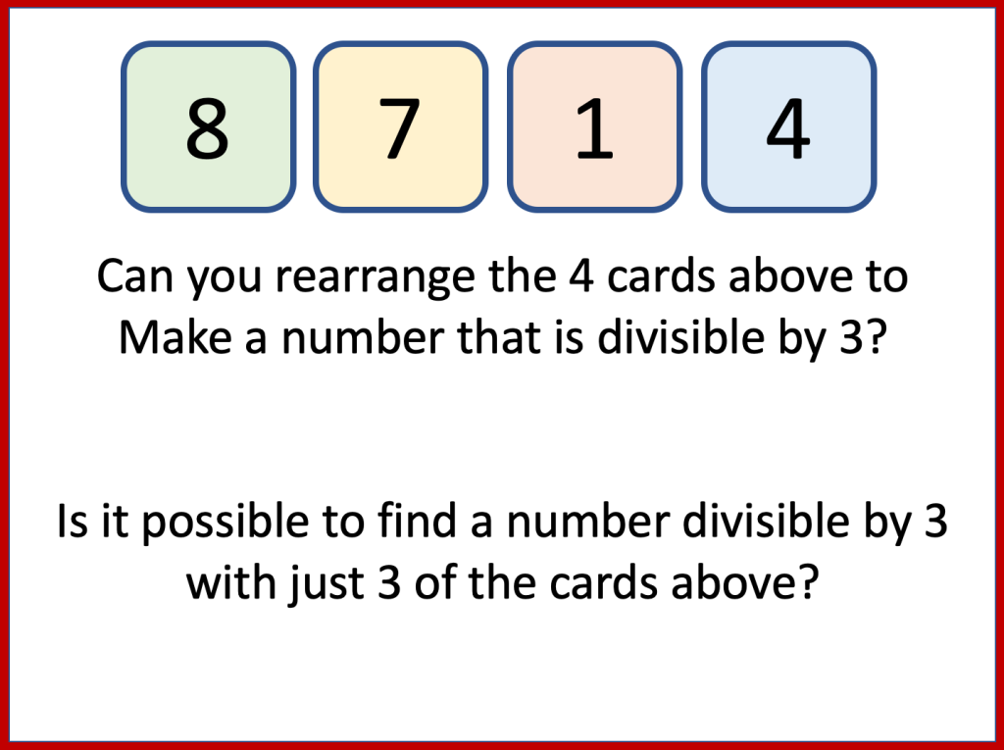

Slide 2
3 digits are written onto cards
The cards are arranged to create a 3 digit number: 752
How many numbers between
25310 and 25319
are divisible by 6?
7
5
2
How many numbers between
25320 and 25329
are divisible by 6?
Can you rearrange the 3 cards above to a number that is divisible by 3?
Each of the three 3-digit numbers in the calculation below are divisible by 3
4 digits are written onto cards
The cards are arranged to create a 4 digit number: 3178
3
1
?
+
6
4
?
3
1
7
8
9
5
?
The last digit in each number is hidden.
Explain why the last digit cannot be an 8 in any of the 3 numbers
How many ways can you arrange the 4 cards so they make a 4 digit number that is divisible by 6?

Slide 3
