Slide 1
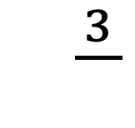
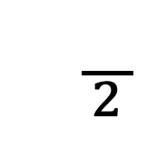
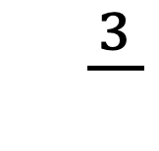
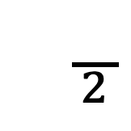
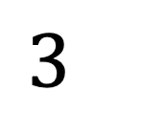
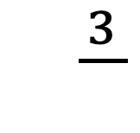
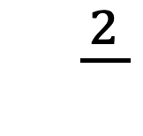
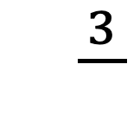
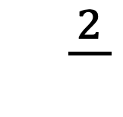
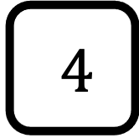
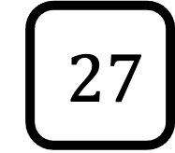
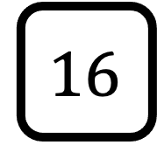
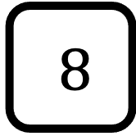
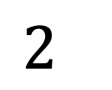
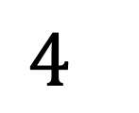
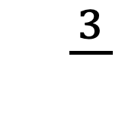
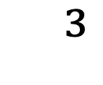
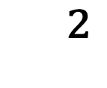
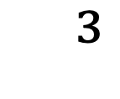
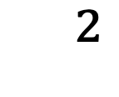
$${}^{2}$$
$${}^{\frac{3}{}}$$
$${}^{3}$$
$$2^{}$$
$$16$$
$$8$$
$${}^{\frac{}{2}}$$
$${}^{\frac{2}{}}$$
$${}^{\frac{3}{}}$$
$${}^{\frac{3}{}}$$
$$3^{}$$
$${}^{3}$$
$$4^{}$$
$${}^{2}$$
$$27$$
$$4$$
$${}^{\frac{3}{}}$$
$${}^{\frac{3}{}}$$
$${}^{\frac{}{2}}$$
$${}^{\frac{2}{}}$$

Slide 2
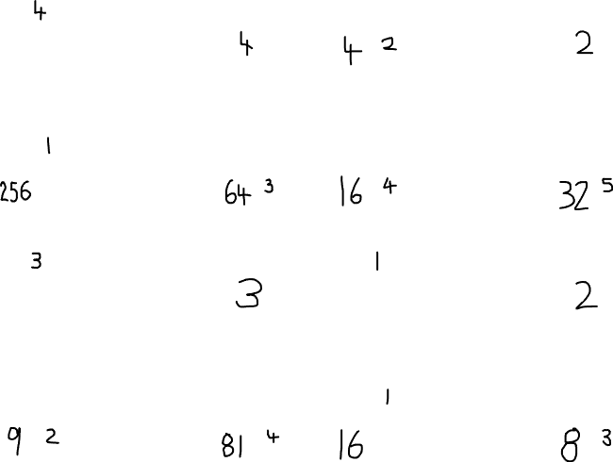
$${}^{2}$$
$${}^{\frac{3}{}}$$
$${}^{3}$$
$$2^{}$$
$$16$$
$$8$$
$${}^{\frac{}{2}}$$
$${}^{\frac{2}{}}$$
$${}^{\frac{3}{}}$$
$${}^{\frac{3}{}}$$
$$3^{}$$
$${}^{3}$$
$$4^{}$$
$${}^{2}$$
$$27$$
$$4$$
$${}^{\frac{3}{}}$$
$${}^{\frac{3}{}}$$
$${}^{\frac{}{2}}$$
$${}^{\frac{2}{}}$$

Slide 3
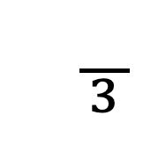
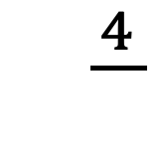

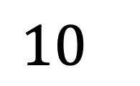
$${}^{2}$$
$${}^{\frac{3}{}}$$
$${}^{3}$$
$$2^{}$$
$$16$$
$$8$$
$${}^{\frac{}{2}}$$
$${}^{\frac{2}{}}$$
$${}^{\frac{3}{}}$$
$${}^{\frac{3}{}}$$
$$3^{}$$
$${}^{3}$$
$${10}^{}$$
$${}^{2}$$
$$27$$
$$10,000$$
$${}^{\frac{3}{}}$$
$${}^{\frac{3}{}}$$
$${}^{\frac{}{3}}$$
$${}^{\frac{4}{}}$$

Slide 4
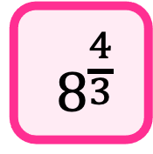
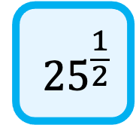
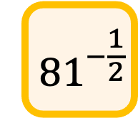
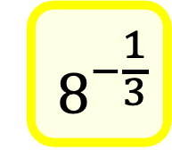
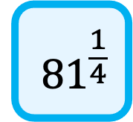
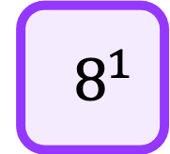
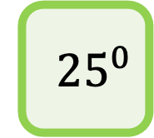
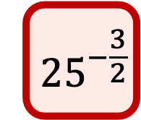
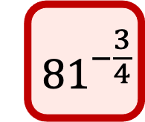
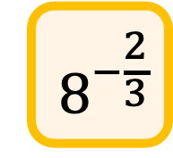
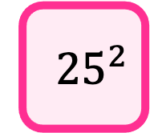
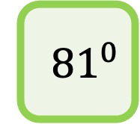
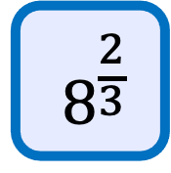
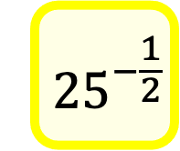
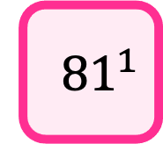
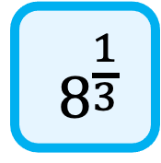
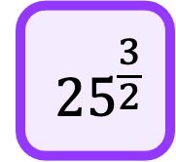
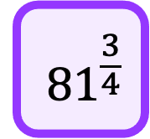
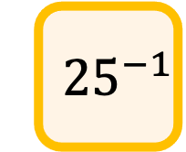
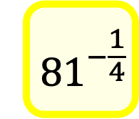
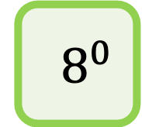
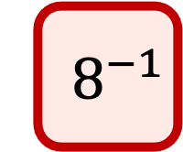
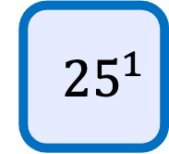
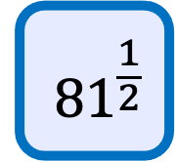
$${ 8}^{−1}$$
$${ 8}^{−\frac{2}{3}}$$
$${ 8}^{−\frac{1}{3}}$$
$${ 8}^{0}$$
$${ 8}^{\frac{1}{3}}$$
$${ 8}^{\frac{2}{3}}$$
$${ 8}^{1}$$
$${ 8}^{\frac{4}{3}}$$
$${ 25}^{−\frac{3}{2}}$$
$${ 25}^{−1}$$
$${ 25}^{−\frac{1}{2}}$$
$${ 25}^{0}$$
$${ 25}^{\frac{1}{2}}$$
$${ 25}^{1}$$
$${ 25}^{\frac{3}{2}}$$
$${ 25}^{2}$$
$${ 81}^{−\frac{3}{4}}$$
$${ 81}^{−\frac{1}{2}}$$
$${ 81}^{−\frac{1}{4}}$$
$${ 81}^{0}$$
$${ 81}^{\frac{1}{4}}$$
$${ 81}^{\frac{1}{2}}$$
$${ 81}^{\frac{3}{4}}$$
$${ 81}^{1}$$

