Slide 1
Flags
Number of colours on the flag | Frequency
2 | 2
3 | 2
4 | 5
5 | 1
6 | 2
Country | Number of colours
Andorra
Brazil
Croatia
Djibouti
Egypt
Finland
Guyana
Hungary
Indonesia
Jordan
Kenya
Lithuania
The table shows the number of colours that appear on 12 different countries national flag (white is counted as a colour)
Croatia has 4 more colours on their flag than Indonesia.
Andorra has a flag with the largest amount of colours.
Finland has 3 fewer colours on their flag than Guyana.
The total number of colours on Lithuania's and Hungary's flags is 6.

Slide 2
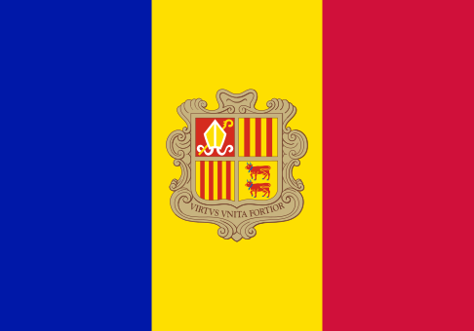
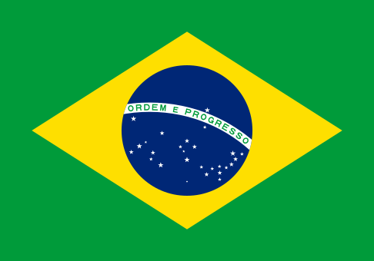
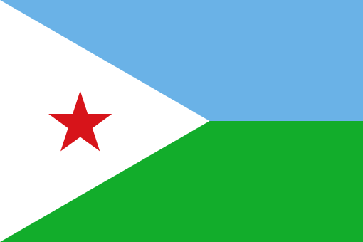
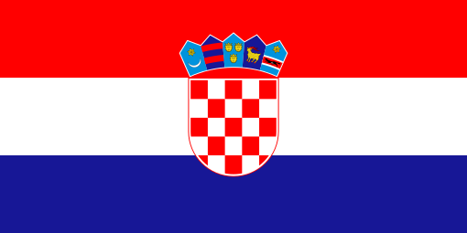


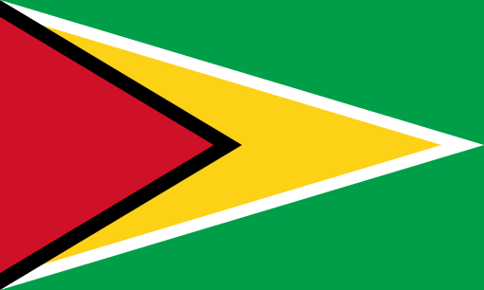

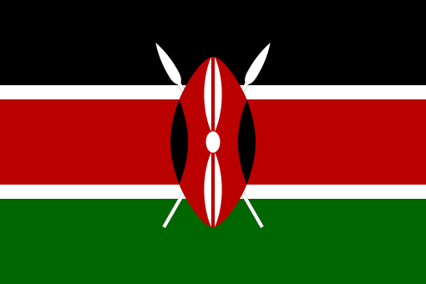



Andorra has 6
Brazil has 4
Croatia has 6
Djibouti has 4
Egypt has 4
Finland has 2
Guyana has 5
Hungary has 3
Indonesia has 2
Jordan has 4
Kenya has 4
Lithuania has 3

