Slide 1
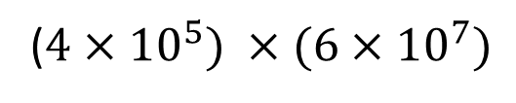

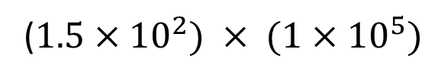


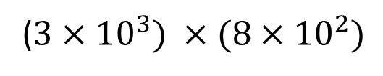









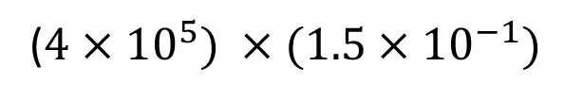


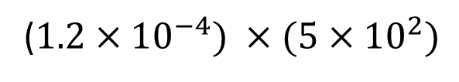


Find the missing index number in each of the following questions so the calculations are correct
$$9.7×{10}^{3}$$
$$× {10}^{} =$$
$$9.7×{10}^{8}$$
$$4.9×{10}^{−4}$$
$$× {10}^{} =$$
$$4.9×10$$
$$5×{10}^{7}$$
$$× {10}^{} =$$
$$5×{10}^{−2}$$
$$1.5×{10}^{9}$$
$$× {10}^{} =$$
($1.5×{10}^{2}) × (1×{10}^{5})$
($3×{10}^{3}) ×(8×{10}^{2})$
$$× {10}^{} =$$
($4×{10}^{5}) ×(6×{10}^{7})$
($1.2×{10}^{−4}) ×(5×{10}^{2})$
$$× {10}^{} =$$
($4×{10}^{5}) ×(1.5×{10}^{−1})$
$$({4×{10}^{−1})}^{2}$$
$$× {10}^{} =$$
$$({2×{10}^{3})}^{4}$$

Slide 2
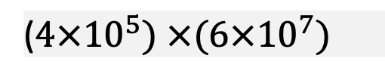

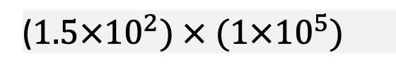

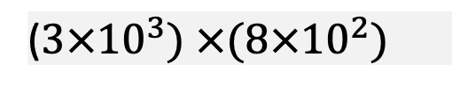




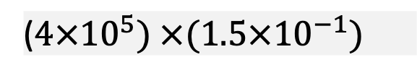

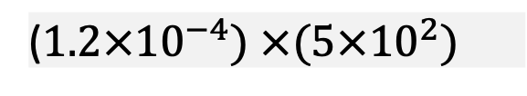


Find the missing index number in each of the following questions so the calculations are correct
$$9.7×{10}^{3}$$
$$× {10}^{} =$$
$$9.7×{10}^{8}$$
$$4.9×{10}^{−4}$$
$$× {10}^{} =$$
$$4.9×10$$
$$5×{10}^{7}$$
$$× {10}^{} =$$
$$5×{10}^{−2}$$
$$1.5×{10}^{9}$$
$$× {10}^{} =$$
($1.5×{10}^{2}) × (1×{10}^{5})$
($3×{10}^{3}) ×(8×{10}^{2})$
$$× {10}^{} =$$
($4×{10}^{5}) ×(6×{10}^{7})$
($1.2×{10}^{−4}) ×(5×{10}^{2})$
$$× {10}^{} =$$
($4×{10}^{5}) ×(1.5×{10}^{−1})$
$$({4×{10}^{−1})}^{2}$$
$$× {10}^{} =$$
$$({2×{10}^{3})}^{4}$$

Slide 3
