Slide 1
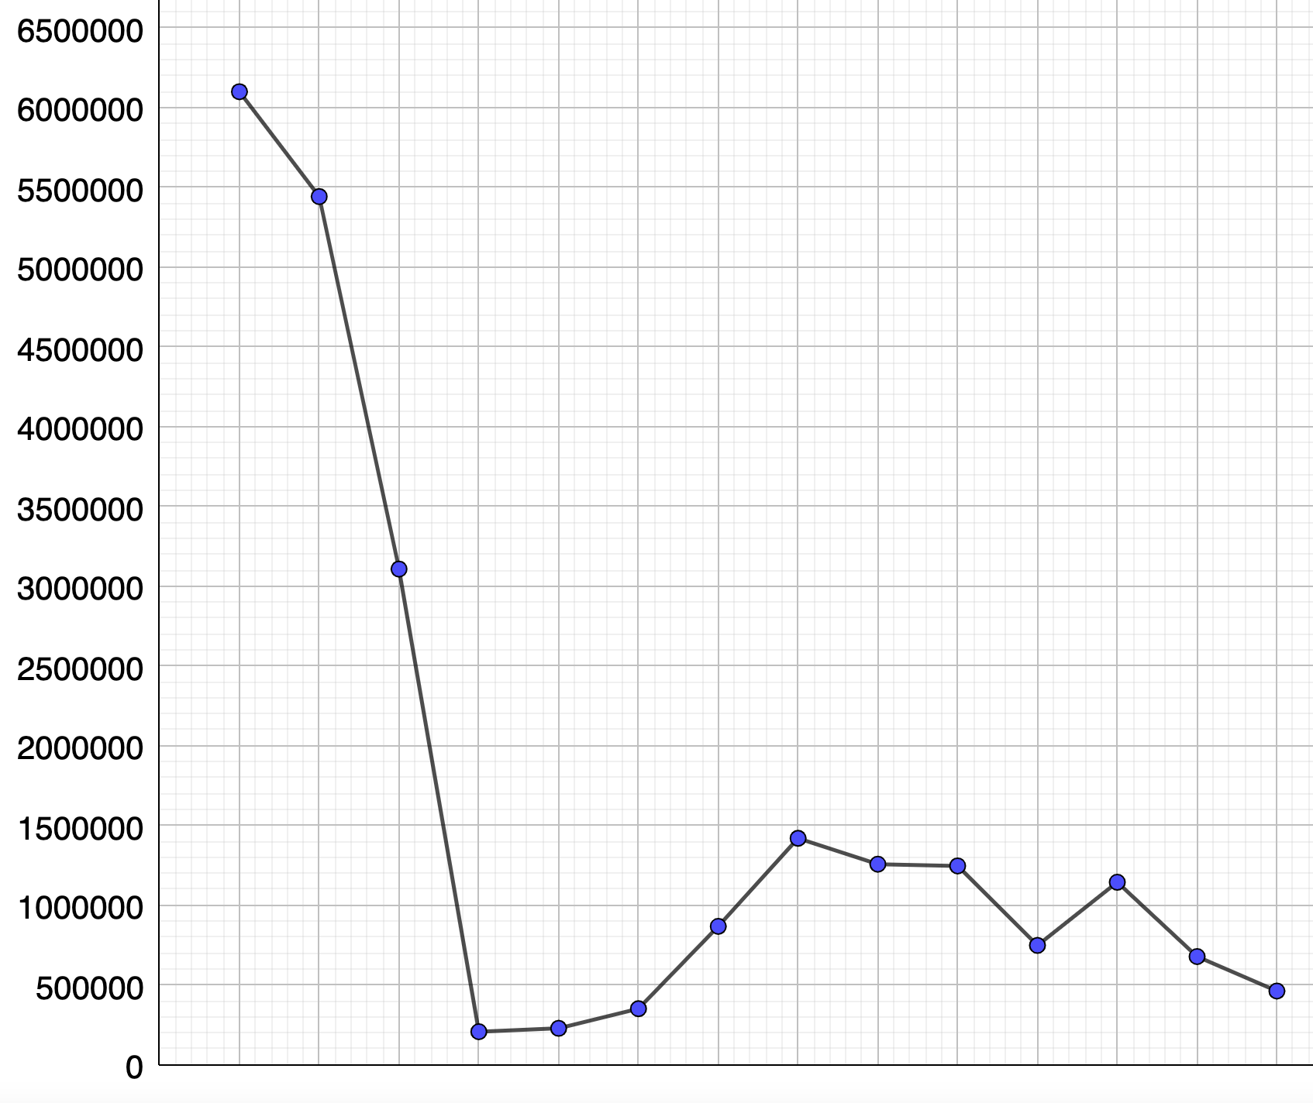
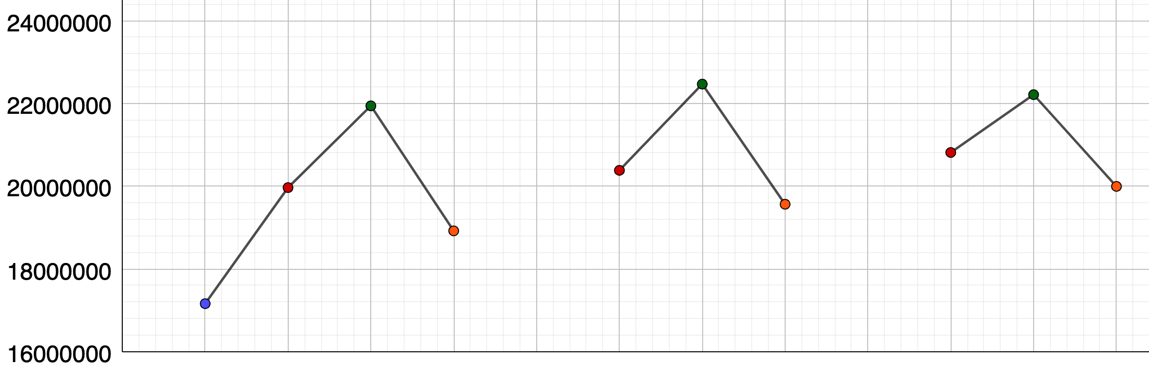
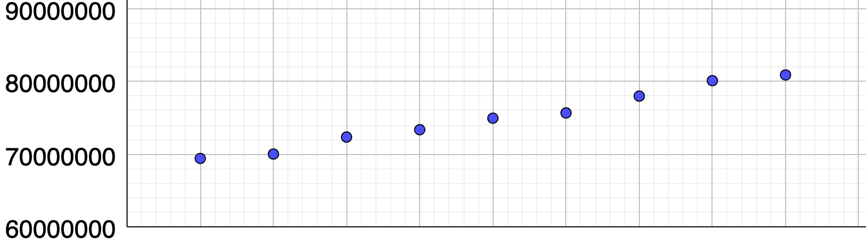
17,689,278 passengers flew during the first quarter in 2018. Plot this point
17,954,489 passengers flew during the first quarter in 2019. Plot this point
Thousands of flights were cancelled due to possible strikes by Heathrow workers. Which quarter/year do you think this was?
Make comments on the peaks and troughs in this time series graph
Ali says, “most passengers fly in January.” Why is this graph unreliable?
Number of passengers flying out of Heathrow during January 2020 and February 2021
Number of passengers flying out of Heathrow during each quarter from 2017 - 2019
Number of passengers
Number of passengers
1 2 3 4
1 2 3 4
1 2 3 4
2017
2018
2019
Number of passengers
2011
2012
2013
2014
2015
2016
2017
2018
2019
2020
January 2020
March 2020
July 2020
April 2020
May 2020
February 2020
June 2020
August 2020
October 2020
January 2021
December 2020
February 2021
Comment on any factors that may affect the number of passengers at Heathrow over a 10-year period. 22.1 million passengers flew in 2020. Predict the numbers who would have flown if there wasn’t a pandemic
September 2020
November 2020

