Slide 1
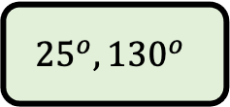
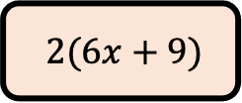
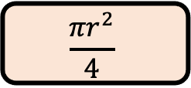
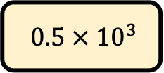
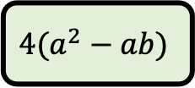
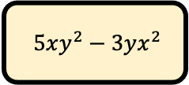
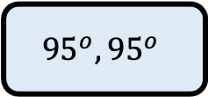
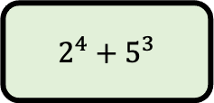
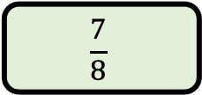
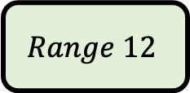
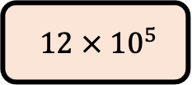
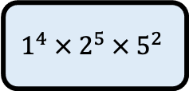
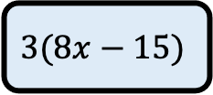
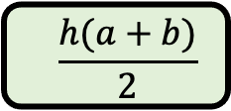
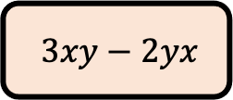
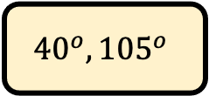
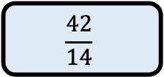
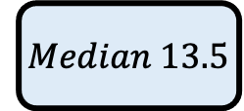
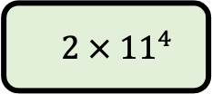
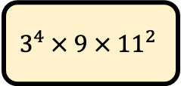
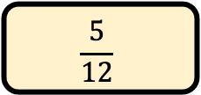
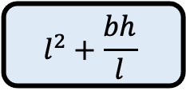
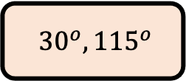
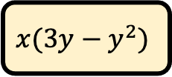
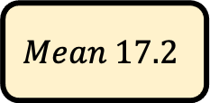
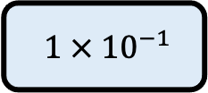
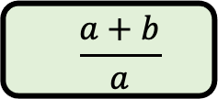
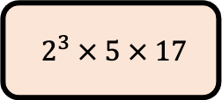
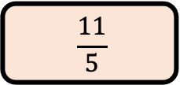
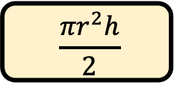
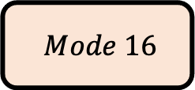
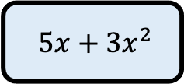
Which of the following….?
1.) Which of the following is written in standard form?
5.) Which of the following is factorised completely?
$$12 × {10}^{5}$$
$$0.5 × {10}^{3}$$
$$1 × {10}^{−1}$$
$$2 × {11}^{4}$$
$$2(6x+9)$$
$$x(3y−y^{2})$$
$$3(8x−15)$$
$$4(a^{2}−ab)$$
2.) Which of the following can be simplified?
6.) Which of the following is equivalent to a recurring decimal?
$$3xy−2yx$$
$$5xy^{2}−3yx^{2}$$
$$5x+3x^{2}$$
$$\frac{a+b}{a}$$
$$\frac{11}{5}$$
$$\frac{5}{12}$$
$$\frac{42}{14}$$
$$\frac{7}{8}$$
3.) Which pair of angles could be from an isosceles triangle?
7.) Which formula wouldn’t calculate the area of a shape?
(b,h,l are lengths)
$${30}^{o}, {115}^{o}$$
$${40}^{o}, {105}^{o}$$
$${95}^{o}, {95}^{o}$$
$${25}^{o}, {130}^{o}$$
$$\frac{{πr}^{2}}{4}$$
$$\frac{{πr}^{2}h}{2}$$
$$l^{2}+\frac{bh}{l}$$
$$\frac{h(a+b)}{2}$$
4.) Which could be a number written as a product of prime factors?
8.) A youth club for children ages 5 to 17 has 30 children in attendance. Which of the following can’t be true?
$$2^{3} × 5 × 17$$
$$3^{4} × 9 × {11}^{2}$$
$$1^{4} × 2^{5} ×{ 5}^{2}$$
$2^{4}+$ $5^{3}$
$$Mode 16$$
$$Mean 17.2$$
$$Median 13.5$$
$$Range 12$$

