Slide 1


Unlock
The
Box

Slide 2
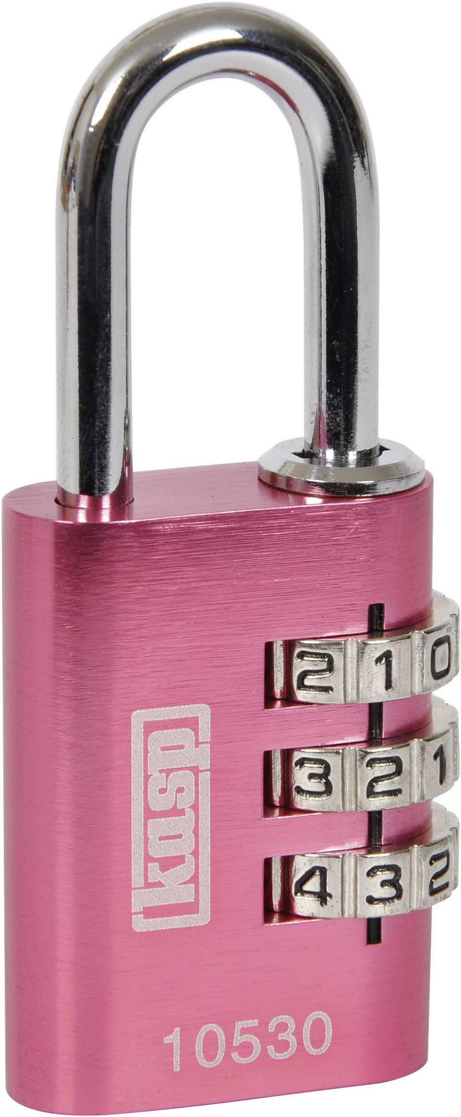
Unlock the PINK PADLOCK
You need to find the 3-digit code
What clues can you share with your group to narrow the options?
Can you make statements about what sort of number you are looking for?
Padlock 1
???
Notes:
423651

Slide 3
Unlock the PINK PADLOCK
THE PIN CODE IS A... 3 digit number
The FIRST and SECOND digit make a 2-digit PRIME
The THIRD digit is a CUBE number
The SUM of the 3 digits is 21
HOW MANY DIFFERENT PIN CODES ARE THERE?
How do you know?
CUBE
PRIME
Notes:
678

Slide 4
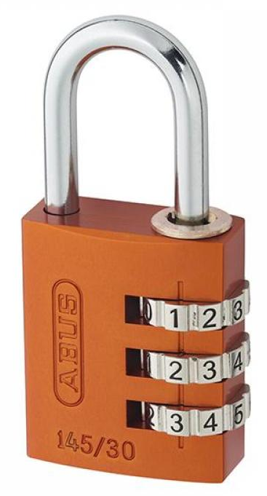
Unlock the ORANGE PADLOCK
You need to find the 3-digit code
What clues can you share with your group to narrow the options?
Can you make statements about what sort of number you are looking for?
Padlock 2
???
Notes:
423651

Slide 5
Unlock the ORANGE PADLOCK
THE PIN CODE IS A... 3 digit number
The 3 digit PIN is DIVISIBLE by 11
All three digits are PRIME numbers
HOW MANY DIFFERENT PIN CODES ARE THERE?
How do you know?
PRIME
PRIME
PRIME
DIVISIBLE BY 11
Notes:
253
352
572
275

Slide 6
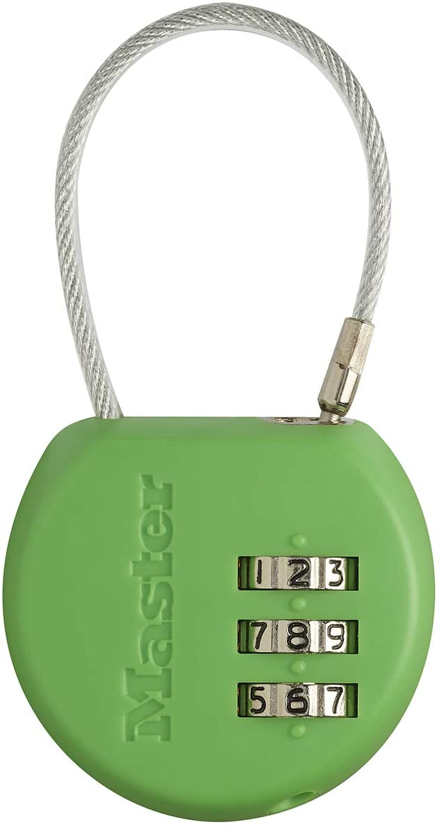
Unlock the GREEN PADLOCK
You need to find the 3-digit code
What clues can you share with your group to narrow the options?
Can you make statements about what sort of number you are looking for?
Padlock 3
???
Notes:
423651

Slide 7
Unlock the GREEN PADLOCK
THE PIN CODE IS A... 3 digit number
The SECOND and THIRD digits make a 2-digit number
The FIRST number is a FACTOR of the 2-digit number
The SUM of the 3 digits is 13
HOW CAN YOU START THIS PROBLEM?
FACTOR
SUM OF DIGITS is 13
Notes:
148, 184, 139, 193, 157, 175, 166
292, 238, 274, 256,
472, 436
535, 580
742
832

Slide 8
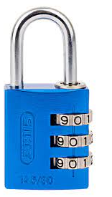
Unlock the BLUE PADLOCK
You need to find the 3-digit code
What clues can you share with your group to narrow the options?
Can you make statements about what sort of number you are looking for?
Padlock 4
???
Notes:
423651

Slide 9
Unlock the BLUE PADLOCK
THE PIN CODE IS A... 3 digit number
If you SQUARE the FIRST digit and ADD the SECOND digit, you’ll get the THIRD digit
The THIRD digit is a SQUARE number
HOW MANY DIFFERENT PIN CODES ARE THERE?
2
SQUARE
+
=
Notes:
134, 189
204, 259
309

