Slide 1
Describe
Title: Ratio & Similar Shapes
Objective:
To be able to use ratio notation to describe scale factors between similar shapes.
Key Words and Diagrams:
Ratio
Similar
Congruent
Scale Factor
Enlargement

Slide 2
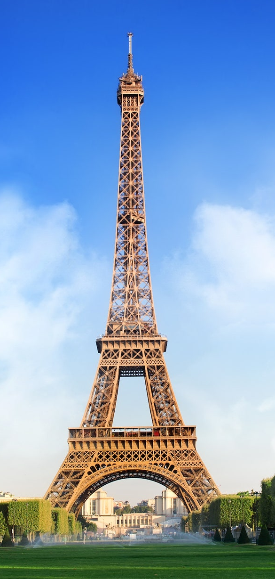
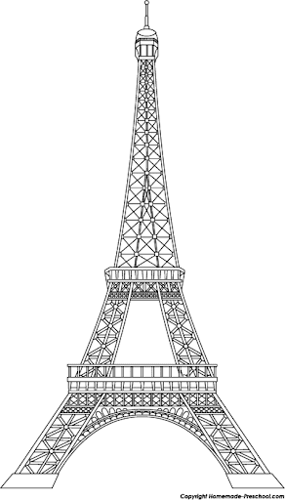
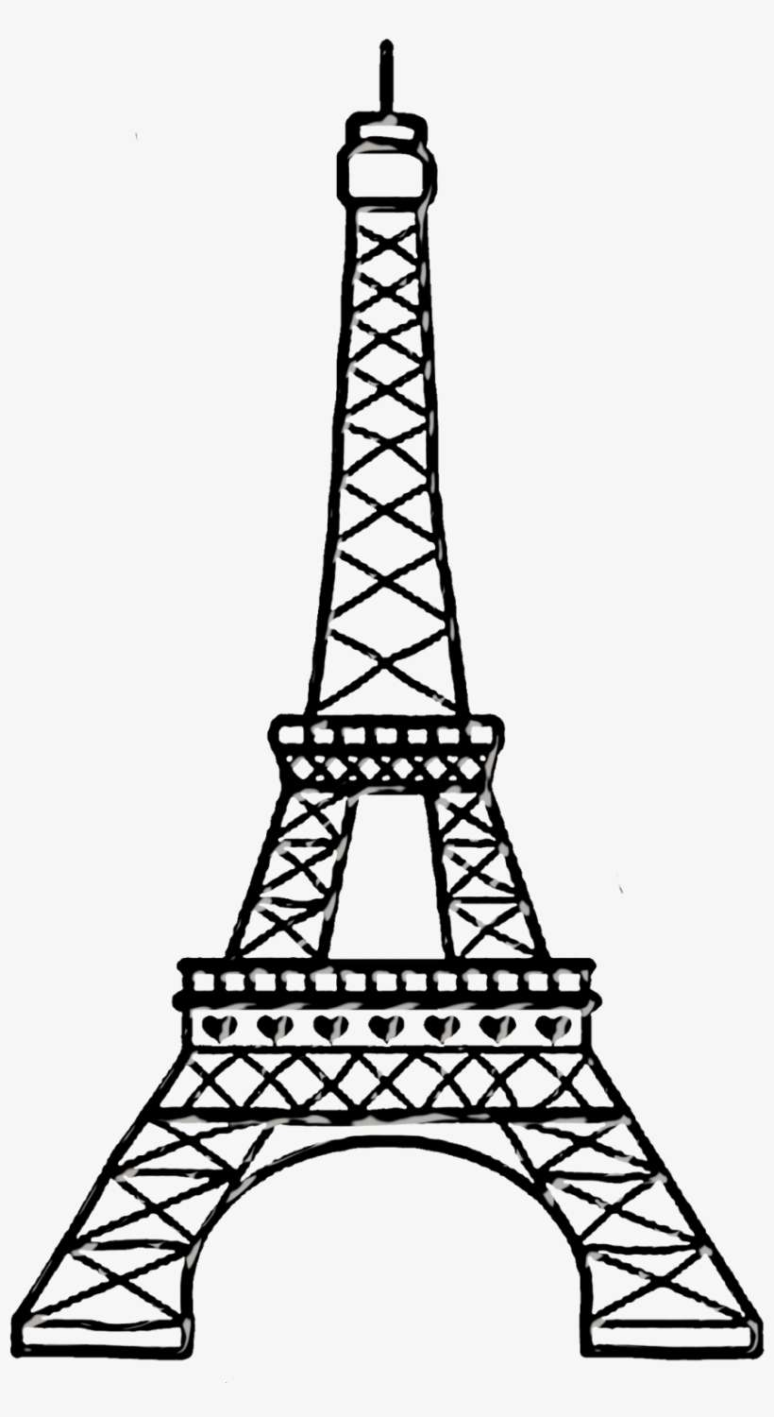



Challenge
sketchcpd.com/similaritySlider
You’re on holiday to Paris & have been to the top of the Eiffel Tower!
You want a model from the gift shop as a memento… Which one will you buy? Why?
A
B
D
C
E
Notes:
A is too wide, E is too tall.
B C and D are a little harder but on resizing… B is too wide, C is correct proportions & D is correct in terms of proportion but all the viewings decks are at the wrong heights!

Slide 3
Challenge
If we start with shape 1… does shape 2 ‘feel right’?
Why?
1
2
Notes:
Too wide

Slide 4
Challenge
If we start with shape 1… does shape 2 ‘feel right’?
Why?
2
1
Notes:
Rotated and too long

Slide 5
Challenge
If we start with shape 1… does shape 2 ‘feel right’?
Why?
1
2
Notes:
Too tall

Slide 6
Challenge
If we start with shape 1… does shape 2 ‘feel right’?
Why?
1
2
Notes:
Wrong angles

Slide 7
Challenge
If we start with shape 1… does shape 2 ‘feel right’?
Why?
1
2
Notes:
Wrong angles

Slide 8
Challenge
If we start with shape 1… does shape 2 ‘feel right’?
Why?
1
2
Notes:
Wrong angles

Slide 9
Challenge
If we start with shape 1… does shape 2 ‘feel right’?
Why?
1
2
Notes:
Wrong angles

Slide 10



Challenge
Jack climbed the beanstalk and found himself in a strange word where everything was larger than at the bottom of the beanstalk!
He knew a giant must live there… he wondered how much larger it was than him, so did some measurements.
Use his measurements to
estimate the height of
the giant.
?
?
?

Slide 11
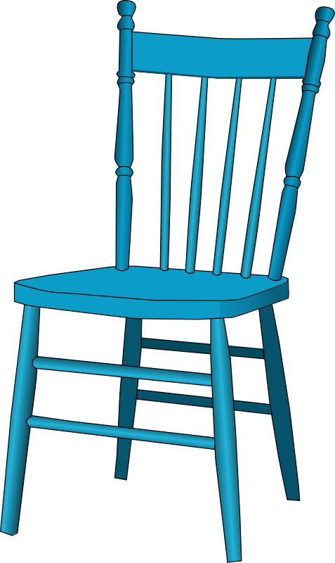
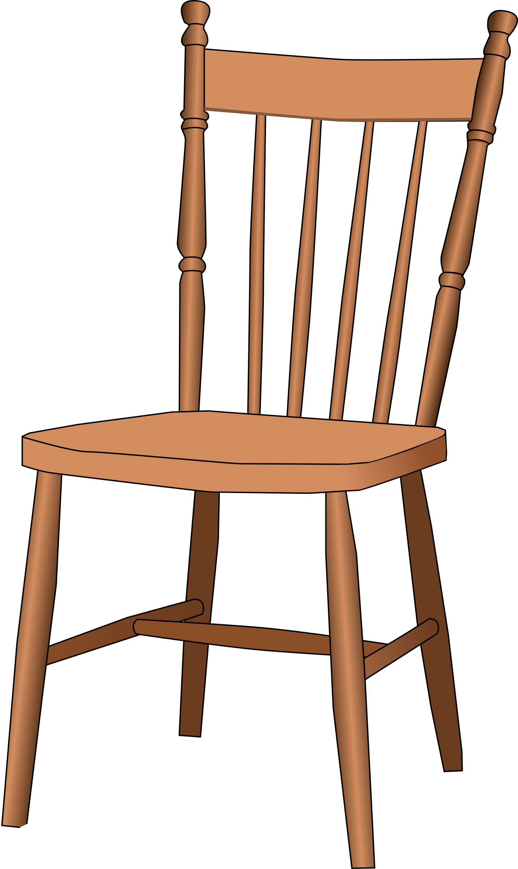
Challenge
1.8m
45cm
?
1.6m

Slide 12


Challenge
5cm
15cm
?
1.6m

Slide 13


Challenge
7m
1.4m
1m
?
1.6m

Slide 14
Challenge
What is the same? What is different?
5m
3m
20m
20m
12m
18m

Slide 15
Challenge
What is the same? What is different?
5m
3m
20m
20m
12m
18m

Slide 16
Challenge
7m
6m
21m
18m

Slide 17
Challenge
12m
8m
30m
24m

Slide 18
Challenge
12m
8m
30m
20m

Slide 19
Challenge
9cm
5cm
36cm
20cm

Slide 20
Challenge
8cm
3cm
21cm
56cm

Slide 21
Challenge
10cm
6cm
20cm
35cm

Slide 22
Challenge
10cm
6cm
30cm
18cm

Slide 23
Challenge
10cm
6cm
30cm
18cm

Slide 24
Challenge
10cm
6cm
30cm
18cm

Slide 25
Challenge
7cm
4cm
21cm
12cm

