Slide 1
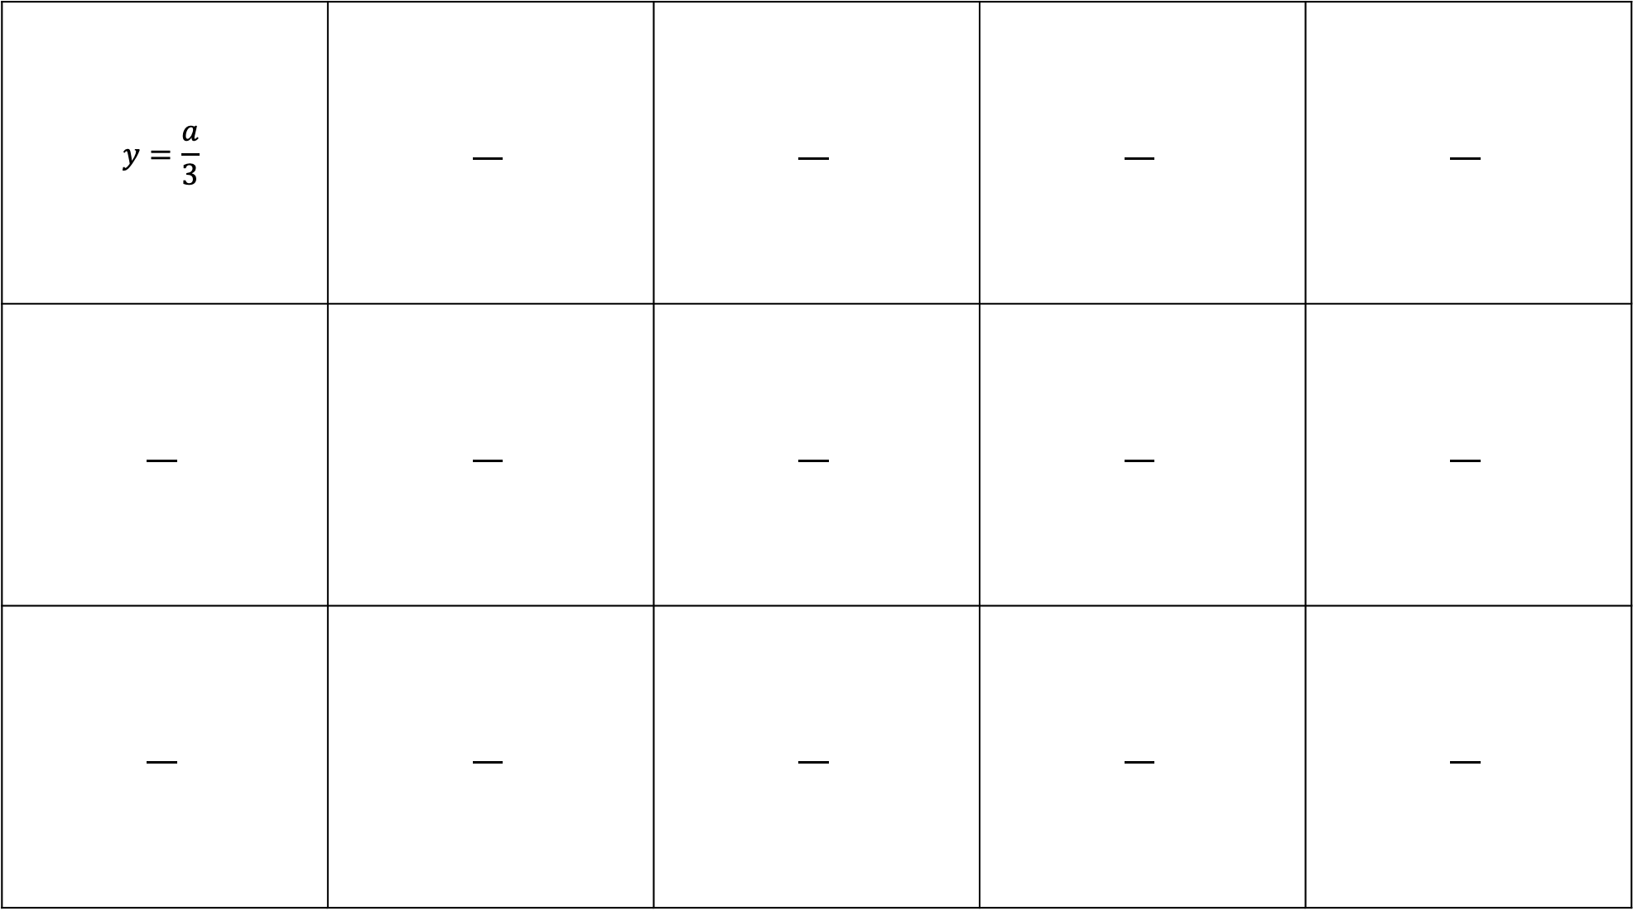
$$y=\frac{a}{3}$$

Slide 2
1 | 2 | 3 | 4 | 5 | 6 | n
3 | 6 | 9 | 12 | 15
1 | 2 | 3 | 4 | 5 | 6 | n
8 | 16 | 24 |  |  |  | 8n
10 | 18 | 26 | 34 | 42 | 50
1 | 2 | 3 | 4 | 5 | 6 | n
-2 | -4 | -6
1 | 2 | 3 | 4 | 5 | 6 | n
3 | 6 | 9
1 | 4 | 7 | 10 | 13 | 16
1 | 2 | 3 | 4 | 5 | 6 | n
0.5 | 1 | 1.5 | 2
1 | 2 | 3 | 4 | 5 | 6 | n
1.3 | 2.6 | 3.9 | 5.2 | 6.5 | 7.8
1 | 2 | 3 | 4 | 5 | 6 | n
 |  |  | 28 | 35
1 | 2 | 3 | 4 | 5 | 6 | n
 | -6 |  |  | -15
1 | 2 | 3 | 4 | 5 | 6 | n
12 | 7 | 2 | -3
1 | 2 | 3 | 4 | 5 | 6 | n
 |  |  |  |  |  | 9n
1 | 2 | 3 | 4 | 5 | 6 | n
 |  |  |  |  |  | 4n
 |  |  |  |  |  | 4n - 7
1 | 2 | 3 | 4 | 5 | 6 | n
 |  |  |  |  |  | 0.1n
1 | 2 | 3 | 4 | 5 | 6 | n
 |  |  |  |  |  | – n
 |  |  |  |  |  | 8 – n
1 | 2 | 3 | 4 | 5 | 6 | n
 |  |  |  |  |  | -11n

Slide 3
1 | 2 | 3 | 4 | 5 | 6 | n
3 | 6 | 9 | 12 | 15
1 | 2 | 3 | 4 | 5 | 6 | n
8 | 16 | 24 |  |  |  | 8n
10 | 18 | 26 | 34 | 42 | 50
1 | 2 | 3 | 4 | 5 | 6 | n
-2 | -4 | -6
1 | 2 | 3 | 4 | 5 | 6 | n
3 | 6 | 9
1 | 4 | 7 | 10 | 13 | 16
1 | 2 | 3 | 4 | 5 | 6 | n
0.5 | 1 | 1.5 | 2
1 | 2 | 3 | 4 | 5 | 6 | n
1.3 | 2.6 | 3.9 | 5.2 | 6.5 | 7.8
1 | 2 | 3 | 4 | 5 | 6 | n
 |  |  | 28 | 35
1 | 2 | 3 | 4 | 5 | 6 | n
 | -6 |  |  | -15
1 | 2 | 3 | 4 | 5 | 6 | n
12 | 7 | 2 | -3
1 | 2 | 3 | 4 | 5 | 6 | n
 |  |  |  |  |  | 9n
1 | 2 | 3 | 4 | 5 | 6 | n
 |  |  |  |  |  | 4n
 |  |  |  |  |  | 4n - 7
1 | 2 | 3 | 4 | 5 | 6 | n
 |  |  |  |  |  | 0.1n
1 | 2 | 3 | 4 | 5 | 6 | n
 |  |  |  |  |  | – n
 |  |  |  |  |  | 8 – n
1 | 2 | 3 | 4 | 5 | 6 | n
 |  |  |  |  |  | -11n

Slide 4
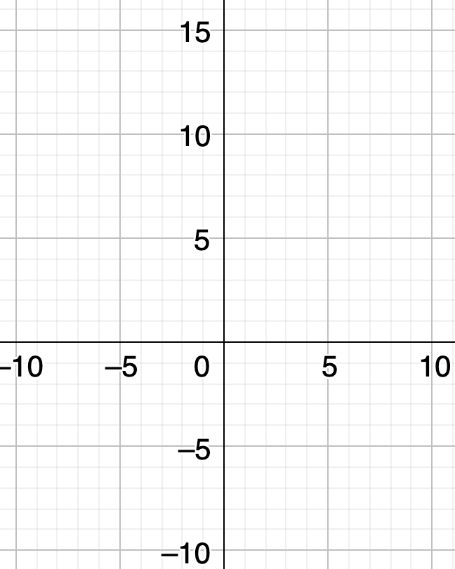
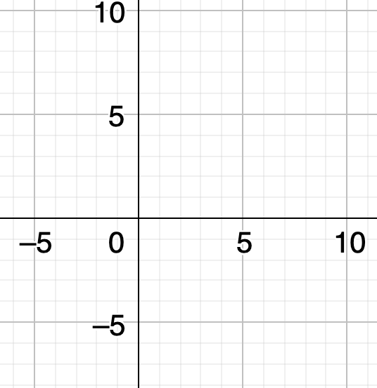
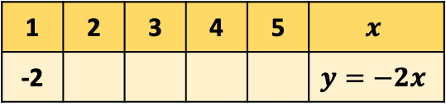
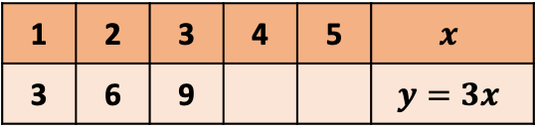
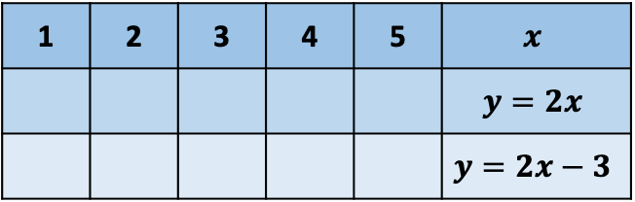
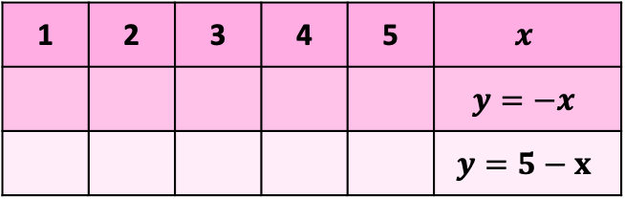
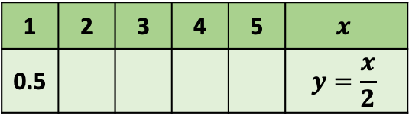
1 | 2 | 3 | 4 | 5 | $$x$$
3 | 6 | 9 |  |  | $$y=3x$$
1 | 2 | 3 | 4 | 5 | $$x$$
 |  |  |  |  | $$y=2x$$
 |  |  |  |  | $$y=2x−3$$
1 | 2 | 3 | 4 | 5 | 6 | n
 |  |  | 28 | 35
1 | 2 | 3 | 4 | 5 | $$x$$
-2 |  |  |  |  | $$y=−2x$$
1 | 2 | 3 | 4 | 5 | $$x$$
 |  |  |  |  | $$y=−x$$
 |  |  |  |  | $$y=5−x$$
1 | 2 | 3 | 4 | 5 | 6 | n
 | -6 |  |  | -15
1 | 2 | 3 | 4 | 5 | $$x$$
0.5 |  |  |  |  | $$y=\frac{x}{2}$$
1 | 2 | 3 | 4 | 5 | 6 | n
1.3 | 2.6 | 3.9 | 5.2 | 6.5 | 7.8
1 | 2 | 3 | 4 | 5 | 6 | n
12 | 7 | 2 | -3
1 | 2 | 3 | 4 | 5 | 6 | n
 |  |  |  |  |  | -11n
1 | 2 | 3 | 4 | 5 | 6 | n
 |  |  |  |  |  | 4n
 |  |  |  |  |  | 4n - 7
1 | 2 | 3 | 4 | 5 | 6 | n
 |  |  |  |  |  | – n
 |  |  |  |  |  | 8 – n

