Slide 1
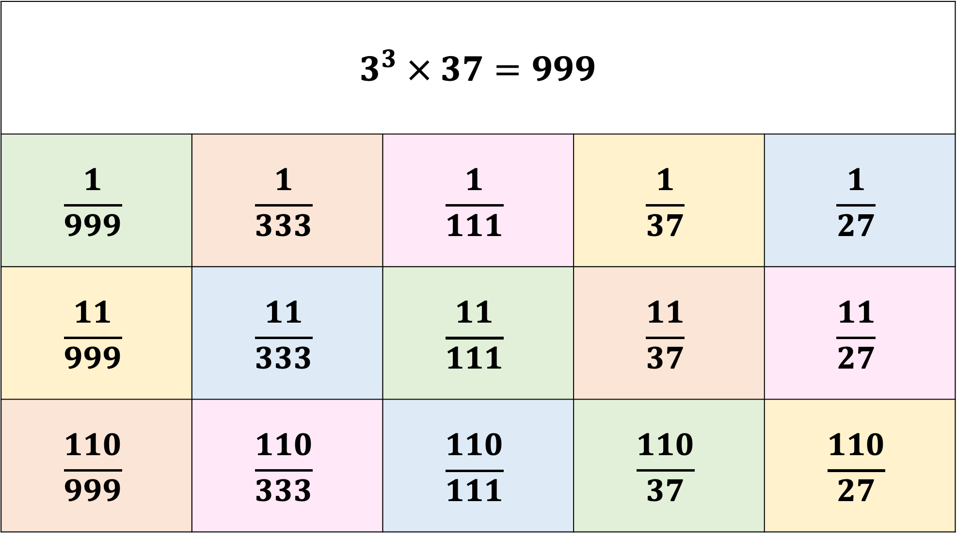
$$3^{3} × 37=999$$
$$\frac{1}{999}$$ | $$\frac{1}{333}$$ | $$\frac{1}{111}$$ | $$\frac{1}{37}$$ | $$\frac{1}{27}$$
$$\frac{11}{999}$$ | $$\frac{11}{333}$$ | $$\frac{11}{111}$$ | $$\frac{11}{37}$$ | $$\frac{11}{27}$$
$$\frac{110}{999}$$ | $$\frac{110}{333}$$ | $$\frac{110}{111}$$ | $$\frac{110}{37}$$ | $$\frac{110}{27}$$

