Slide 1
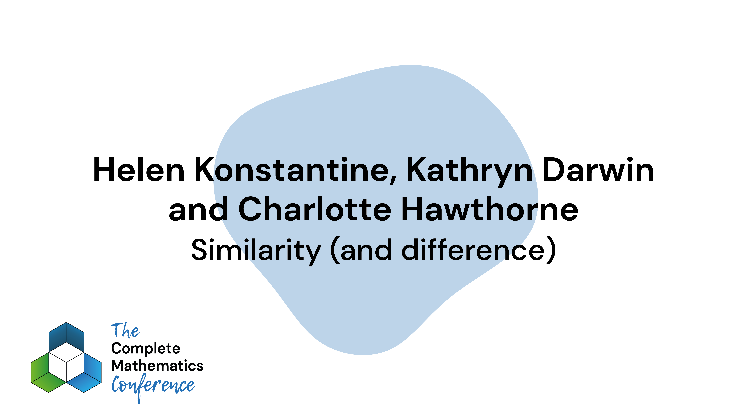
Notes:
1ish
4:10
Helen

Slide 2

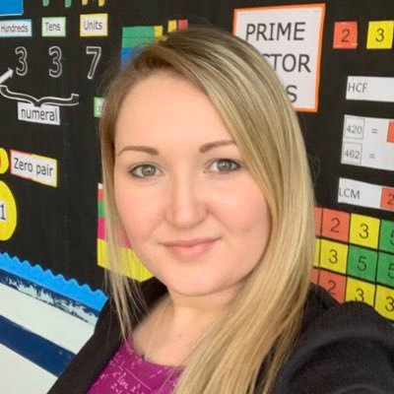
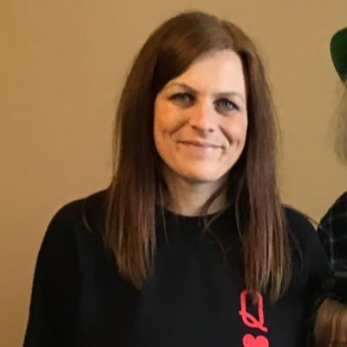
Kathryn Darwin
@Arithmaticks
arithmaticks.wordpress.com
Charlotte Hawthorne
@mrshawthorne7
sketchCPD.com
Helen Konstantine
@giftedHKO
mathshko.com
Notes:
Helen
Kathryn
Charlotte

Slide 3
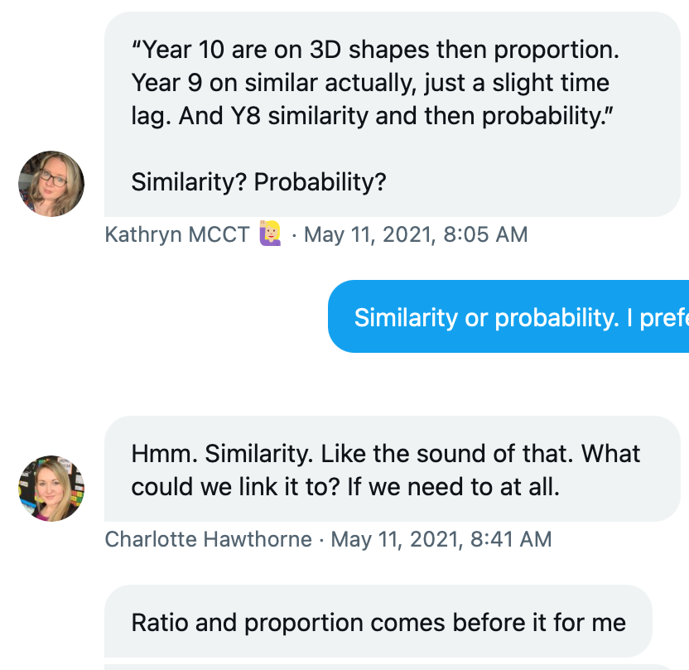
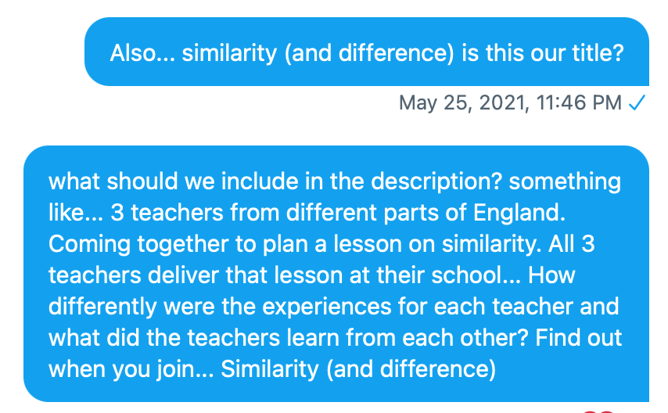
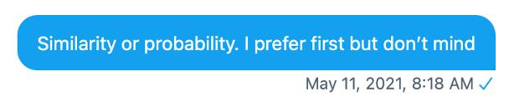
Why Similarity?
Notes:
Charlotte

Slide 4

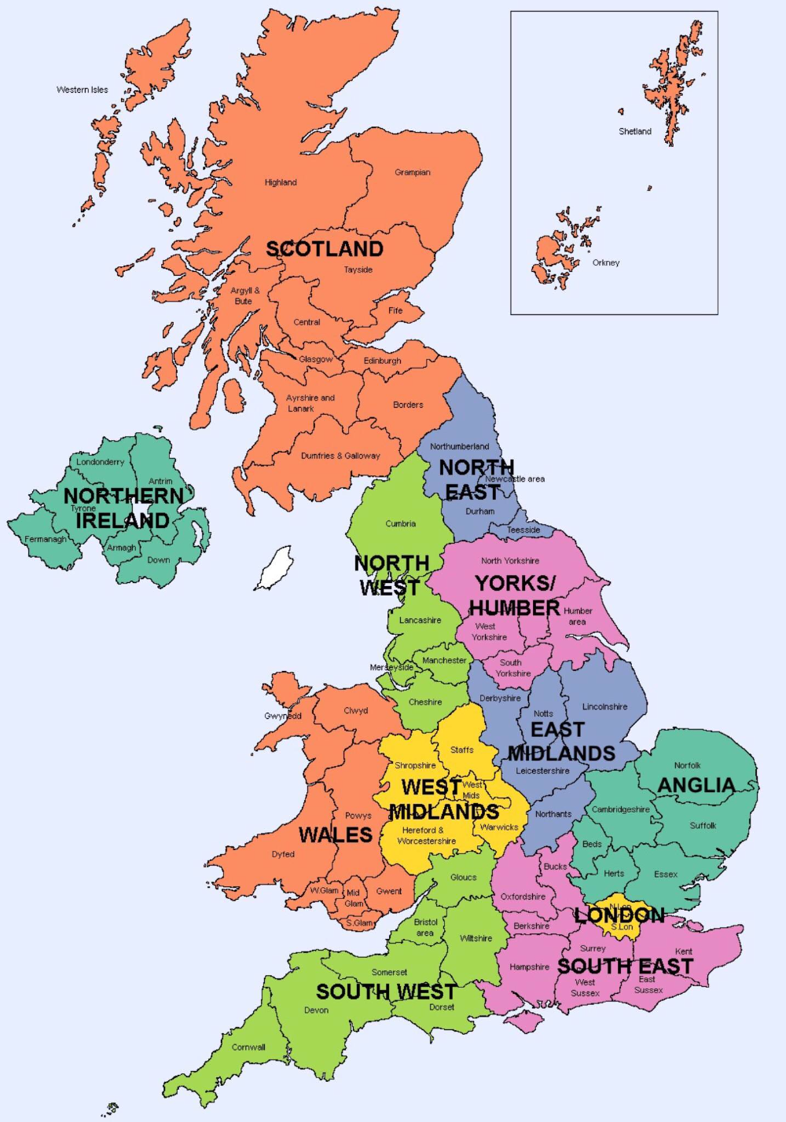


Notes:
Charlotte
Helen
Kathryn

Slide 5
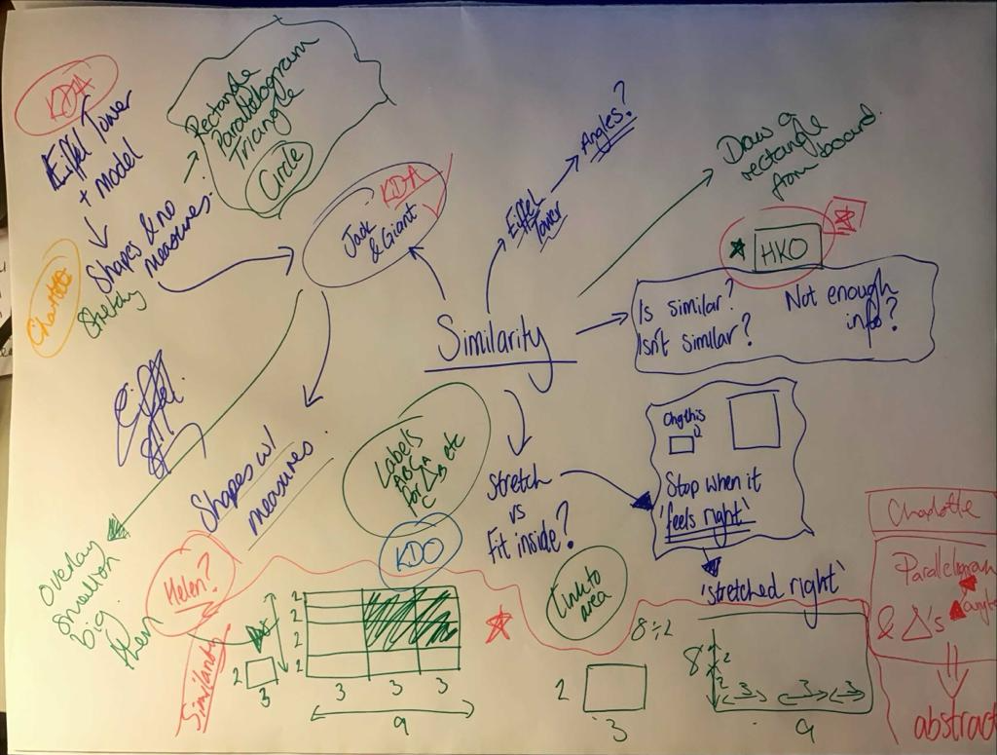
The first meeting
Notes:
CONCEPT
Kathryn

Slide 6
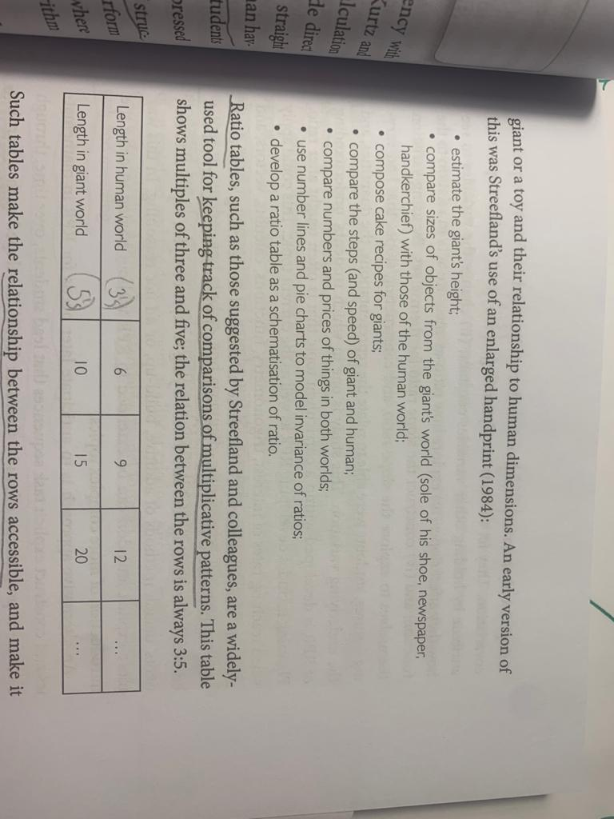
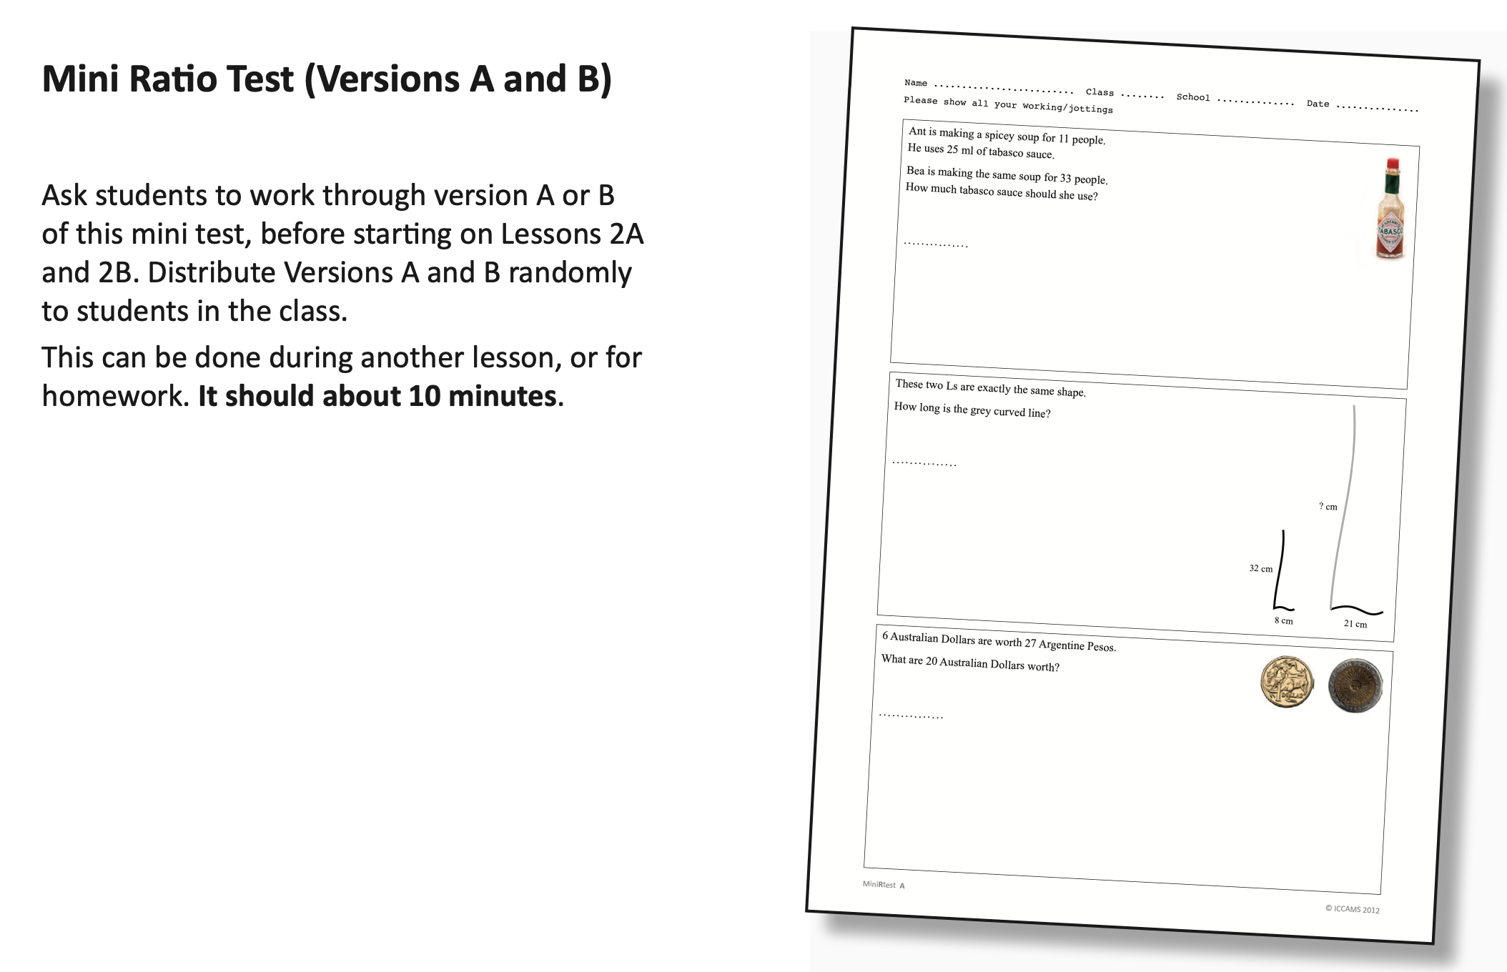
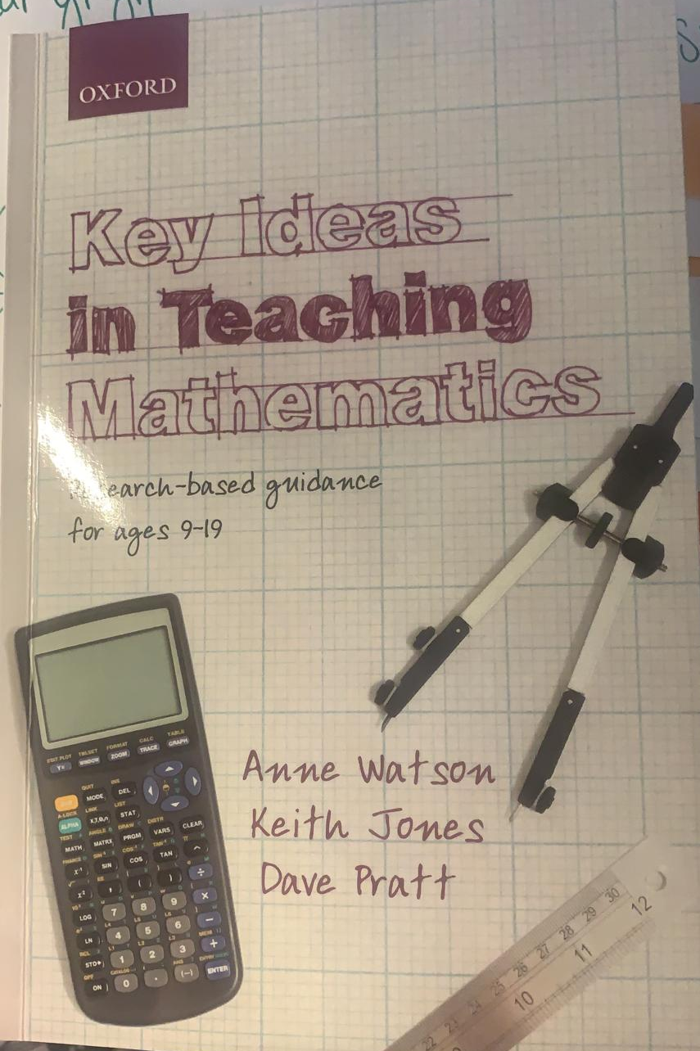

Influences
Notes:
CONCEPT – Kathryn giant
Helen ICCAMS

Slide 7
What we decided we needed in the lesson
Understand what similarity means
Shapes with measures and without
Discussion on angles in similar shapes
Real life similar shapes (Eiffel Tower)
Allow time to ‘play’ with the shapes
Notes:
Charlotte

Slide 8
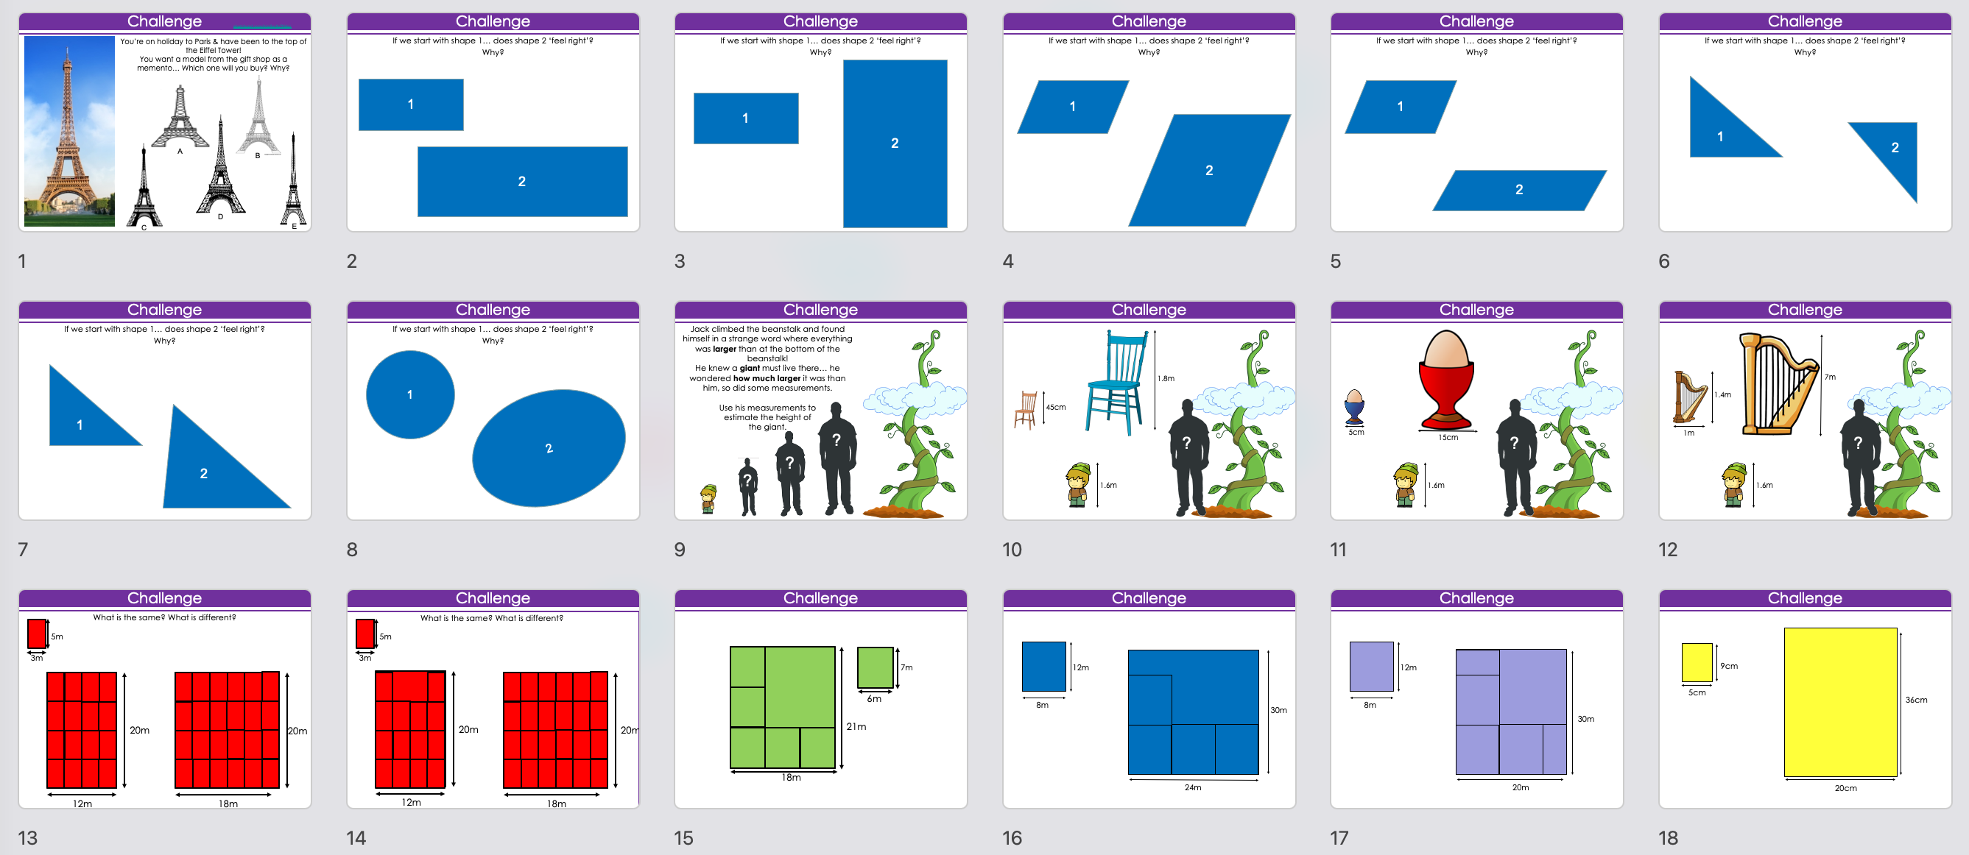
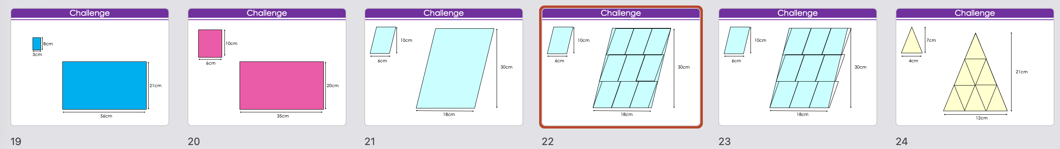
Notes:
Charlotte (CAVEAT – CHALLENGE)

Slide 9
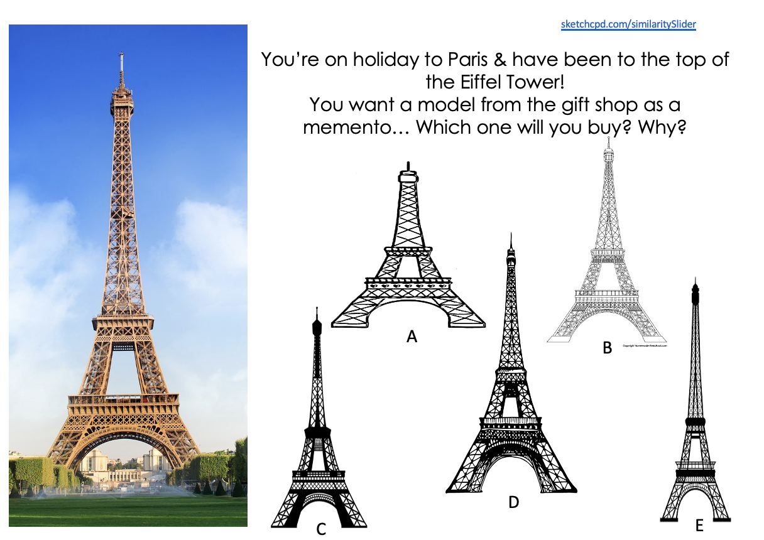
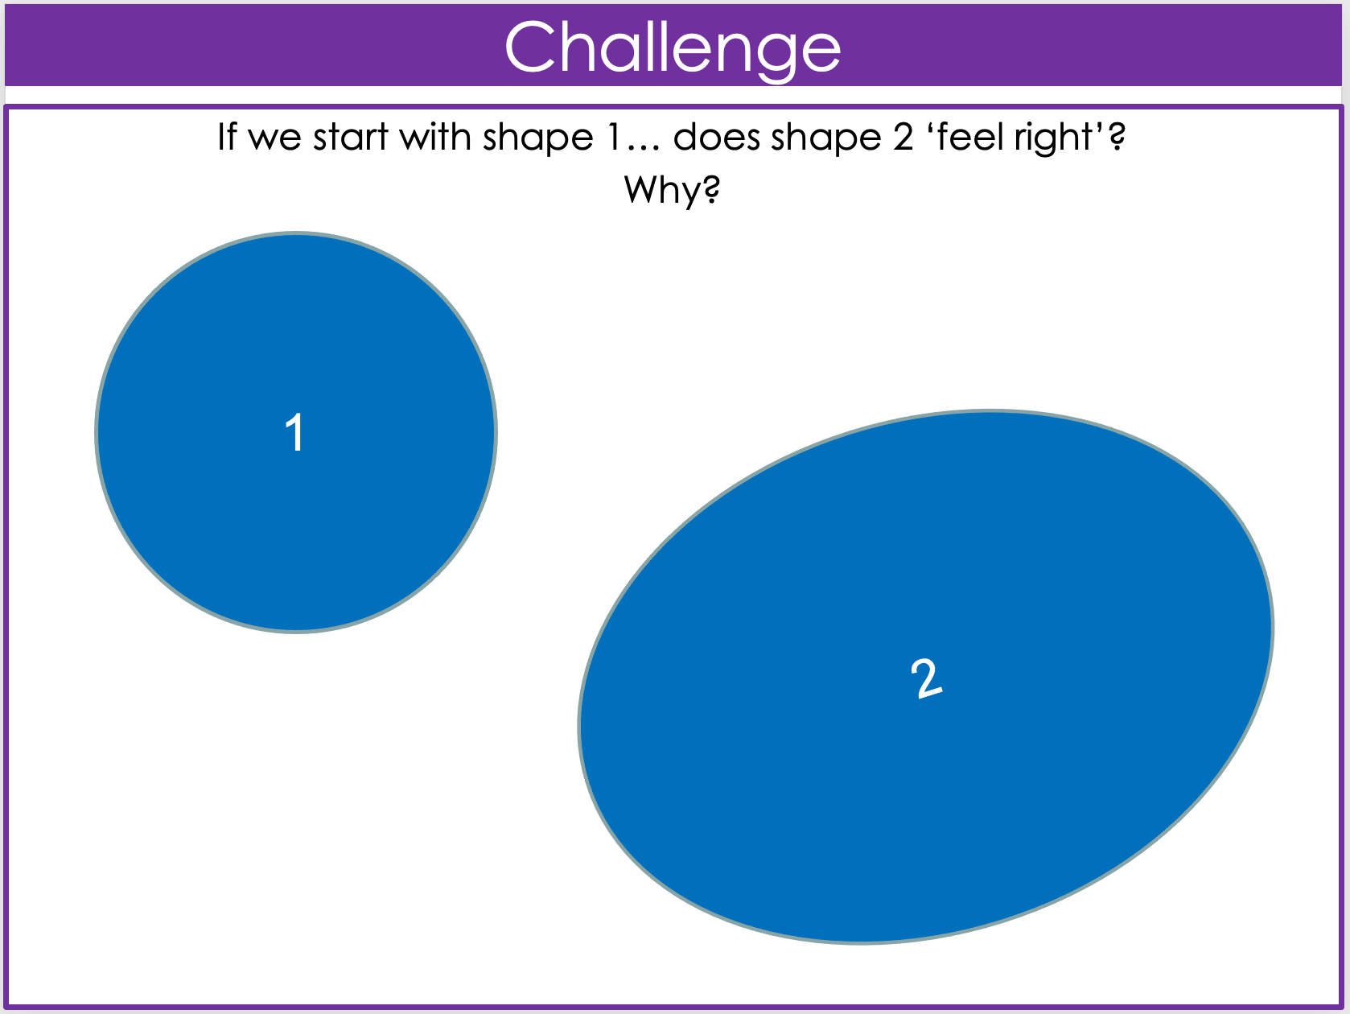
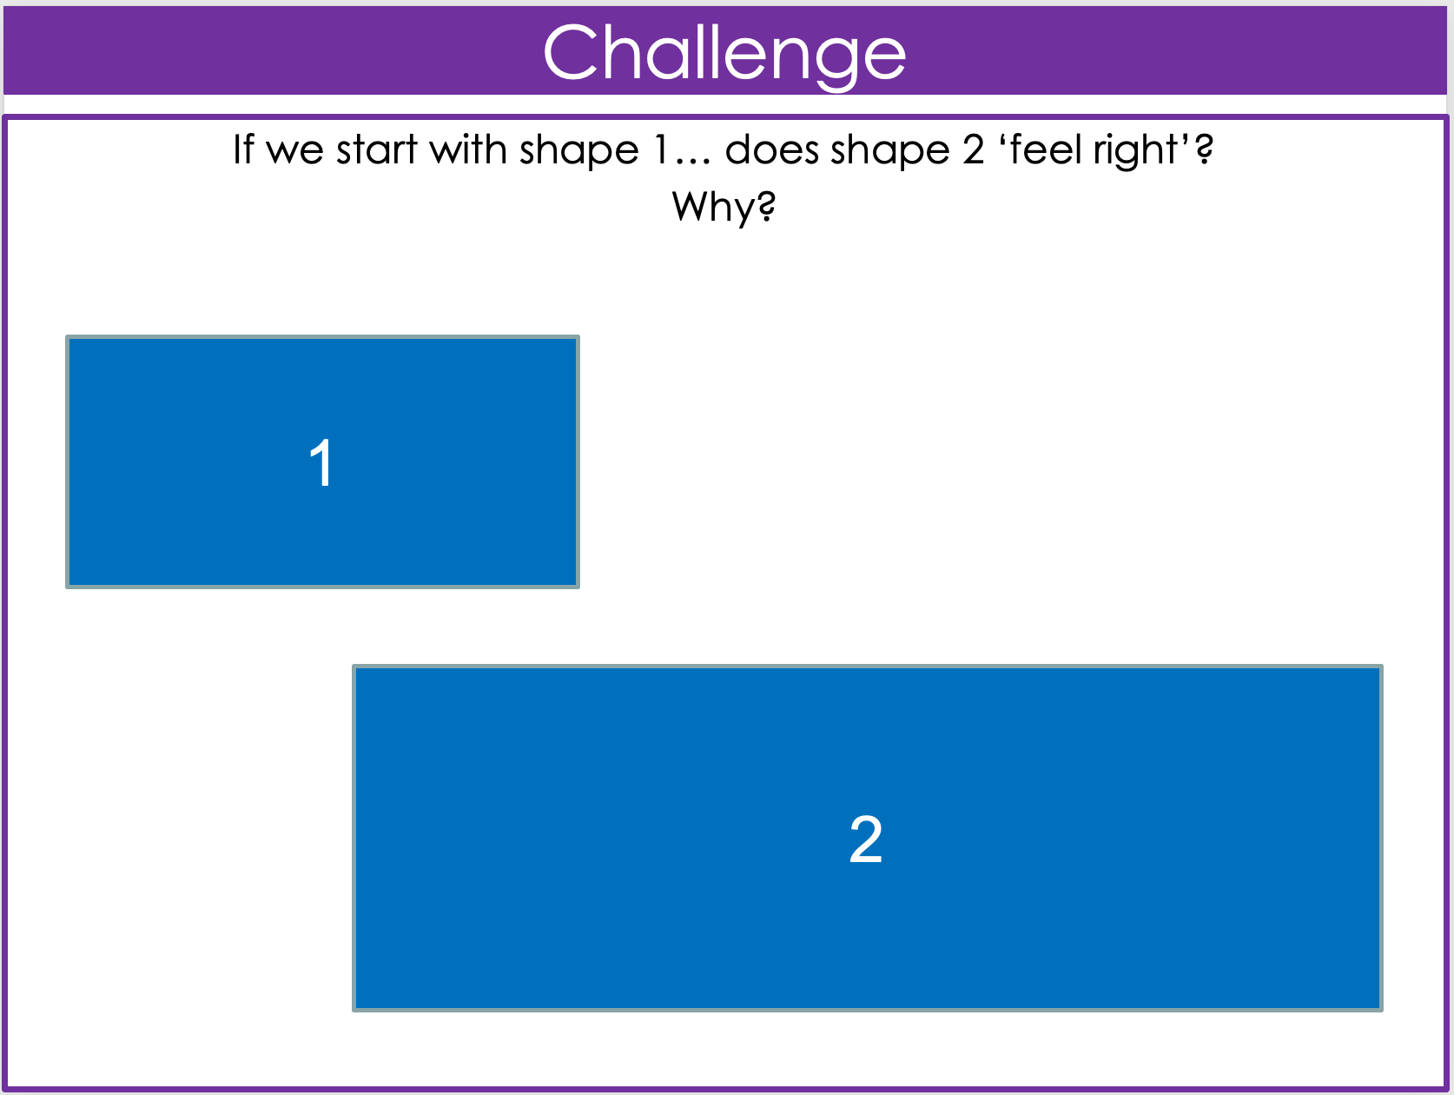
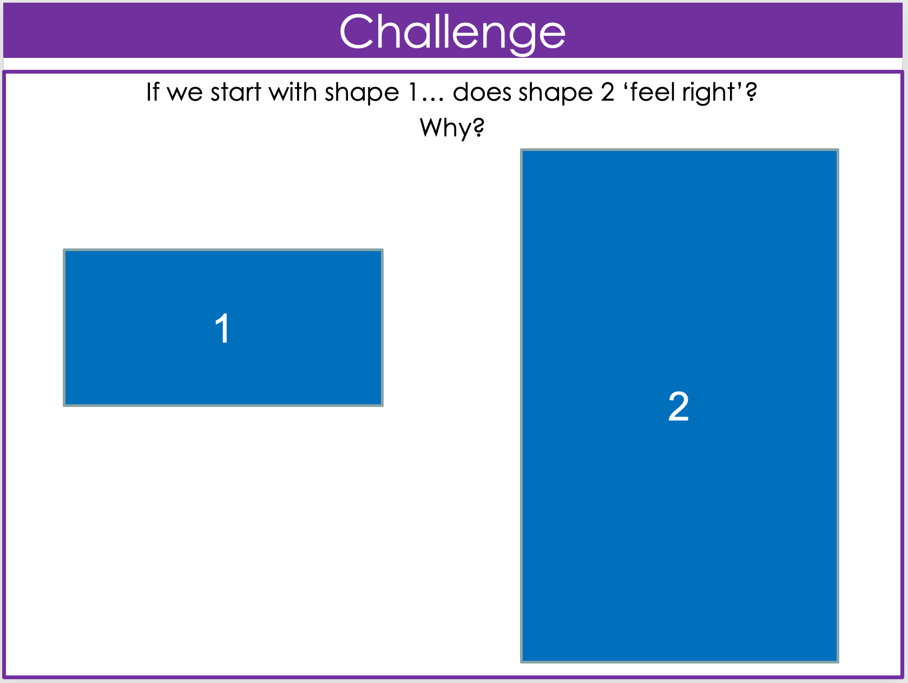
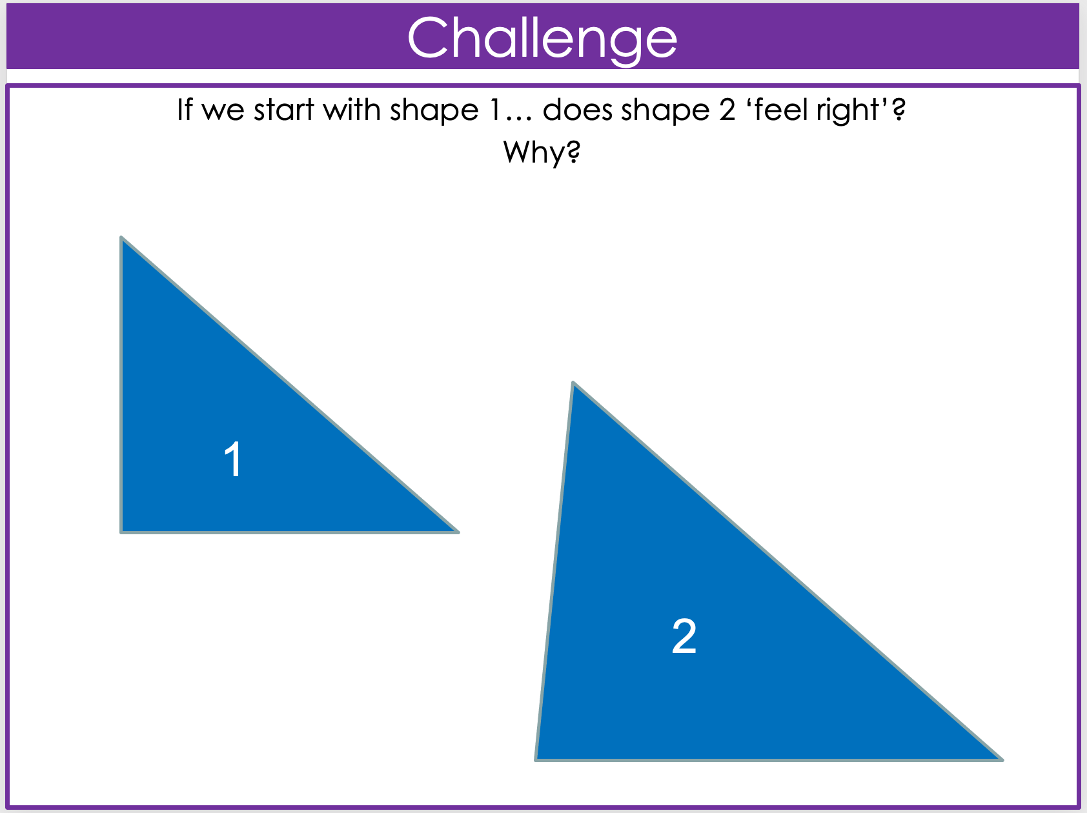
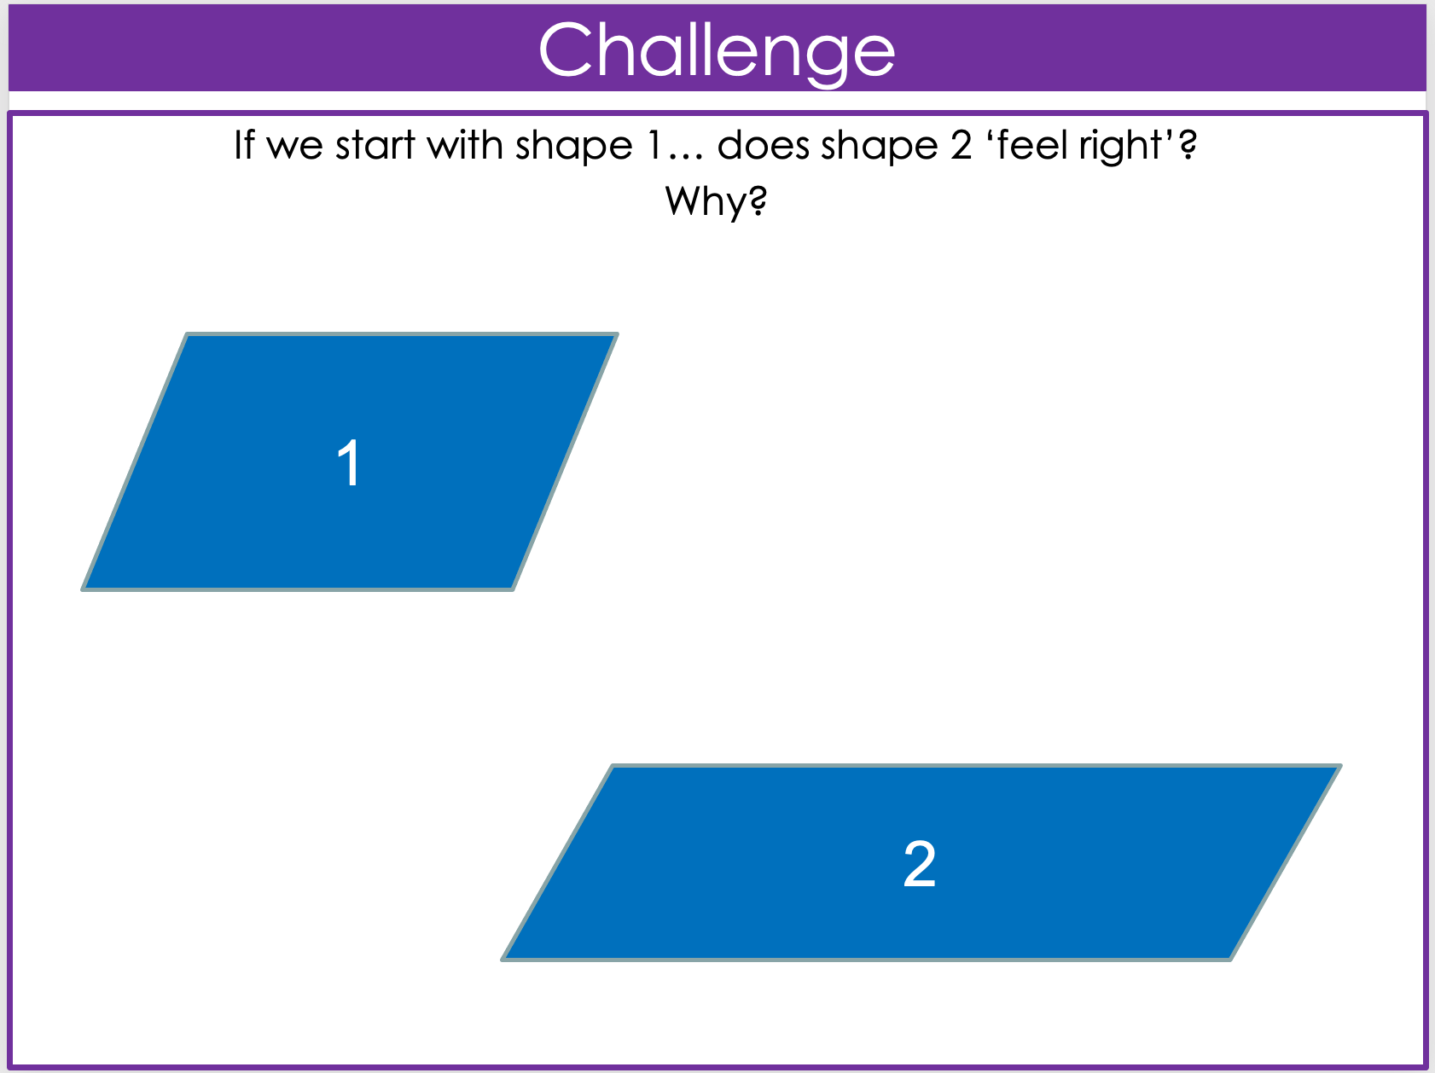
IMAGE A
IMAGE B
IMAGE C
Are they similar? (By inspection)
IMAGE D
IMAGE E
IMAGE F
Notes:
Charlotte

Slide 10
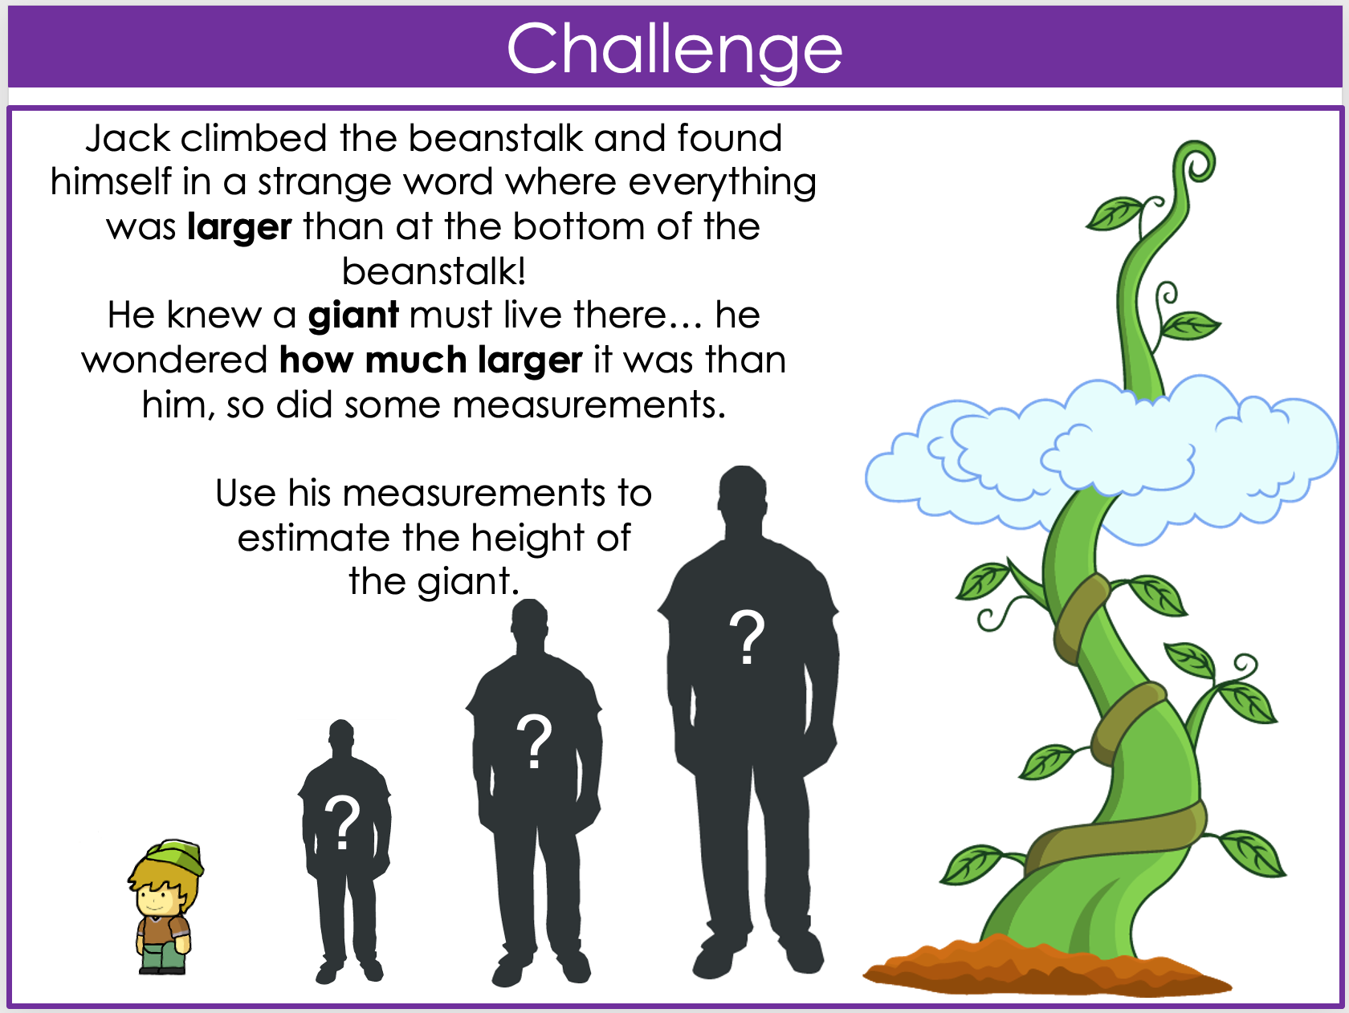
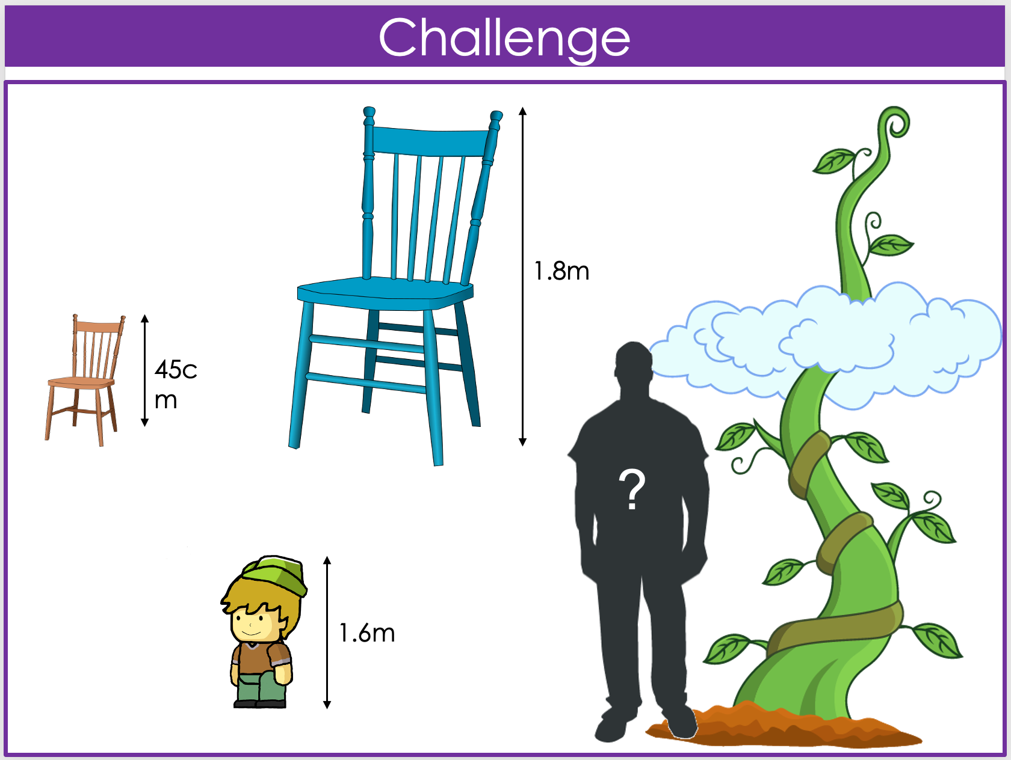
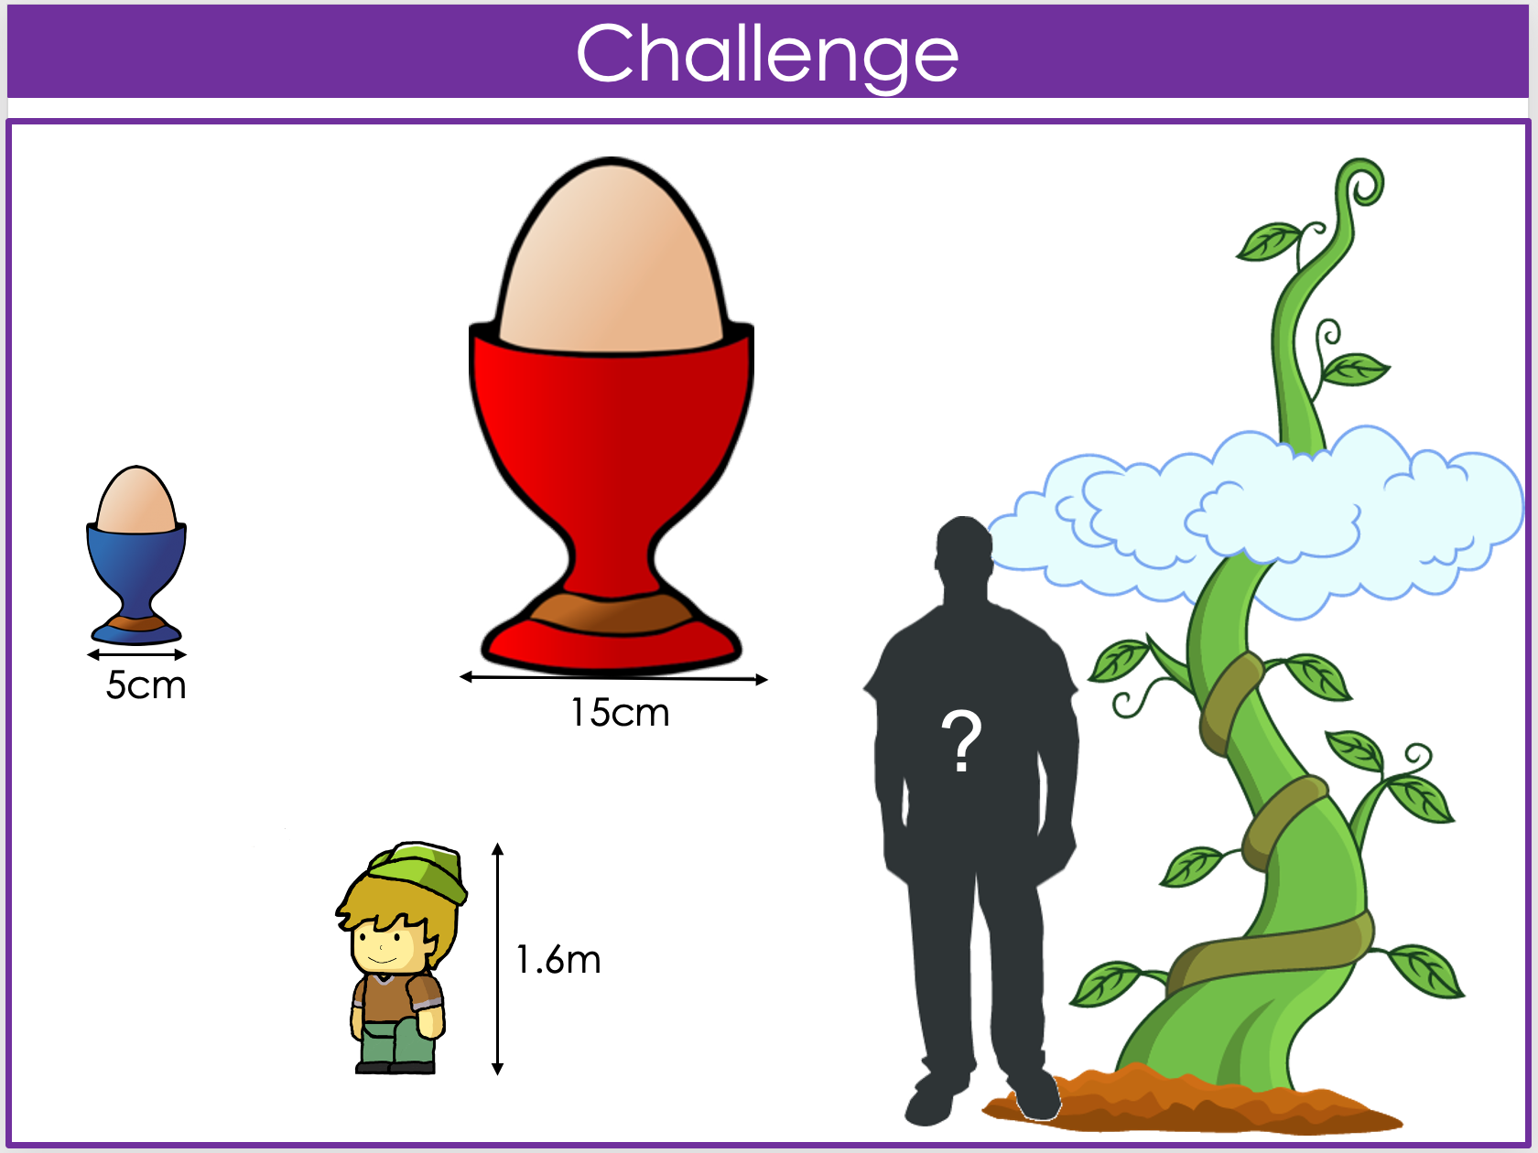
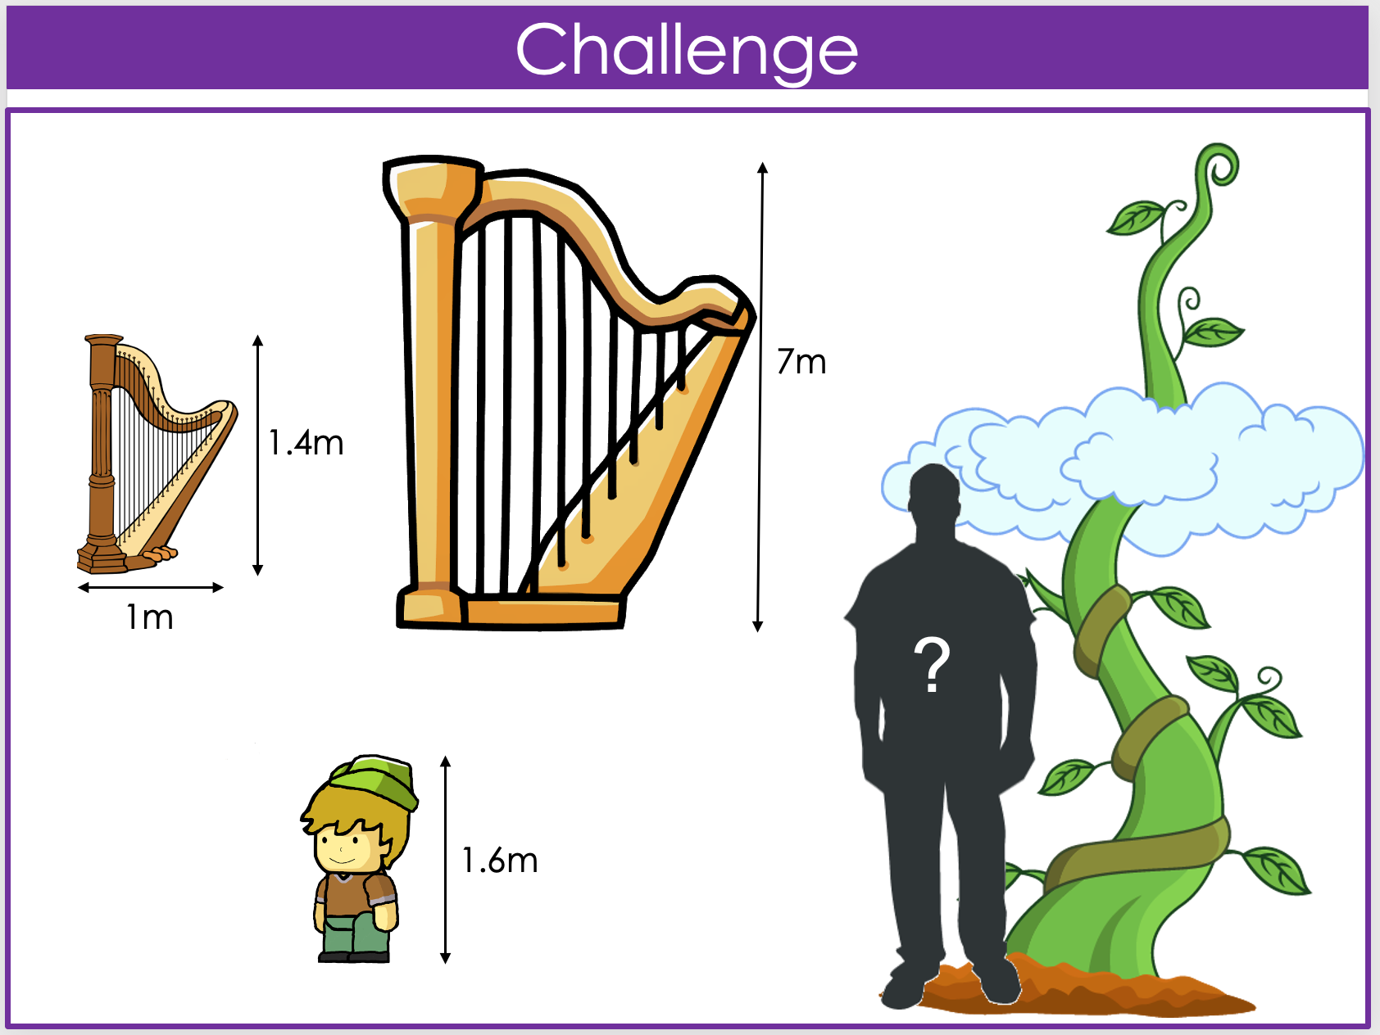
IMAGE A
IMAGE B
Jack and the Beanstalk
IMAGE C
IMAGE D
Notes:
Kathryn

Slide 11
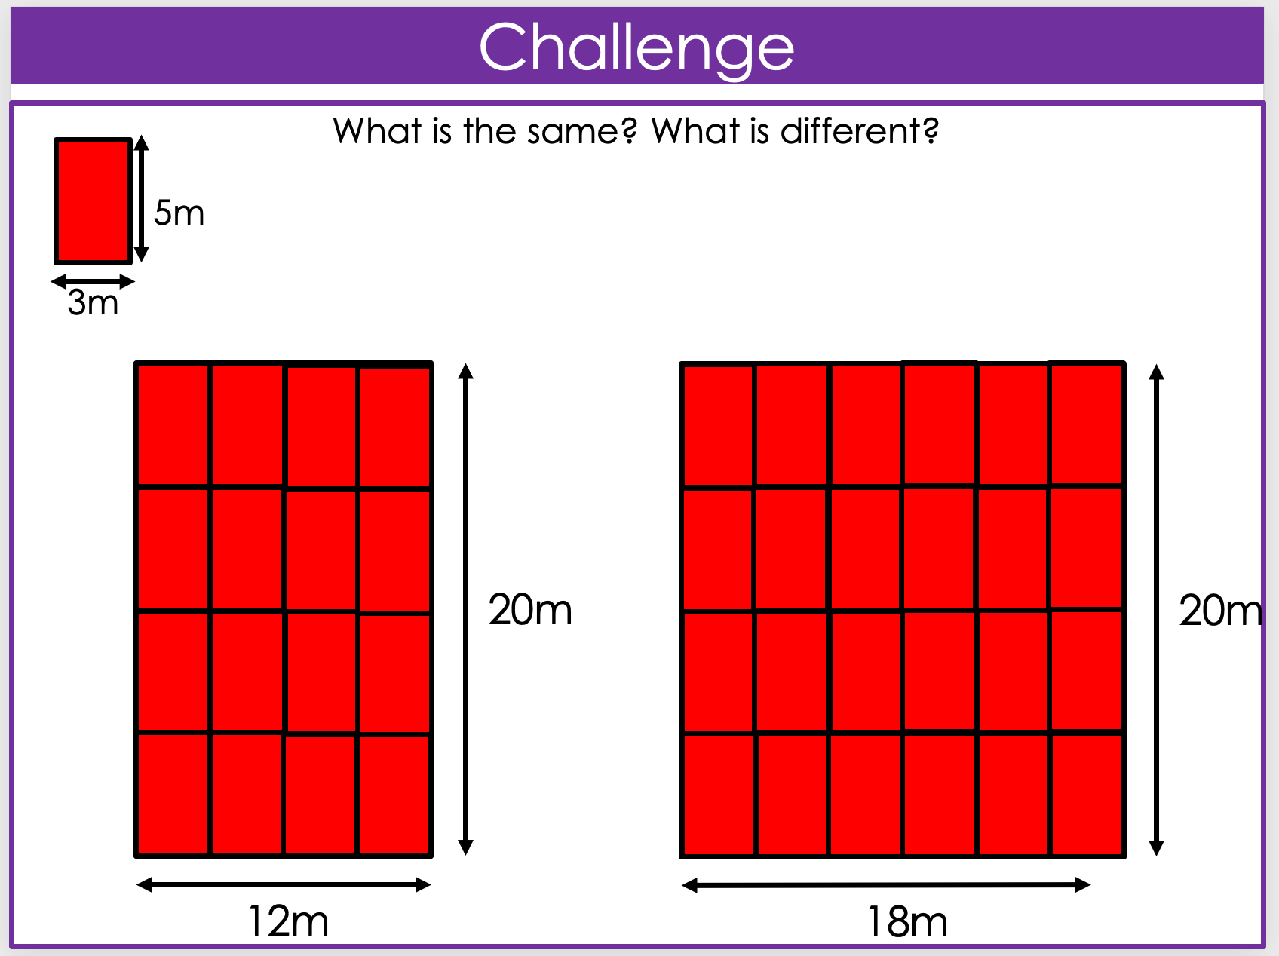
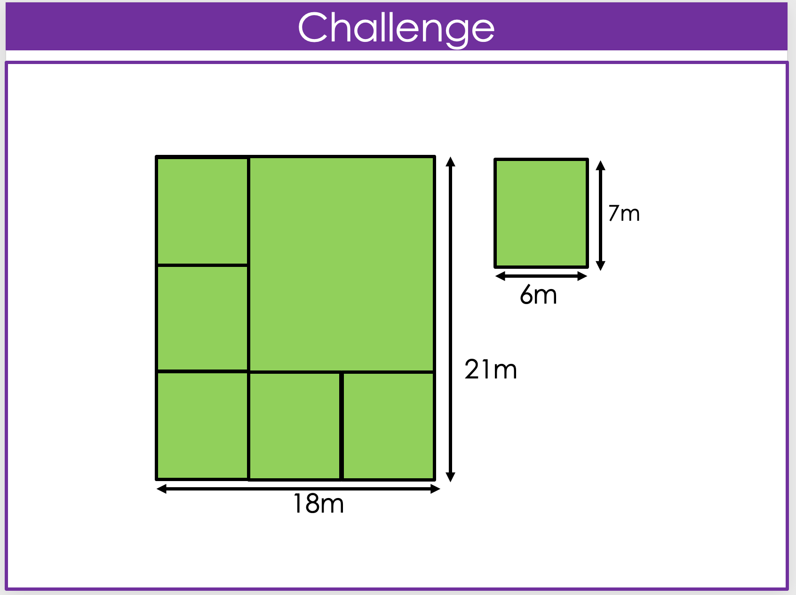
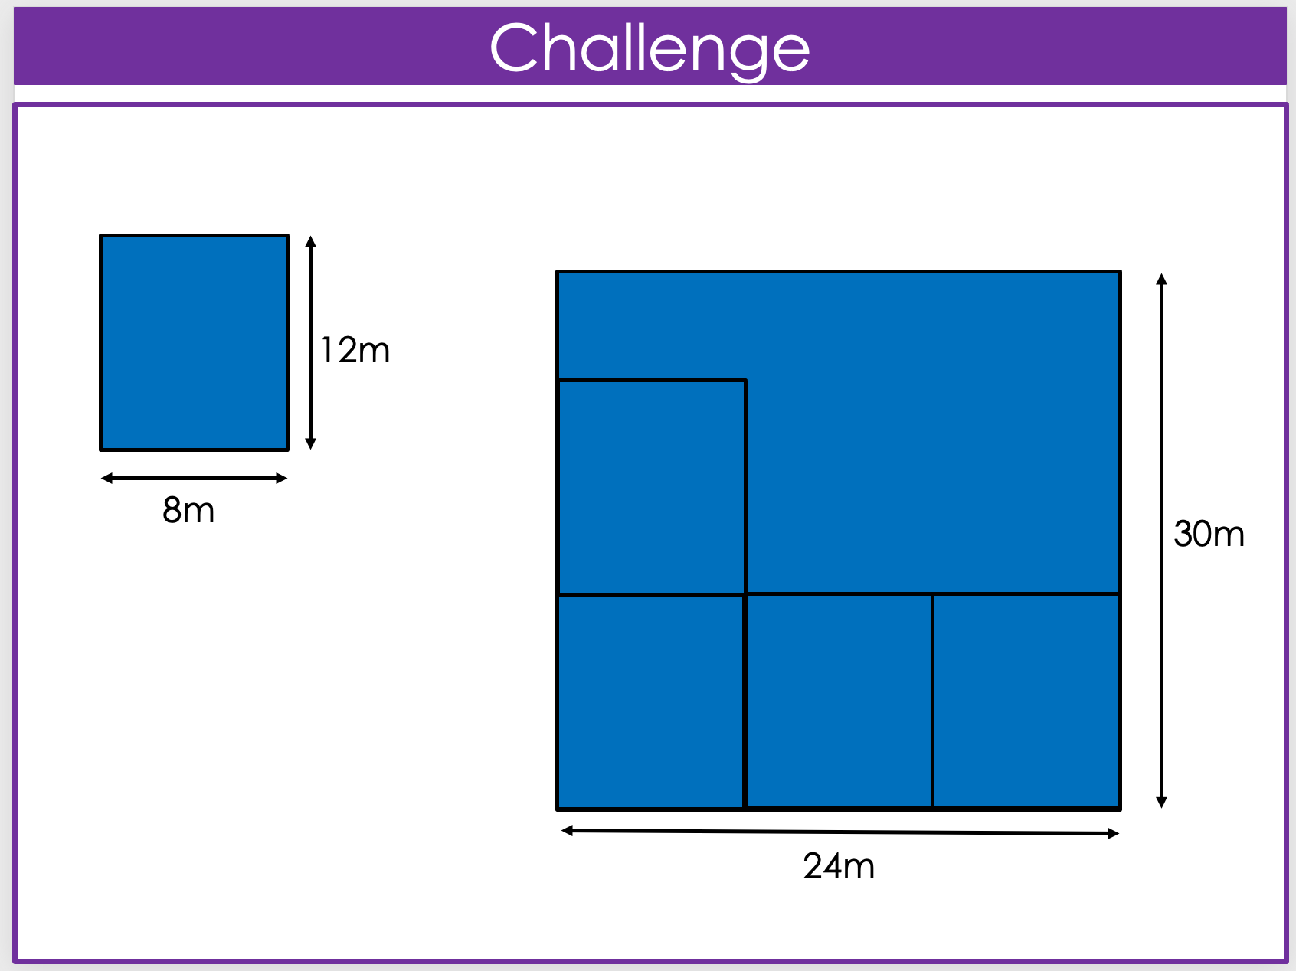
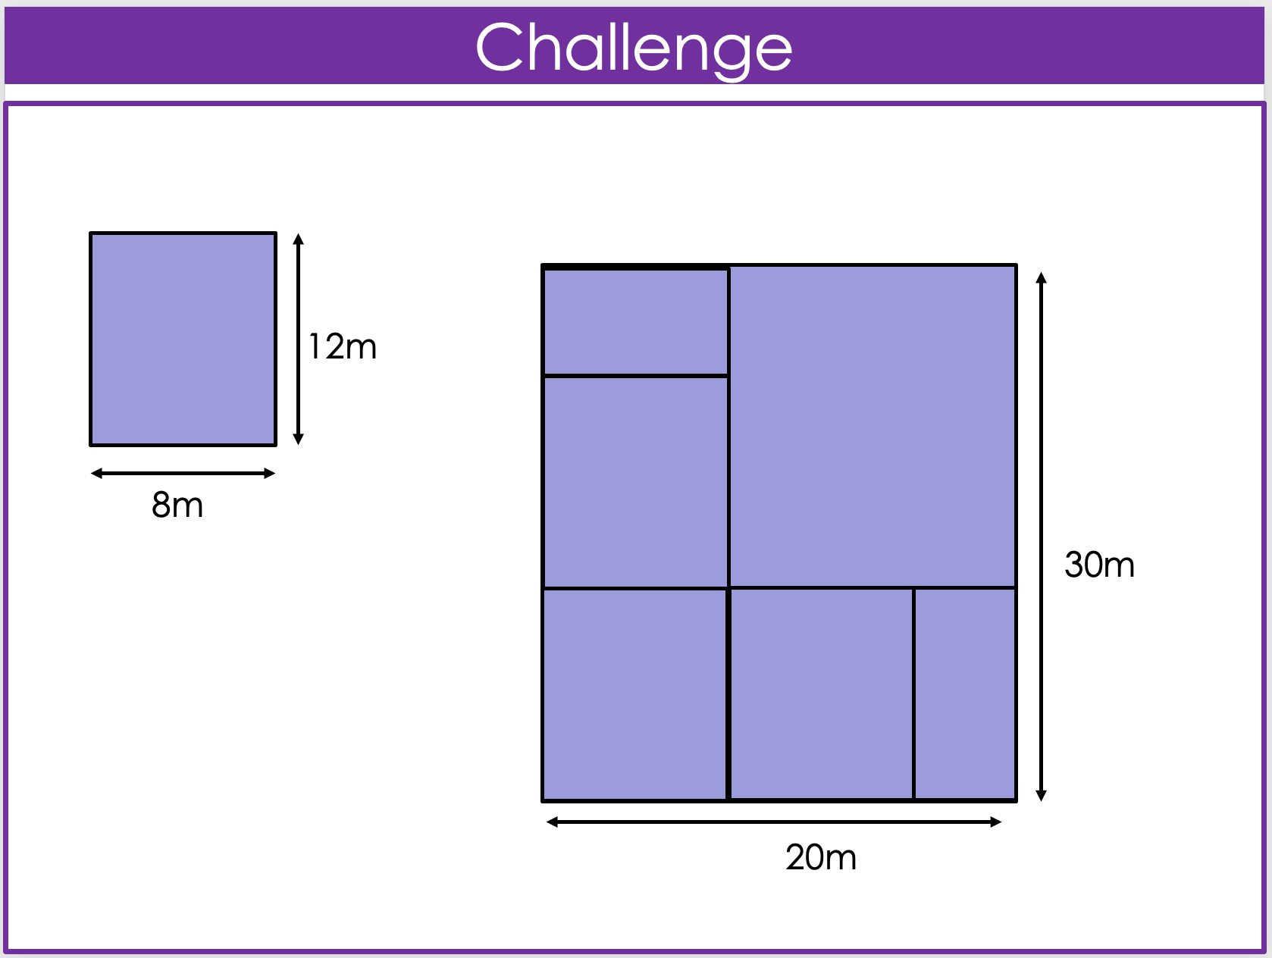
IMAGE A
IMAGE B
What’s the Same and what’s different?
IMAGE C
IMAGE D
Notes:
Helen
L to R
Fit…didn’t fit, decimal

Slide 12
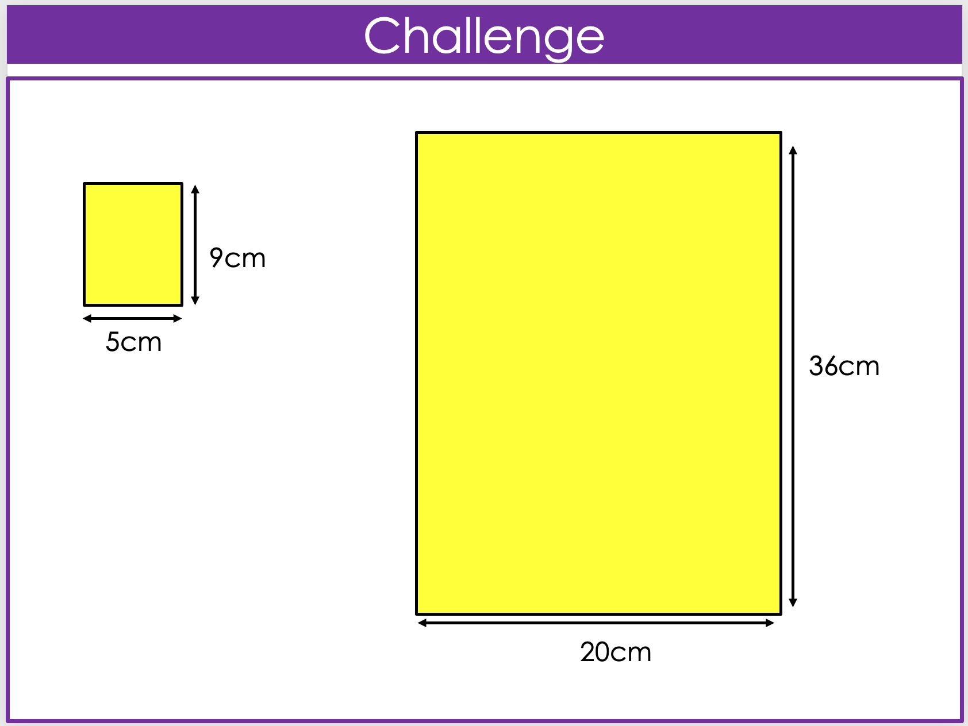
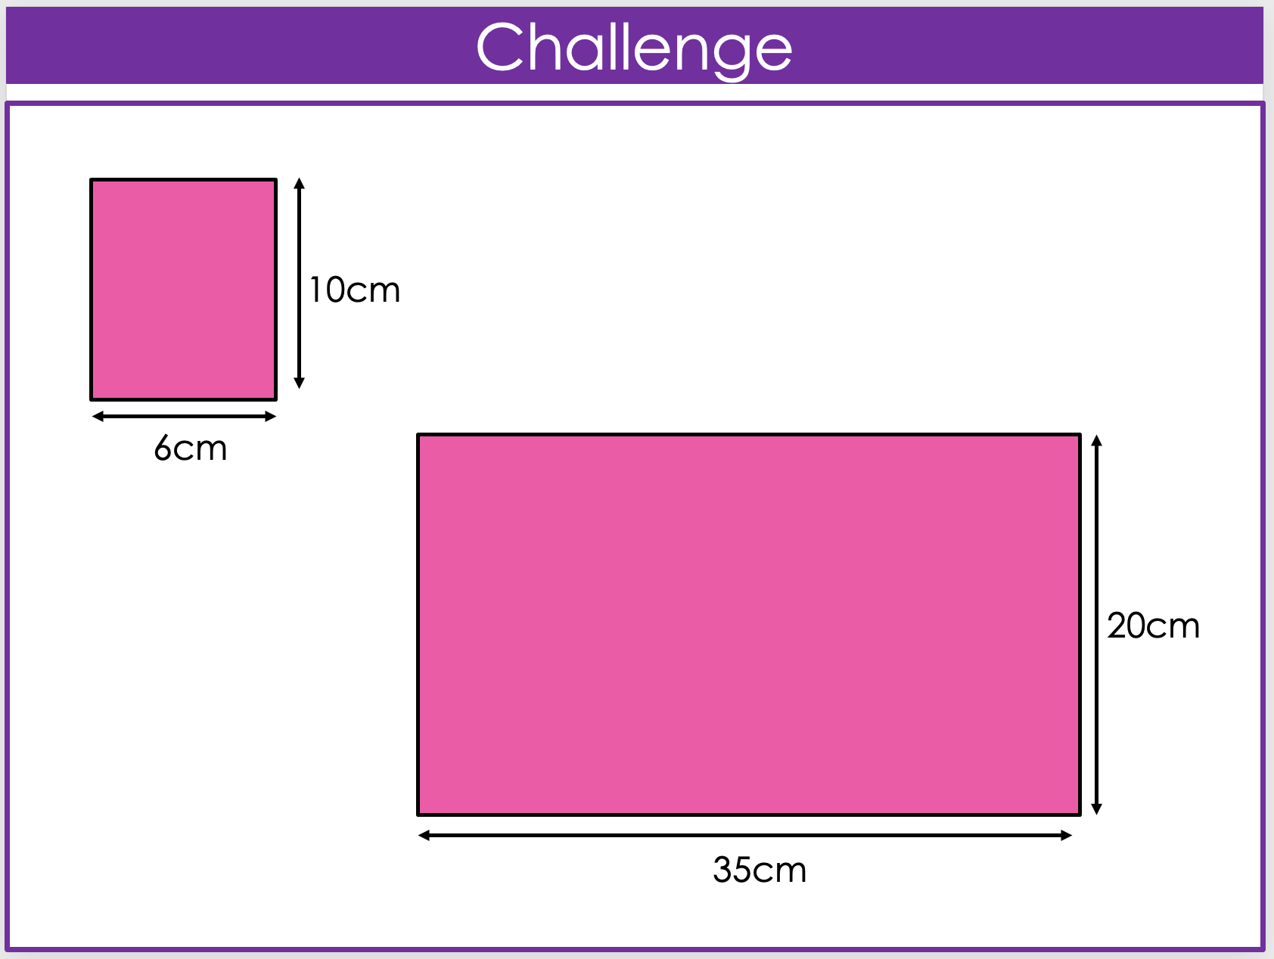
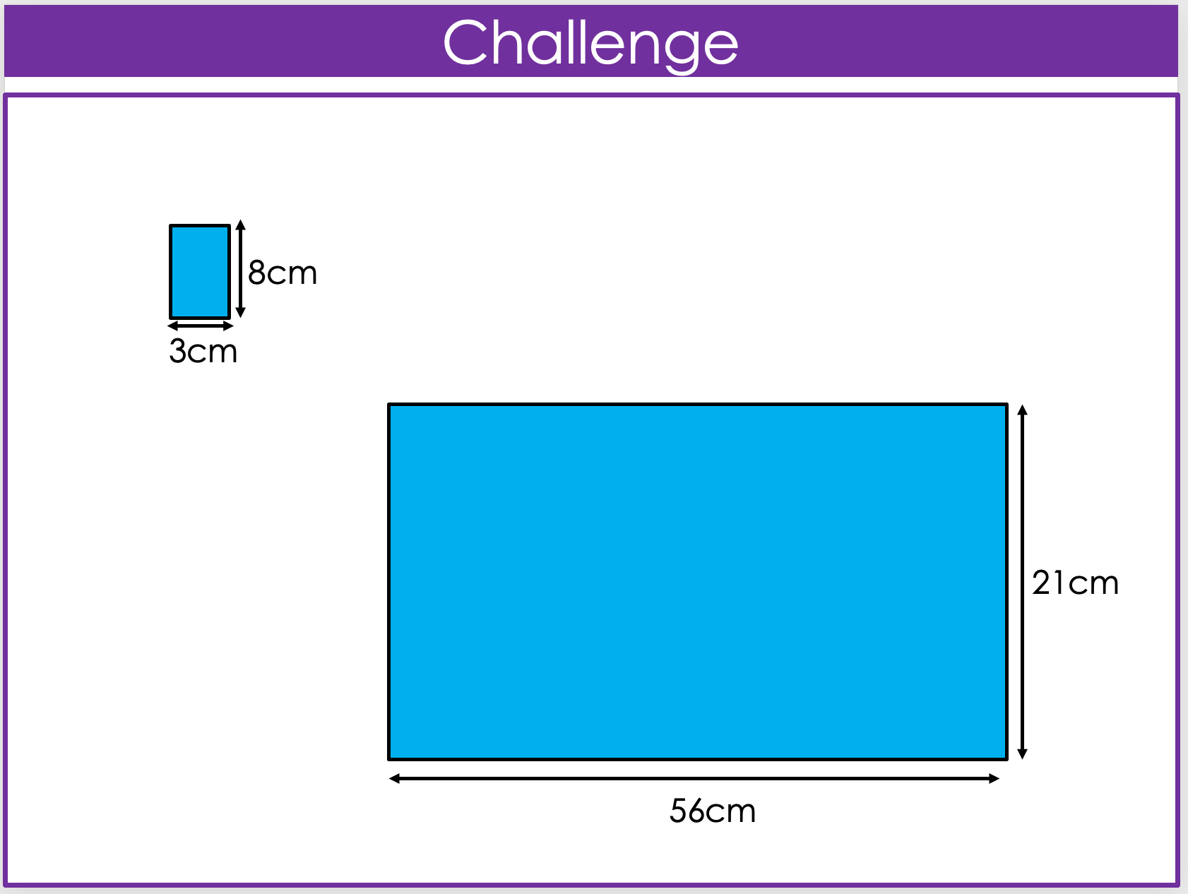
Comparing lengths
IMAGE C
IMAGE A
IMAGE B
Notes:
PLANNNNNN
Helen
Yellow, blue, pink

Slide 13
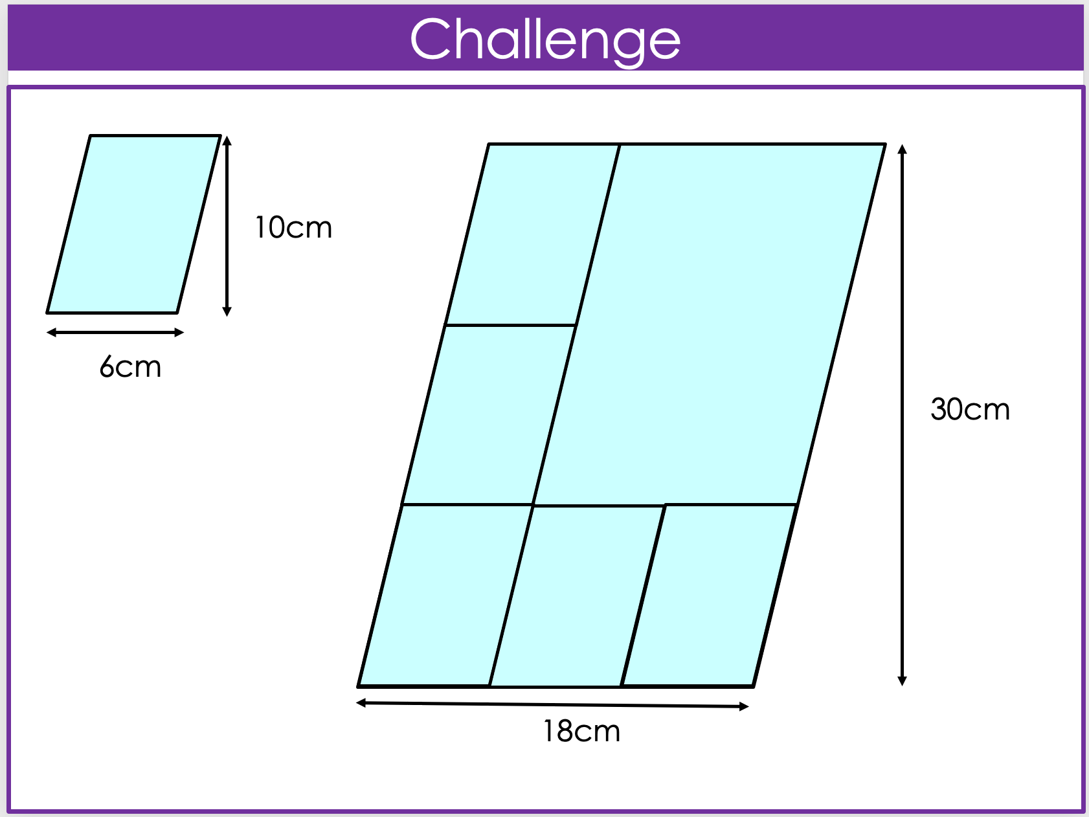
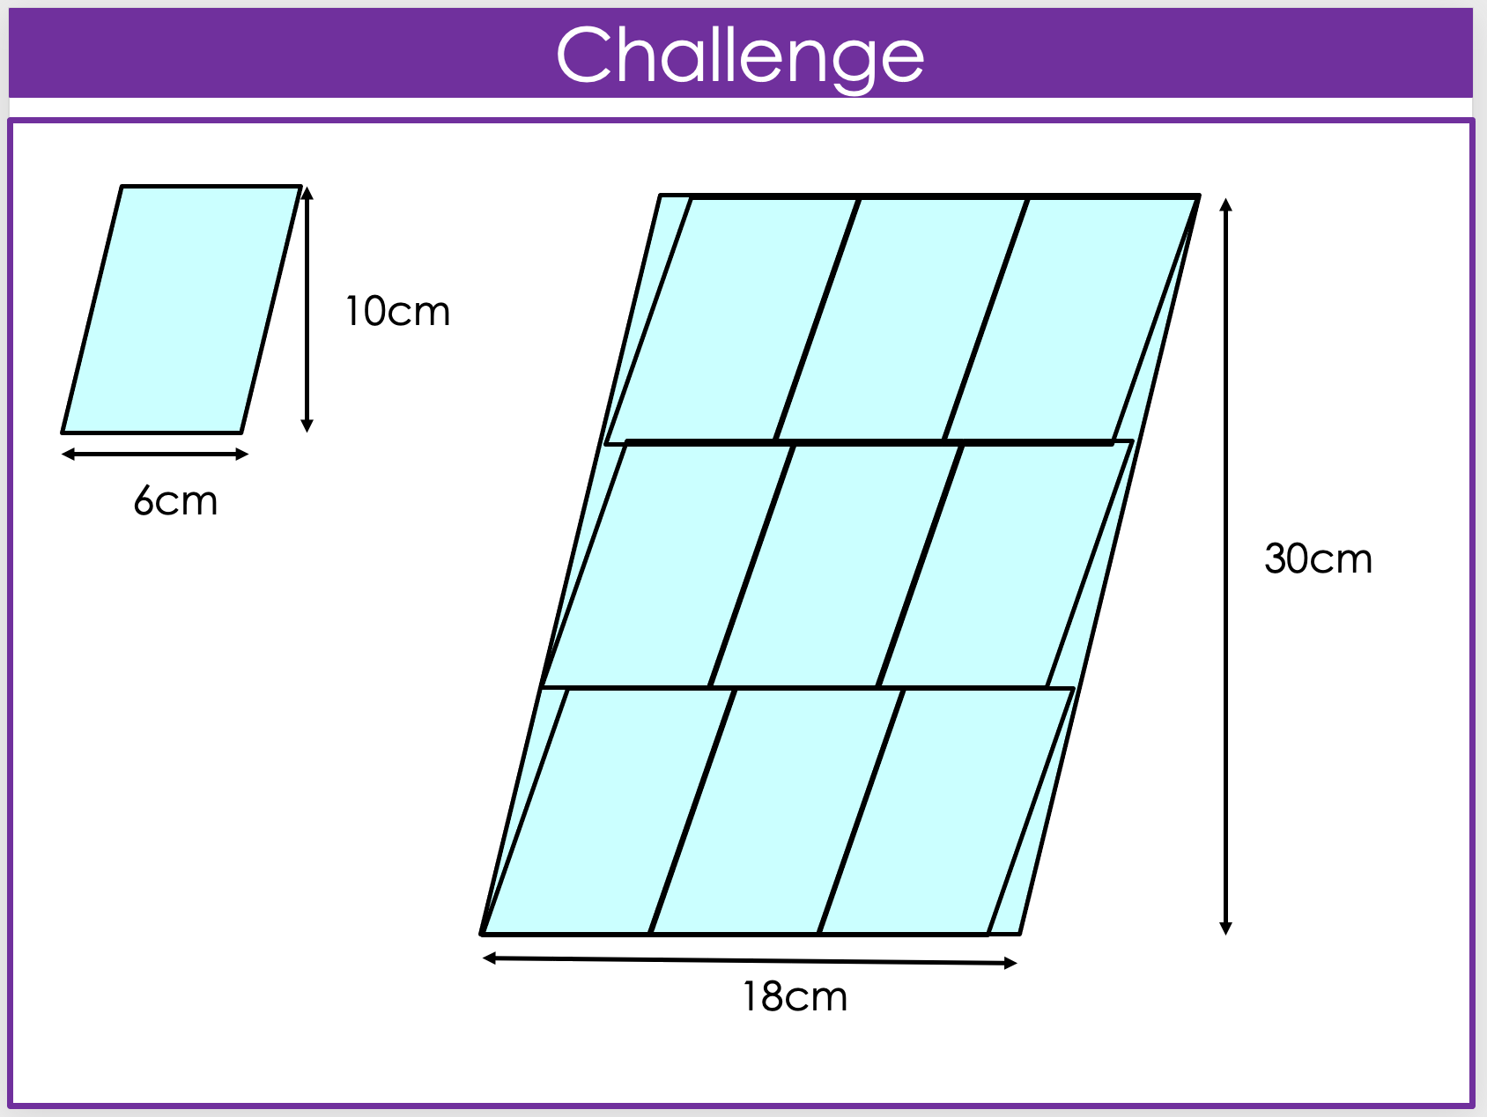
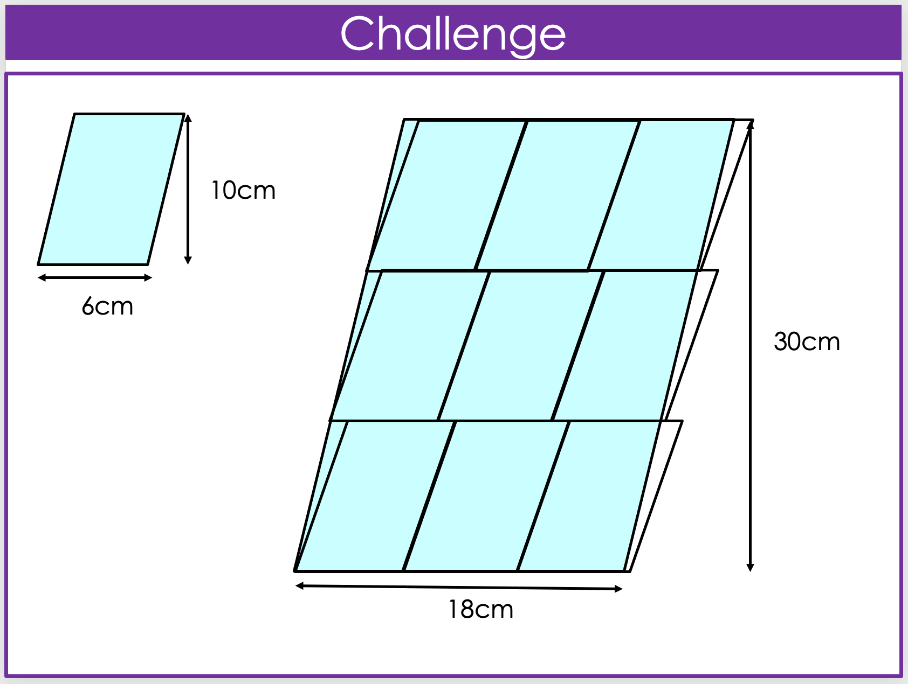
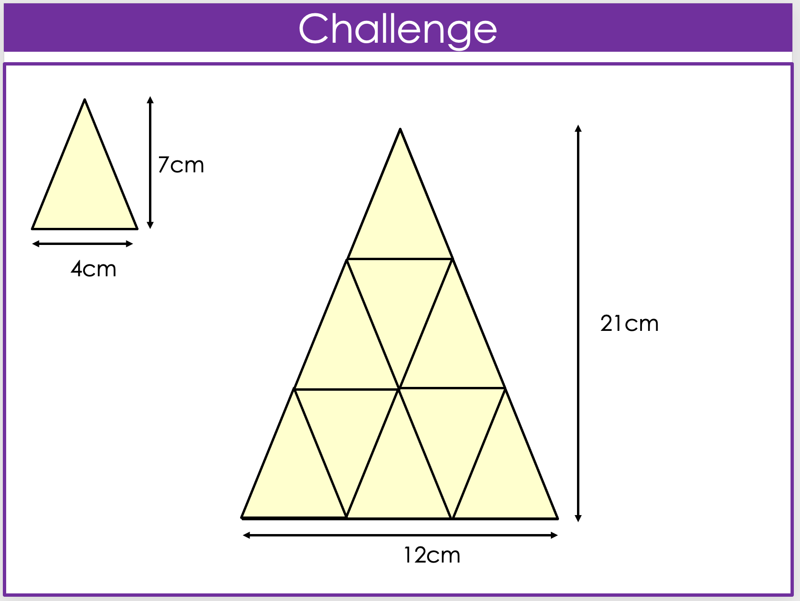
IMAGE A
IMAGE B
A variety of shapes and links to finding the areas of similar shapes
IMAGE C
IMAGE D
Notes:
CHARLOTTE & Helen - areas

Slide 14
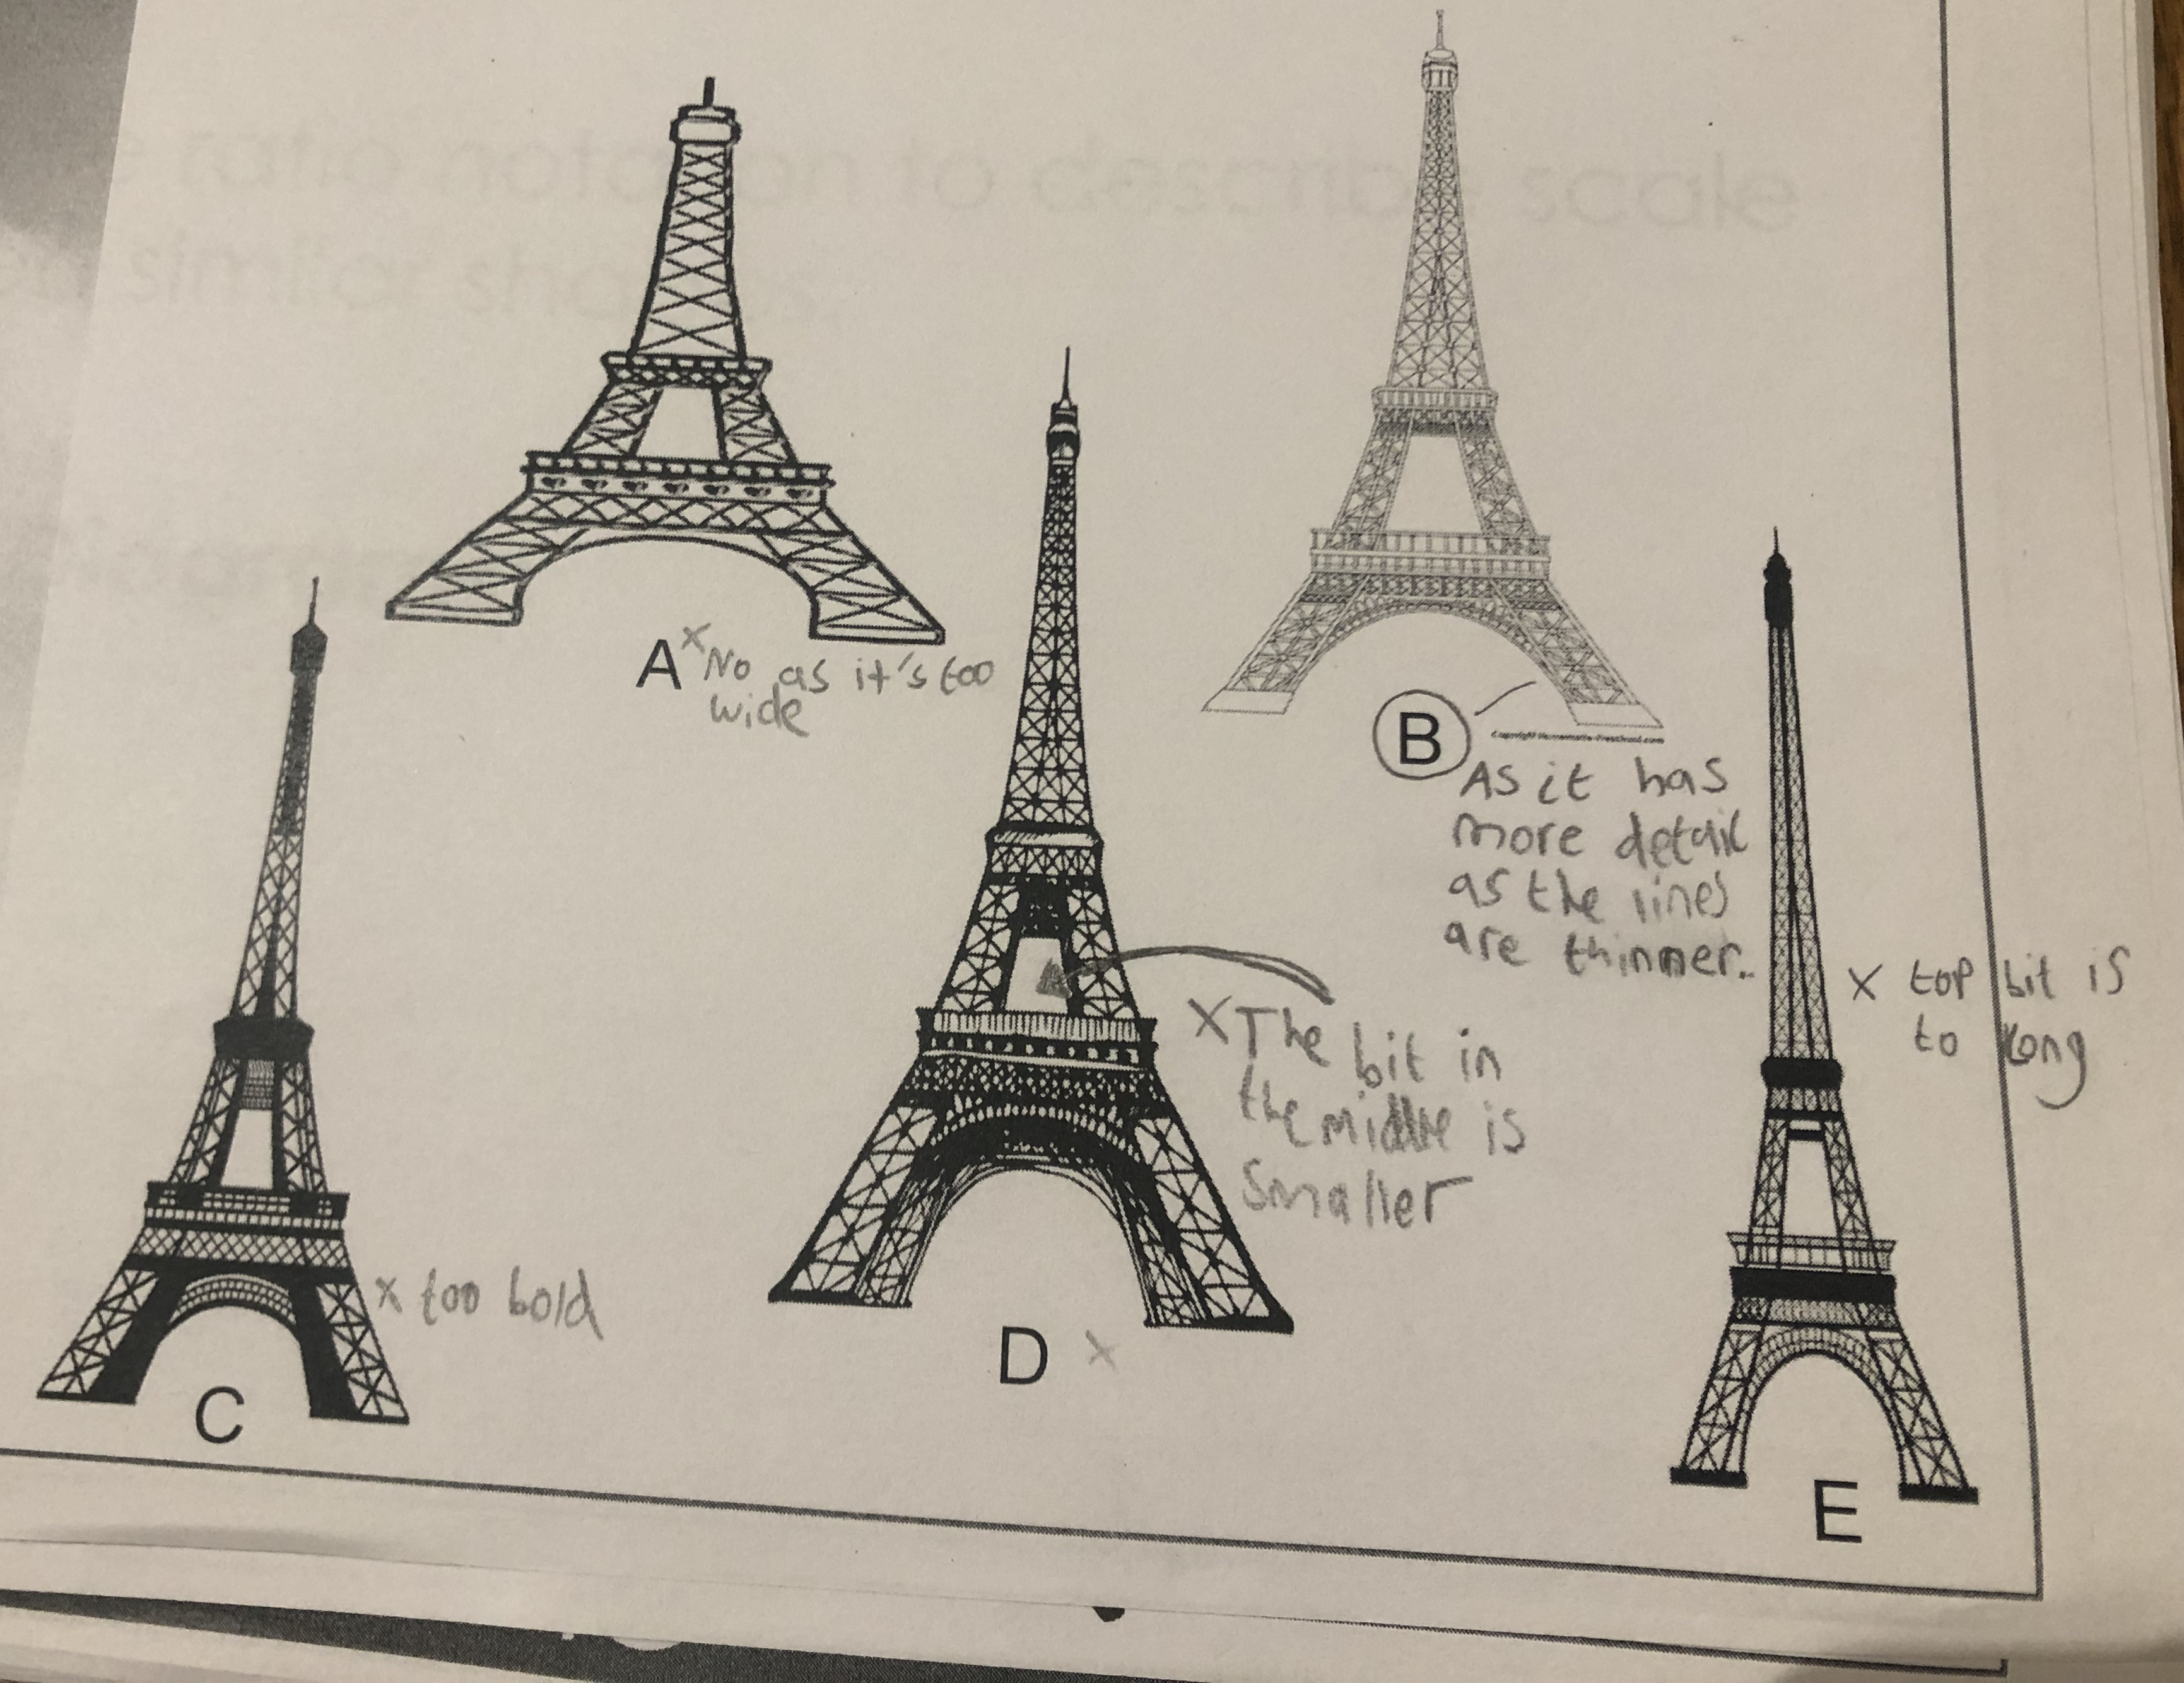
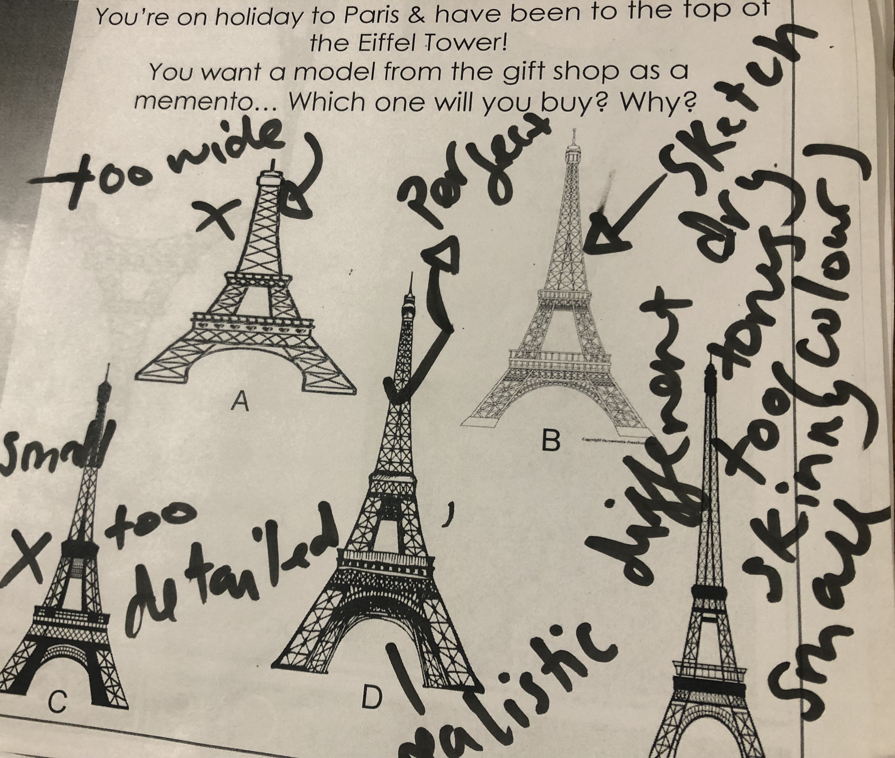
“too tall”
“cartoony”
“seems wrong”
“stretched”
“too fat”
“too wide”
“too skinny”
Notes:
Helen

Slide 15
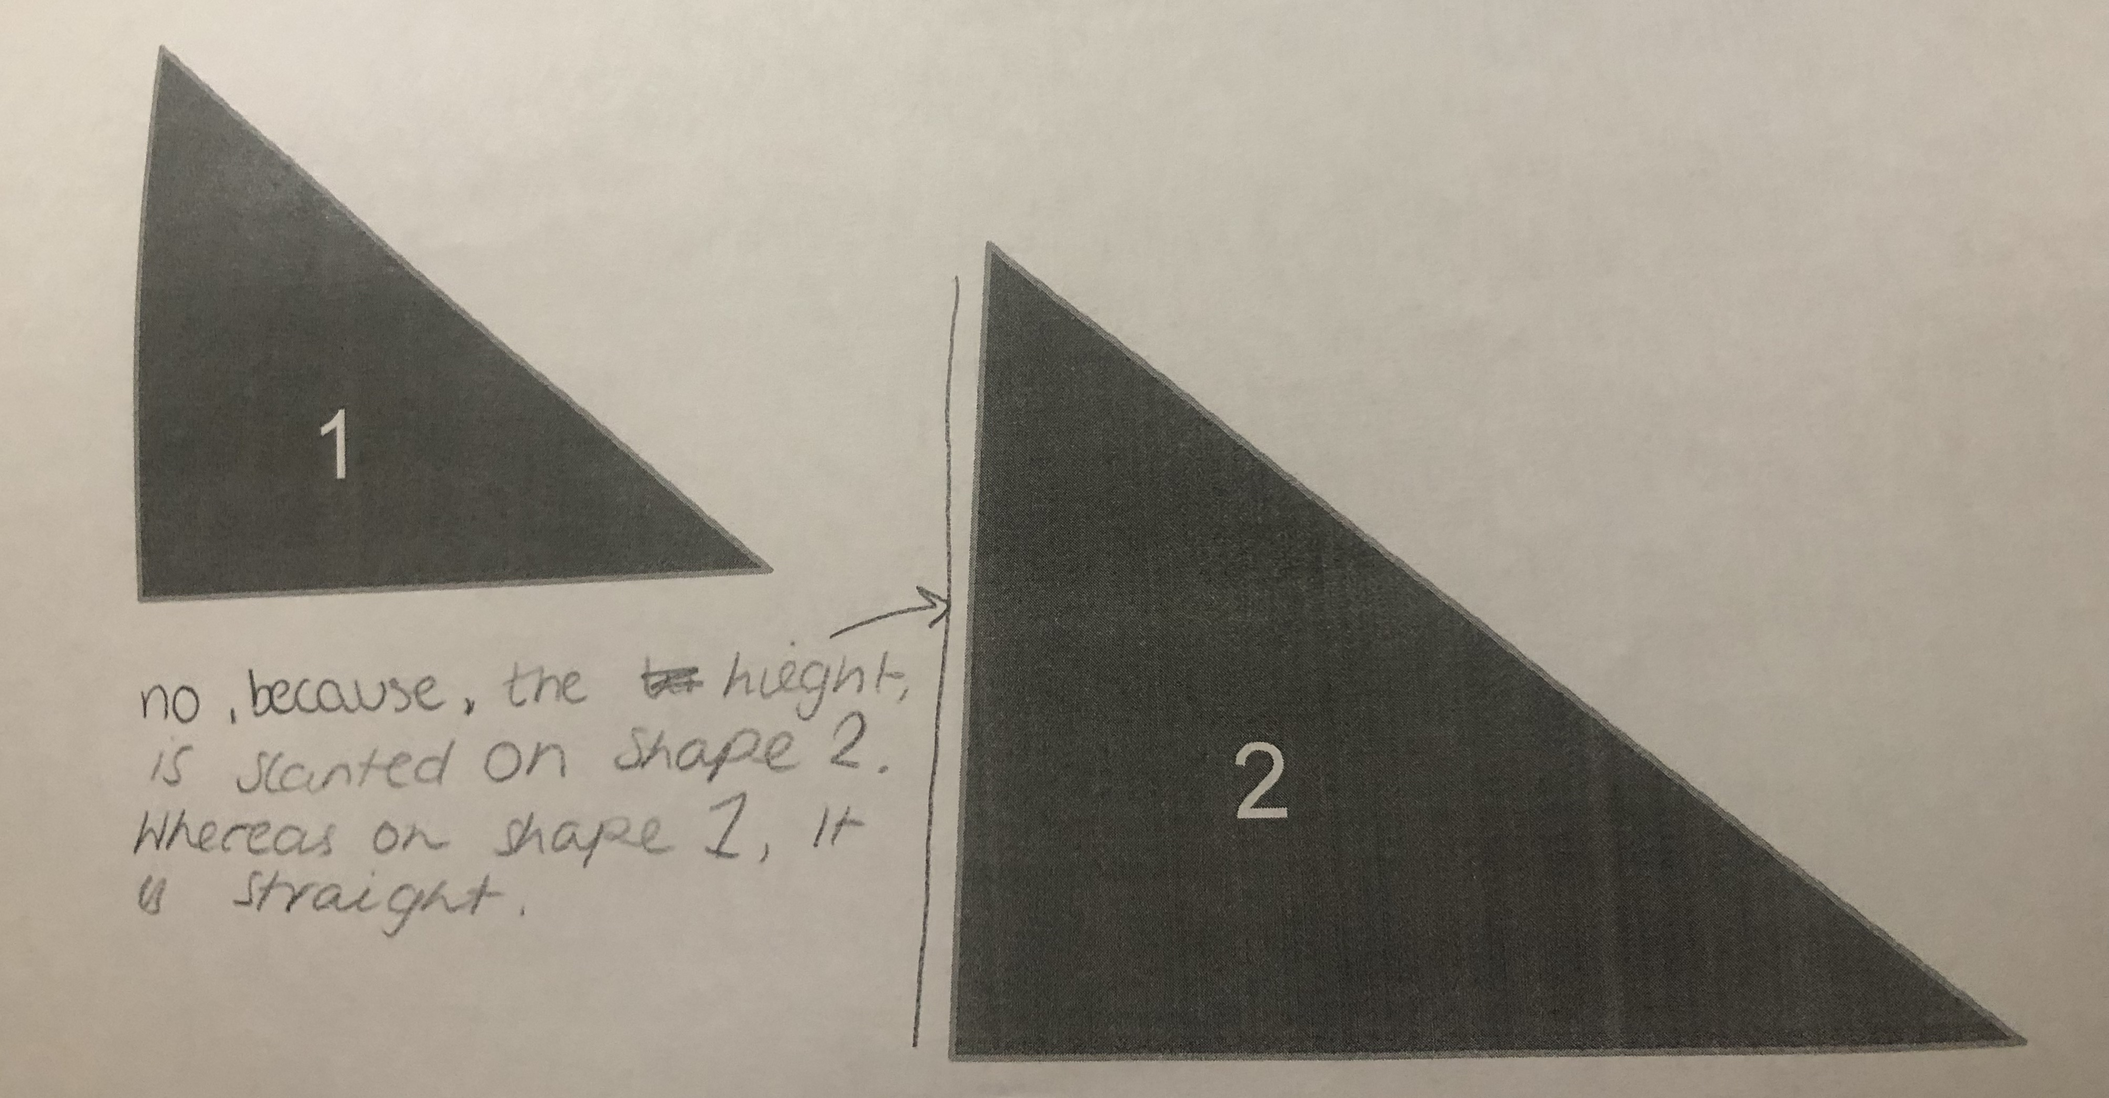
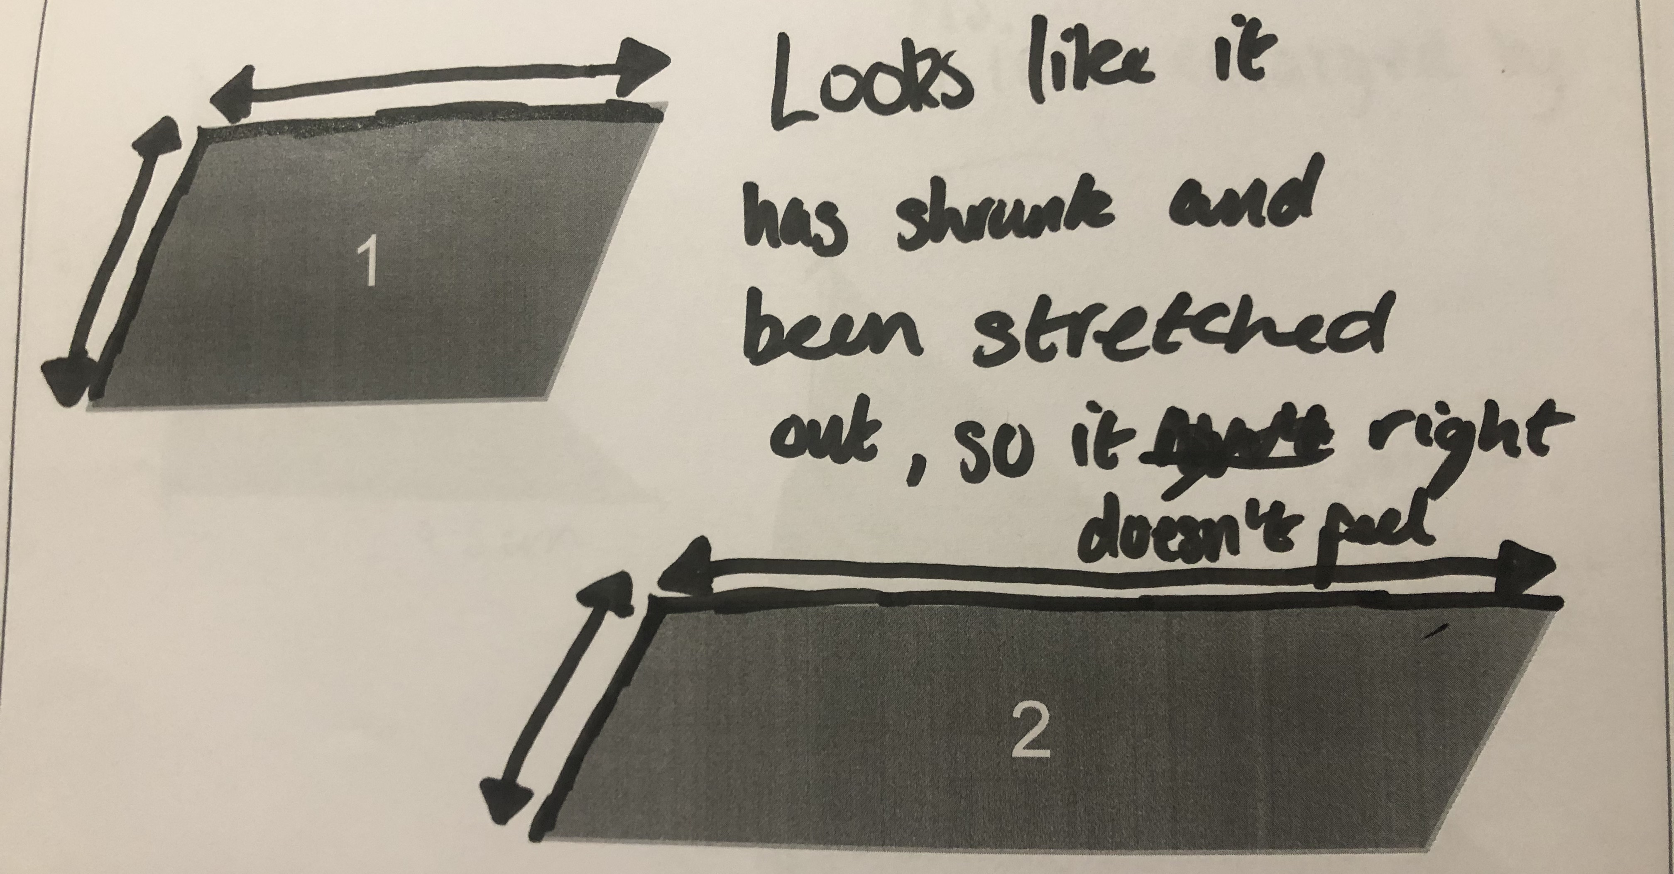
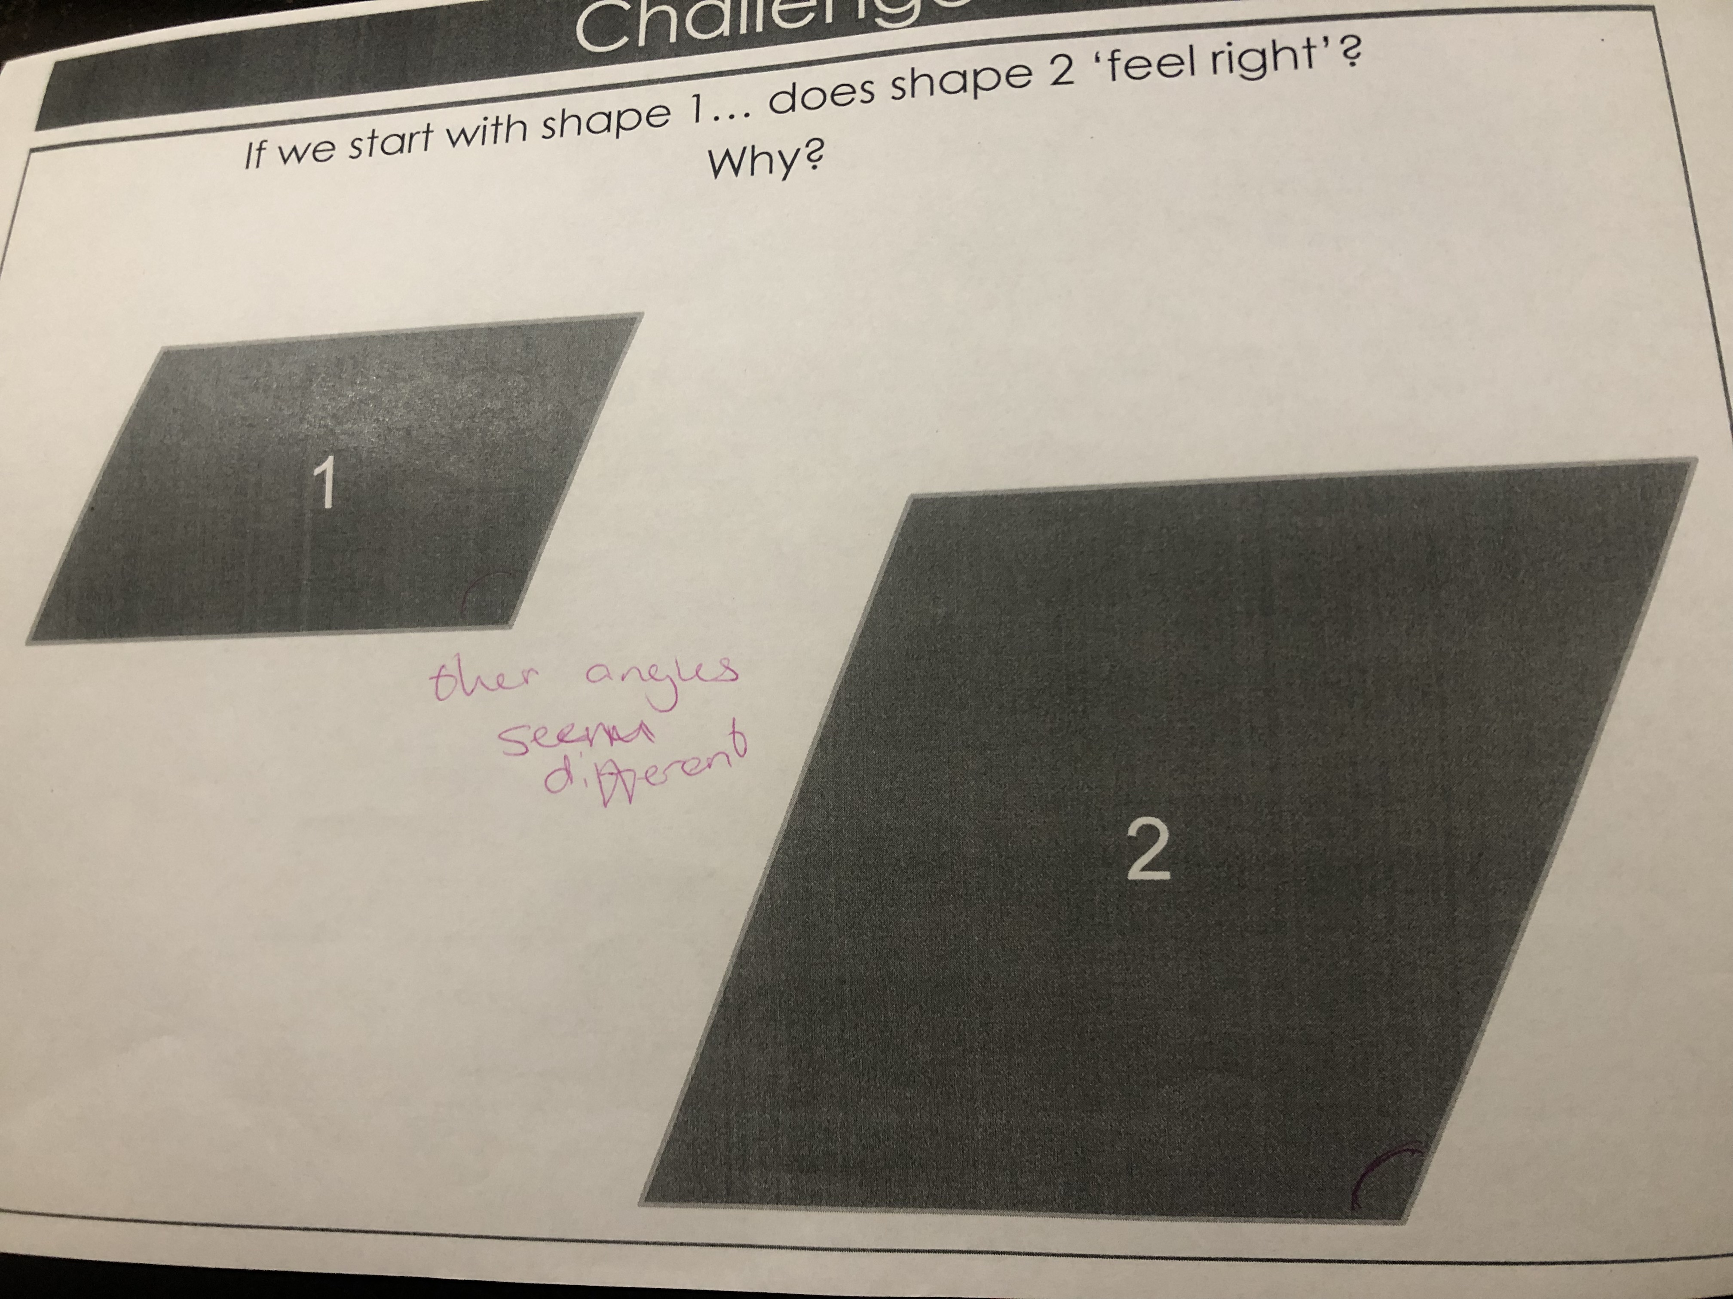
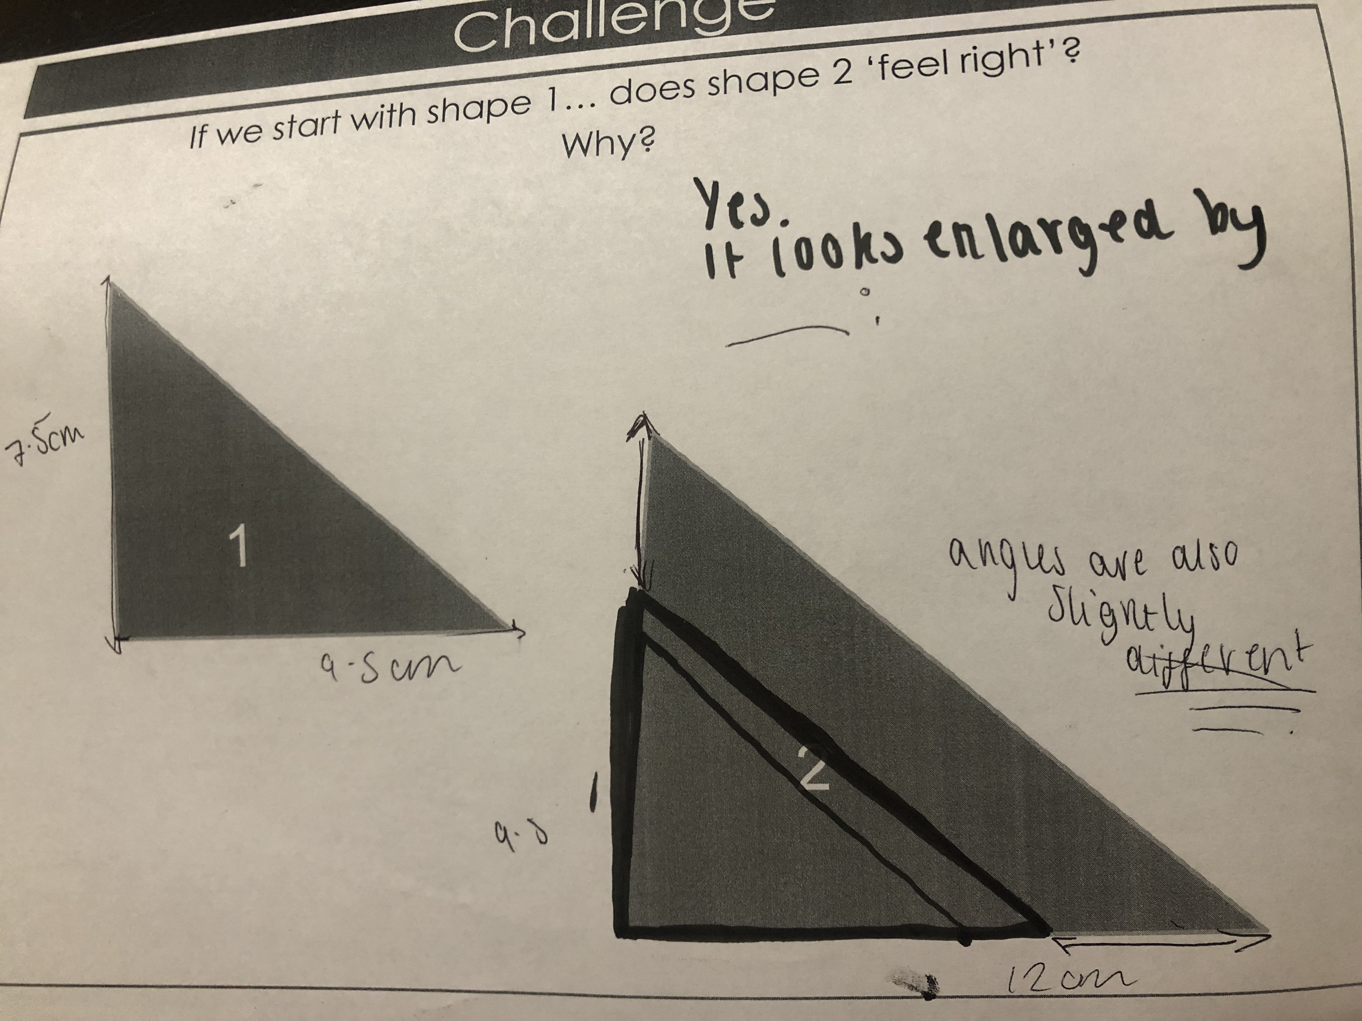
IMAGE A
IMAGE B
IMAGE C
IMAGE D
Notes:
Helen

Slide 16
IMAGE A
IMAGE B
Jack and the Beanstalk
IMAGE C
IMAGE D
Notes:
Kathryn

Slide 17
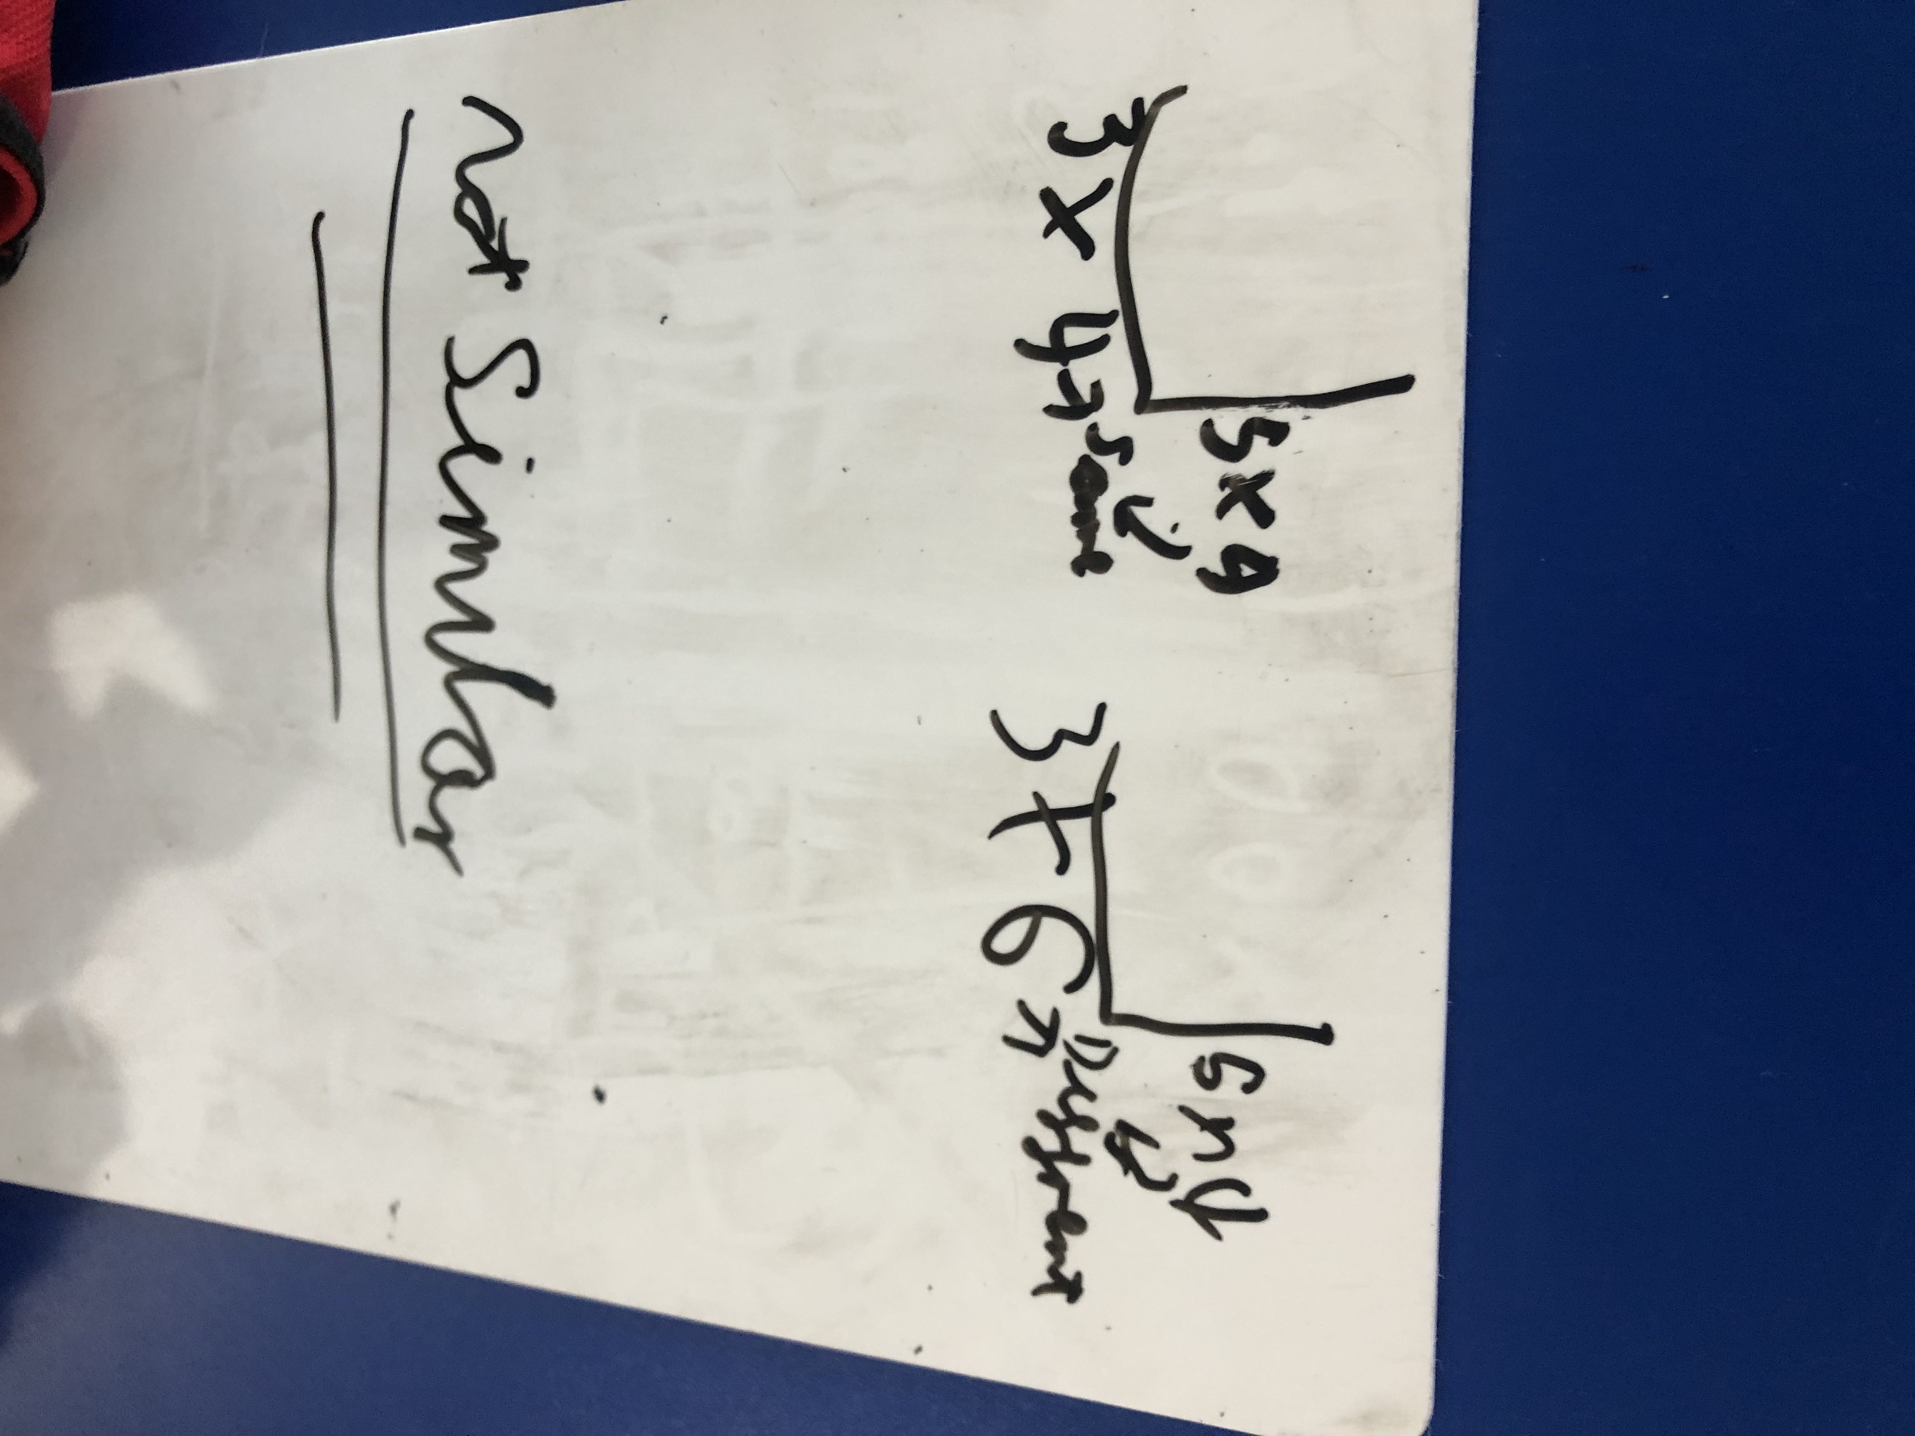
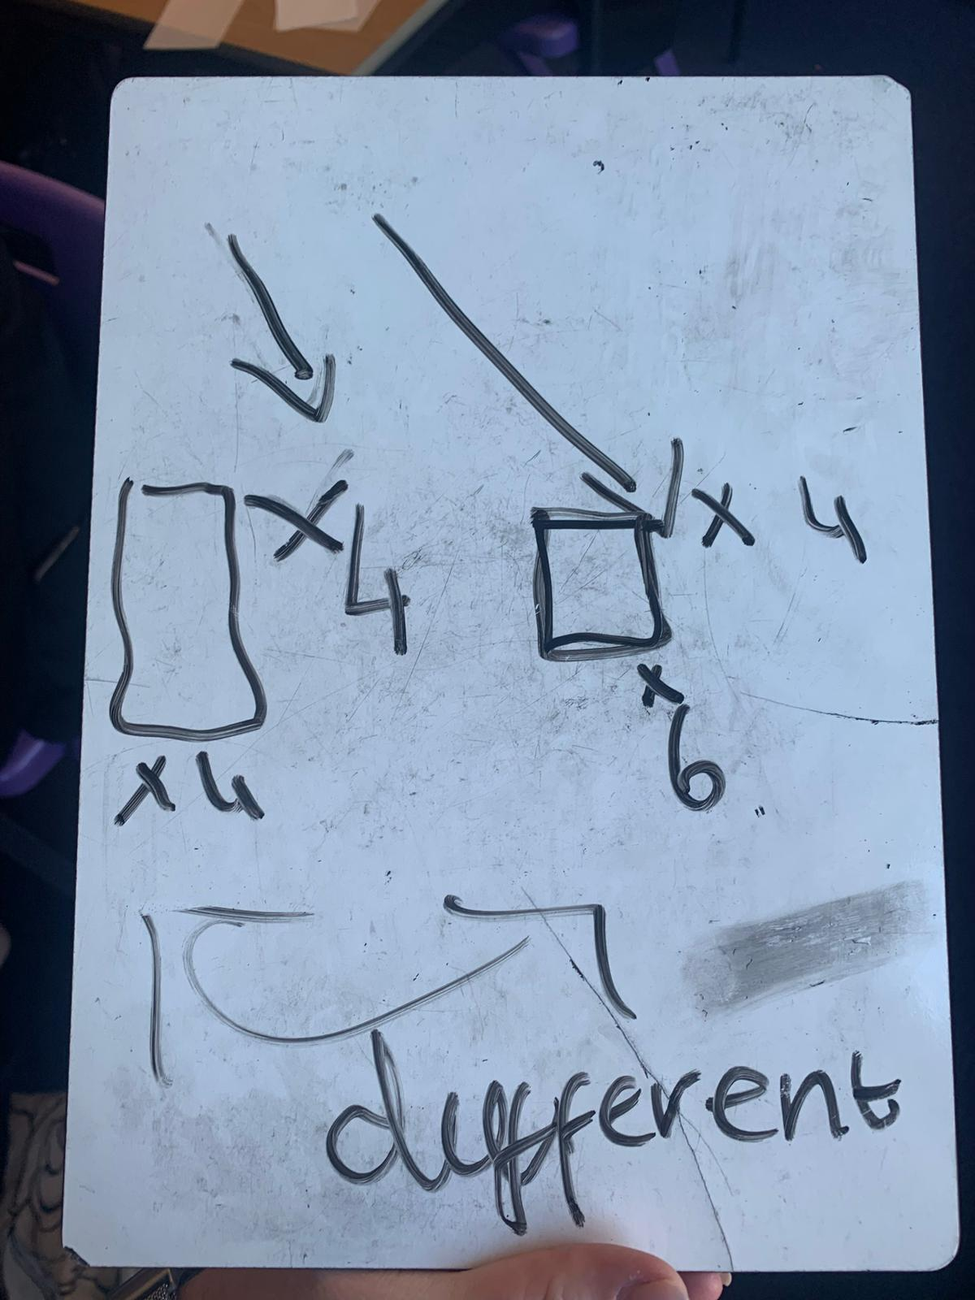
Notes:
Helen

Slide 18
Notes:
Helen & Kathryn

Slide 19
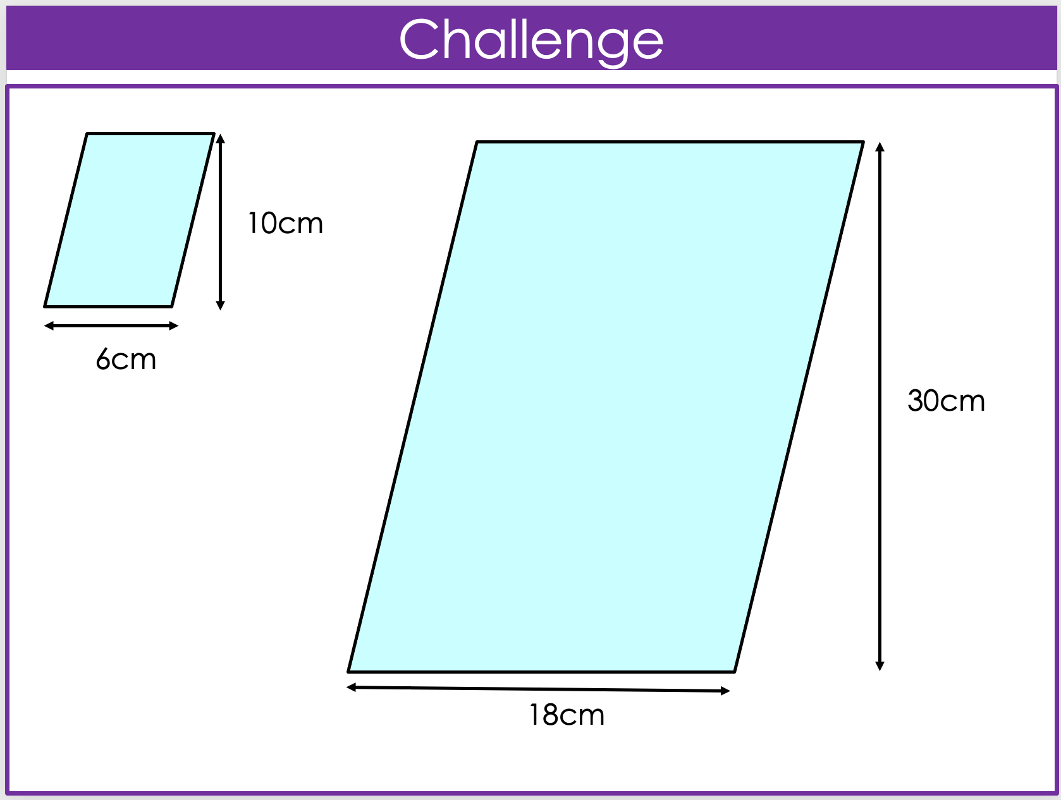
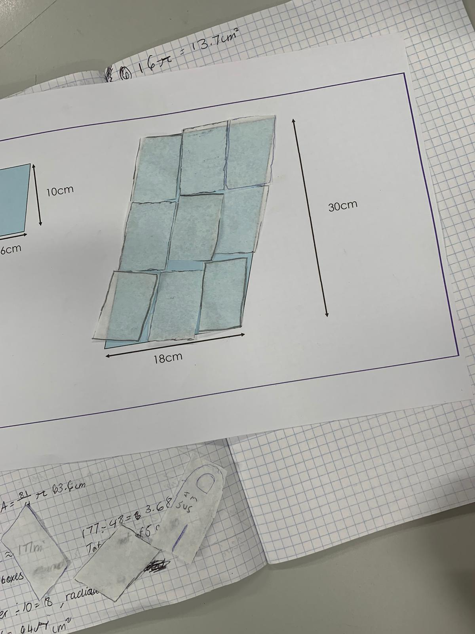
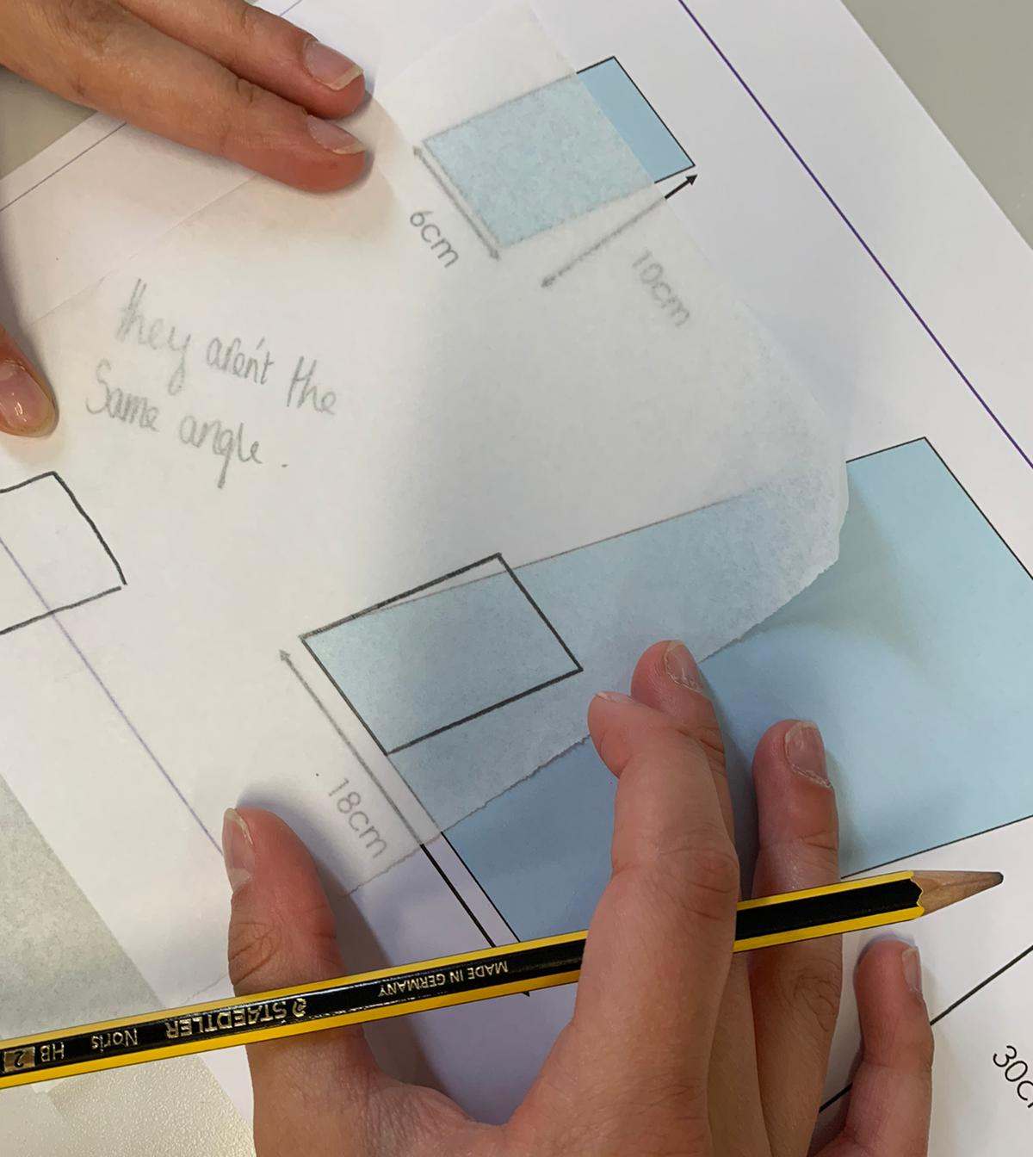
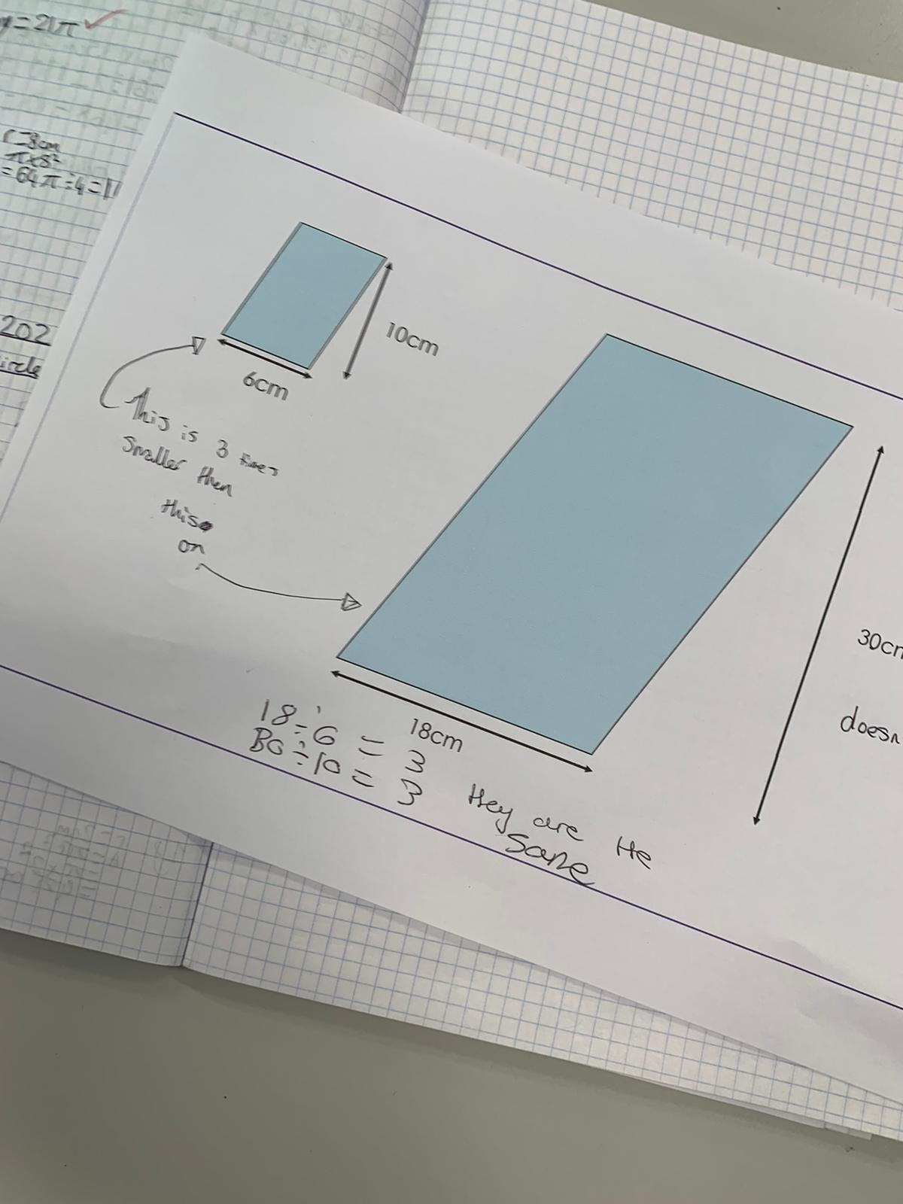
Notes:
Charlotte

Slide 20
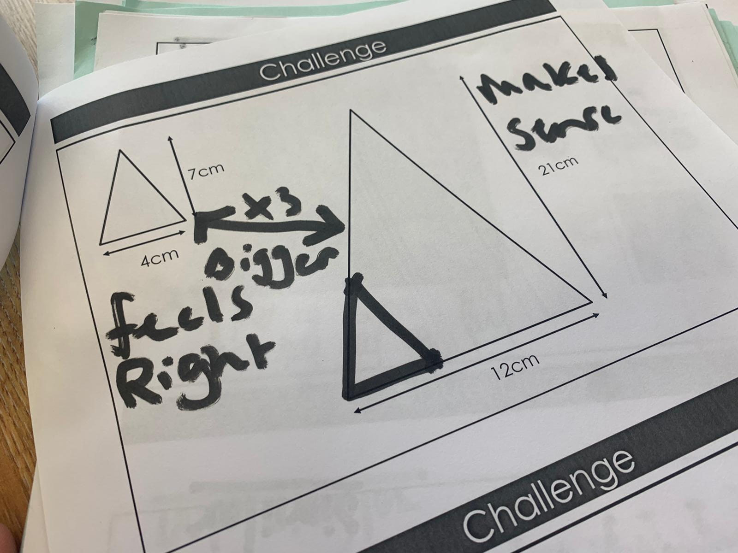
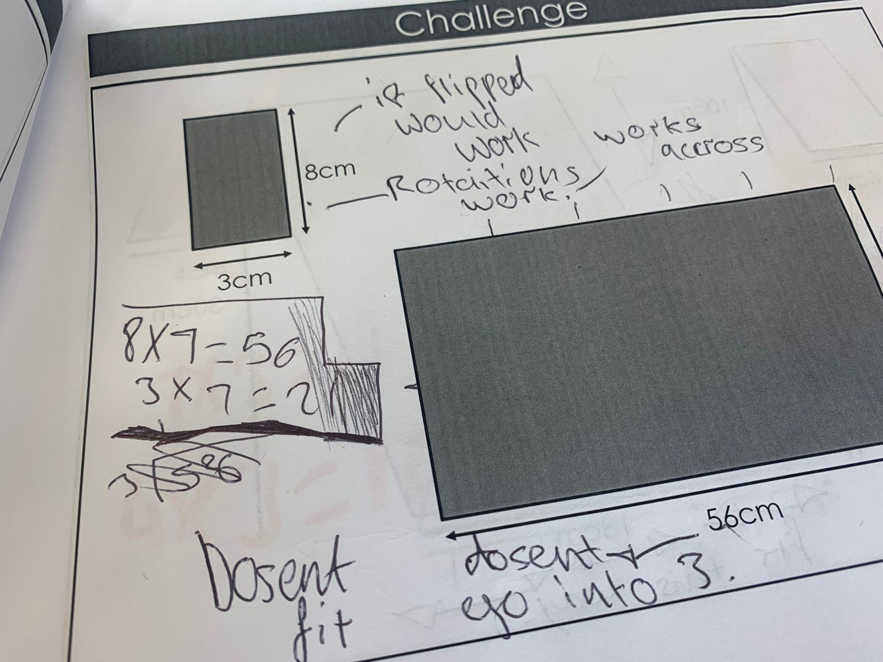
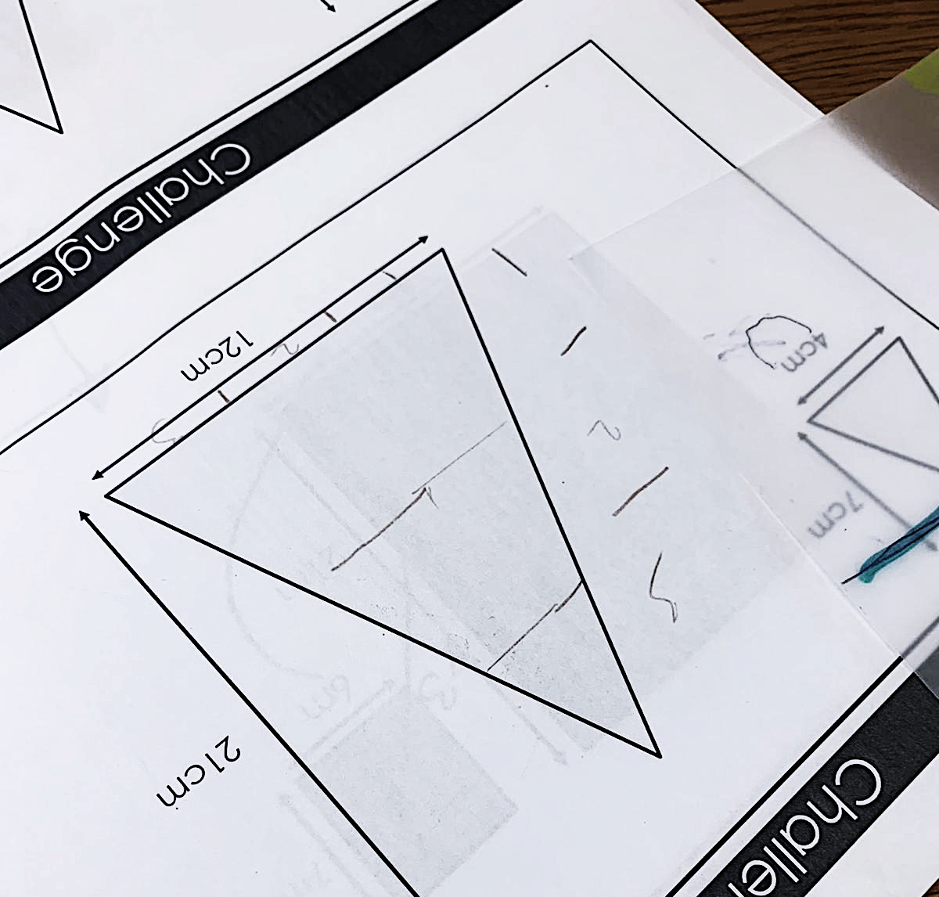
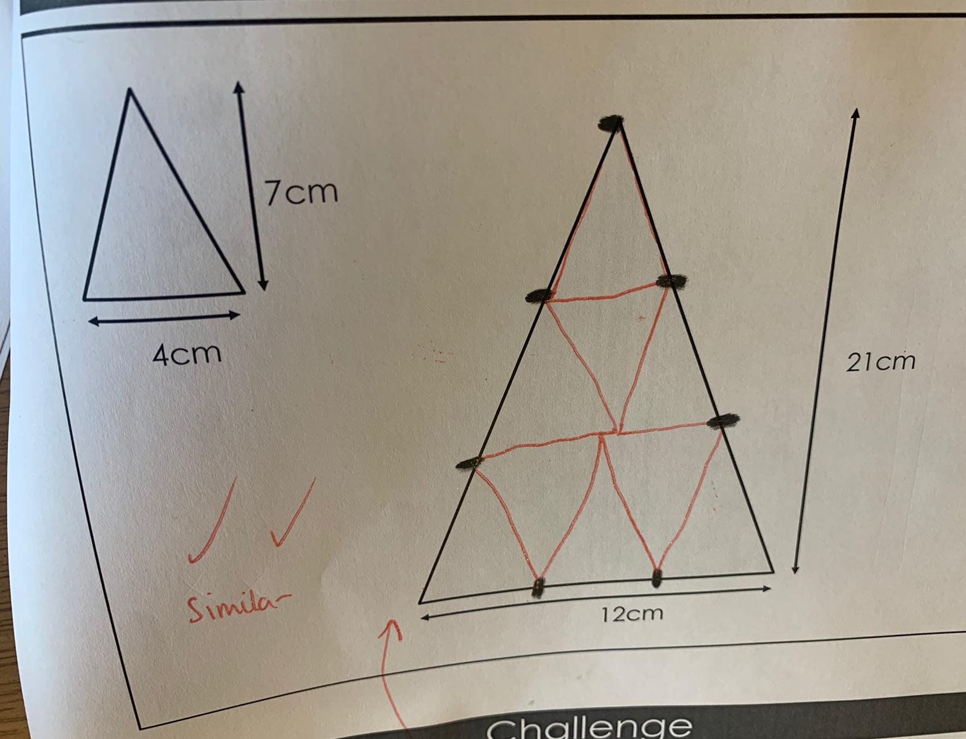

Notes:
Kathryn

Slide 21
Fixed notion of shapes
Sense of similarity
Estimating before using values
Rectangly-rectangles
Language
Viewing in other ways
Different classroom cultures
Varying shapes
Listen!
Physically playing with the Maths
Linking different ways of checking similarity
Notes:
Language used
Letting kids talk vs just telling them…BALANCE…CARE
Physically playing with the maths
Having a sense of similarity through more than just comparing the numbers…rated addition within a shape?
Giving them more than one way to see similarity
Some rectangles not as rectangly as others
Different cultures (of schools/classrooms)
Not being afraid just to listen…allow discussions
Informal intro to proof

Slide 22

Resources
Follow on tasks
Link to helen’s site/blog post
Notes:
Charlotte

Slide 23
Notes:
Charlotte – overcoming bottom middle

Slide 24
Notes:
Kathryn

Slide 25
What would we do differently? (Similarity)
Make sure shapes are to scale – tracing paper
Eiffel tower – image choice
How we prompt
Sequencing of the lesson
Next steps – links, viewed in other ways
Notes:
Helen…
All

Slide 26
Students won’t do what you expect – adapting resources
Nice to hear and talk about how others teach
Three was a nice number ‘v’ dept
Not being afraid just to listen
Benefit of lots of experiences
Gave trust in the lesson
Collaboration in dept vs collaboration with others
Nice to hear and talk about how others teach
Notes:
Kathryn
All

Slide 27
Charlotte Hawthorne
@mrshawthorne7
Kathryn Darwin
@Arithmaticks
Helen Konstantine
@giftedHKO
Notes:
Helen – Materials… link to blog.

