Slide 1
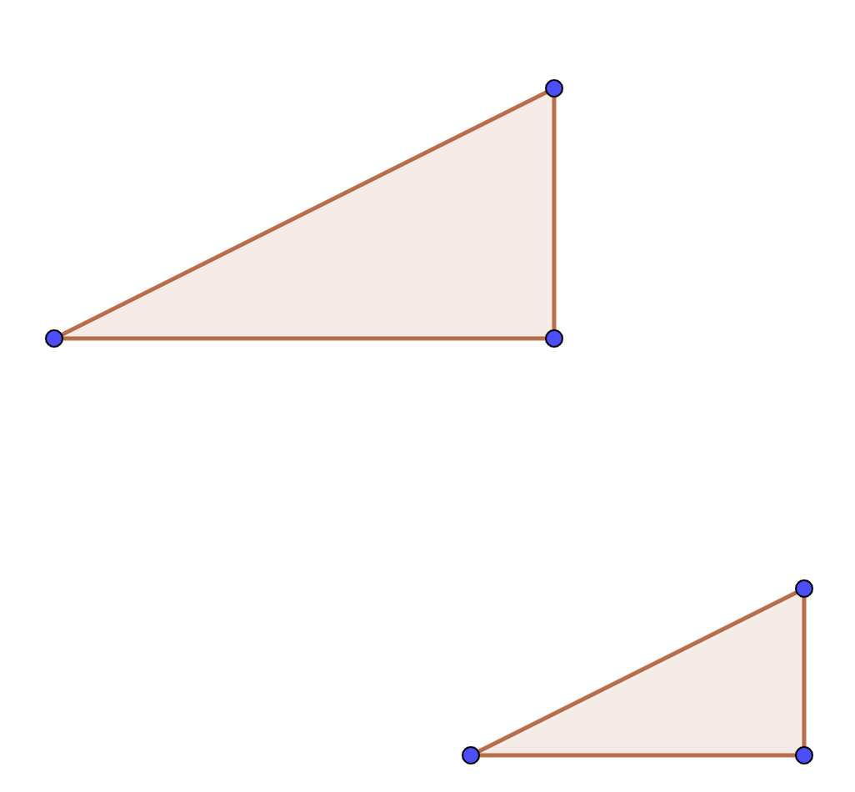
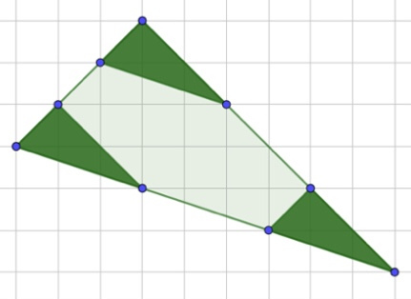




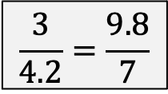

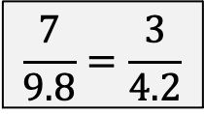

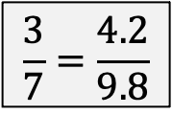
Shape A is SIMILAR to shape B
Find the co-ordinate C
Amy makes shapes ABCD with identical tiles. Is shape ABCD SIMILAR to a single tile?
ABCD is SIMILAR to EFGH
E
7cm
F
$$(10, 9)$$
9.8cm
A
3cm
B
A
A
B
H
G
$$(10, 6)$$
4.2cm
$$(4, 6)$$
D
C
$$C$$
Which of the following is incorrect
B
$$\frac{3}{7}=\frac{4.2}{9.8}$$
$$\frac{7}{9.8}=\frac{3}{4.2}$$
$$\frac{3}{4.2}=\frac{9.8}{7}$$
$$(9, 1)$$
$$(13, 1)$$
D
C
Bilal draws a rhombus with sides of length 7cm
Cara says she can draw a shape that has lengths that are twice as long but isn’t SIMILAR. Is she correct?
3 congruent shapes are placed onto a shape. What does this tell you about the larger and smaller shapes?
A
7cm
B
D
C

