Slide 1



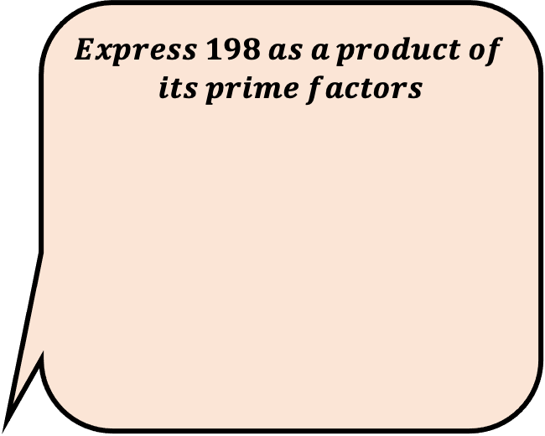
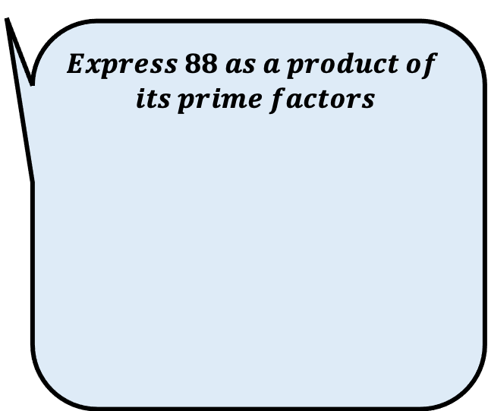
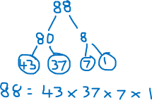
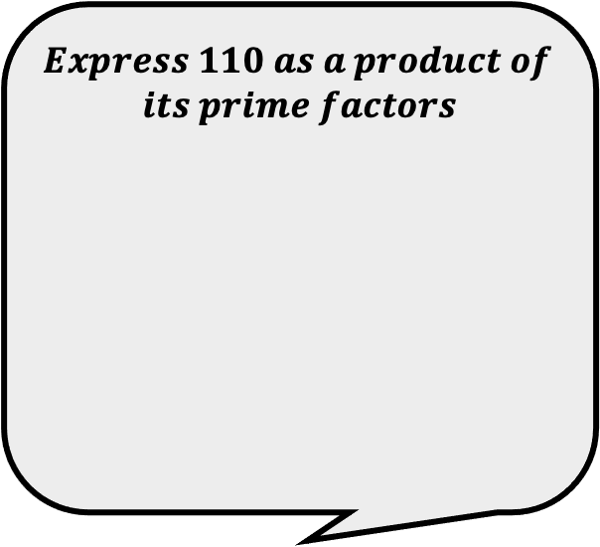
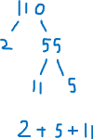
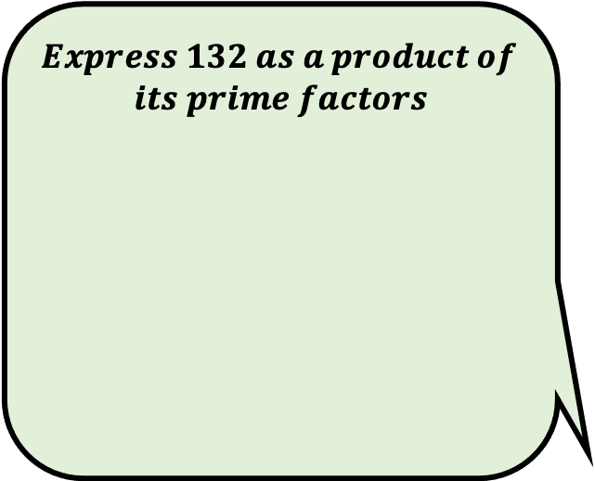

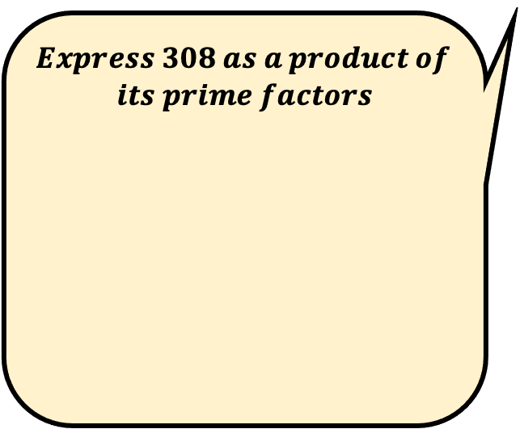
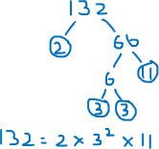
$$Express 88 as a product of$$
$$its prime factors$$
$$Express 308 as a product of$$
$$its prime factors$$
Find the errors in each persons answer.
Answer the questions correctly.
What do you notice about your answers?
Ali’s Answer
Ella’s Answer
$$Express 198 as a product of$$
$$its prime factors$$
$$Express 110 as a product of$$
$$its prime factors$$
$$Express 132 as a product of$$
$$its prime factors$$
Bilal’s Answer
Cara’s Answer
Demi’s Answer

