Slide 1




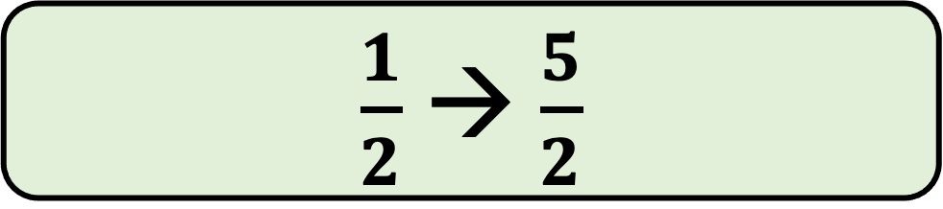

Question 1
Which of the “input → output” results below is incorrect for the function machine below?
input
output
$$×11$$
$$−3$$
$$7 → 74$$
$\frac{1}{2}$ $→$ $\frac{5}{2}$
A
B
$−1 → −8$
0$→ −3$
c
D

Slide 2
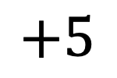






Question 2
For the function machine below
What is the input if the output is $−3$
input
output
$$×4$$
$$+5$$
$$\frac{1}{2}$$
$$−2$$
A
B
$2$
$$−32$$
c
D

Slide 3
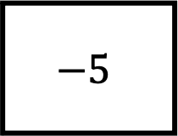

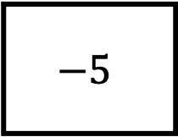

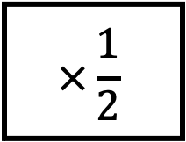
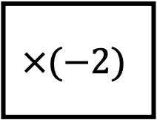
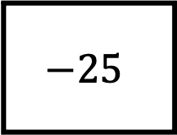
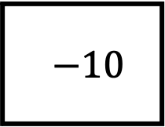
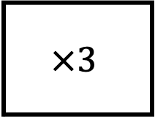
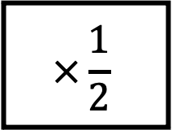
Question 3
Which of the pair of rules below do not map 9 onto 2?
9
2
$$?$$
$$?$$
A
$$×3$$
$$−25$$
B
$$−5$$
$$×\frac{1}{2}$$
c
$$×\frac{1}{2}$$
$$−5$$
D
-$−10$
$$×(−2)$$

Slide 4

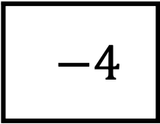

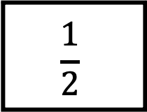
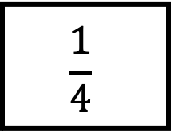
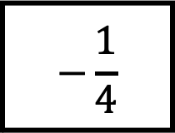
Question 4
Which of the following can fill the gap?
-5
$$× ?$$
2
$$−3$$
A
$$−\frac{1}{4}$$
B
$$\frac{1}{2}$$
c
$$\frac{1}{4}$$
D
-$−4$

Slide 5
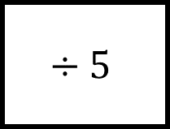
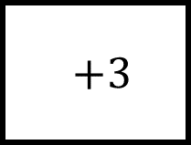


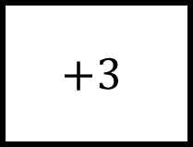


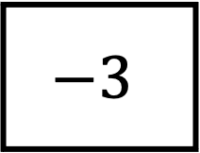


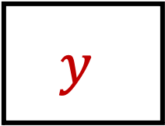
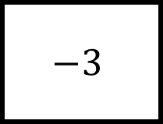
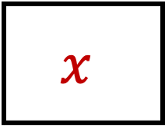

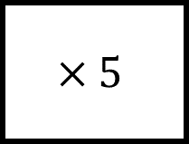





Question 5
Which function machine maps $y$ back to $x$?
$$x$$
$$−3$$
$$y$$
$$×5$$
A
$$+3$$
$$÷5$$
B
$$−3$$
$$÷5$$
$$y$$
$$x$$
$$y$$
$$x$$
c
$$−3$$
$$×5$$
D
-$+3$
$$×5$$
$$y$$
$$x$$
$$y$$
$$x$$

Slide 6
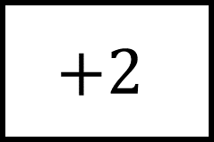
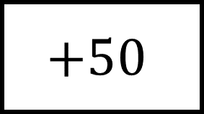
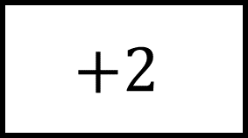
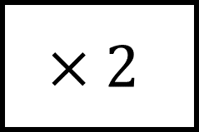
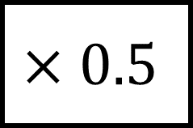
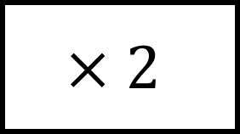
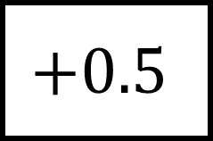
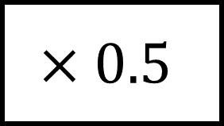
Question 6
Kayla takes a taxi to work
She pays an initial charge of £2 and 50p a mile
What needs to go in the gaps above?
Number of miles
Total cost
A
$$×2$$
$$+50$$
B
$$×0.5$$
$$+2$$
c
$$+0.5$$
$$×2$$
D
$$+2$$
$$×0.5$$

Slide 7
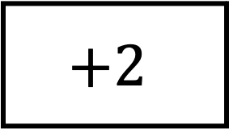
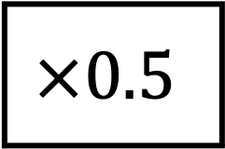
Question 7
Kayla takes a taxi to work.
If her journey is 7 miles
How much does her journey cost?
Number of miles
$$×0.5$$
$$+2$$
Total cost
£4.50
£5.50
A
B
£9.50
£3.52
c
D

Slide 8
Question 8
Kayla takes a taxi to work.
If her journey costs £7
How many miles did she travel?
Number of miles
$$×0.5$$
$$+2$$
Total cost
10 miles
2.5 miles
A
B
4.5 miles
9 miles
c
D

Slide 9
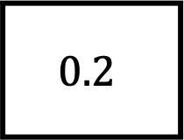

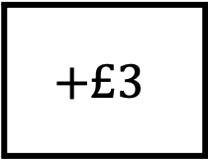

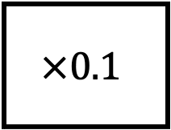
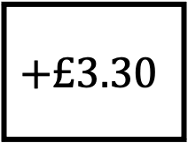
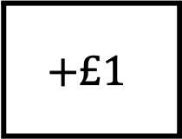
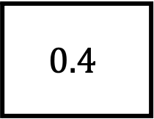
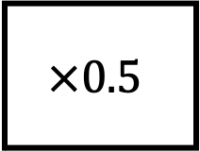
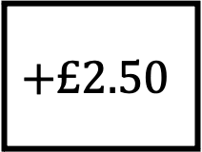
Question 9
Kayla uses a different taxi company.
Her journey for 5 miles costs £3.50
Which pair wouldn’t fill the boxes?
5 miles
$$?$$
$$?$$
£3.50
A
$$×0.5$$
$$+£1$$
B
$$0.2$$
$$+£2.50$$
c
$$×0.1$$
$$+£3$$
D
$$0.4$$
$$+£3.30$$

Slide 10
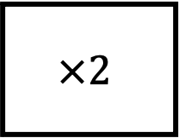
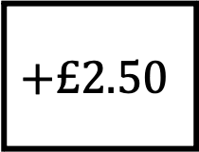
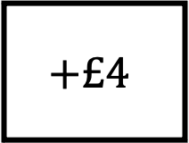
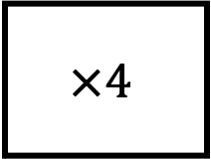
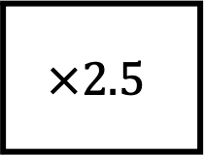
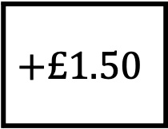
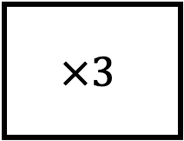
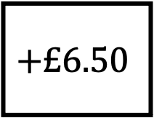
Question 10
Kayla uses a different taxi company.
Her journey for 4 miles costs £14
Her journey for 5 miles costs £16.50
Which pair fills the boxes?
miles
cost
A
$$×4$$
$$+£2.50$$
B
$$×2.5$$
$$+£4$$
c
$$×3$$
$$+£1.50$$
D
$$×2$$
$$+£6.50$$

