Slide 1
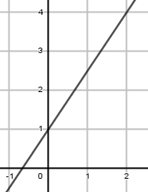
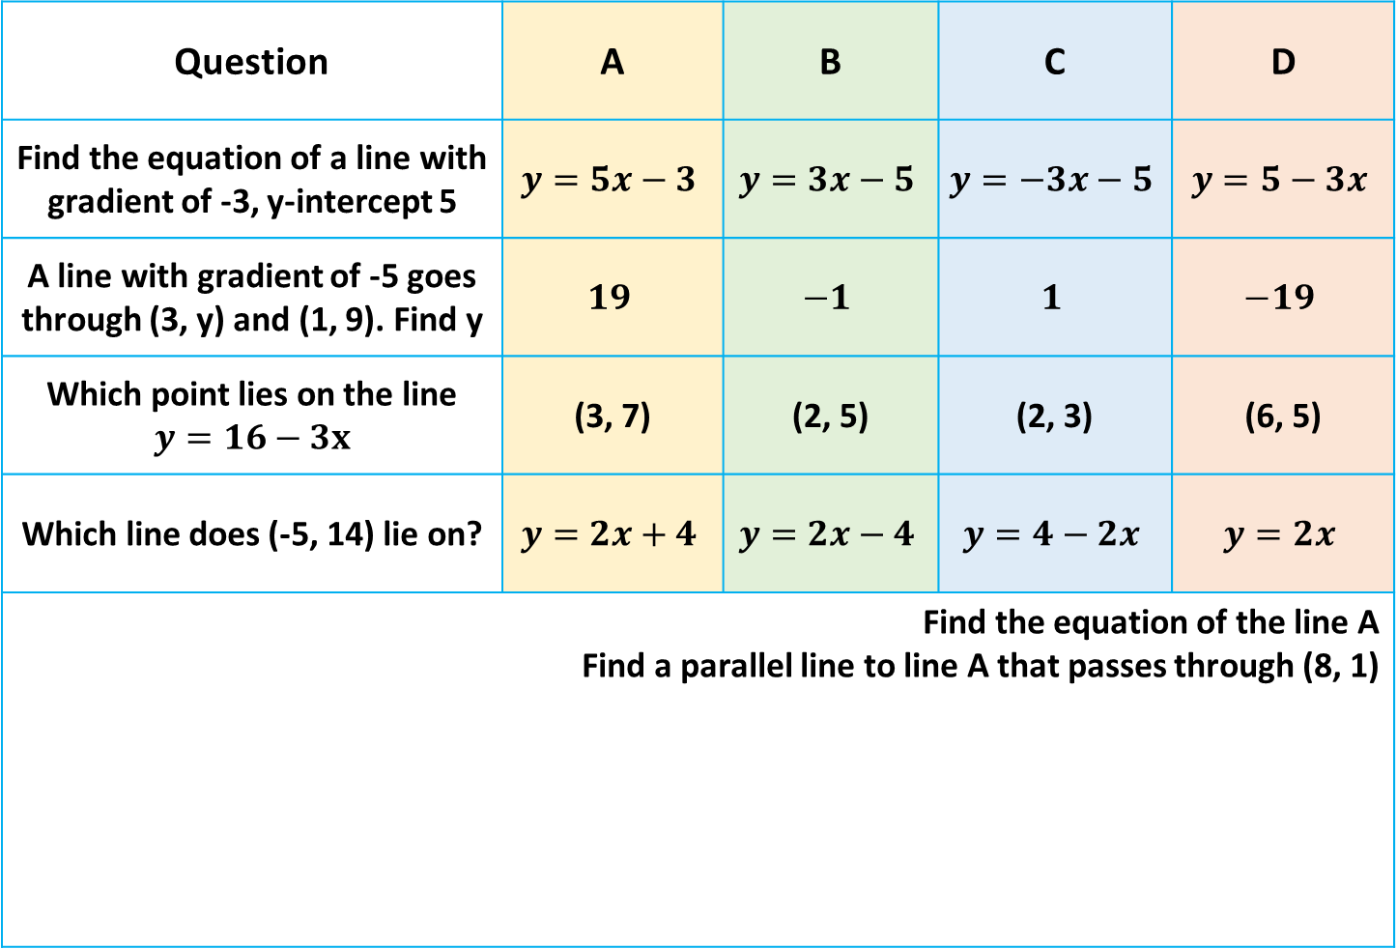
Multiple Choice
Question | A | B | C | D
Find the equation of a line with gradient of -3, y-intercept 5 | $$y=5x−3$$ | $$y=3x−5$$ | $$y=−3x−5$$ | $$y=5−3x$$
A line with gradient of -5 goes through (3, y) and (1, 9). Find y | $$19$$ | $$−1$$ | $$1$$ | $$−19$$
Which point lies on the line $$y=16−3x$$ | (3, 7) | (2, 5) | (2, 3) | (6, 5)
Which line does (-5, 14) lie on? | $$y=2x+4$$ | $$y=2x−4$$ | $$y=4−2x$$ | $$y=2x$$
Find the equation of the line A Find a parallel line to line A that passes through (8, 1) | Find the equation of the line A Find a parallel line to line A that passes through (8, 1) | $$2$$ | $$0.2$$ | $$\frac{1}{5}$$
line A
Notes:
1 4 9 16 25 36 49

Slide 2



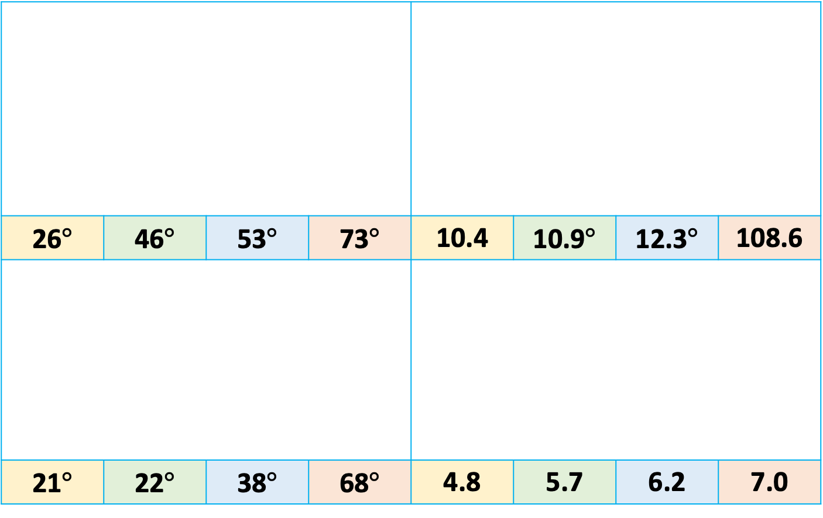
















Multiple Choice
Find the value of $x$
26$°$ | 46$°$ | 53$°$ | 73$°$ | 10.4 | 10.9$°$ | 12.3$°$ | 108.6
21$°$ | 22$°$ | 38$°$ | 68$°$ | 4.8 | 5.7 | 6.2 | 7.0
Find the value of $x$
$$x$$
$$4cm$$
$$5.5cm$$
$$130°$$
$$6cm$$
$$50°$$
$$5cm$$
$$x$$
Find the value of $x$
Find the value of $x$
$$4.2cm$$
$${71}^{o}$$
$$8cm$$
$$3cm$$
$$65°$$
$$x$$
$$x$$
Notes:
1 4 9 16 25 36 49

Slide 3
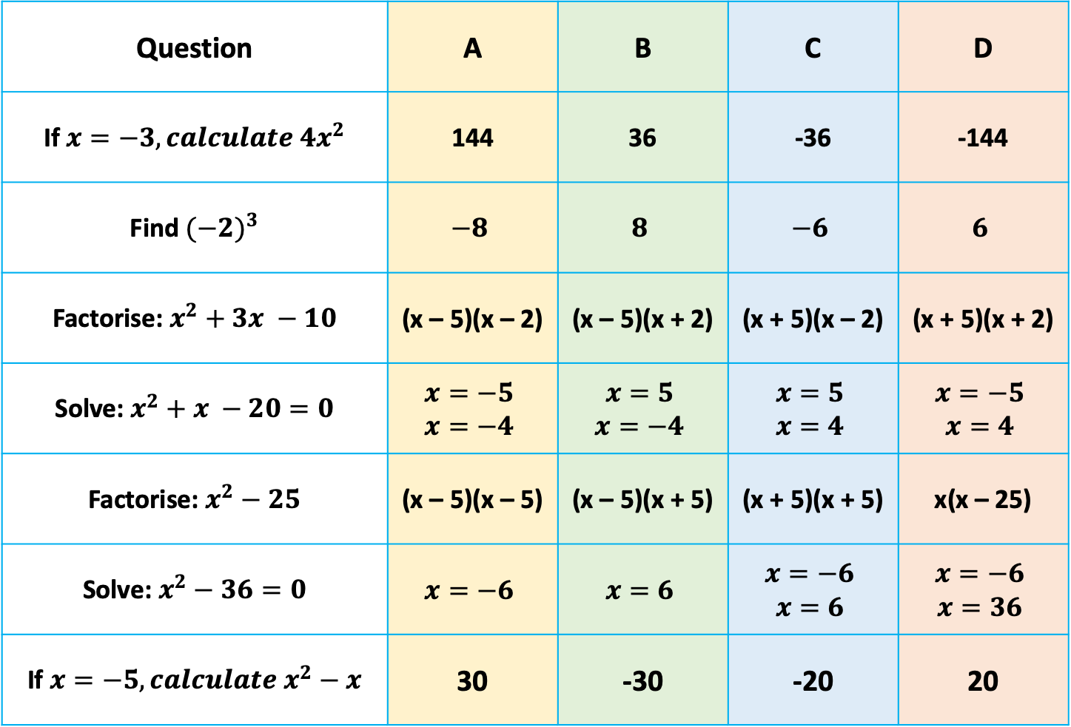
Multiple Choice
Question | A | B | C | D
If $x=−3, calculate 4x^{2}$ | 144 | 36 | -36 | -144
Find ${(−2)}^{3}$ | $$−8$$ | $$8$$ | $$−6$$ | $$6$$
Factorise: $x^{2}+3x −10$ | (x – 5)(x – 2) | (x – 5)(x + 2) | (x + 5)(x – 2) | (x + 5)(x + 2)
Solve: $x^{2}+x −20=0$ | $$x=−5$$ $$x=−4$$ | $$x=5$$ $$x=−4$$ | $$x=5$$ $$x=4$$ | $$x=−5$$ $$x=4$$
Factorise: $x^{2}−25$ | (x – 5)(x – 5) | (x – 5)(x + 5) | (x + 5)(x + 5) | x(x – 25)
Solve: $x^{2}−36=0$ | $$x=−6$$ | $$x=6$$ | $$x=−6$$ $$x=6$$ | $$x=−6$$ $$x=36$$
If $x=−5, calculate x^{2}−x$ | 30 | -30 | -20 | 20
Notes:
1 4 9 16 25 36 49

Slide 4
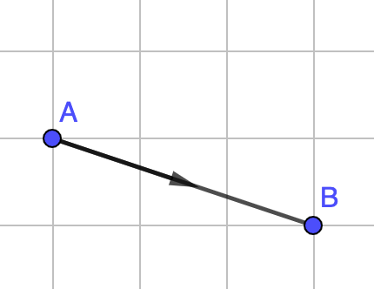
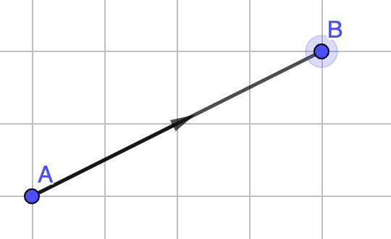
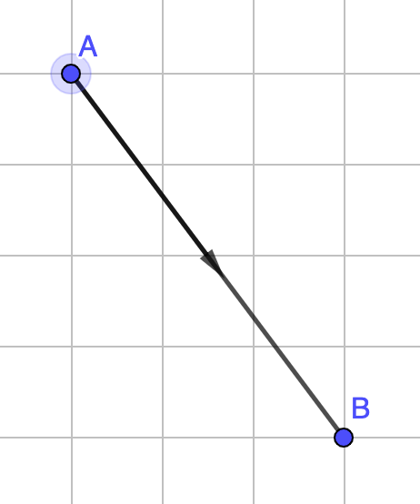



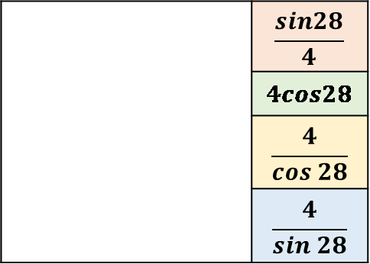
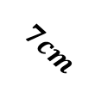
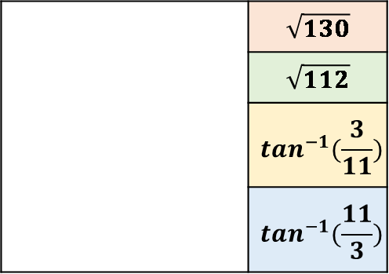




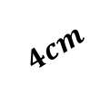
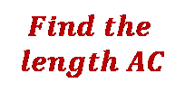

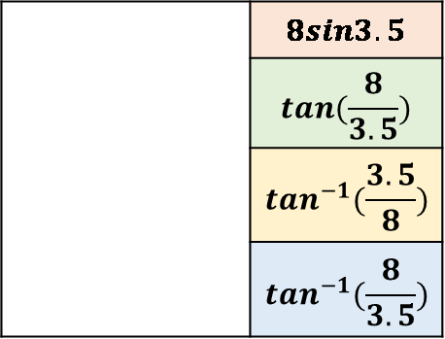
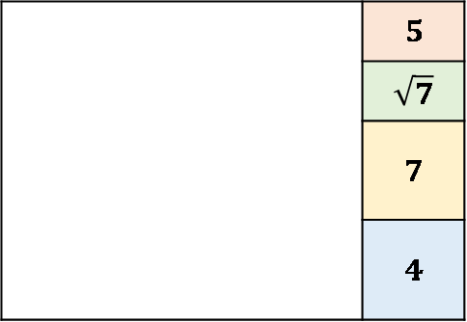

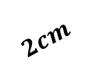
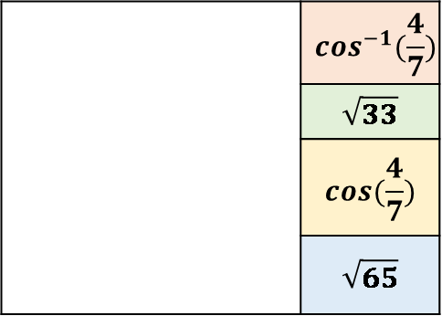


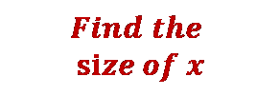
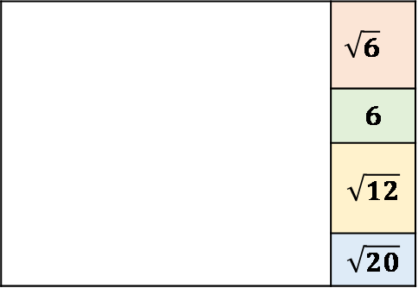
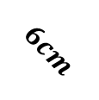
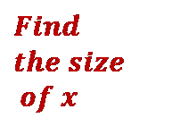
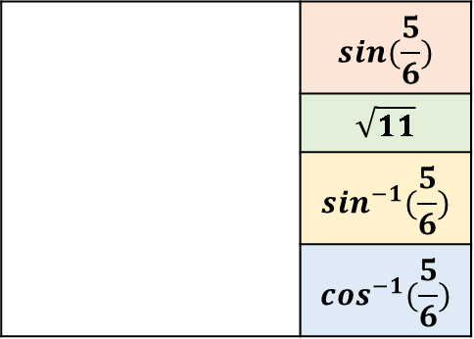
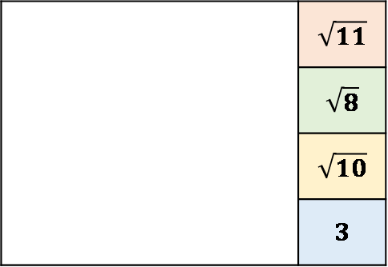



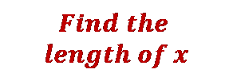
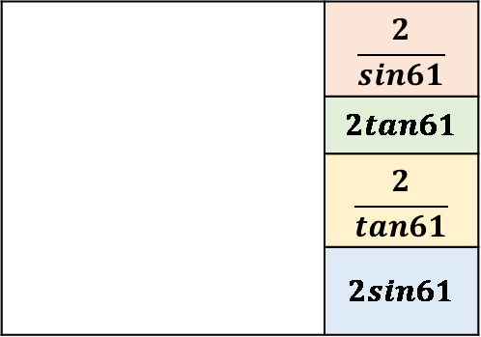
Trigonometry
 | $$\frac{sin28}{4}$$
 | $$4cos28$$
 | $$\frac{4}{cos 28}$$
 | $$\frac{4}{sin 28}$$
 | $$sin(\frac{5}{6})$$
 | $$\sqrt{11}$$
 | $$\sin^{−1}(\frac{5}{6})$$
 | $$\cos^{−1}(\frac{5}{6})$$
 | $$\cos^{−1}(\frac{4}{7})$$
 | $$\sqrt{33}$$
 | $$cos(\frac{4}{7})$$
 | $$\sqrt{65}$$
$$4cm$$
$$Find the$$
$$size of x$$
$$B$$
$$Find the$$
$$length AC$$
$${28}^{o}$$
$$x$$
$$5cm$$
$$7cm$$
$$4cm$$
$$6cm$$
$$x$$
$$Find the$$
$$length of x$$
$$A$$
$$C$$
3.5$cm$
 | $$\sqrt{130}$$
 | $$\sqrt{112}$$
 | $$\tan^{−1}(\frac{3}{11})$$
 | $$\tan^{−1}(\frac{11}{3})$$
 | $$\frac{2}{sin61}$$
 | $$2tan61$$
 | $$\frac{2}{tan61}$$
 | $$2sin61$$
 | $$8sin3.5$$
 | $$tan(\frac{8}{3.5})$$
 | $$\tan^{−1}(\frac{3.5}{8})$$
 | $$\tan^{−1}(\frac{8}{3.5})$$
$$Find the$$
$$length AC$$
$$x$$
$$2cm$$
$${61}^{o}$$
$$x$$
$$8cm$$
$$11cm$$
$$C$$
$$Find$$
$$the size$$
$$of x$$
$$3cm$$
$$Find the$$
$$length of x$$
$$A$$
 | $$\sqrt{11}$$
 | $$\sqrt{8}$$
 | $$\sqrt{10}$$
 | $$3$$
 | $$\sqrt{6}$$
 | $$6$$
 | $$\sqrt{12}$$
 | $$\sqrt{20}$$
 | $$5$$
 | $$\sqrt{7}$$
 | $$7$$
 | $$4$$
Notes:
1 4 9 16 25 36 49

Slide 5
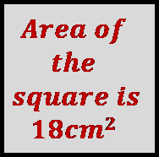
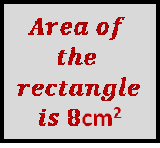
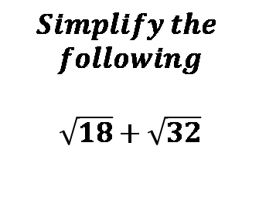

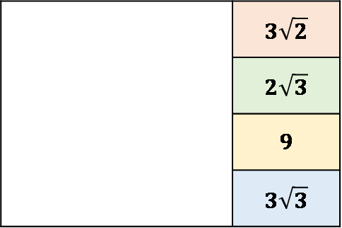

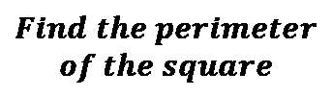
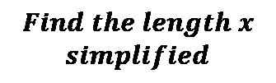
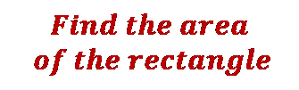

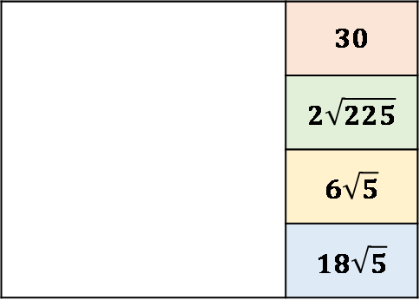
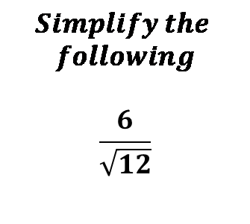
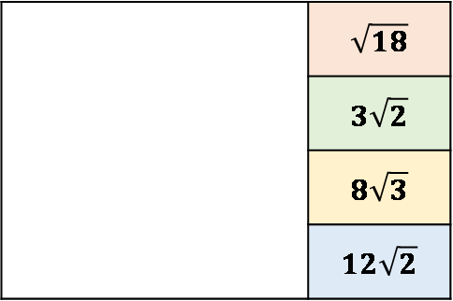
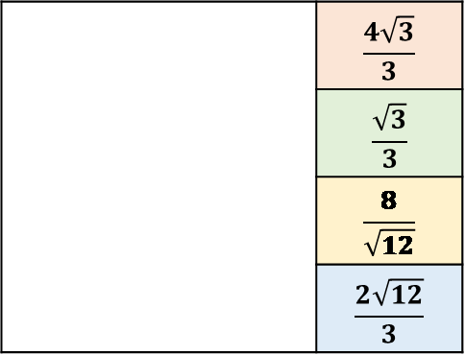
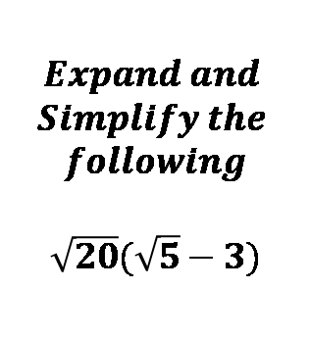
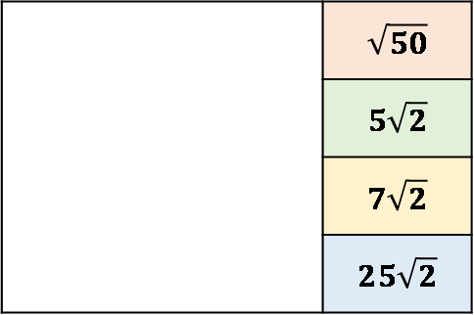
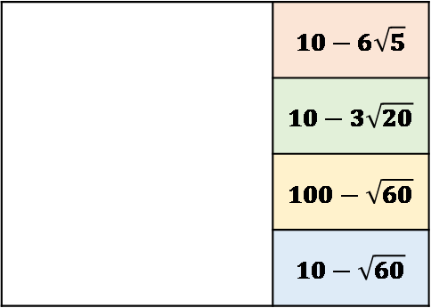
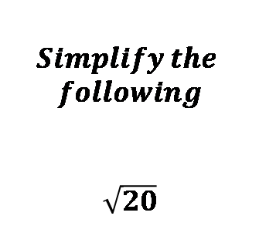
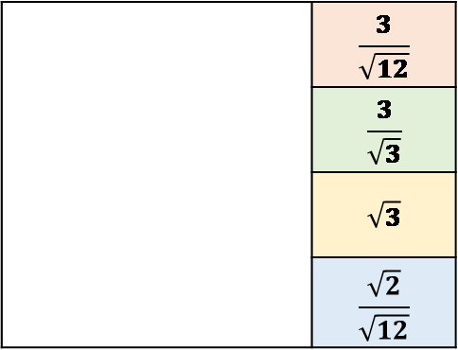
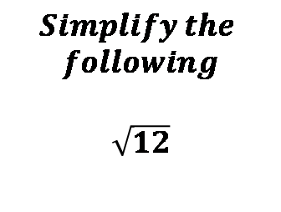
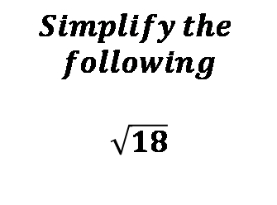
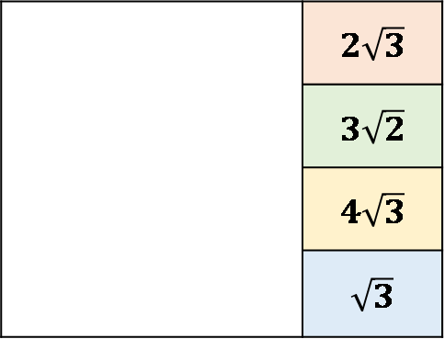
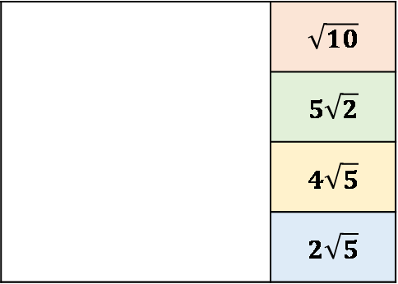

Surds
$$Find the perimeter$$
$$of the square$$
 | $$3\sqrt{2}$$
 | $$2\sqrt{3}$$
 | $$9$$
 | $$3\sqrt{3}$$
 | $$\sqrt{50}$$
 | $$5\sqrt{2}$$
 | $$7\sqrt{2}$$
 | $$25\sqrt{2}$$
 | $$\sqrt{18}$$
 | $$3\sqrt{2}$$
 | $$8\sqrt{3}$$
 | $$12\sqrt{2}$$
$$Simplify the$$
$$following$$
$$\sqrt{18}$$
$$Simplify the$$
$$following$$
$$\sqrt{18}+\sqrt{32}$$
$$Area of$$
$$the$$
$$square is$$
$$18cm2$$
 | $$2\sqrt{3}$$
 | $$3\sqrt{2}$$
 | $$4\sqrt{3}$$
 | $$\sqrt{3}$$
 | $$\frac{3}{\sqrt{12}}$$
 | $$\frac{3}{\sqrt{3}}$$
 | $$\sqrt{3}$$
 | $$\frac{\sqrt{2}}{\sqrt{12}}$$
 | $$\frac{4\sqrt{3}}{3}$$
 | $$\frac{\sqrt{3}}{3}$$
 | $$\frac{8}{\sqrt{12}}$$
 | $$\frac{2\sqrt{12}}{3}$$
$$Find the length x$$
$$simplified$$
$$Simplify the$$
$$following$$
$$\sqrt{12}$$
$$Simplify the$$
$$following$$
$$\frac{6}{\sqrt{12}}$$
$$\sqrt{12}$$
$$Area of$$
$$the$$
$$rectangle$$
$is 8$cm²
$$x$$
$$Simplify the$$
$$following$$
$$\sqrt{20}$$
$$Expand and$$
$$Simplify the$$
$$following$$
$$\sqrt{20}(\sqrt{5}−3)$$
$$Find the area$$
$$of the rectangle$$
 | $$\sqrt{10}$$
 | $$5\sqrt{2}$$
 | $$4\sqrt{5}$$
 | $$2\sqrt{5}$$
 | $$10−6\sqrt{5}$$
 | $$10−3\sqrt{20}$$
 | $$100−\sqrt{60}$$
 | $$10−\sqrt{60}$$
 | $$30$$
 | $$2\sqrt{225}$$
 | $$6\sqrt{5}$$
 | $$18\sqrt{5}$$
$$2\sqrt{5}$$
$$\sqrt{45}$$

Slide 6




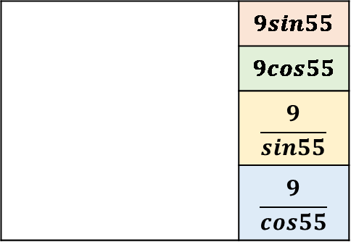



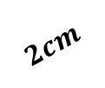
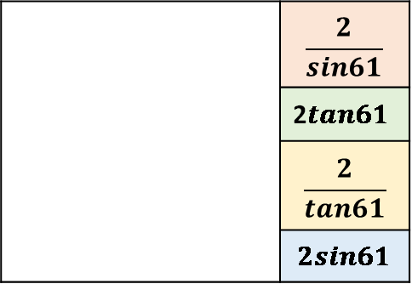
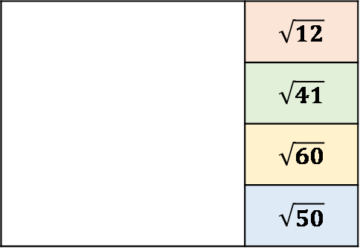


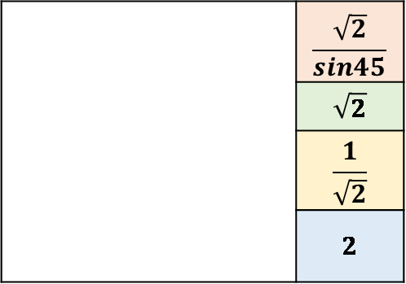

Trigonometry
 | $$\frac{sin28}{4}$$
 | $$4cos28$$
 | $$\frac{4}{cos 28}$$
 | $$\frac{4}{sin 28}$$
 | $$sin(\frac{5}{6})$$
 | $$\sqrt{11}$$
 | $$\sin^{−1}(\frac{5}{6})$$
 | $$\cos^{−1}(\frac{5}{6})$$
 | $$\cos^{−1}(\frac{4}{7})$$
 | $$\sqrt{33}$$
 | $$cos(\frac{4}{7})$$
 | $$\sqrt{65}$$
$$4cm$$
$$Find the$$
$$size of x$$
$$B$$
$$Find the$$
$$length AC$$
$${28}^{o}$$
$$x$$
$$5cm$$
$$7cm$$
$$4cm$$
$$6cm$$
$$x$$
$$Find the$$
$$length of x$$
$$A$$
$$C$$
3.5$cm$
 | $$\sqrt{130}$$
 | $$\sqrt{112}$$
 | $$\tan^{−1}(\frac{3}{11})$$
 | $$\tan^{−1}(\frac{11}{3})$$
 | $$\frac{\sqrt{2}}{sin45}$$
 | $$\sqrt{2}$$
 | $$\frac{1}{\sqrt{2}}$$
 | $$2$$
 | $$8sin3.5$$
 | $$tan(\frac{8}{3.5})$$
 | $$\tan^{−1}(\frac{3.5}{8})$$
 | $$\tan^{−1}(\frac{8}{3.5})$$
$$Find the$$
$$length AC$$
$$Find the value of$$
$$sin{(45}^{o})$$
$$x$$
$$8cm$$
$$11cm$$
$$C$$
$$Find$$
$$the size$$
$$of x$$
$$1cm$$
$$3cm$$
$${45}^{o}$$
$$A$$
$$Find the length AG$$
 | $$\sqrt{12}$$
 | $$\sqrt{41}$$
 | $$\sqrt{60}$$
 | $$\sqrt{50}$$
 | $$\frac{2}{sin61}$$
 | 2$tan61$
 | $$\frac{2}{tan61}$$
 | $$2sin61$$
 | $$9sin55$$
 | $$9cos55$$
 | $$\frac{9}{sin55}$$
 | $$\frac{9}{cos55}$$
$$Find the$$
$$length AC$$
A
B
$$2cm$$
D
C
$$x$$
$$9cm$$
$${61}^{o}$$
$$C$$
3cm
F
$${55}^{o}$$
4cm
$$Find the$$
$$length of x$$
H
5cm
G
$$A$$
Notes:
1 4 9 16 25 36 49

Slide 7
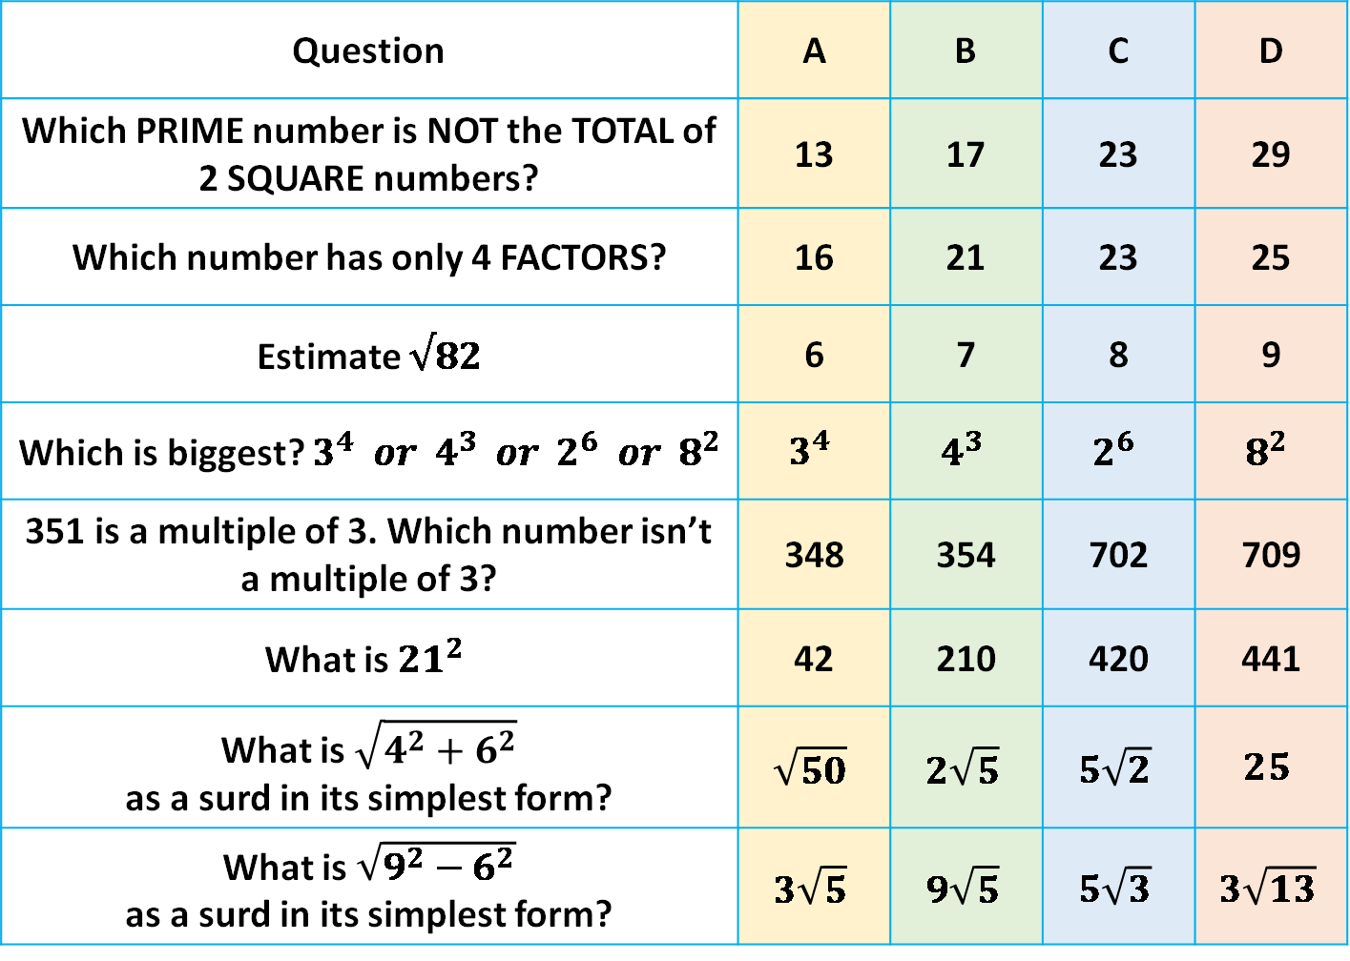
Multiple Choice
Question | A | B | C | D
Which PRIME number is NOT the TOTAL of 2 SQUARE numbers? | 13 | 17 | 23 | 29
Which number has only 4 FACTORS? | 16 | 21 | 23 | 25
Estimate $√82$ | 6 | 7 | 8 | 9
Which is biggest? $3^{4} or 4^{3} or 2^{6} or 8^{2}$ | $$3^{4}$$ | $$4^{3}$$ | $$2^{6}$$ | $$8^{2}$$
351 is a multiple of 3. Which number isn’t a multiple of 3? | 348 | 354 | 702 | 709
What is ${21}^{2}$ | 42 | 210 | 420 | 441
What is $\sqrt{4^{2}+6^{2}}$ as a surd in its simplest form? | $$\sqrt{50}$$ | $$2\sqrt{5}$$ | $$5\sqrt{2}$$ | $$25$$
What is $\sqrt{9^{2}−6^{2}}$ as a surd in its simplest form? | $$3\sqrt{5}$$ | $$9\sqrt{5}$$ | $$5\sqrt{3}$$ | $$3\sqrt{13}$$
Notes:
1 4 9 16 25 36 49

Slide 8

Multiple Choice
Question | A | B | C | D
I use a quarter of a pint of milk on my cereal a day. How many days does 4 pints last? | 1 | 12 | 16 | 4
represents 12 people on a pictogram What does represent? | 36 | 48 | 44 | 42
Which whole number is closest to $\sqrt{50}$ | 25 | 7 | 8 | 5
$Work out \frac{1}{12}+\frac{5}{6}$ (in its simplest terms) | $$\frac{11}{12}$$ | $$\frac{6}{18}$$ | $$\frac{1}{3}$$ | $$\frac{66}{72}$$
A rectangle has a length that is 6 times its width. If the perimeter is 42cm, find the area | $${54cm}^{2}$$ | $$42{cm}^{2}$$ | $${49cm}^{2}$$ | $${216cm}^{2}$$
I buy a coat for £56 in a 20% off sale. What did the coat cost before the sale? | £67.20 | £70 | £44.80 | £65
Work out the value of $\frac{7^{6} × 7^{−2}}{7^{2}}$ | 49 | 343 | 2401 | 7
Solve $−12=\frac{x}{3}$ | $$4$$ | $$−4$$ | $$36$$ | $$−36$$
Notes:
1 4 9 16 25 36 49

Slide 9

Multiple Choice
Question | A | B | C | D
I travel 18 miles in 30 minutes, What is my speed in miles per hour? | 0.6mph | 9mph | 18mph | 36mph
Change 456g into kg | 0.456 | 4.56 | 45.6 | 456000
Write 0.68 as fraction in its simplest form | $$\frac{17}{25}$$ | $$\frac{68}{100}$$ | $$\frac{3}{4}$$ | $$\frac{34}{50}$$
Simplify: 3m – m – m + 3m | $$0$$ | $$4m$$ | $$8m$$ | $$6m$$
Find the nth term of the sequence 8, 11, 14, 17… | $$3n+5$$ | $$5n+3$$ | $$n+3$$ | $$3n+8$$
A square has an area of 81cm² Find the perimeter of the square | 18cm | 36cm | 20.25 | 162
Evaluate $5+3 × 2$ | 30 | 10 | 11 | 11
Solve $x−8=−17$ | $$−25$$ | $$25$$ | $$−9$$ | $$9$$
Notes:
1 4 9 16 25 36 49

Slide 10

Multiple Choice
Question | A | B | C | D
Write the ratio 32 : 24 in its simplest form | 4 : 3 | 16 : 12 | 3 : 4 | 2 : 3
Write the ratio 7.5 : 2.5 in the form n : 1 | $$2 :3$$ | $$3 :1$$ | $$1 :3$$ | $$6 :1$$
Write the ratio 12 : 30 in the form 1 : n | $$1 :19$$ | 1: $\frac{12}{30}$ | 1 : 2.6 | 1 : 2.5
Write down the ratio of 350 cm to 25 cm. Give your answer in its simplest form. | $$14 :1$$ | $$1 :13$$ | $$12 :1$$ | $$13 :1$$
Molly, Paige and Demi share 42 sweets in the ratio 3 : 2 : 1 Work out the number of sweets Paige receives. | $$21$$ | $$7$$ | $$14$$ | $$12$$
Jerry and Mick share some money in the ratio 2 : 3 Mick gets £900 Work out how much money Jerry gets | $$360$$ | $$600$$ | $$180$$ | $$300$$
Carly and James share some money in the ratio 5 : 3 Carly gets £70 more than James. Work out how much money James gets. | 105 | 175 | 50 | 14
Notes:
1 4 9 16 25 36 49

Slide 11
Multiple Choice
Questions | A | B | C | D
Which term isn’t in this linear sequence: 10, 14, 18, 22, 26… | 174 | 210 | 243 | 258
Find the missing term in the linear sequence: 83, ….. , 91 | 84 | 85 | 86 | 87
Which isn’t a multiple of 6? | 432 | 363 | 246 | 138
Which term is in the linear sequence: 7, 12, 17, 22... | 327 | 371 | 273 | 725
Find the missing term in the linear sequence: 165, ….. ,187 | 175 | 176 | 177 | 178
Notes:
1 4 9 16 25 36 49

Slide 12




Multiple Choice
$$\frac{12}{28}$$ | $$\frac{18}{49}$$ | $$\frac{24}{56}$$ | $$\frac{27}{63}$$ | 1$\frac{1}{2}$ | 1$\frac{1}{4}$ | 1$\frac{5}{8}$ | $$\frac{5}{8}$$
$$\frac{1}{4}$$ | $$\frac{1}{7}$$ | $$\frac{1}{6}$$ | $$\frac{1}{16}$$ | $$\frac{4}{9}$$ | $$\frac{9}{25}$$ | $$\frac{1}{4}$$ | $$\frac{3}{8}$$
Find the fraction that isn’t equivalent to…
Find the fraction in the middle of 1 and 2$\frac{1}{4}$
$$\frac{3}{7}$$
$$1$$
2$\frac{1}{4}$
Find the fraction shaded
Which fraction is closest to 0.4?
Notes:
1 4 9 16 25 36 49

Slide 13

Multiple Choice
The points A, B, C, D & E are plotted on a 1cm co-ordinate grid. How far apart in cm are each of the co-ordinate pairs below? | A | B | C | D
$$A:\left(0, 4\right) and B:(6, 4)$$ | 0 | 6 | 4 | 2
$$B:\left(6, 4\right) and C:(6, 1)$$ | 5 | 2 | 1 | 3
$$C:\left(6, 1\right) and D:(6, −2)$$ | -1 | 3 | 1 | 0
$$D:\left(6, −2\right) and E:(2, 1)$$ | 5 | 3 | 4 | 1
$$E:\left(2, 1\right) and B:(−4, −7)$$ | 8 | 6 | 10 | 3
Notes:
1 4 9 16 25 36 49

Slide 14





Multiple Choice
$$3π+12$$ | $$3π+4$$ | $$3π$$ | $$3π+6$$ | $$3π+12$$ | $$3π+4$$ | $$3π$$ | $$3π+6$$
$$3π+4$$ | $$12π$$ | $$3π$$ | $$4π$$ | $$3π$$ | $$6π$$ | $$9π$$ | $$36π$$
Find the Perimeter
Find the Perimeter
$$6cm$$
$$6cm$$
Find the Area
Find the Area
$$2cm$$
$$6cm$$
Notes:
1 4 9 16 25 36 49

Slide 15





Multiple Choice
Describe the vector $\vec{AB}$
$$\left(\begin{aligned}3 \\ 1\end{aligned}\right)$$ | $$\left(\begin{aligned}3 \\ −1\end{aligned}\right)$$ | $$\left(\begin{aligned}−3 \\ −1\end{aligned}\right)$$ | $$\left(\begin{aligned}−3 \\ 1\end{aligned}\right)$$ | $$\left(\begin{aligned}3 \\ 4\end{aligned}\right)$$ | $$\left(\begin{aligned}−4 \\ 3\end{aligned}\right)$$ | $$\left(\begin{aligned}−3 \\ −4\end{aligned}\right)$$ | $$\left(\begin{aligned}3 \\ −4\end{aligned}\right)$$ | $$\left(\begin{aligned}−3 \\ 0\end{aligned}\right)$$ | $$\left(\begin{aligned}0 \\ −3\end{aligned}\right)$$ | $$\left(\begin{aligned}3 \\ 0\end{aligned}\right)$$ | $$\left(\begin{aligned}0 \\ 3\end{aligned}\right)$$
$$\left(\begin{aligned}−1 \\ −4\end{aligned}\right)$$ | $$\left(\begin{aligned}−4 \\ 1\end{aligned}\right)$$ | $$\left(\begin{aligned}−1 \\ 4\end{aligned}\right)$$ | $$\left(\begin{aligned}1 \\ 4\end{aligned}\right)$$ | $$\left(\begin{aligned}4 \\ 0\end{aligned}\right)$$ | $$\left(\begin{aligned}0 \\ 4\end{aligned}\right)$$ | $$\left(\begin{aligned}0 \\ −4\end{aligned}\right)$$ | $$\left(\begin{aligned}−4 \\ 0\end{aligned}\right)$$ | $$\left(\begin{aligned}4 \\ 2\end{aligned}\right)$$ | $$\left(\begin{aligned}4 \\ −2\end{aligned}\right)$$ | $$\left(\begin{aligned}2 \\ 4\end{aligned}\right)$$ | $$\left(\begin{aligned}−4 \\ −2\end{aligned}\right)$$
Notes:
1 4 9 16 25 36 49

