Slide 1
Similarity

Slide 2


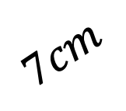






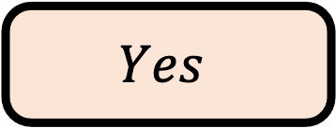
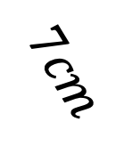
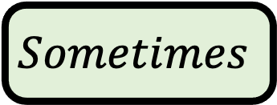



$${35}^{o}$$
$$Q1$$
$$Are triangles ABC and DEF congruent?$$
$$B$$
$$E$$
$$F$$
$${52}^{o}$$
$${52}^{o}$$
$$C$$
$$7cm$$
$${78}^{o}$$
$$7cm$$
$${78}^{o}$$
$$D$$
$$A$$
$$Yes$$
$$No$$
$$Sometimes$$

Slide 3
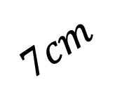

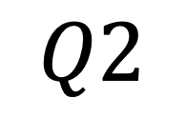

$${35}^{o}$$
$$Q2$$
$$Are triangles ABC and DEF congruent?$$
$$B$$
$$E$$
$$F$$
$${51}^{o}$$
$${51}^{o}$$
$$C$$
$$7cm$$
$${78}^{o}$$
$$7cm$$
$${78}^{o}$$
$$D$$
$$A$$
$$Yes$$
$$No$$
$$Sometimes$$

Slide 4
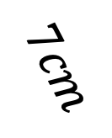
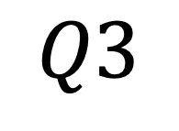


$${35}^{o}$$
$$Q3$$
$$Are triangles ABC and DEF congruent?$$
$$B$$
$$E$$
$$F$$
$${52}^{o}$$
$$C$$
$$7cm$$
$$7cm$$
$${76}^{o}$$
$$7cm$$
$${76}^{o}$$
$$D$$
$$A$$
$$Yes$$
$$No$$
$$Sometimes$$

Slide 5
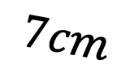
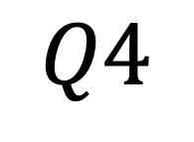
$${35}^{o}$$
$$Q4$$
$$Are triangles ABC and DEF congruent?$$
$$B$$
$$E$$
$$7cm$$
$$F$$
$${52}^{o}$$
$$C$$
$$7cm$$
$${76}^{o}$$
$$7cm$$
$${76}^{o}$$
$$D$$
$$A$$
$$Yes$$
$$No$$
$$Sometimes$$

Slide 6




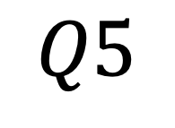


$${35}^{o}$$
$$Q5$$
$$Are triangles ABC and DEF congruent?$$
$$D$$
$$B$$
$$E$$
$${50}^{o}$$
$$F$$
$${54}^{o}$$
$$C$$
$${78}^{o}$$
$${76}^{o}$$
$$A$$
$$Yes$$
$$No$$
$$Sometimes$$

Slide 7





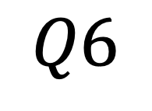



$${35}^{o}$$
$$Q6$$
$$Are triangles ABC and ACD congruent?$$
$$B$$
$${58}^{o}$$
$$D$$
$$C$$
$${43}^{o}$$
$${79}^{o}$$
$${79}^{o}$$
$$A$$
$$Yes$$
$$No$$
$$Sometimes$$

Slide 8





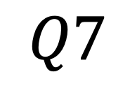
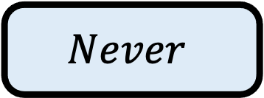


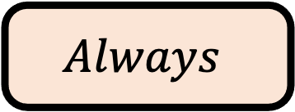
$${35}^{o}$$
$$Q7$$
$$Are triangles ABC and ACD congruent?$$
$$B$$
$${58}^{o}$$
$$C$$
$${43}^{o}$$
$${79}^{o}$$
$${58}^{o}$$
$$A$$
$$D$$
$$Always$$
$$Never$$
$$Sometimes$$

Slide 9


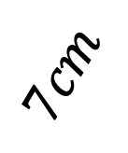
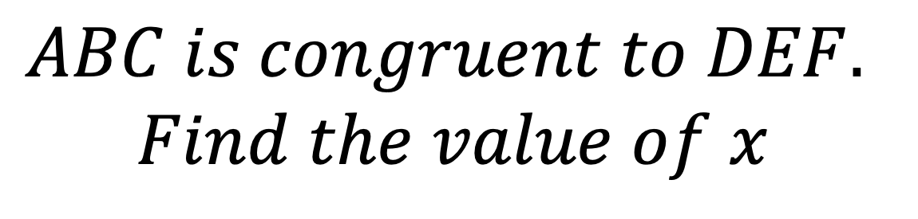

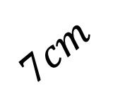
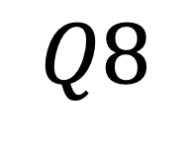

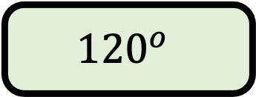

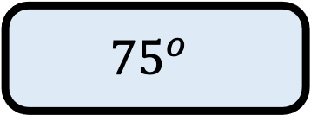


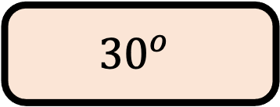

$$Q8$$
$$ABC is congruent to DEF.$$
$$Find the value of x$$
$$D$$
$$B$$
$$E$$
$$x$$
$$F$$
$$C$$
$$7cm$$
$${30}^{o}$$
$${75}^{o}$$
$${75}^{o}$$
$$7cm$$
$$A$$
$${30}^{o}$$
$${75}^{o}$$
$${120}^{o}$$

Slide 10




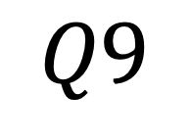
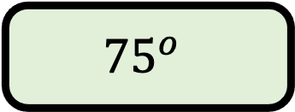



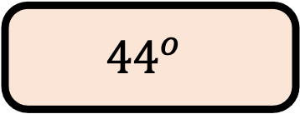

$$Q9$$
$$ABC is congruent to DEF.$$
$$Find the value of x$$
$$B$$
$${44}^{o}$$
$$D$$
$$C$$
$$x$$
$${75}^{o}$$
$${75}^{o}$$
$$A$$
$${44}^{o}$$
$${61}^{o}$$
$${75}^{o}$$

Slide 11
