Slide 1
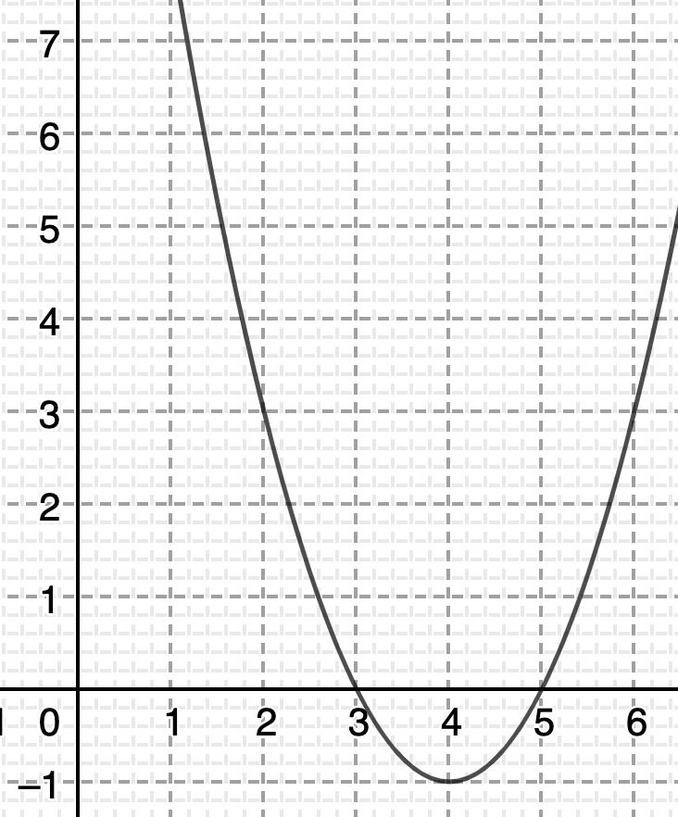
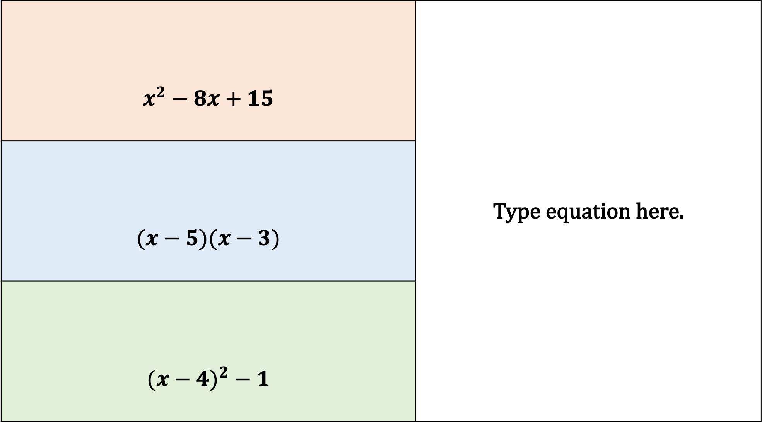
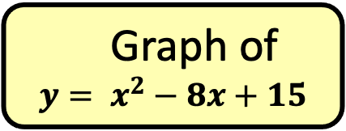
D
$$x^{2}−8x+15$$
$$(x−5)(x−3)$$
$${(x−4)}^{2} − 1$$
A
Expression
Graph of
$y= x^{2}−8x+15$
B
Factorised
C
Complete the square

Slide 2
Find the missing information… a and b represent integers

Slide 3
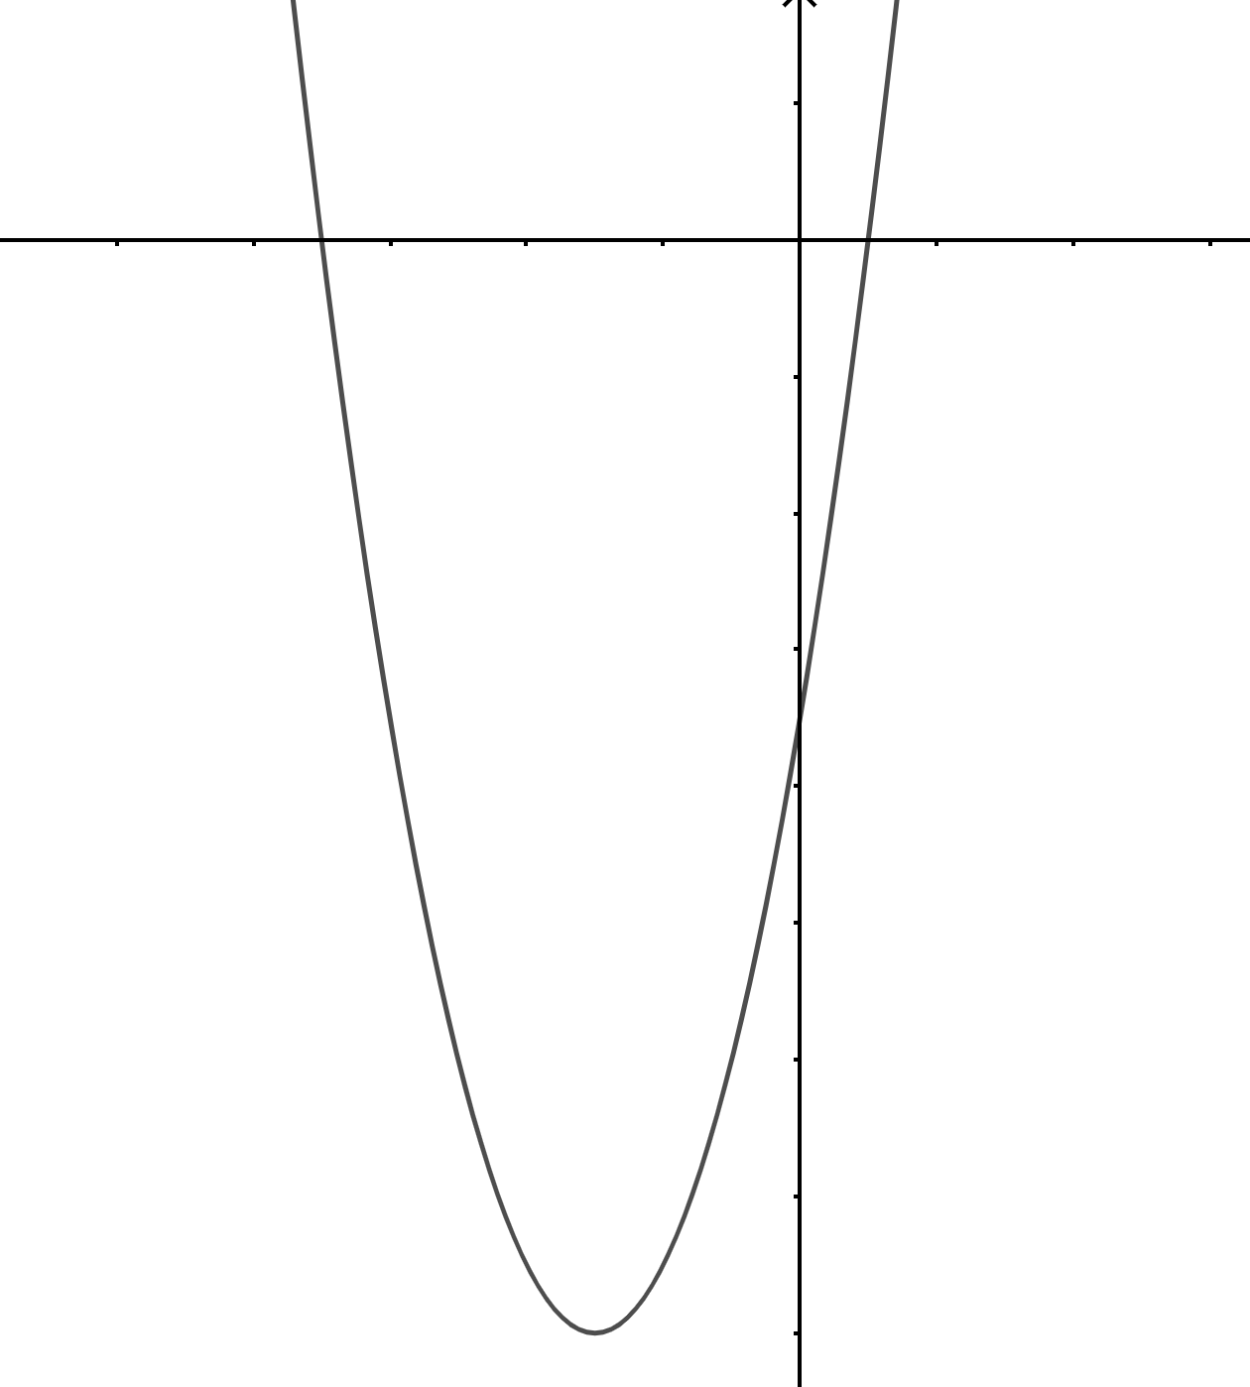


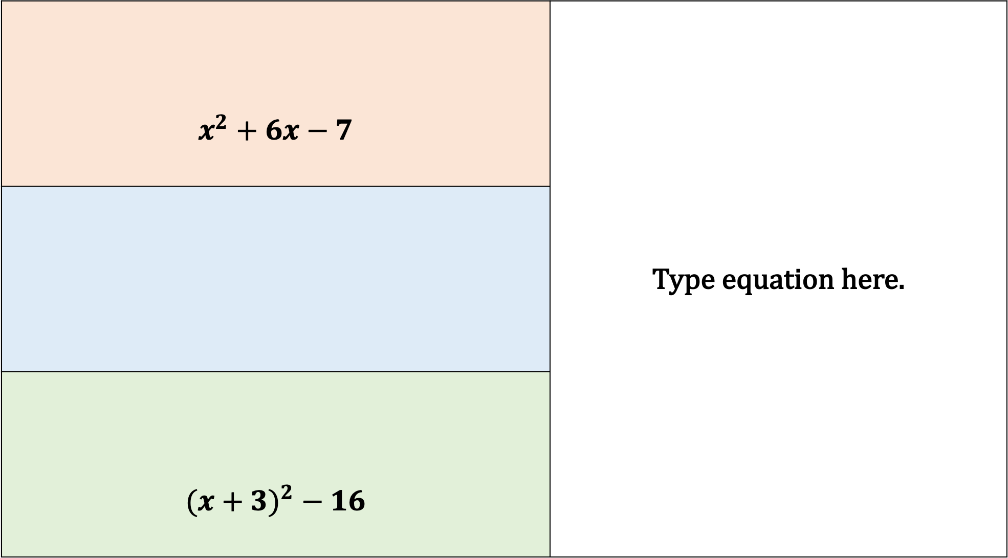


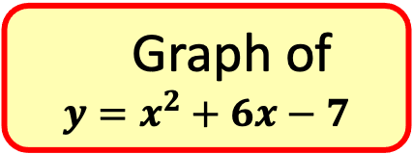
D
$$x^{2}+6x−7$$
$${(x+3)}^{2} − 16$$
A
Expression
Graph of
$$y=x^{2}+6x−7$$
$$w$$
$$x$$
$$y$$
B
Factorised
C
Complete the square
$$z$$

Slide 4

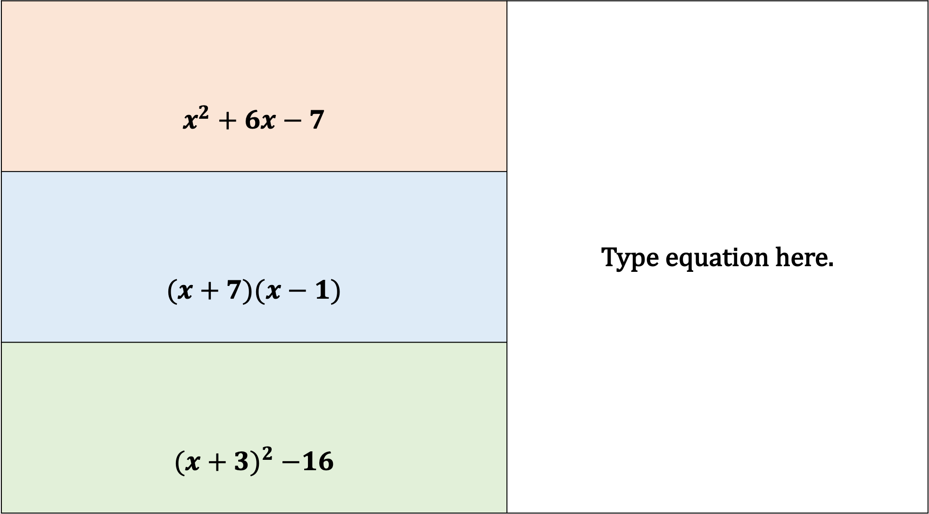



D
$$x^{2}+6x−7$$
$$(x+7)(x−1)$$
$${(x+3)}^{2} −16$$
A
Expression
Graph of
$$y=x^{2}+6x−7$$
$$−7$$
$$−3$$
$$1$$
B
Factorised
C
Complete the square
$$−16$$

Slide 5
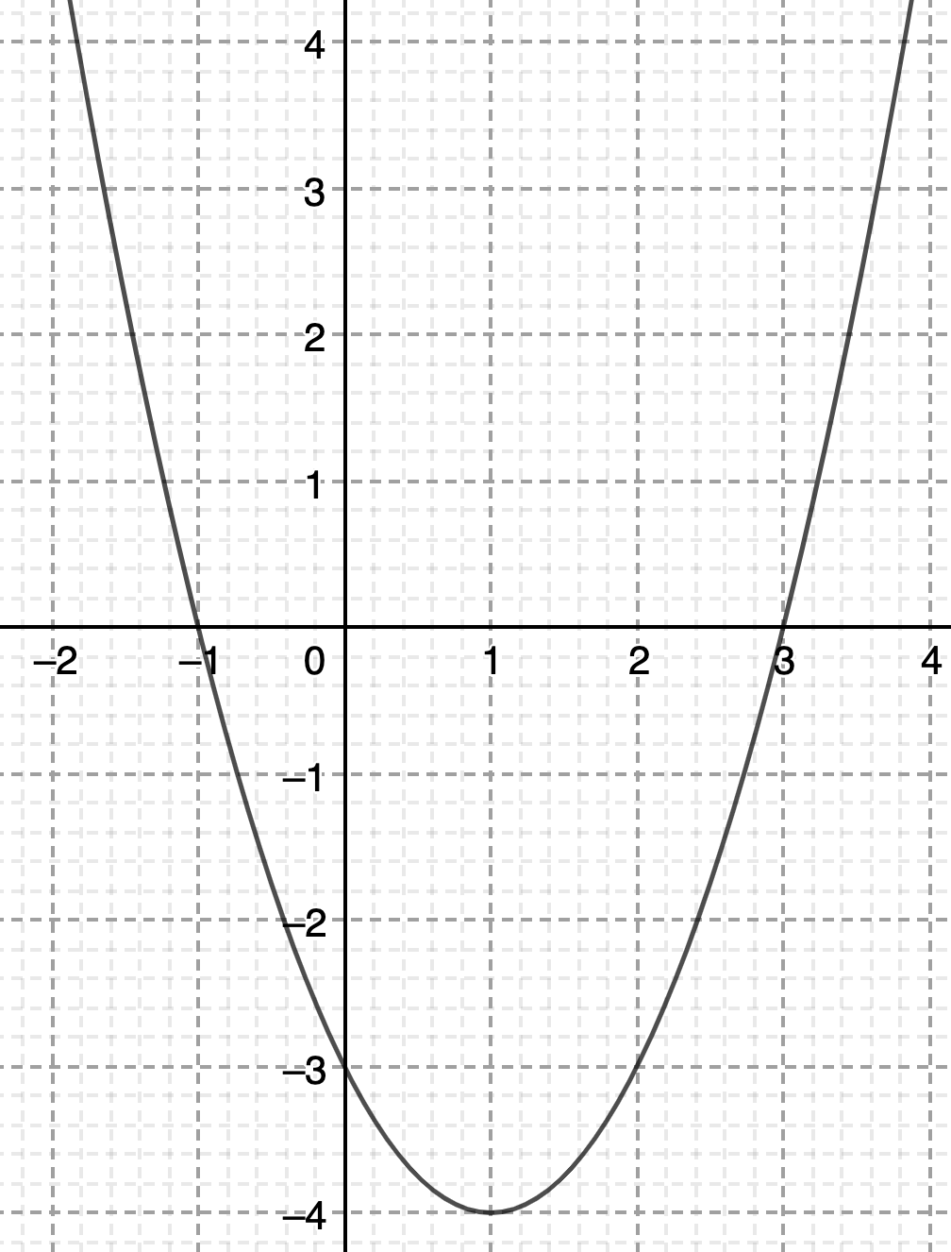
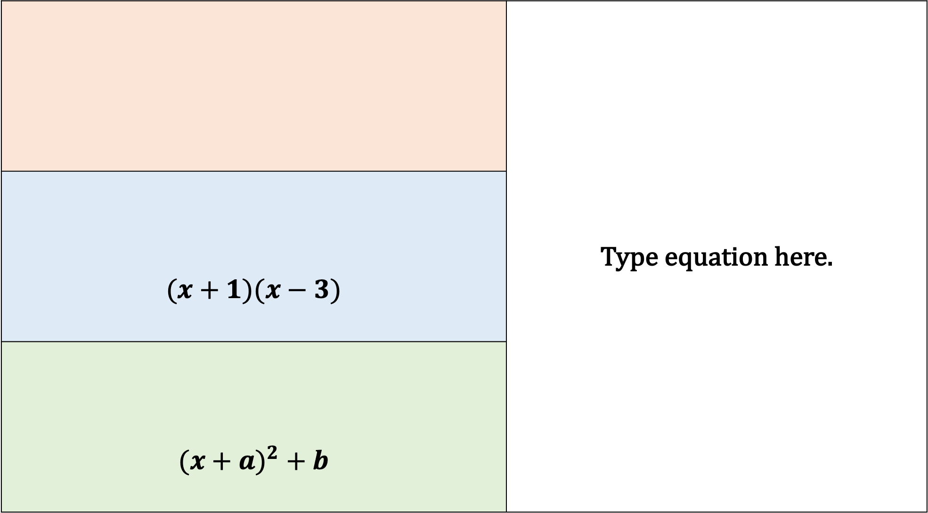
$$(x+1)(x−3)$$
$${(x+a)}^{2} + b$$
A
D
Expression
Graph
B
Factorised
C
Complete the square

Slide 6

$$x^{2}−2x−3$$
$$(x+1)(x−3)$$
$${(x−1)}^{2} − 4$$
A
D
Expression
Graph
B
Factorised
C
Complete the square

Slide 7
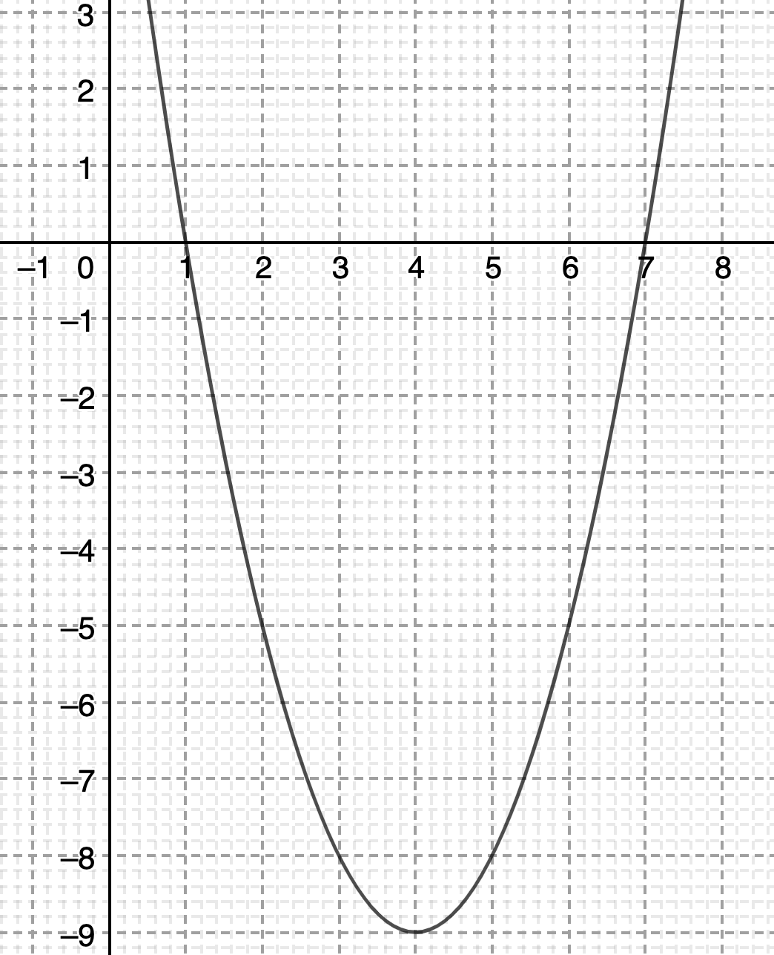
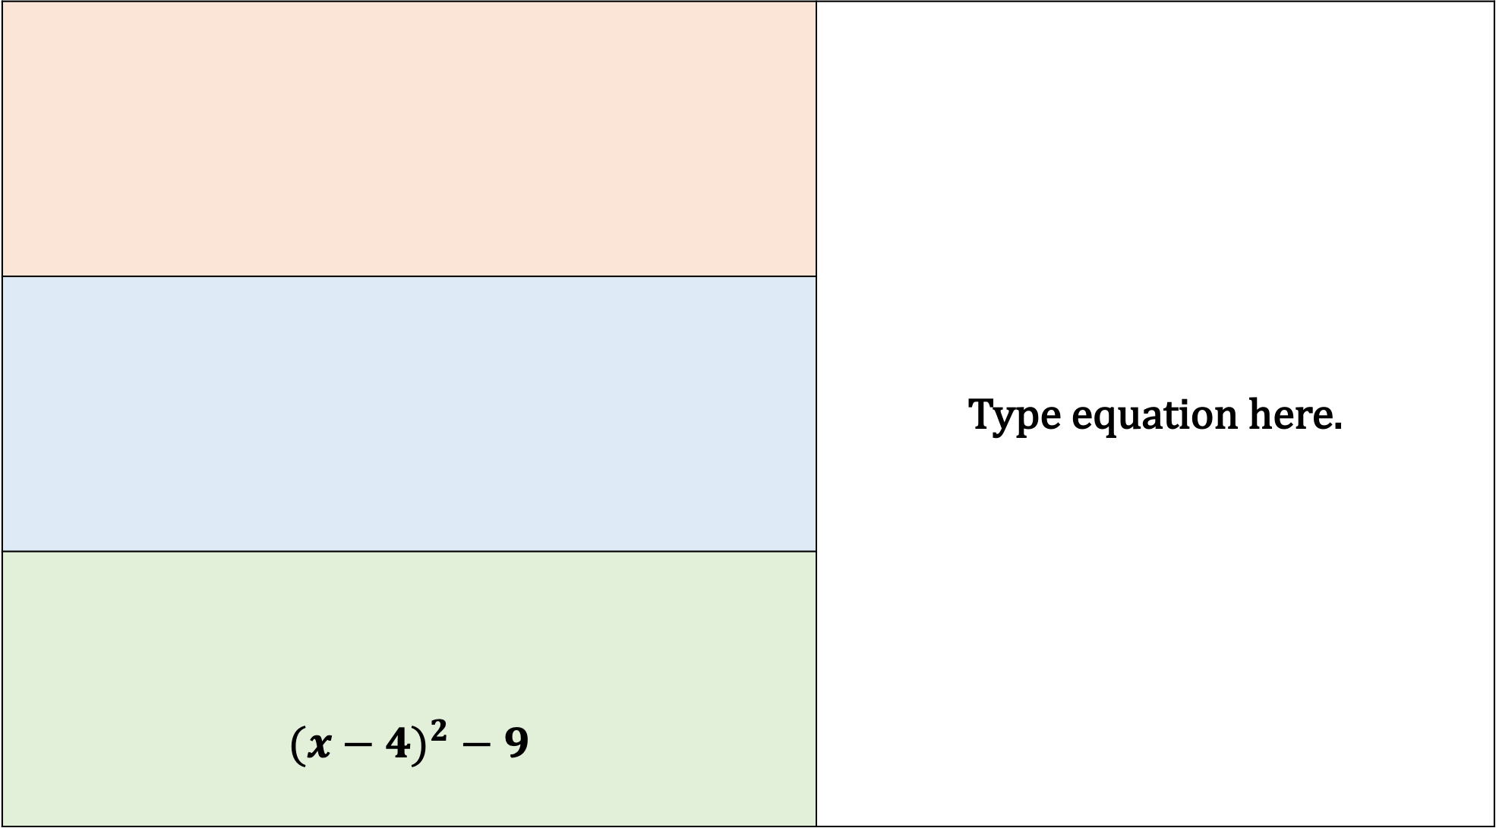
$${(x−4)}^{2} − 9$$
A
D
Expression
Graph
B
Factorised
C
Complete the square

Slide 8

$$x^{2}−8x+7$$
$$\left(x−7\right)(x−1)$$
$${(x−4)}^{2} − 9$$
A
D
Expression
Graph
B
Factorised
C
Complete the square

Slide 9
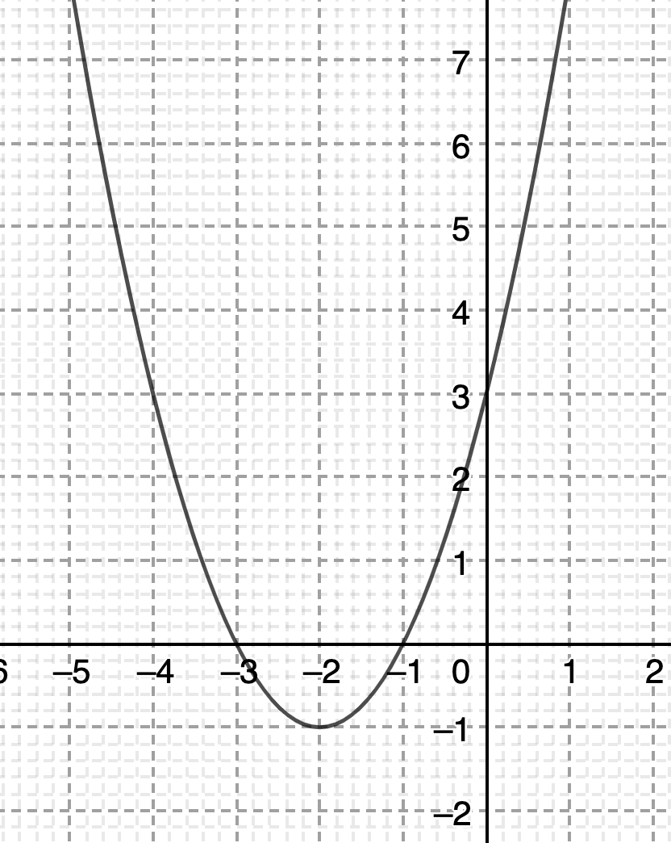

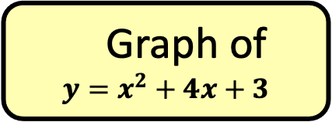
D
$$x^{2}+4x+3$$
$${(x+a)}^{2} + b$$
A
Expression
Graph of
$${y=x}^{2}+4x+3$$
B
Factorised
C
Complete the square

Slide 10

$$x^{2}+4x+3$$
$$(x+3)(x+1)$$
$${(x+2)}^{2} −1$$
A
D
Expression
Graph
B
Factorised
C
Complete the square

Slide 11
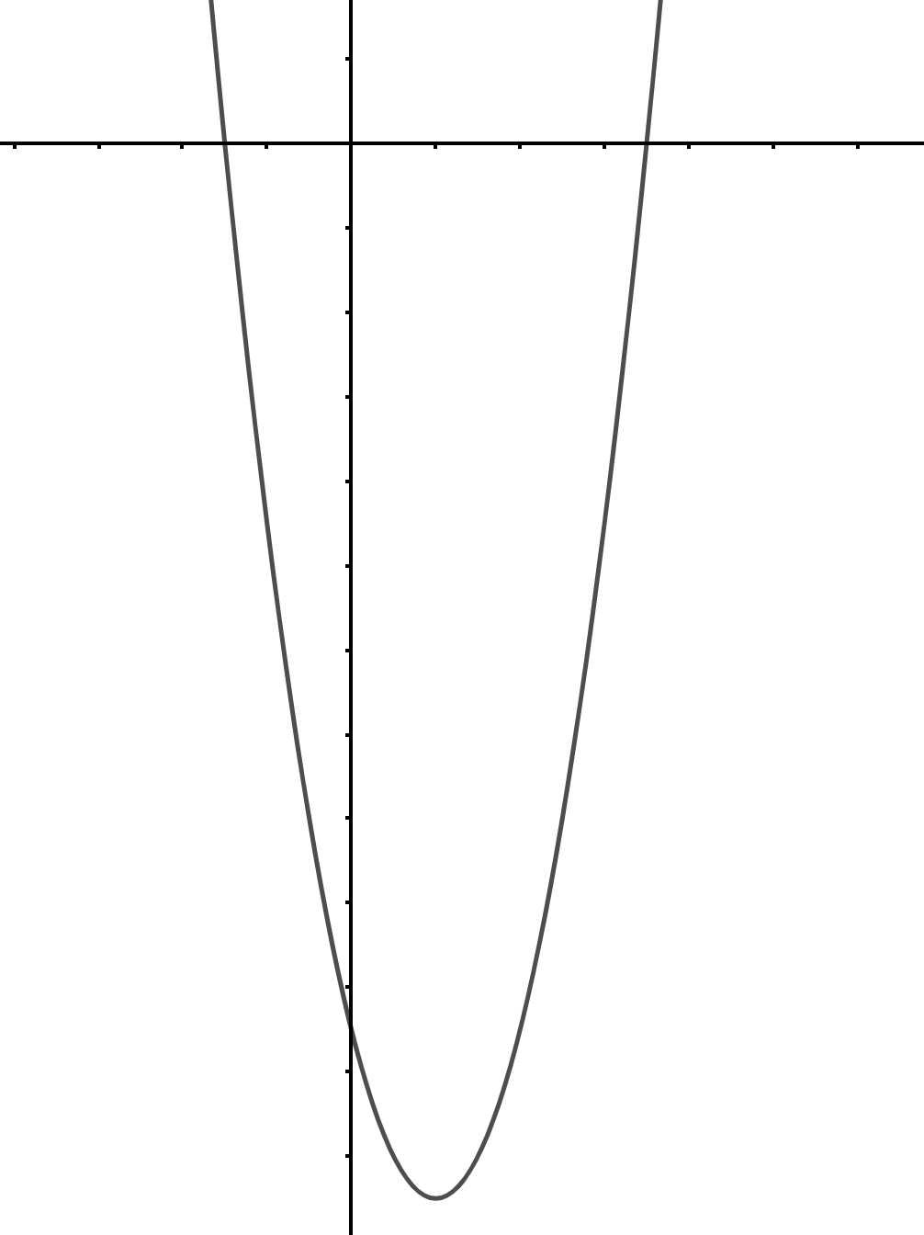

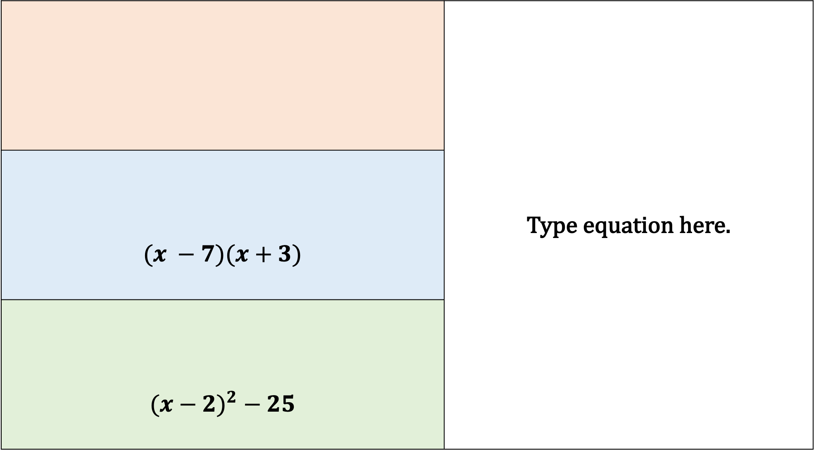



$$(x −7)(x+3)$$
$${(x−2)}^{2} − 25$$
A
$$w$$
$$y$$
Expression
$$x$$
D
Graph
B
Factorised
C
Complete the square
$$z$$

Slide 12

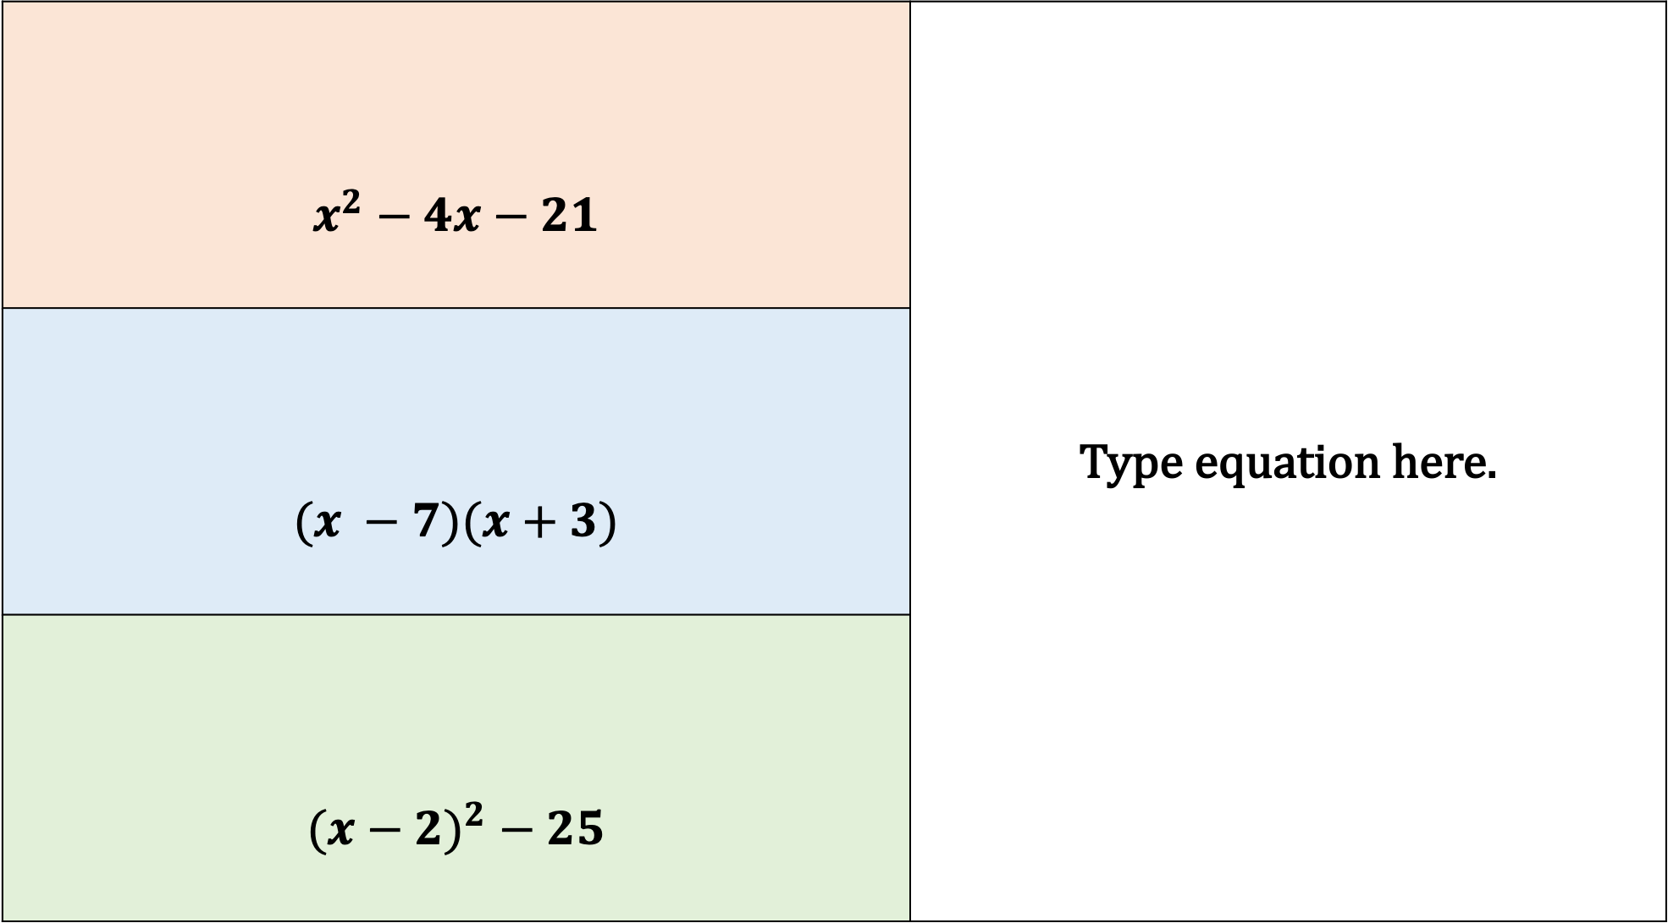



$$x^{2}−4x−21$$
$$(x −7)(x+3)$$
$${(x−2)}^{2} − 25$$
A
$$−3$$
$$7$$
Expression
$$2$$
D
Graph
B
Factorised
C
Complete the square
$$−25$$

