Slide 1
Quadratics

Slide 2
Express in the form: ${ (x+b)}^{2}+ c$ Use the images to help you
$$x−5$$
$$x^{2}−10x+24$$ | ${(x−5)}^{2}−1$
$$x^{2}−10x+26$$
$$x^{2}−10x−1$$
$$x^{2}−10x+50$$
$$x^{2}−10x$$
$$x^{2}−10x+c$$
$$x+3$$
$$x^{2}+6x+9$$ | ${(x+3)}^{2}$
$$x^{2}+6x+10$$
$$x^{2}+6x+11$$
$$x^{2}+6x+12$$
$$x^{2}+6x$$
$$x+3$$
$$x−5$$
$$x^{2}+6x+9={(x+3)}^{2}$$
$$x^{2}−10x+25={(x−5)}^{2}$$
Express in the form: ${ (x−b)}^{2}+ c$
$$x^{2}−2x+2$$
$$x^{2}−4x+2$$
$$x^{2}−6x+2$$
$$x^{2}−8x+2$$
$$x^{2}−10x+2$$
$$x−1$$
Solve the following:
$${(x−1)}^{2}=36$$
$$x^{2}−2x−35=0$$
36
$${2x}^{2}+6x−4$$
$$x+3$$
48
Solve the following:
$${(x+3)}^{2}=48$$
$$x^{2}+6x−39=0$$
Express in the form: ${ (x+b)}^{2}+ c$
$$x^{2}+2x+25$$
$$x^{2}+4x+25$$
$$x^{2}+6x+25$$
$$x^{2}+8x+25$$
$$x^{2}+10x+25$$
$$x−4$$
Use the diagrams to help write
${2x}^{2}+6x−4$ in the form
$${ a(x+b)}^{2}+ c$$
$Solve$: ${2x}^{2}+6x−4=0$
50
Solve the following:
$${(x−4)}^{2}=50$$
$$x^{2}−8x−34=0$$

Slide 3
Express in the form: ${ (x+b)}^{2}+ c$ Use the images to help you
$$x−5$$
$$x^{2}−10x+24$$ | ${(x−5)}^{2}−1$
$$x^{2}−10x+26$$ | ${(x−5)}^{2}+1$
$$x^{2}−10x−1$$ | ${(x−5)}^{2}−26$
$$x^{2}−10x+50$$ | ${(x−5)}^{2}+25$
$$x^{2}−10x$$ | ${(x−5)}^{2}−25$
$$x^{2}−10x+25$$ | ${(x−5)}^{2}$
$$x^{2}+6x+9$$ | ${(x+3)}^{2}$
$$x^{2}+6x+10$$ | $${(x+3)}^{2}+1$$
$$x^{2}+6x+11$$ | $${(x+3)}^{2}+2$$
$$x^{2}+6x+12$$ | $${(x+3)}^{2}+3$$
$$x^{2}+6x$$ | $${(x+3)}^{2}−9$$
$$x+3$$
$$x−5$$
$$x+3$$
$$x^{2}+6x+9={(x+3)}^{2}$$
$$x^{2}−10x+25={(x−5)}^{2}$$
Express in the form: ${ (x−b)}^{2}+ c$
$$x^{2}−2x+2$$ | $${(x−1)}^{2}+1$$
$$x^{2}−4x+2$$ | $${(x−2)}^{2}−2$$
$$x^{2}−6x+2$$ | $${(x−3)}^{2}−7$$
$$x^{2}−8x+2$$ | $${(x−4)}^{2}−14$$
$$x^{2}−10x+2$$ | $${(x−5)}^{2}−23$$
$$x−1$$
Solve the following:
$${(x−1)}^{2}=36$$
$$x^{2}−2x−35=0$$
36
$${2x}^{2}+6x−4$$
$$x+3$$
48
Solve the following:
$${(x+3)}^{2}=48$$
$$x^{2}+6x−39=0$$
Express in the form: ${ (x+b)}^{2}+ c$
$$x^{2}+2x+25$$ | $${(x+1)}^{2}+24$$
$$x^{2}+4x+25$$ | $${(x+2)}^{2}+21$$
$$x^{2}+6x+25$$ | $${(x+3)}^{2}+16$$
$$x^{2}+8x+25$$ | $${(x+4)}^{2}+9$$
$$x^{2}+10x+25$$ | $${(x+5)}^{2}$$
$$x−4$$
Use the diagrams to help write
${2x}^{2}+6x−4$ in the form
$${ a(x+b)}^{2}+ c$$
$Solve$: ${2x}^{2}+6x−4=0$
50
Solve the following:
$${(x−4)}^{2}=50$$
$$x^{2}−8x−34=0$$

Slide 4
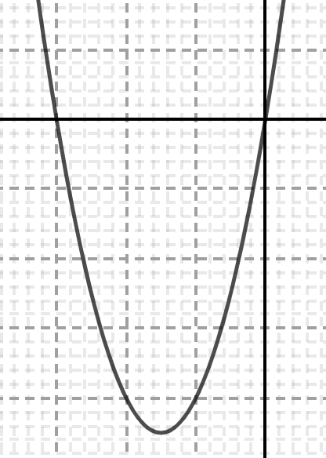
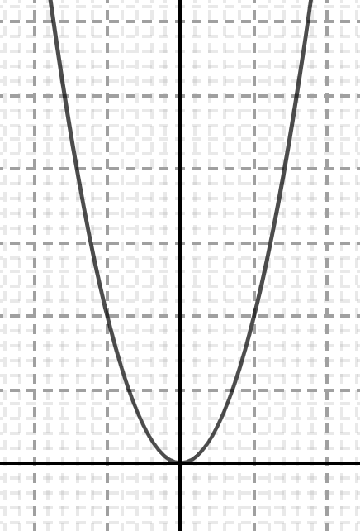
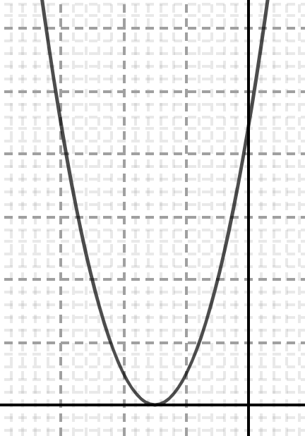
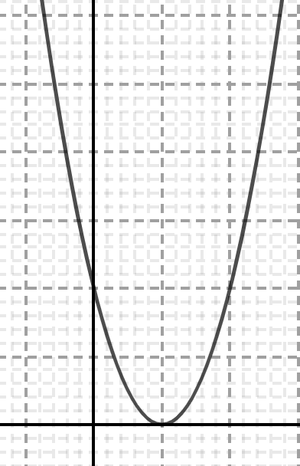
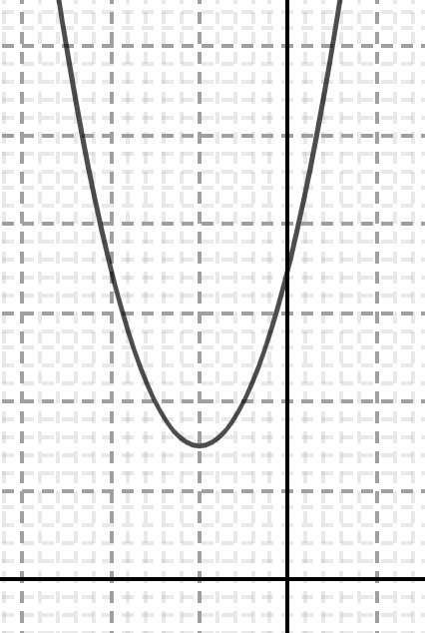
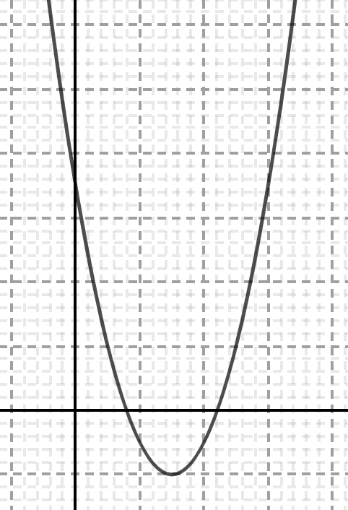
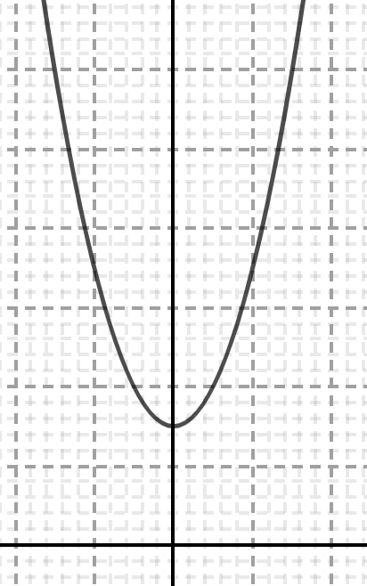
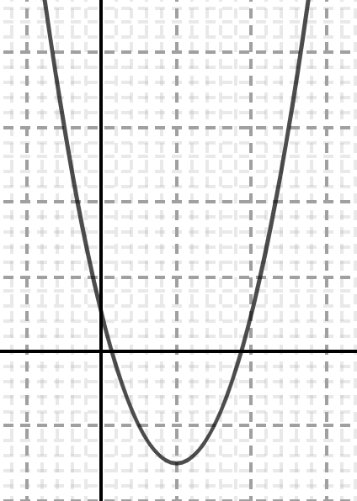
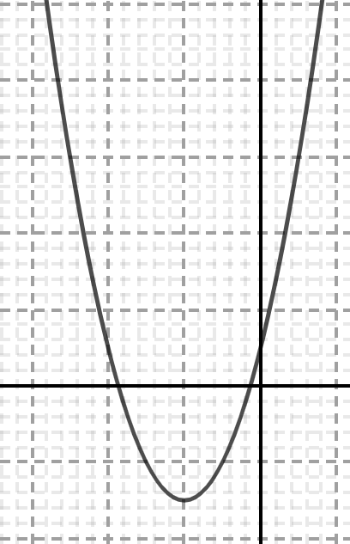
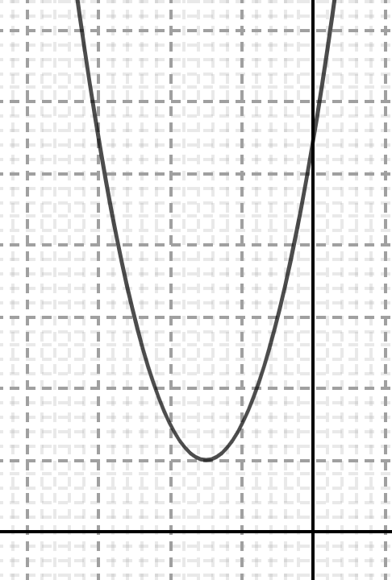
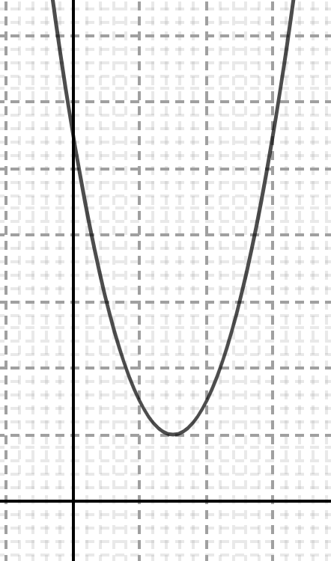
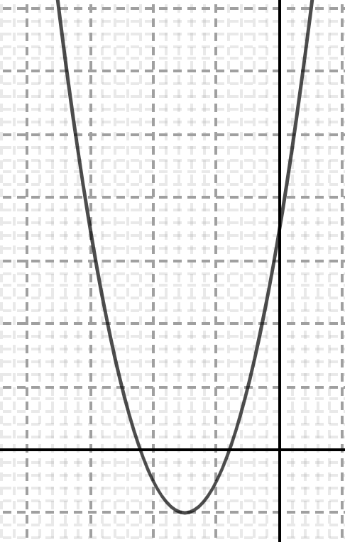
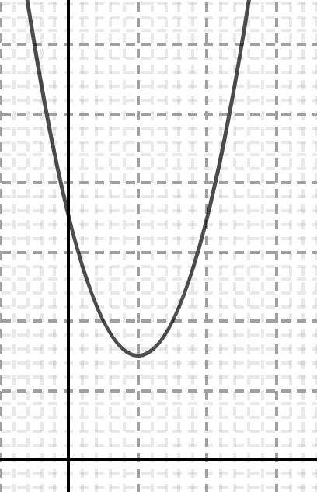
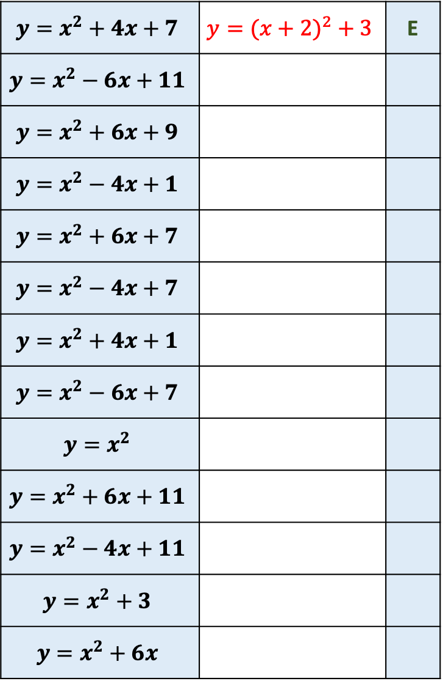
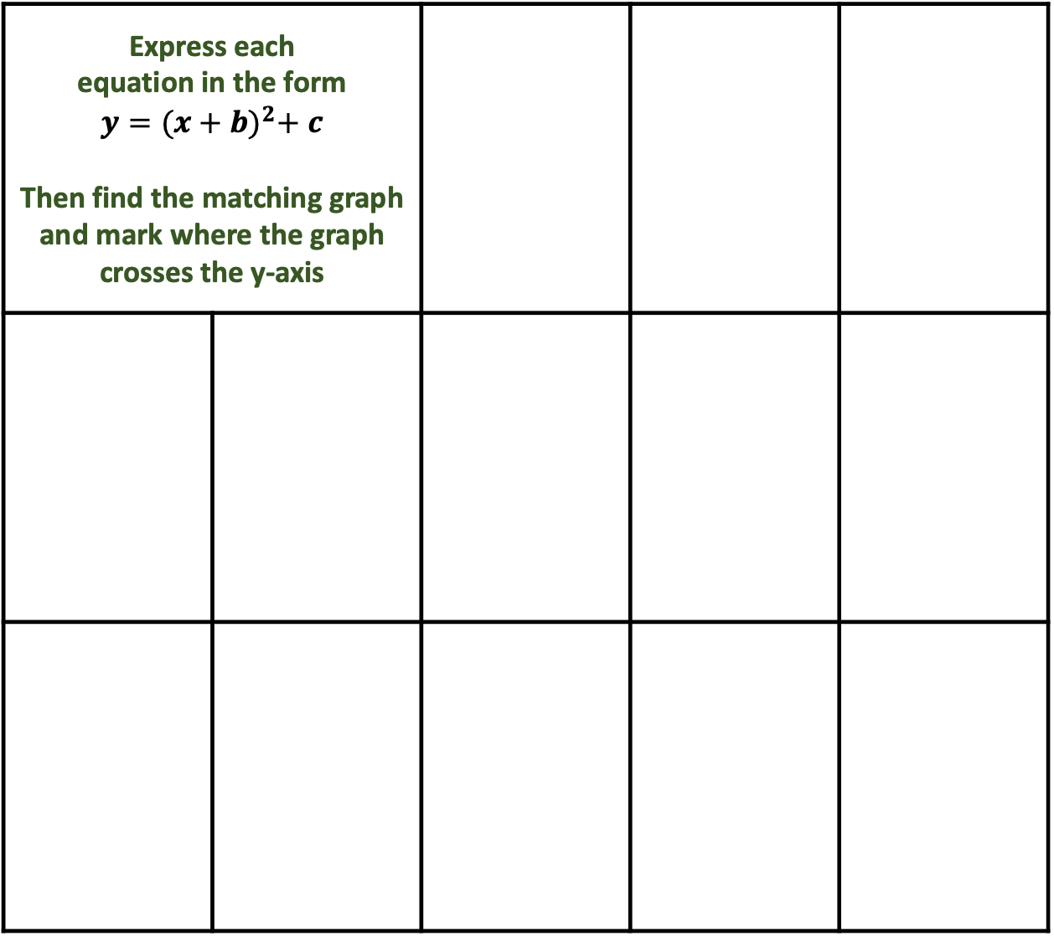
B
C
Express each equation in the form $$y={(x+b)}^{2}+ c$$ Then find the matching graph and mark where the graph crosses the y-axis
A
$$y=x^{2}+4x+7$$ | $$y={(x+2)}^{2} + 3$$ | E
$$y=x^{2}−6x+11$$
$$y=x^{2}+6x+9$$
$$y=x^{2}−4x+1$$
$$y=x^{2}+6x+7$$
$$y=x^{2}−4x+7$$
$$y=x^{2}+4x+1$$
$$y=x^{2}−6x+7$$
$$y=x^{2}$$
$$y=x^{2}+6x+11$$
$$y=x^{2}−4x+11$$
$$y=x^{2}+3$$
$$y=x^{2}+6x$$
D
E
F
G
H
I
J
K
L
M

Slide 5
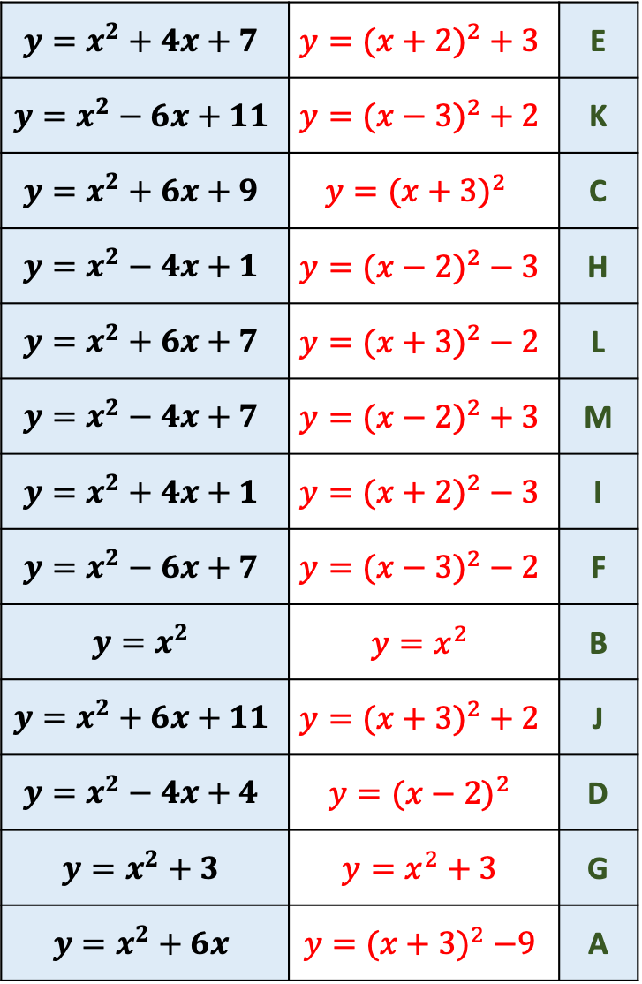
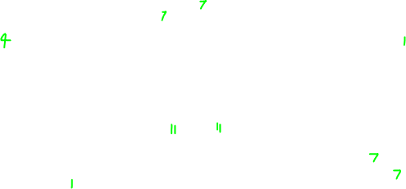
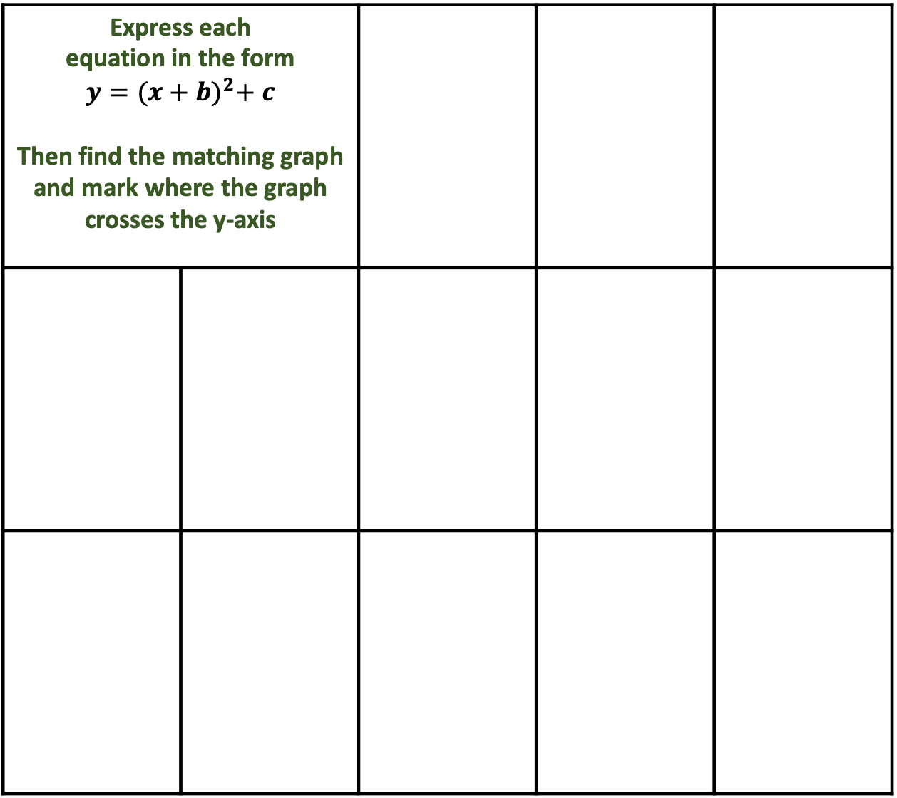
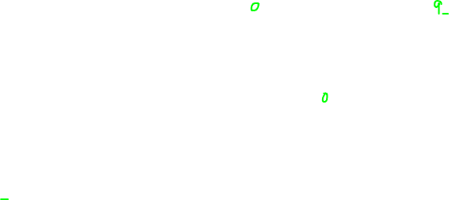
B
C
Express each equation in the form $$y={(x+b)}^{2}+ c$$ Then find the matching graph and mark where the graph crosses the y-axis
A
$$y=x^{2}+4x+7$$ | $$y={(x+2)}^{2} + 3$$ | E
$$y=x^{2}−6x+11$$ | $$y={(x−3)}^{2} + 2$$ | K
$$y=x^{2}+6x+9$$ | $$y={(x+3)}^{2}$$ | C
$$y=x^{2}−4x+1$$ | $$y={(x−2)}^{2} − 3$$ | H
$$y=x^{2}+6x+7$$ | $$y={(x+3)}^{2} − 2$$ | L
$$y=x^{2}−4x+7$$ | $$y={(x−2)}^{2} + 3$$ | M
$$y=x^{2}+4x+1$$ | $$y={(x+2)}^{2} − 3$$ | I
$$y=x^{2}−6x+7$$ | $$y={(x−3)}^{2} − 2$$ | F
$$y=x^{2}$$ | $$y=x^{2}$$ | B
$$y=x^{2}+6x+11$$ | $$y={(x+3)}^{2} + 2$$ | J
$$y=x^{2}−4x+4$$ | $$y={(x−2)}^{2}$$ | D
$$y=x^{2}+3$$ | $$y=x^{2}+3$$ | G
$$y=x^{2}+6x$$ | $$y={(x+3)}^{2} −9$$ | A
D
E
F
G
H
I
J
K
L
M

