Slide 1
Circle Theorems
(Angle from a diameter/in a semi circle)

Slide 2
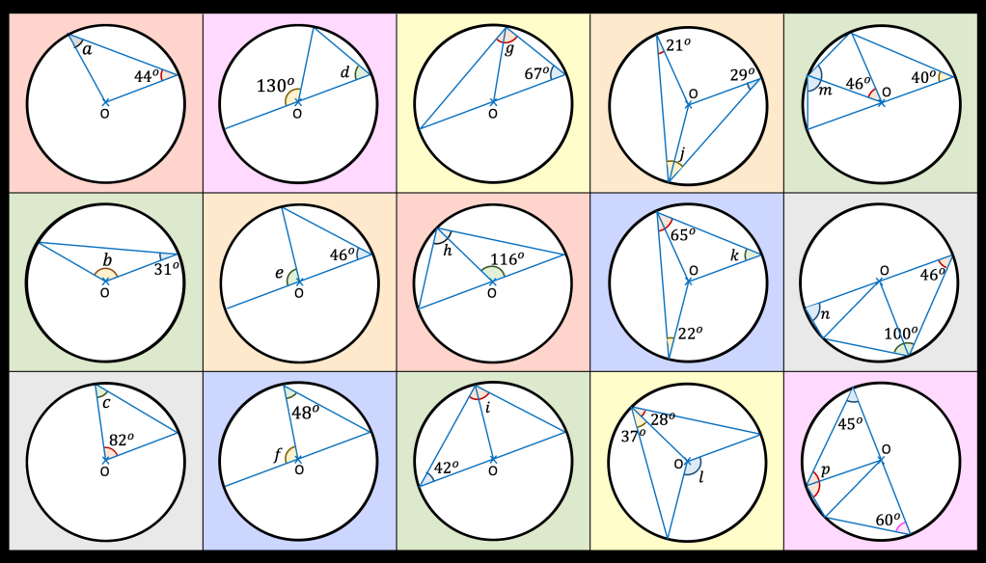

Slide 3




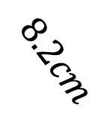
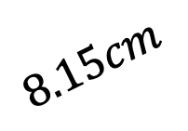
Question 1
Determine whether the statements below are
Correct, Could be correct or Incorrect
Points A, B, C and D are on the circumference
$$A$$
AB is the diameter
AB is a chord
CD is the diameter
Where AB and CD intersect is
the centre of the circle
$$8.2cm$$
$$D$$
$$8.15cm$$
$$C$$
$$B$$

Slide 4



Question 2
Determine whether the statements below are
Correct, Could be correct or Incorrect
Points A and B are on the circumference and O is the centre
$$B$$
Triangle AOB is an EQUILATERAL
Triangle AOB is an ISOSCELES
Triangle AOB is a SCALENE
Triangle AOB is a RIGHT-ANGLED
$$A$$
$$O$$

Slide 5



Question 3
Determine whether the statements below are
Correct, Could be correct or Incorrect
Points A, B, C and D are on the circumference and O is the centre
$$B$$
Triangles AOB and BOC are congruent
Triangles AOB and DOC are congruent
Triangles BOC and AOD are congruent
Triangles AOD and DOC are congruent
$$A$$
$$C$$
$$O$$
$$D$$

Slide 6




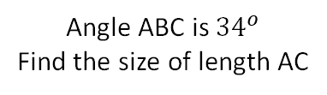













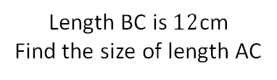





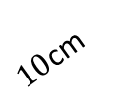



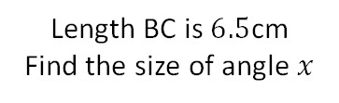













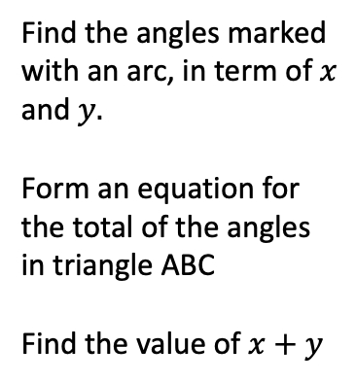



Find the missing angles
AB is the diameter of the circle. O is the centre and C is a point on the circumference
A, B, and C are points on the circumference of a circle
Is the length AB a diameter? Explain how you know
Find the angles marked with an arc, in term of $x$
and $y.$
Form an equation for the total of the angles in triangle ABC
Find the value of $x+y$
$$C$$
$$C$$
$$A$$
$$A$$
$$B$$
$$B$$
$${68}^{o}$$
$$x$$
$${57}^{o}$$
$10$cm
$$O$$
$$O$$
$${34}^{o}$$
$$C$$
$$y$$
$$y$$
$$B$$
$8$cm
$$C$$
$$B$$
$$A$$
$$A$$
$$C$$
$$C$$
$$B$$
$$7x+20$$
$${112}^{o}$$
A, B and C are all points of the circumference. AB is a diameter of length $13$cm
$$B$$
$$2x+3$$
$${95}^{o}$$
$$A$$
$$A$$
$$8x−13$$
$$A$$
$${63}^{o}$$
$$A$$
$$A$$
$$B$$
$$C$$
$${34}^{o}$$
$$C$$
$$C$$
$\sqrt{12}$cm
$$B$$
$$C$$
$$x$$
$$B$$
$${122}^{o}$$
$\sqrt{13}$cm
$$B$$
$$A$$
$$B$$
$5$cm
Length BC is $6.5$cm
Find the size of angle $x$
Angle ABC is ${34}^{o}$
Find the size of length AC
Length BC is $12$cm
Find the size of length AC
$$C$$
$${55}^{o}$$
$$A$$

Slide 7
Find the missing angles
AB is the diameter of the circle. O is the centre and C is a point on the circumference
A, B, and C are points on the circumference of a circle
Is the length AB a diameter? Explain how you know
Find the angles marked with an arc, in term of $x$
and $y.$
Form an equation for the total of the angles in triangle ABC
Find the value of $x+y$
$$C$$
$$C$$
$$A$$
$$A$$
$$B$$
$$B$$
$${68}^{o}$$
$$x$$
$${57}^{o}$$
$10$cm
$$O$$
$$O$$
$${34}^{o}$$
$$C$$
$$y$$
$$y$$
$$B$$
$8$cm
$$C$$
$$B$$
$$A$$
$$A$$
$$C$$
$$C$$
$$B$$
$$7x+20$$
$${112}^{o}$$
A, B and C are all points of the circumference. AB is a diameter of length $13$cm
$$B$$
$$2x+3$$
$${95}^{o}$$
$$A$$
$$A$$
$$8x−13$$
$$A$$
$${63}^{o}$$
$$A$$
$$A$$
$$B$$
$$C$$
$${34}^{o}$$
$$C$$
$$C$$
$\sqrt{12}$cm
$$B$$
$$C$$
$$x$$
$$B$$
$${122}^{o}$$
$\sqrt{13}$cm
$$B$$
$$A$$
$$B$$
$5$cm
Length BC is $6.5$cm
Find the size of angle $x$
Angle ABC is ${34}^{o}$
Find the size of length AC
Length BC is $12$cm
Find the size of length AC
$$C$$
$${55}^{o}$$
$$A$$

