Slide 1
Circle Theorems
(Angle at the centre)

Slide 2





Question 4
Determine whether the statements below are
Correct, Could be correct or Incorrect
Points A, B, C and D, are on the circumference, BD is a diameter and O is the centre
$$D$$
ABCD is a RECTANGLE
ABCD is a KITE
ABCD is a IRREGULAR QUADRILATERAL
$$A$$
$$O$$
$$C$$
$$B$$

Slide 3




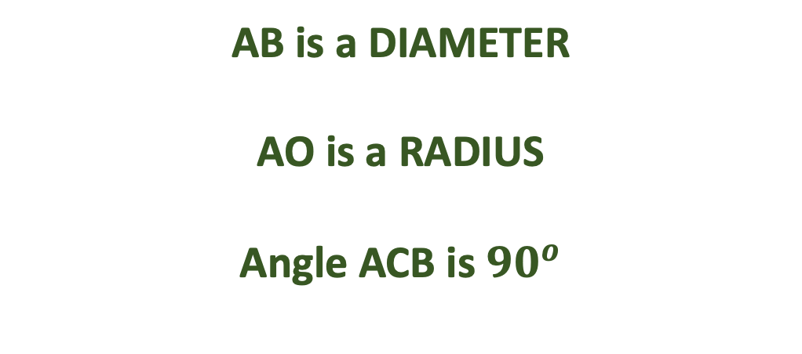
Question 5
Determine whether the statements below are
Correct, Could be correct or Incorrect
Points A, B and C are on the circumference and O is the centre
$$A$$
AB is a DIAMETER
AO is a RADIUS
Angle ACB is ${90}^{o}$
$$O$$
$$C$$
$$B$$

Slide 4


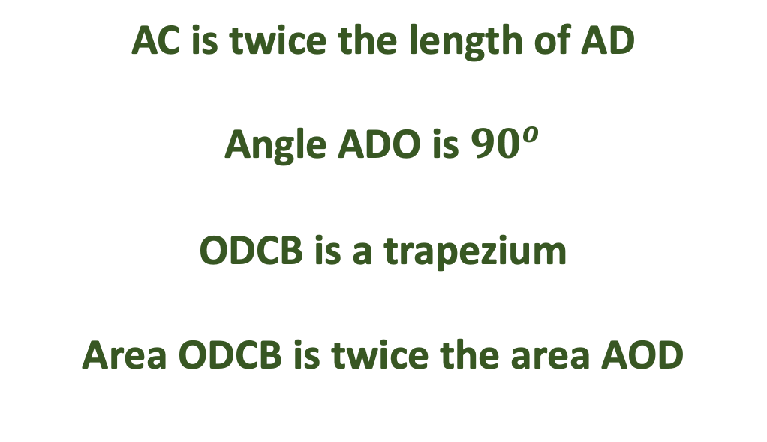
Question 6
Determine whether the statements below are
Correct, Could be correct or Incorrect
Points A, B and C are on the circumference and O is the centre
$$A$$
AC is twice the length of AD
Angle ADO is ${90}^{o}$
ODCB is a trapezium
Area ODCB is twice the area AOD
$$D$$
$$O$$
$$C$$
$$B$$

Slide 5


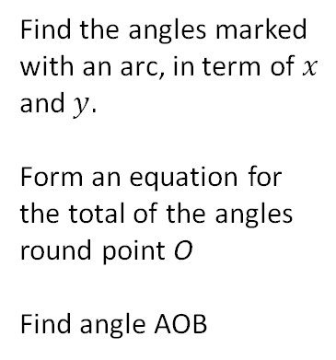

































A, B and C are points on the circumference and O is the centre
All vertices except “o” lie on the circumference. Find the size of the marked angles
$${27}^{o}$$
$${27}^{o}$$
$${130}^{o}$$
$${48}^{o}$$
Find the angles marked with an arc, in term of $x$
and $y.$
Form an equation for the total of the angles round point O
Find angle AOB
o
$$C$$
o
o
$$x$$
$$f$$
$$h$$
$$j$$
$$y$$
$$B$$
$$O$$
$${27}^{o}$$
$${48}^{o}$$
$${75}^{o}$$
$$A$$
$$e$$
o
o
o
$$g$$
$$i$$
o
$${102}^{o}$$
$$b$$
o
All vertices labelled A, B, C lie on the circumference. O is the centre
o is the centre of the circle
$$a$$
$${66}^{o}$$
Find the size of the marked angles
A
C
C
C
$${55}^{o}$$
All vertices except “o” lie on the circumference.
$$k$$
C
Find the size of
the marked
angles
B
o
o
o
$$c$$
o
$${41}^{o}$$
$${180}^{o}$$
$$l$$
$${228}^{o}$$
$$m$$
$${118}^{o}$$
$$n$$
o
A
A
B
A
o
$${40}^{o}$$
B
B
$$d$$

Slide 6
A, B and C are points on the circumference and O is the centre
All vertices except “o” lie on the circumference. Find the size of the marked angles
$${27}^{o}$$
$${27}^{o}$$
$${130}^{o}$$
$${48}^{o}$$
Find the angles marked with an arc, in term of $x$
and $y.$
Form an equation for the total of the angles round point O
Find angle AOB
o
$$C$$
o
o
$$x$$
$$f$$
$$h$$
$$j$$
$$y$$
$$B$$
$$O$$
$${27}^{o}$$
$${48}^{o}$$
$${75}^{o}$$
$$A$$
$$e$$
o
o
o
$$g$$
$$i$$
o
$${102}^{o}$$
$$b$$
o
All vertices labelled A, B, C lie on the circumference. O is the centre
o is the centre of the circle
$$a$$
$${66}^{o}$$
Find the size of the marked angles
A
C
C
C
$${55}^{o}$$
All vertices except “o” lie on the circumference.
$$k$$
C
Find the size of
the marked
angles
B
o
o
o
$$c$$
o
$${41}^{o}$$
$${180}^{o}$$
$$l$$
$${228}^{o}$$
$$m$$
$${118}^{o}$$
$$n$$
o
A
A
B
A
o
$${40}^{o}$$
B
B
$$d$$

