Slide 1
Circle Theorems
(Angles in a segment/from the same point)

Slide 2
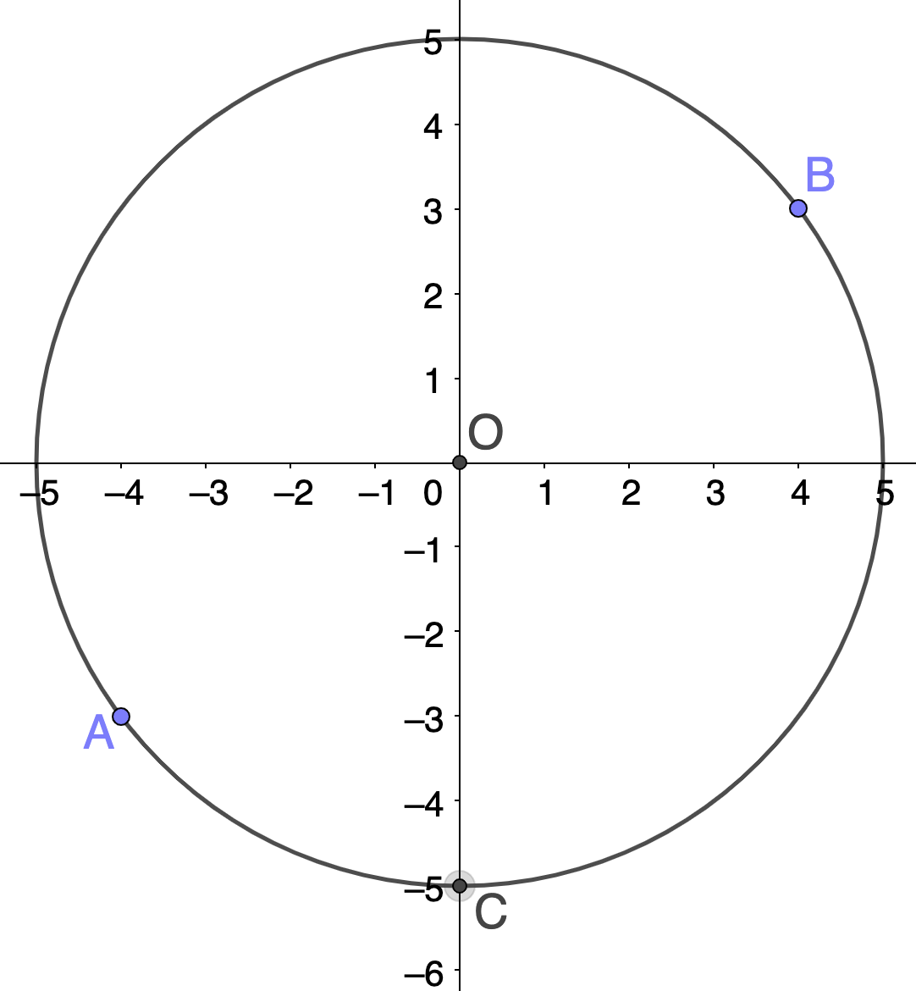
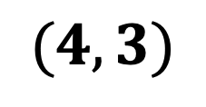
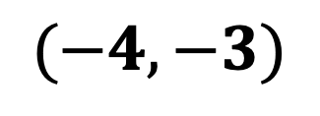
$(4, 3)$
Find the following
Length OB
Length AB
Angle ACB
Length AC
Length BC
$(−4, −3)$

Slide 3































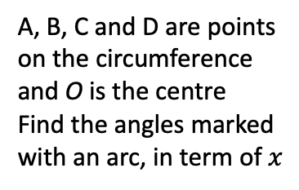




















$$C$$
A, B, C and D are points on the circumference and O is the centre
A, B, C and D are points on the circumference and O is the centre
Find the angles marked with an arc, in term of $x$
$$x$$
$$D$$
$$C$$
$$B$$
$$C$$
$$O$$
$$B$$
$${118}^{o}$$
$$D$$
$$A$$
$${72}^{o}$$
$${75}^{o}$$
$$y$$
$$C$$
$${68}^{o}$$
$$O$$
$$B$$
$$O$$
$$B$$
$$A$$
$$x$$
$$O$$
$$6cm$$
$${31}^{o}$$
$$A$$
$$A$$
$${35}^{o}$$
$$x$$
$${29}^{o}$$
Find the value of $x$
Find the value of $y$
Find the area of the shaded sector
$${41}^{o}$$
$$y$$
Find the angles and lengths marked
$$7cm$$
$${35}^{o}$$
$${40}^{o}$$
$${42}^{o}$$
$${30}^{o}$$
$$a$$
$$d$$
$$g$$
$$o$$
$$c$$
$$f$$
$$b$$
$${52}^{o}$$
$${49}^{o}$$
$$e$$
$${60}^{o}$$
$${61}^{o}$$
$$h$$

Slide 4

$$C$$
A, B, C and D are points on the circumference and O is the centre
A, B, C and D are points on the circumference and O is the centre
Find the angles marked with an arc, in term of $x$
$$x$$
$$D$$
$$C$$
$$B$$
$$C$$
$$O$$
$$B$$
$${118}^{o}$$
$$D$$
$$A$$
$${72}^{o}$$
$${75}^{o}$$
$$y$$
$$C$$
$${68}^{o}$$
$$O$$
$$B$$
$$O$$
$$B$$
$$A$$
$$x$$
$$O$$
$$6cm$$
$${31}^{o}$$
$$A$$
$$A$$
$${35}^{o}$$
$$x$$
$${29}^{o}$$
Find the value of $x$
Find the value of $y$
Find the area of the shaded sector
$${41}^{o}$$
$$y$$
Find the angles and lengths marked
$$7cm$$
$${35}^{o}$$
$${40}^{o}$$
$${42}^{o}$$
$${30}^{o}$$
$$a$$
$$d$$
$$g$$
$$o$$
$$c$$
$$f$$
$$b$$
$${52}^{o}$$
$${49}^{o}$$
$$e$$
$${60}^{o}$$
$${61}^{o}$$
$$h$$

Slide 5
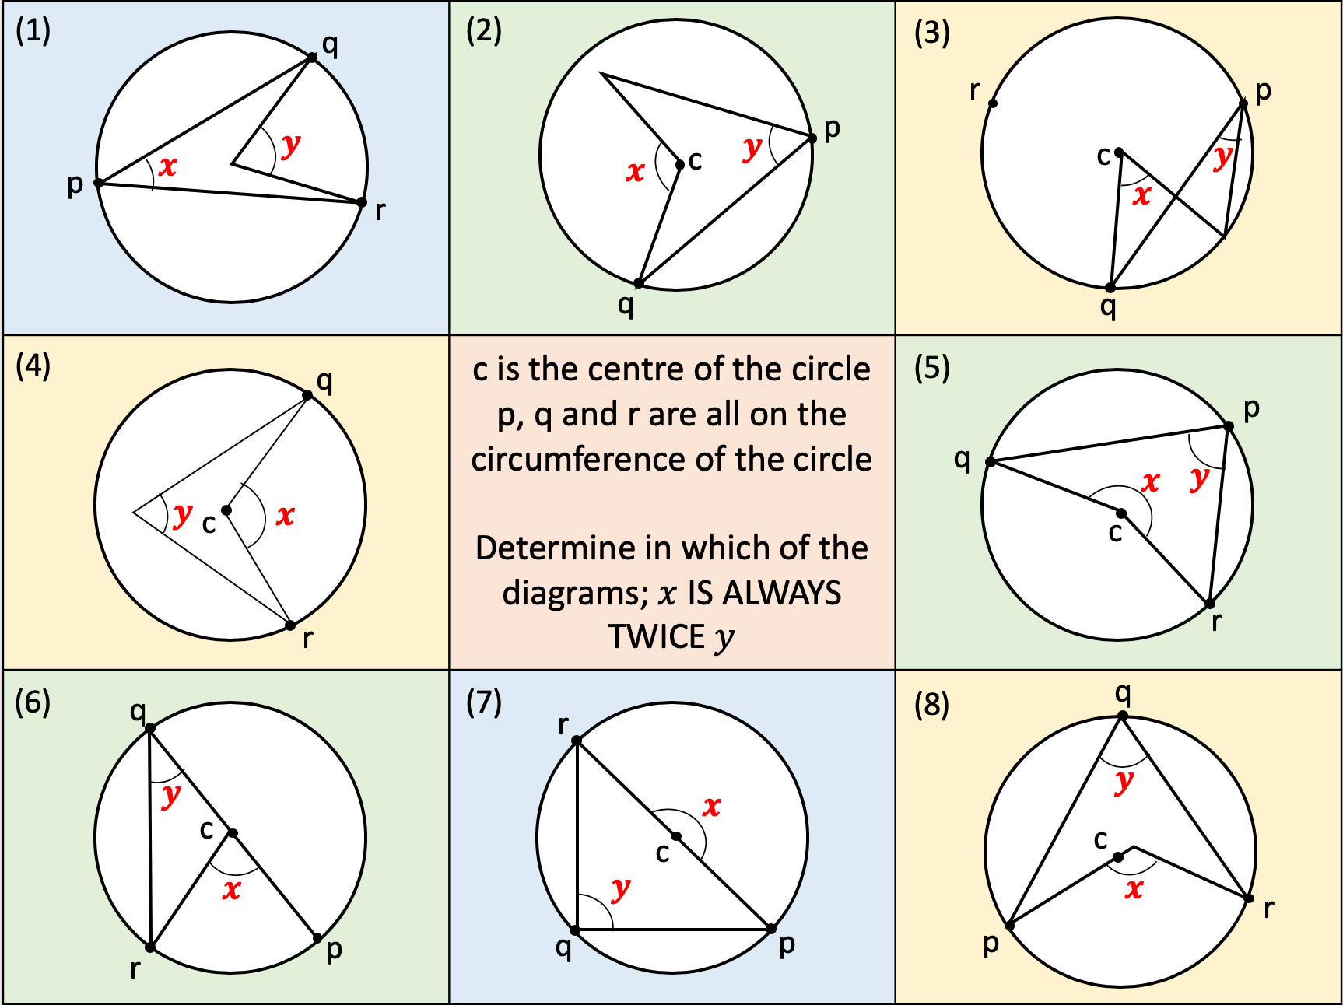

Slide 6
