Slide 1
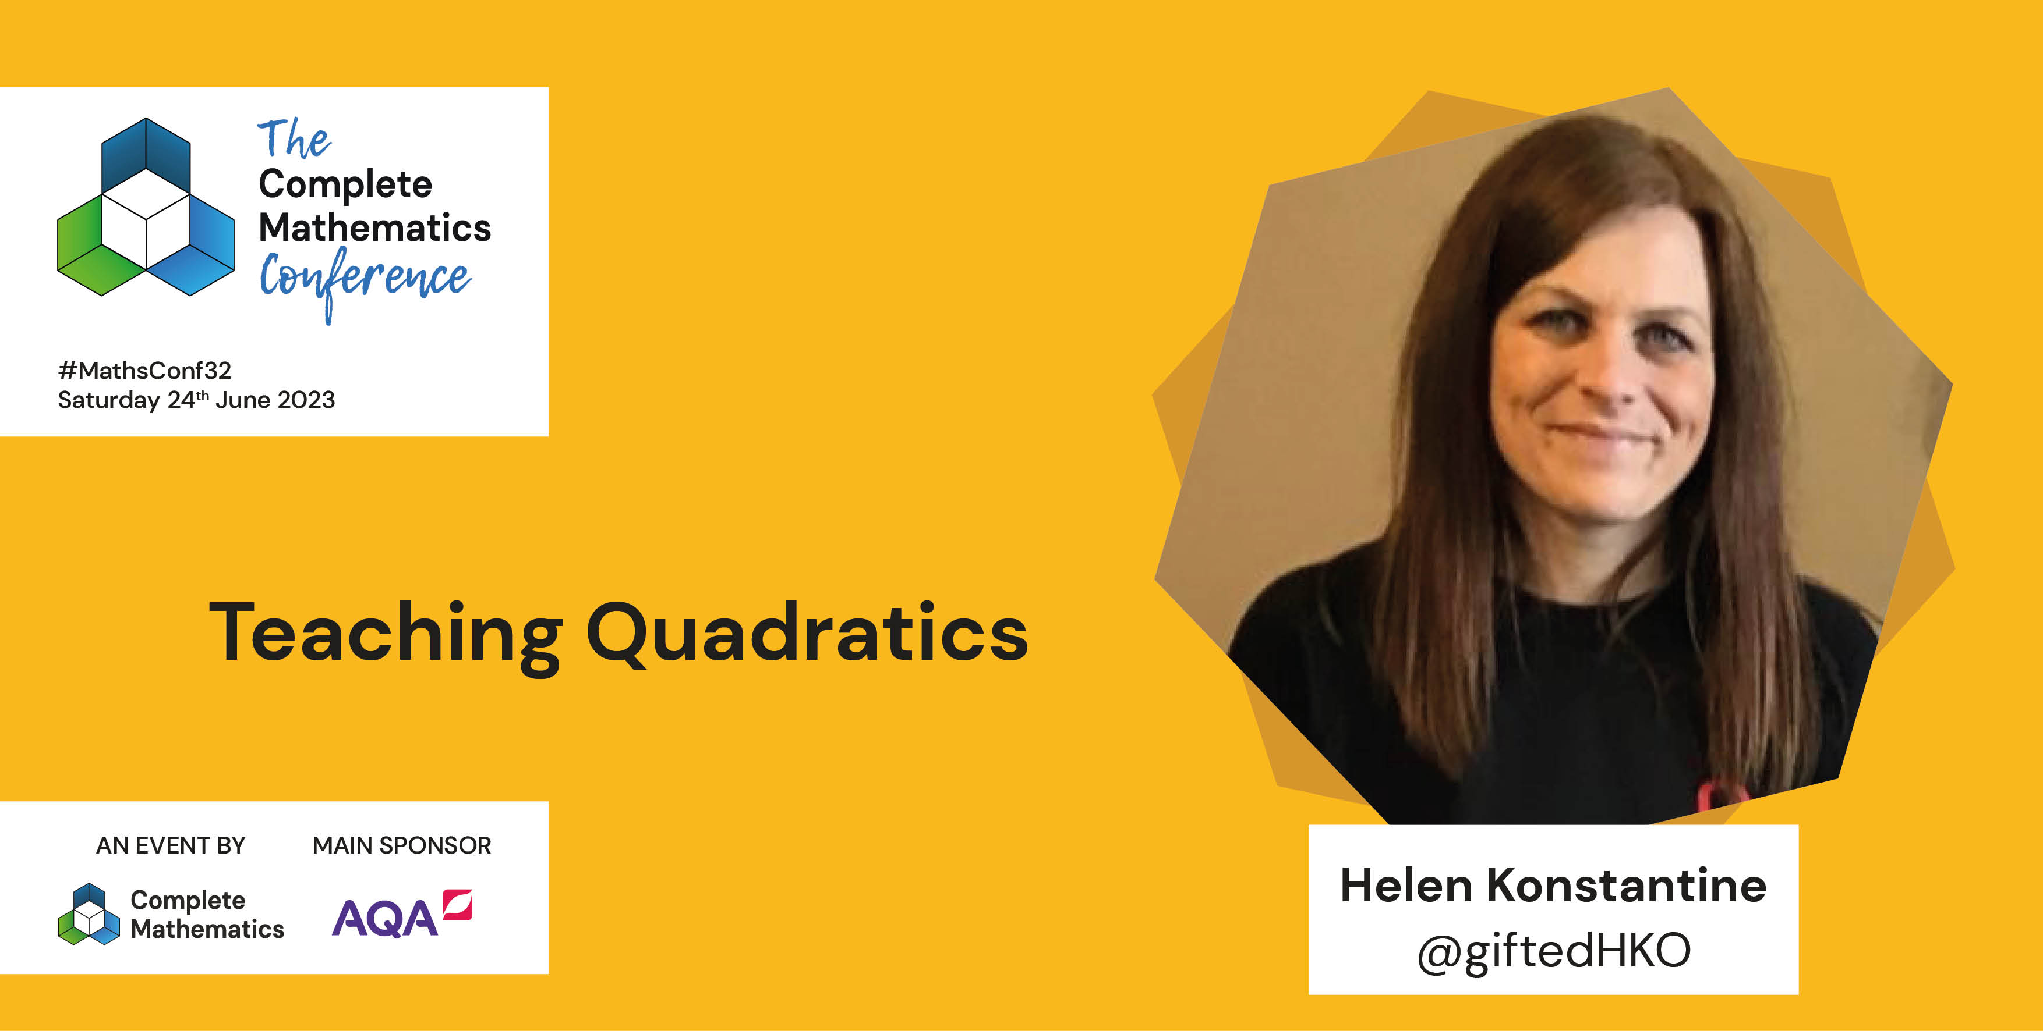
1
Notes:
A little about me
Been teaching for around 17 years
I teach in London
I like thinking about Maths teaching, tasks and Qs – website and twitter
Noting ideas down and reflective practice – lunch duty and drive home.
Why do a talk on quadratics? I don’t think I have taught it well. Still got lots I want to change but this is where I am right now.
Procedural and abstract.

Slide 2
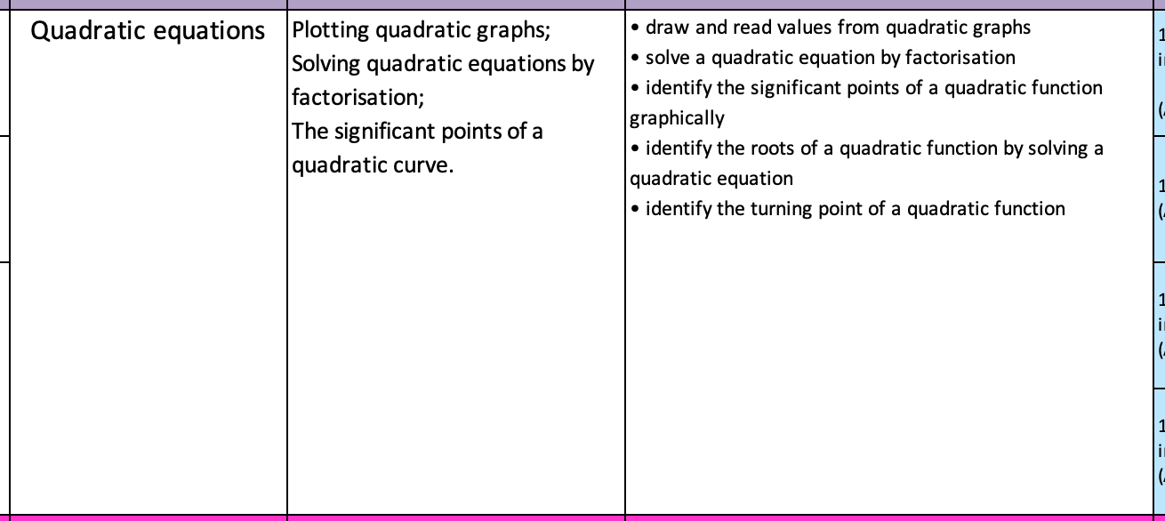
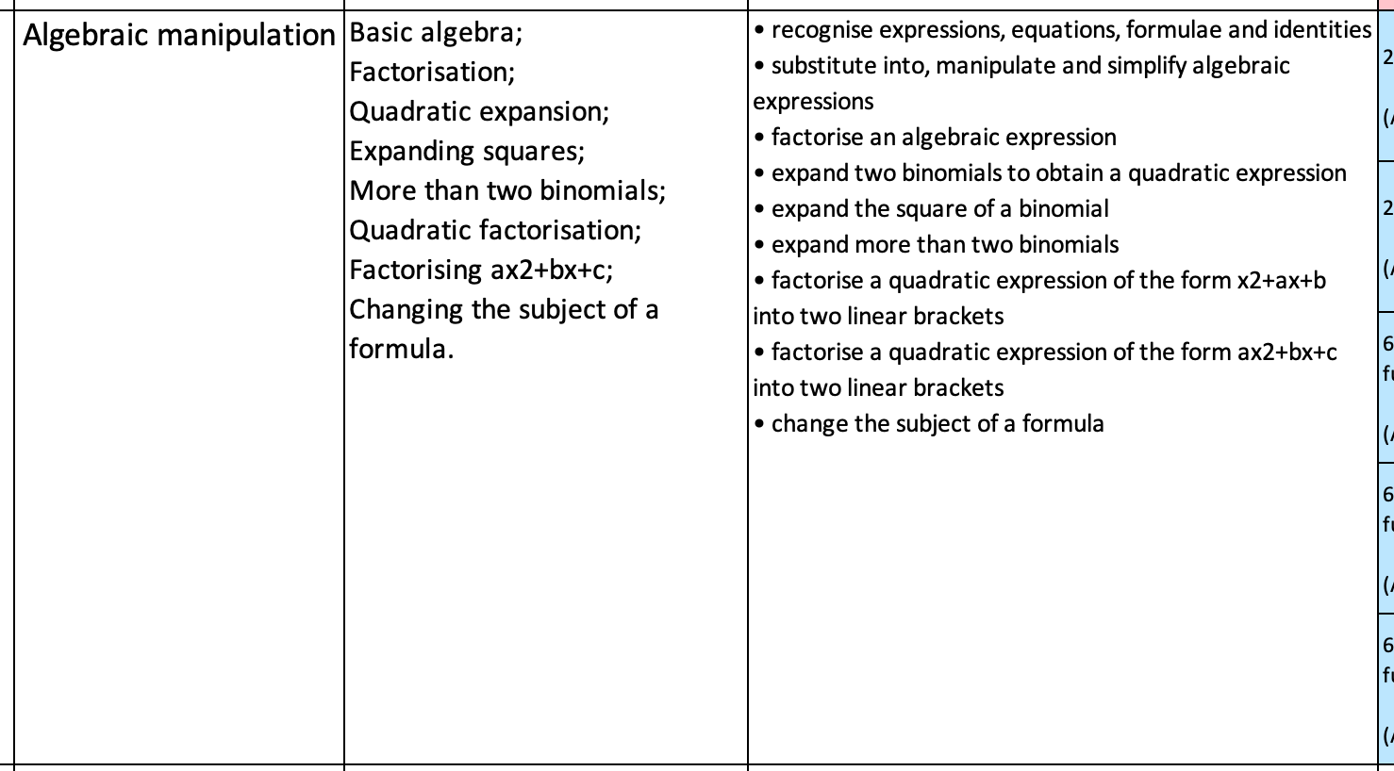
2
Notes:
School context
Year 10 – set 1, mixed, set 4
Quadratics are taught in two chunks. One at the end of year 9, second in the middle of year 10
Why are they learning it? What connections can be made?

Slide 3
3
In the literature specifically on quadratics, it is considered important for students to make sense of the reasons for representing quadratic relationships with different equation forms—
‘general form’ (y = ax² + bx + c),
‘factored form’ (y = a(x – r)(x – s)), and
‘standard (or turning point) form’ (y = a(x – h)² + k).
Otherwise, it is argued that students think of quadratics as a lot of disparate procedures or unrelated and “complicated tricks” like factorising, completing the square, and using the quadratic formula.
Quadratic figural patterns can be configured with different spatial structures that visually match the different equation forms.
Wilkie, K.J. Coordinating visual and algebraic reasoning with quadratic functions.
Notes:
This is interesting – otherwise it doesn’t make sense why we just don’t teach the formula – job done!

Slide 4
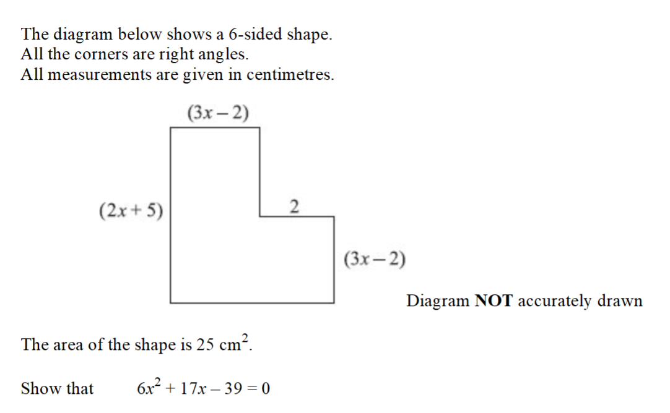
4
Notes:
These Qs are often given in exams – I don’t like them because I don’t find them engaging. I just don’t care about the answer but I know students need to solve this type of question.

Slide 5
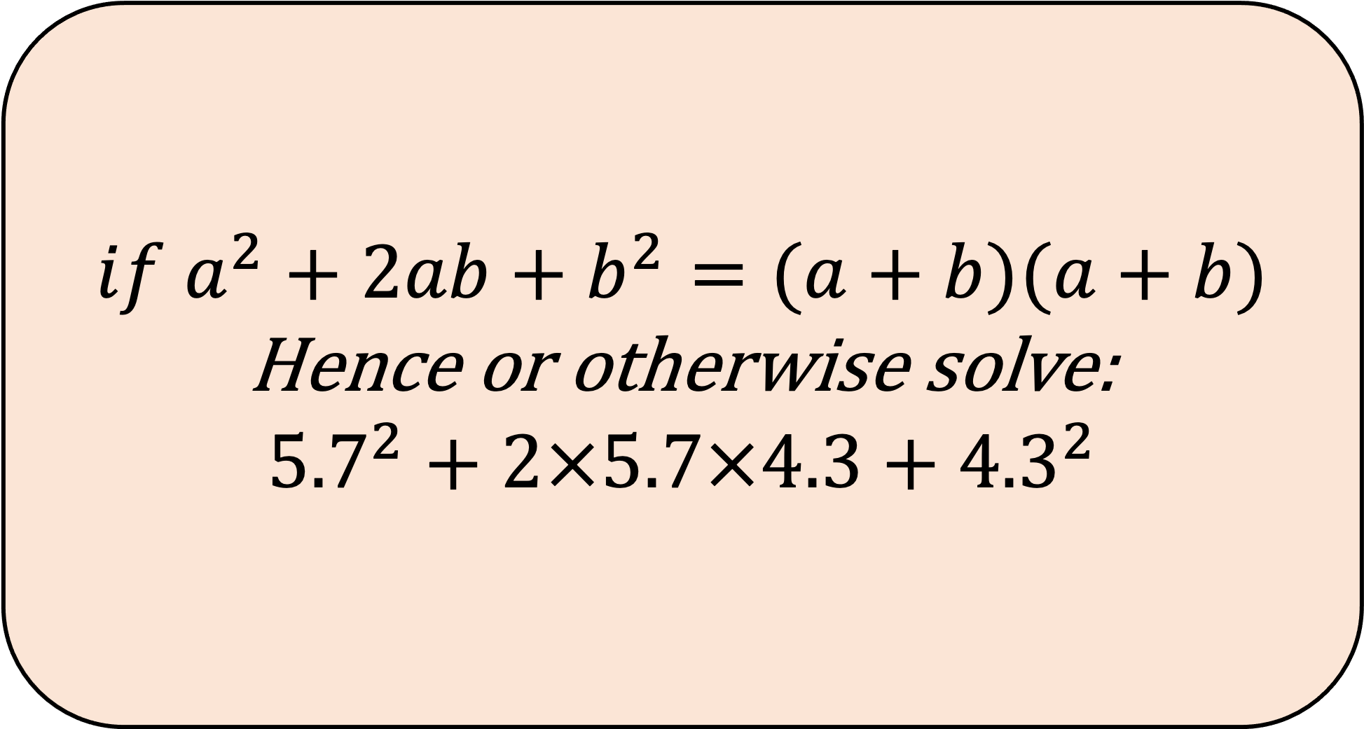
5
$$if a^{2}+2ab+b^{2}=(a+b)(a+b)$$
Hence or otherwise solve:
$${5.7}^{2}+2×5.7×4.3+{4.3}^{2}$$
Notes:
This question is more engaging. You can solve it how its written but actually there is a really neat way to solve it using the factored form. Both expanding and factorizing have benefit when solving all manner of number questions.
Highlights the need to view expressions in different ways.
Richness and connections between number

Slide 6
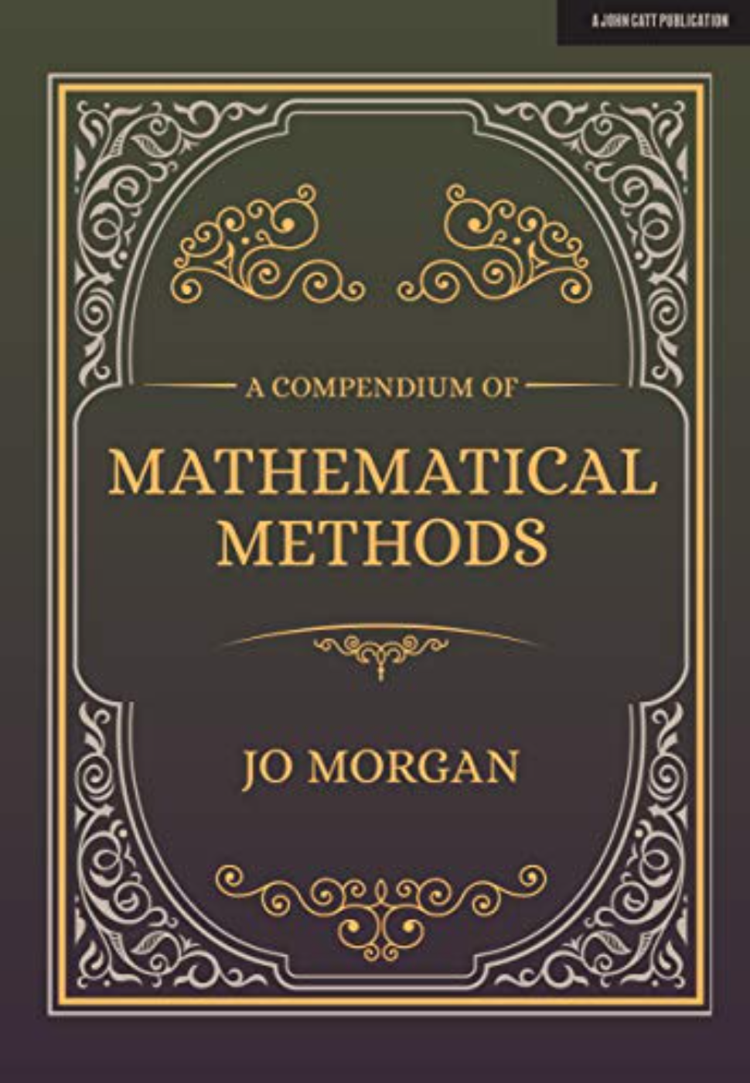
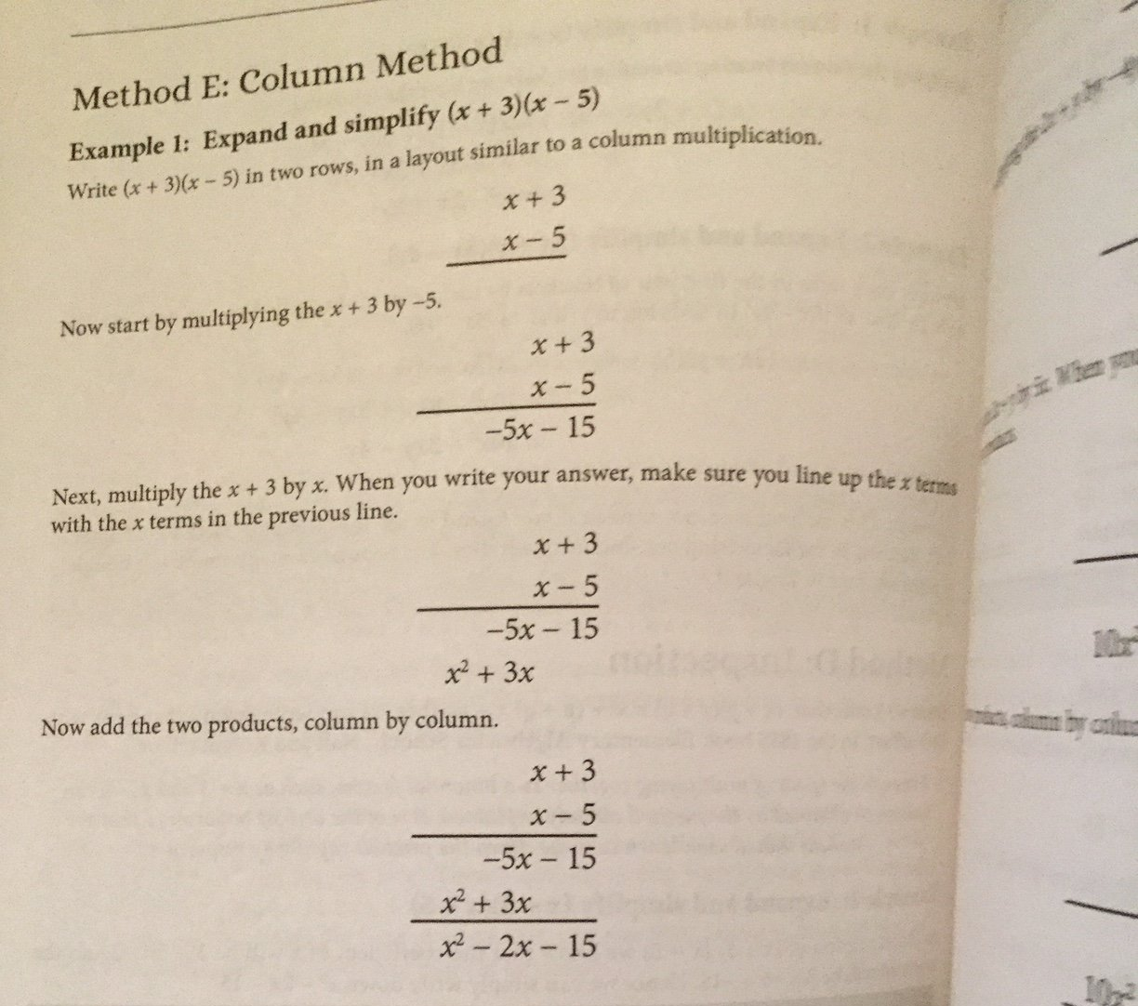
6
Notes:
If you wanted a workshop on how to actually teach factorizing etc, then you are better reading Jo Morgan’s A compendium or mathematical methods. For me, my issues with teaching Quadratics wasn’t the how to to factorise but why?
So, this workshop will be a look at some nice tasks/Qs/prompts for students to see why the various forms are useful.

Slide 7
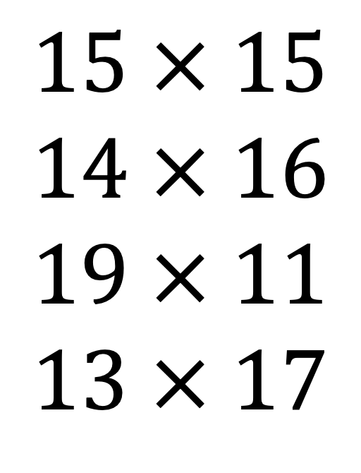

7
$$Calculate the following$$
$$15 × 15$$
$$14 × 16$$
$$19 × 11$$
$$13 × 17$$
Notes:
So let’s begin this first task. A little background on this series of Qs. I was considering the various ways we rearrange algebra tiles. I noticed that I could make a rectangle or a rectangle with just the x squared tiles and the x tiles, and the other tiles were added to make a rectilinear shape. I realized that when we multiply two-digit numbers between 10 and less than 20 together (so 10 + a and 10 + b where a and b are single digit integers., we end up with a solution that is 10 squared, plus 10a + 10b + ab. If they a+b=10 then we would have 100+100+ab.

Slide 8
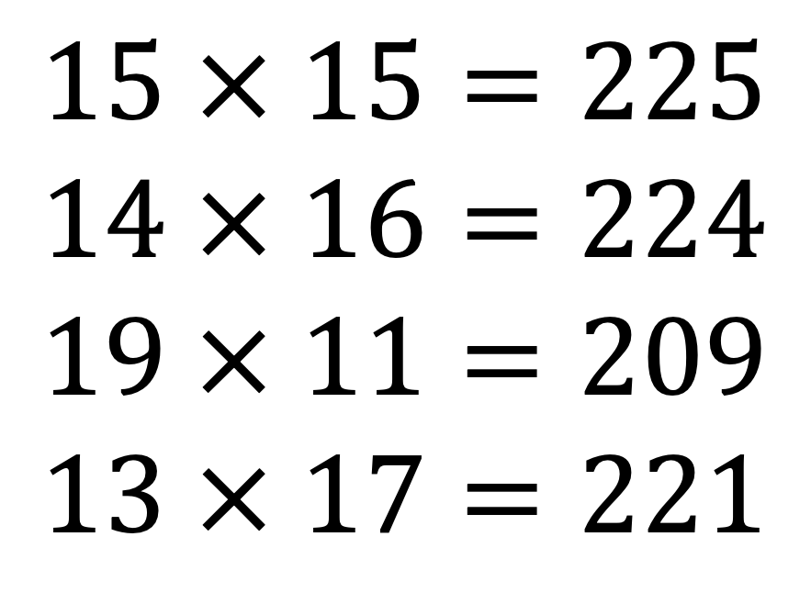
8
$$Calculate the following$$
$$15 × 15=225$$
$$14 × 16=224$$
$$19 × 11=209$$
$$13 × 17=221$$
Notes:
So let’s begin this first task. A little background on this series of Qs. I was considering the various ways we rearrange algebra tiles. I noticed that I could make a rectangle or a rectangle with just the x squared tiles and the x tiles, and the other tiles were added to make a rectilinear shape. I realized that when we multiply two-digit numbers between 10 and less than 20 together (so 10 + a and 10 + b where a and b are single digit integers., we end up with a solution that is 10 squared, plus 10a + 10b + ab. If they a+b=10 then we would have 100+100+ab.

Slide 9
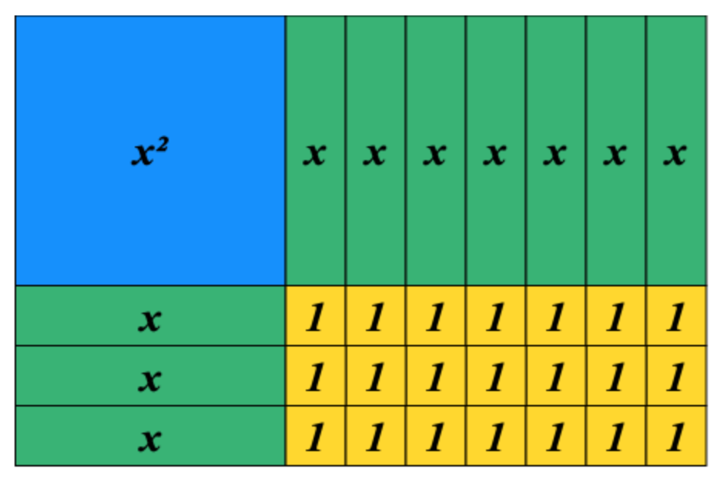
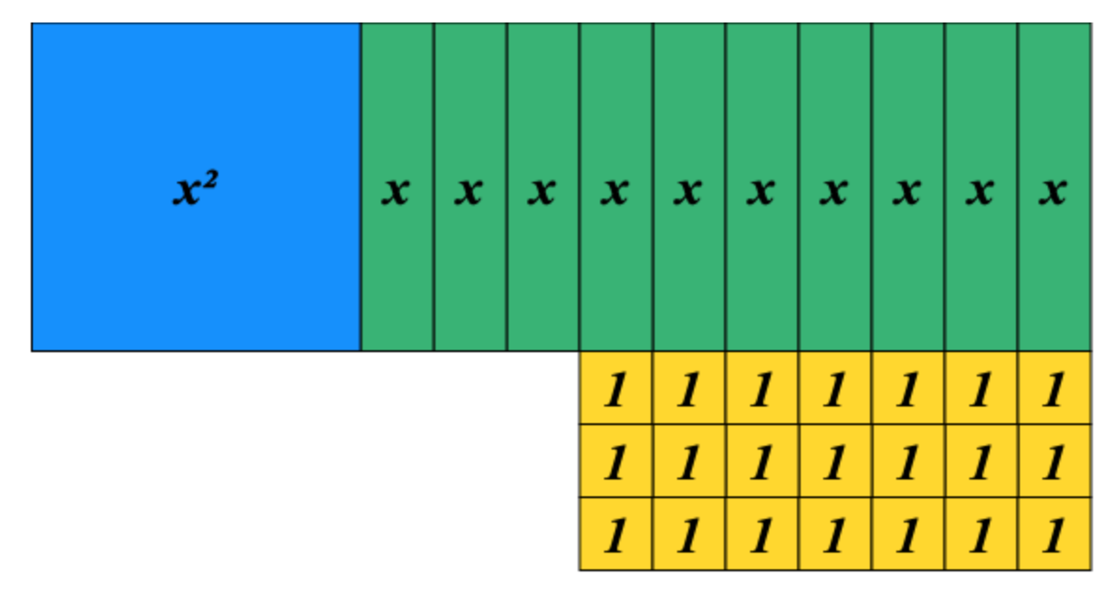
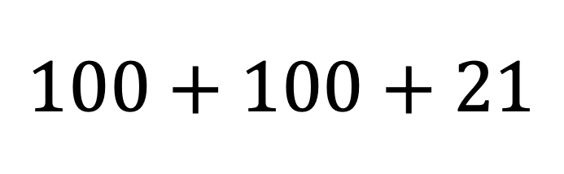
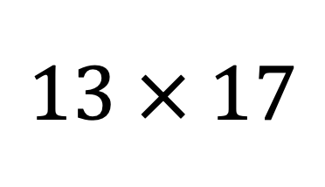
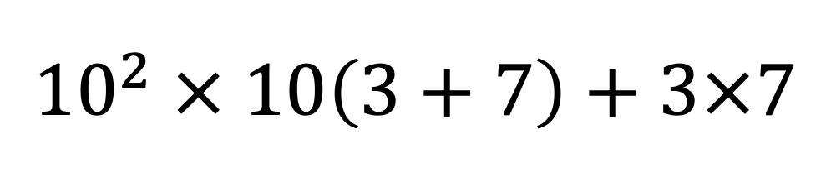
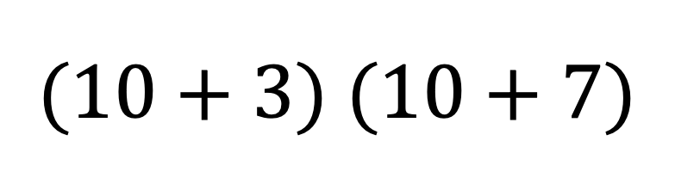
$$13 × 17$$
$${10}^{2} × 10\left(3+7\right)+3×7$$
$$(10+3) (10+7)$$
$$100+100+21$$
9
Notes:
I found it intriguing these would usually take me a while to calculate, 11x19, 12x18, 13x17, 14x16, 15x15 were suddenly were quick and easy.

Slide 10
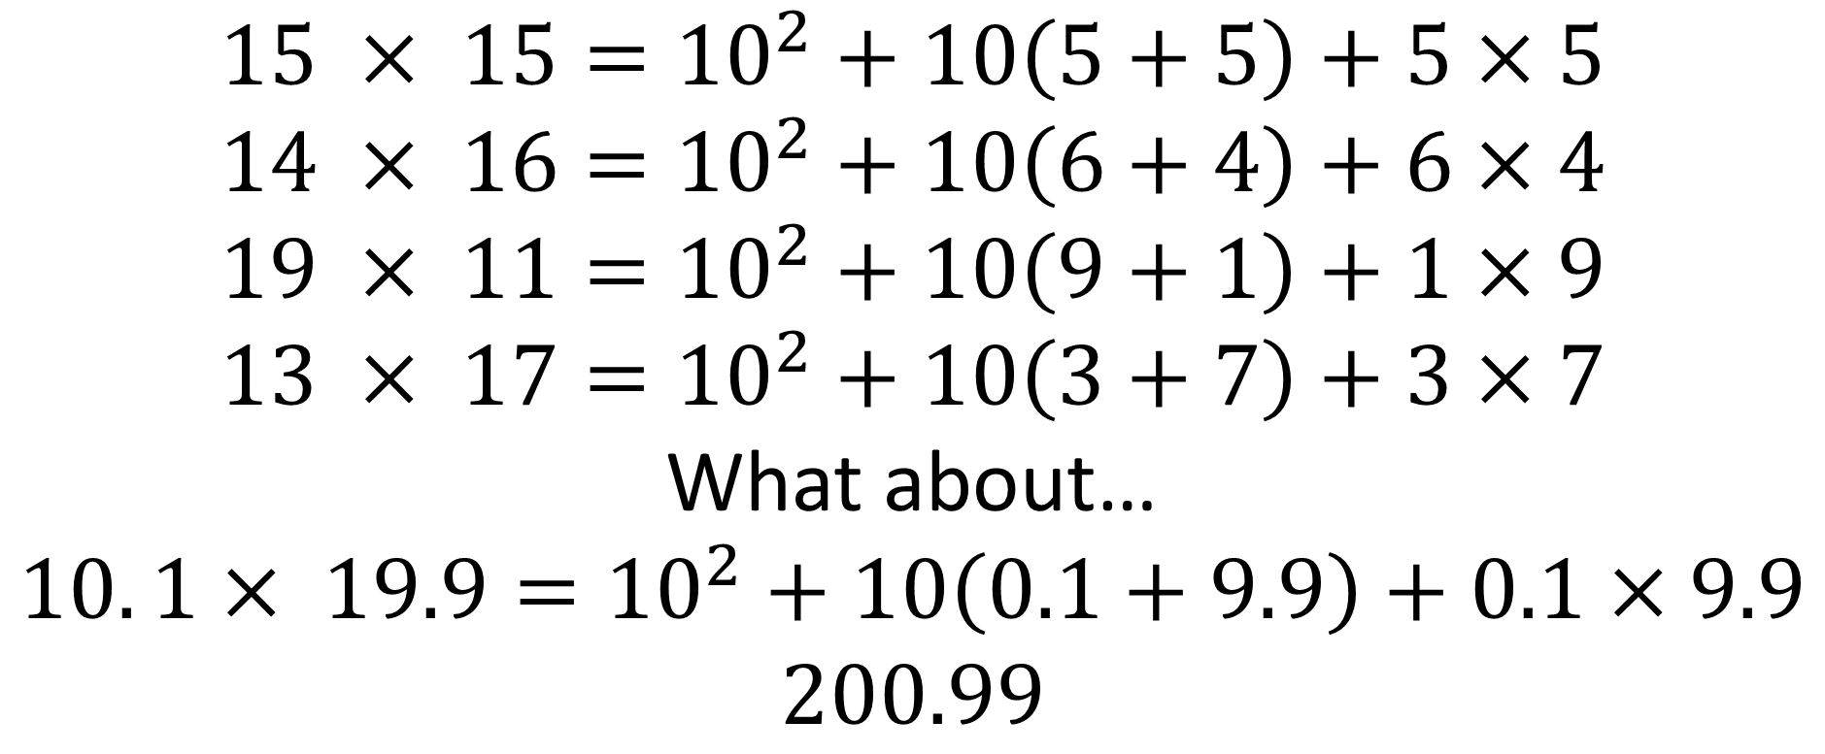
$$Calculate the following$$
$$15 × 15={10}^{2}+10\left(5+5\right)+5×5$$
$$14 × 16={10}^{2}+10\left(6+4\right)+6×4$$
$$19 × 11={10}^{2}+10\left(9+1\right)+1×9$$
$$13 × 17={10}^{2}+10\left(3+7\right)+3×7$$
What about…
$$10. 1× 19.9={10}^{2}+10\left(0.1+9.9\right)+0.1×9.9$$
$$200.99$$
10
Notes:
Extension

Slide 11
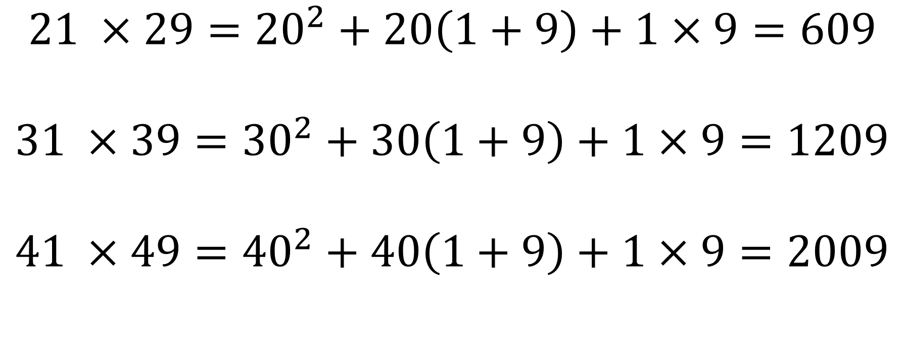
$$Calculate the following$$
$$21 ×29={20}^{2}+20\left(1+9\right)+1×9=609$$
$$31 ×39={30}^{2}+30\left(1+9\right)+1×9=1209$$
$$41 ×49={40}^{2}+40\left(1+9\right)+1×9=2009$$
11
Notes:
Extend the thinking further.

Slide 12




$$23 × 27={20}^{2}+20\left(3+7\right)+3×7$$
12
Notes:
Can we generalise this? For any number?
(10a + b)(10a + c) = 100ab + 10a(b+c) + bc

Slide 13


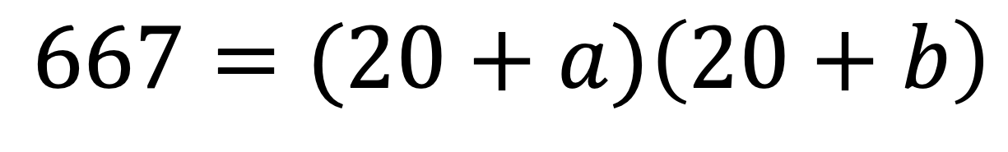






$$667=(20+a)\left(20+b\right)$$
13
Notes:
Can we generalise this? For any number?
(10a + b)(10a + c) = 100ab + 10a(b+c) + bc

Slide 14






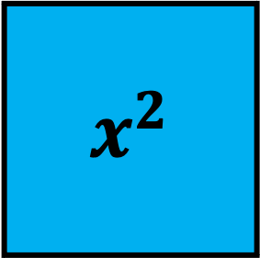


14
$$x$$
$$x^{2}$$
$$x$$
$$x$$
1
1
$$x$$
1
1
$$x$$
Notes:
Arrange to make a rectangle

Slide 15





15
$$x^{2}$$
$$x$$
$$x$$
$$x$$
$$x$$
$$x$$
1
1
1
1
Notes:
Are there other ways to do this?

Slide 16


16
$$x$$
$$x^{2}$$
$$x$$
$$x$$
$$x$$
1
1
$$x$$
1
1
$$x$$

Slide 17






17
$$x^{2}$$
$$x$$
$$x$$
$$x$$
$$x$$
$$x$$
$$x$$
1
1
1
1

Slide 18
18
$$x$$
$$x^{2}$$
$$x$$
$$x$$
1
$$x$$
1
1
$$x$$
1
1
1
1
$$x$$
1
1

Slide 19




19
$$x^{2}$$
$$x$$
$$x$$
$$x$$
$$x$$
1
1
1
$$x$$
1
1
1
$$x$$
1
1
1

Slide 20
20
$$x^{2}$$
$$x^{2}$$
$$x$$
$$x$$
$$x$$
$$x$$
1
1
$$x$$
$$x$$
1
1
$$x$$
$$x$$
1
1
1
1
$$x^{2}$$
$$x$$
$$x^{2}$$
$$x$$
$$x$$
$$x$$
1
$$x$$
$$x$$
1
1
1
1
$$x$$
$$x$$
1
1
1
1
$$x$$
$$x$$

Slide 21
2.)
$$10m$$
$$4.5m$$
3.)
$$x$$
$$2$$
4.)
5.)
21
$$x^{2}$$
$$4x$$ | $$12$$
$$x^{2}$$ | $$2x$$
$$5x$$
$$x$$
$$2m$$
$$1$$
Find the total area
Find the total area
Find the missing area
Find the missing lengths
6.)
$$\sqrt{13}$$
$$2$$
7.)
$$\sqrt{17}$$
$$3$$
8.)
$$3\sqrt{7}$$
$$5$$
9.)
10.)
$$45$$ | $$6\sqrt{5}$$
$$9\sqrt{5}$$
$$50$$ | $$5\sqrt{2}$$
$$20\sqrt{5}$$
$$1$$
$$2$$
$$3$$
Find the total area
Find the total area
Find the total area
Find the missing area
Find the missing area
Find 3 unique solutions to fill the 3 expressions below
Factorise the following expressions
$$x^{2}−12x+20$$
$$x^{2}−9x+20$$
$$x^{2}−21x+20$$
$$x^{2}−x−20$$
$$x^{2}+19x−20$$
$$x^{2}+8x−20$$
$${2x}^{2}−24x+40$$
$$20−8x−x^{2}$$
$${18x−40−2x}^{2}$$
$$x^{2}$$
 | $$20$$
$$(x )(x )$$ | $$x^{2}+…x+20$$
$$(x )(x )$$ | $$x^{2}+…x+20$$
$$(x )(x )$$ | $$x^{2}+…x+20$$
Notes:
When I need to plot graphs later and I substitute into a Q like y = x^2 – 12x + 20 which is y = (x– 10)(x – 2) I find it easier to work out y = (3-10)(3-2) , y = -7

Slide 22
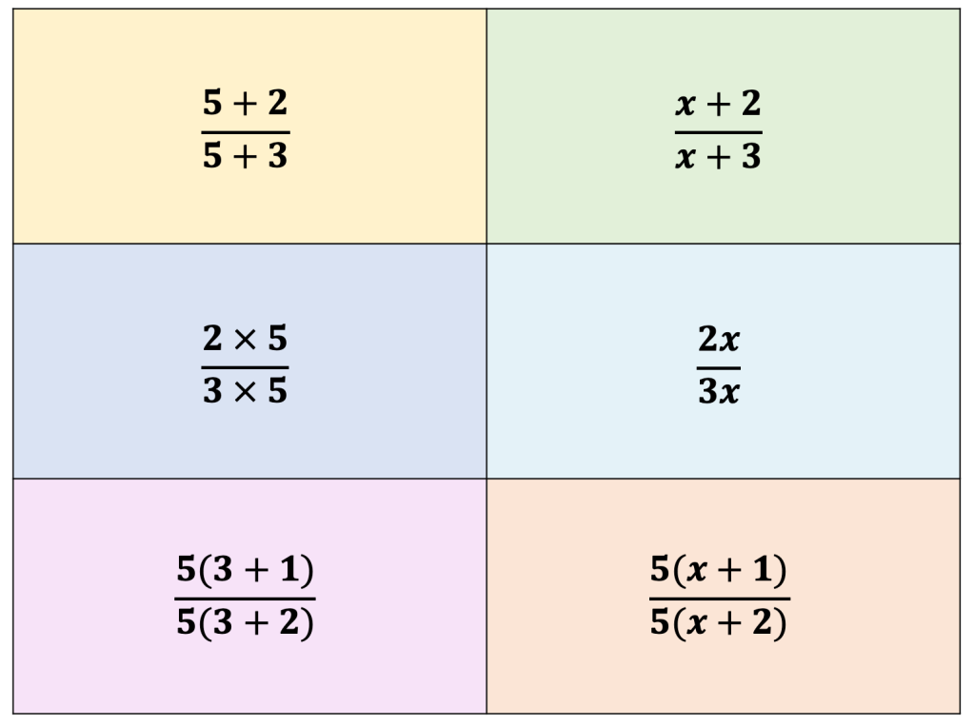
22

Slide 23
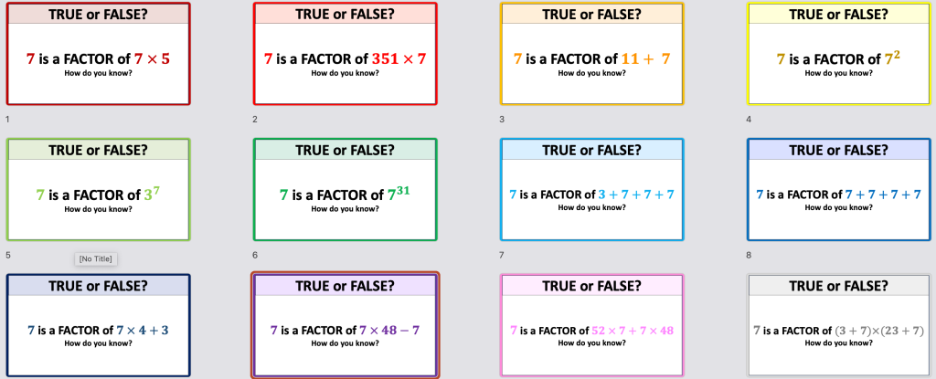
23
Notes:
I also want students to understand that if I factorise 40 = 8x5 it means 8 and 5 are factors so when I factorise a quadratics both the bracketed expressions are factors and not always the terms in the brackets.

Slide 24
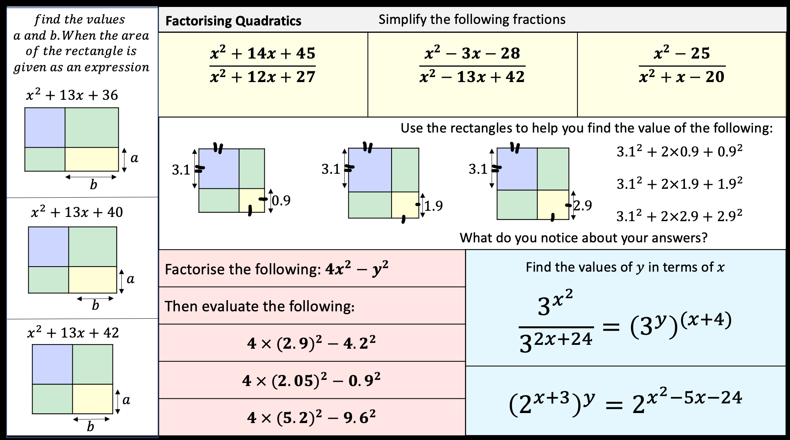

Slide 25
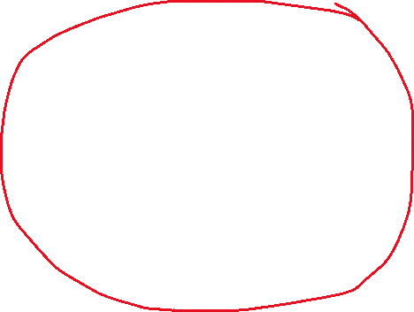
25
Notes:
This is one I like to look at in more depth. Difference of two squares can be one students forget or fail to recognise but it has lots of lovely tasks you can use.

Slide 26
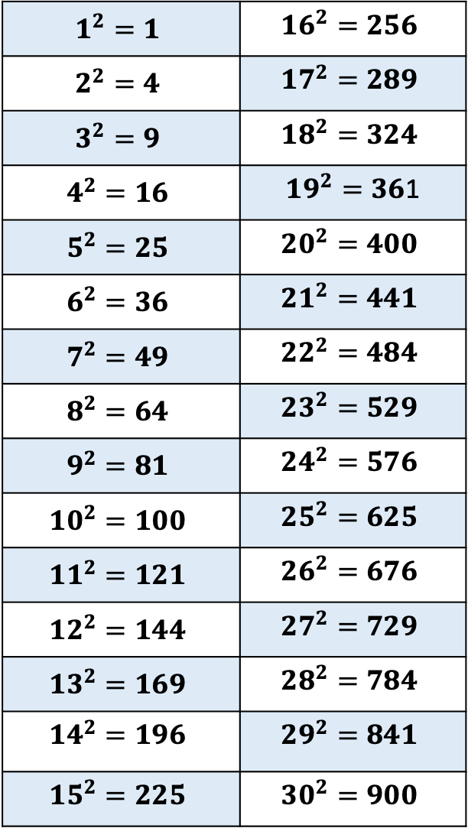
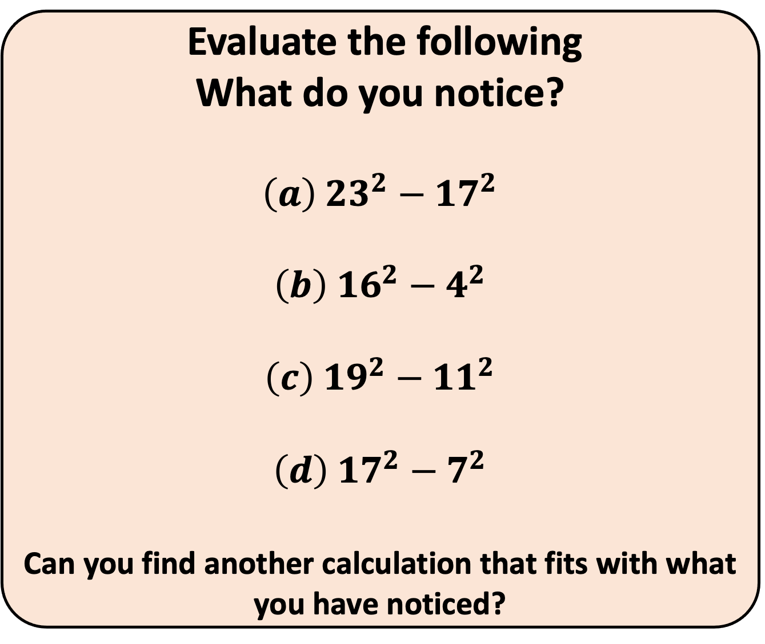
$$1^{2}=1$$ | $${16}^{2}=256$$
$$2^{2}=4$$ | $${17}^{2}=289$$
$$3^{2}=9$$ | $${18}^{2}=324$$
$$4^{2}=16$$ | ${19}^{2}=36$1
$$5^{2}=25$$ | $${20}^{2}=400$$
$$6^{2}=36$$ | $${21}^{2}=441$$
$$7^{2}=49$$ | $$22^{2}=484$$
$$8^{2}=64$$ | $${23}^{2}=529$$
$$9^{2}=81$$ | $${24}^{2}=576$$
$${10}^{2}=100$$ | $${25}^{2}=625$$
$${11}^{2}=121$$ | $${26}^{2}=676$$
$${12}^{2}=144$$ | $${27}^{2}=729$$
$${13}^{2}=169$$ | $${28}^{2}=784$$
$${14}^{2}=196$$ | $${29}^{2}=841$$
$${15}^{2}=225$$ | $${30}^{2}=900$$
Evaluate the following
What do you notice?
$${\left(a\right) 23}^{2}−{17}^{2}$$
$${\left(b\right) 16}^{2}−4^{2}$$
$${\left(c\right) 19}^{2}−{11}^{2}$$
$${\left(d\right) 17}^{2}−7^{2}$$
Can you find another calculation that fits with what you have noticed?
Notes:
I like this problem
Students can try to find the solutions via calculator or the list to the left but it’s the why that is important

Slide 27
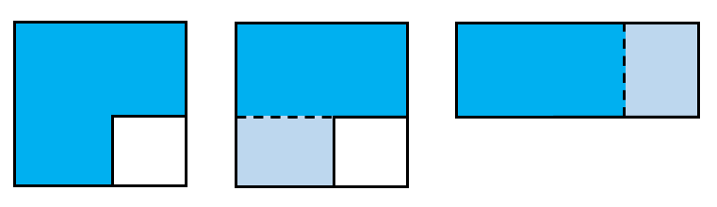






$$10cm$$
$$10cm$$
$$10+4$$
$$10−4$$
$$4cm$$
$$4cm$$
27

Slide 28




$$10cm$$
$$10cm$$
$$10+4$$
$$10−4$$
$$4cm$$
$$4cm$$
$${10}^{2}−4^{2}$$
$$(10+4)(10−4)$$
$$100−16$$
$$14×6$$
28

Slide 29








$$x$$
$$x$$
$$x+y$$
$$x−y$$
$$y$$
$$y$$
$$x^{2}−y^{2}$$
$$(x+y)(x−y)$$
29

Slide 30














$$7cm$$
All the rectilinear shapes below are made by taking a square and cutting a square away from it. The shape is then cut and reformed to make a rectangle. Find the lengths of the rectangle.
$$6.3$$
$$5cm$$
$$3.7$$
$$5cm$$
$$4x$$
$$9y$$
$$3a+b$$
$$2cm$$
$$6cm$$
$$2y$$
$$5x$$
$$b+1$$
$$1cm$$
Notes:
Reinforcing area of compound shapes, Ss always prefer to split the shape they have than take an area that isn’t there from a larger square.

Slide 31
How many prime numbers are 1 less than a square number?
31

Slide 32
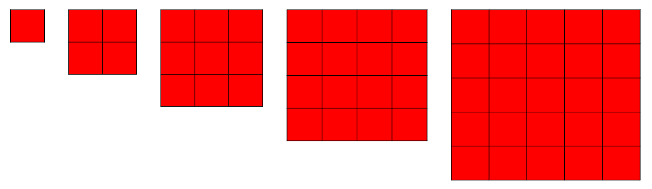
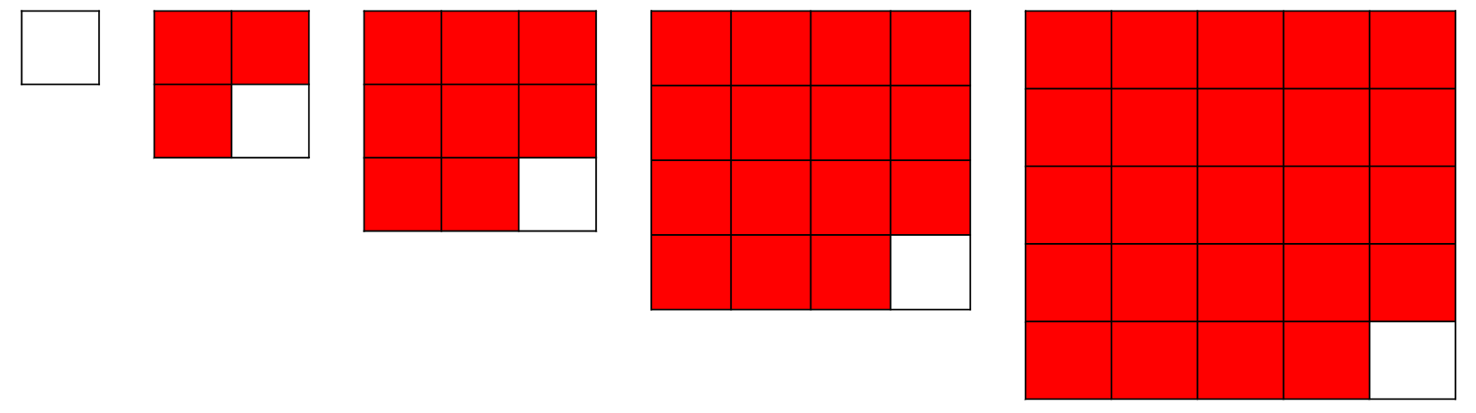
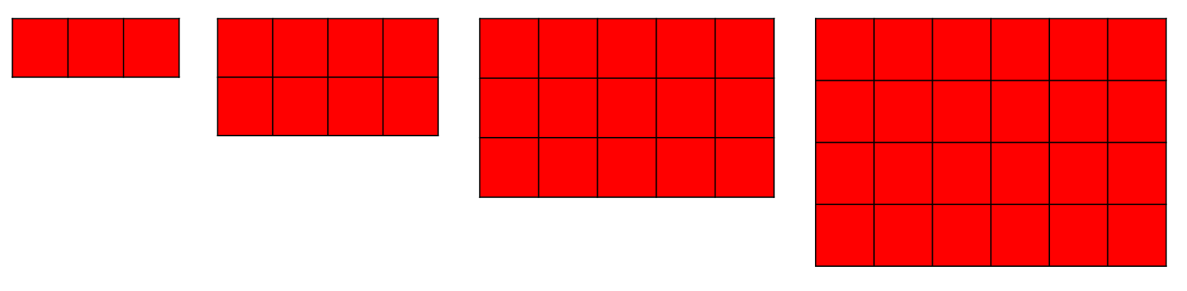


How many prime numbers are 1 less than a square number?
32

Slide 33
33
$$x$$
$$x^{2}$$
$$x$$
$$x$$
$$x$$
1
1
$$x$$
1
1
$$x$$

Slide 34


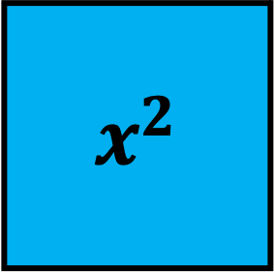





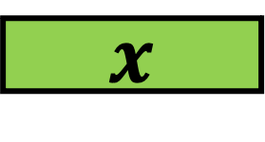


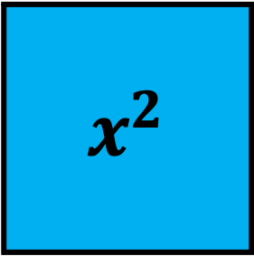

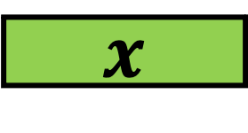



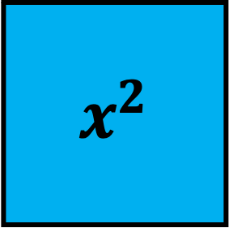



34
$$x^{2}$$
$$x$$
$$x$$
$$x$$
$$x$$
$$x$$
$$x^{2}$$
$$x$$
$$x$$
$$x$$
$$x$$
1
1
1
1
$$x$$
1
1
1
$$x$$
1
$$x$$
$$x^{2}$$
$$x$$
$$x$$
$$x$$
$$x$$
$$x$$
1
1
1
1
$$x$$

Slide 35

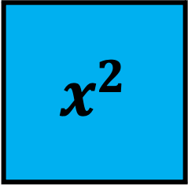




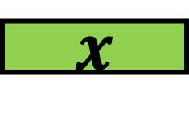
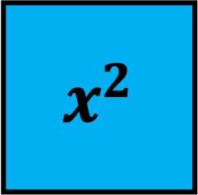
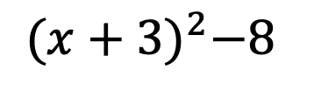
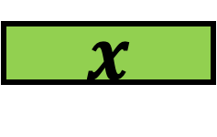

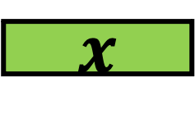
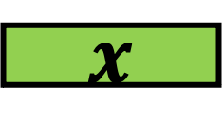
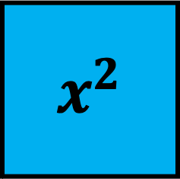
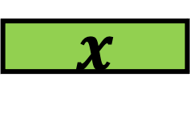
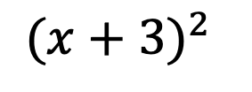
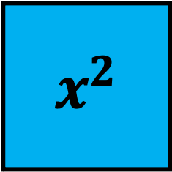

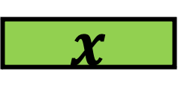

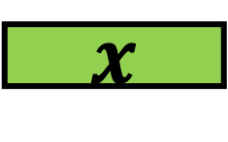

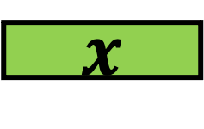



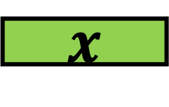

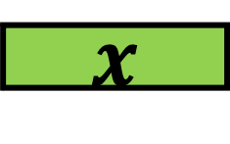

35
$$x^{2}$$
$$x^{2}$$
$$x$$
$$x$$
$$x$$
$$x$$
$$x$$
$$x$$
$$x$$
$$x$$
$$x$$
1
1
$$x$$
$$x$$
$$x$$
$$x^{2}$$
$$x$$
$$x$$
$$x$$
$$x^{2}$$
$$x$$
$$x$$
$$x$$
$${(x+3)}^{2}$$
$${(x+3)}^{2}−8$$
$$x$$
1
1
1
$$x$$
1
$$x$$
1
1
1
$$x$$
$$x$$
1
1
1
$$x$$

Slide 37


37

Slide 38
38
Area is 100cm²
Area is 100cm²
Notes:
(x+5.5)^2 – 5.5^2 + 24 = 100

Slide 39


39
Area is 100cm²
Area is 100cm²
Notes:
(x+5.5)^2 – 5.5^2 + 24 = 100

Slide 40


40
$$x$$
What value could $x$
be so the area is ${0cm}^{2}$

Slide 41

41
$$0$$
What value could $x$
be so the area is ${0cm}^{2}$

Slide 42






$$x$$
$$4$$
42
1
1
1
1
What value could $x$
be so the area is ${0cm}^{2}$

Slide 43



$$x$$
$$2$$
43
1
1
1
1
What value could $x$
be so the area is ${0cm}^{2}$

Slide 44

$$−2$$
$$2$$
44
1
1
1
1
What value could $x$
be so the area is ${0cm}^{2}$

Slide 45


$$x$$
$$5$$
45
1
1
1
1
1
1
What value could $x$
be so the area is ${0cm}^{2}$

Slide 46



$$x$$
$$3$$
46
1
1
1
$$2$$
1
1
1
What value could $x$
be so the area is ${0cm}^{2}$

Slide 47

$$−3$$
$$3$$
47
1
1
1
$$2$$
1
1
1
What value could $x$
be so the area is ${0cm}^{2}$

Slide 48
48
$$1$$
$$x$$
What value could $x$
be so the area is ${0cm}^{2}$

Slide 49






 | If the total area of the shape above or left was 0. What would the lengths be?
49
$$x^{2}$$
$$x$$
$$x$$
$$x$$
$$x^{2}$$
$$x$$
$$x$$
$$x$$
$$x$$
1
1
$$x$$
1
1
1
1
1
$$x$$
1
$$x$$
$$x$$
$$x$$
1
1
$${(x+3)}^{2}−4$$
$$x^{2}$$
$$x$$
$$x$$
$$x$$
$$x$$
$$x$$
$${(x+3)}^{2}−4=0$$
$$x$$
1
1
1
1
1
$$\left(x+5\right)\left(x+1\right)=0$$
$$(x+5)(x+1)$$

Slide 50

50

Slide 51
Complete the tables to generate the first 5 terms of each nth term
The first one has been done for you
51
Complete the tables to generate the first 4 terms of each nth term. Use the images to help you
Fill in the missing gap in the tables below
 | 1 | 2 | 3 | 4
$$n^{2}$$
 | 1 | 2 | 3 | 4 | 5
$$n^{2}$$ | 1 | 4 | 9 | 16 | 25
$$3n$$ | 3 | 6 | 9 | 12 | 15
$$n^{2}+3n−2$$ | 2 | 8 | 16 | 26 | 38
 | 1 | 2 | 3 | 4 | 5
 | 2 | 8 | 18 | 32 | 50
 | -3 | -6 | -9 | -12 | -15
 | 3 | 6 | 13 | 24 | 39
 | 1 | 2 | 3 | 4
$$n^{2}$$
$$+2n$$
$$n^{2}+2n$$
 | 1 | 2 | 3 | 4 | 5
$${2n}^{2}$$
$$5n$$
$${2n}^{2}+5n+1$$
 | 1 | 2 | 3 | 4 | 5
 | 5 | 20 | 45 | 80 | 125
 | -2 | -2 | -2 | -2 | -2
 | 7 | 26 | 55 | 94 | 143
 | 1 | 2 | 3 | 4 | 5
$$3n^{2}$$
$$−2n$$
$${3n}^{2}−2n$$
 | 1 | 2 | 3 | 4
$$n^{2}$$
$$+2n$$
$$+3$$
$$n^{2}+2n+3$$
 | 1 | 2 | 3 | 4 | 5
 | 0.5 | 2 | 4.5 | 8 | 12.5
 | 0.5 | 1 | 1.5 | 2 | 2.5
 | 4 | 6 | 9 | 13 | 18
 | 1 | 2 | 3 | 4 | 5
$$4n^{2}$$
$$−3n$$
$$4n^{2}−3n+5$$

Slide 52
A square of unknown length has another square with area 4units² cut away.
What could the remaining area be?
52

Slide 53

$$1^{2}−4$$ $$\left(1−2\right)\left(1+2\right)$$ $$−3$$ | $$2^{2}−4$$ $$\left(2−2\right)\left(2+2\right)$$ $$0$$ | $$1^{2}−4$$ $$\left(3−2\right)\left(3+2\right)$$ $$5$$ | $$1^{2}−4$$ $$\left(4−2\right)\left(4+2\right)$$ $$12$$ | $$1^{2}−4$$ $$\left(5−2\right)\left(5+2\right)$$ $$21$$ | $$1^{2}−4$$ $$\left(6−2\right)\left(6+2\right)$$ $$32$$
53

Slide 54





$$x^{2}−4=\left(x+2\right)\left(x−2\right)$$
What happens to the area of the shape when the original square has lengths between -2 and 2?
54

Slide 55







Anita says that each output comes from 2 different input values
Bilal says the smallest possible output value is $−1$
Cara says that if the input is an integer there are infinite output numbers that are prime
$$x$$
$$+3$$
$$squared$$
$$−1$$
$$y$$
Emma says its possible to get any positive output value
Dilraj says that there are no input values that would result in the same output values in both function machines

Slide 56




Anita says that each output comes from 2 different input values
Bilal says the smallest possible output value is $−1$
Cara says that if the input is an integer there are infinite output numbers that are prime
Dilraj says that there are no input values that would result in the same output values in both function machines
Emma says its possible to get any positive output value

Slide 57





Cara says that if the input is an integer there are infinite output numbers that are prime
57

Slide 58




$$x^{2}+4x+4=(x+2)(x+2)$$
$$x^{2}−1=(x )(x )$$
$$x^{2}$$
$$x$$
$$x$$
$$x^{2}$$
$$x$$
$$x$$
1
1
$$−x$$
-1
$$x$$
1
1
$$x$$ | $$−4$$ | $$−3$$ | $$−2$$ | $$−1$$ | $$0$$ | $$1$$ | $$2$$ | $$3$$ | $$4$$
$$y$$
$$x$$ | $$−4$$ | $$−3$$ | $$−2$$ | $$−1$$ | $$0$$ | $$1$$ | $$2$$ | $$3$$ | $$4$$
$$y$$
58
$$x^{2}−2x−3=(x )(x )$$
$$x^{2}+1$$
$$x^{2}$$
$$−x$$
$$−x$$
$$−x$$
$$x^{2}$$
1
$$x$$
-1
-1
-1
$$x$$ | $$−4$$ | $$−3$$ | $$−2$$ | $$−1$$ | $$0$$ | $$1$$ | $$2$$ | $$3$$ | $$4$$
$$y$$
$$x$$ | $$−4$$ | $$−3$$ | $$−2$$ | $$−1$$ | $$0$$ | $$1$$ | $$2$$ | $$3$$ | $$4$$
$$y$$

Slide 59
59

Slide 60
60

Slide 63

63

Slide 64

64

Slide 65

65

Slide 66

66

Slide 67



Slide 68















