Slide 1
1.
2.
$$Direct Proportion$$ | $$A is directly proportional to B.$$ $$When A=8, B=12.$$ $$Find a formula for B in terms of A$$ $$Use the formula to determine$$ $$Which of the following are correct$$ | $$C is directly proportional to D.$$ $$When C=6, D=15.$$ $$Find a formula for D in terms of C$$ $$Find D when C=12$$ $$Find C when D=4$$
$$x is directly proportional to y.$$ $$When x=2, y=\sqrt{8}$$ $$Find y when x=\sqrt{6}$$
$$E is directly proportional to F.$$ $$When E=\frac{3}{7}, F=\frac{4}{5}$$ $$Find F when E=\frac{5}{14}$$ | $$G is directly proportional to H.$$ $$When G=5, H=\sqrt{300}$$ $$Find G when H=\sqrt{24}$$ | $$J is directly proportional to K.$$ $$When J=\frac{1}{2}, K=\frac{3}{11}$$ $$Find J when K=\frac{4}{5}$$
$$L is directly proportional to M.$$ $$When L=4 × {10}^{3}, M=1.6 × {10}^{4}$$ $$Find M when L=5 × {10}^{−2}$$ | $$How many pounds is$$ $$equivalent to \text{€}5.85,$$ $$if £8 is equivelent$$ $$to \text{€}9.36?$$ | $$15\% of x is 14.4.$$ $$What is 23\% of x?$$
3.
$$A$$ | $$2.4$$
$$B$$ | $$3.6$$
$$A$$ | $$\sqrt{20}$$
$$B$$ | $$3\sqrt{5}$$
$$A$$ | $$9.6$$
$$B$$ | $$14.2$$
$$A$$ | $$\frac{5}{9}$$
$$B$$ | $$\frac{5}{6}$$
4.
5.
6.
7.
8.
9.

Slide 2
2.
3.
$$Direct Proportion$$ | $$a is directly proportional to b^{2}.$$ $$When a=20, b=2.$$ $$Write an equation for b in terms of a$$ $$Complete the following table$$ | $$a is directly proportional to \sqrt{b}.$$ $$When a=8, b=25.$$ $$Find a formula for a in terms of b$$ $$Find a when b=4$$ $$Find b when a=6.4$$
$$a is directly proportional to b.$$ $$When a=8, b=2$$ $$Write an equation for b in terms of a$$ $$Find b when a=6$$
$$a is directly proportional to b^{3}.$$ $$When a=50, b=10$$ $$Which of the following are correct?$$ | $$a is directly proportional to \sqrt[3]{b}.$$ $$When a=3, b=64$$ $$Find a when b=125$$ | $$The perimeter, P, of a regular$$ $$hexagon directly proportional the$$ $$length, L, of one side of the hexagon$$ $$When P=72, L=12$$ $$Write an equation connecting P and L$$
$$The surface area, S, of a cube is$$ $$directly prortional to the square$$ $$of one of its edges, E.$$ $$When S=294, E=7$$ $$Find E when S=150$$ | $$The Perimeter, P, of a square is$$ $$directly prortional to the square$$ $$root of its area, A.$$ $$When P=24, A=36$$ $$Find P when A=49$$ | $$The volume V, of a sphere is$$ $$directly prortional to the cube$$ $$of the spheres′ radius, R.$$ $$When V=36π, R=3$$ $$Write an equation for V in terms of R$$
1.
$$a$$ | $$20$$ |  | $$125$$ | $$320$$
$$b$$ | $$2$$ | $$3$$
4.
5.
6.
$$a$$ | $$50$$ | $$1280$$ | $$10.8$$ | $$18$$
$$b$$ | $$10$$ | $$4$$ | $$6$$ | $$120$$
7.
8.
9.

Slide 3
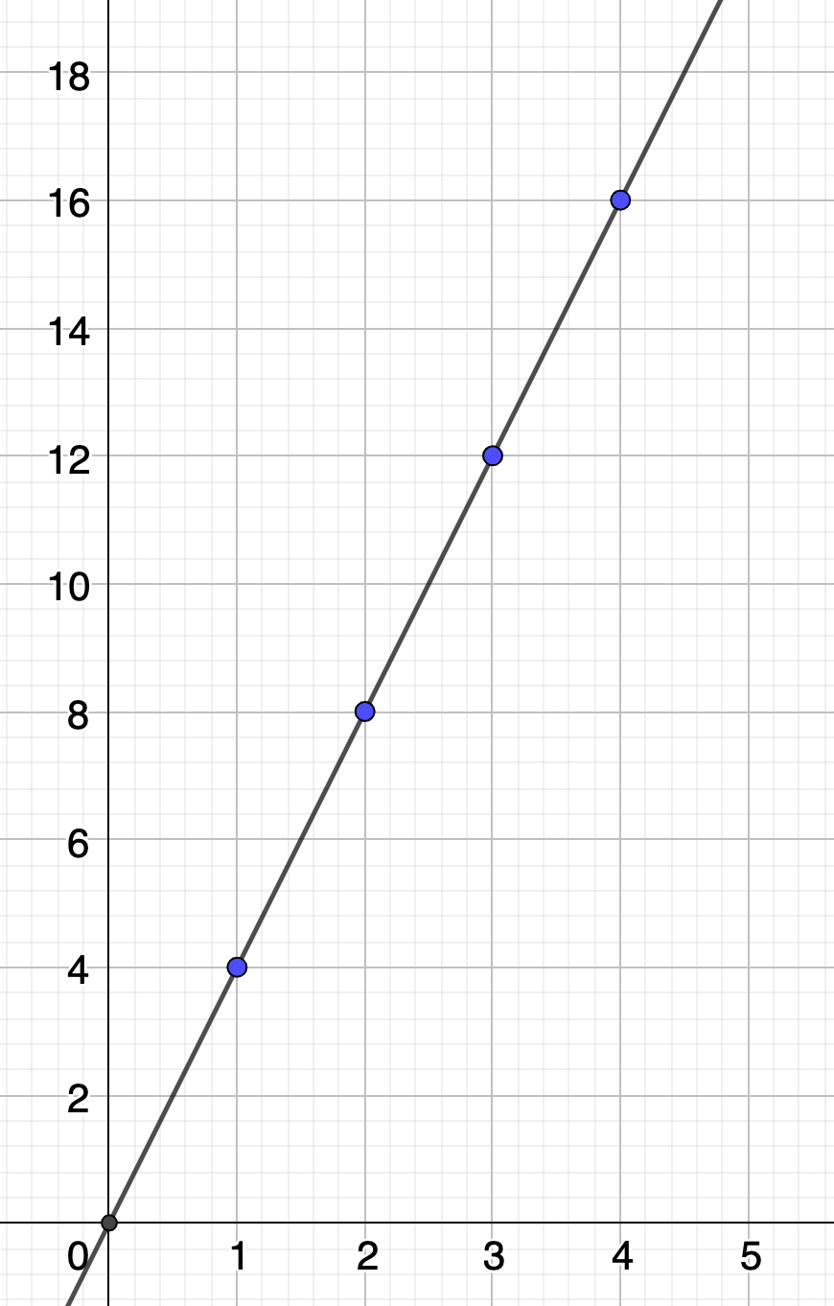
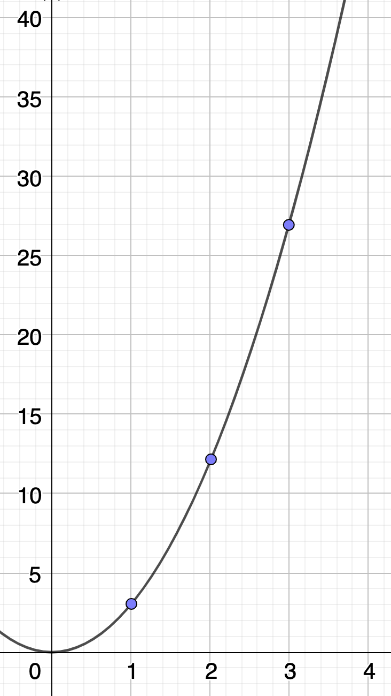
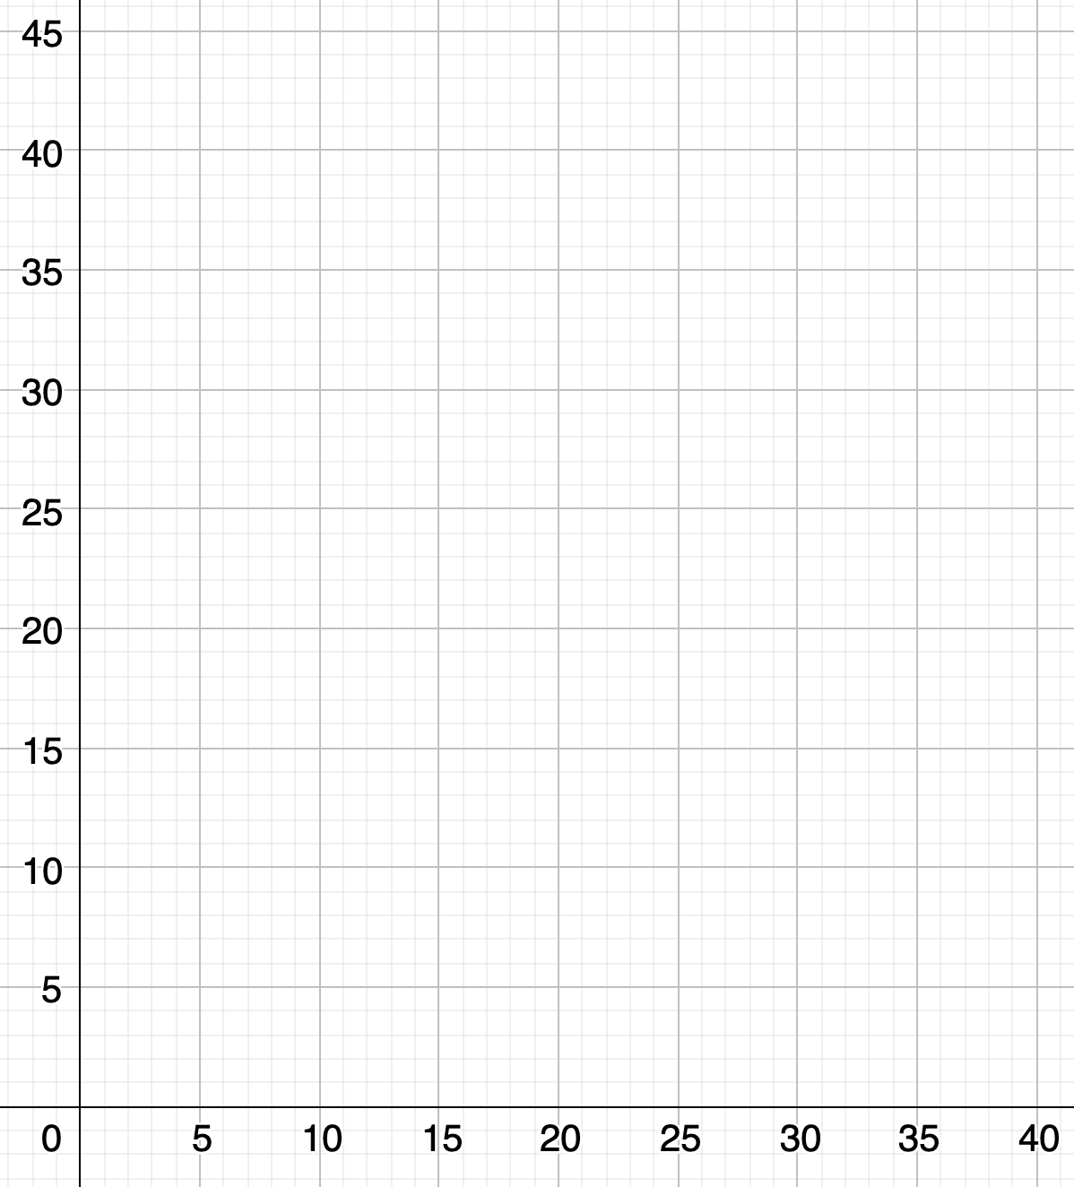
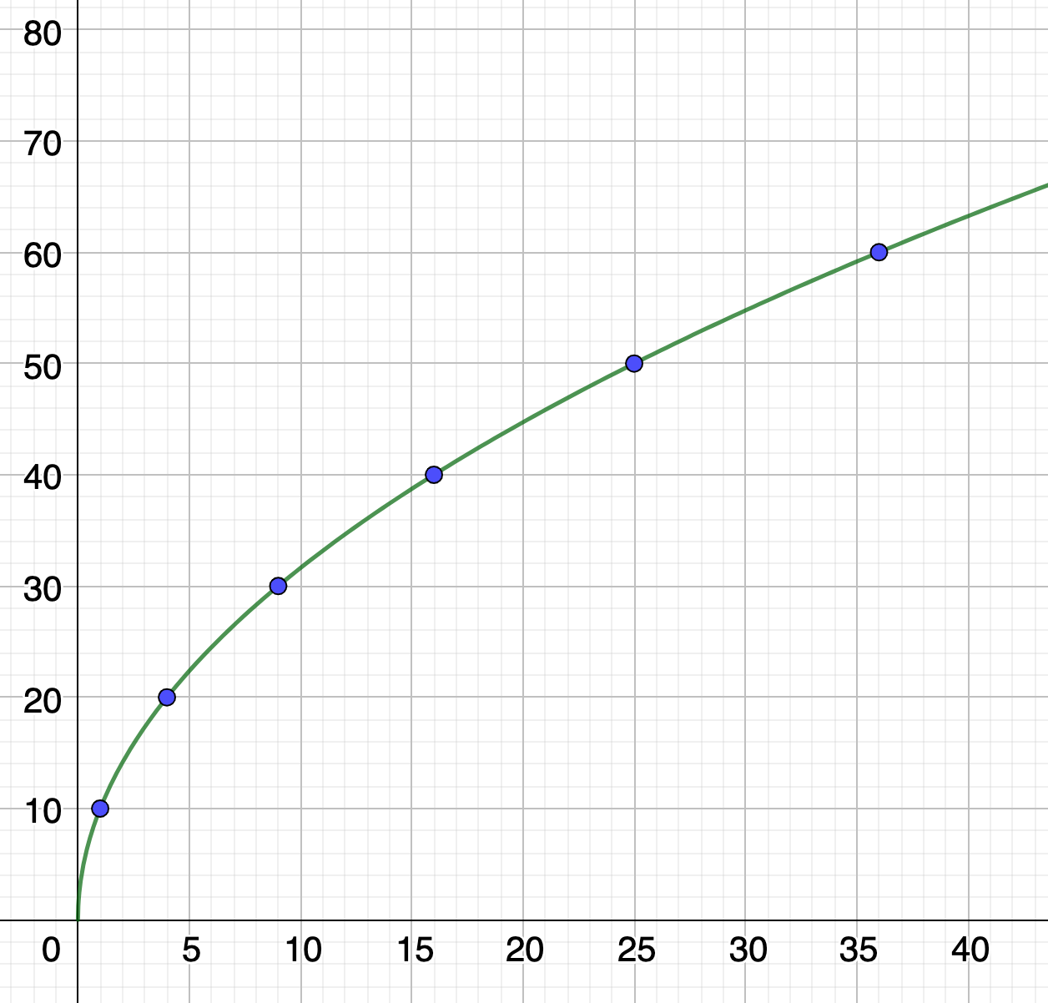
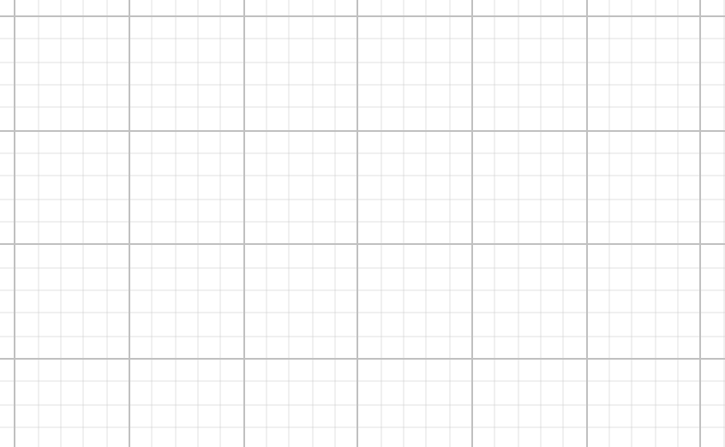
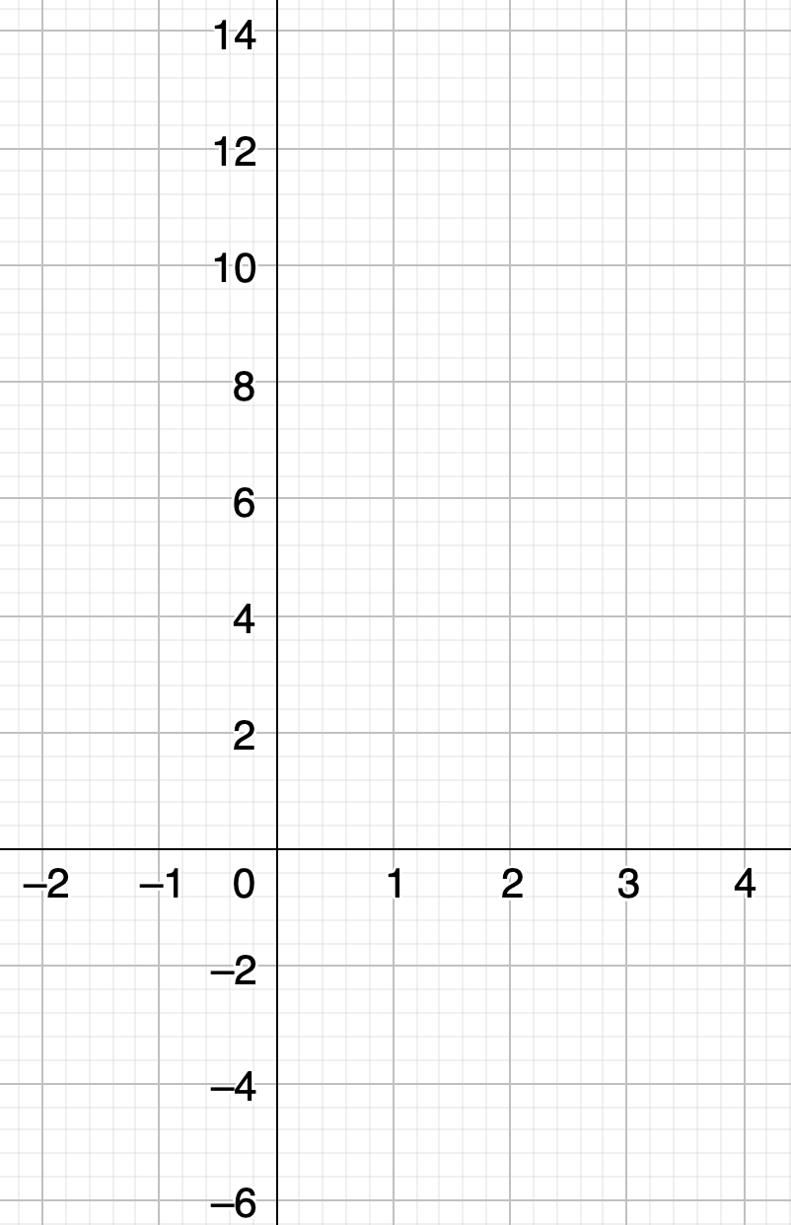
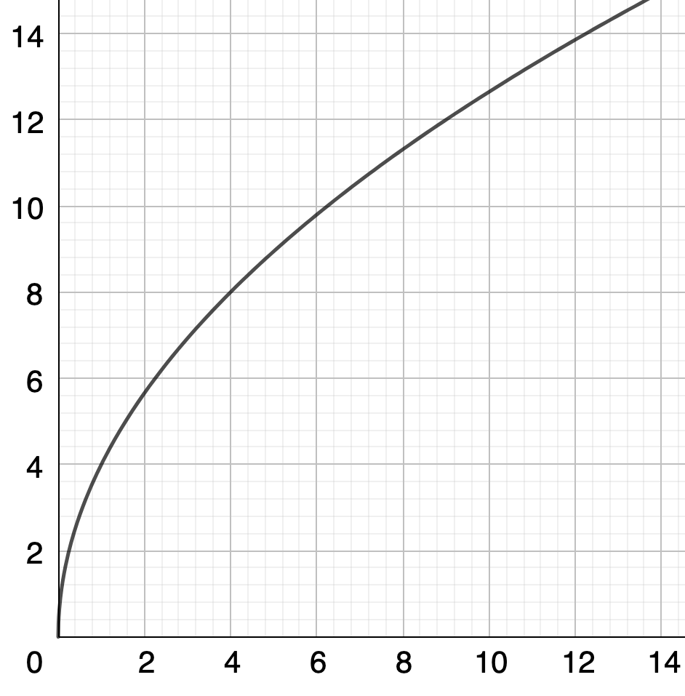
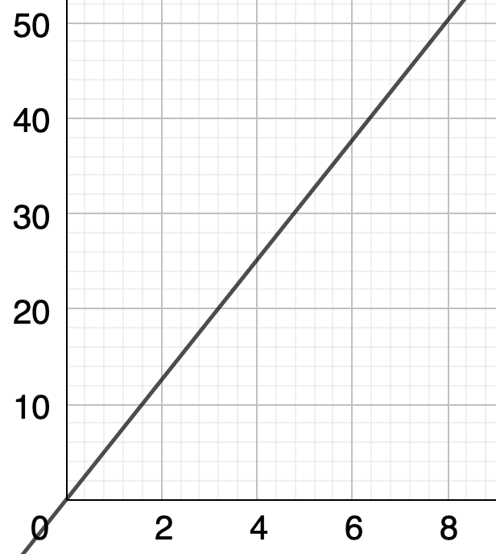
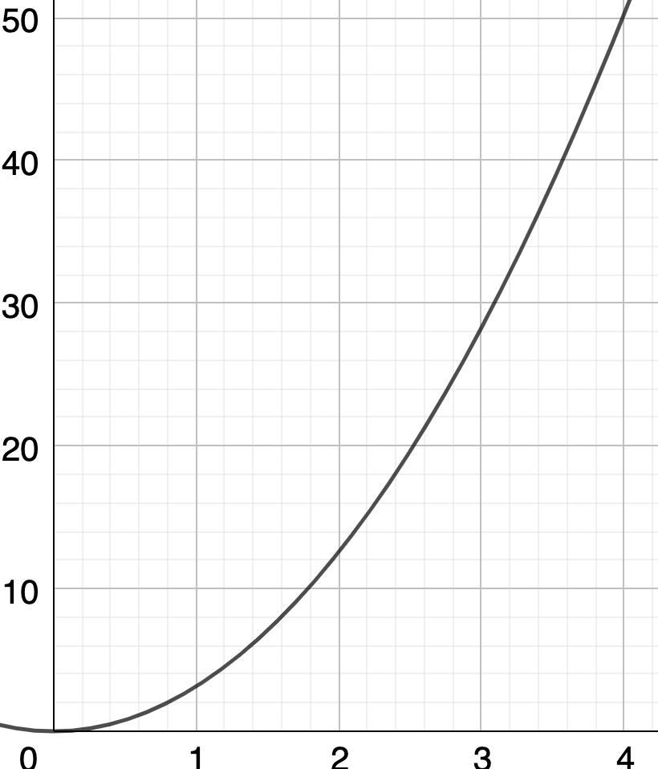
$$y is directly proportional to \sqrt{x}$$
$$The total cost of fuel bought at a petrol station is directly$$
$$proportional to number of litres bought.$$
$$When x=1, y=10$$
$$When x=4, y=20$$
These have been plotted onto the graph below. Complete the graph
$$When 30 litres are$$
$$bought, it costs £45$$
Complete the graph for $0≤x≤40$
x | $$9$$ | $$16$$ | $$25$$ | $$36$$
y
$$y is directly proportional to x$$
$$y is directly proportional to x^{2}$$
$$y is directly proportional to x^{3}$$
Find an equation for $y$ in terms of $x$
Find an equation for $y$ in terms of $x$
$$x$$ | 0
$$y$$ | 0
$$Complete the table below$$
$$x$$ | $$y$$
$$−2$$ | $$−4$$
$$−1$$
$$0$$
$$1$$
$$2$$
$$3$$
Which Graph matches each of the following:
The area of a circle plotted against its radius
The circumference of a circle plotted against its radius
The perimeter of a square plotted against its area
Graph A
Graph B
Graph C

Slide 4
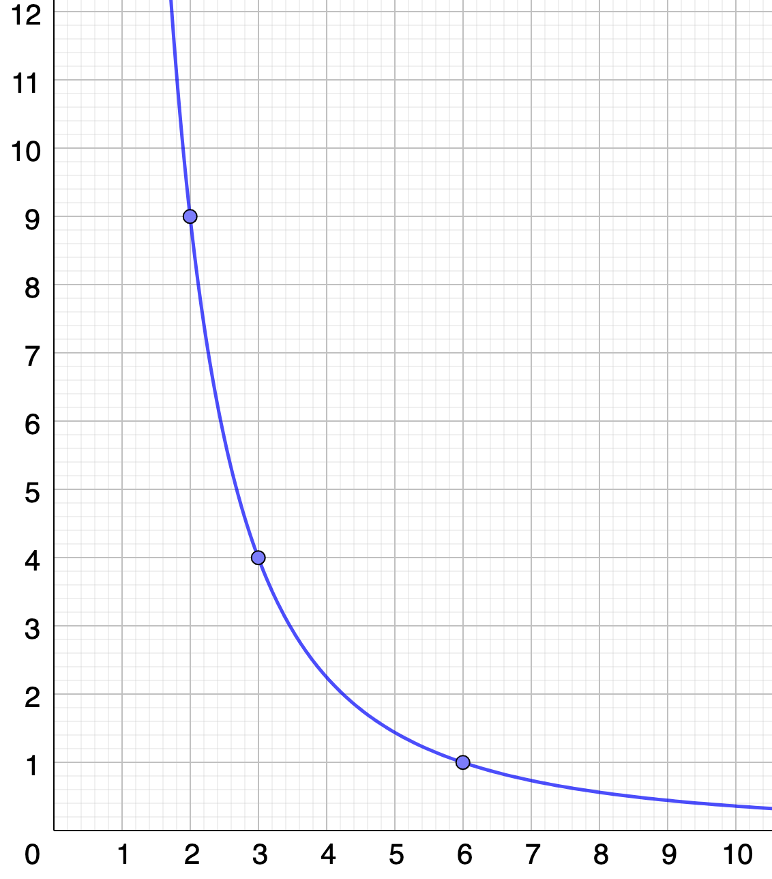
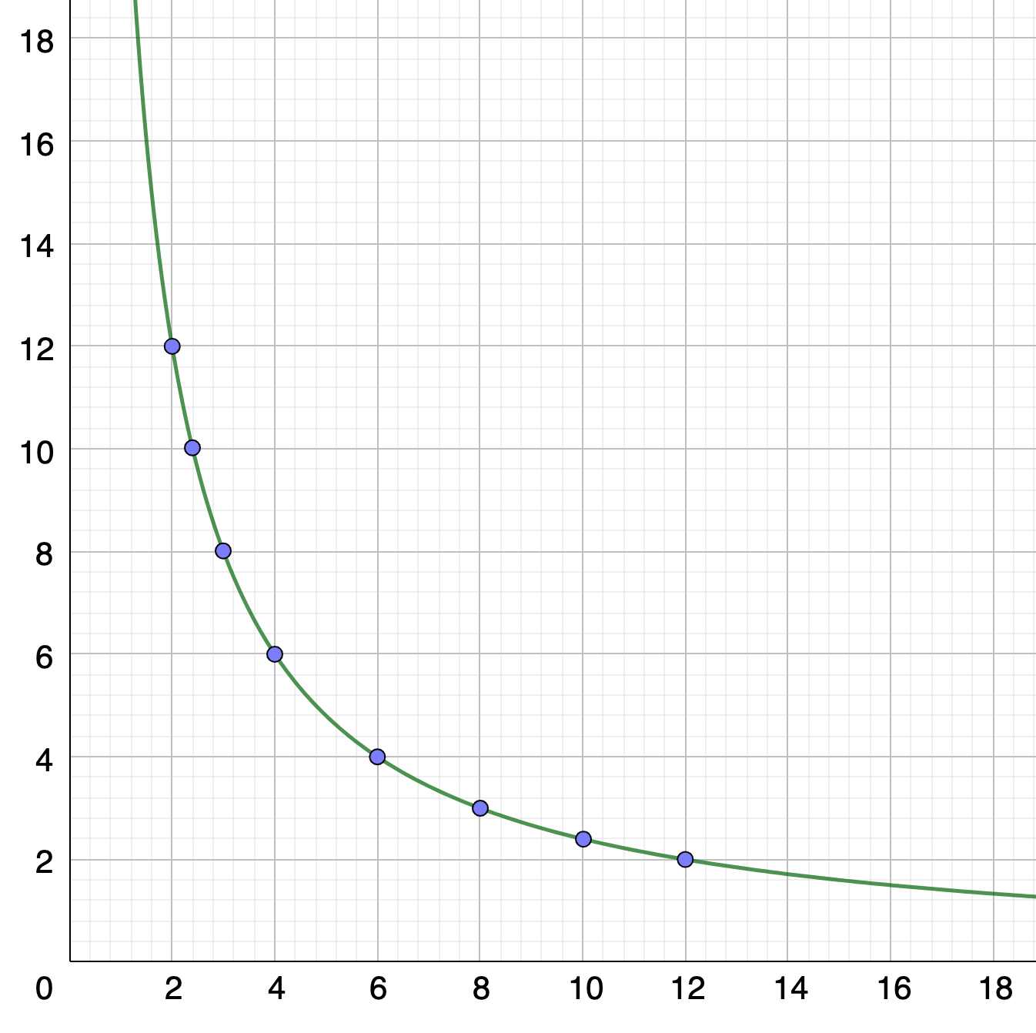
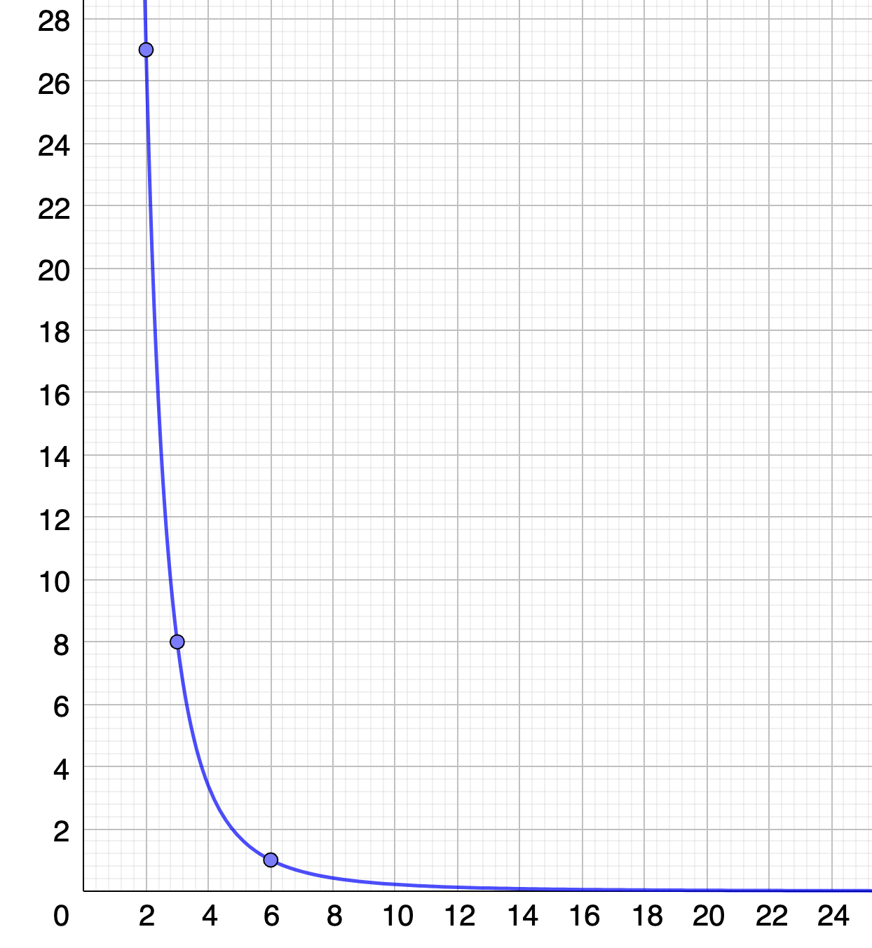
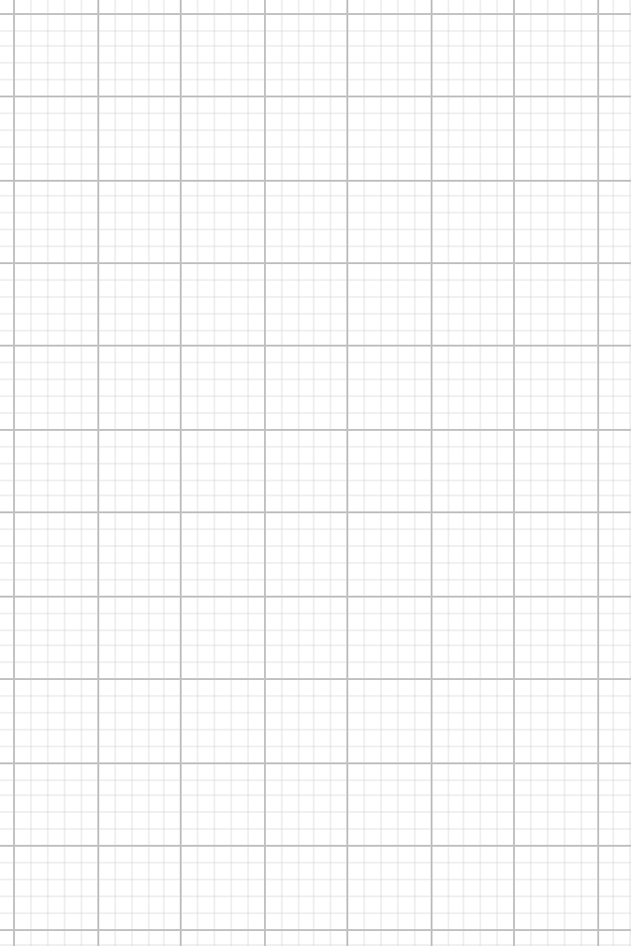
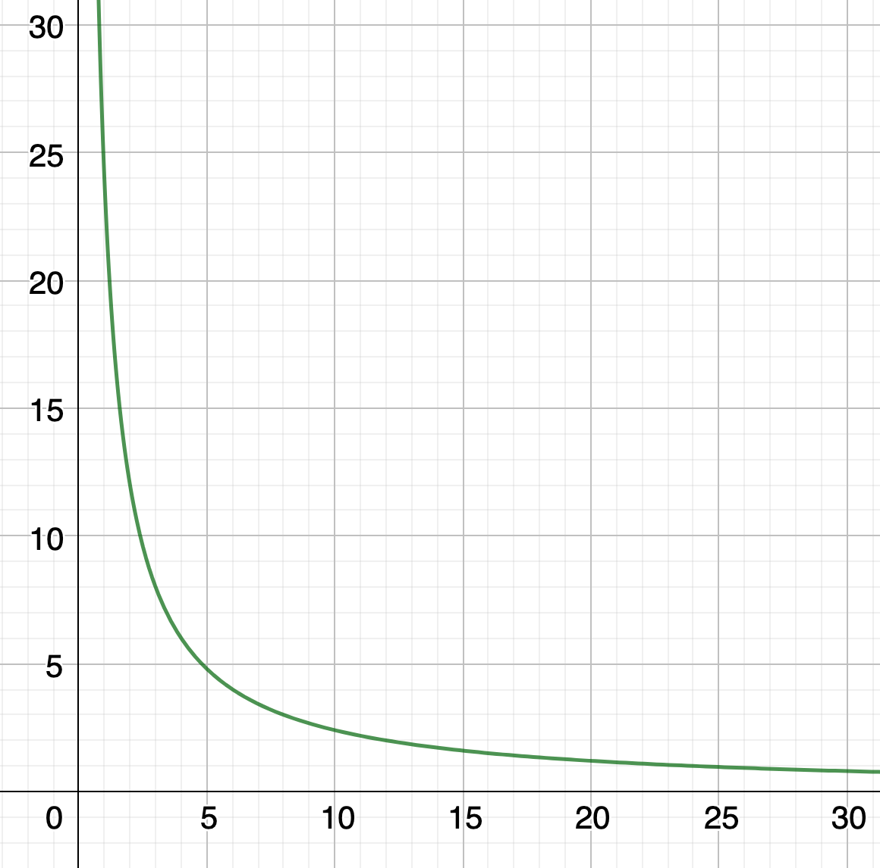
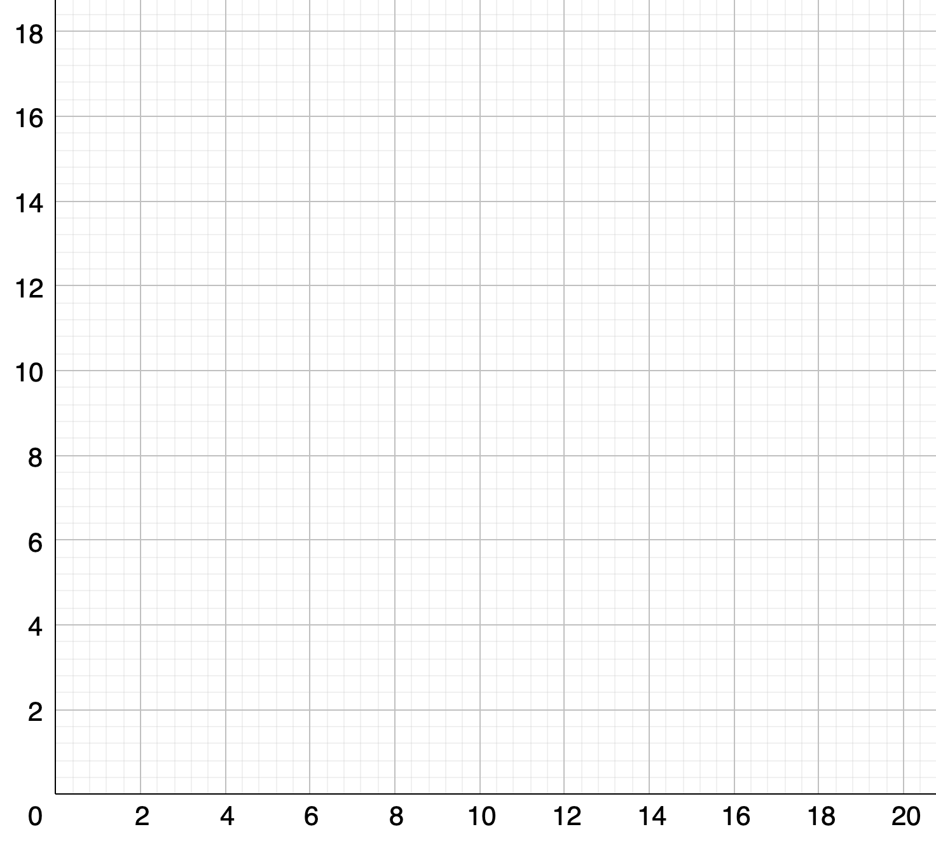
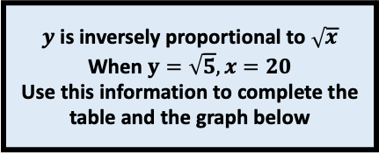
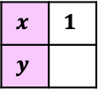
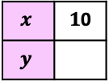
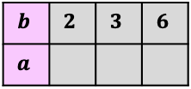

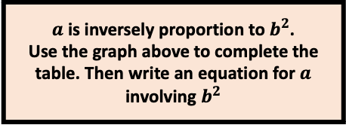

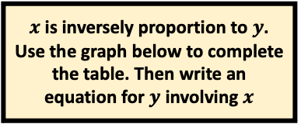

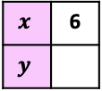
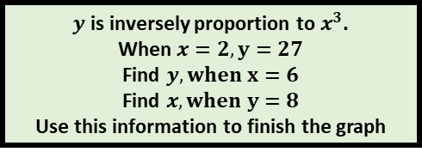

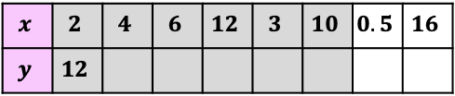

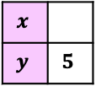
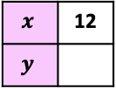
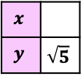
$x$ is inversely proportion to $y$. Use the graph below to complete the table. Then write an equation for $y$ involving $x$
$$b$$ | $$2$$ | $$3$$ | $$6$$
$$a$$
$y$ is inversely proportion to $x^{3}$.
When $x=2, y=27$
Find $y, when x=6$
Find $x, when y=8$
Use this information to finish the graph
$y$ is inversely proportional to $\sqrt{x}$
When $y=\sqrt{5}, x=20$
Use this information to complete the table and the graph below
$$x$$
$$y$$ | $$\sqrt{5}$$
$$x$$ | $$1$$
$$y$$
$$x$$
$$y$$ | $$5$$
$$x$$ | 6
$$y$$
$$x$$ | $1$0
$$y$$
$$x$$ | 12
$$y$$
$a$ is inversely proportion to $b^{2}$.
Use the graph above to complete the table. Then write an equation for $a$ involving $b^{2}$
$$x$$ | $$2$$ | $$4$$ | $$6$$ | $$12$$ | $$3$$ | $$10$$ | $$0.5$$ | $$16$$
$$y$$ | $$12$$
The area of the rectangle is 24cm² The graph show the possible lengths, $l$ and widths, $w$ of the rectangle
Find the missing widths in the rectangles and mark the (length, width) on the graph
$$24$$
$$6$$
$12$
$$8$$
$$4.8$$

