Slide 1
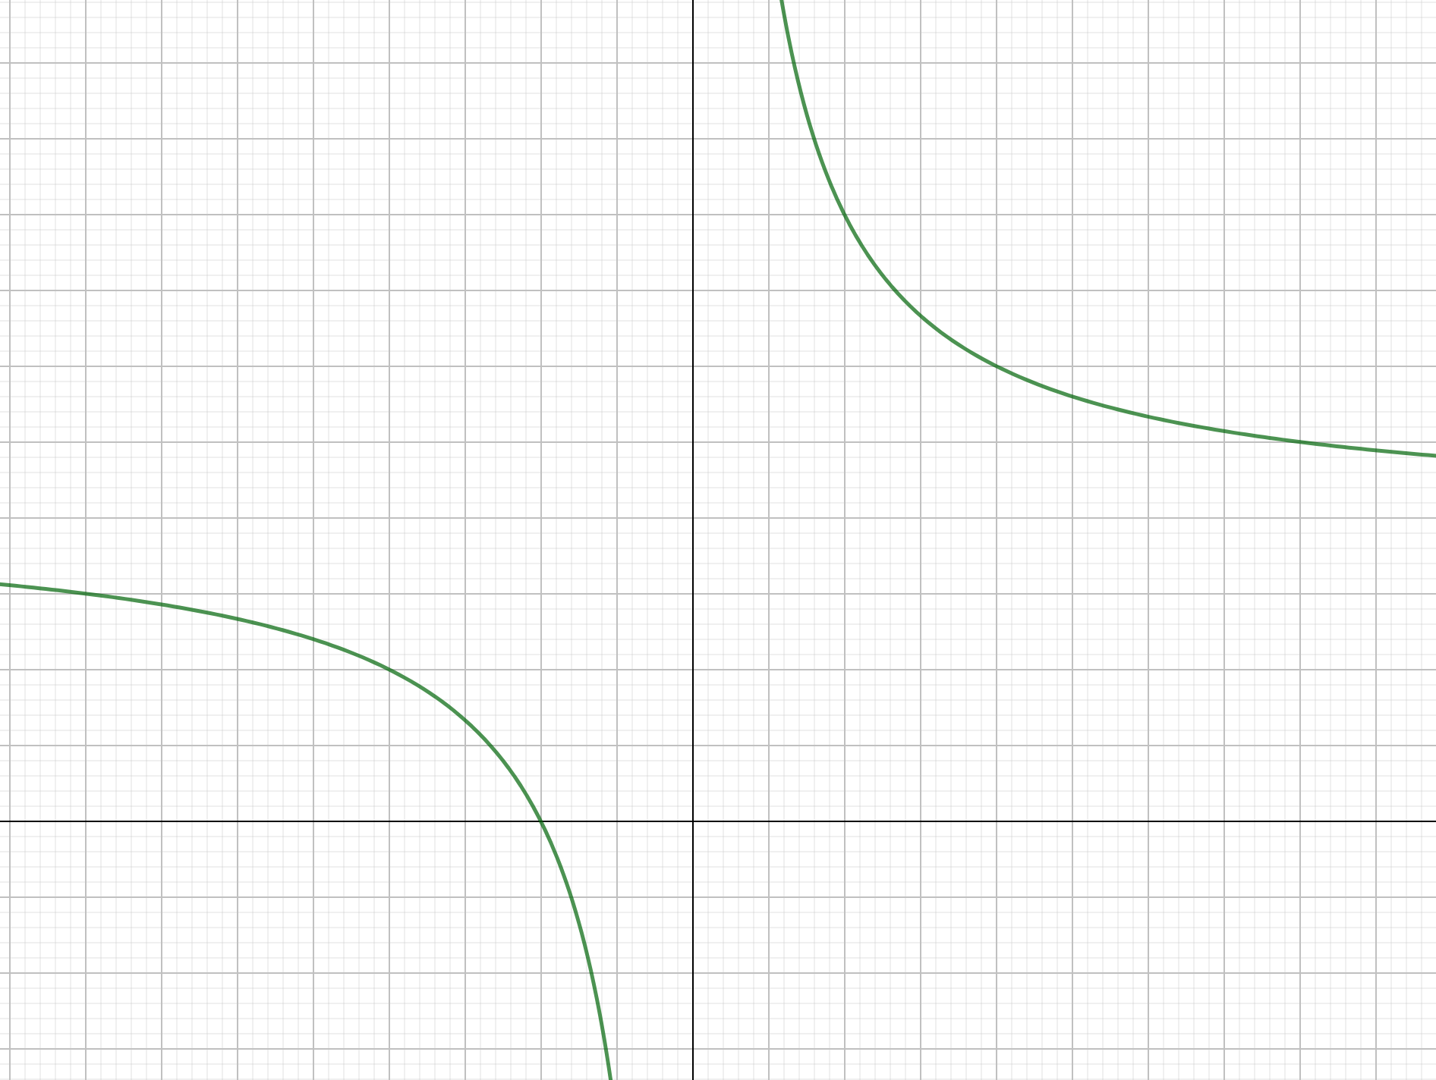
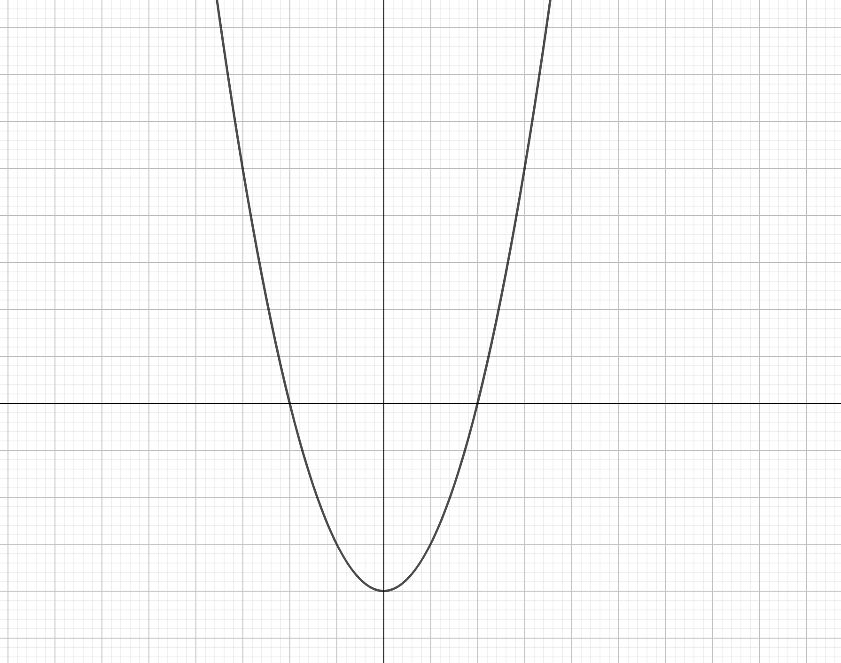
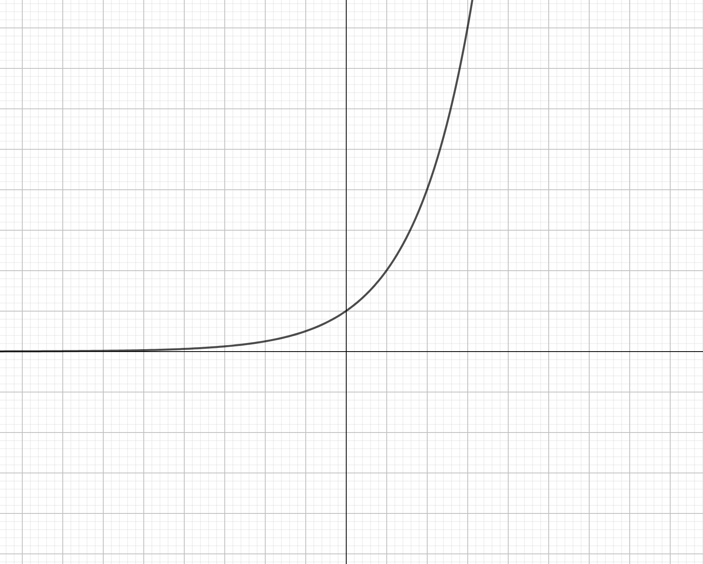
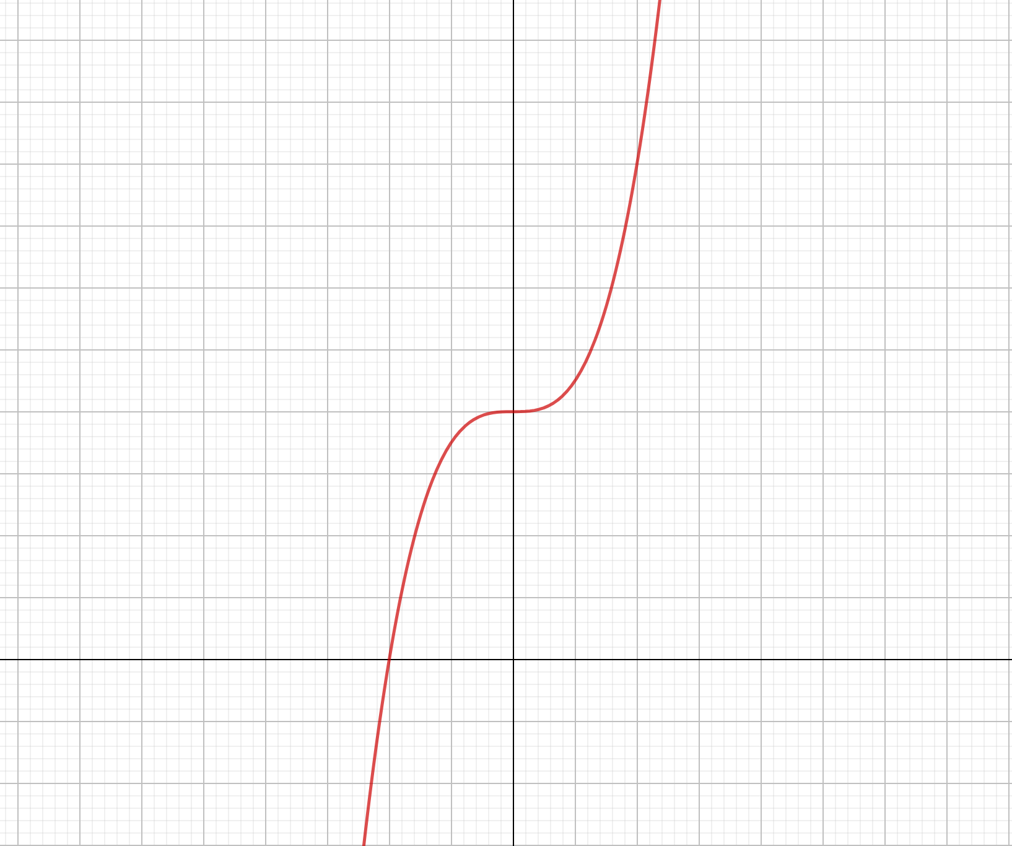

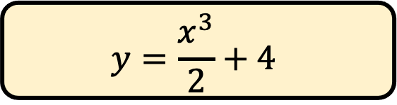


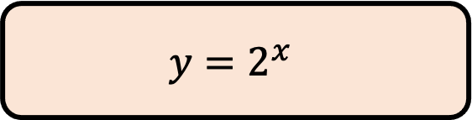
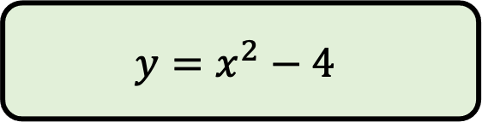


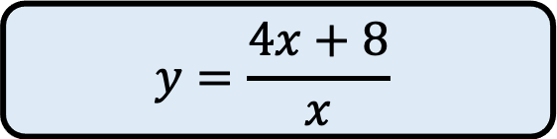

$$Match the graphs$$
$$with the$$
$$correct equation$$
$$y=2^{x}$$
A
$$y=\frac{x^{3}}{2}+4$$
B
$$y=\frac{4x+8}{x}$$
C
$$y=x^{2}−4$$
D

Slide 2
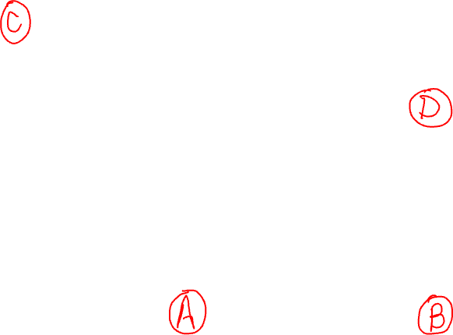
$$Match the graphs$$
$$with the$$
$$correct equation$$
$$y=2^{x}$$
A
$$y=\frac{x^{3}}{2}+4$$
B
$$y=\frac{4x+8}{x}$$
C
$$y=x^{2}−4$$
D

Slide 3
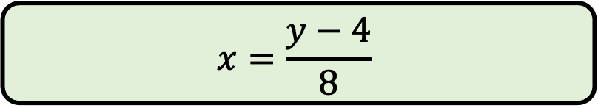
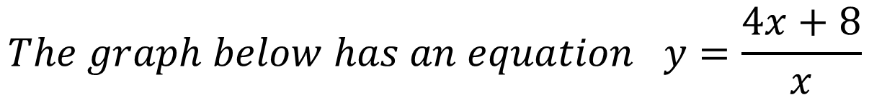
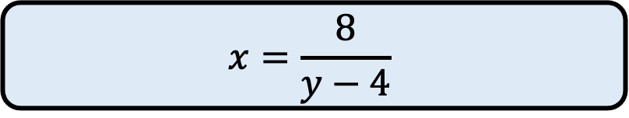
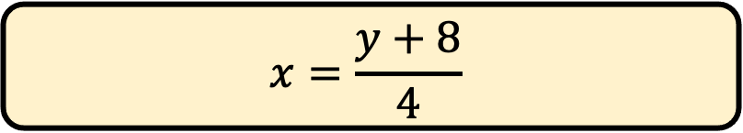
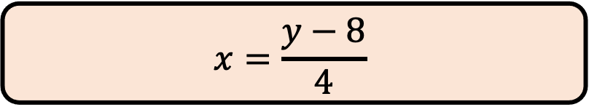
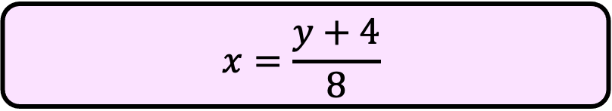
$$The graph below has an equation y=\frac{4x+8}{x}$$
$$Rearrange the equation to make x the subject.$$
$$x=\frac{y−8}{4}$$
A
$$x=\frac{y+8}{4}$$
B
$$x=\frac{8}{y−4}$$
C
$$x=\frac{y−4}{8}$$
D
$$x=\frac{y+4}{8}$$
E

Slide 4
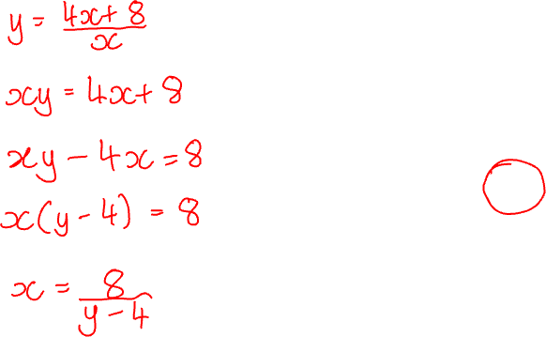
$$The graph below has an equation y=\frac{4x+8}{x}$$
$$Rearrange the equation to make x the subject.$$
$$x=\frac{y−8}{4}$$
A
$$x=\frac{y+8}{4}$$
B
$$x=\frac{8}{y−4}$$
C
$$x=\frac{y−4}{8}$$
D
$$x=\frac{y+4}{8}$$
E

Slide 5
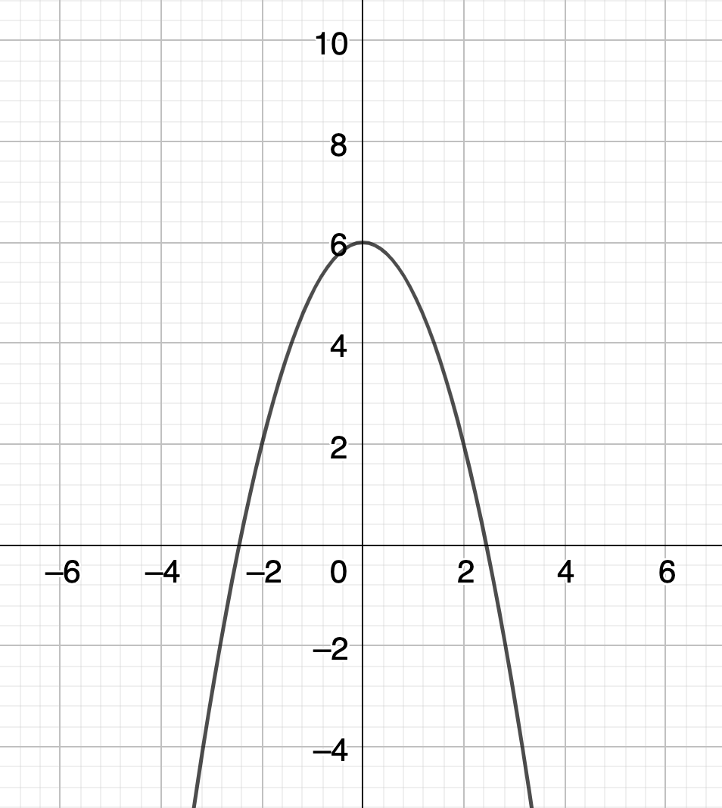
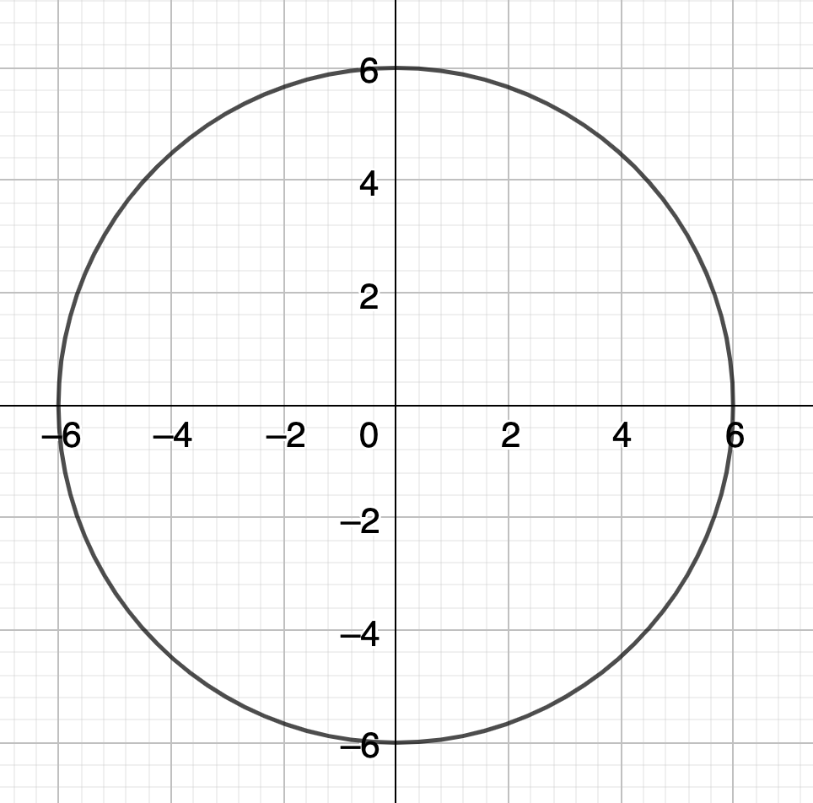
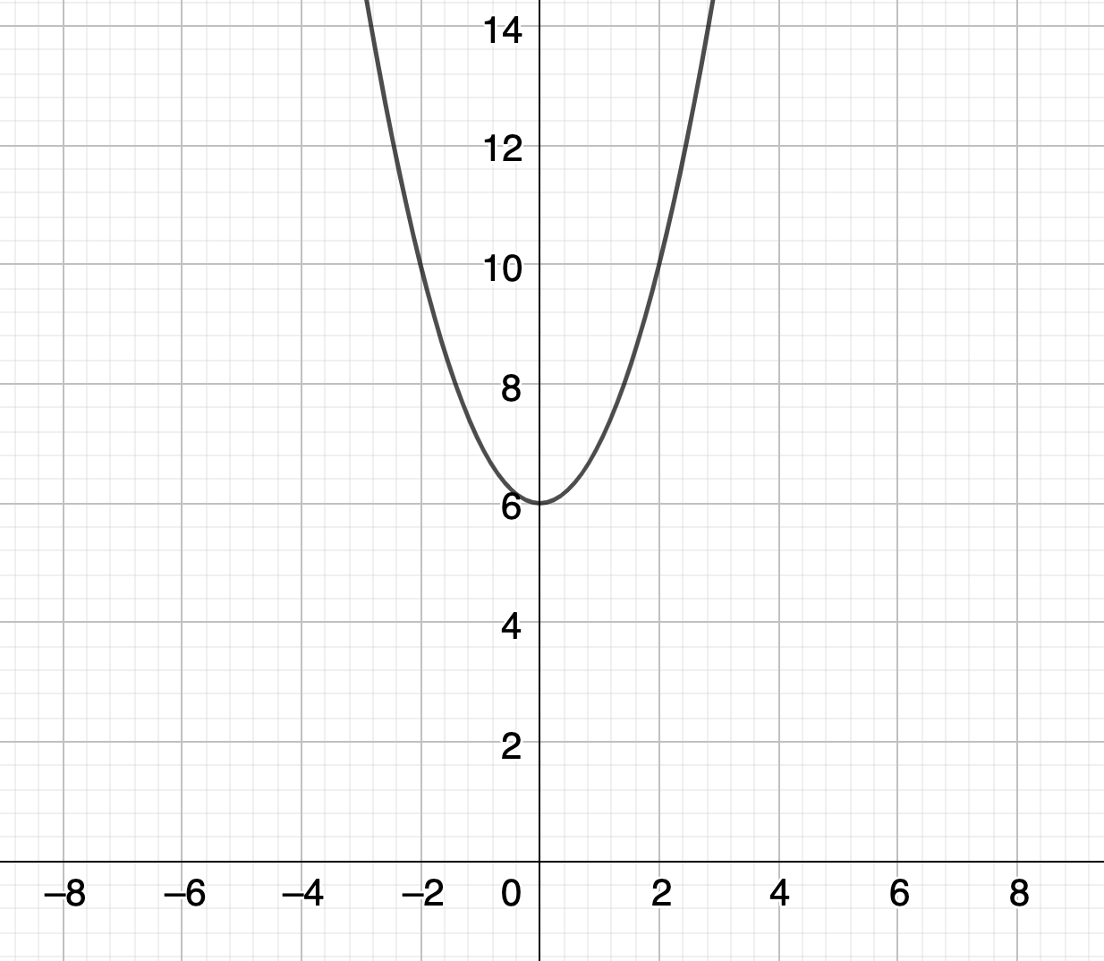
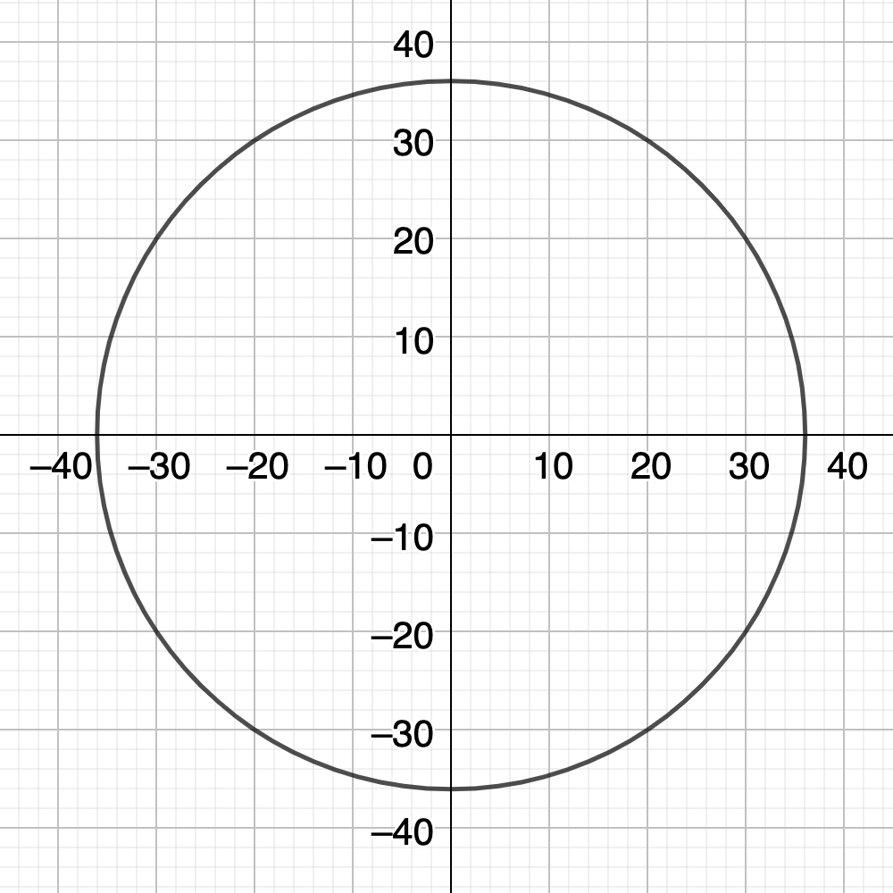
$$Which image shows the graph of y=\sqrt{36−x^{2}}$$
A
C
B
D

Slide 6
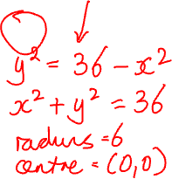
$$Which image shows the graph of y=\sqrt{36−x^{2}}$$
A
C
B
D

Slide 7
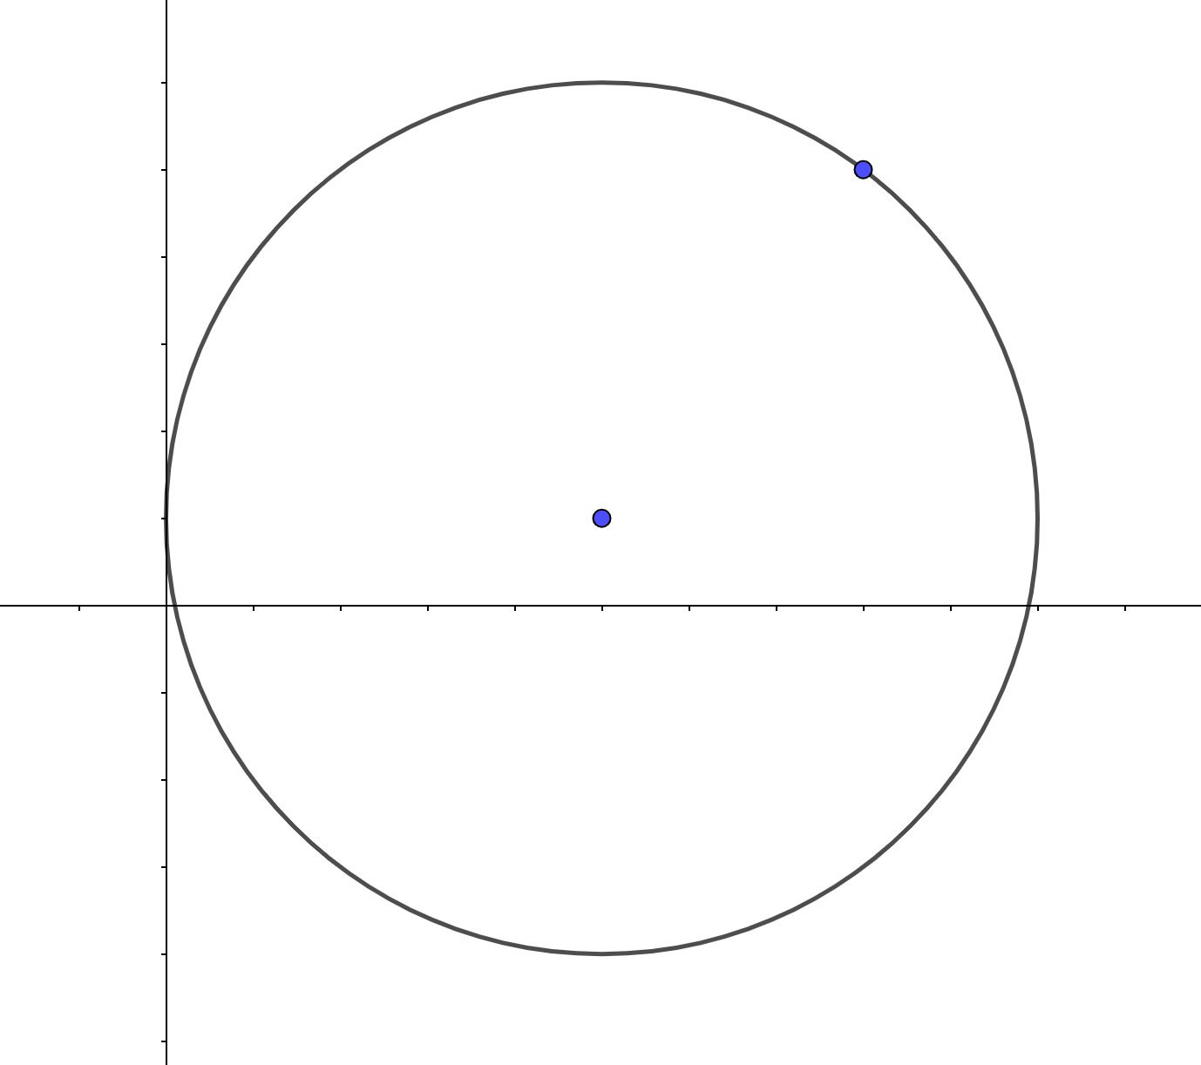
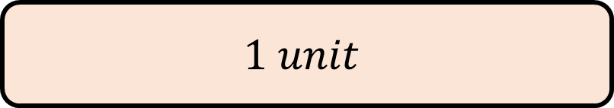

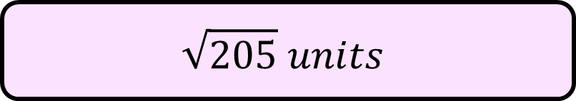
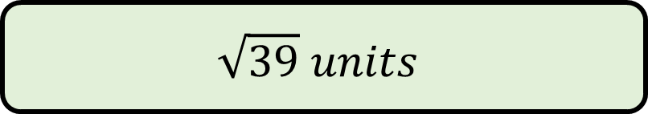
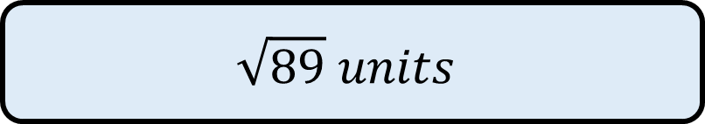

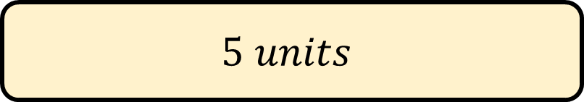
$$A circle with centre \left(5, 1\right) has a point \left(8, 5\right) on its circumference$$
$$Find the length of the radius OA$$
$$(8, 5)$$
$$1 unit$$
A
$$5 units$$
B
$$(5, 1)$$
$$\sqrt{89} units$$
C
$$\sqrt{39} units$$
D
$$\sqrt{205} units$$
E

Slide 8
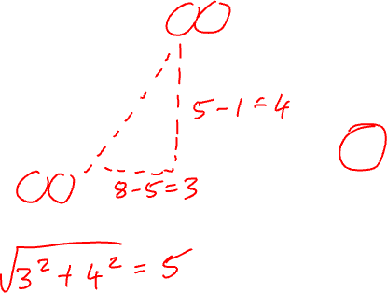
$$A circle with centre \left(5, 1\right) has a point \left(8, 5\right) on its circumference$$
$$Find the length of the radius OA$$
$$(8, 5)$$
$$1 unit$$
A
$$5 units$$
B
$$(5, 1)$$
$$\sqrt{89} units$$
C
$$\sqrt{39} units$$
D
$$\sqrt{205} units$$
E

Slide 9
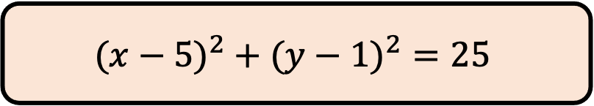
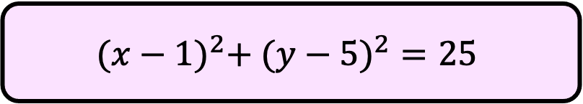
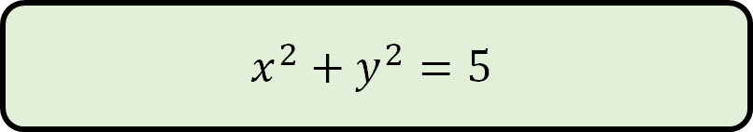

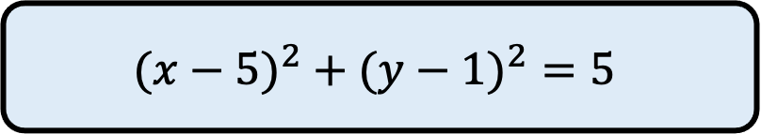
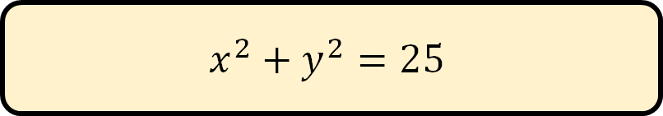
$$A circle with centre \left(5, 1\right) has a point \left(8, 5\right) on its circumference$$
$$Find the equation of$$
$$the graph of the circle$$
$$(8, 5)$$
$${(x−5)}^{2} + ({y−1)}^{2}=25$$
A
$$x^{2}+y^{2}=25$$
B
$$(5, 1)$$
$${(x−5)}^{2} + ({y−1)}^{2}=5$$
C
$$x^{2}+y^{2}=5$$
D
$${(x−1)}^{2}+ ({y−5)}^{2}=25$$
E

Slide 10
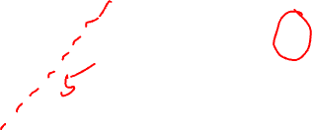
$$A circle with centre \left(5, 1\right) has a point \left(8, 5\right) on its circumference$$
$$Find the equation of$$
$$the graph of the circle$$
$$(8, 5)$$
$${(x−5)}^{2} + ({y−1)}^{2}=25$$
A
$$x^{2}+y^{2}=25$$
B
$$(5, 1)$$
$${(x−5)}^{2} + ({y−1)}^{2}=5$$
C
$$x^{2}+y^{2}=5$$
D
$${(x−1)}^{2}+ ({y−5)}^{2}=25$$
E

Slide 11
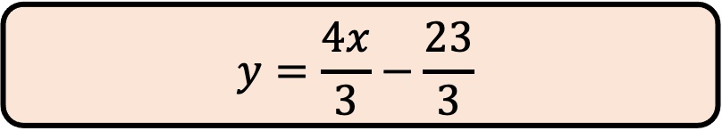
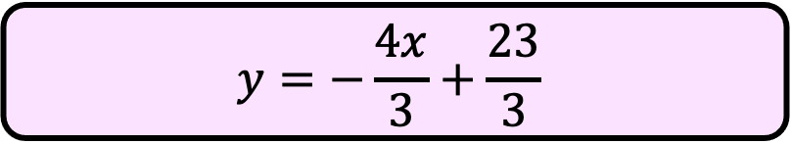
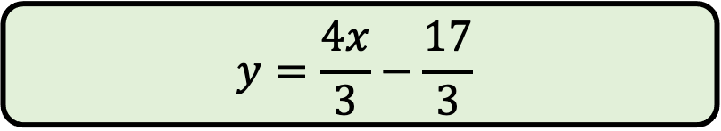

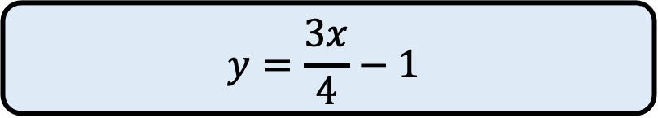
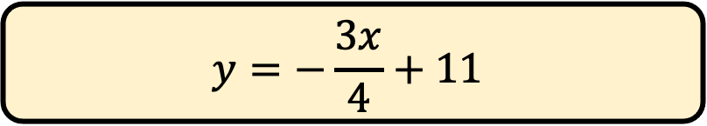
$$A circle with centre \left(5, 1\right) has a point \left(8, 5\right) on its circumference$$
$$Find the equation of the$$
$$line passing O and A$$
$$(8, 5)$$
$$y=\frac{4x}{3}−\frac{23}{3}$$
A
$$y=−\frac{3x}{4}+11$$
B
$$(5, 1)$$
$$y=\frac{3x}{4}−1$$
C
$$y=\frac{4x}{3}−\frac{17}{3}$$
D
$$y=−\frac{4x}{3}+\frac{23}{3}$$
E

Slide 12
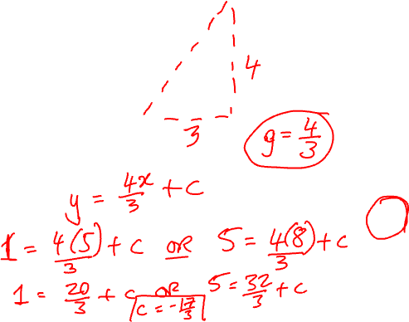
$$A circle with centre \left(5, 1\right) has a point \left(8, 5\right) on its circumference$$
$$Find the equation of the$$
$$line passing O and A$$
$$(8, 5)$$
$$y=\frac{4x}{3}−\frac{23}{3}$$
A
$$y=−\frac{3x}{4}+11$$
B
$$(5, 1)$$
$$y=\frac{3x}{4}−1$$
C
$$y=\frac{4x}{3}−\frac{17}{3}$$
D
$$y=−\frac{4x}{3}+\frac{23}{3}$$
E

Slide 13
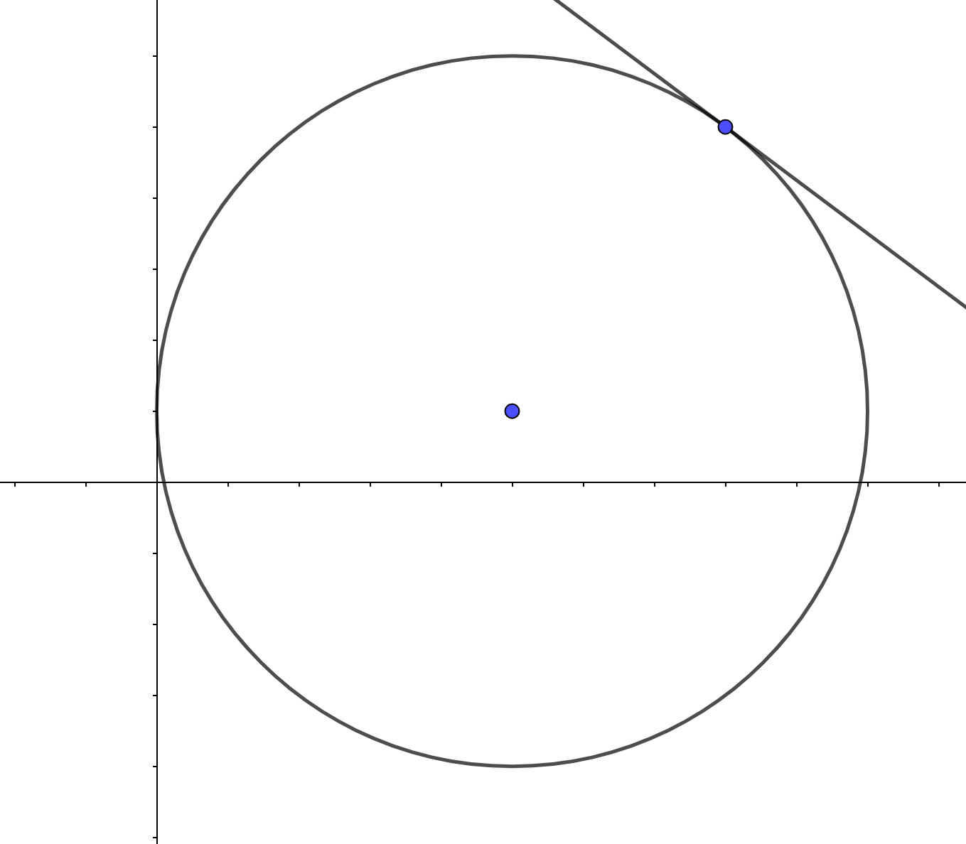
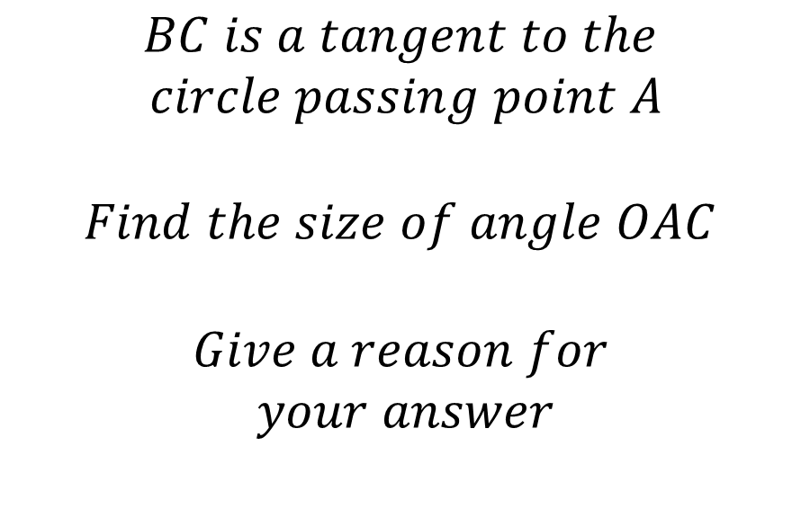
$$A circle with centre \left(5, 1\right) has a point \left(8, 5\right) on its circumference$$
$$(8, 5)$$
$$BC is a tangent to the$$
$$circle passing point A$$
$$Find the size of angle OAC$$
$$Give a reason for$$
$$your answer$$
$$(5, 1)$$

Slide 14
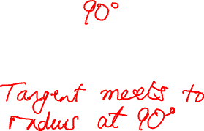
$$A circle with centre \left(5, 1\right) has a point \left(8, 5\right) on its circumference$$
$$(8, 5)$$
$$BC is a tangent to the$$
$$circle passing point A$$
$$Find the size of angle OAC$$
$$Give a reason for$$
$$your answer$$
$$(5, 1)$$

Slide 15
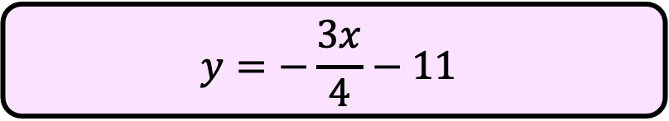
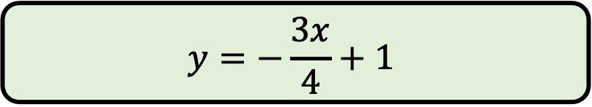
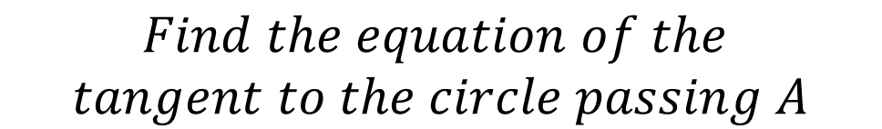
$$A circle with centre \left(5, 1\right) has a point \left(8, 5\right) on its circumference$$
$$Find the equation of the$$
$$tangent to the circle passing A$$
$$(8, 5)$$
$$y=\frac{4x}{3}−\frac{23}{3}$$
A
$$y=−\frac{3x}{4}+11$$
B
$$(5, 1)$$
$$y=\frac{3x}{4}−1$$
C
$$y=−\frac{3x}{4}+1$$
D
$$y=−\frac{3x}{4}−11$$
E

Slide 16
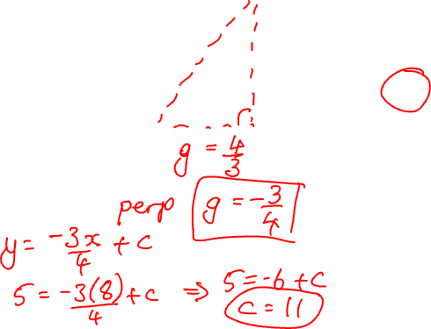
$$A circle with centre \left(5, 1\right) has a point \left(8, 5\right) on its circumference$$
$$Find the equation of the$$
$$tangent to the circle passing A$$
$$(8, 5)$$
$$y=\frac{4x}{3}−\frac{23}{3}$$
A
$$y=−\frac{3x}{4}+11$$
B
$$(5, 1)$$
$$y=\frac{3x}{4}−1$$
C
$$y=−\frac{3x}{4}+1$$
D
$$y=−\frac{3x}{4}−11$$
E

Slide 17
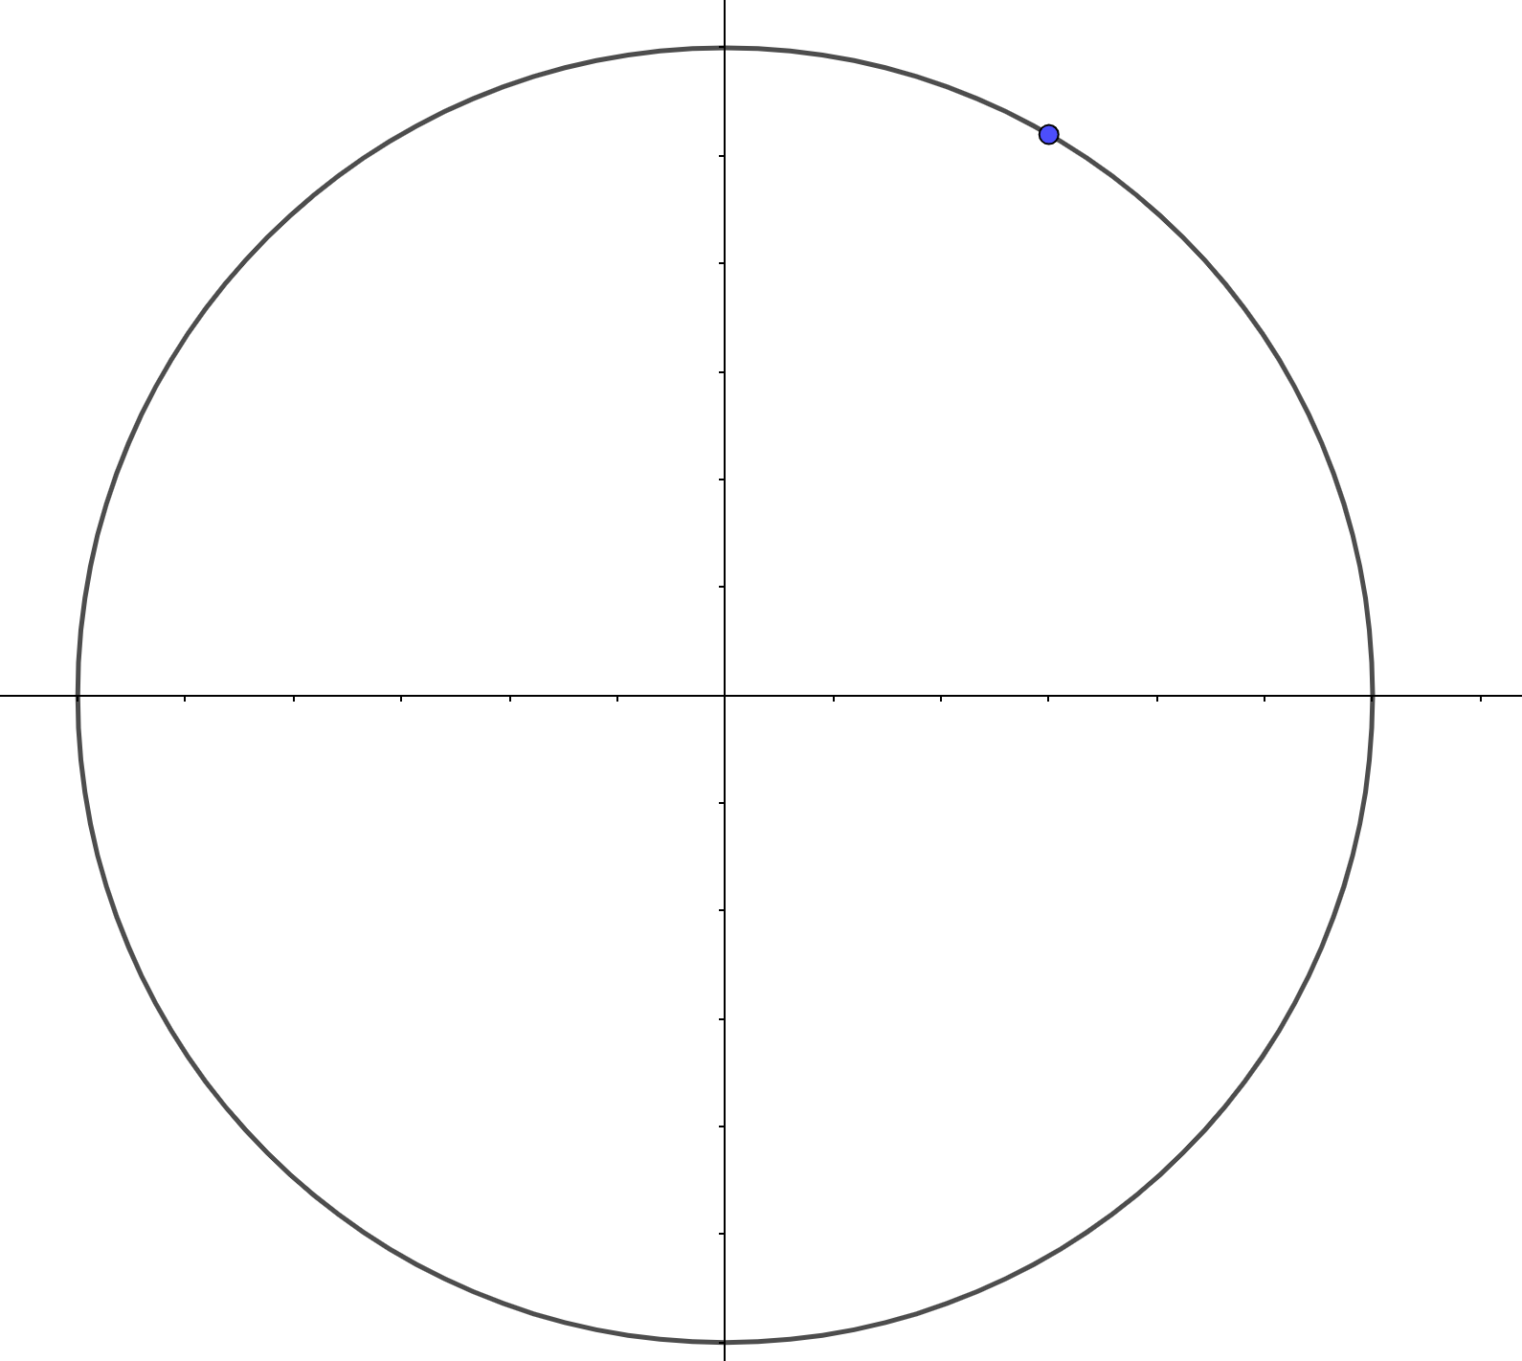

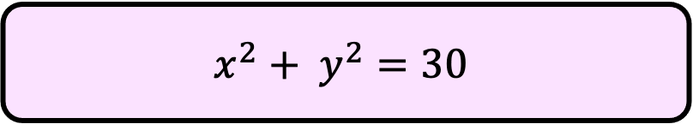
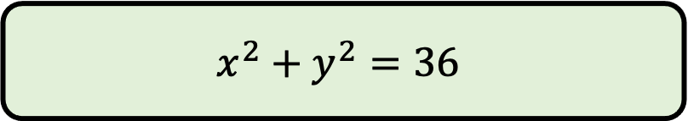





$$A circle with centre \left(0, 0\right) has a point A at \left(3, \sqrt{27}\right) on its circumference$$
$$A$$
$$Find the equation of the circle$$
$${. (x−3)}^{2} + ({y−\sqrt{27})}^{2}=36$$
A
$$x^{2}+y^{2}=6$$
B
$$0$$
$${. (x−3)}^{2} + ({y−\sqrt{27})}^{2}=6$$
C
$$x^{2}+y^{2}=36$$
D
$$x^{2}+ y^{2}=30$$
E

Slide 18

$$A circle with centre \left(0, 0\right) has a point A at \left(3, \sqrt{27}\right) on its circumference$$
$$A$$
$$Find the equation of the circle$$
$${. (x−3)}^{2} + ({y−\sqrt{27})}^{2}=36$$
A
$$x^{2}+y^{2}=6$$
B
$$0$$
$${. (x−3)}^{2} + ({y−\sqrt{27})}^{2}=6$$
C
$$x^{2}+y^{2}=36$$
D
$$x^{2}+ y^{2}=30$$
E

Slide 19






$$A circle with centre \left(0, 0\right) has a point A at \left(3, \sqrt{27}\right) on its circumference$$
$$Find the size of the angle that$$
$$OA makes with the x−axis$$
$$A$$
$${60}^{o}$$
A
$${63}^{o}$$
B
$$0$$
$${30}^{o}$$
C
$${45}^{o}$$
D
$${50}^{o}$$
E

Slide 20

$$A circle with centre \left(0, 0\right) has a point A at \left(3, \sqrt{27}\right) on its circumference$$
$$Find the size of the angle that$$
$$OA makes with the x−axis$$
$$A$$
$${60}^{o}$$
A
$${63}^{o}$$
B
$$0$$
$${30}^{o}$$
C
$${45}^{o}$$
D
$${50}^{o}$$
E

