Slide 1
Transformation of Graphs

Slide 2
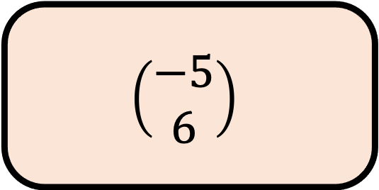

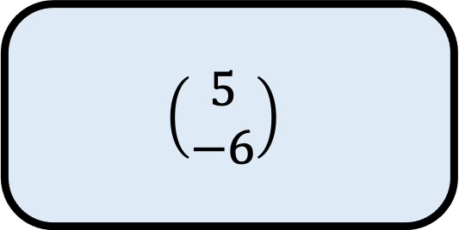
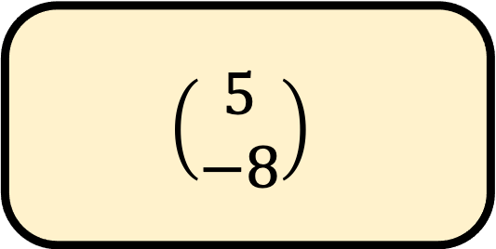
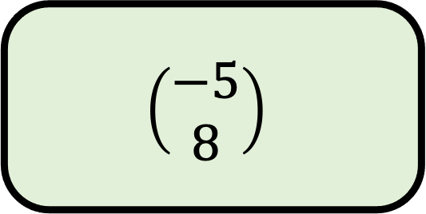
$${35}^{o}$$
A
$$\left(\begin{aligned}5 \\ −6\end{aligned}\right)$$
B
Choose the vector that translates the point
(–2, 7) to the point (3, –1)
$$\left(\begin{aligned}5 \\ −8\end{aligned}\right)$$
C
$$\left(\begin{aligned}−5 \\ 8\end{aligned}\right)$$
D
$$\left(\begin{aligned}−5 \\ 6\end{aligned}\right)$$

Slide 3
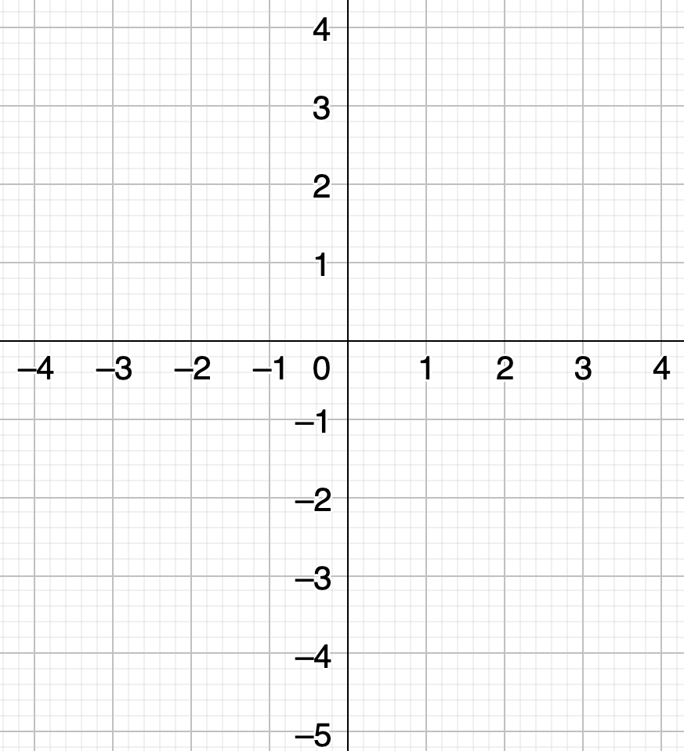
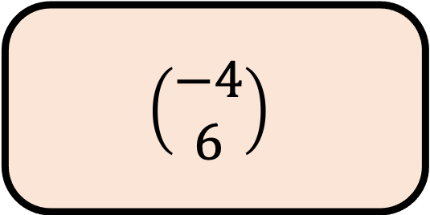
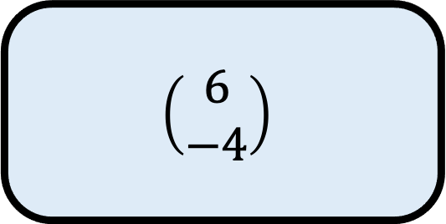
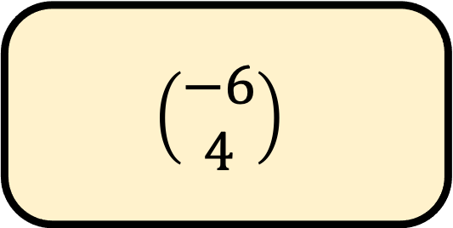

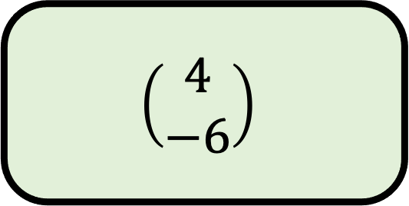
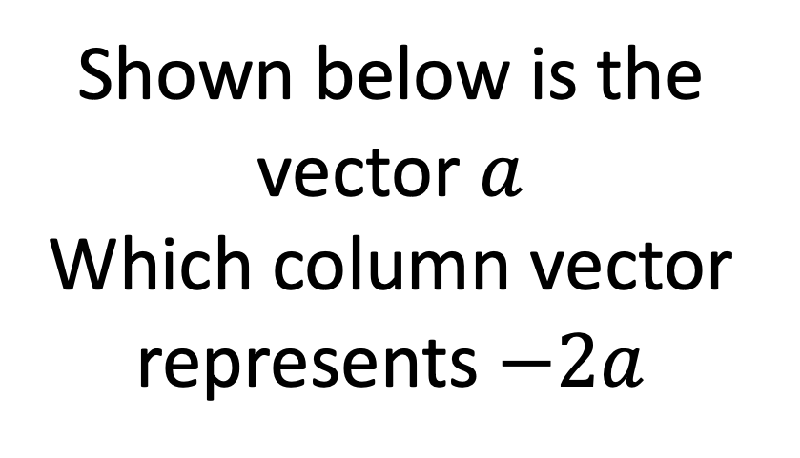
$${35}^{o}$$
A
$$\left(\begin{aligned}6 \\ −4\end{aligned}\right)$$
Shown below is the vector $a$
Which column vector represents $−2a$
B
$$\left(\begin{aligned}−6 \\ 4\end{aligned}\right)$$
C
$$\left(\begin{aligned}4 \\ −6\end{aligned}\right)$$
$$a$$
D
$$\left(\begin{aligned}−4 \\ 6\end{aligned}\right)$$

Slide 4
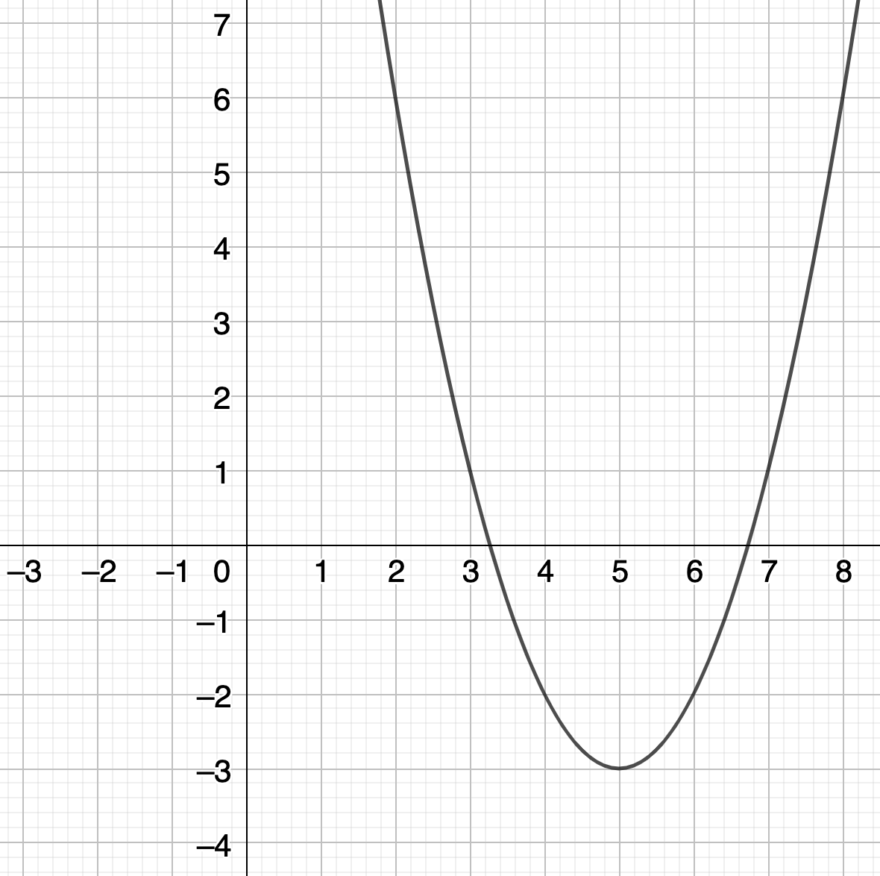
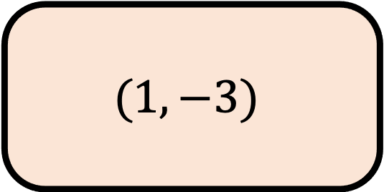
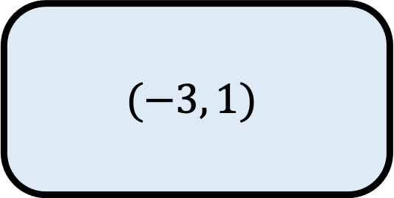
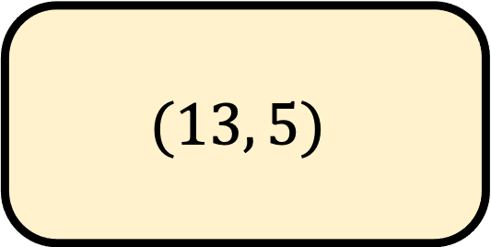
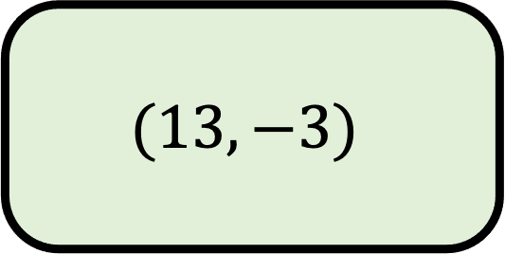
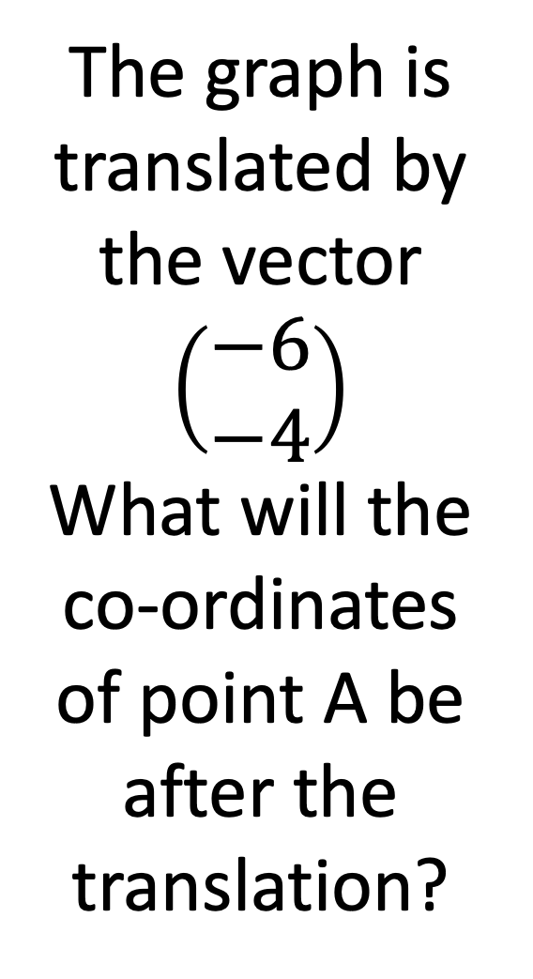

$${35}^{o}$$
A
$$(−3, 1)$$
The graph is translated by the vector $\left(\begin{aligned}−6 \\ −4\end{aligned}\right)$
What will the co-ordinates of point A be after the translation?
B
$$(13, 5)$$
C
$$A$$
$$(13, −3)$$
D
$$(1, −3)$$

Slide 5

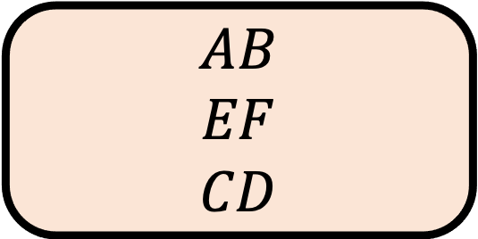

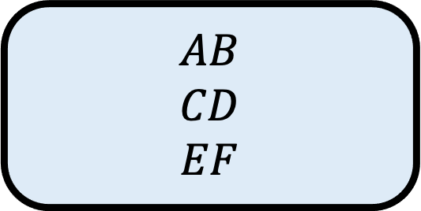

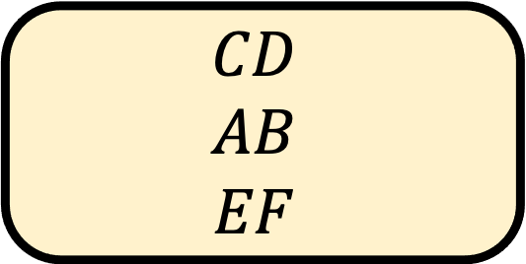

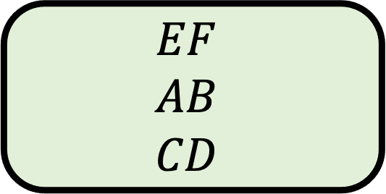

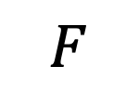
$${35}^{o}$$
A
$$AB$$
$$CD$$
$$EF$$
$$C$$
Put these lines in order from smallest to biggest
Which order is correct?
$$E$$
B
$$CD$$
$$AB$$
$$EF$$
$$D$$
$$F$$
C
$$A$$
$$EF$$
$$AB$$
$$CD$$
D
$$AB$$
$$EF$$
$$CD$$
$$B$$

Slide 6
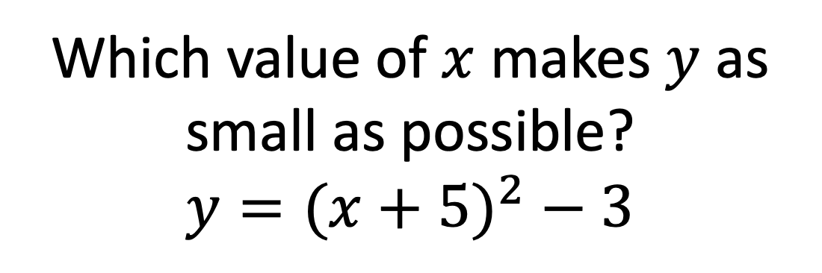
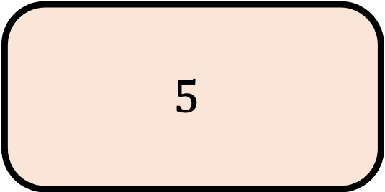
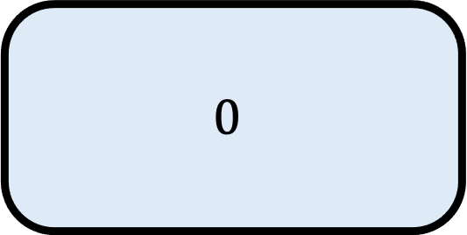
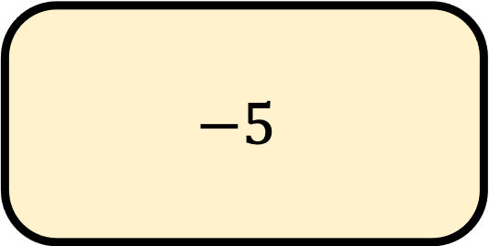
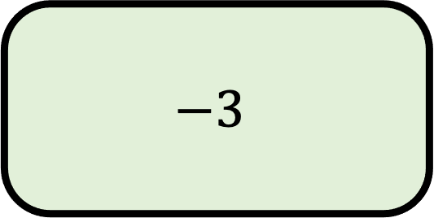
$${35}^{o}$$
A
$$0$$
B
$$−5$$
Which value of $x$ makes $y$ as small as possible?
$$y={(x+5)}^{2} − 3$$
C
$$−3$$
D
$$5$$

Slide 8
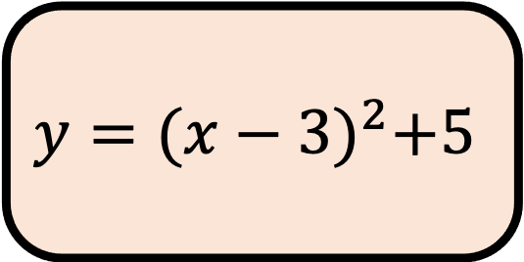
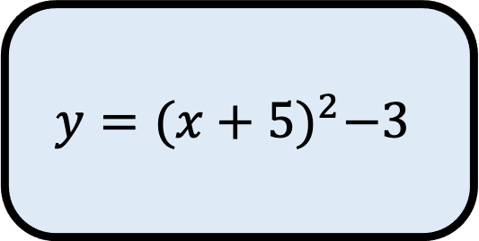
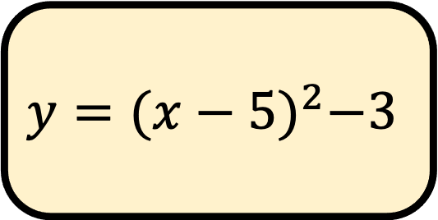
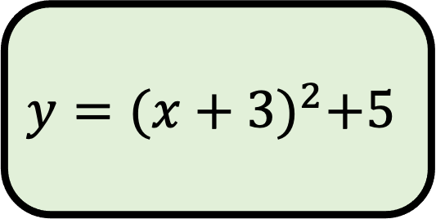
$${35}^{o}$$
A
$$y={(x+5)}^{2}−3$$
Which equation matches the graph?
B
$$y={(x−5)}^{2}−3$$
C
$$y={(x+3)}^{2}+5$$
D
$$y={(x−3)}^{2}+5$$

Slide 9
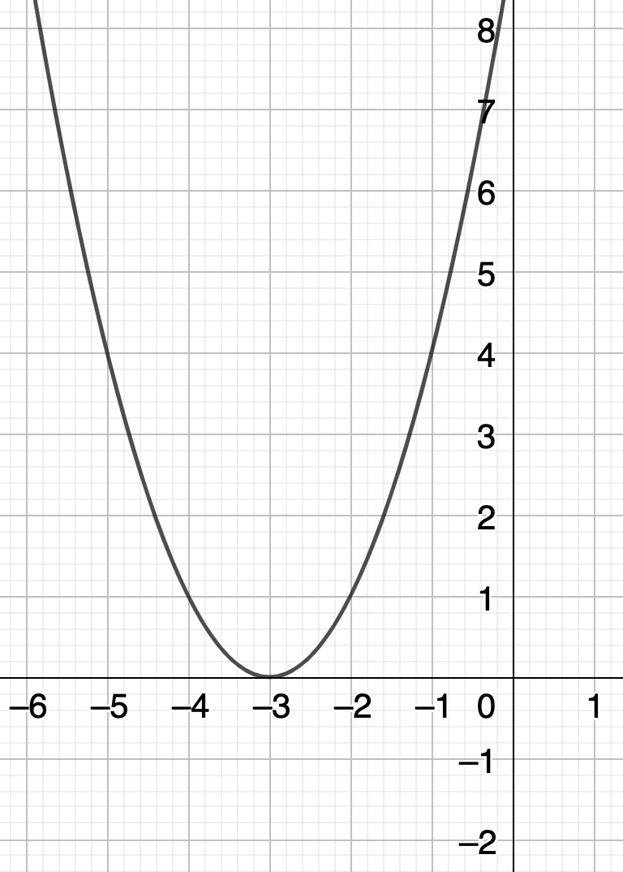
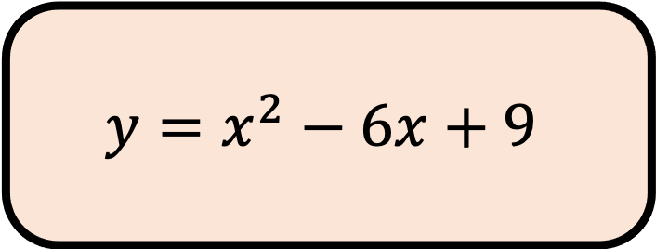
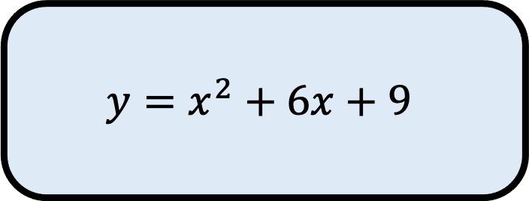
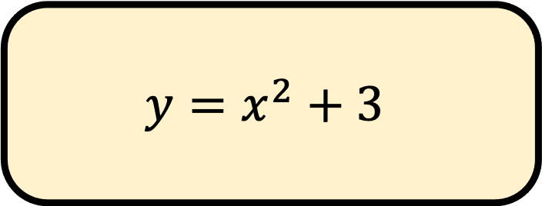
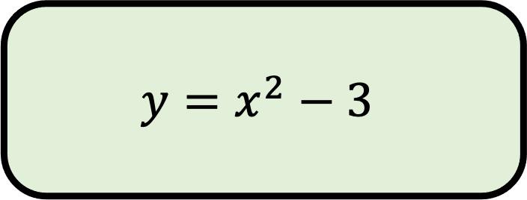
$${35}^{o}$$
A
$$y=x^{2}+6x+9$$
Which equation matches the graph?
B
$$y=x^{2}+3$$
C
$$y=x^{2}−3$$
D
$$y=x^{2}−6x+9$$

Slide 10
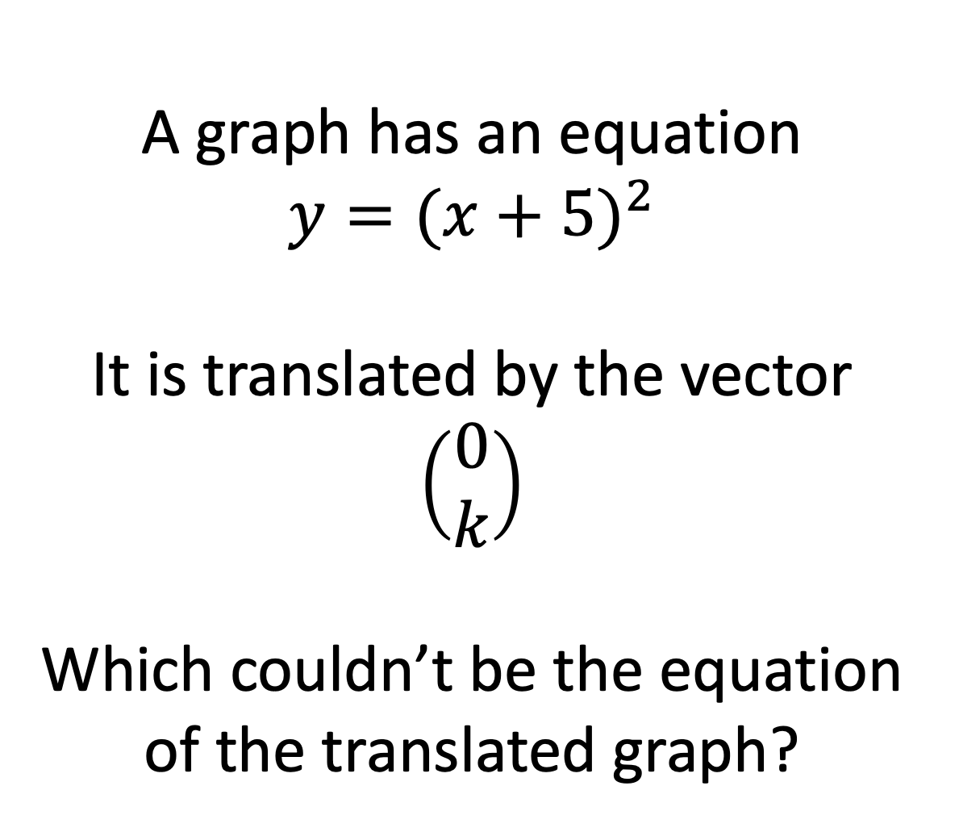
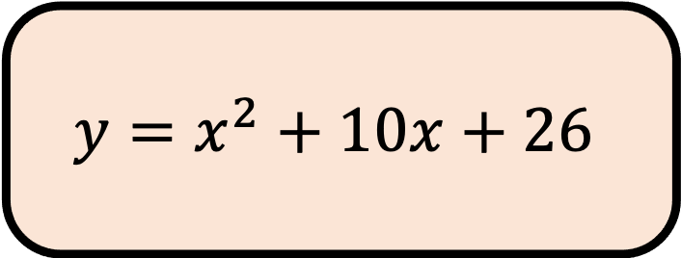
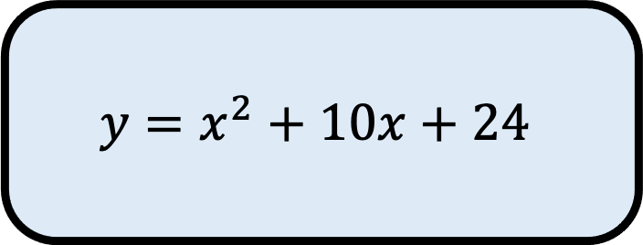
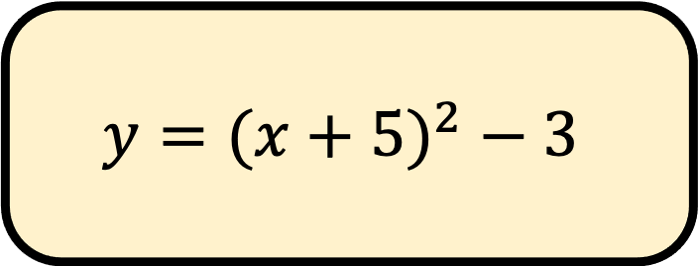
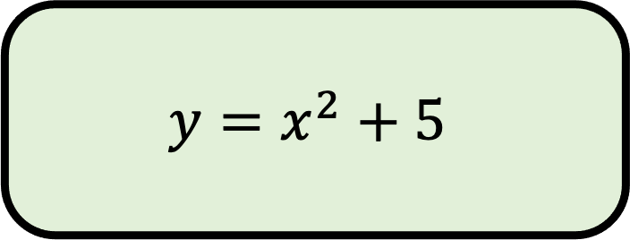
$${35}^{o}$$
A
$$y=x^{2}+10x+24$$
A graph has an equation
$$y={(x+5)}^{2}$$
It is translated by the vector
$$\left(\begin{aligned}0 \\ k\end{aligned}\right)$$
Which couldn’t be the equation of the translated graph?
B
$$y={(x+5)}^{2} − 3$$
C
$$y=x^{2}+5$$
D
$$y=x^{2}+10x+26$$

