Slide 1
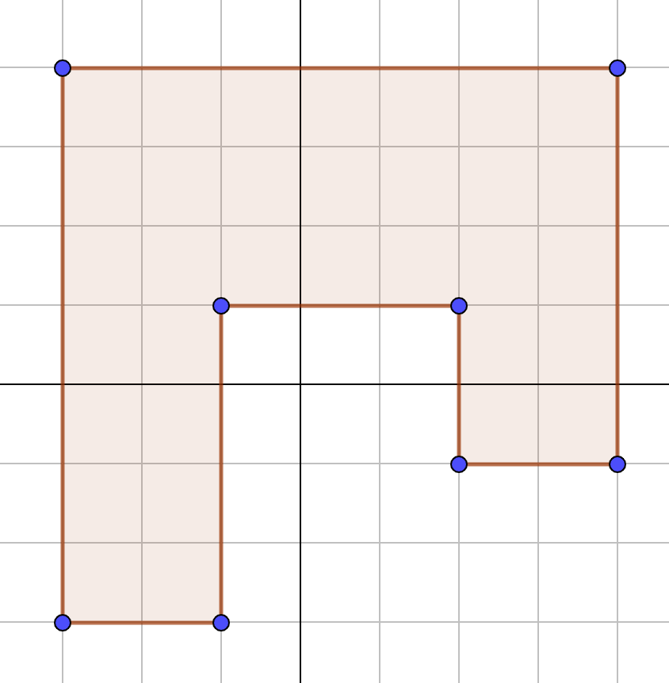
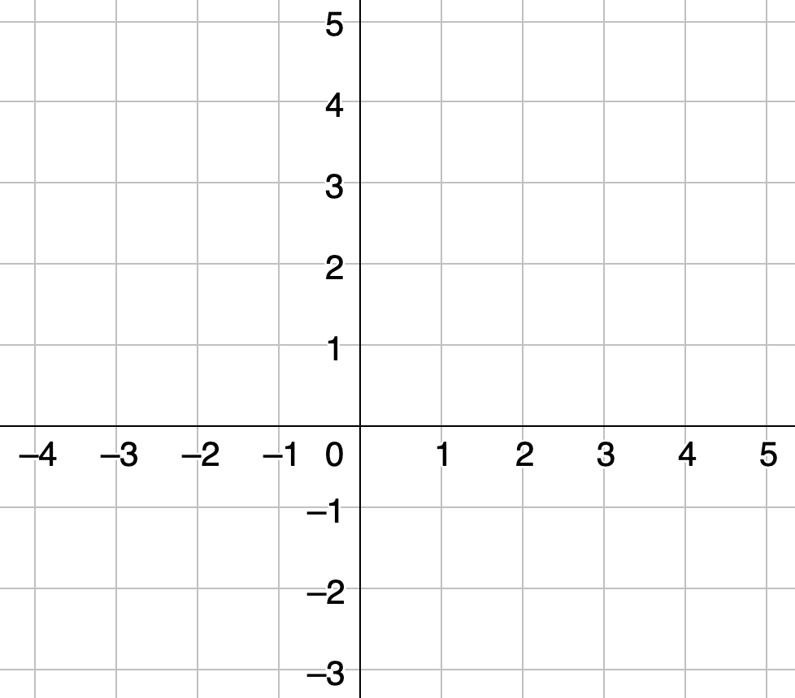
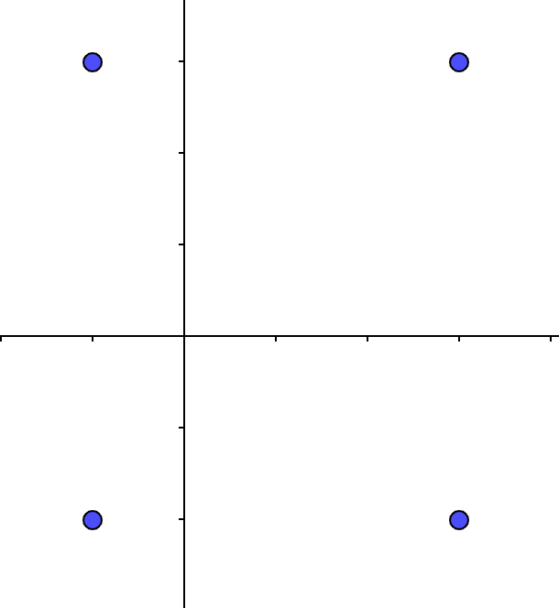
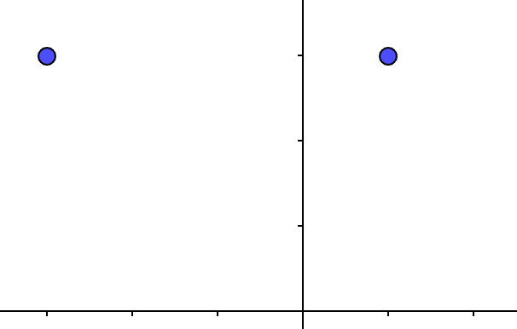
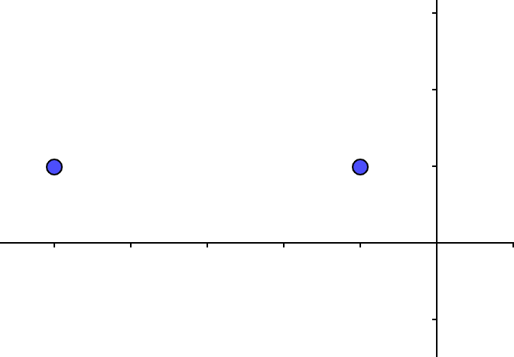
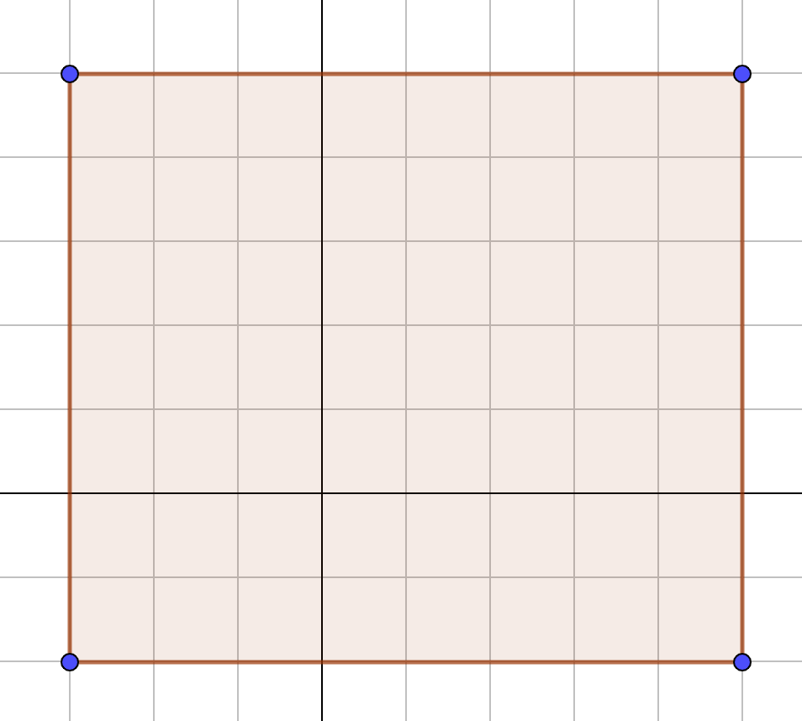

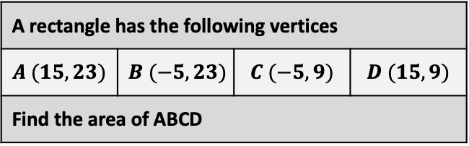


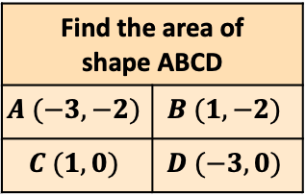










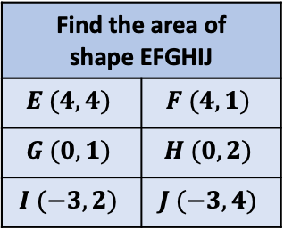

Area of 2D shapes: All shapes are plotted onto grids that are drawn on centimetre square paper
Find the area of shape ABCD
$$A (−3, −2)$$ | $$B (1, −2)$$
$$C (1, 0)$$ | $$D (−3, 0)$$
$$D (−1, 3)$$
$$A (3, 3)$$
Find the area of shape ABCD
Find the area of shape EFGHIJ
$$E (4, 4)$$ | $$F (4, 1)$$
$$G (0, 1)$$ | $$H (0, 2)$$
$$I (−3, 2)$$ | $$J (−3, 4)$$
Find the area of the shape drawn on centimetre paper
$$C (−1, −2)$$
$$B (3, −2)$$
$$A (−3, 3)$$
$$B (1, 3)$$
$$A$$
$$B$$
Rectangle ABCD has another rectangle EFGH removed, resulting in a shape with an area of 44cm² Find co-ordinates G and H
G
H
A and B are two of the vertices of a square. Find the area of ABCD
$$E$$
$$F$$
$$A (−5, 1)$$
$$B (−1, 1)$$
The area of rectangle ABCD is 32cm² Find both pairs of possible co-ordinates C and D
C | D
C | D
A rectangle has the following vertices
$$A (15, 23)$$ | $$B (−5, 23)$$ | $$C (−5, 9)$$ | $$D (15, 9)$$
Find the area of ABCD
$$D$$
$$C$$

Slide 2
Area of 2D shapes: All shapes are plotted onto grids that are drawn on centimetre square paper
Find the area of shape ABCD
$$A (−3, −2)$$ | $$B (1, −2)$$
$$C (1, 0)$$ | $$D (−3, 0)$$
$$D (−1, 3)$$
$$A (3, 3)$$
Find the area of shape ABCD
Find the area of shape EFGHIJ
$$E (4, 4)$$ | $$F (4, 1)$$
$$G (0, 1)$$ | $$H (0, 2)$$
$$I (−3, 2)$$ | $$J (−3, 4)$$
Find the area of the shape drawn on centimetre paper
$$C (−1, −2)$$
$$B (3, −2)$$
$$A (−3, 3)$$
$$B (1, 3)$$
$$A$$
$$B$$
Rectangle ABCD has another rectangle EFGH removed, resulting in a shape with an area of 44cm² Find co-ordinates G and H
G
H
A and B are two of the vertices of a square. Find the area of ABCD
$$E$$
$$F$$
$$A (−5, 1)$$
$$B (−1, 1)$$
The area of rectangle ABCD is 32cm² Find both pairs of possible co-ordinates C and D
C | D
C | D
A rectangle has the following vertices
$$A (15, 23)$$ | $$B (−5, 23)$$ | $$C (−5, 9)$$ | $$D (15, 9)$$
Find the area of ABCD
$$D$$
$$C$$

Slide 3




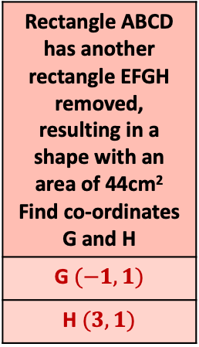


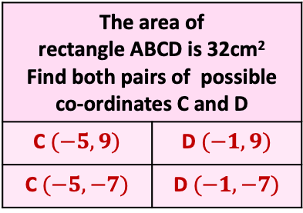
Area of 2D shapes: All shapes are plotted onto grids that are drawn on centimetre square paper
Find the area of shape ABCD
$$A (−3, −2)$$ | $$B (1, −2)$$
$$C (1, 0)$$ | $$D (−3, 0)$$
$$D (−1, 3)$$
$$A (3, 3)$$
$$33cm2$$
$$18cm2$$
Find the area of shape ABCD
Find the area of shape EFGHIJ
$$E (4, 4)$$ | $$F (4, 1)$$
$$G (0, 1)$$ | $$H (0, 2)$$
$$I (−3, 2)$$ | $$J (−3, 4)$$
$$20cm2$$
$$8cm2$$
Find the area of the shape drawn on centimetre paper
$$C (−1, −2)$$
$$B (3, −2)$$
$$A (−3, 3)$$
$$B (1, 3)$$
$$A$$
$$B$$
Rectangle ABCD has another rectangle EFGH removed, resulting in a shape with an area of 44cm² Find co-ordinates G and H
G $(−1, 1)$
H $(3, 1)$
A and B are two of the vertices of a square. Find the area of ABCD
$$E$$
$$F$$
$$A (−5, 1)$$
$$B (−1, 1)$$
$$4^{2}=16cm2$$
The area of rectangle ABCD is 32cm² Find both pairs of possible co-ordinates C and D
C $(−5, 9)$ | D $(−1, 9)$
C $(−5, −7)$ | D $(−1, −7)$
A rectangle has the following vertices
$$A (15, 23)$$ | $$B (−5, 23)$$ | $$C (−5, 9)$$ | $$D (15, 9)$$
Find the area of ABCD
$$20 × 14=280cm2$$
$$D$$
$$C$$

