Slide 1
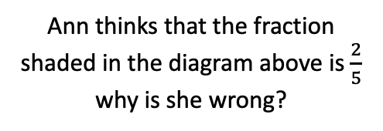

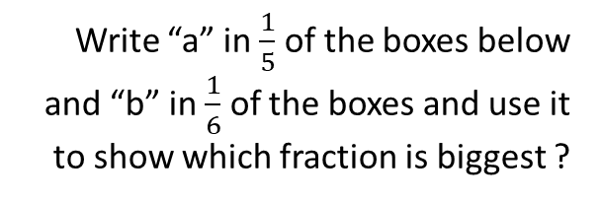




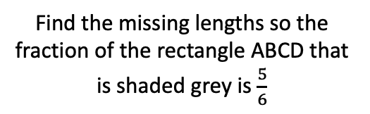
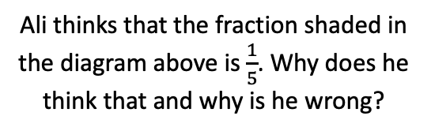

1
What fraction is shaded in each diagram?
4
5
Shade $\frac{1}{2}$ of the diagram below?
What fraction is shaded in each diagram, write your answer in its simplest form?
Shade each diagram
with the fraction stated?
6
$$(a)$$
$$(b)$$
$$\frac{5}{6}$$
$$(c)$$
Write “a” in $\frac{1}{5}$ of the boxes below and “b” in $\frac{1}{6}$ of the boxes and use it to show which fraction is biggest ?
2
7
$$\frac{2}{3}$$
Ali thinks that the fraction shaded in the diagram above is $\frac{1}{5}$. Why does he think that and why is he wrong?
$$\frac{7}{10}$$
3
8
What fraction of the rectangle ABCD is shaded grey?
Find the missing lengths so the fraction of the rectangle ABCD that is shaded grey is $\frac{5}{6}$
9
Ann thinks that the fraction shaded in the diagram above is $\frac{2}{5}$ why is she wrong?
4cm
A
B
A
B
3cm
6cm
D
10cm
C
D
C

Slide 2
1
What fraction is shaded in each diagram?
4
5
Shade $\frac{1}{2}$ of the diagram below?
What fraction is shaded in each diagram, write your answer in its simplest form?
Shade each diagram
with the fraction stated?
6
$$(a)$$
$$(b)$$
$$\frac{5}{6}$$
$$(c)$$
Write “a” in $\frac{1}{5}$ of the boxes below and “b” in $\frac{1}{6}$ of the boxes and use it to show which fraction is biggest ?
2
7
$$\frac{2}{3}$$
Ali thinks that the fraction shaded in the diagram above is $\frac{1}{5}$. Why does he think that and why is he wrong?
$$\frac{7}{10}$$
3
8
What fraction of the rectangle ABCD is shaded grey?
Find the missing lengths so the fraction of the rectangle ABCD that is shaded grey is $\frac{5}{6}$
9
Ann thinks that the fraction shaded in the diagram above is $\frac{2}{5}$ why is she wrong?
4cm
A
B
A
B
3cm
6cm
D
10cm
C
D
C

Slide 3
1
What fraction is shaded in each diagram?
4
5
Shade $\frac{1}{2}$ of the diagram below?
What fraction is shaded in each diagram, write your answer in its simplest form?
Shade each diagram
with the fraction stated?
6
$$(a)$$
$$(b)$$
$$\frac{5}{6}$$
$$(c)$$
Write “a” in $\frac{1}{5}$ of the boxes below and “b” in $\frac{1}{6}$ of the boxes and use it to show which fraction is biggest ?
2
7
$$\frac{2}{3}$$
Ali thinks that the fraction shaded in the diagram above is $\frac{1}{5}$. Why does he think that and why is he wrong?
$$\frac{7}{10}$$
3
8
What fraction of the rectangle ABCD is shaded grey?
Find the missing lengths so the fraction of the rectangle ABCD that is shaded grey is $\frac{5}{6}$
9
Ann thinks that the fraction shaded in the diagram above is $\frac{2}{5}$ why is she wrong?
4cm
A
B
A
B
3cm
6cm
D
10cm
C
D
C

