Slide 1
Trigonometry

Slide 2
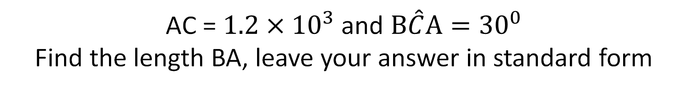

3 standard form
1
AC = $1.2×{10}^{3}$ and $B\hat{C}A={30}^{0}$
Find the length BA, leave your answer in standard form
B
C
A
Answer in S.F

Slide 3


3 standard form
1
AC = $1.2×{10}^{3}$ and $B\hat{C}A={30}^{0}$
Find the length BA, leave your answer in standard form
B
$${1.2×{10}^{3}×sin30}^{0}$$
$${1.2×{10}^{3}×\frac{1}{2}}^{}$$
$${0.6×{10}^{3}}^{}$$
$${6×10}^{2}cm$$
$${30}^{0}$$
C
A
$$1.2×{10}^{3}$$
Answer in S.F

Slide 4

2
AC = 8cm and angle $B\hat{A}C={40}^{0}$
Find the area of the triangle ABC
A
C
B
Answer to 2dp

Slide 5

2
AC = 8cm and angle $B\hat{A}C={40}^{0}$
Find the area of the triangle ABC
$$8cm$$
A
C
$${40}^{0}$$
$${8×tan40}^{0}$$
$$\frac{1}{2}×8×({8×tan40}^{0})$$
$$26.85{cm}^{2}$$
B
Answer to 2dp

Slide 6
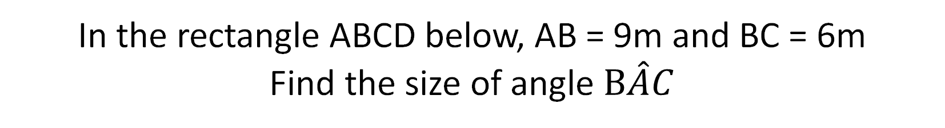
3
In the rectangle ABCD below, AB = 9m and BC = 6m
Find the size of angle $B\hat{A}C$
A
B
D
C
Answer to 1dp

Slide 7

3
In the rectangle ABCD below, AB = 9m and BC = 6m
Find the size of angle $B\hat{A}C$
A
$$9cm$$
B
$${\tan^{−1}\left(\frac{6}{9}\right)}^{}$$
$${33.7}^{o}$$
$$6cm$$
D
C
Answer to 1dp

Slide 8
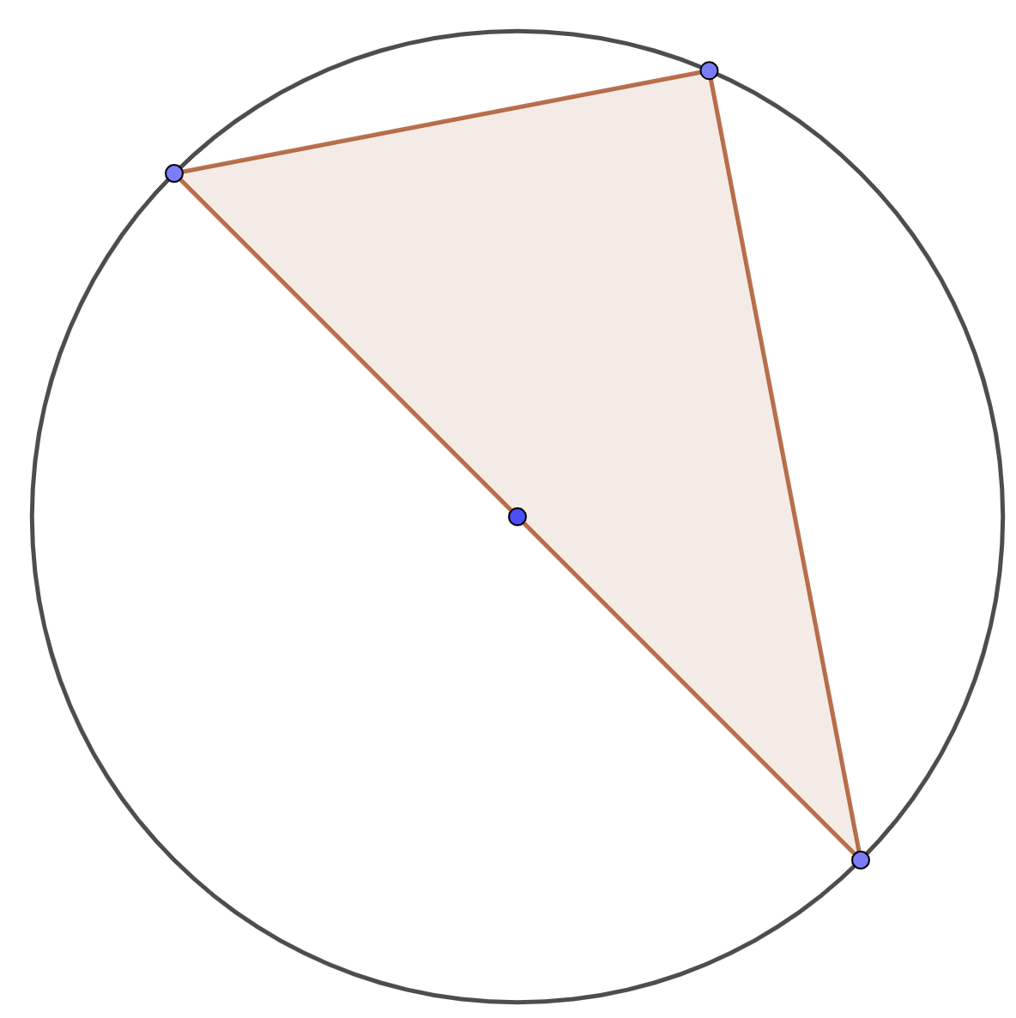
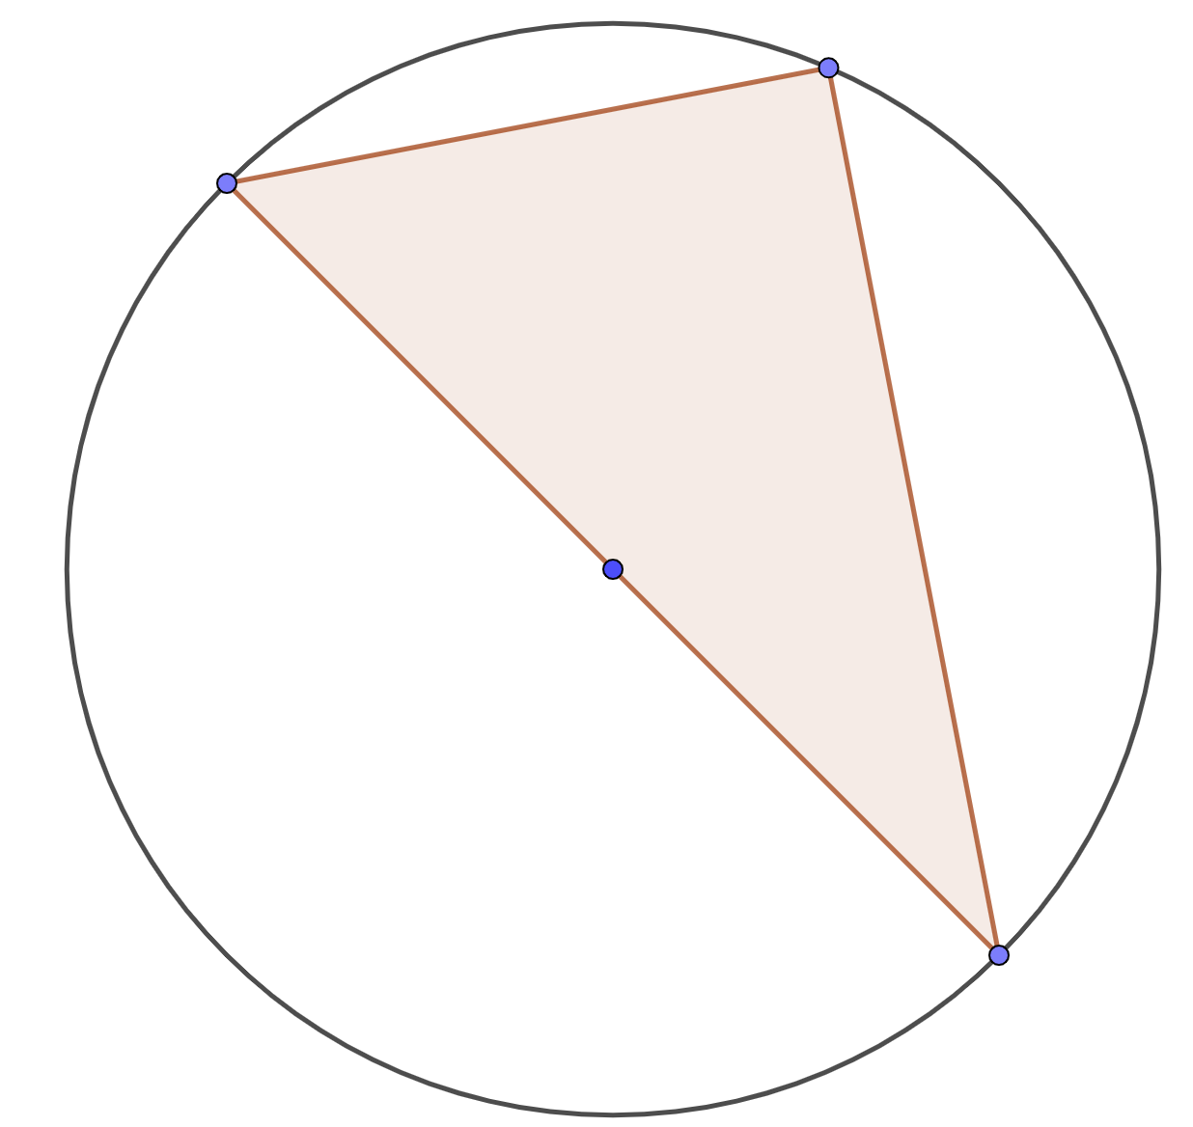
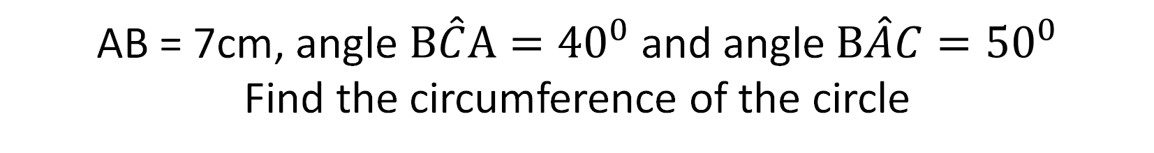
4 circle theorem
AB = 7cm, angle $B\hat{C}A={40}^{0}$ and angle $B\hat{A}C={50}^{0}$
Find the circumference of the circle
4
3 standard form
B
A
C
Answer to 2dp

Slide 9




4 circle theorem
AB = 7cm, angle $B\hat{C}A={40}^{0}$ and angle $B\hat{A}C={50}^{0}$
Find the circumference of the circle
4
3 standard form
B
$$7cm$$
A
$${50}^{0}$$
$$AB= \frac{7}{cos50}$$
$$\frac{7π}{cos50}$$
$${40}^{0}$$
$$34.21{cm}^{}$$
C
Answer to 2dp

Slide 10




5 similarity
AB = 4cm, AD = 10cm, angle $B\hat{C}A={35}^{0}$
Find the length of DE
5
3 standard form
A
Answer to nearest cm
B
C
D
E

Slide 11

5 similarity
AB = 4cm, AD = 10cm, angle $B\hat{C}A={35}^{0}$
Find the length of DE
5
3 standard form
A
Answer to nearest cm
$$4cm$$
$$DE= \frac{10}{tan35}$$
$${35}^{0}$$
B
C
$$14cm$$
D
E

Slide 12
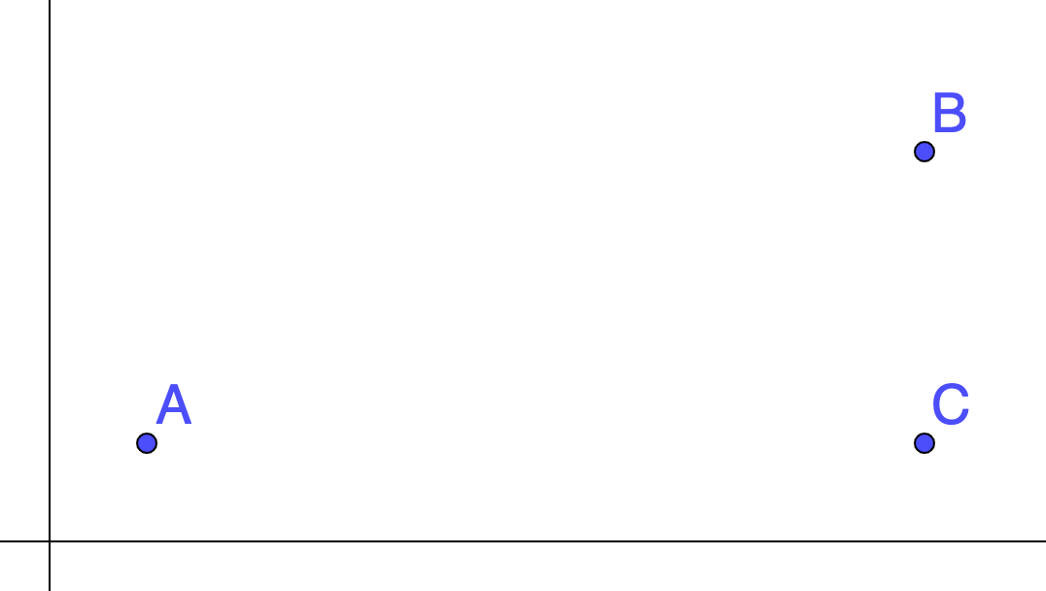
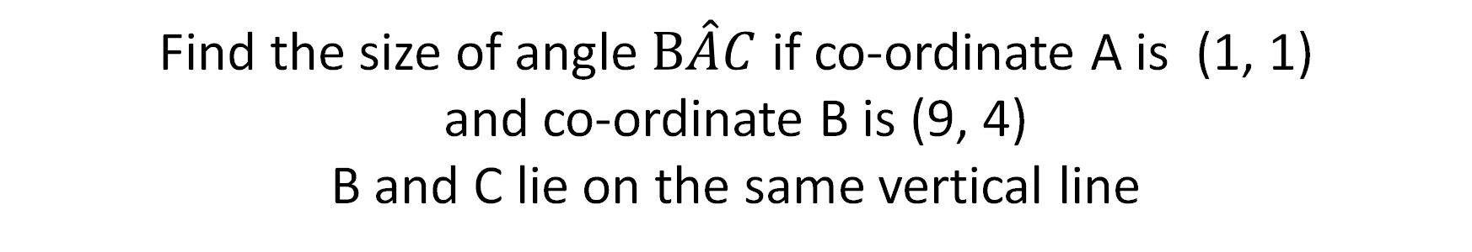
6
Find the size of angle $B\hat{A}C$ if co-ordinate A is (1, 1)
and co-ordinate B is (9, 4)
B and C lie on the same vertical line
Answer to nearest degree

Slide 13

6
Find the size of angle $B\hat{A}C$ if co-ordinate A is (1, 1)
and co-ordinate B is (9, 4)
B and C lie on the same vertical line
Answer to nearest degree
$${\tan^{−1}\left(\frac{3}{8}\right)}^{}$$
(9, 4)
$${21}^{o}$$
$$3cm$$
(1, 1)
$$8cm$$
(9, 1)

Slide 14
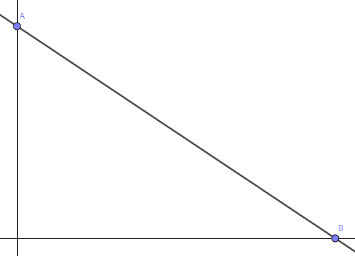
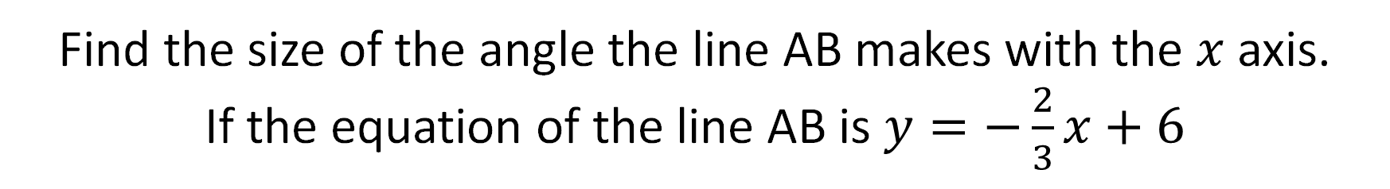
7
Find the size of the angle the line AB makes with the $x$ axis.
If the equation of the line AB is $y=−\frac{2}{3}x+6$
Answer to nearest degree

Slide 15

7
Find the size of the angle the line AB makes with the $x$ axis.
If the equation of the line AB is $y=−\frac{2}{3}x+6$
(0, 6)
Answer to nearest degree
$${\tan^{−1}\left(\frac{6}{9}\right)}^{}$$
$0=−\frac{2}{3}x+6$
$${34}^{o}$$
$$6cm$$
$\frac{2}{3}x=6$
$$x=9$$
$$9cm$$
(9, 0)

Slide 16

8
AB = 13cm, AC = 12cm, angle $B\hat{C}A={90}^{0}$
and angle $C\hat{B}D={42}^{0}$ Find the length of CD
B
A
D
C
Answer to 1dp

Slide 17
8
AB = 13cm, AC = 12cm, angle $B\hat{C}A={90}^{0}$
and angle $C\hat{B}D={42}^{0}$ Find the length of CD
$$\sqrt{{13}^{2}−{12}^{2}}=5$$
B
$$5tan42$$
$${42}^{o}$$
$$13cm$$
$$4.5cm$$
A
D
C
$$12cm$$
Answer to 1dp

Slide 18
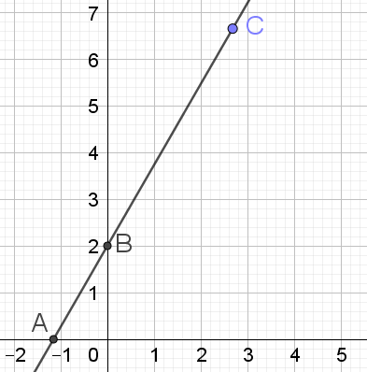
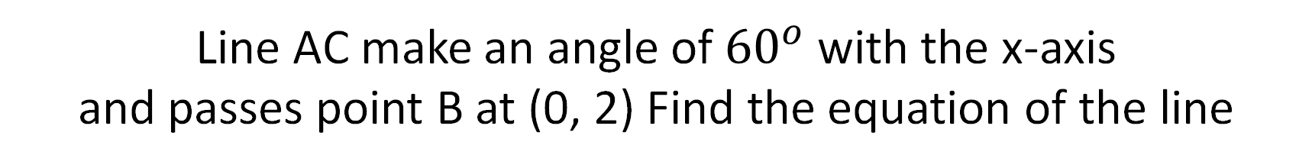
9
Line AC make an angle of ${60}^{o}$ with the x-axis
and passes point B at (0, 2) Find the equation of the line
Answer to 1dp

Slide 19
9
Line AC make an angle of ${60}^{o}$ with the x-axis
and passes point B at (0, 2) Find the equation of the line
$$tan60=\sqrt{3}$$
$$y=(\sqrt{3})x+2$$
$${60}^{o}$$
Answer to 1dp

Slide 20
