Slide 1
Isosceles and other Triangles

Slide 2
1
In the triangle below AB = BC. Find the length of AB
B
AC = 5cm
The perimeter of the triangle is 21cm
A
C

Slide 3
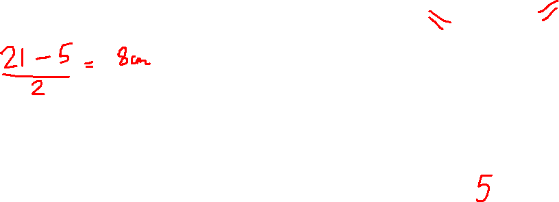
1
In the triangle below AB = BC. Find the length of AB
B
AC = 5cm
The perimeter of the triangle is 21cm
A
C

Slide 4
2
In the triangle below AB = BC. Find the length of AB
B
AB: AC = 3 : 1
The perimeter of the triangle is 21cm
A
C

Slide 5
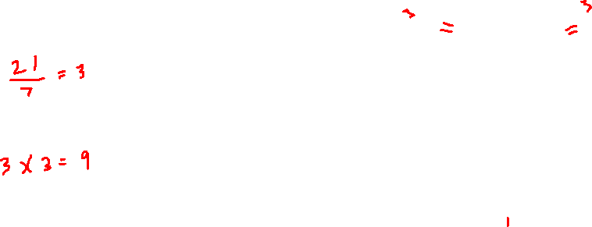
2
In the triangle below AB = BC. Find the length of AB
B
AB: AC = 3 : 1
The perimeter of the triangle is 21cm
A
C

Slide 6
3
In the triangle below AB = BC. Find the length of AB
BC: AC = 5 : 4
The perimeter of the triangle is 21cm
B
A
C

Slide 7

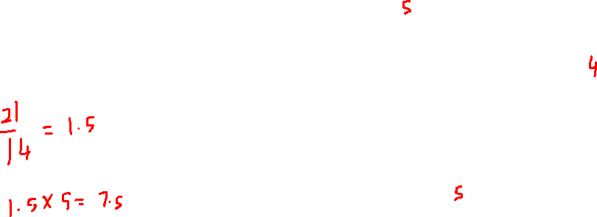
3
In the triangle below AB = BC. Find the length of AB
BC: AC = 5 : 4
The perimeter of the triangle is 21cm
B
A
C

Slide 8
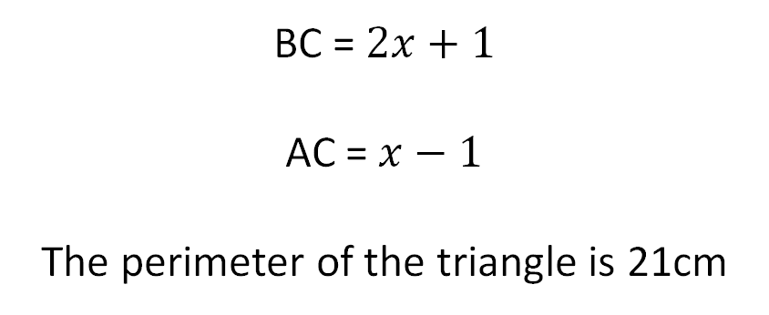
4
In the triangle below AB = BC. Find the length of AB
B
BC = $2x+1$
AC = $x−1$
The perimeter of the triangle is 21cm
A
C

Slide 9
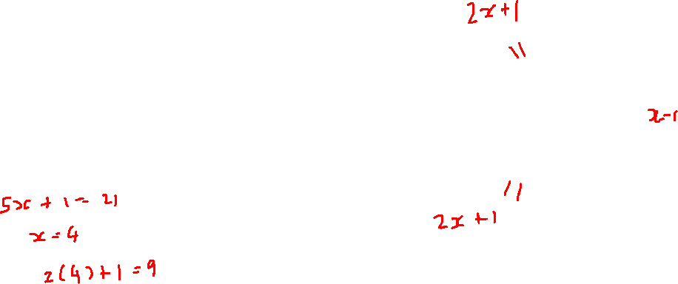
4
In the triangle below AB = BC. Find the length of AB
B
BC = $2x+1$
AC = $x−1$
The perimeter of the triangle is 21cm
A
C

Slide 10
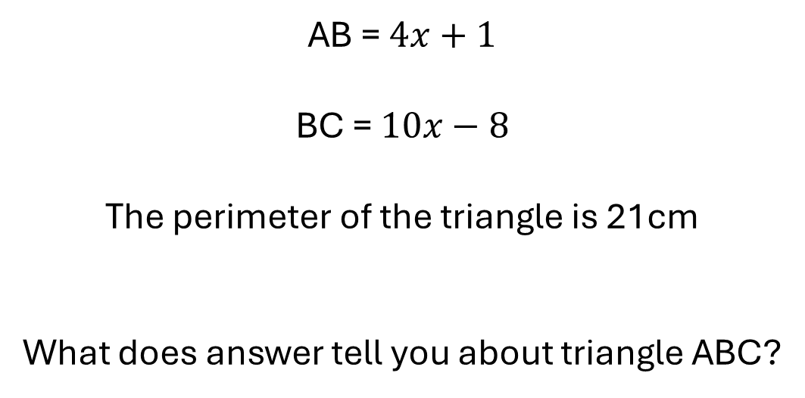
5
In the triangle below AB = BC. Find the length of AB
B
AB = $4x+1$
BC = $10x−8$
The perimeter of the triangle is 21cm
What does answer tell you about triangle ABC?
A
C

Slide 11
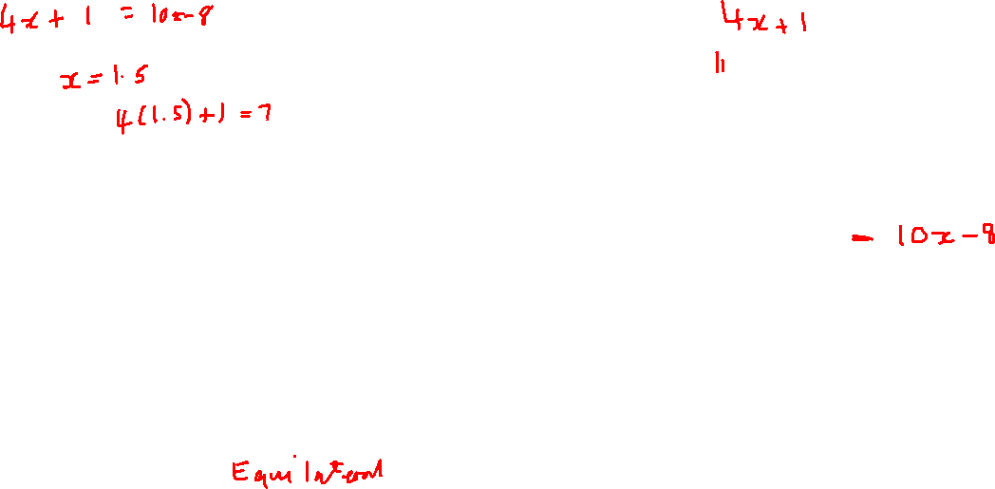
5
In the triangle below AB = BC. Find the length of AB
B
AB = $4x+1$
BC = $10x−8$
The perimeter of the triangle is 21cm
What does answer tell you about triangle ABC?
A
C

Slide 12
6
In the triangle below AB = BC. Find the length of AB
B
M is the midpoint of AC
BM = 10cm
The area of the triangle is 30cm²
The perimeter of the triangle is 21cm
A
C
M

Slide 13
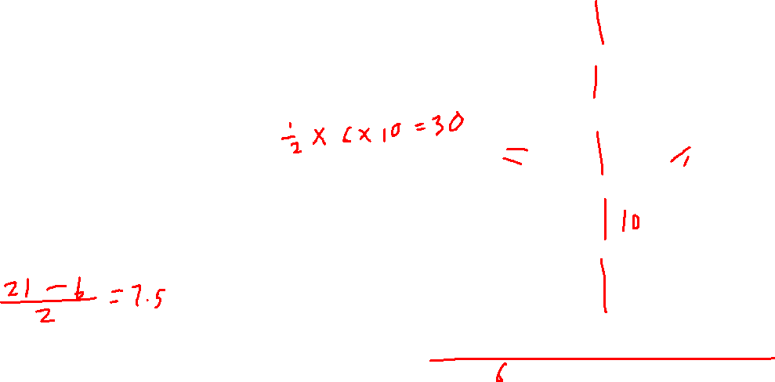
6
In the triangle below AB = BC. Find the length of AB
B
M is the midpoint of AC
BM = 10cm
The area of the triangle is 30cm²
The perimeter of the triangle is 21cm
A
C
M

Slide 14
7
In the triangle below AB = BC. Find the length of AB
B
AC = 8cm
The area of the triangle is 12cm²
C
A

Slide 15
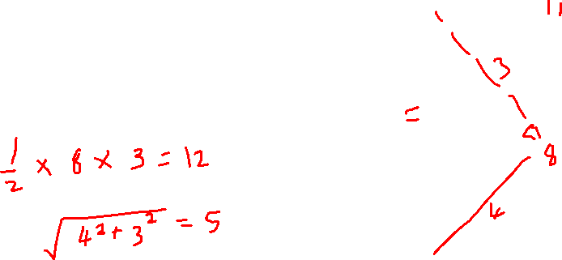
7
In the triangle below AB = BC. Find the length of AB
B
AC = 8cm
The area of the triangle is 12cm²
C
A

Slide 16
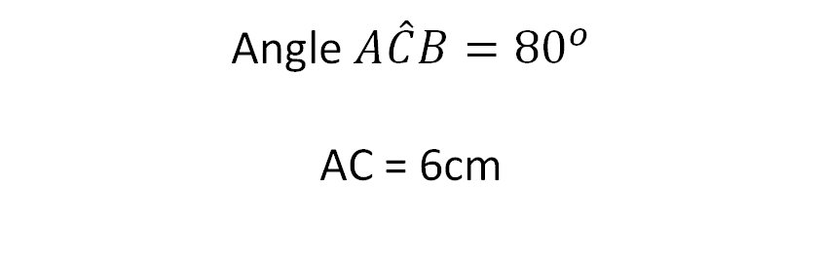
8
In the triangle below AB = BC. Find the length of AB
B
Angle $A\hat{C}B={80}^{o}$
AC = 6cm
A
C

Slide 17

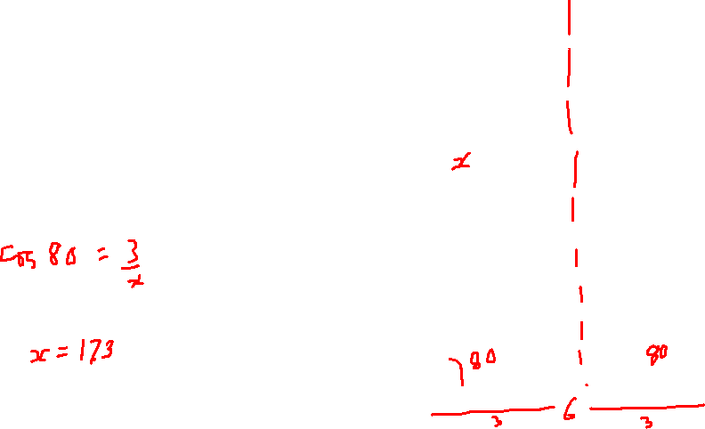
8
In the triangle below AB = BC. Find the length of AB
B
Angle $A\hat{C}B={80}^{o}$
AC = 6cm
A
C

Slide 18
9
In the triangle below AB = BC. Find the size of angle $A\hat{C}B$
B
DBA is a straight line
DB and BC are two of the lengths in a regular 15-sided shape
D
A
C

Slide 19
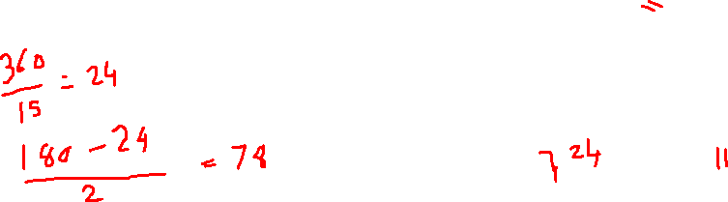
9
In the triangle below AB = BC. Find the size of angle $A\hat{C}B$
B
DBA is a straight line
DB and BC are two of the lengths in a regular 15-sided shape
D
A
C

Slide 20
10
In the triangle below AB = BC. Find co-ordinates of point C
B
Triangle ABC is drawn on a centimetre square grid.
C is plotted at (10, 1)
B is plotted at (6, 9)
A
C

Slide 21
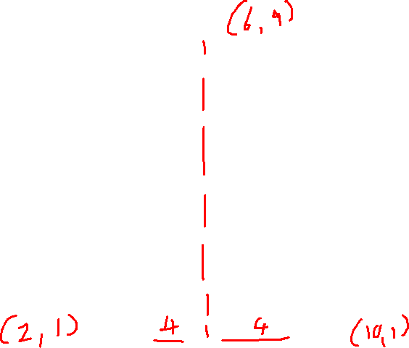
10
In the triangle below AB = BC. Find co-ordinates of point C
B
Triangle ABC is drawn on a centimetre square grid.
C is plotted at (10, 1)
B is plotted at (6, 9)
A
C

Slide 22
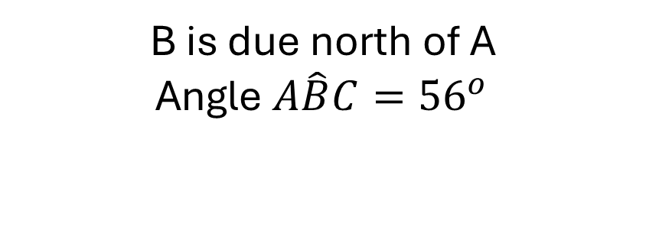
11
In the triangle below AB = BC. Find the bearing of A from C
B
N
B is due north of A
Angle $A\hat{B}C={56}^{o}$
A
C

Slide 23
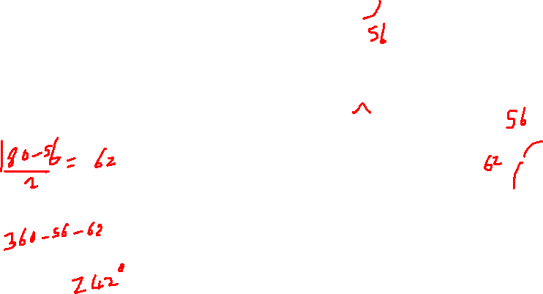
11
In the triangle below AB = BC. Find the bearing of A from C
B
N
B is due north of A
Angle $A\hat{B}C={56}^{o}$
A
C

Slide 24
12
In the triangle below AB = BC. Find the length of AB
A
C
In triangle BDE
BD = BE
AD = 2cm
DE = 8cm
AC = 9.6cm
D
E
B

Slide 25
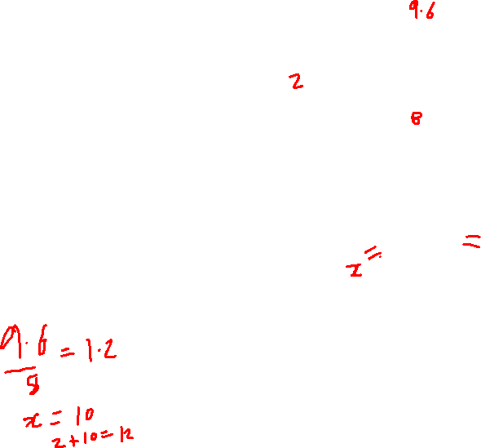
12
In the triangle below AB = BC. Find the length of AB
A
C
In triangle BDE
BD = BE
AD = 2cm
DE = 8cm
AC = 9.6cm
D
E
B

Slide 26
